Slide 1
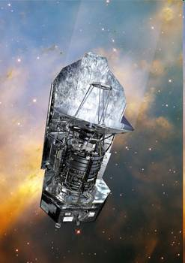
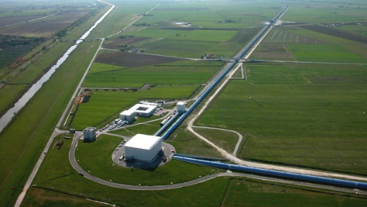
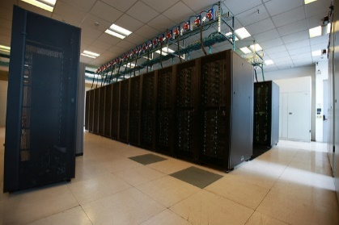
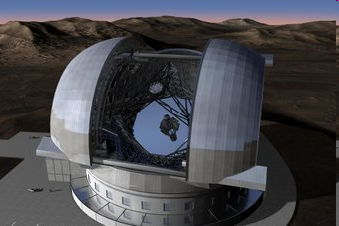
Evolving the VO from interoperable data collections to an integrated system of services for data-intensive science
Archive
Archive
world-wide Science Cloud → «data lake»
Archive
Archive
Need to find, access, interoperate, re-use
Virtual Observatory

