Slide 1
Summary 1st day
Carole Jackson
Rob van der Meer

Slide 2
Highlights at the table
New KM3NeT and CTA collaboration on CORELib.
Sky maps can be done, but can it be done efficiently? (indexing)
Meta descriptions of software for data (indexing)
Role for ASTERICS to get the message through Radio astronomy has high memory demand, high bandwidth.
Integrating CASA in Jupyter notebooks is a radio solution for a radio problem. How do we influence other wavelengths?
ASTERICS should prepare to support ESCAPE.
Citizen Science. It is all in English! Create platforms that are naturally multilingual.
White Rabbit for 4G/5G telecom, Banks

Slide 3
Your highlights
Survey at the table
Summary paragraph per table if you want to bring the message across to people that not attended the meeting

Slide 4
ASTERICS All-hands group activity
Ice sculpting

Slide 5
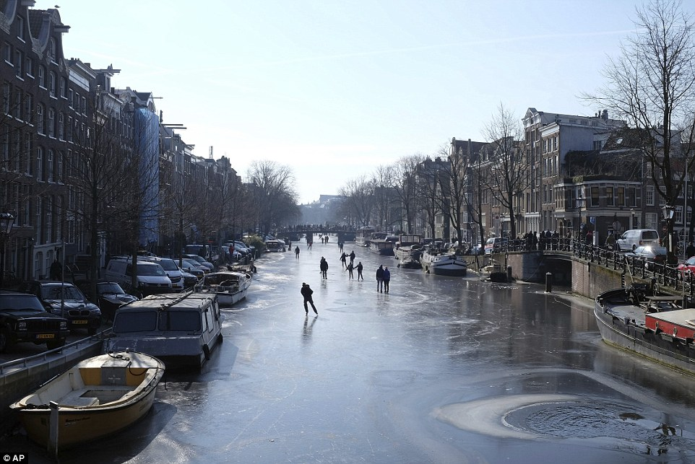
Some history

Slide 6
Provenance
What happened with the data?
What will happen with the data?
You will see how much of the data will chip off and disappear to make something special form the raw material you started with.
Can you trace back what happened?

Slide 7
Group activity
Working together with persons with unknown skills
Working with unknown tools
Working with unknown material
Working together to get a great result

