Slide 1
AENEAS SKA Federation Services
Matthew Viljoen
EGI Foundation
AENEAS WP3,5,6 F2F, Bologna
13 November 2018

Slide 2
SKA Federation Services
Aim
Understand what we mean by a ‘Federation Service’
Consistency between current WP3,5,6 deliverables
Proposal
An SKA ‘Federation Service’ is a centrally provisioned and coordinated service (i.e. not by any one SRC/ESDC) for the benefit of all SRCs
The Federation Services layer consists of all the components expected to be provided by each site to support ESDC federation. Federation enables integration of site resources and relative computing/data management in a standardized and transparent way. (D3.2)
SKA Federation Services are included in the central portfolio
AENEAS WP3,5,6 F2F, Bologna

Slide 3
Proposed list of SKA Federation Services
AAI,
IT Security Management (monitoring, security response)
Accounting
Monitoring
Configuration management
Federated incident and request management
Operations coordination
Software validation and distribution
T6.1 is covering federated AAI aspects
T6.2, 6.3 is covering service requirements
AENEAS WP3,5,6 F2F, Bologna

Slide 4
Service Portfolio
Matthew Viljoen
EGI Foundation
AENEAS WP3,5,6 F2F, Bologna
13 November 2018

Slide 5
D6.2 (the Service Portfolio deliverable)
From GA:
[...] By adopting standards for service portfolio management, Task 6.2 “Interoperable Federated IT Service Management System” will define the AENEAS service portfolio, which is meant to provide capabilities delivered by the combination of relevant services from existing e-Infrastructure service catalogues, and Community Services delivering ad-hoc applications, pipelines and data products necessary to extract knowledge from SKA data. [...]
D6.2 AENEAS Service Portfolio (EGI Foundation) due M24
Leveraging the project findings and the services of existing e-Infrastructure catalogues, the deliverable will describe the services of the AENEAS Service Portfolio, the portfolio structure and the service portfolio management procedures adopted in the project.
AENEAS WP3,5,6 F2F, Bologna

Slide 6
But...
AENEAS will never deliver any services – it will cease at the end of the project.
There cannot be an ‘AENEAS Portfolio’
D6.2 AENEAS Service Portfolio (EGI Foundation) due M24
D6.2 A proposed framework for designing and implementing a Service Portfolio for the European Science Data Center and SKA (EGI Foundation) due M24
This document provides a framework and recommendations for the European Science Data Centres (ESDCs) to implement a Service Portfolio for the SKA supporting the Regional Centres (SRCs). The focus here is on the perspective of the federated e-Infrastructures providing enabling services, not the end-users and researchers producing the knowledge outputs.
AENEAS WP3,5,6 F2F, Bologna

Slide 7
D6.2 Content
Introduction to Service Portfolio Management in context of SKA
Existing examples of federated service portfolio management (EGI,EOSC,EBI etc.)
Service Portfolio scenarios for SKA
Central coordination service portfolio
Typical SRC/ESDC service portfolio
Interoperation with existing service portfolios (EGI,EOSC-hub, eInfraCentral)
Note: service portfolio definition is high level, strategic!
AENEAS WP3,5,6 F2F, Bologna

Slide 8
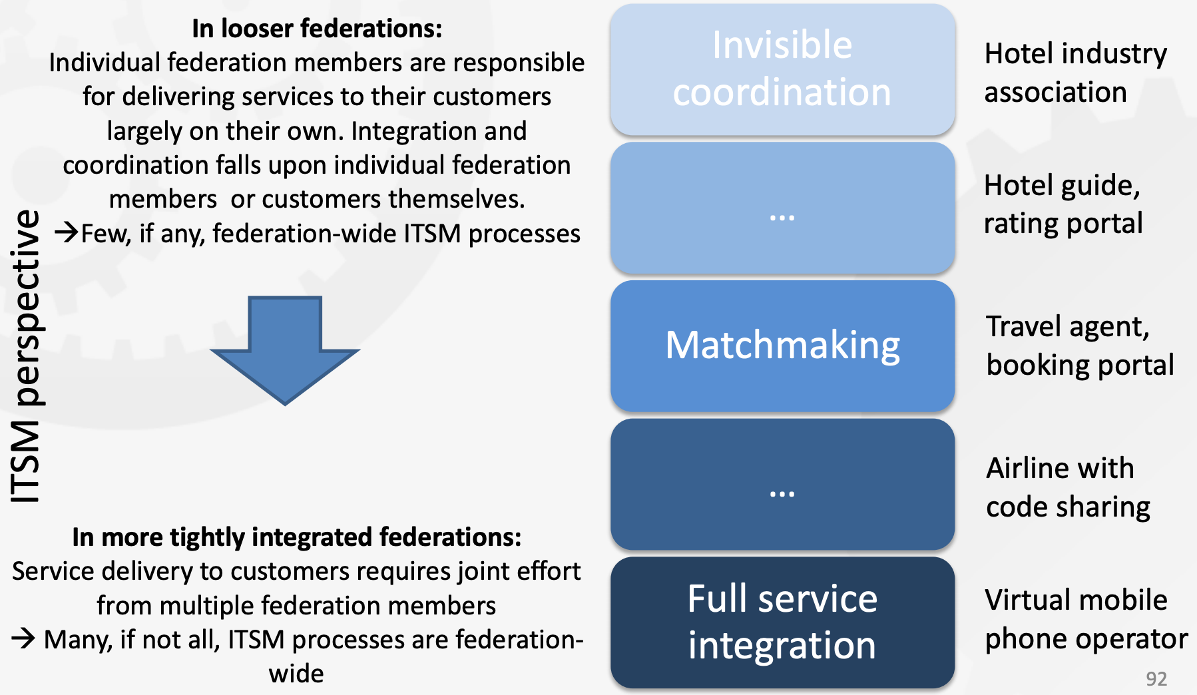
Possible scenarios
For SKA
e.g. User interfacing with ESRC
e.g. User interfacing solely with central SKA portal
AENEAS WP3,5,6 F2F, Bologna

Slide 9
Central coordination service portfolio
Federated Services
Portal (and project management inc. approval, booking etc.)
Distributed Helpdesk Frontend
Accounting
AAI
Monitoring and accounting
SLA and order management
Security
Training
Workload management and Orchestration
Information system
Data Management, Curation and Preservation
Applications database
Communication tools
Other Services
SDP for each observatory
AAI at each observatory
AENEAS WP3,5,6 F2F, Bologna

Slide 10
Typical ESRC service portfolio
Gateway interface
Computing platform interface
Archive/repository interface
Local helpdesk
AAI for users
AENEAS WP3,5,6 F2F, Bologna

