Slide 1
AENEAS Communication and Outreach
Ivona Kostadinova (ASTRON)

Slide 2
Audiences
Key audiences/communities
SKAO
Potential partners in the ESRC
Radio Astronomy community
E-infrastructure providers
PRACE, GEANT, EGI, EUDAT
AARNET, SANReN,European NReNs
Potential funding sources for SRC
Other audiences
Larger astronomy and science communities (EURO-VO, CERN, ALMA,??)
Academic research infrastructure
General public

Slide 3
Communication & Dissemination tools/channels
Publications
Events
Website
Social media (Twitter)
Media outlets

Slide 4
Key Metrics (KPIs)
Number of AENEAS team members attending/presenting AENEAS work
Audiences and reach of the events attended (international, national + number of participants)
Dissemination via our publications
Traffic through our website
Engagement on social media
Media coverage

Slide 5
Publications
Actions
AENEAS reports (aka deliverables)
AENEAS brochure
White papers?
Peer-reviewed publications?
Press Release (end of project)
Content in multimedia or
interactive format?
Post publications on website and promote on social media
Use various EC communication channels (online and print)
Use SKA to broadcast (newsletter) and share our results
Publish summary article or interview with partners such as GEANT Connect newsletter, EGI newsletter, what else?
We need to prioritize
Notes:
Publish final results/or particularly interesting result in any of the EC media platforms (Horizon Magazine, Research*eu, Futuris, etc)
Publish interesting results/article via partners – such as the GEANT Connect newsletter, the EGI newsletter, what else?
Promote results in SKA bulletin, and newsletter

Slide 6
Events
Actions
RDA Plenary Meeting
EOSC-hub week (April)
SKA Science Meetings (April)
SKA Board Meetings
EGI conference (May)
EHPCSW 2019 (May)
EWASS (June)
ADASS (Oct)
Presentations (Talks/Posters)
Panel Discussions/Workshops?
AENEAS featured at a partner’s booth
Make part of the final AENEAS AHM a venue for project dissemination by inviting key stakeholders?
Keep a record of your event attendance
Accessible to all project members at https://www.astron.nl/aeneas2020/doku.php?id=intra:reportingec

Slide 7
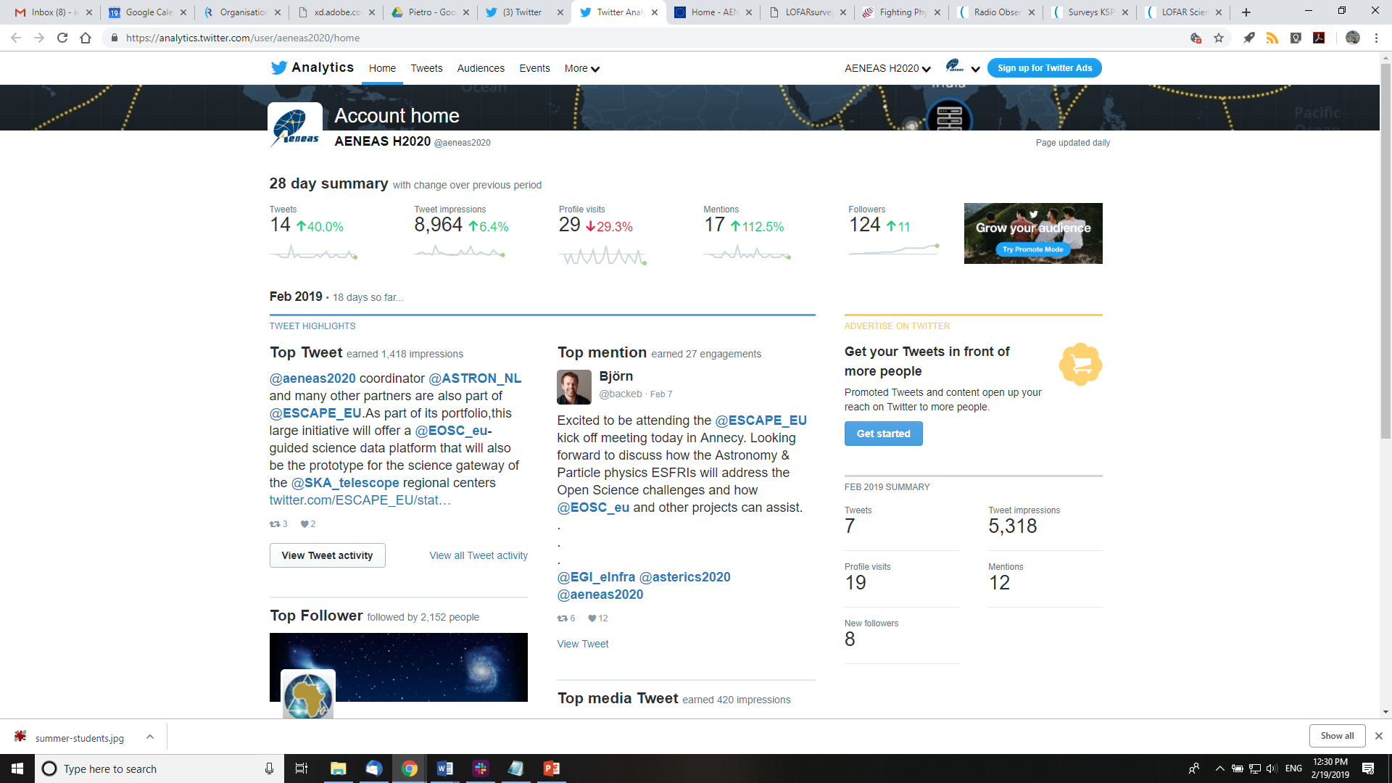
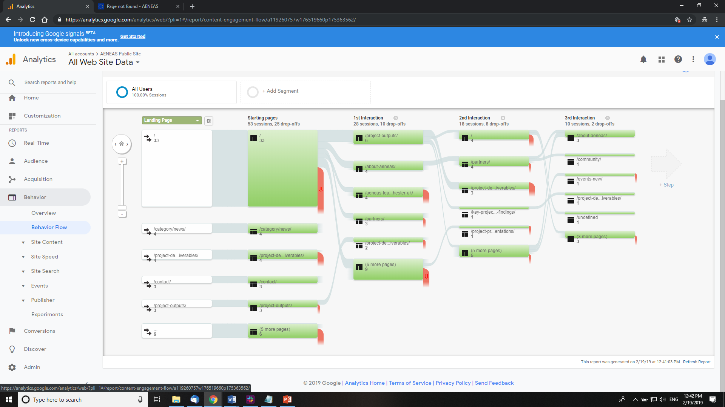
Online presence
KEY OBSERVATIONS
Building a community via social media
Post regular news on our website
Create context

Slide 8
To decide going forward
AENEAS LEADERSHIP: Defined core goal for dissemination so that we can focus our efforts
ME: what kind of communication strategy will deliver maximum impact

Slide 9
Suggestions & Discussion
GENERAL PUBLIC: Have a presence at 1-2 outreach events, give a public talk on SKA and the data challenges
ASTRONOMERS: Presence at key conferences such as EWASS, peer reviewed publication?, convert final deliverable into a white paper (where to submit?)
SKAO & SKA COMMUNITY: write short updates with result and send to SKA Comms Office for featuring in their newsletter
EU PARTNERS in ESRC: ???

Slide 10
Questions?

