Slide 1


SRCs – Science Requirements
Keith Grainge
27th June 2019

Slide 2
Contents
Cosmology
  The observations
  The science
  Analysis of SDP data products at SRCs
(“Slow Transients”)
(Fast Radio Bursts)

Slide 3
Cosmology with the SKA1
Thanks to Richard Battye
More details at: arXiv:1811.02743
Continuum science
  Source surveys
    2D correlation function
    Integrated Sachs-Wolfe
    Cosmic Dipole, Isotropy, Homogeneity
  Radio Weak Lensing (RWL)
HI Galaxies (HIGRS)
HI intensity mapping (IM)

Slide 4
Medium Deep Band 2 Survey
SKA1-MID in Band 2 (0.95 – 1.76 GHz)
Covering 5,000deg^{2.}
10,000 hours.
Single point FoV~1 deg²
Integration time per pointing is 2 hours
2 sub-bands to cover all Band 2
Commensal (?) with the magnetism KSP
  Data products for all 4 polarisations will be required.
The weak lensing experiment requires use of the longest baselines (150km).
HI requires spectral line data products.

Slide 5
Wide shallow Band 1 survey
SKA1-MID in Band 1.
Covers 20,000deg².
10,000 hours.
Integration time pointing is ~1 hour
3 sub-bands to cover all Band 1
HI IM data products are primarily autocorrelations
  Some short baseline visibilities for calibration
  “Fast-scanning” at constant elevation observing mode
Continuum mapping
  150km baselines desired
  Is this commensal with the IM experiment?

Slide 6
Deep SKA1-LOW Survey
HI IM (interferometric) with SKA1-LOW
Covers 100 deg²
5,000 hours
  Handful of fields with 1000+ hour integration
  Is this even a capability of SDP’s?
Frequencies 200 – 350 MHz
  Equivalent to z = 3 – 6
  Two sub-bands
Commensal with EoR observations 50 – 200 MHz (4 more sub-bands)

Slide 7
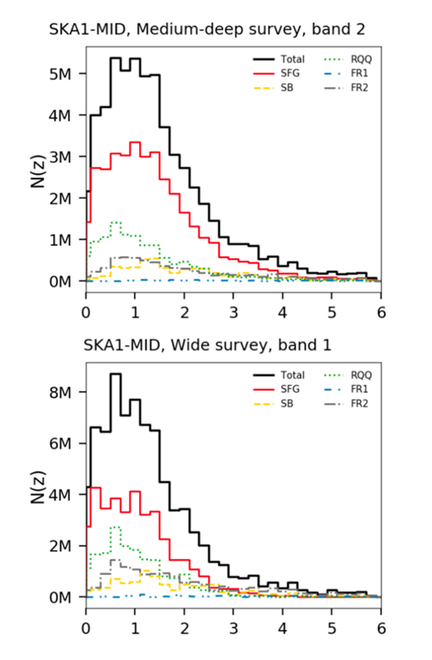
Surveys – source counts
Medium-Deep band 2
5000 deg²
8μJy detection
6x10⁷ sources
HIGRS & RWL
Wide band 1
20000 deg²
22μJy detection
10⁸ sources
2D corr fn & IM

Slide 8
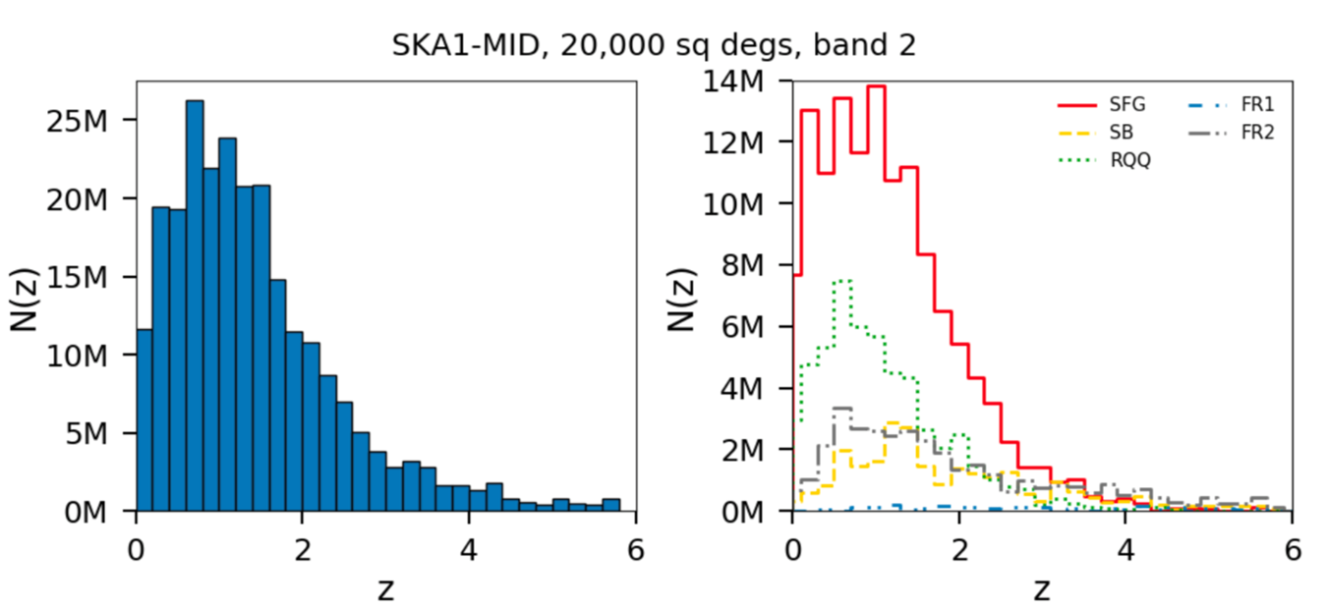
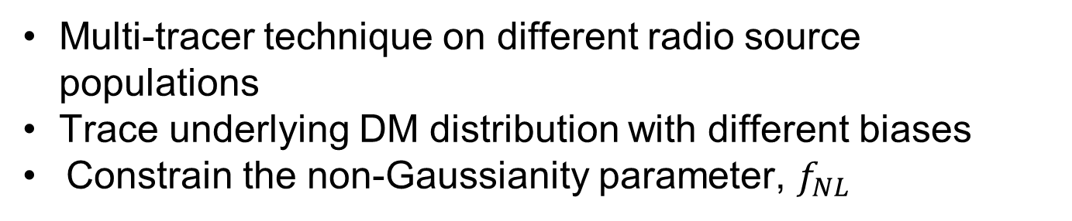
2D correlation function
Multi-tracer technique on different radio source populations
        Trace underlying DM distribution with different biases
        Constrain the non-Gaussianity parameter, $f_{NL}$

Slide 9
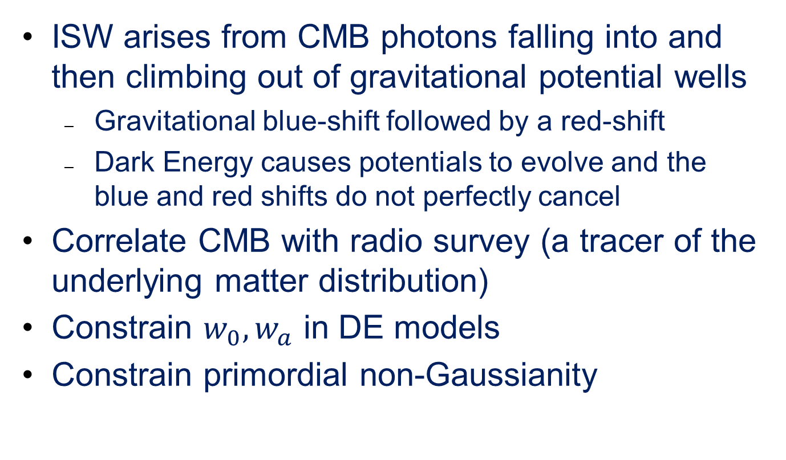
Integrated Sachs-Wolfe Effect
ISW arises from CMB photons falling into and then climbing out of gravitational potential wells
  Gravitational blue-shift followed by a red-shift
  Dark Energy causes potentials to evolve and the blue and red shifts do not perfectly cancel
Correlate CMB with radio survey (a tracer of the underlying matter distribution)
Constrain $w_{0}, w_{a}$ in DE models
Constrain primordial non-Gaussianity

Slide 10
Cosmic Dipole, Isotropy, Homogeneity
Continuum radio survey study scales at z ∼ 1
  not been in causal contact since the first horizon crossing during inflation
  contain information that was frozen in during cosmological inflation
Test fundamental assumptions of modern cosmology
  Statistical isotropy
  Combine with redshifts, test statistical homogeneity of the cosmos
Measure cosmic radio dipole to ~1 deg
  Test assumption that the CMB and the overall large-scale structure frames agree

Slide 11
Issues
Absolute calibration
Uniformity of noise level
Survey completeness
False positive rate
Source classification
  Identify different populations
  Effect on “count” of objects

Slide 12
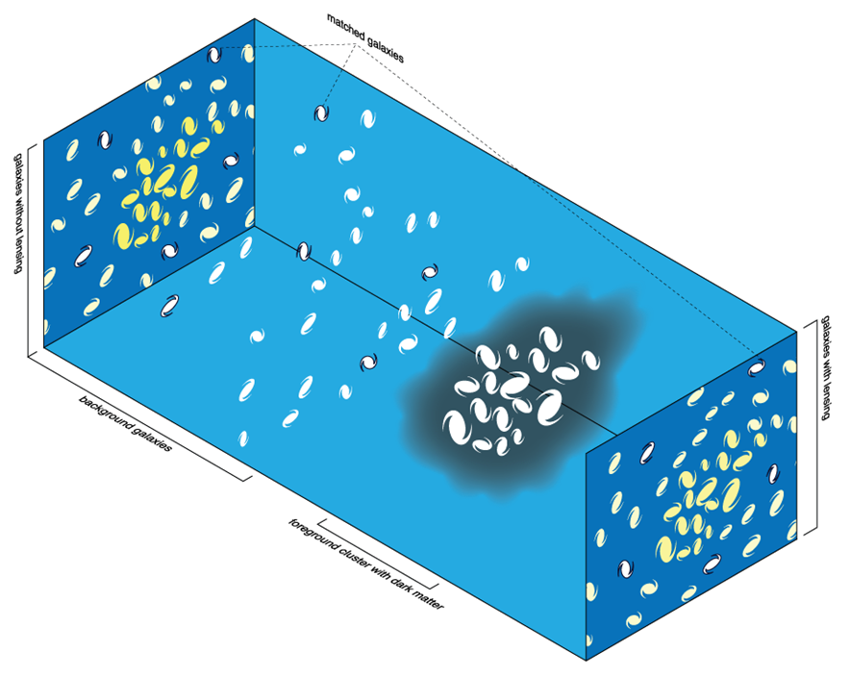
Weak lensing
Coherent distortion of galaxy shapes
Measure shear field
Key features:
  Galaxy number density and area
  Shape estimation systematics
Probe:
  Geometry of the Universe
  Structure evolution
  Dark Energy

Slide 13
Issues
Unbiased estimate of source ellipticity critical
Longest baselines essential
Perform fitting in the uv-plane
  Source positions and spectral index as prior information from image cubes/catalogue
  Use gridded visibility data product
Estimate shear-map and account for systematic errors (e.g. intrinsic alignment)
  Polarisation may help

Slide 14
HI galaxy survey probes
Baryon Acoustic Oscillations
  Standard ruler from preferred clustering scale
Redshift Space Distortions
  Test alternative theories of gravity
Doppler magnification
  Radial motion induced redshift distortion vs angular size
Direct peculiar velocity measurements
  Tully-Fisher relation gives peculiar velocity field
Void statistics
  Complementary probe of matter clustering
Cross-correlation with γ-ray maps
  Dark matter annihilation
Cross-correlation with gravitational wave sources

Slide 15
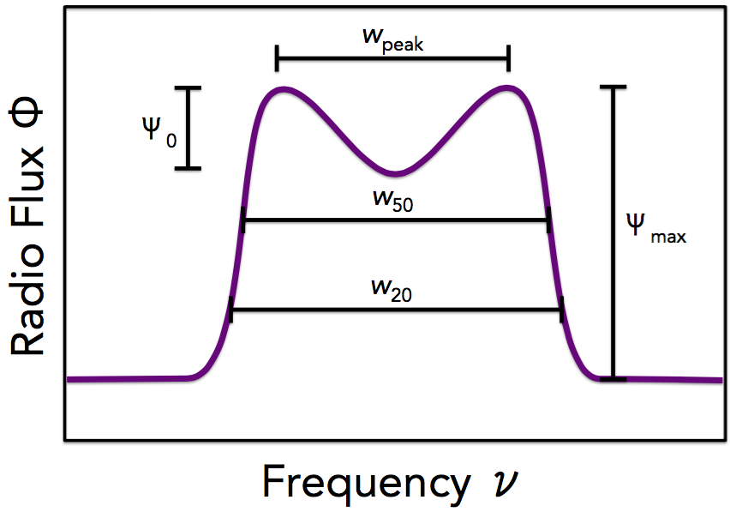
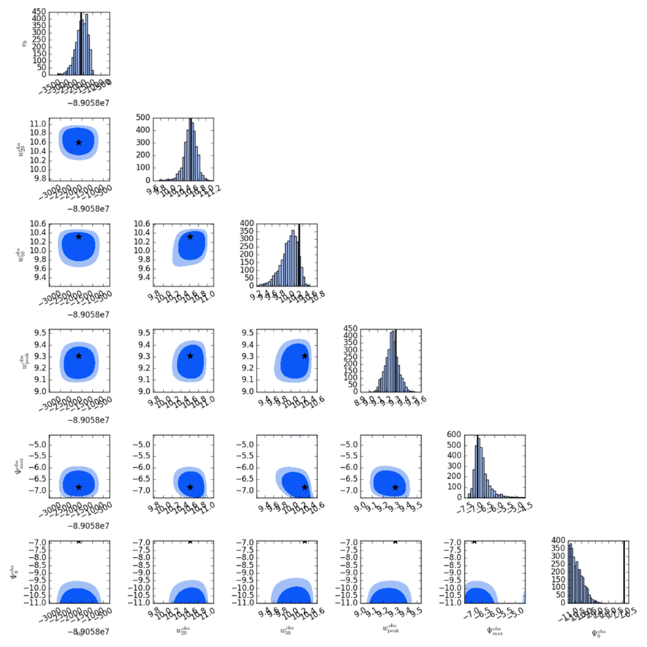
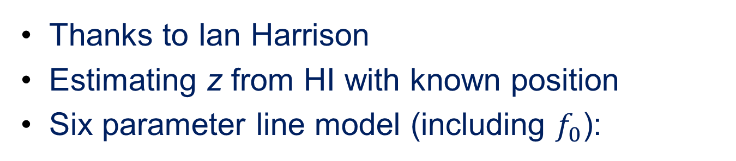
SKA redshifts
Thanks to Ian Harrison
Estimating z from HI with known position
Six parameter line model (including $f_{0}$):

Slide 16
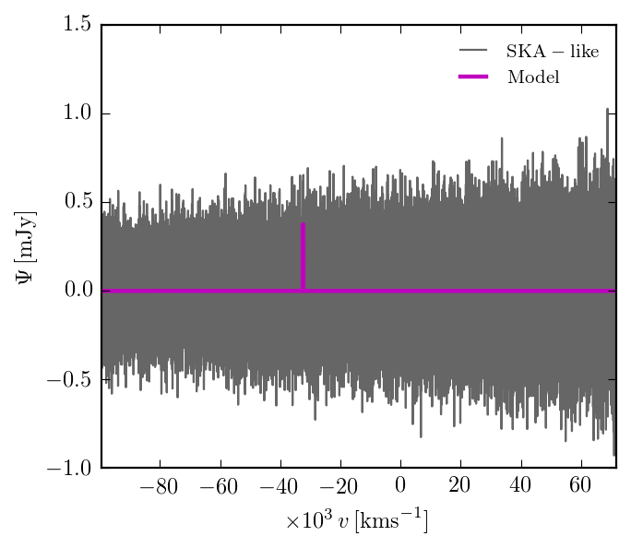
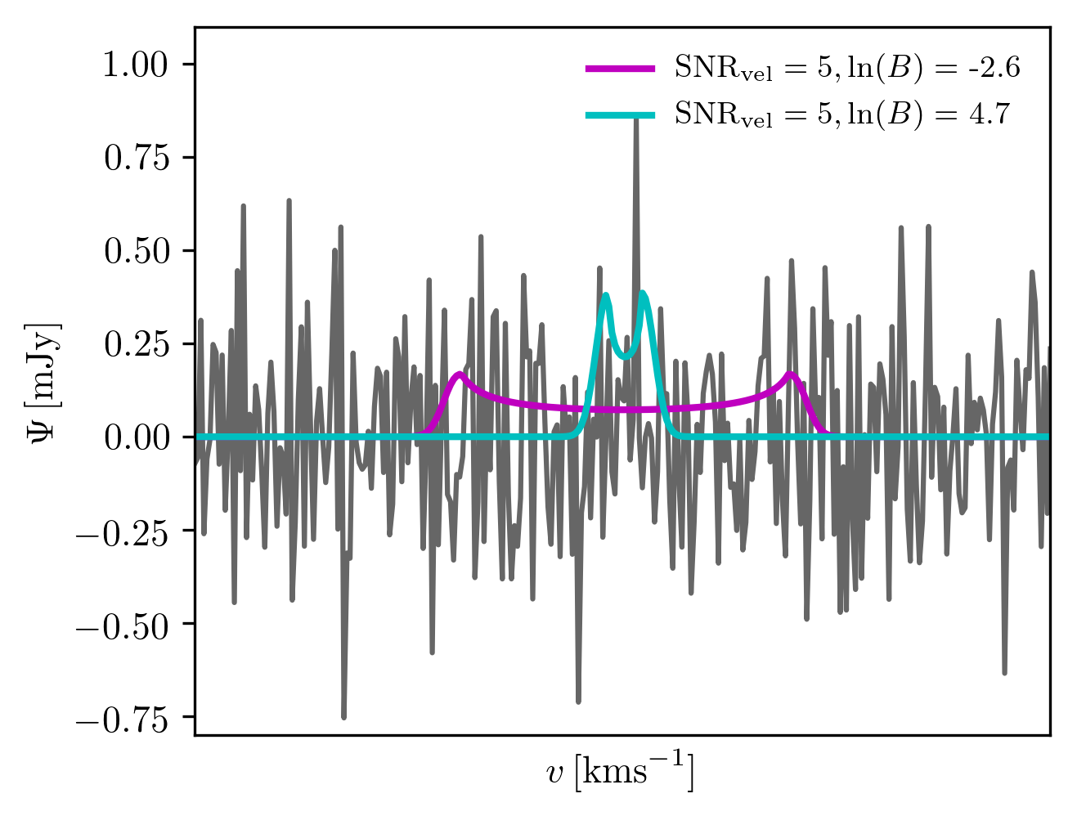
Bayesian model fitting
Bayesian model fitting in 1D data sets mimicking cutout cubes at positions of known sources (detected in SKA1-MID continuum survey)

Slide 17
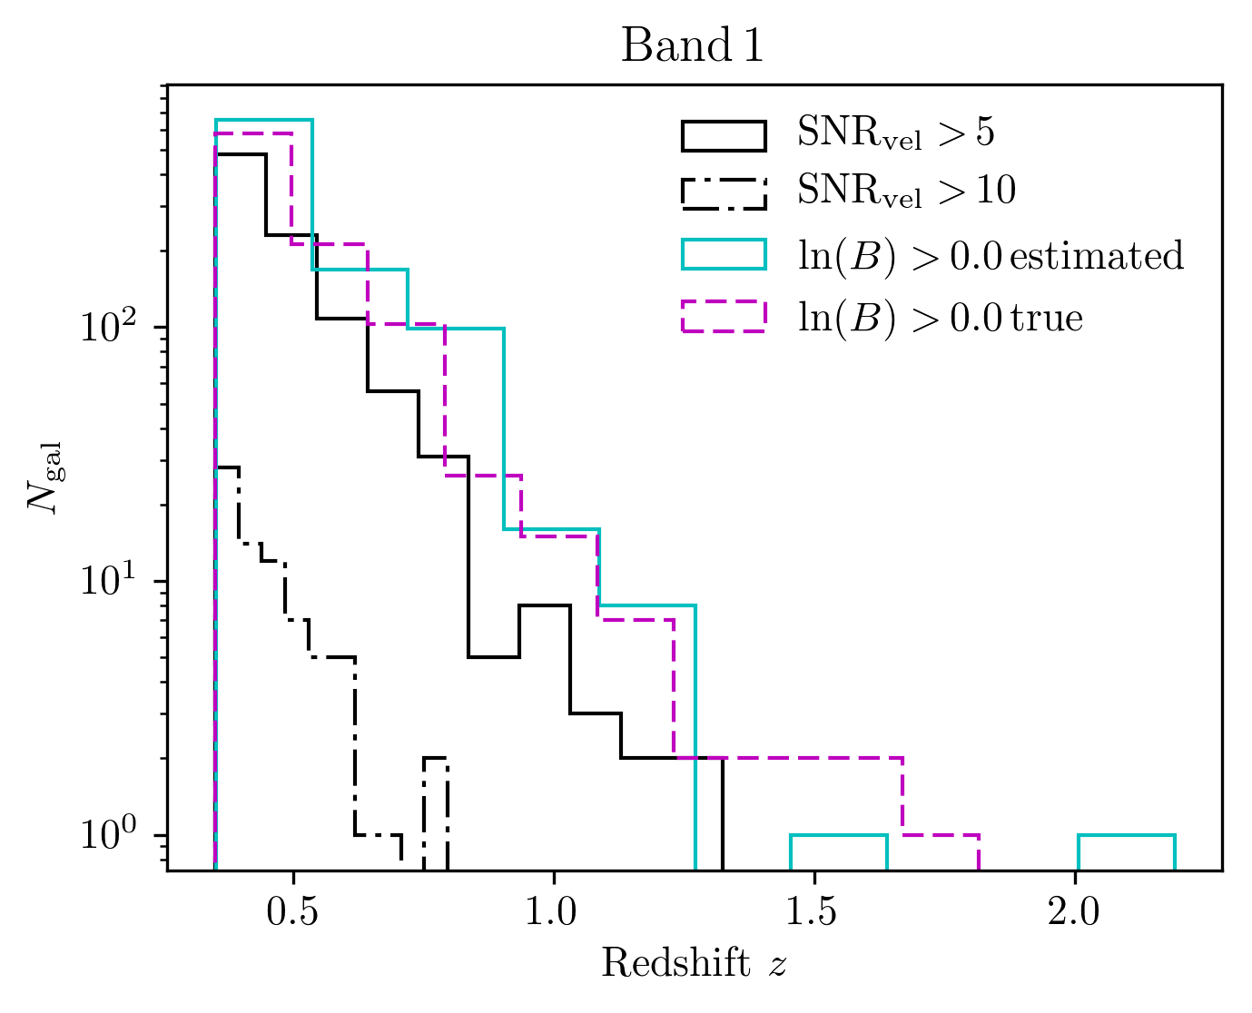
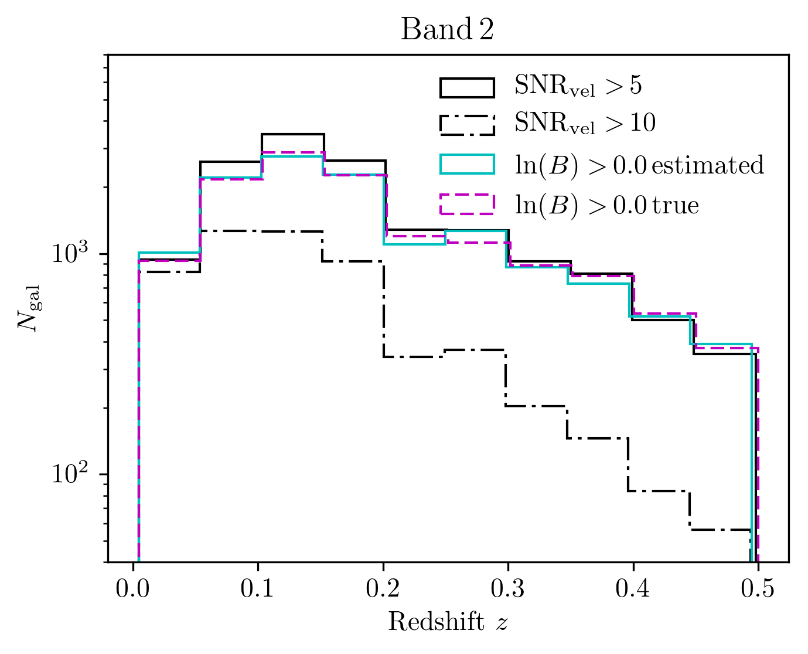
Simulation results
Comparison of using Bayesian evidence to hard SNR cut
(Harrison, Lochner & Brown 2017)

Slide 18
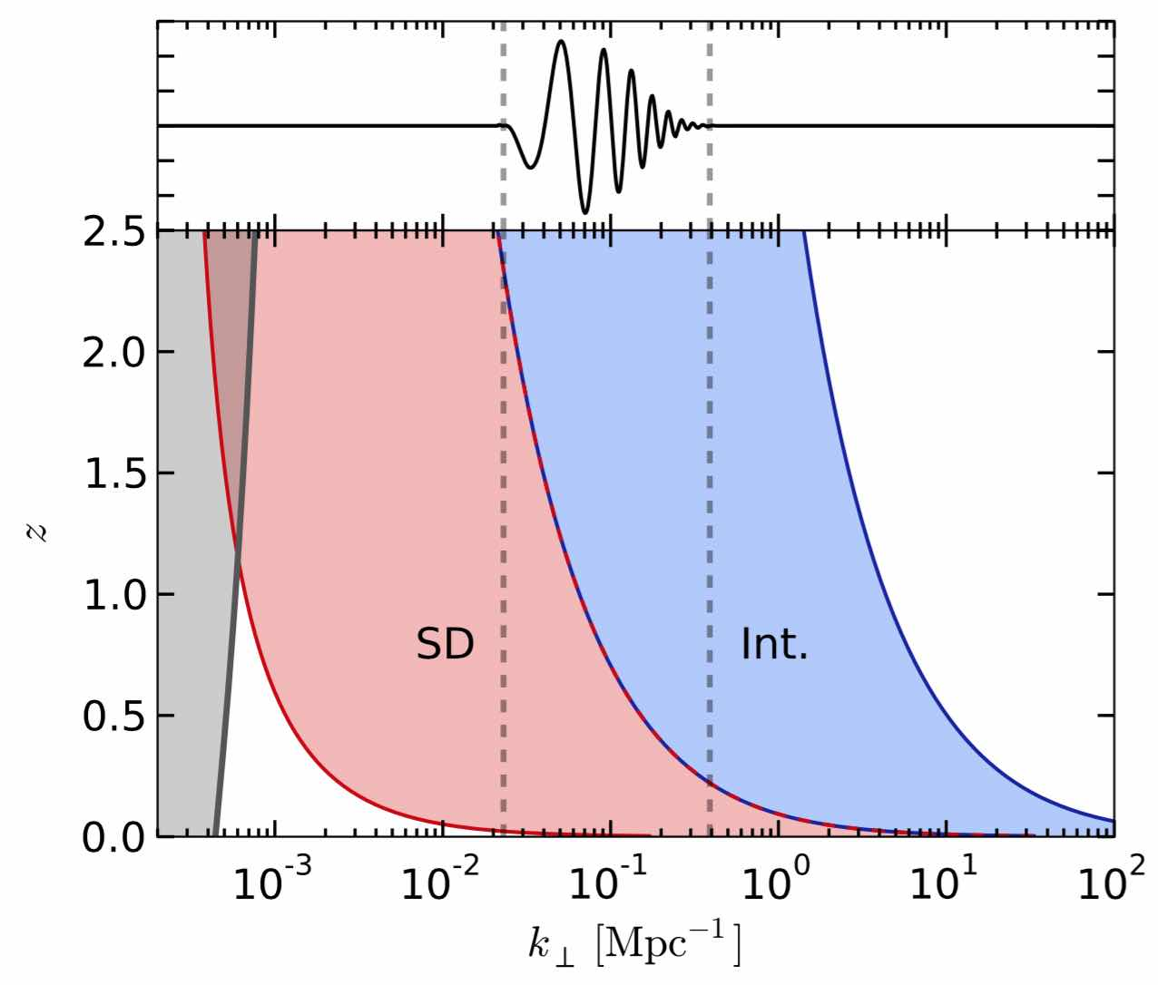
Intensity Mapping with SKA
BAO signal
(Bull et al, 2015)
SD = single dish mode
Int = interferometer mode

Slide 19
Issues
To access the angular scales of interest have to observe in “single dish” mode – autocorrelations
  Perhaps use visibilities for calibration
“1/f” noise becomes a substantial problem
  Fast scanning mode
  Careful calibration using noise source
Post processing:
  Map making: image full hemisphere using HEALPix
  “De-striping”
  Foreground removal
  Calculate 3-d power spectrum
  A great deal to be transferred from CMB experiments

Slide 20
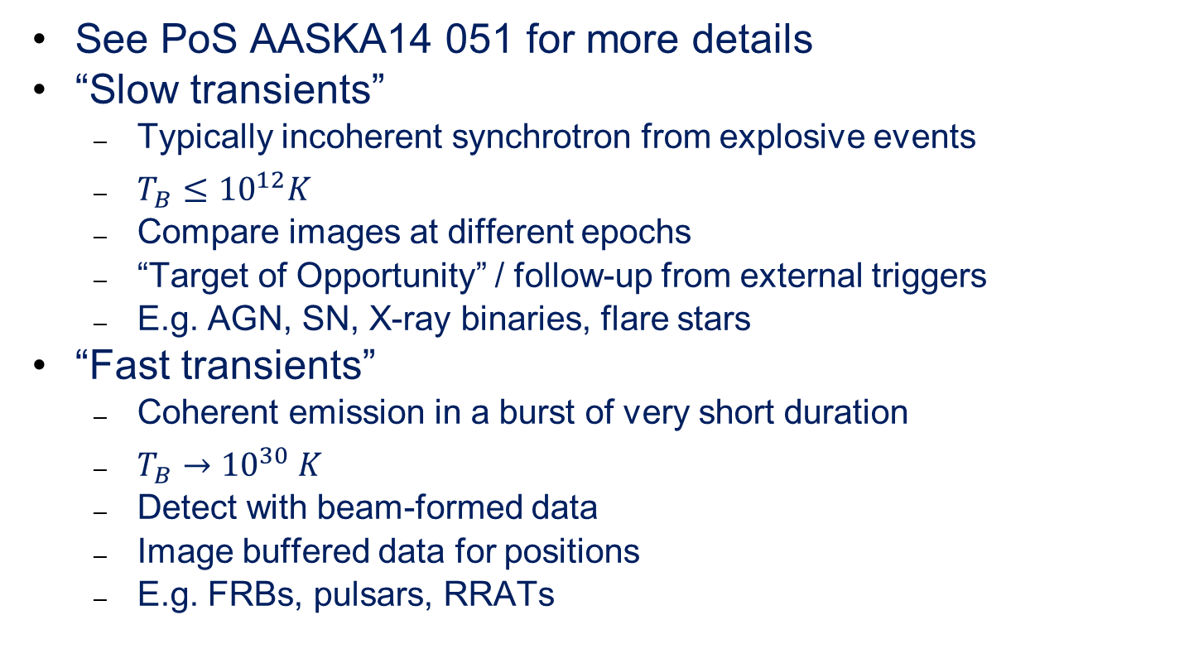
Fast and slow transients
See PoS AASKA14 051 for more details
“Slow transients”
  Typically incoherent synchrotron from explosive events
  $T_{B}≤{10}^{12}K$
  Compare images at different epochs
  “Target of Opportunity” / follow-up from external triggers
  E.g. AGN, SN, X-ray binaries, flare stars
“Fast transients”
  Coherent emission in a burst of very short duration
  $T_{B}→{10}^{30} K$
  Detect with beam-formed data
  Image buffered data for positions
  E.g. FRBs, pulsars, RRATs

Slide 21
Slow transients – luminosity vs rise time
Pietka, Fender & Keane (2015)
Also intraday variability due to scintillation

Slide 22
Slow transient observing
Commensal search in all SKA observations
  Break other surveys into multiple visits with ~ 10 day cadence
  If “fast” commensal, act as a trigger for other observatories
Monitoring programmes on known objects
  Use of sub-arrays potentially important
“Target-of-Opportunity” observations
  Triggered from other facilities e.g. gravity wave detections
  High urgency observations
  Robotised telescope operation
Dedicated survey
  High cadence, near real-time transient search
  E.g. half sky with 2 day cadence
    Possible to match with LSST
    Needs fast mapping algorithms

Slide 23
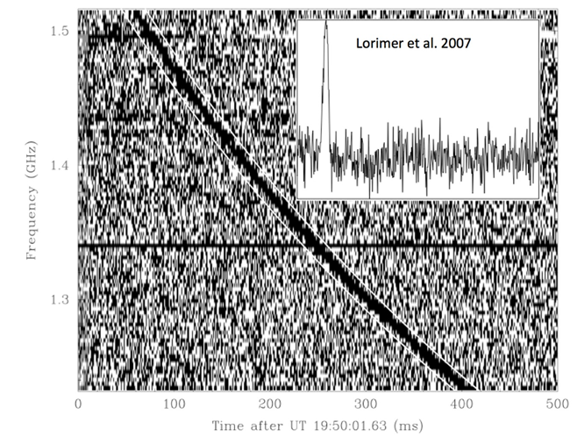
Fast Radio Bursts - Lorimer burst
Thanks to Manisha Caleb for FRB slides

Slide 24
Fast Radio Bursts
Fast - Only last a few ms; Radio - Discovery wavelength; Burst - Appear and disappear in a flash.
Bright (< 10⁴⁴ erg s⁻¹), narrow and highly dispersed (DMs ~200 - 2600 pc/cc) pulses that are mostly singular and unique in their own way.
Brightness temperatures (> 10³⁵ K) imply coherent emission
DM = ∫ne.dl pc cm⁻³ = integrated line-of-sight electron column density —> proxy for distance
Seen at 400 MHz, 1.4 GHz, 2 GHz, 800 MHz and 4 - 8 GHz.
No statistically significant counterpart observed yet

Slide 25
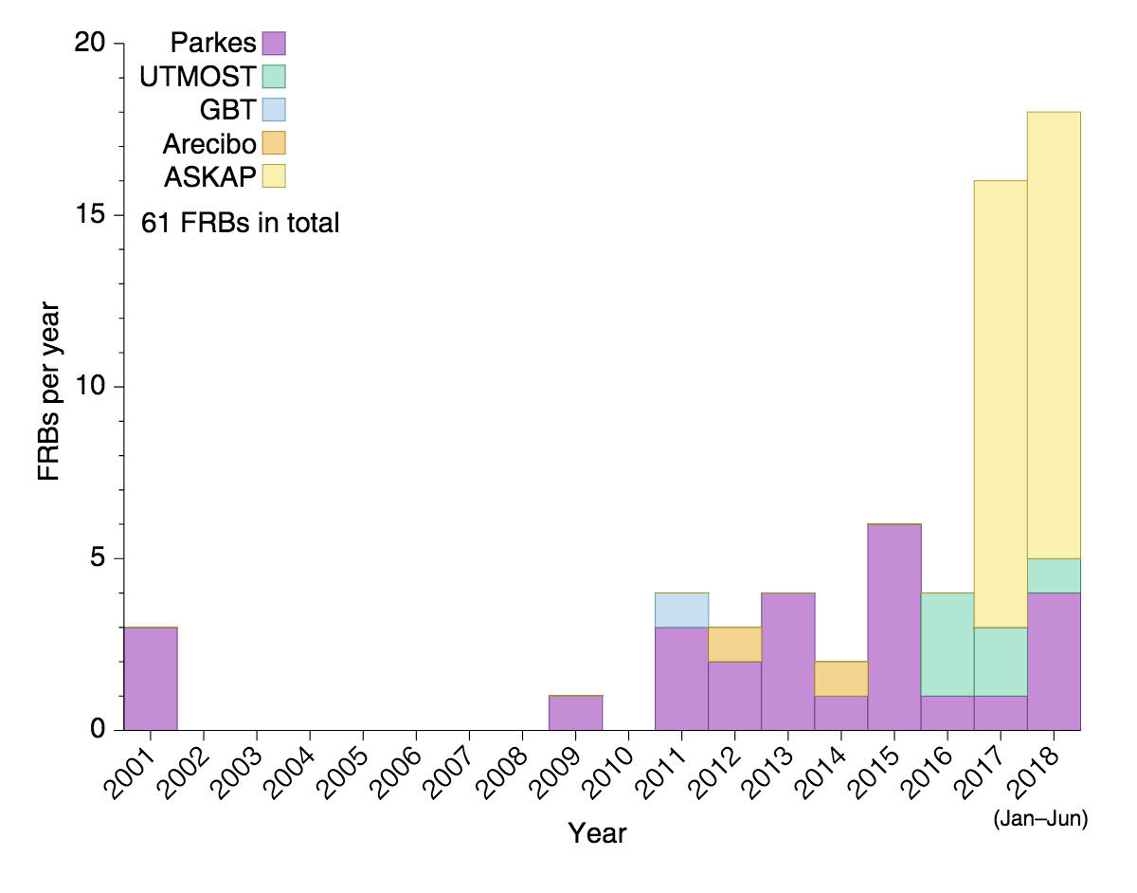
Discovery of FRBs with time
Jun 2018: 61+ FRBs
Multiple telescopes
Recent SKA conference: 250 FRBs
  Mostly CHIME
    400-800 MHz
Rumours of ~ 1000 detections now
None (1?) at <200MHz
  Scattering?
Credit: Evan Keane

Slide 26
Repeating FRBs
FRB 121102
Non-cataclysmic progenitor
  Unlike other FRBs (?)
Highly clustered in time, no underlying periodicity
More than a 100 repeat pulses
Observed DMs consistent to within a few %
Frequency structure in pulses
Highly polarised
Localised to a host galaxy
Intrinsically wide pulses. No signs of temporal broadening of pulse widths.
  Other FRBs : Intrinsic widths narrower; some exhibit temporal broadening
There are now > dozen repeater FRBs
  2 (more?) populations?

Slide 27
Localisation
ASKAP has now localised 3 FRBs (~0.1” position error)
  Detected in incoherent mode
  Buffered data used to image FRB candidates
  Optical redshifts obtained towards host galaxies
Results compatible with DM vs z predictions
Paper in Science coming soon…

Slide 28
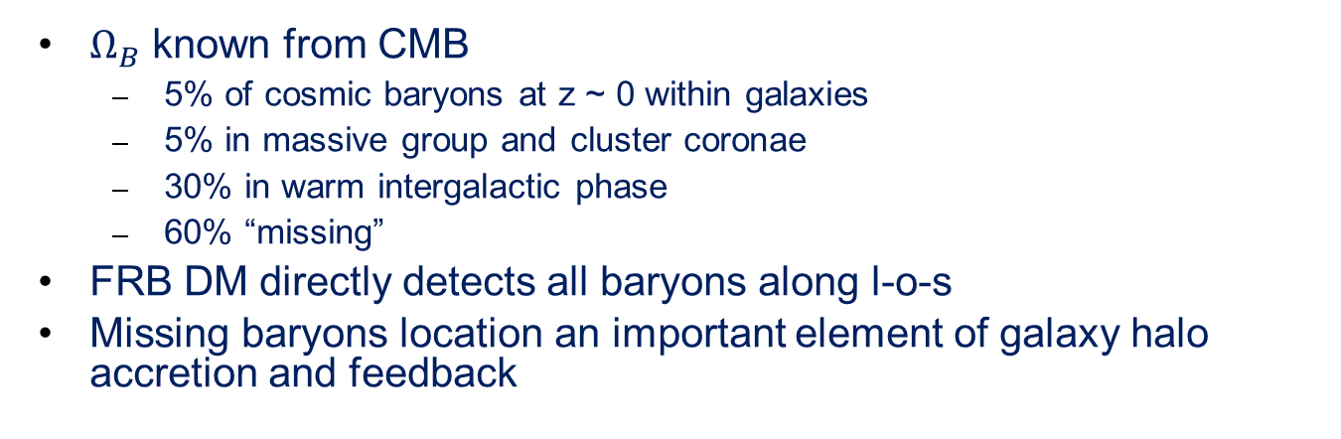
“Missing Baryons” with FRBs
z=1 FRB DM probability distribution
$Ω_{B}$ known from CMB
  5% of cosmic baryons at z ~ 0 within galaxies
  5% in massive group and cluster coronae
  30% in warm intergalactic phase
  60% “missing”
FRB DM directly detects all baryons along l-o-s
Missing baryons location an important element of galaxy halo accretion and feedback

Slide 29
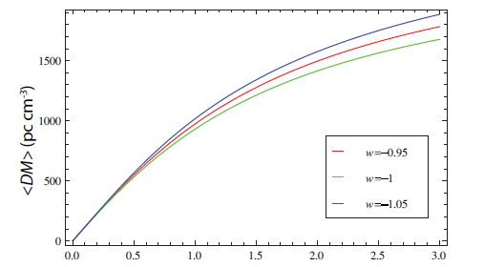
Cosmology with FRBs
FRBs as cosmic ruler; measure DM(z)
Zhou et al. 2014

