Slide 1
Accessibility and Software Tools (also WP6 work: AAI and ITSM)
Matthew Viljoen
WP6

Slide 2
Accessibility and Software Tools Requirements
Common Software Environments (REQ-AENEAS-04-01)
Each SRC shall support and maintain a set of common software environments across all SRCs agreed by the SRC Alliance. RDM
Software Tools available at SRCs (REQ-AENEAS-04-02)
The Alliance will develop guidelines and procedures for the qualification, certification, maintenance and adoption of all software tools available at the SRCs (including those contributed by users). RDM
Science Gateway (REQ-AENEAS-04-03)
Each SRC will host a single Science Gateway used by all SRC users, compliant with SKAO policies on user access interface. SPM
External Software (REQ-AENEAS-04-04)
The SRCs will enable users to develop and run software in the SRCs. RDM, ISM
Time-Sensitive Requests (REQ-AENEAS-04-05)
The SRCs will have the capability to provide support for time sensitive requests in accordance with policy. ISRM
Response Time (REQ-AENEAS-04-06)
The SRCs will provide information on timing and prioritisation of all requests for data and processing. ISRM

Slide 3
Accessibility and Software Tools - Design Recommendations

Slide 4
Archives of preprocessed and high level scientific products should be published using astronomical standards such as IVOA standards.
Access to data, services and software repositories should follow FAIR principles wherever possible
The catalogue of live services should be defined at the ESRC
Released software should follow defined procedures (testing, preproduction…) and security implications should be considered
Interfaces with user support and incident/request processing should be established

Slide 5
AA(A)I Requirements
User Support and Access (REQ-AENEAS-07-03)
A global federated AAAI (authentication, authorisation, accounting, infrastructure) system with single sign-on will be in place. ISM
For SMS acronyms please refer to https://fitsm.itemo.org/

Slide 6
AAI Implementation Design Recommendations

Slide 7
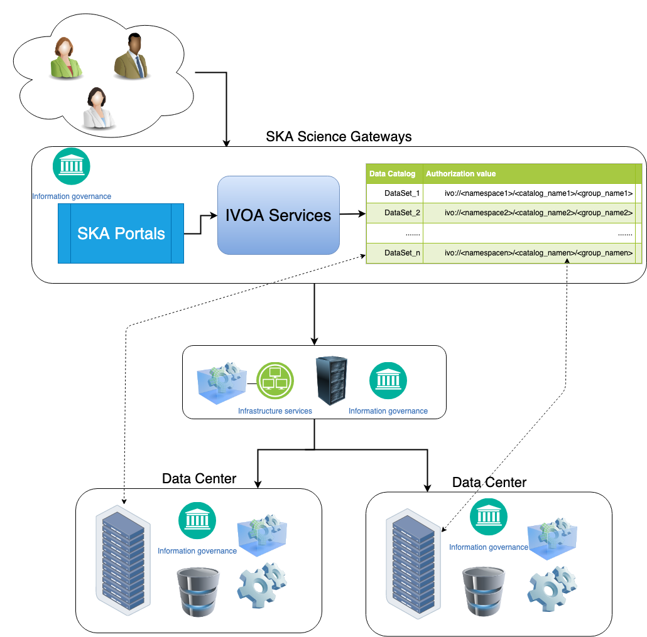
ESRC AAI overview
Access via AARC BPA compliant “community first” architecture
28 June 2019, ESRC Design Workshop, Lyon
Notes:
Data conforming to IVOA standards

Slide 8
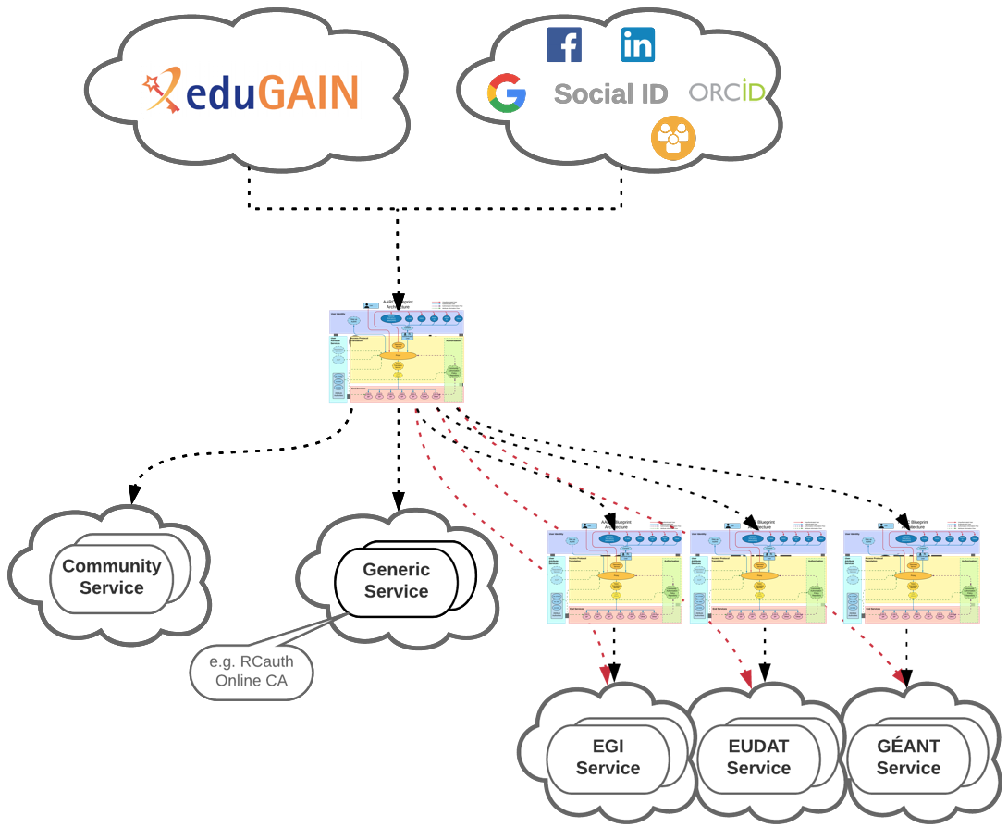
AARC BPA “community-first” architecture
28 June 2019, ESRC Design Workshop, Lyon

Slide 9
Federated AA(A)I – Design Notes
ESRC design document contains links to current guidelines regarding technical interoperability and policy interoperability
HTC/’grid’ tools tested by WP3 can fit into the federated BPA model
Bridges exist for Certificate-based authentication tools (e.g. RCauth)
Work being done to introduce OAuth/OIDC to other tools
Enables fully web-based/CLI user interaction
Tools already fit for purpose for federated accounting
AENEAS effort used to demonstrate federated AAI collaborative tools at ASTRON
28 June 2019, ESRC Design Workshop, Lyon
Notes:
GÉANT Data Protection Code of Conduct version 1 (DPCoCo-v1) [DPCoCo-v1] is implicit, since it reflects the Data Protection Directive and means compliance with applicable European rules (see [AARC-G040]).
To reduce the burden on the users and increase the likelihood that they will read the AUP as they access resources from multiple service and resource providers, the AAI services should adopt the WISE Baseline AUP model [WISE-AUP].

Slide 10
IT Service Management in Research
Shift in expected results
FP7 → H2020 = Publications → Services
Focus on sustainability
Major cultural shift
Increased customer expectations
Commoditisation of digital services
XaaS (Anything as a Service) now commonplace
Skills, experience and knowledge gap
Limited to no formal training in how to professionally plan, deliver, operate and control IT services
Have we become service providers?
28 June 2019, ESRC Design Workshop, Lyon

Slide 11
ITSM: Benefits and risks in practice
Typical benefits (excerpt):
Understand organization (federation) structure
Customer focus, alignment of IT and their customers
Repeatability of desired outputs
Higher effectiveness and efficiency
Reduce organization fragmentation / silos
Facilitate/capture innovation
Improved reputation
Potential risks (excerpt):
Processes and procedures may become too bureaucratic, more paperwork
Lower effectiveness and efficiency, if …
Staff are not aware of processes and measures
Top management lacks a clear commitment and related actions
Personnel do not accept the system
Processes are bypassed
28 June 2019, ESRC Design Workshop, Lyon

Slide 12
ITSM-related Requirements
Governance
Interfaces between each SRC and the SKAO will be compliant with policies agreed between the SRCs and the SKAO. (REQ-AENEAS-01-04) SPM
Interfaces between SRCs will be compliant with policies agreed by the SRC Alliance. (REQ-AENEAS-01-05) definition of SMS (by SKAO?)
Resources and services provided by the countries of the European SKA Regional Centre shall be coordinated at the European level. (REQ-AENEAS-01-07) SPM
The European SKA Regional Centre will determine how the policies agreed between the SKAO and the SRCs are to be implemented. (REQ-AENEAS-01-08) SMS definition
User Support and Access
A helpdesk system will be the preferred mode of interaction between users and the SRCs and the SKA Observatory. A knowledgebase with relevant information and documentation (REQ-AENEAS-07-06) ISRM
Distribution of Requests - Requests will be distributed to the nodes based on user needs, the services offered by the nodes and proximity to the user. (REQ-AENEAS-07-07) ISRM
Science Archive
Each SRC will preserve, curate and make available to users Observatory Data Products, in compliance with SKAO data access policies and data security standards. (REQ-AENEAS-02-01) ISM
For SMS acronyms please refer to https://fitsm.itemo.org/

Slide 13
ITSM-related Design Recommendations
28 June 2019, ESRC Design Workshop, Lyon

Slide 14
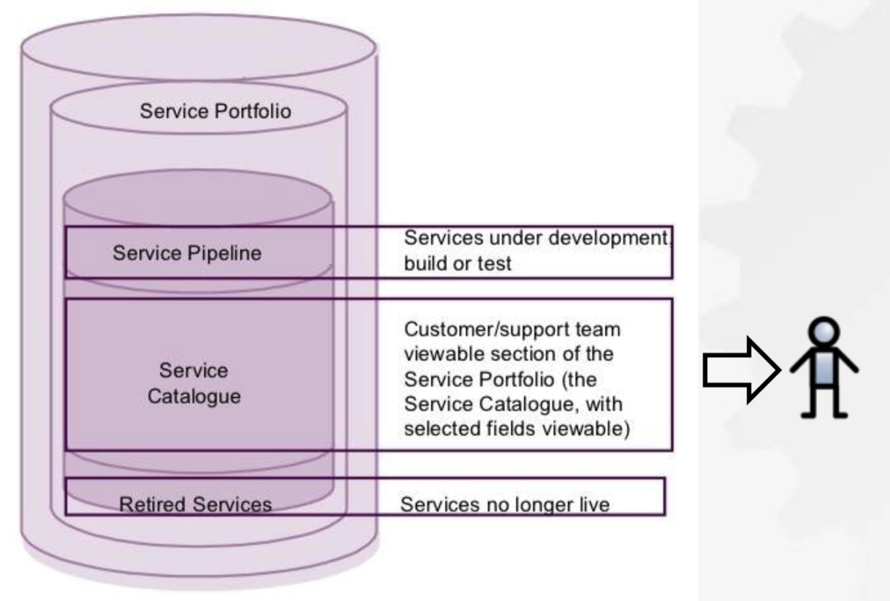
D6.2 :: A proposed framework for designing and implementing a Service Portfolio for the ESDC and SKA
Summary
The difference between a Service Portfolio and the Service Catalogue
D6.2 provides a framework and recommendations to implement a Service Portfolio for the SKA
The goal of Service Portfolio Management is to define and maintain a service portfolio, which is a list of all services offered by a provider at some point (in prep, live, discontinued)
Two Service Portfolios are proposed:
Centrally coordinated services (inc. federation + observatory)
Services for the ESDC/ESRC
ESDC services may be loosely/tightly integrated, or something in between
Service categories are proposed and implementation suggestions are made based on production level services currently available.
28 June 2019, ESRC Design Workshop, Lyon

Slide 15
Service Mangement System advantages
Establishes groundwork how service delivery can happen in a federated environment
Within ESRC
across multiple teams in an organization
across multiple organizations in the ESRC
between ESRC and the SKAO
between ESRC and the observatories
between ESRC and other SRCs
Assists with understanding/fulfilling expectations and changing circumstances
28 June 2019, ESRC Design Workshop, Lyon

