Slide 1
AENEAS WP4
Network Design
Analysis of Global SKA Data Transport and Optimal European Storage Topologies

Slide 2
Network Traffic profile for an SRC

Slide 3
Network Connectivity to a SRC
e.g. Images
medium bandwidth & RTT
Other Archives
Web Portal Access
Light weight
SRC n
Users
SDP Data Products
High bandwidth
Large RTT
Data Chunk Visualisation
Image portion
Moderate bandwidth
Replication of advanced data products
Medium bandwidth
Large RTT
SRC m

Slide 4
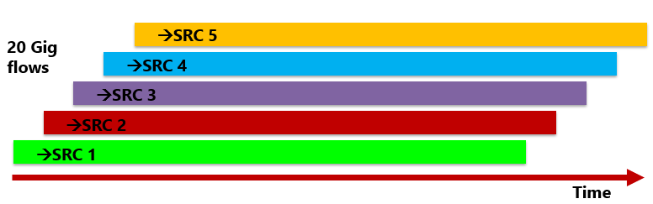
Types of Network Traffic (1)
The Telescope Data Products will be large continuous data transfers.
  Concurrent flows ~100 GBytes pushed by SDP
  long-distance paths RTT up to 300ms.
  Data rates into ESRC
  ~20 Gbit/s/telescope for equal shares
  100 Gbit/s /telescope for all Data Products.
These high bandwidth long-haul flows require loss free end-to-end networks with no bottlenecks.
This implies the use of well designed
  site access links and
  campus networks with high performance DMZ and
  On-site data transfer nodes capable of large (1GByte) TCP buffers.

Slide 5
Types of Network Traffic (2)
The amount of data that will need to be exchanged around the world between SRCs is unclear.
  SRC would be federated providing reciprocal storage and compute of the Data Products
  assume that some data will be exchanged
  remote job submission & retrieval as part of a distributed work flow
Data will be exchanged with other non-SKA archives
Scientists will need to access the ESRC via some form of advanced portal
  Requires timely response but low RTT helps
Pubic access to SKA data
This implies
  an advanced federated form of human access control
  highly controlled public access to the Data Products and Advanced Data Products
  Flexible but secure site ACLs and DMZ.

Slide 6
Network Model within the ESDC
Trends
  Fewer sites but each with larger storage
Assumptions
  20 Gbits/s at a time from each Telescope
  peak 40 Gbit/s to a site
  At a given time all of a Data Product goes to one site
  10 Gigabits/s to other ESDC sites
  10 Gigabits/s to non SKA data Archives
  10 Gigabits/s to other RDC
70 Gigabit/s (peak) to each site.
Say 100 Gigabit/s for SKA to each site in 2024/25. This is affordable.
(c.f. the UK WLCG sites which have 10-40 Gbit/s dedicated links now)

Slide 7
Network Architecture for the ESDC

Slide 8
Network Architecture
SKAnet formed from an overlay network on the IP network
Based on linked Virtual Routing and Forwarding (VRF) with the domains provided by the NRENs in each country
NRENs directly connect to the edge routers in each site.
GÉANT is the aggregator network
  Interconnects the VRF domains
  Access to inter-continental links
  Access to Cloud services
There are Operational requirements
  Sites
  NRENs
  GÉANT

Slide 9
Advantages of peering VRFs
Isolation of SKA traffic from the network traffic of other users
VRFs make it easier to implement the routing and policies that are defined by different NRENs and physical sites
The SKA traffic can be engineered by the NRENs and sites to use specific paths and routes to provide the high bandwidth required by SKA
It is easy to include dedicated point-to-point links where required without allowing their use by non-SKA traffic
The layer 3 routing of the overlay provides isolation of network faults and strictly limits broadcast storms should they occur
The overlay is resilient against failures of a link
Configuration actions have to be undertaken by the NREN and a Site to join the SKA VRF which provides an extra layer of security

Slide 10
Global
Network Architecture

Slide 11
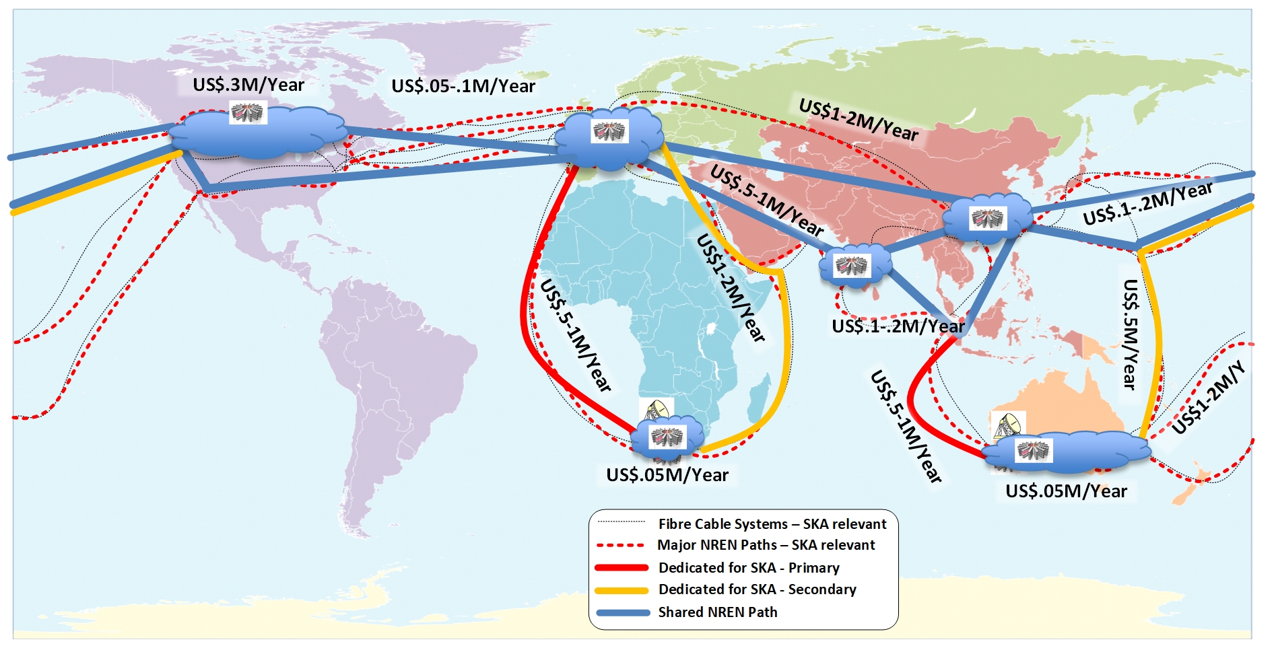
Global VRF Overlay and Dedicated Links
OPEX Link and transmission on the academic networks
with 10 to 15 year IRUs priced in 2024 US dollars.
Dedicated Primary 100 Gigabit link USD 750 K each per year sum=2M USD
Dedicated Backup 100 Gigabit link USD 2M each per year sum=4M USD
Use of shared NREN paths.
Notes:
WACS & Indigo
New affordable path Singapore - Europe

Slide 12
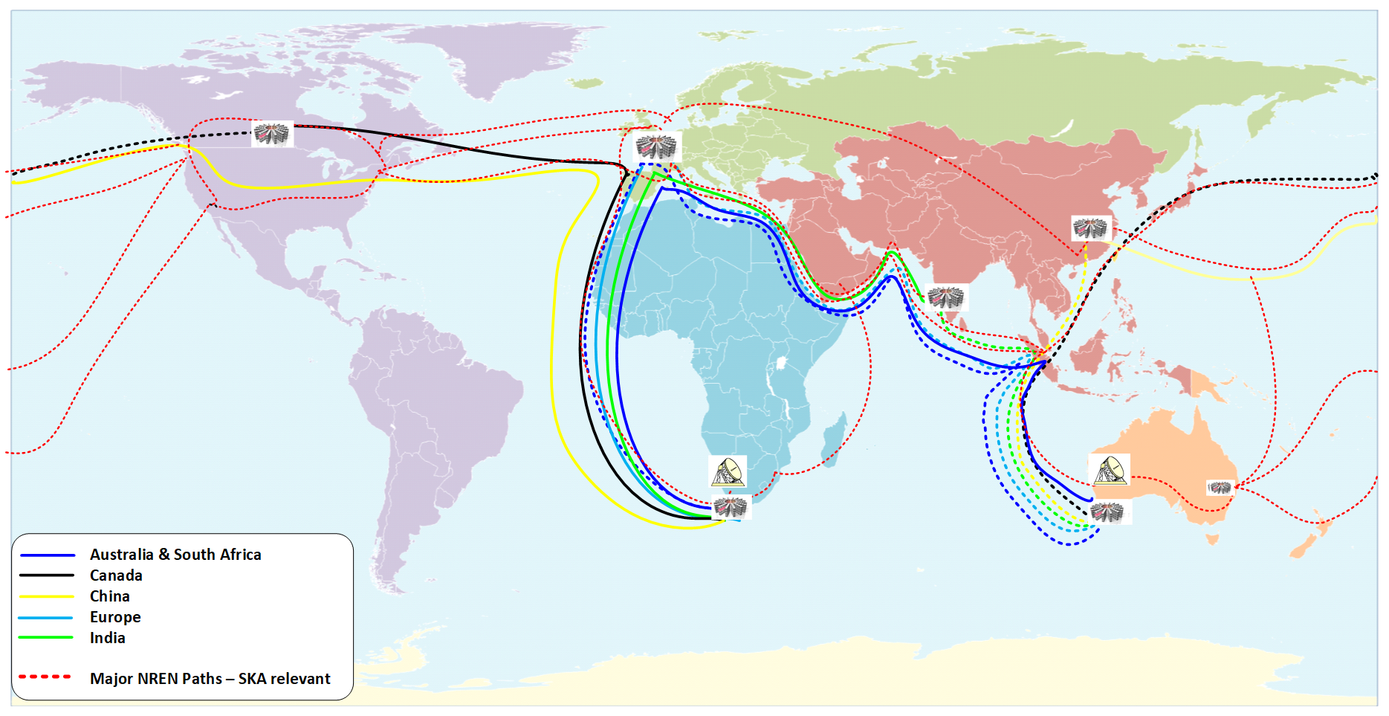
Paths for the SKA Data Product flows
Solid lines represent data from SKA1-Mid to the SRCs
Dashed lines represent data from SKA1-Low to the SRCs
Large RTT up to 300 ms
Large fraction used of shared NREN paths for the continuous data flows.
Impact of moving Advanced Data Products??
Notes:
WACS & Indigo
New affordable path Singapore - Europe

Slide 13

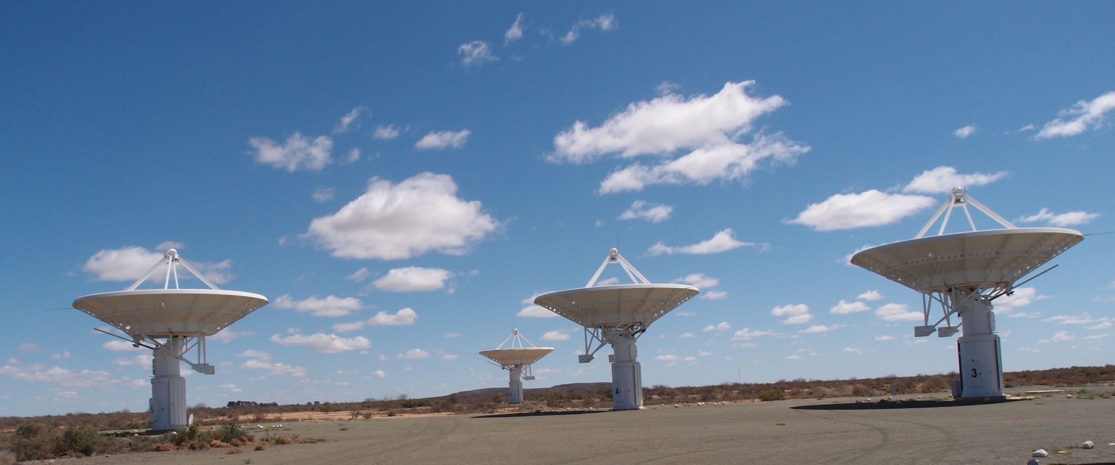
Questions ?
Thanks to Richard Hughes-Jones

