Slide 1
Redmine for ASTERICS-OBELICS
Cécile Barbier – LAPP
16 october 2015

Slide 2
Redmine overview
Project Management Web Application that provides:
An issue tracking system
News, documents and files management
Wikis & forums
Gantt charts and calendars
SCM (Software Configuration Management) integration for software VCS (Version Control Systems) like SVN, Git, Mercurial …

Slide 3
Redmine ASTERICS-OBELICS connexion
https://forge.in2p3.fr/projects/asterics-obelics
Connexion on top right of the web page:
‘CAS Sign In’ for all users with a CNRS certificate or a CTA account
for any other user:
if you don’t have an account yet on https://forge.in2p3.fr, ‘Register’ and enter ‘ASTERICS-OBELICS’ in the Project field of the form
connect using ‘Sign In’ once your account is activated
Support: cecile.barbier@lapp.in2p3.fr

Slide 4
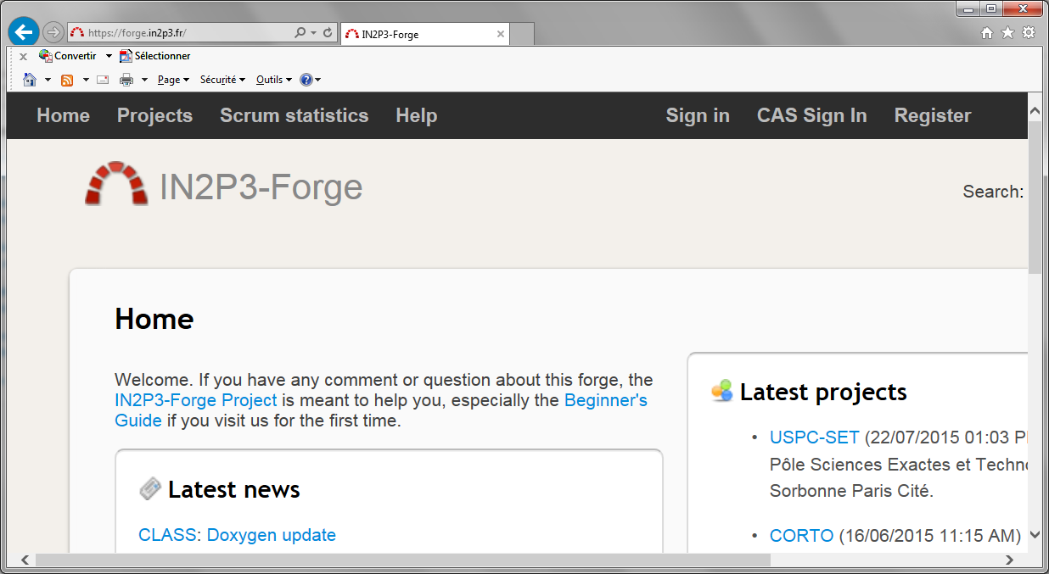
Redmine connexion
Others users
any time
except first time
Other users
first time
Only users with
a CNRS certificate
or a CTA account

Slide 5
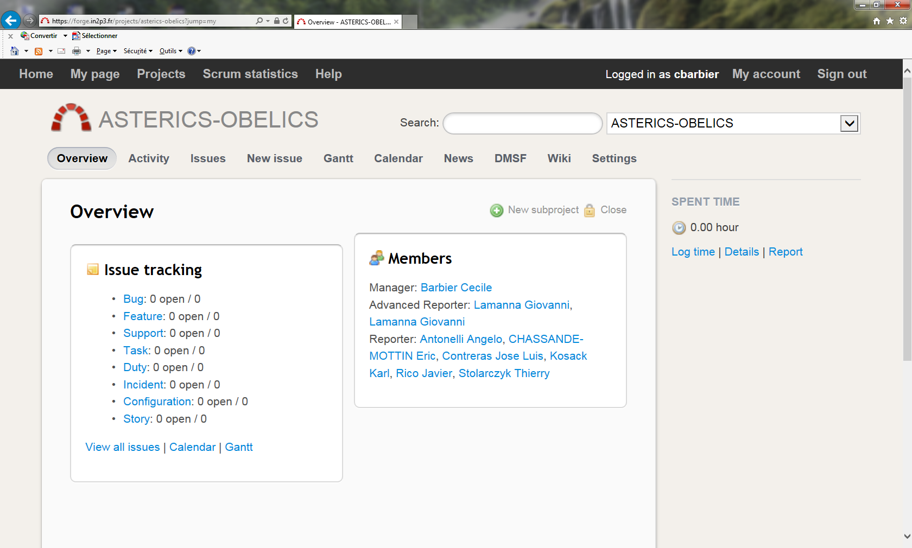
Redmine ASTERICS-OBELICS overview

