Slide 1
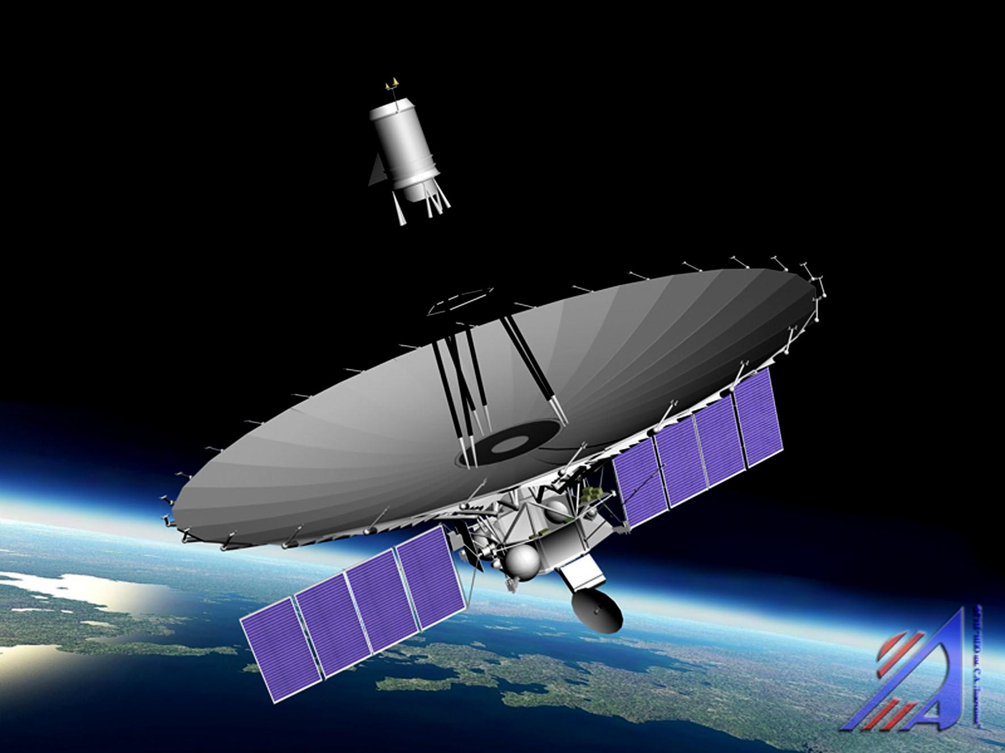
Next Generation Space VLBI Workshop
ASTRON/JIVE
17-19, October 2022
The filamentary
structure of 3C 279
probed by RadioAstron
Antonio Fuentes, Jose Gómez, Guang-Yao Zhao, Rocco Lico, Ilje Cho, Thalia Traianou, Teresa Toscano, Rohan Dahale,
Manel Perucho, Jose M. Martí, Andrew Chael, Kazu Akiyama, Katie Bouman, He Sun,
Andrei Lobanov, Yuri Kovalev + RadioAstron Collaboration
preprint available here: https://www.researchsquare.com/article/rs-1449452/v1

Slide 2
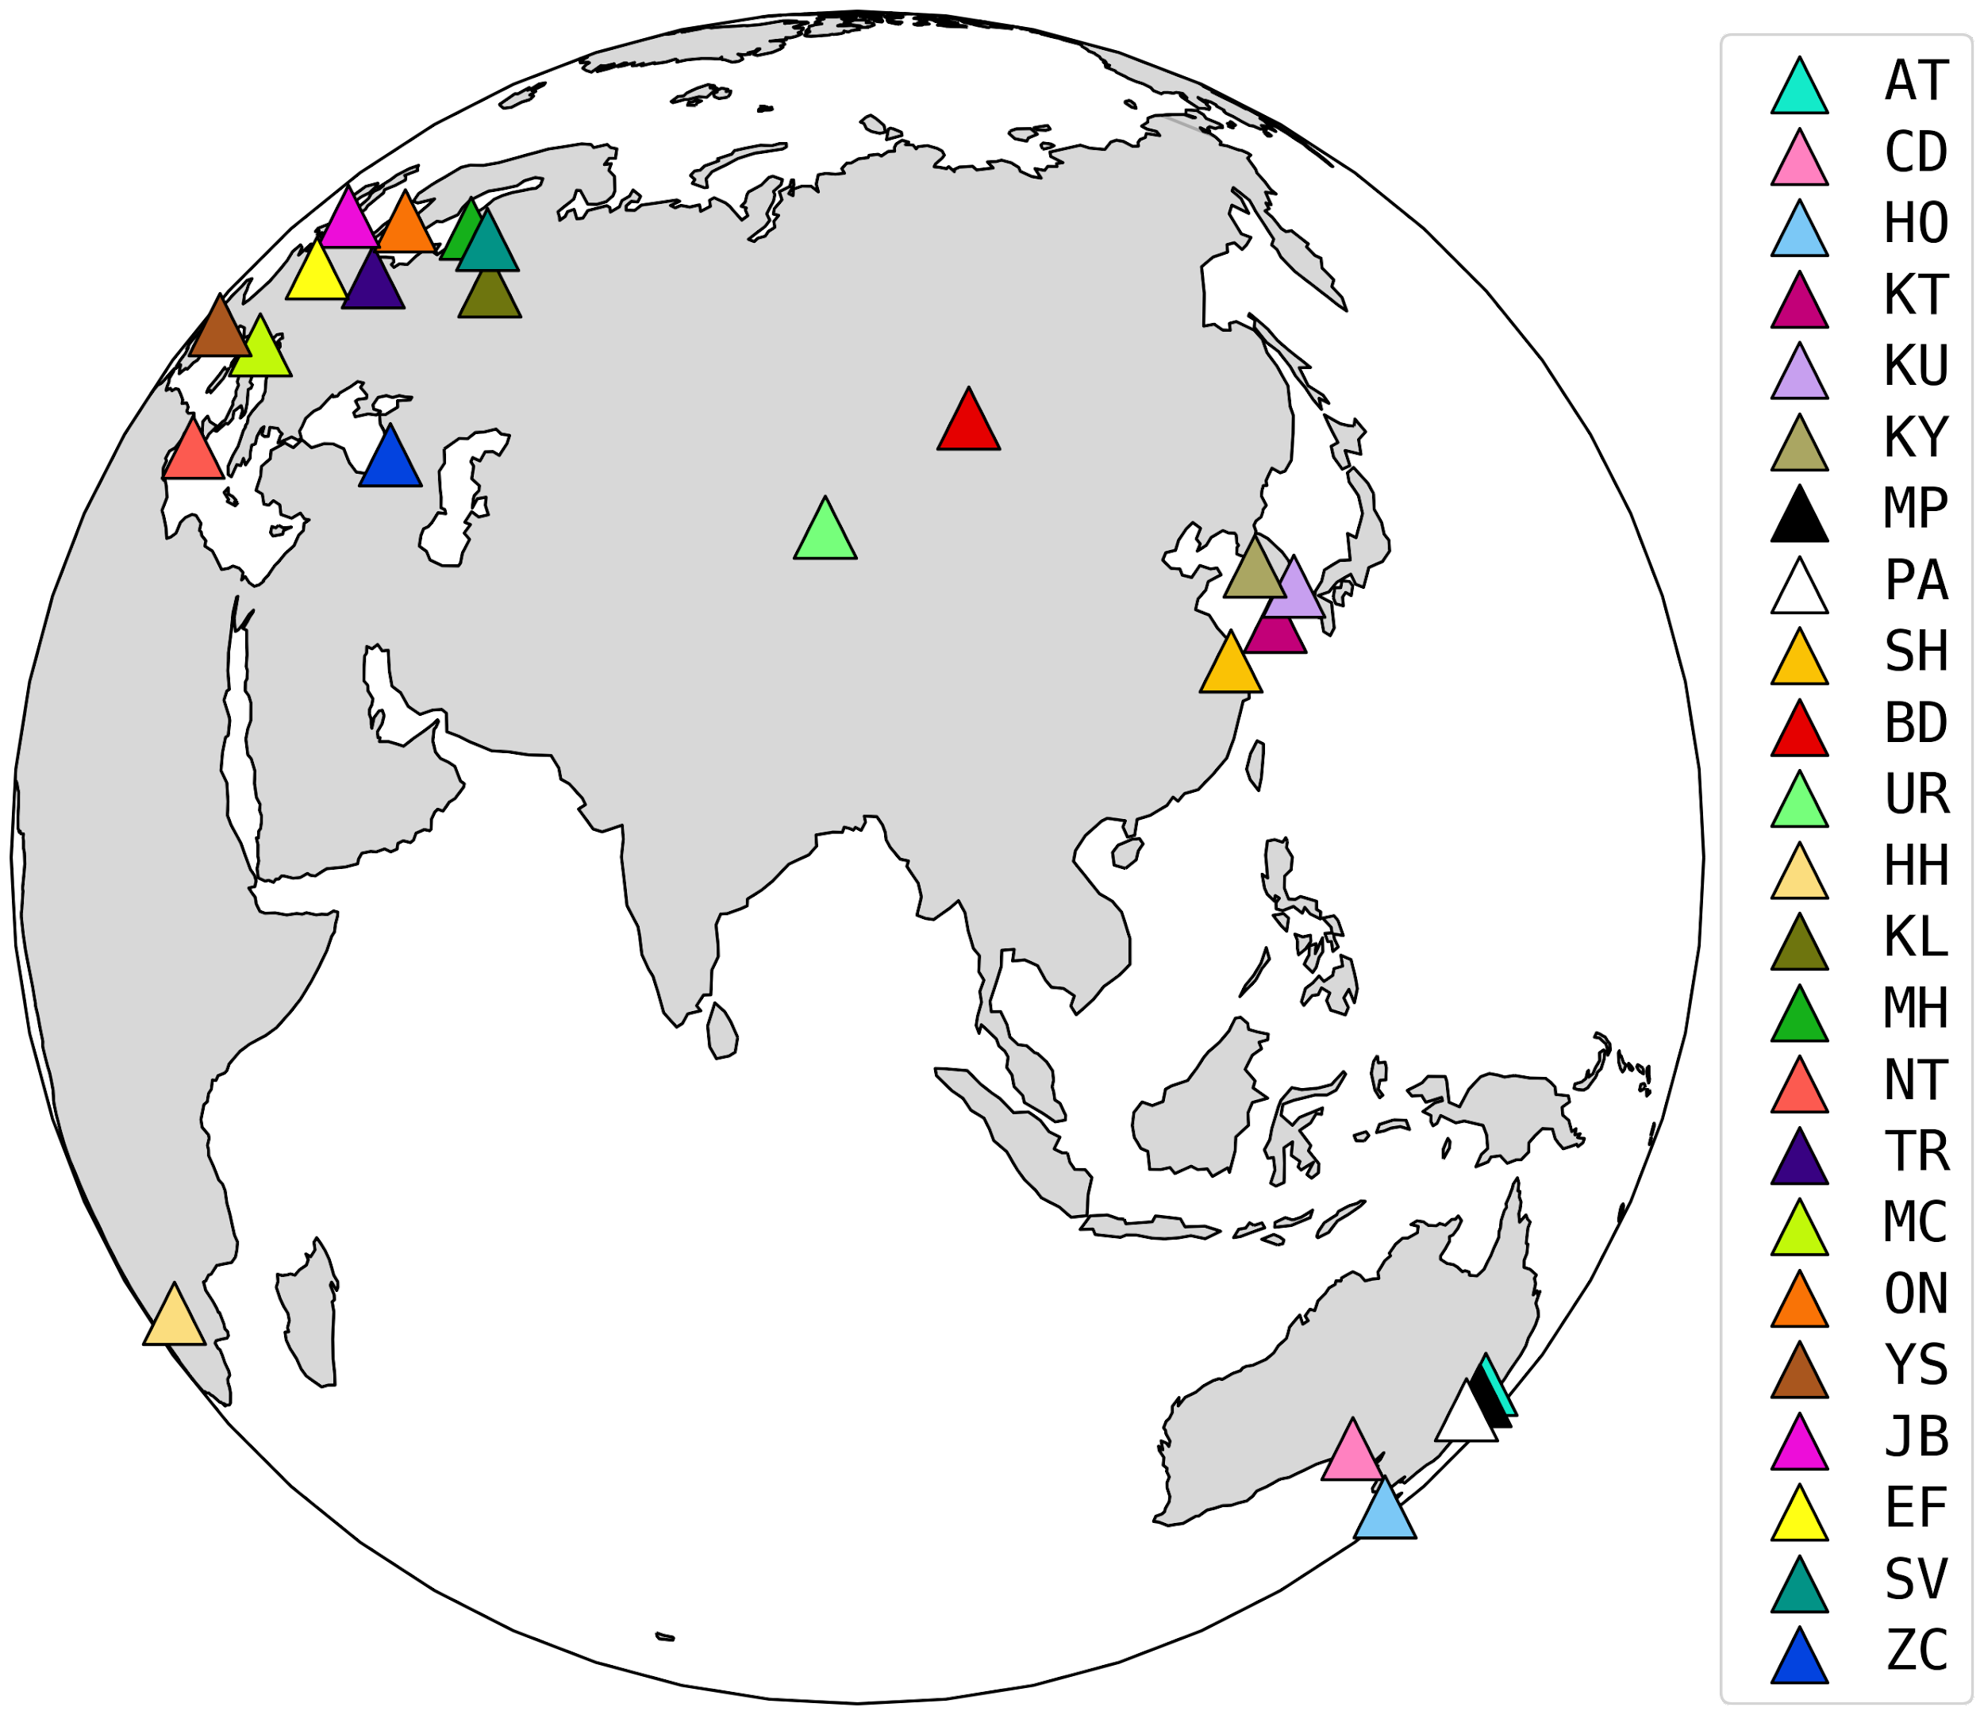
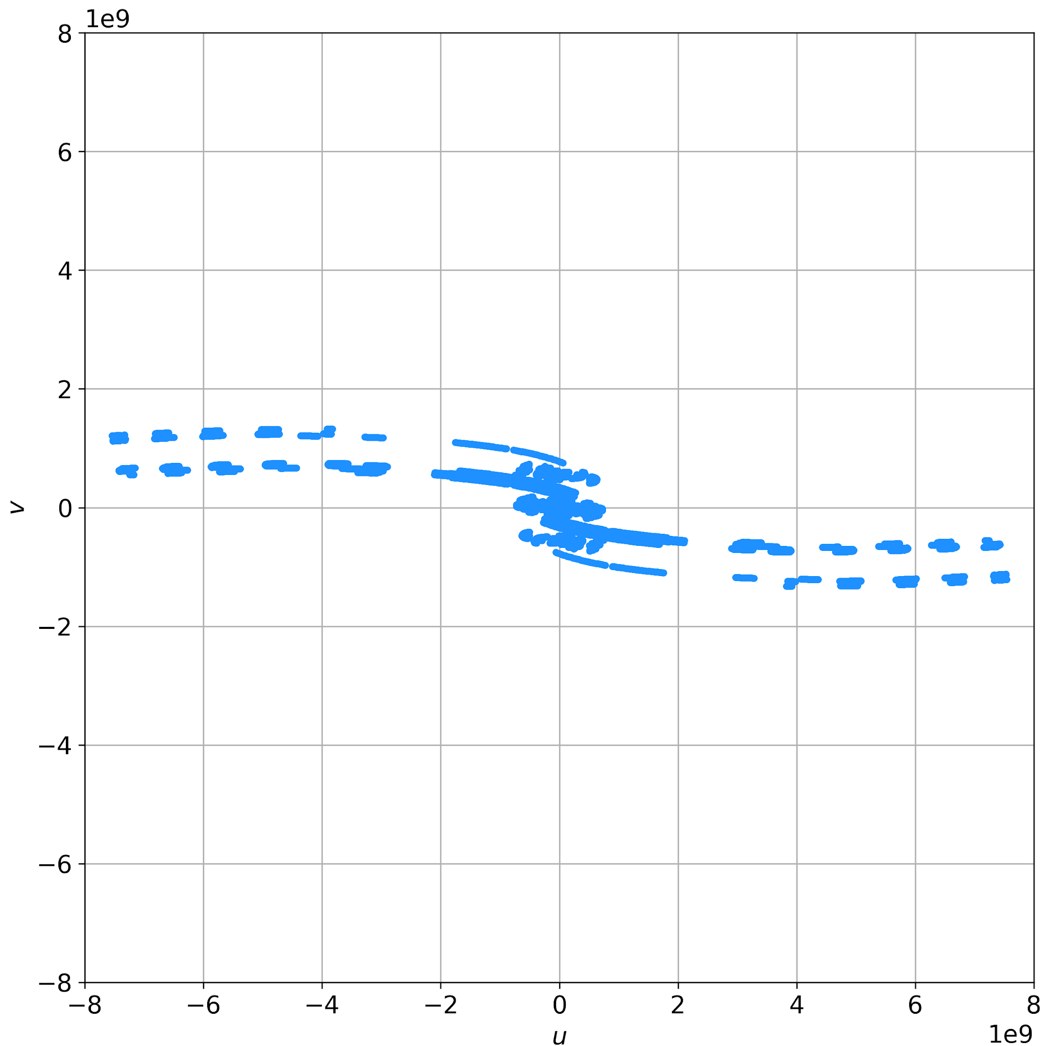
Observations
Observations
Observed on 10 March 2014 w/ the space VLBI mission RadioAstron
At 22 GHz (1.3 cm)
Supported by a ground array of 23 antennas
Full polarization mode
RA
27 μas
~8 ED

Slide 3
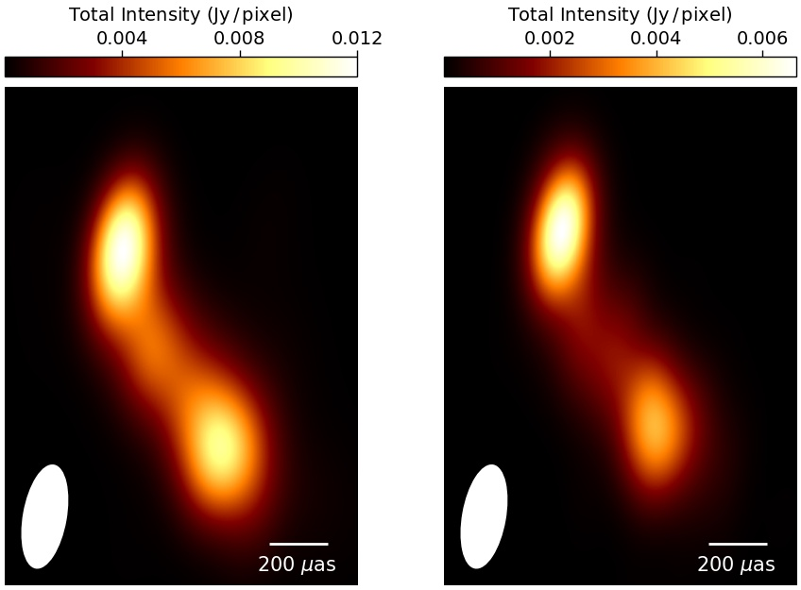
Results
Results
Our 22 GHz image is consistent with the 43 GHz image of the same epoch.
RadioAstron @ 22 GHz
convolved w/ BU beam
VLBA-BU-BLAZAR @ 43 GHz
27 μas
~8 ED

Slide 4
Results
Results
Our 22 GHz image is consistent with the 43 GHz image of the same epoch.
Can we compare it with the EHT 1mm image? (Kim et al. 2020)
RadioAstron @ 22 GHz
convolved w/ BU beam
VLBA-BU-BLAZAR @ 43 GHz
EHT 1mm
27 μas
~8 ED

Slide 5
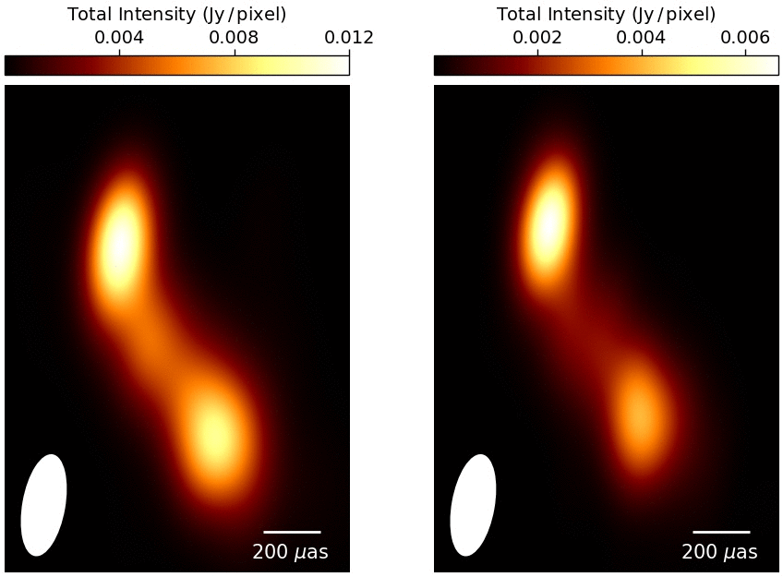
Results
Results
Our 22 GHz image is consistent with the 43 GHz image of the same epoch.
Can we compare it with the EHT 1mm image? (Kim et al. 2020)
RadioAstron @ 22 GHz
VLBA-BU-BLAZAR @ 43 GHz
EHT 1mm
27 μas
~8 ED

Slide 6
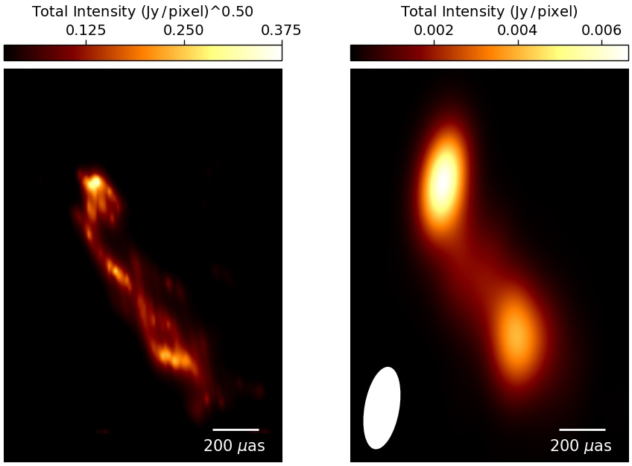
Results
Results
Thanks to RadioAstron, we obtain a comparable resolution to the EHT
+ all the extended emission seen in the 43 GHz image.
RadioAstron @ 22 GHz
VLBA-BU-BLAZAR @ 43 GHz
EHT 1mm
27 μas
~8 ED
Fuentes et al, submitted

Slide 7
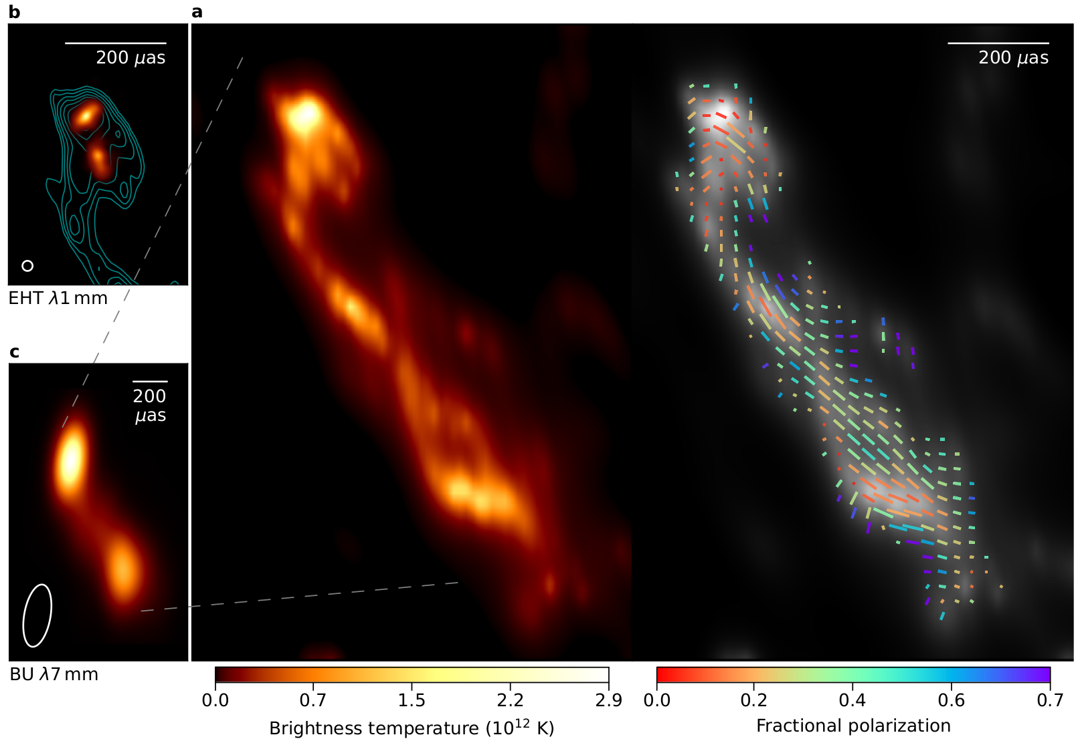
Imaging
Imaging
Fuentes et al, submitted
Image reconstruction using eht-imaging.
First time RML methods were used to image space VLBI data.
First, we imaged ground-only data.
Then, we added space baselines and used that image as init/prior.
First round of closure-only imaging due to poor a priori calibration.

Slide 8
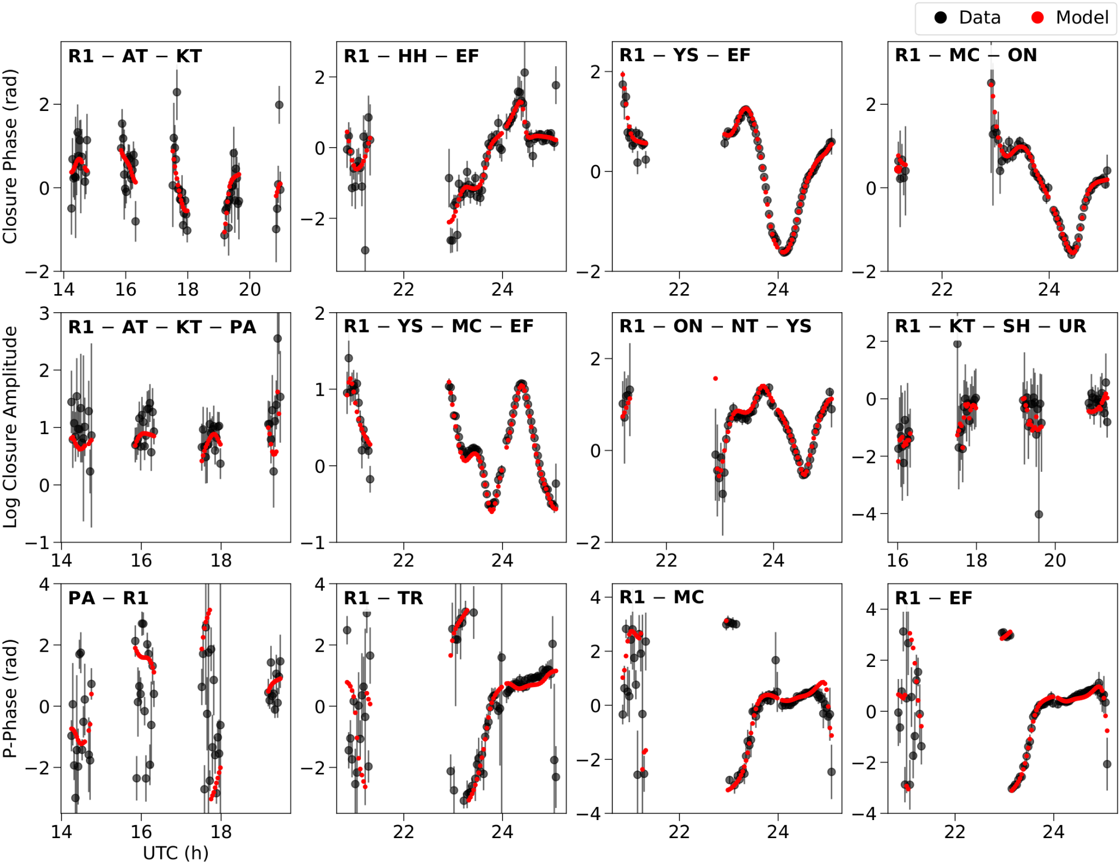
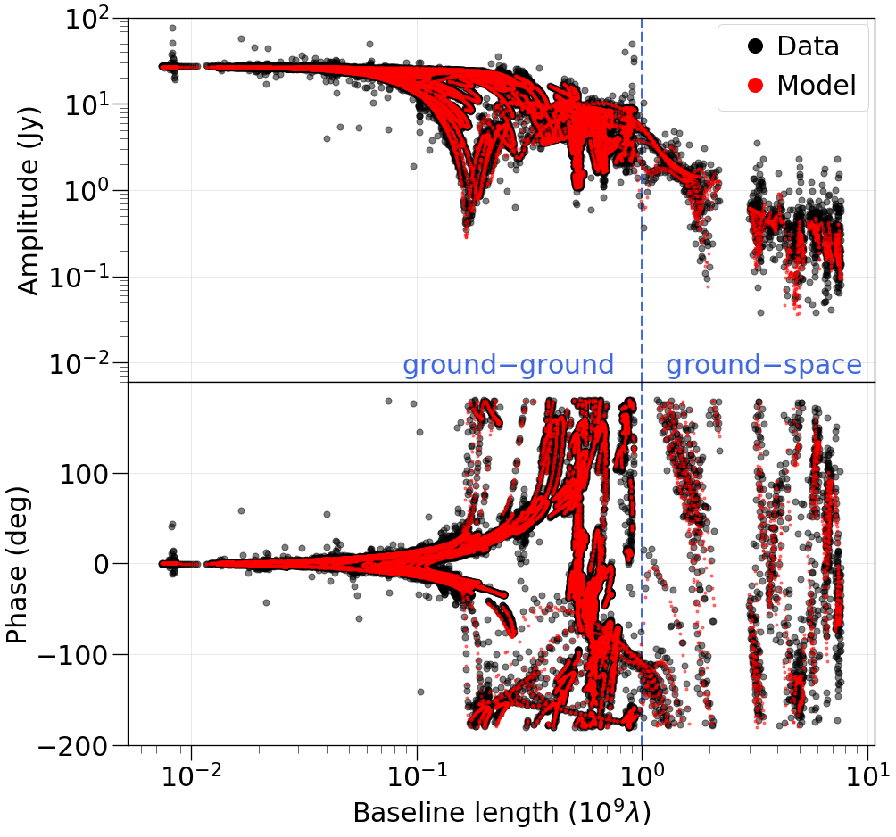
Imaging
Imaging
Image fitting to the data
Fuentes et al, submitted

Slide 9
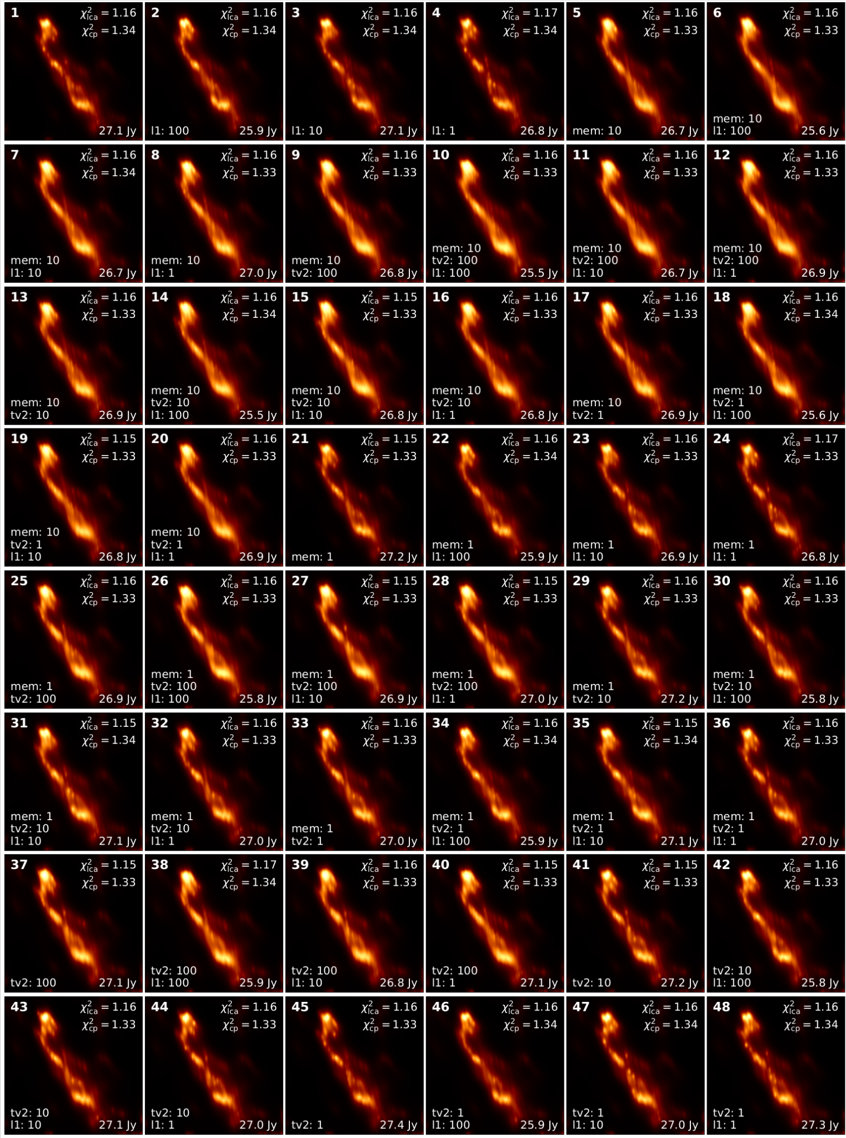
Imaging
Imaging
Parameter survey
Fuentes et al, submitted

Slide 10
Comparison with the EHT
Comparison with the EHT
Core structure is consistent with the EHT image. The base is elongated and tilted.
Although 3 years apart, position angle of the core is roughly the same.
The southern EHT component coincides with one of the 3 filaments departing from the core.

Slide 11
Comparison with the EHT
Comparison with the EHT
Fuentes et al, submitted
Core structure is consistent with the EHT image. The base is elongated and tilted.
Although 3 years apart, position angle of the core is roughly the same.
The southern EHT component coincides with one of the 3 filaments departing from the core.
RadioAstron is able to capture 2 (and possibly 3) extended helical filaments, thanks to the ultra-high angular resolution and large dynamic range.

Slide 12
Filaments
Filaments
The filaments present a spatial periodicity of 175 pc (de-projected).
Possible origin:
Precession of the jet: discarded in Kim+20
BH or inner disk processes: discarded, it implies superluminal propagation speed
Anchored to outer disk: discarded, it implies a too large disk
Current driven instabilities: discarded, jet is already fully accelerated
Kelvin-Helmholtz instabilities are then the most plausible explanation.
Fuentes et al, submitted

Slide 13
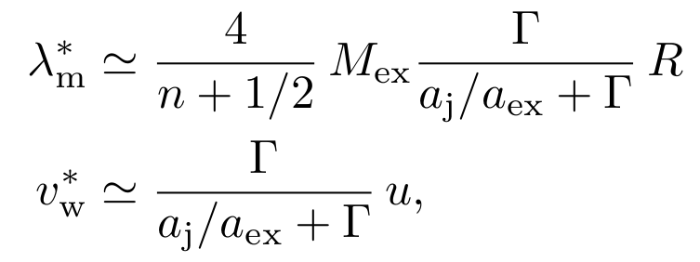
Filaments
Filaments
In the context of Kelvin-Helmholtz instabilities:
Elliptical modes can produce the observed helical structure.
A helical mode interfering with the elliptical can cause the possible third filament.
We can derive the wavelength of the mode and wave velocity.
We obtain a jet Mach number >= 10, which indicates a jet kinetically dominated.
This also sets an upper limit of 20 for the Lorentz factor.
Fuentes et al, submitted

Slide 14
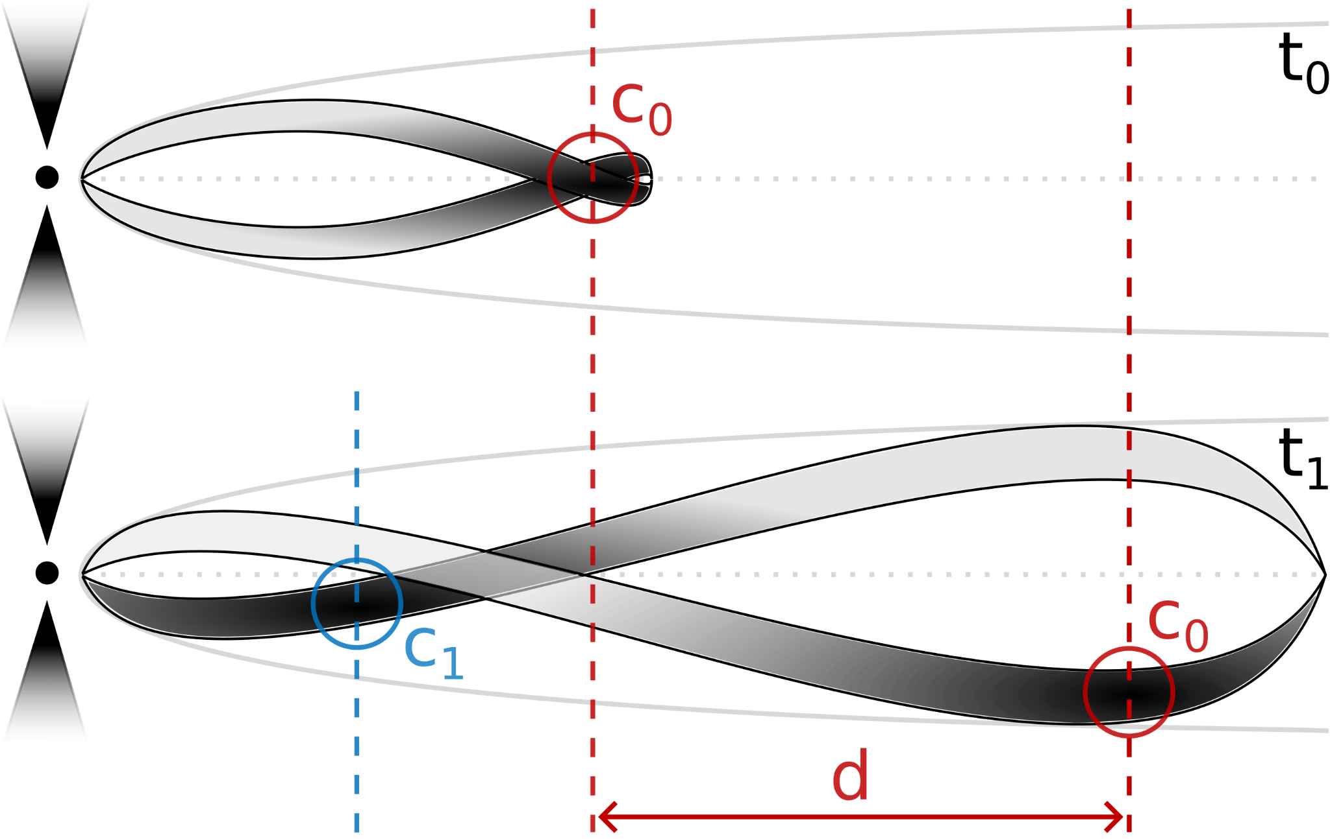
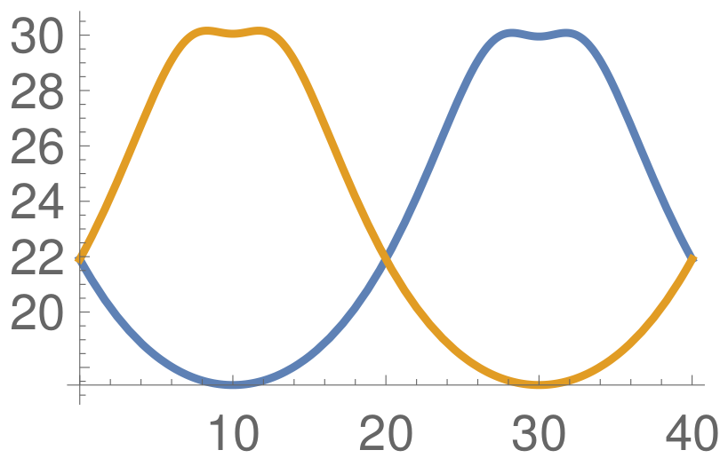
Filaments
Filaments
A novel model to explain traveling components:
Marscher and Gear (1985) model propose shock waves traveling downstream the jet.
The estimated propagation speed of the fitted components (Jorstad+2017) ≤ inferred jet flow speed, which discards shocks.
Certain regions within the filaments have an increased emissivity.
Local changes in the fluid properties (velocity, viewing angle) can Doppler boost the emission in this regions.
As the filaments are formed and evolve downstream the jet, so do the components, leading to the usually observed traveling components.
doppler
c₁
c₂
distance

Slide 15
Polarization
Polarization
The source is mildly polarized, degree of polarization ~10%
EVPAs follow the filaments propagation direction, indicating a strong toroidal component of the magnetic field.
Based on the strong transverse asymmetry and RMHD simulations, we infer:
a flow Lorentz factor of ~13, in agreement with Jorstad+17
a helical magnetic field rotating clockwise
an intrinsic pitch angle of ~45º (~86º in the observer frame)
RMHD simulation (Fuentes et al. 2018, 2021)

Slide 16
Can the ngEHT see the filaments?
Can we see this with the ngEHT?
Fuentes et al, submitted
The EHT couldn’t see the extended emission.
Could the ngEHT see it?
Take our RadioAstron image and generate synthetic data with the ngEHT coverage.
Image the data.

Slide 17
Summary
Summary
We have imaged 3C 279 at 1 cm with a nominal resolution of 27 μas thanks to RadioAstron and 23 ground antennas.
The ultra-high angular resolution and large dynamic range allowed us to see helical filaments “emanating” from the core and extending up to 175 pc (de-projected).
The elongated and tilted core structure is consistent with the EHT 1 mm image and the perpendicular southern component coincides with one of our filaments.
The filaments are probably caused by Kelvin-Helmholtz instabilities in a kinetically dominated flow with a Lorentz factor of ~13.
We propose a novel model to explain traveling components downstream the jet. These are the result of local flow changes within filamentary structures triggered by plasma instabilities.
We observe a magnetic field predominantly toroidal. Together with the strong emission asymmetry, we infer a helical magnetic field rotating clockwise with an intrinsic pitch angle of ~45º.

