Slide 1
The role of Earth-based arrays in future SVLBI missions
David Jauncey
CSIRO Astronomy and Space Science, Australian Telescope National Facility, Epping, NSW, Australia
and
Research School of Astronomy and Astrophysics, Australian National University Canberra, ACT, Australia

Slide 2
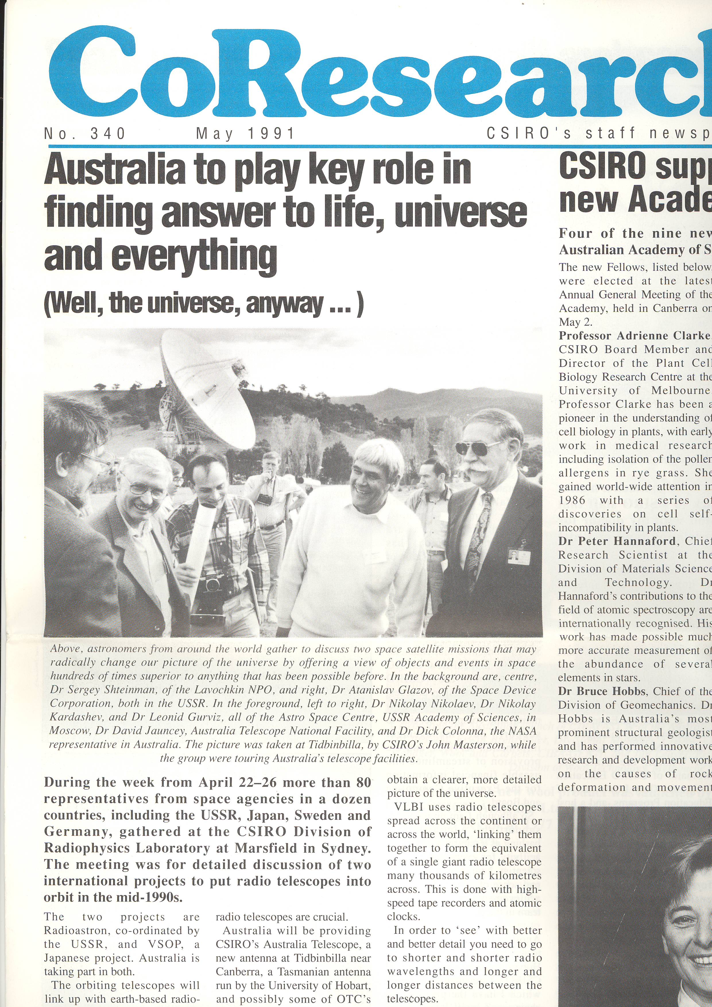
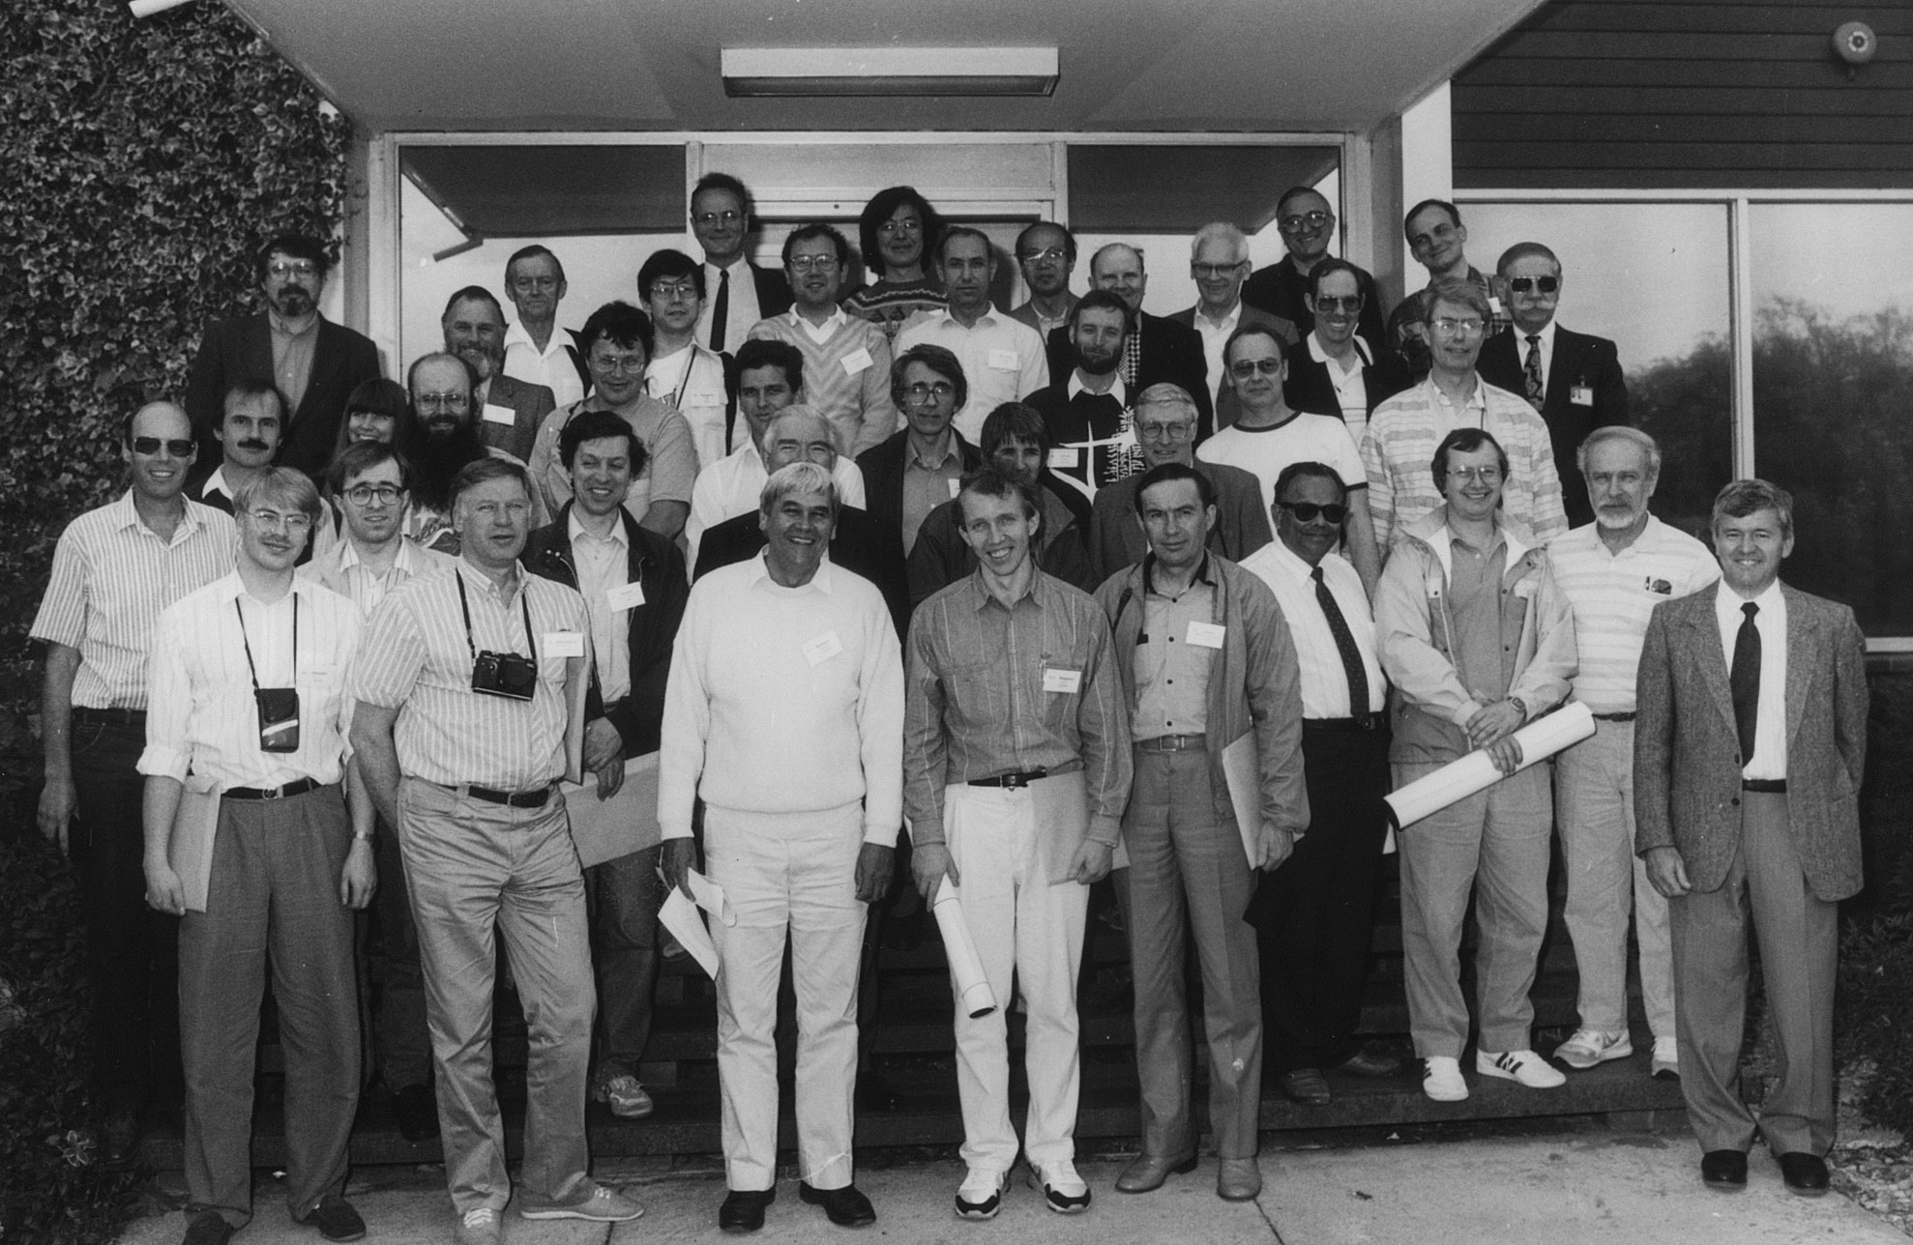
The First Space VLBI Work Week April 22-26 1991
During the week more than 80 representatives from Space Agencies in a dozen countries, gathered at the CSIRO Division of Radiophysics at Marsfield in Sydney. The meeting was for detailed discussion of two international projects to put radio telescopes into orbit in the mid-1990s.

Slide 3
The role of Earth-based arrays
Ground arrays and facilities have several principal roles;
Provide the Earth to space baselines for SVLBI observations
As essentially all of the sources of interest are variable, to provide the necessary accurate and appropriate flux density and polarization measurements, on timescales from hours to days to weeks to months to years
Provide the monitoring mas imaging observations, in parallel with the flux density measurements of item 2, into which the space observations must fit.
Provide the overall long-term variability, preferably at ~15 GHz, to determine the state of activity of all sources in the space observation program.
Details of the above are clearly dependent on the time-scales of the individual sources.

Slide 4
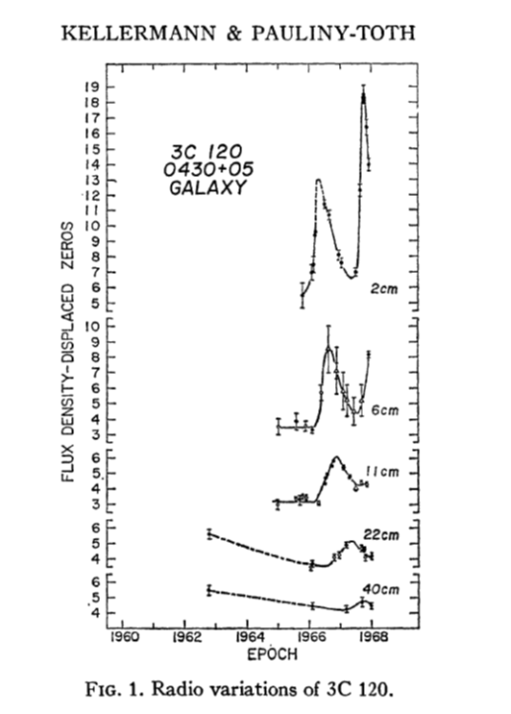
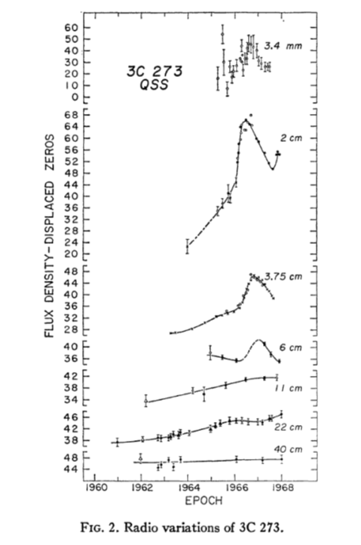
The sources that would be likely targets of
cm wavelength SVLBI show intrinsic variability
on time scales of months to years, as shown
here with 3C120 and 3C273. To determine the
state of activity over the SVLBI observations,
long term flux density monitoring on weekly
time scale is needed. The facilities that have
provided such monitoring data in the past,
are now no longer available.
Rather than providing multi-frequency
monitoring, the 15 GHz monitoring, as was
provided previously by the OVRO Blazar
Program, would likely be sufficient, and would
be a principal task for the ground facilities.

Slide 5
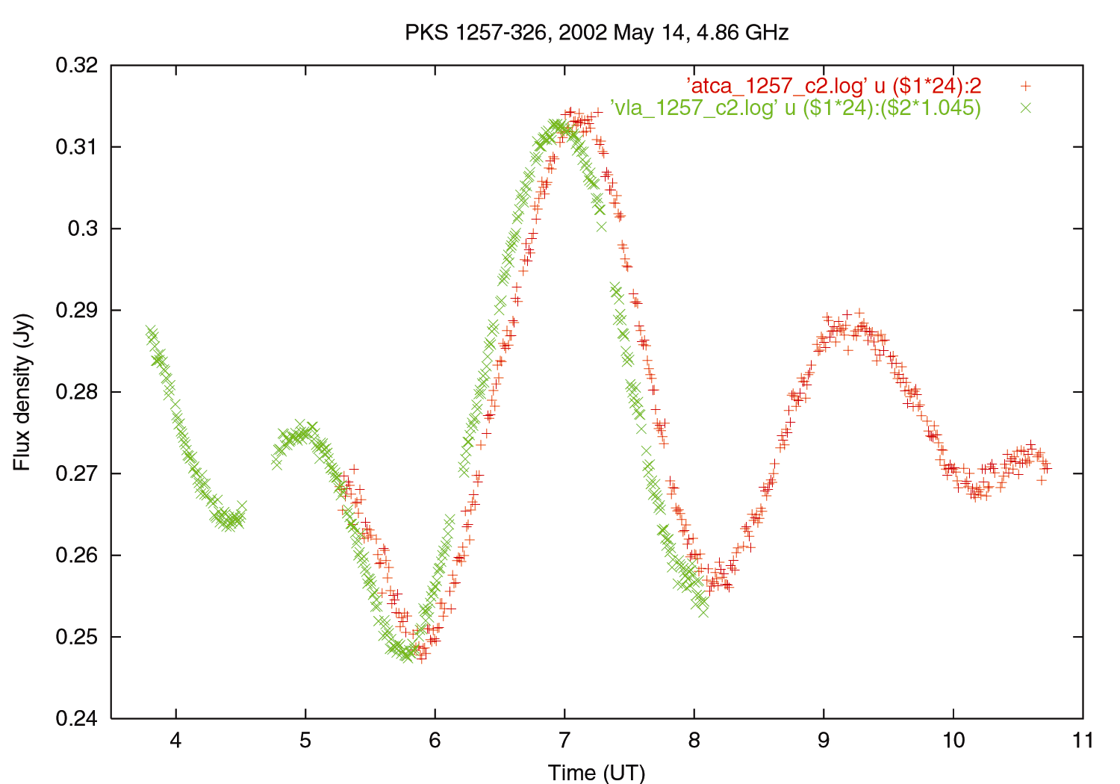
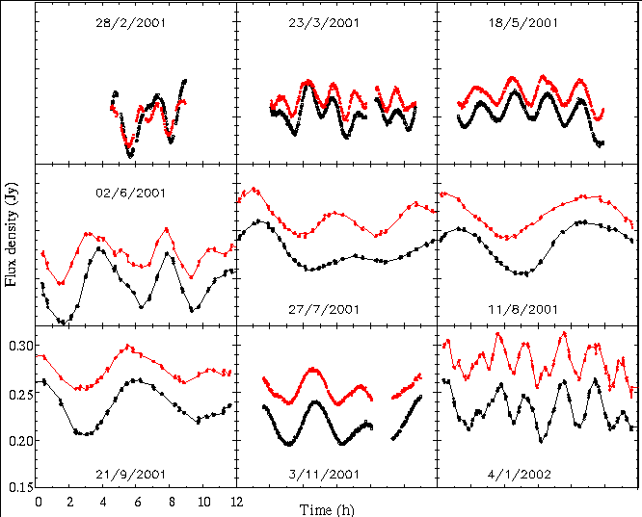
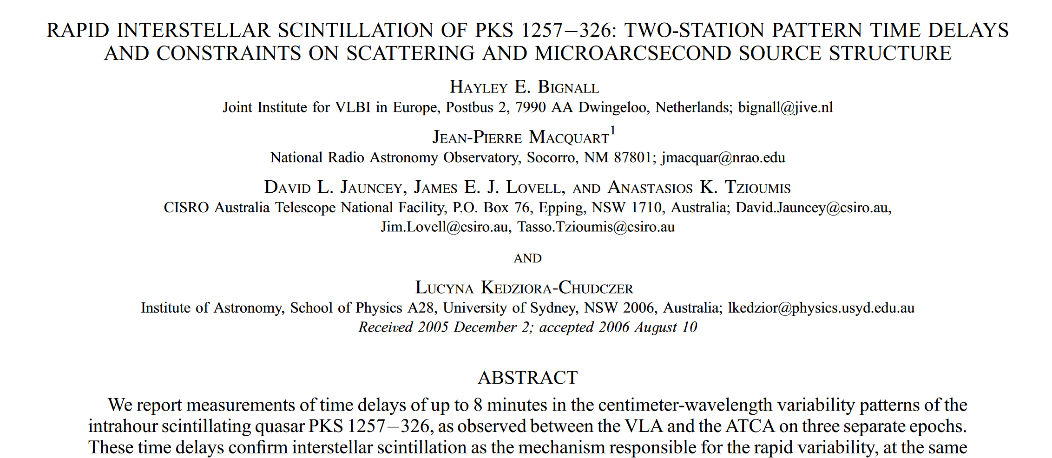
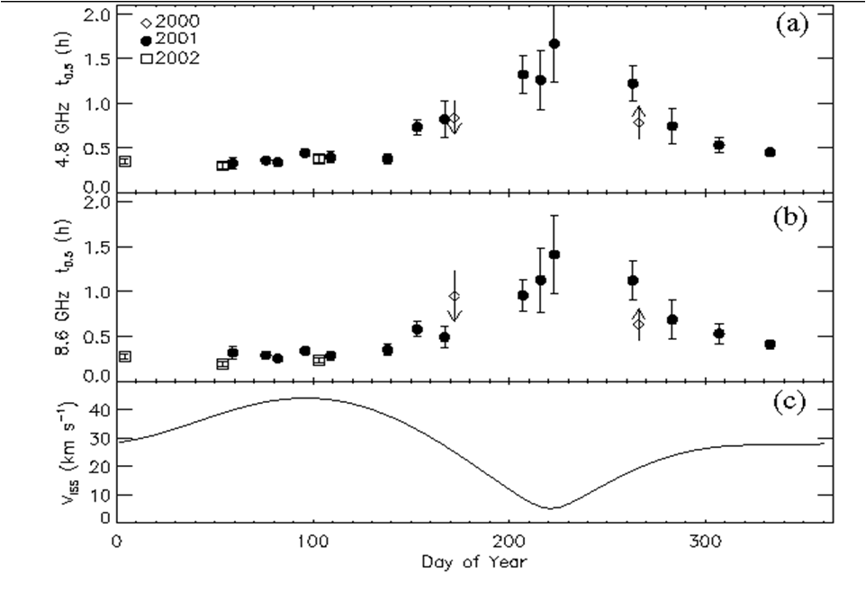
Time delay VLA-ATCA
Proof of the origin of the IDV as inter-stellar scintillation in PKS 1257-326
PKS 1257-326 annual cycle measurements

Slide 6
MASIV Array
The Micro-Arcsecond Scintillation-Induced Variability Array
Otherwise known as “the VLA in Dis-Array”!
Divided the VLA into 5 sub-arrays, each source observed every 2 hours at 5 GHz
Four epochs, January, May, September 2002, January 2003
A large number of flat-spectrum sources, Dec > 0, both strong and weak samples
Overall 56% showed significant variability on timescales of 3 days or less

Slide 7
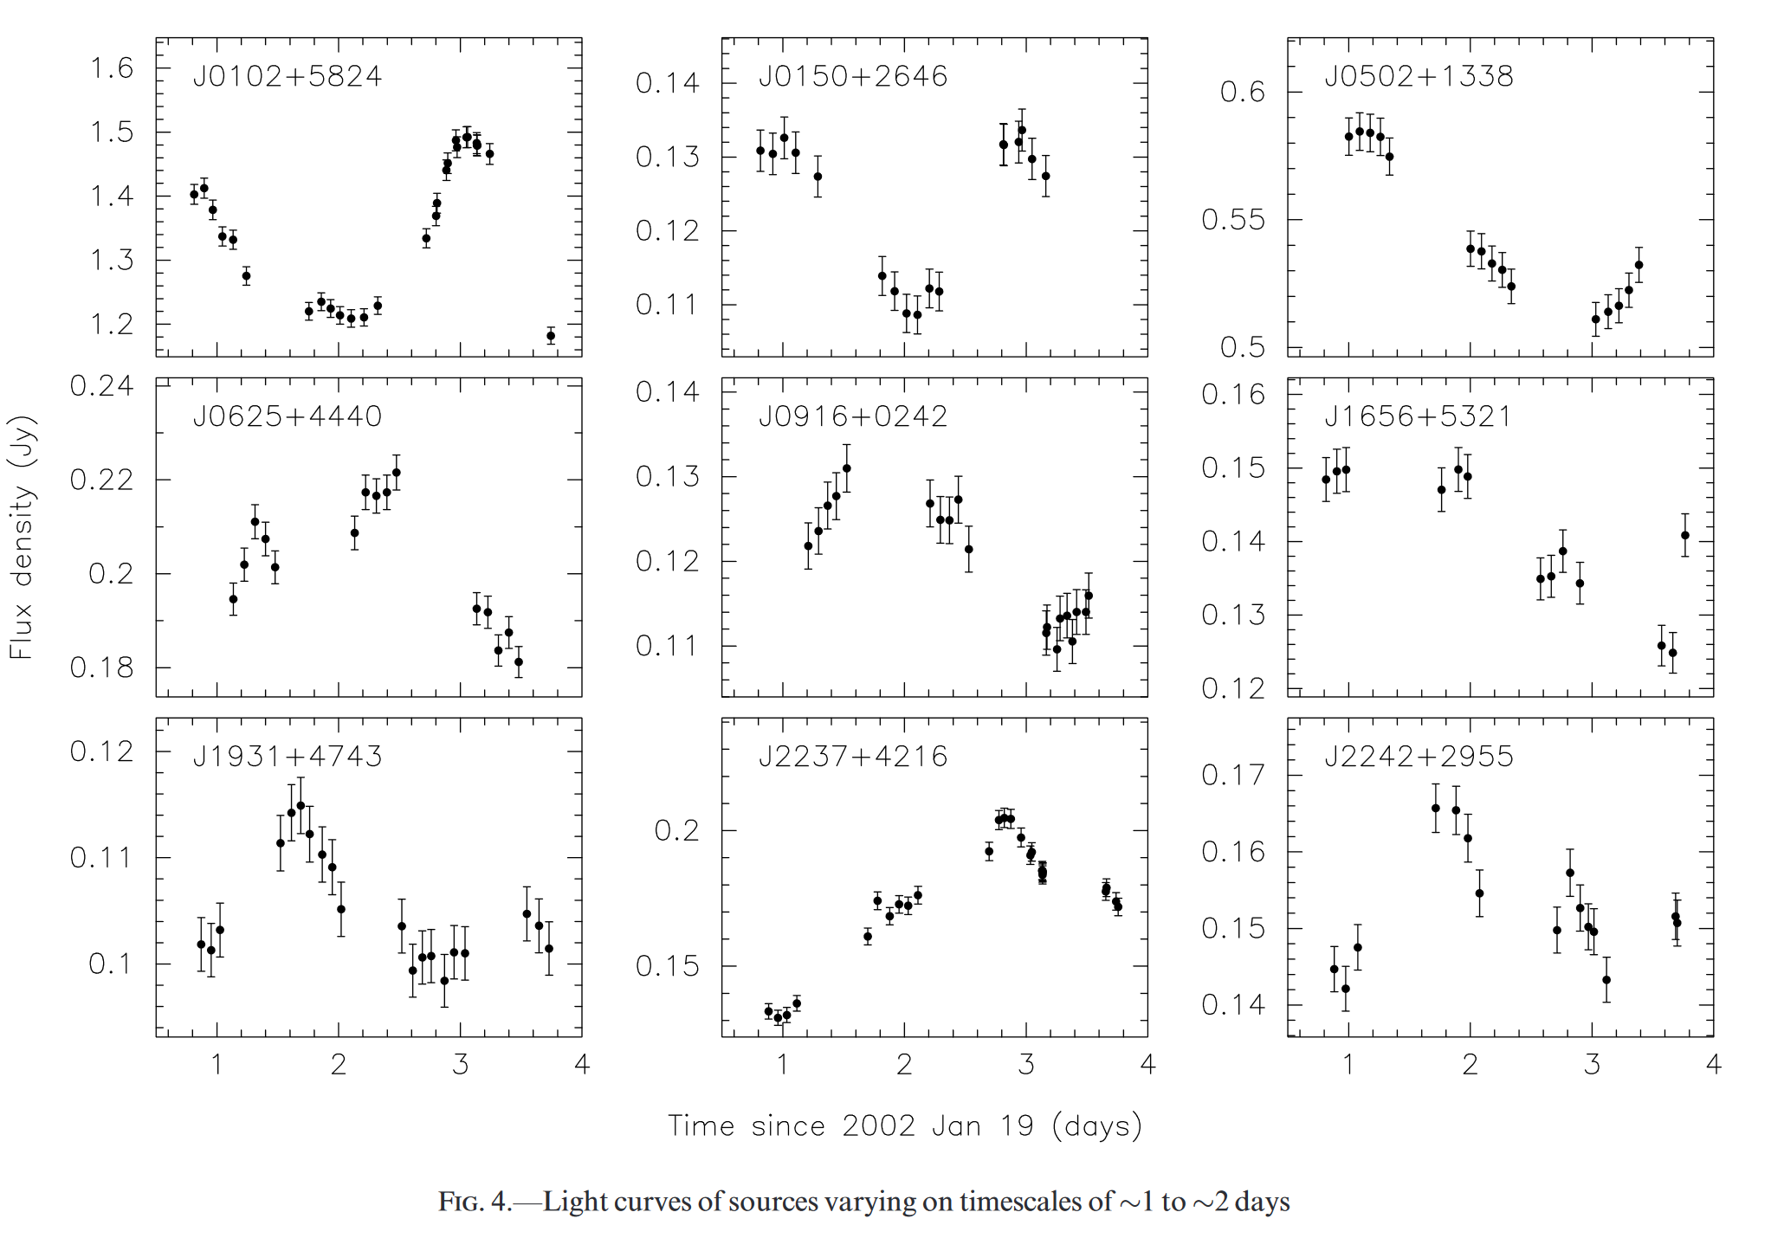
In addition to the slower intrinsic variability, many sources have been shown to also exhibit intra-day variability, IDV, at cm wavelengths. Extensive observations have shown that such rapid variability in extragalactic radio sources is caused by inter-stellar scintillation, ISS.
With ISS at cm wavelengths, the observed time scales have been found to range from minutes, for a small number of highly variable sources, through hours and on to days.
Some examples of MASIV variability
Light curves varying on timescales of ~1 to ~2 days Light curves varying on timescales from a few hours to ~1 day

Slide 8
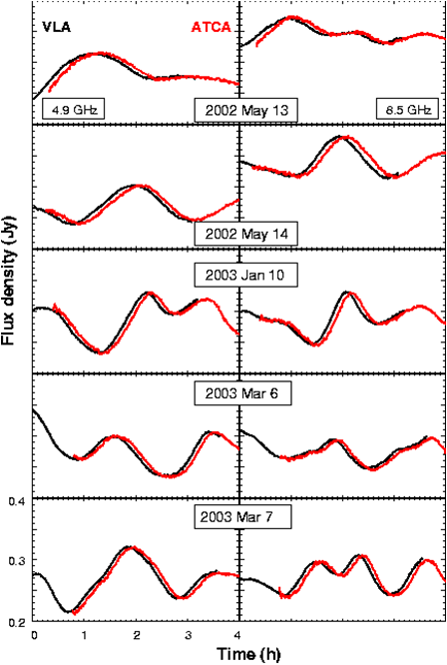
How long is the time delay in PKS1257-326?
Simultaneous observations of PKS 1257-326 at the VLA and ATCA at 4.9 and 8.5 GHz, over five separate days. The maximum delay was 8 minutes and 15 seconds, with an rms of 20 seconds. Thus, for large space-ground baselines of order 10 Earth diameters, delays of up to and hour and a half may be expected.
For ISS variability with time scales of hours, such delays will have a significant affect on the correlated SVLBI observations and will need careful evaluation. The problem is exacerbated as the small space telescope will be unable to determine the timing of the pattern.

Slide 9
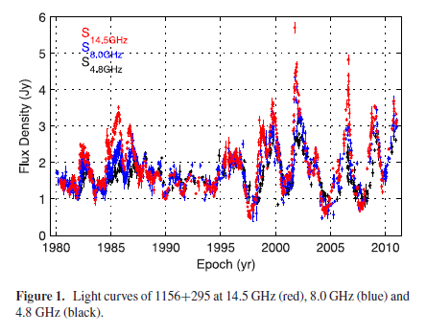
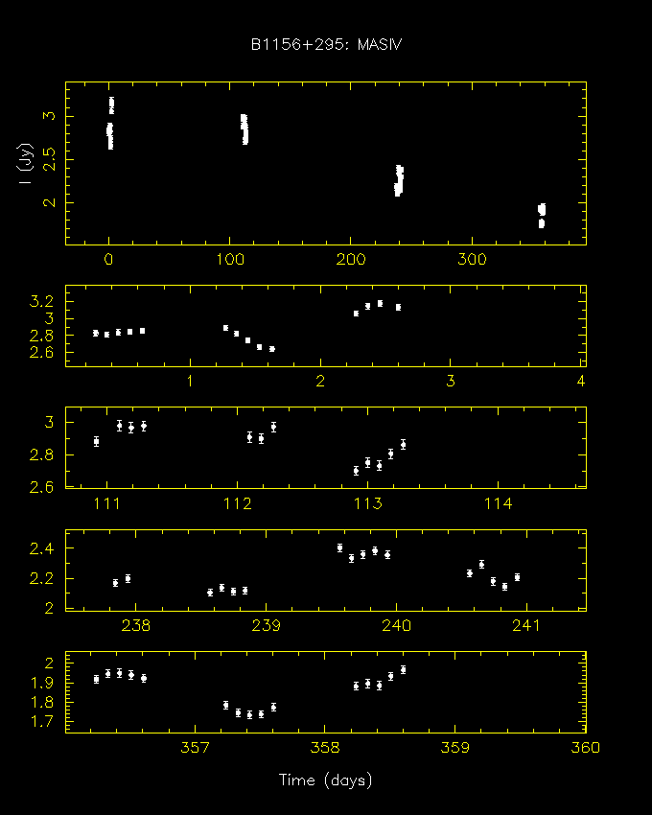
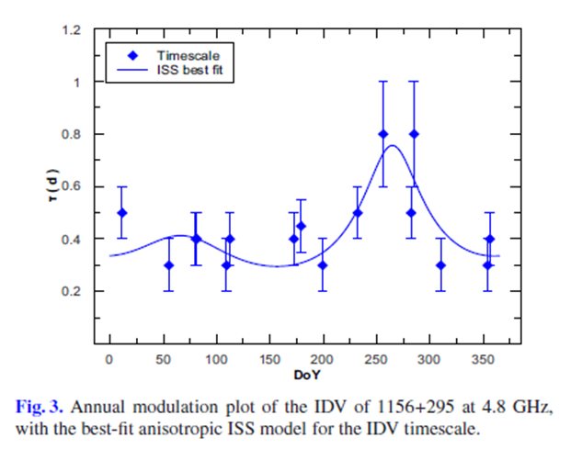
The MASIV 5 GHz sequence of
observations of 1156+295.
Flux density observations over 30 years, at 4.8, 8.0 and 14.5 GHz of the source 1156+295, show it to be a highly variable, core-dominated quasar. 1156+295 was included in the MASIV survey 5 GHz program, and the sequence of three-monthly observations is shown above. These reveal significant IDV which is best interpreted as ISS. The slower timescale present in the third period suggest the likely presence of an Annual Cycle, which later observations confirmed, thus establishing the presence of ISS.

Slide 10
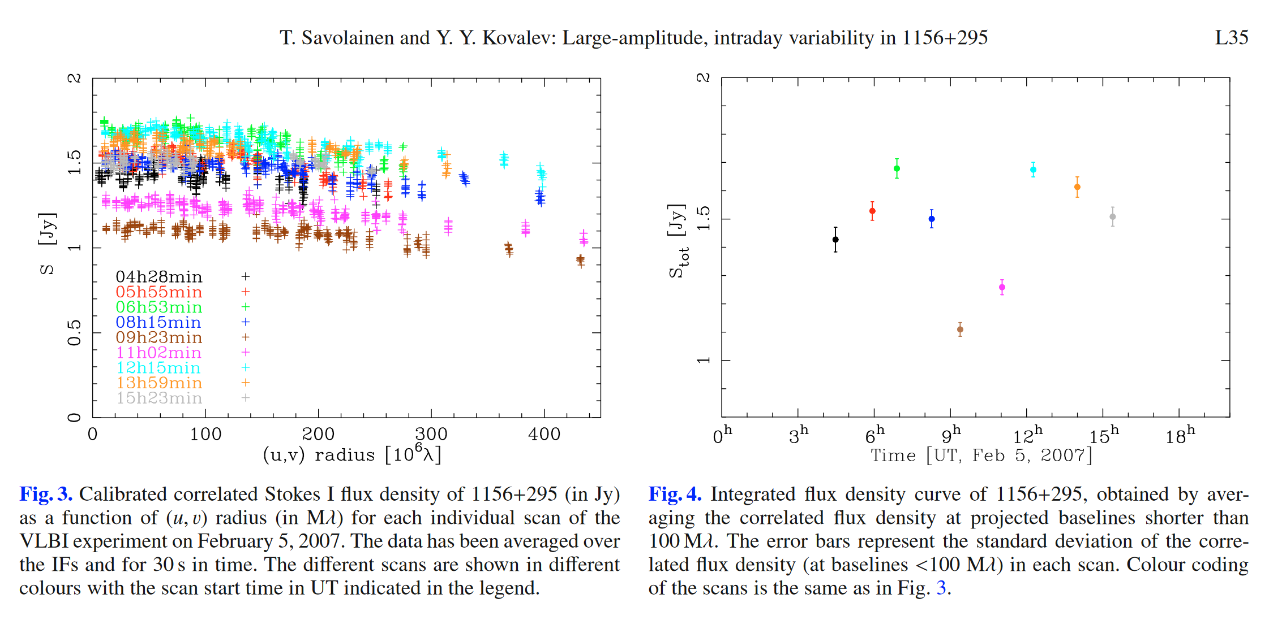
MASIV observations of the highly core-dominated flat-spectrum radio quasar, 1156+295, revealed the presence of ISS. Some years after the MASIV observations, while imaging 1156+295, with the VLBA at 15 GHz, Savolainen and Kovalev serendipitously discovered large-amplitude variability in the correlated 15 GHz flux density, with a timescale of only 2.7 hours. The individual component responsible for the variability was effectively unresolved.

Slide 11
Interstellar Scintillation and its effects on
cm-wavelength SVLBI can be quite significant.
Possible ways to minimize them:
Concentrate on those sources that do not show ISS
This requires careful evaluation to ascertain the absence of ISS, which could be obtained by repetition of MASIV-like observations.
Take considerable care in determining the source flux density immediately before the SVLBI observations, throughout the observations and immediately following the observations.
Concentrate on an observing frequency where ISS is minimized, namely 22 GHz and above

Slide 12
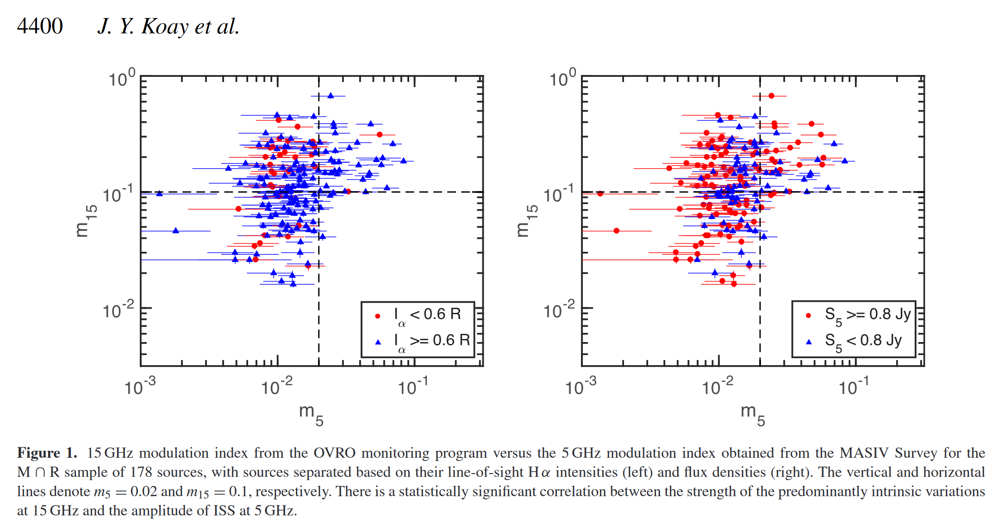
The above plots of the 15 GHz modulation index from the OVRO blazar monitoring program, demonstrate the close relationship between those MASIV strong scintillators at 5 GHz, m_5 > 2%, and the strong 15 GHz OVRO variables, m_15 >10%.
MASIV sources with scintillation amplitudes are all strong slow OVRO 15 GHz variables.

Slide 13
Considerable effort is clearly needed from the Earth-based facilities and arrays to support the planned SVLBI missions.

Slide 14
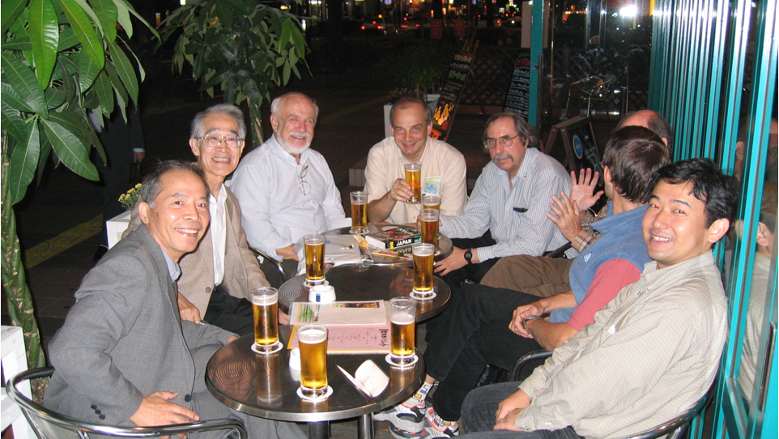
The effort is worthwhile; Celebrations on the night before the presentation of the 2005 Laurels for Team Achievement Award to the VLBI Space Observatory Team VSOP.

