Slide 1

Time & Frequency References for (sub-)mm Space VLBI
T. K. Sridharan
Lead Calibration Scientist, ngVLA
National Radio Astronomy Observatory
Shep Doeleman, Michael Johnson, Kari Haworth
CfA | Harvard & Smithsonian
Guangning Yang, Kenji Numata, Anthony Yu, Peter Kurczynski, Eliad Peretz
NASA Goddard
Nathan Newbury, Laura Sinclair
NIST
Jade Wang, Neal Spellmeyer
MIT - Lincoln Laboratory
ng-Space-VLBI Workshop, Oct 22

Slide 2
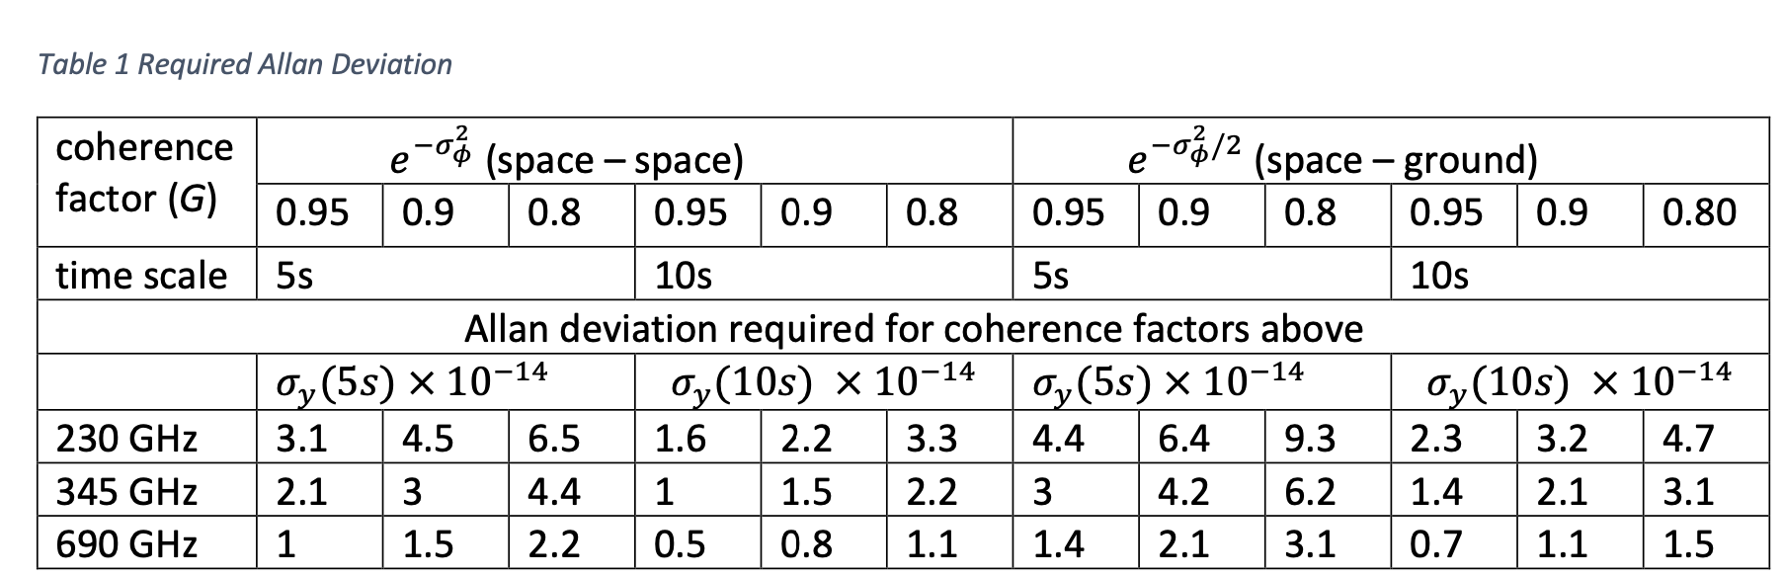

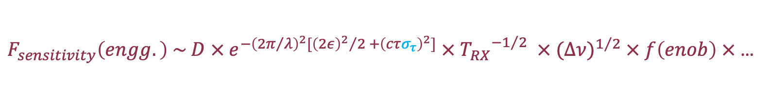


Sub-mm Space-VLBI Ref. Requirements
$$G= e^{{{−σ}_{φ}}^{2}}$$
where
$$σ_{φ}=2πυτσ_{y}\left(τ\right);$$
$$σ_{y}(τ)$$
: Allan deviation
(from T. K. Sridharan, 2021, Space-VLBI internal note)
$F_{sensitivity}\left(engg.\right) \sim D × e^{−{\left({2π}/λ\right)}^{2}[{{\left(2ε\right)}^{2}}/2 +{\left(cτσ_{τ}\right)}^{2}]} ×{{ T}_{RX}}^{−1/2} × {(∆ν)}^{1/2} × f\left(enob\right) ×$ …
T.K.Sridharan, EHE Engineering Study, 05/27/22
Jade Wang

Slide 3
~ 10s time scale shown for
reference options
T.K.Sridharan, EHE Engineering Study, 05/27/22

Slide 4
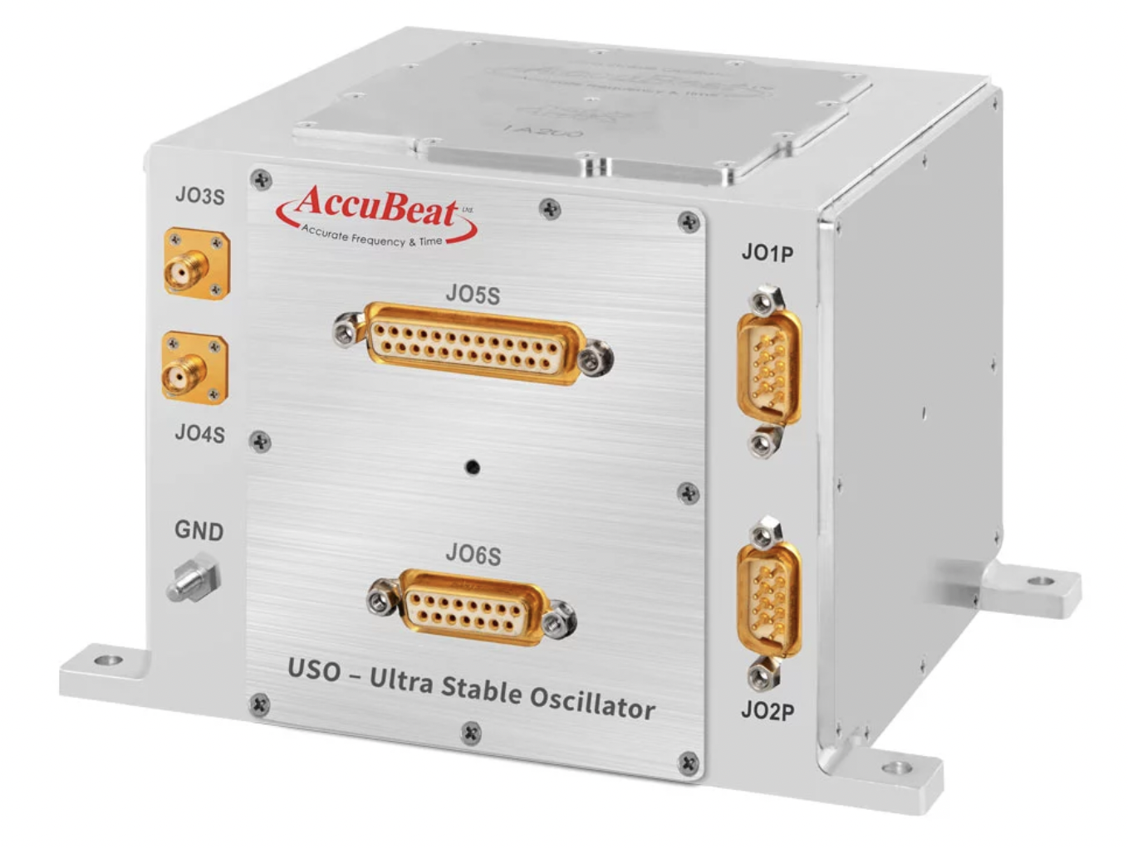
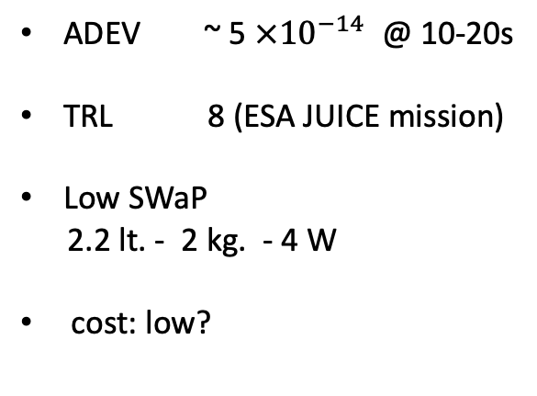
Accubeat USO
ADEV ~ 5 $×{10}^{−14}$ @ 10-20s
TRL 8 (ESA JUICE mission)
Low SWaP
2.2 lt. - 2 kg. - 4 W
cost: low?
T.K.Sridharan, EHE Engineering Study, 05/27/22

Slide 5
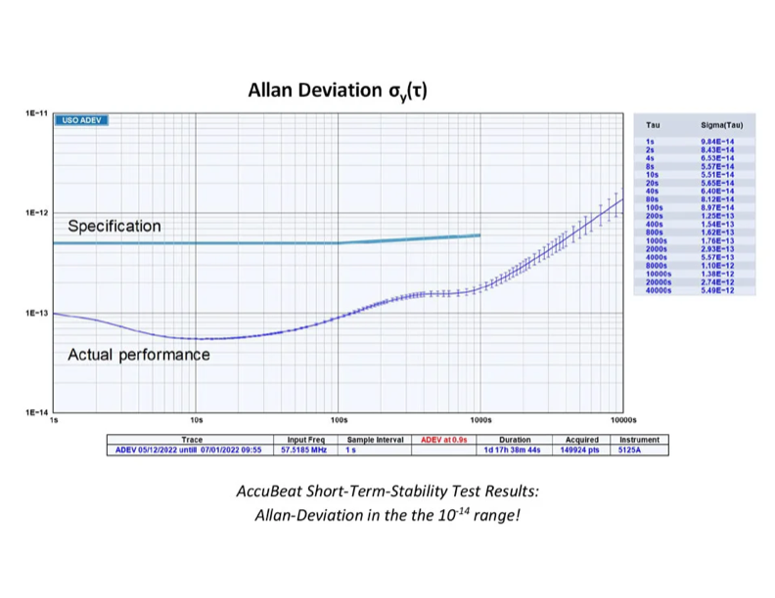
Accubeat USO
Barely meets needs
75% @ 230 GHz
50% @ 345 GHz
Insufficient margin
Prospects for improvement
T.K.Sridharan, EHE Engineering Study, 05/27/22

Slide 6
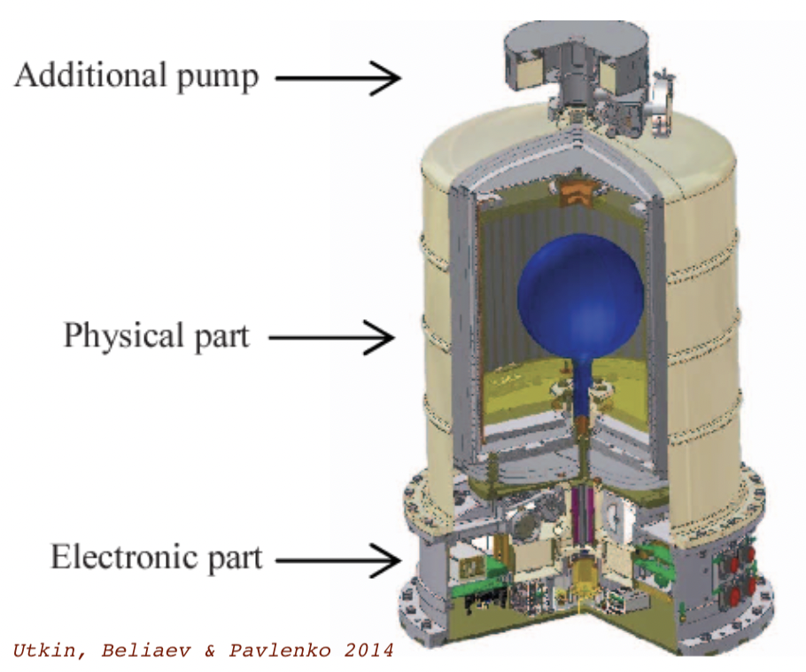
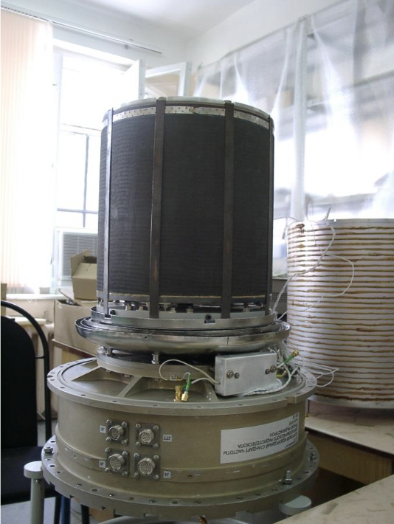
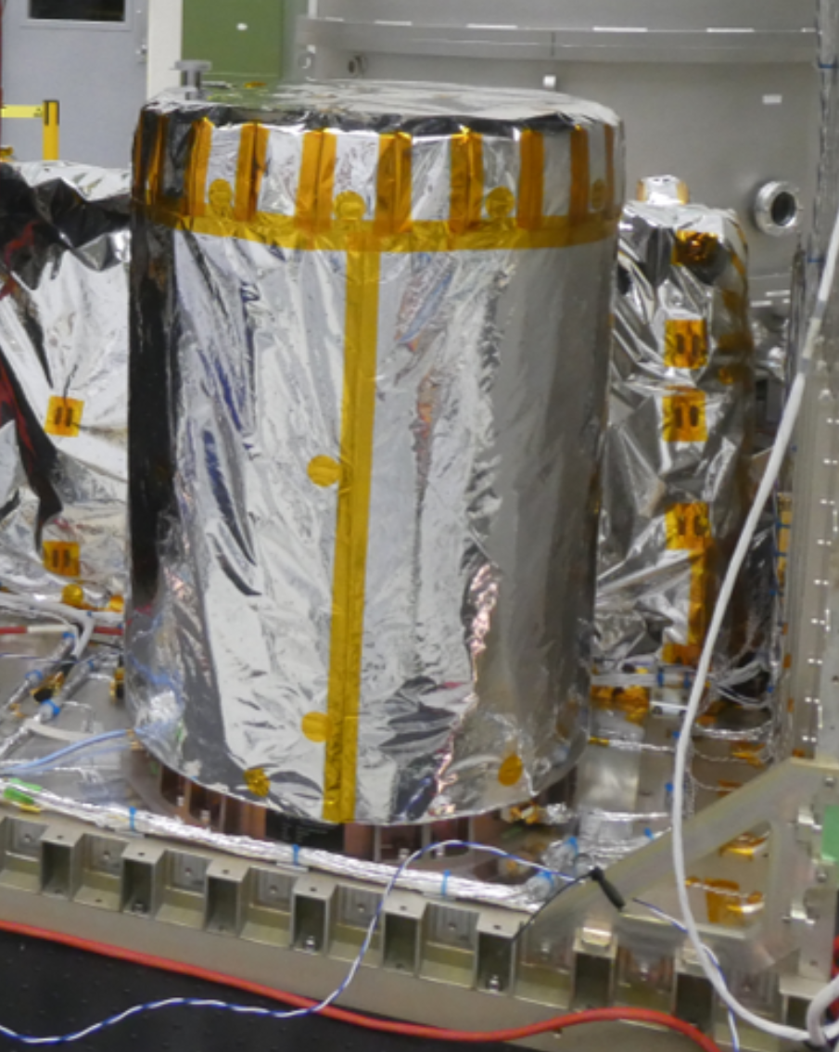
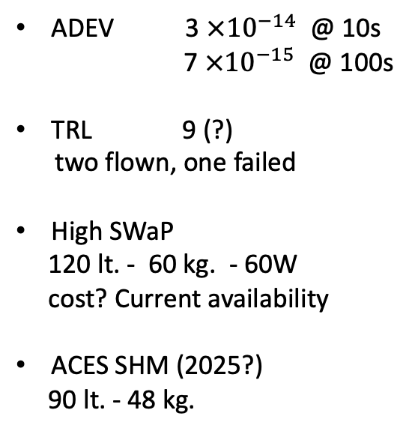
Active H-masers – Gold Standard
ADEV 3 $×{10}^{−14}$ @ 10s
7 $×{10}^{−15}$ @ 100s
TRL 9 (?)
two flown, one failed
High SWaP
120 lt. - 60 kg. - 60W
cost? Current availability
ACES SHM (2025?)
90 lt. - 48 kg.
ACES SHM
(Neuchatel)
Vrmya VCH-1010
(Radioastron)
T.K.Sridharan, EHE Engineering Study, 05/27/22

Slide 7
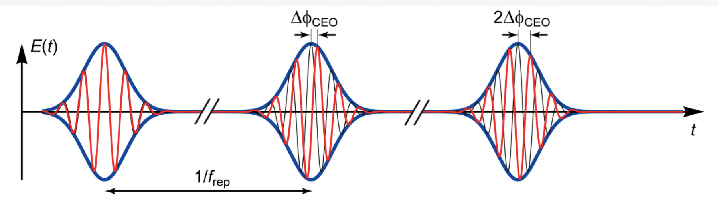
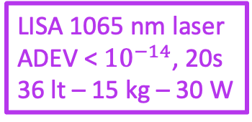
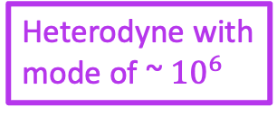
- NIR laser
Vescent 1556 nm
Comb
self referenced
Octave spanning
f-2f locked
Heterodyne with
mode of ~ ${10}^{6}$
4 lt. – 3 kg. - 17 W
LISA 1065 nm laser
ADEV < ${10}^{−14}$, 20s
36 lt – 15 kg – 30 W
NASA funded Internal project - Yang

Slide 8
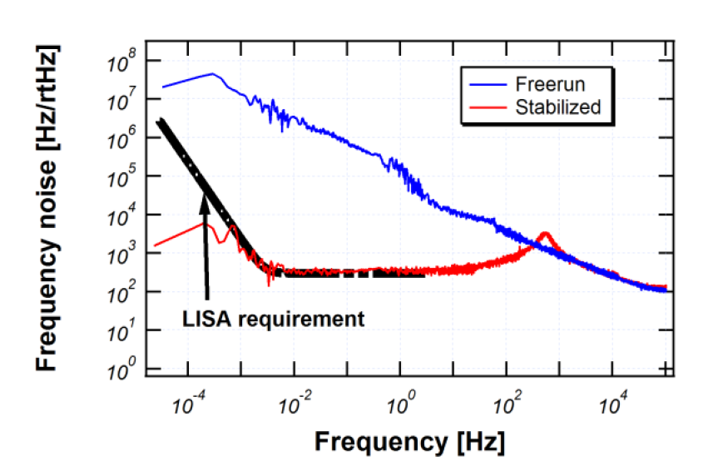
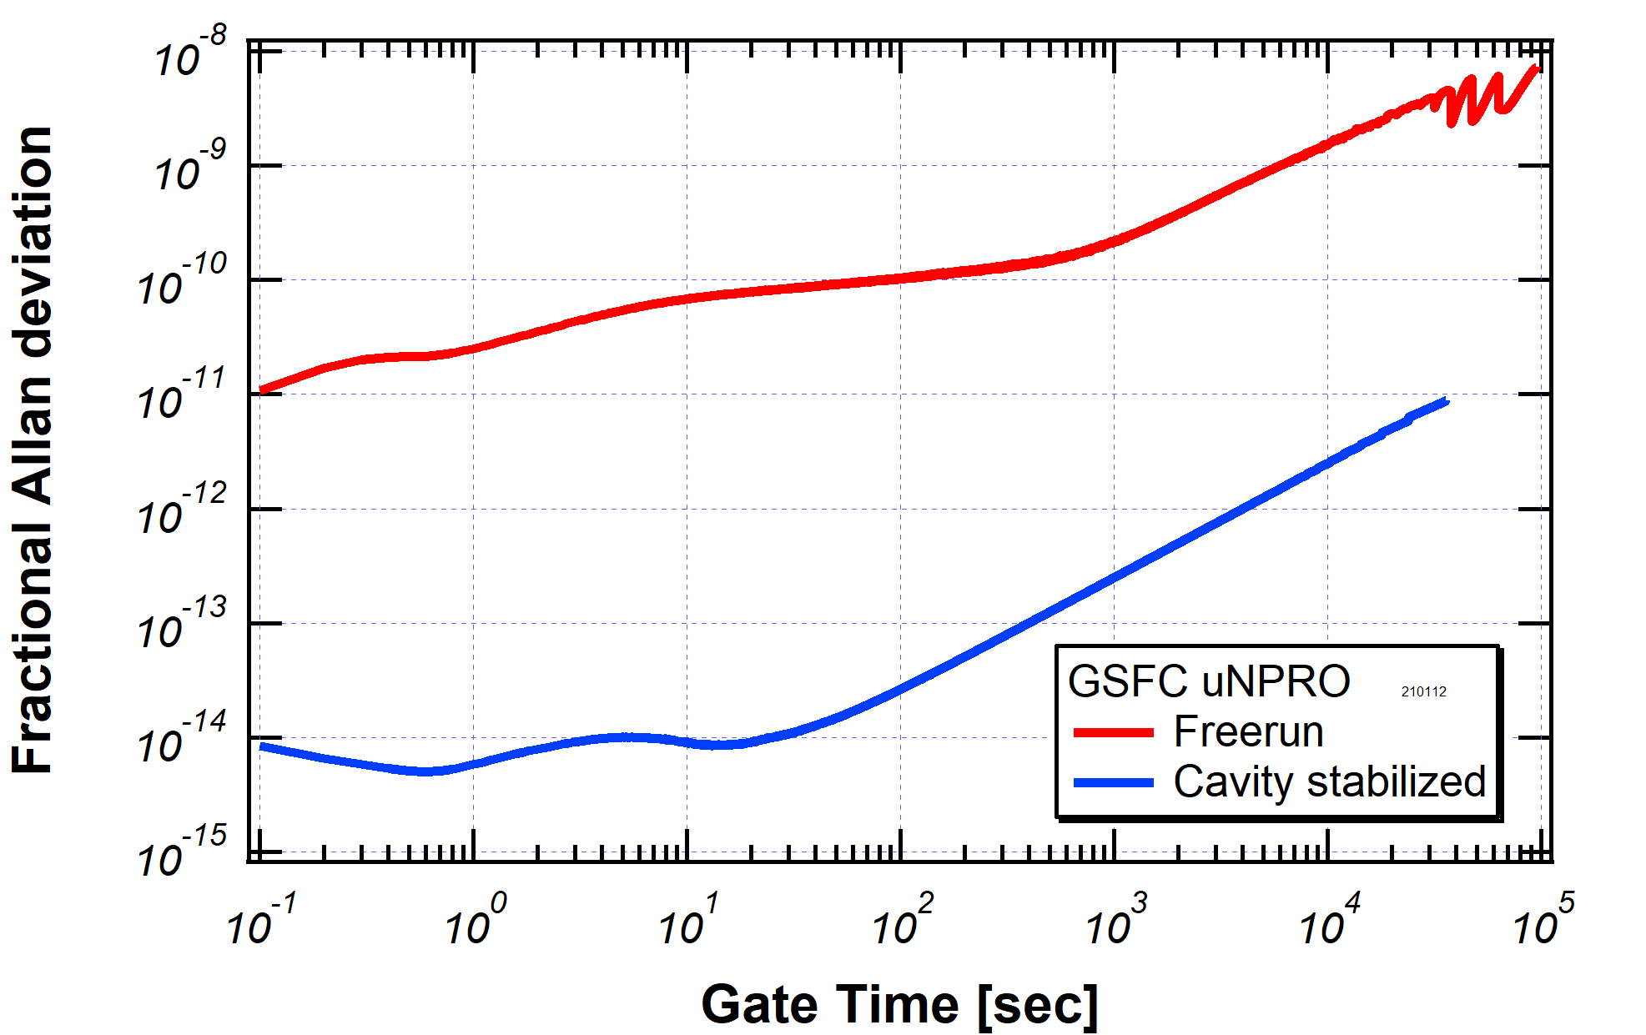
LISA Laser Performance
VLBI req (1E-14)
Yang et al 2022

Slide 9
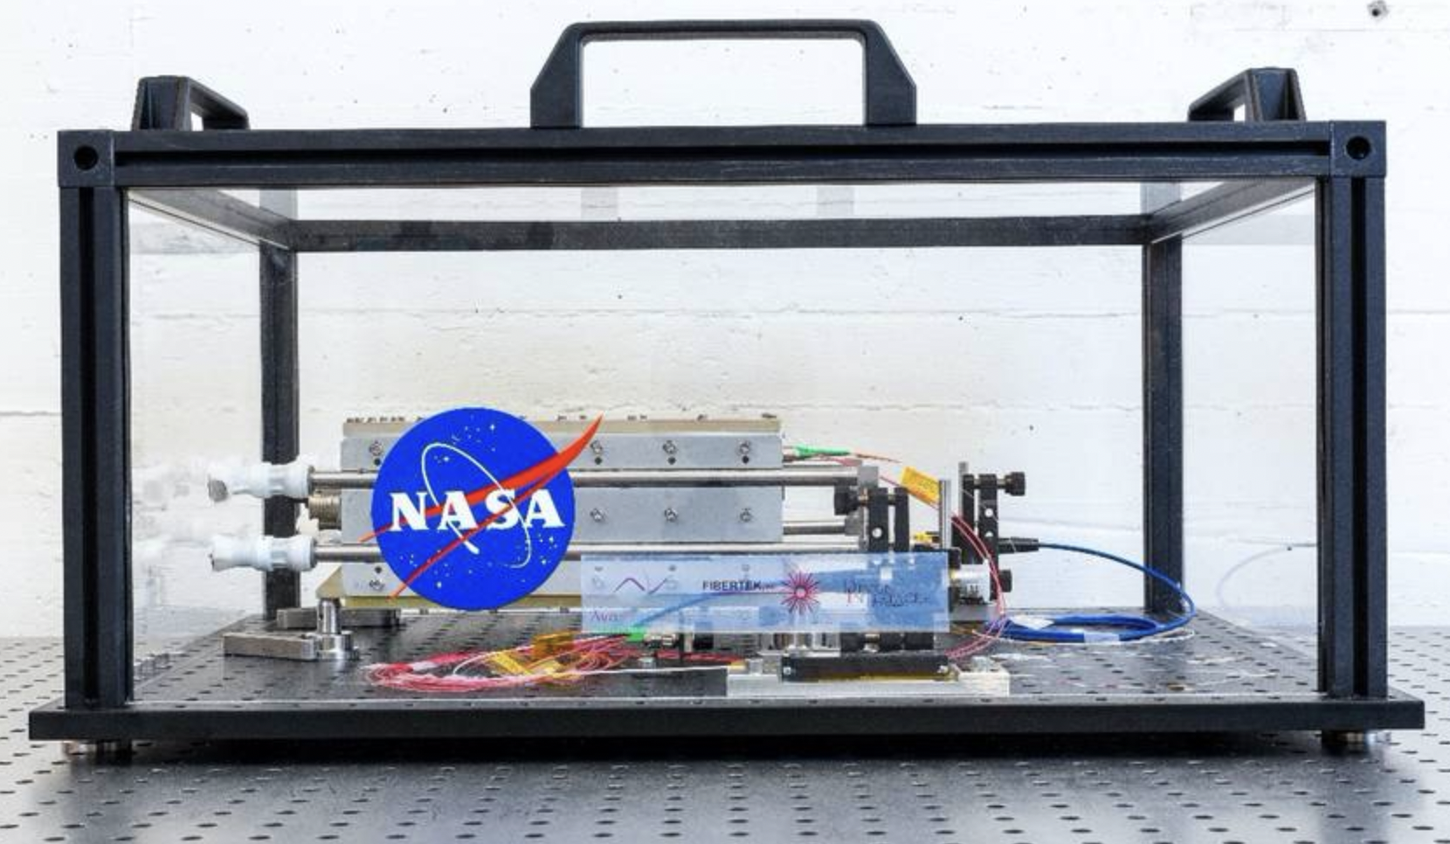
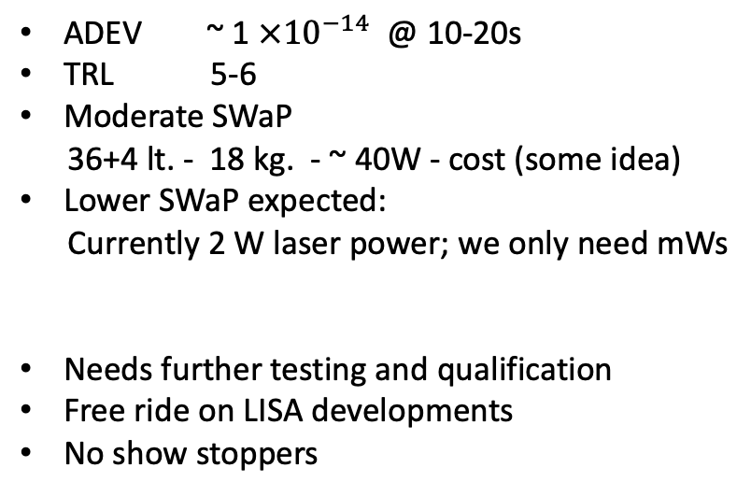
LISA laser (+ Vescent OFC)
ADEV ~ 1 $×{10}^{−14}$ @ 10-20s
TRL 5-6
Moderate SWaP
36+4 lt. - 18 kg. - ~ 40W - cost (some idea)
Lower SWaP expected:
Currently 2 W laser power; we only need mWs
Needs further testing and qualification
Free ride on LISA developments
No show stoppers
Numata, Yu et al
T.K.Sridharan, EHE Engineering Study, 05/27/22

Slide 10
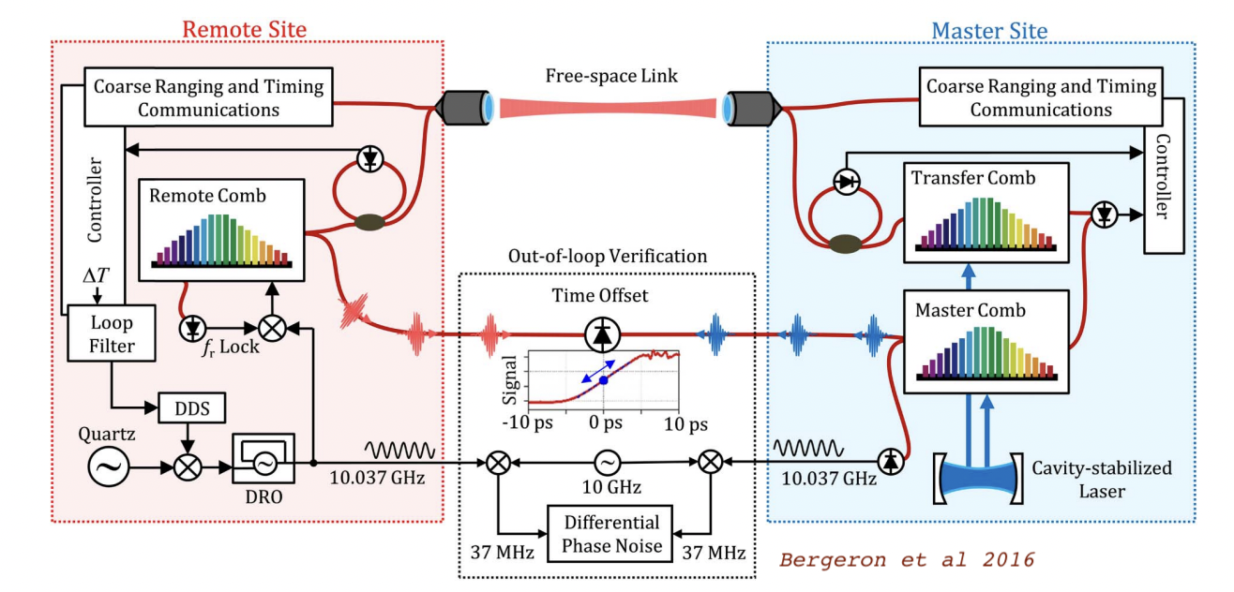
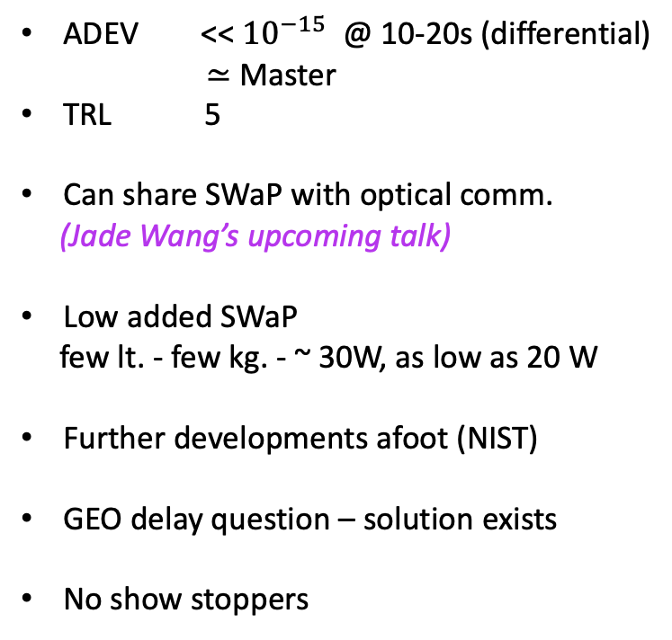
O-TWTFT - NIST
ADEV << ${10}^{−15}$ @ 10-20s (differential)
$≃$ Master
TRL 5
Can share SWaP with optical comm.
(Jade Wang’s upcoming talk)
Low added SWaP
few lt. - few kg. - ~ 30W, as low as 20 W
Further developments afoot (NIST)
GEO delay question – solution exists
No show stoppers
T.K.Sridharan, EHE Engineering Study, 05/27/22

Slide 11
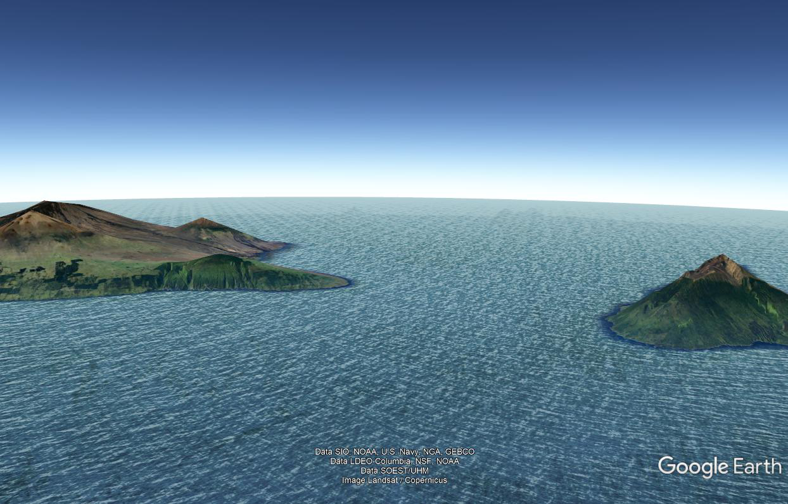
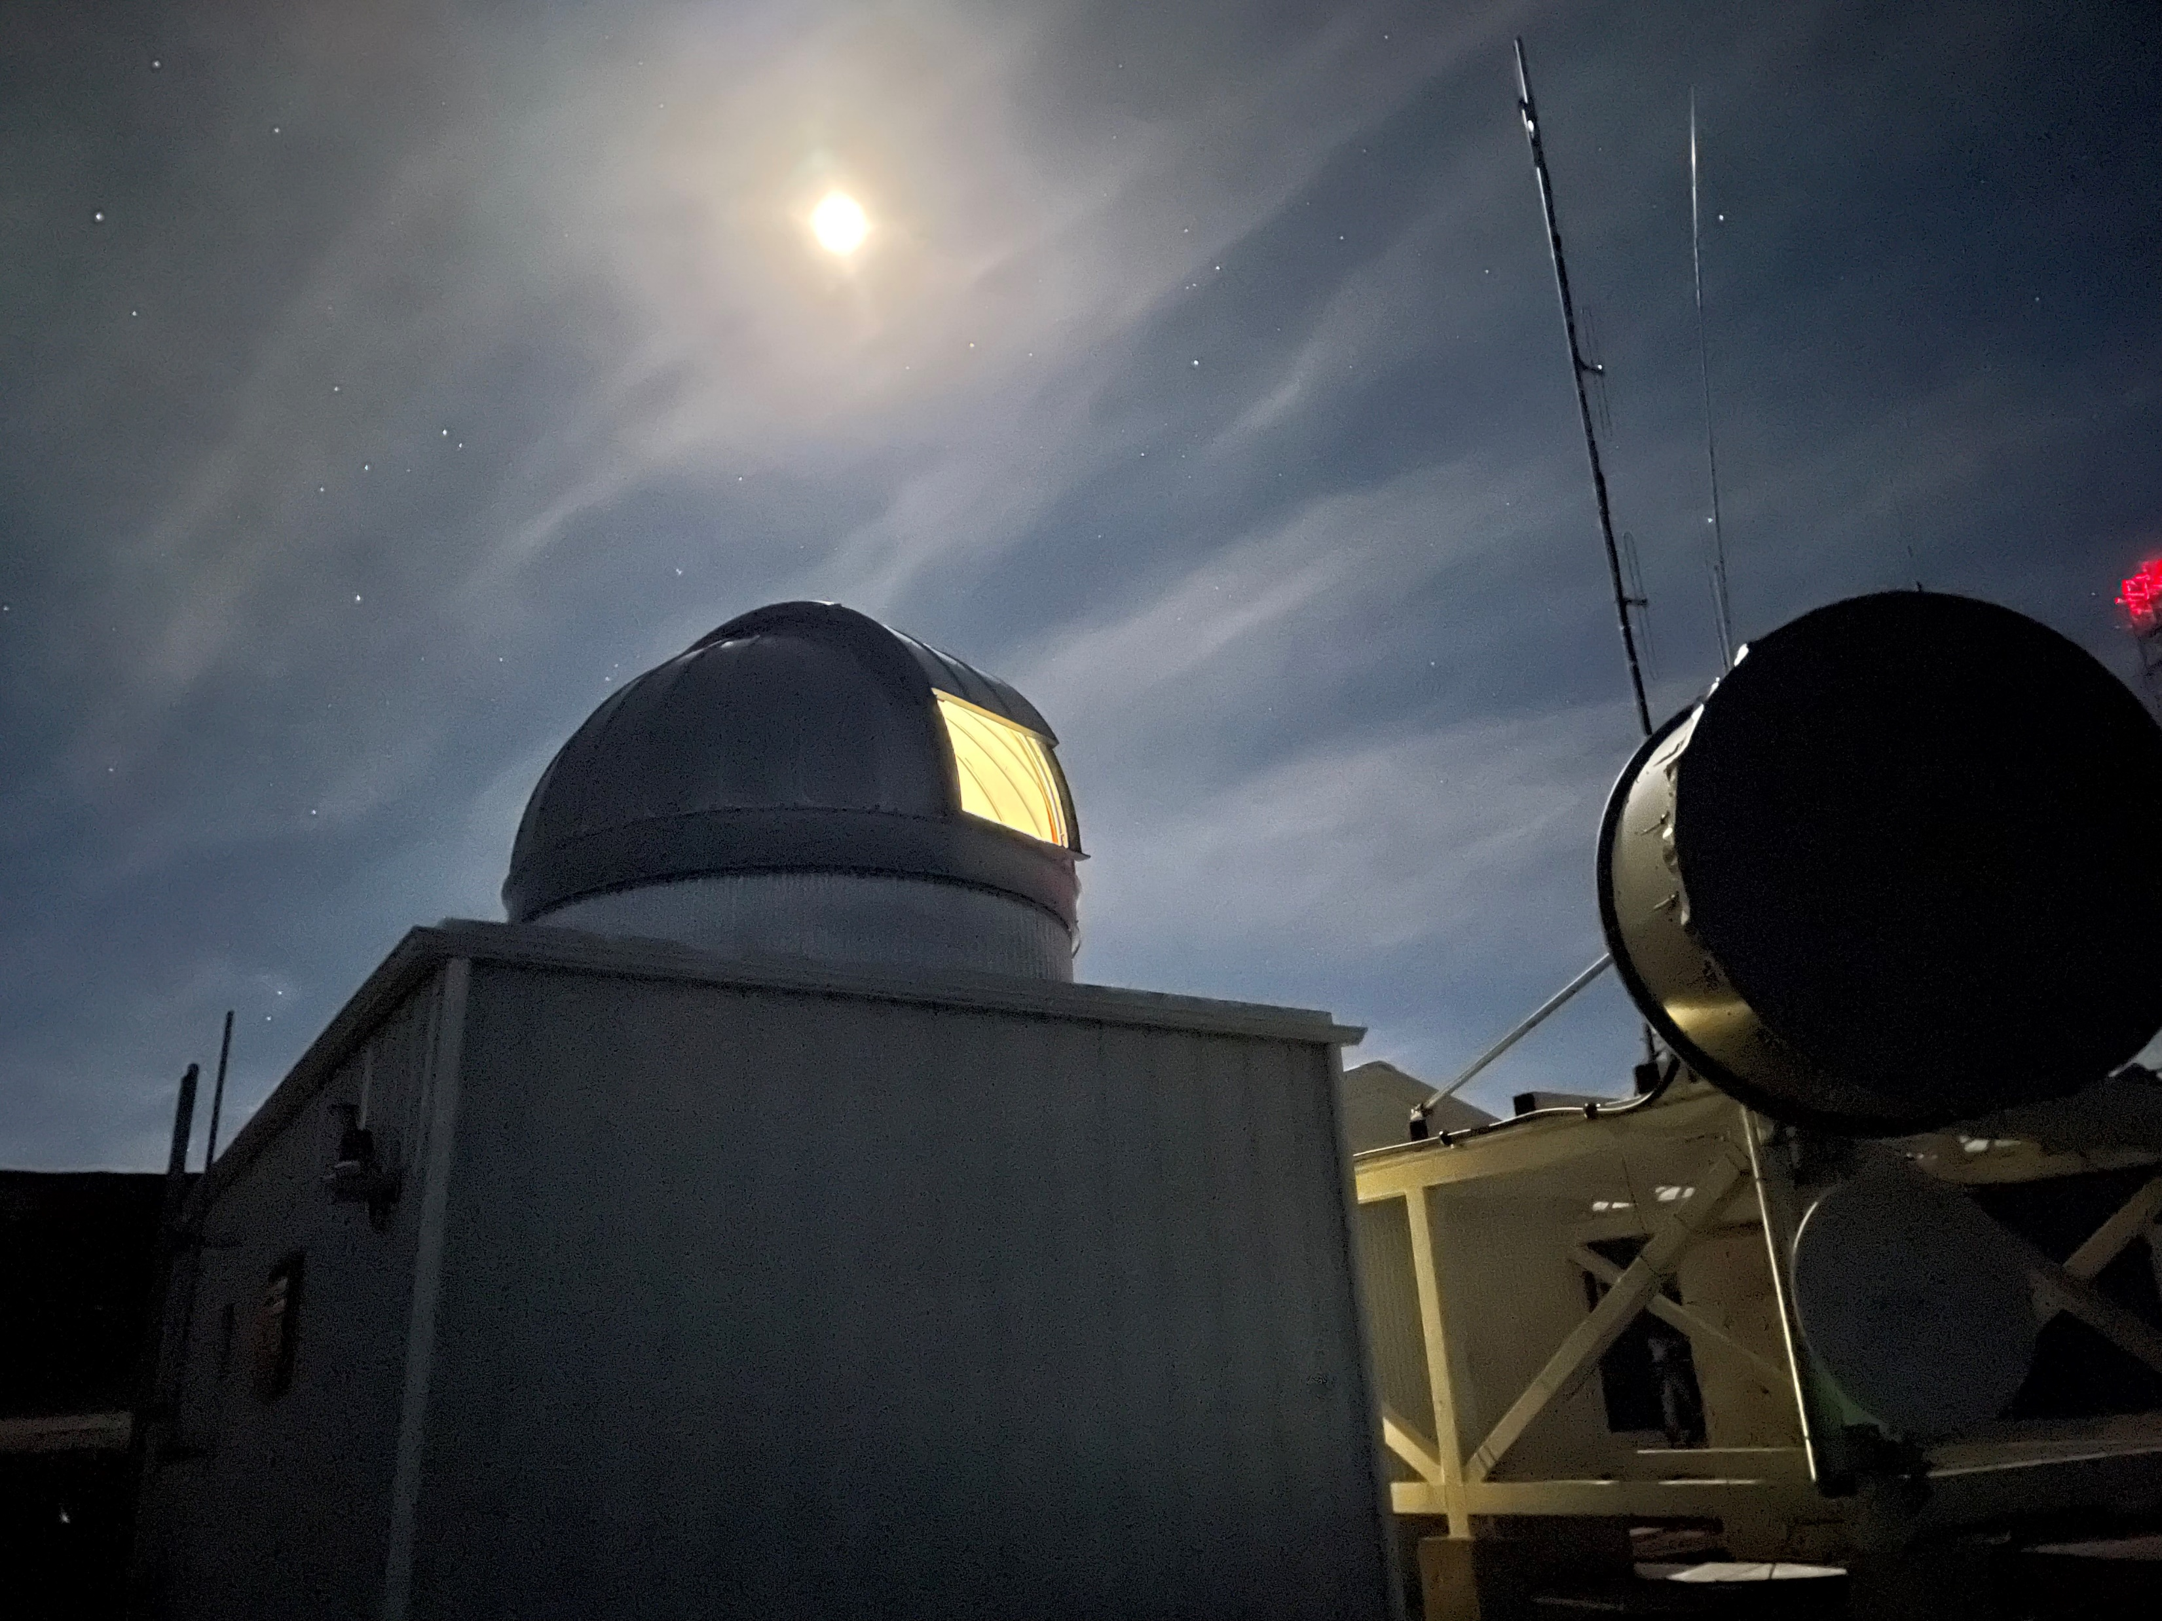
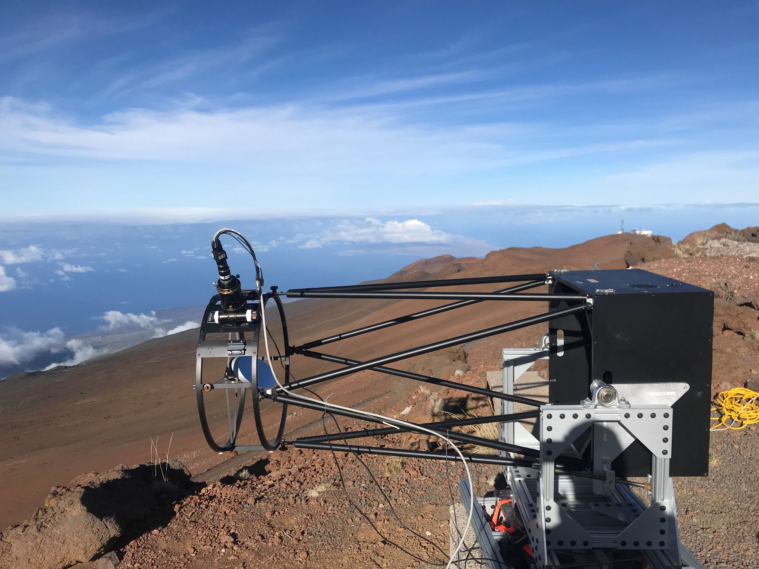
PEACOCS over a 300-km Turbulent Air Path
Photon Efficient…; ~ 1 photon every 60 pulses
Hawaii
150 km
Maui
2 PEACOCS Systems
Hawaii (Mauna Loa Observatory)
Cateye Retroreflector
Maui (Haleakala Summit)
Google Earth Image with Relief exaggerated by 3X
Sinclair, Newbury et al 2022

Slide 12
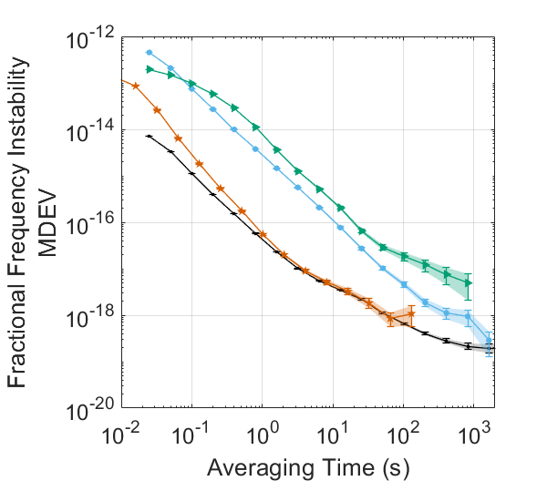
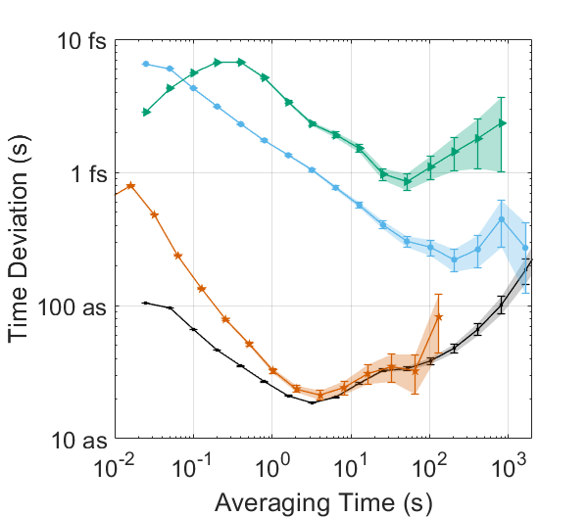
Synchronization Across 300 km of Air:
Instability of PEACOCS Time Transfer
300-km link, 3 mW launch power
300-km link, 32 uW launch power
2-km link, 3 mW launch power
System Noise Floor: 0 km
State of the Art Optical Atomic Clocks
Sinclair, Newbury et al 2022
Notes:
Add curve for state of the art optical clocks

Slide 13
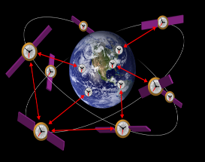
What’s Next?
Faster, Farther, and in a Smaller Package…
Satellite
(ground-to-GEO)
35,000 km
Satellite
(ground-to-MEO)
10,000 km
Also position and
velocity
Comparable link loss
1000 km
300 km
Long-range terrestrial
Distance
Aircraft-to-aircraft
100 km
Aircraft
30 km
Across Boulder N-to-S
10 km
Across Boulder W-to-E
Within satellite cluster
4 km
NIST campus
2 km
Quadcopter
//
~ 5 km/s
0 m/s
25 m/s
175 m/s
Sinclair, Newbury et al 2022
Velocity
Notes:
Make pt that link losses are comparable

Slide 14
Comparative Overview
Technology. Vol. Mass. Power. ADEV. TRL. Cost Comment
lt. Kg. W
USO 2.2 2 2? 5e-14 8 low? Needs margin improvement
H-maser 90/120 50-60 50 3e-14 9? ?
LISA+OFC 40 18 40 1e-14 5-6 * SWaP can go down
O-TWTFT. few few ~ 30 << 1e-15 4-5 low? SWaP sharing with laser comm
MIT-LL SBS Sr+ Stimulated Brillouin Laser 2-3 ? paths to lower current high SWaP
Optical combs are the way to go,
VLBI community should adopt these new technologies, specifically for mm/sub-mm
EHE mission concept is heeding this conlcusion,
pursuing multiple optical paths
ng-Space-VLBI Workshop, Oct 22

Slide 15
10s time scale shown
for reference options
T.K.Sridharan, EHE Engineering Study, 05/27/22

