Slide 1
The Cassini-Huygens Mission
The Huygens VLBI tracking Experiment
Jean-Pierre Lebreton
(Former) ESA Huygens Project Scientist and Mission Manager
Research Associate, LPC2E, (CNRS/Univ-Orleans/CNES)
jean-pierre.lebreton@cnrs-orleans.fr
Next Generation Space VLBI Workshop, 17-19 October 2022, ASTRON/JIVE, Dwingeloo, The Netherlands

Slide 2
Outline
Brief Overview of the Cassini-Huygens Mission
Huygens Doppler « Problem »
Snapshots of Huygens scientific return
The Huygens VLBI Experiment
(possible) future opportunities for VLBI probe tracking

Slide 3
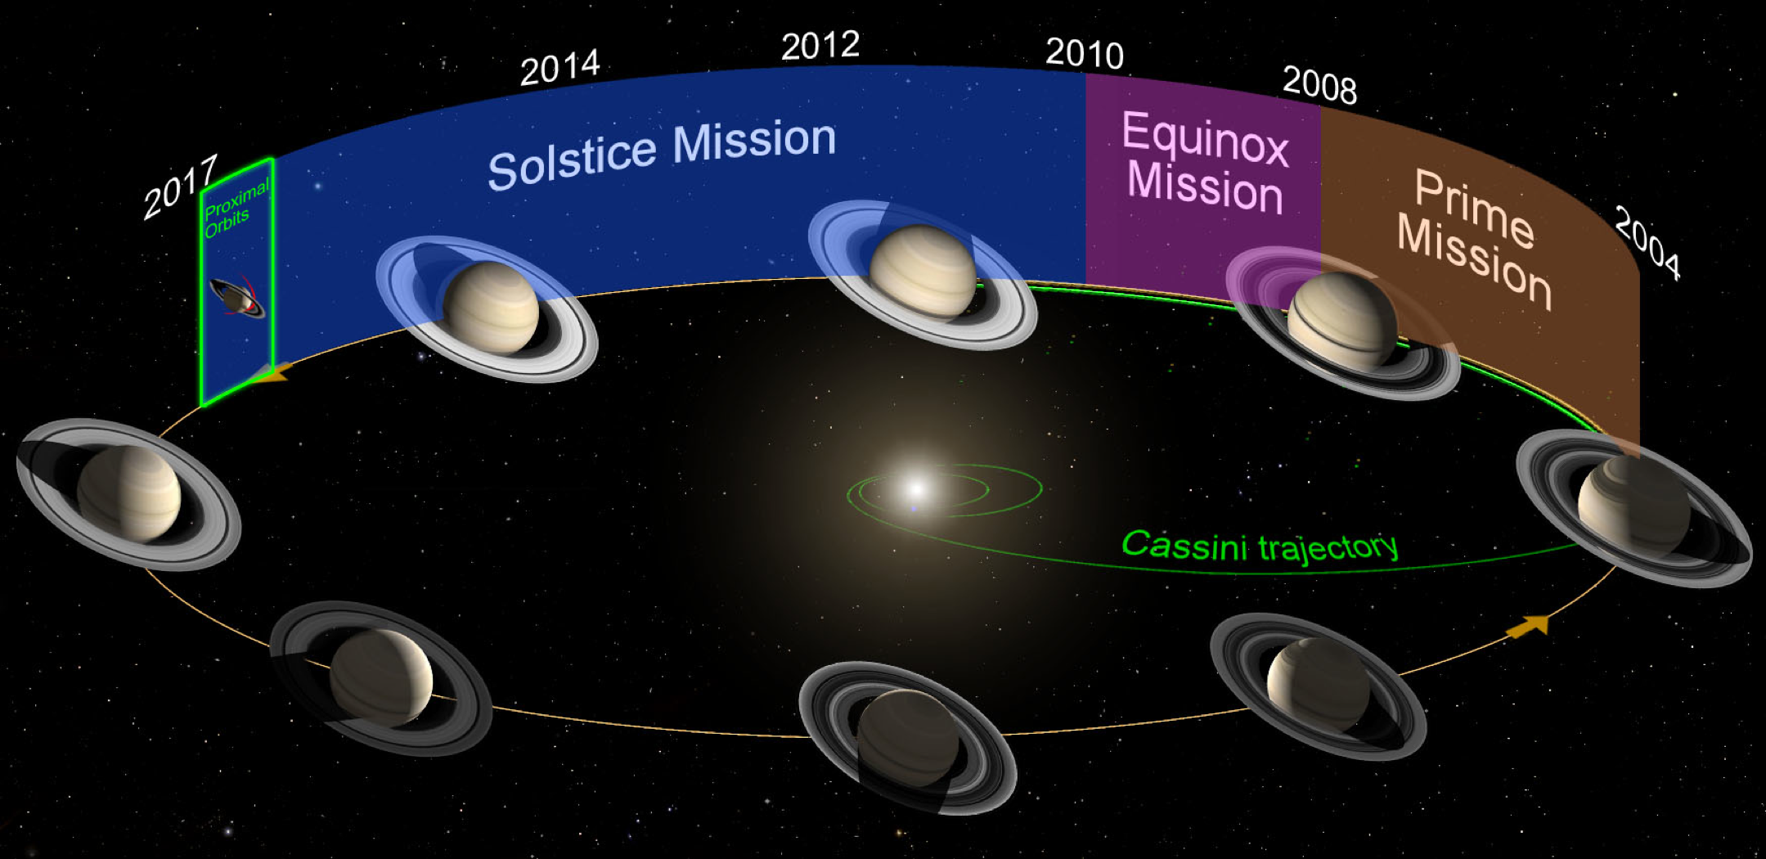
The Cassini-Huygens Mission
International NASA/ESA/ASI mission to explore Saturn’s system
NASA (Cassini) Orbiter and ESA (Huygens) Titan Probe
Launched on 15th October 1997
Arrived at Saturn (Saturn Orbit Insertion) in June/July 2004. planned for 4 years.
Huygens entry, descent, landing on 14 January 2005
End of mission (after 2 extensions: 2 + 7 years) on 15 September 2017
2 Saturn (and Titan) seasons covered
15-10-1997

Slide 4
Cassini Orbiter as radio relay for the Huygens data on two S-band channels: Doppler « problem »
In-flight performance validation in 2000 showed bandwidth of the Huygens Receivers on board Cassini was too narrow to accommodate Doppler shift due to relative velocity between Huygens and Cassini
Several corrective actions put in place. New mission scenario validated in mid 2004.

Slide 5
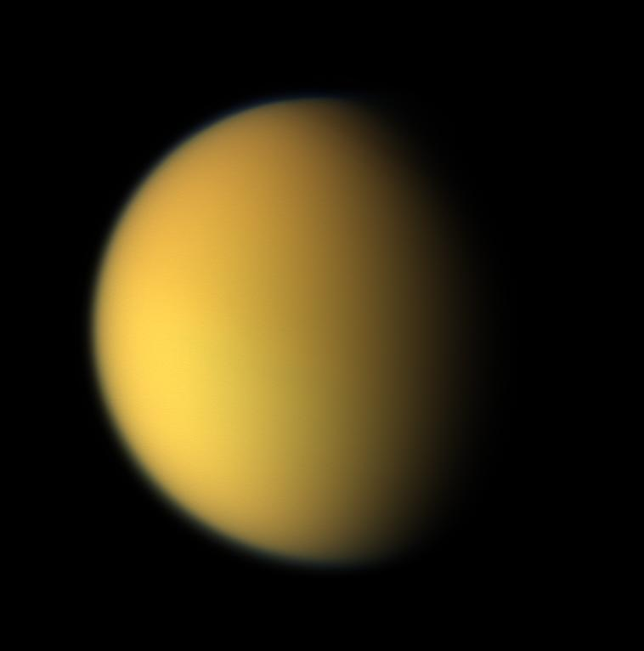
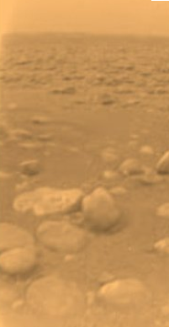
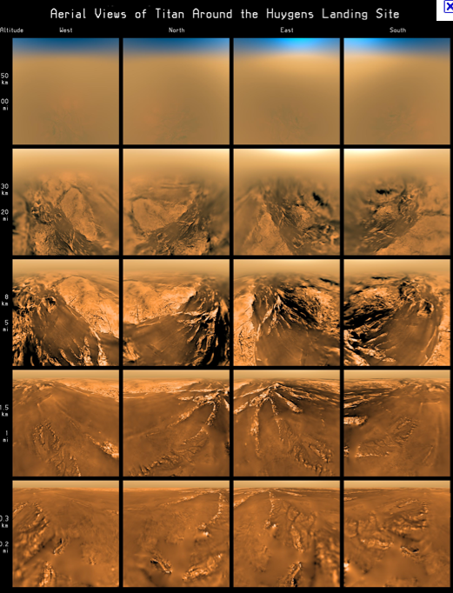
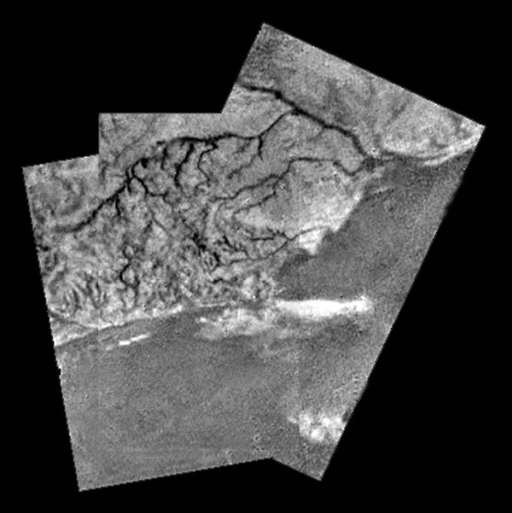
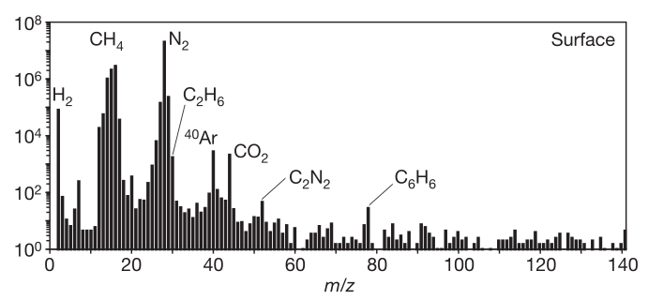
How Cassini-Huygens lifted Titan’s veil for the first time: Huygens landing
Notes:
been the subject of considerable speculation and discussion1. The Huygens probe entered Titan’s atmosphere on 14 January 2005 and descended to the surface using a parachute system2. Here we report measurements made just above and on the surface of Titan by the Huygens Surface Science Package3,4. Acoustic sounding over the last 90 m above the surface reveals a relatively smooth, but not completely flat, surface surrounding the landing site. Penetrometry and accelerometry measurements during the probe impact event reveal that the surface was neither hard (like solid ice) nor very compressible (like a blanket of fluffy aerosol); rather, the Huygens probe landed on a relatively soft solid surface whose properties are analogous to wet clay, lightly packed snow and wet or dry sand. The probe settled gradually by a few millimetres after landing.
This natural color composite was taken during the Cassini spacecraft's April 16, 2005, flyby of Titan. It is a combination of images taken through three filters that are sensitive to red, green and violet light.It shows approximately what Titan would look like to the human eye: a hazy orange globe surrounded by a tenuous, bluish haze. The orange color is due to the hydrocarbon particles which make up Titan's atmospheric haze. This obscuring haze was particularly frustrating for planetary scientists following the NASA Voyager mission encounters in 1980-81. Fortunately, Cassini is able to pierce Titan's veil at infrared wavelengths (see PIA06228).
North on Titan is up and tilted 30 degrees to the right.The images to create this composite were taken with the Cassini spacecraft wide angle camera on April 16, 2005, at distances ranging from approximately 173,000 to 168,200 kilometers (107,500 to 104,500 miles) from Titan and from a Sun-Titan-spacecraft, or phase, angle of 56 degrees. Resolution in the images is approximately 10 kilometers per pixel.

Slide 6
The genesis of the Huygens VLBI experiment
« ESTEC Corridor discussion » between ESA Telecom engineer (Kees V’t Klooster) and I about how to use a 50 k€ for an innovative project initiative that would support Huygens.
Study initiated with JIVE (under Leonid Gurvits leadership) in 2002.
Project studied and developed in several phases. Supported by adequate funding.
VLBI tracking of the Ultra-stable Huygens 3.5 W radio transmission with a network of 17 Earth-based radio telescope
Successfully operated on 14th January 2005
14 January 2005. Leonid discusses the early signal with Jacques Louet
Head of the Project Department, ESA/ESTEC

Slide 8
Huygens Descent Trajectory Reconstruction
Major effort put in place to best reconstruct a « commonly » agreed descent trajectory using all possible science products and spacecraft navigation and Huygens engineering data products
Data sharing protocol was put in place
GBT and Parkes Doppler measurements data included as data products
1st version of DTWG trajectory available with 24 hours
Independent parrallel effort by VLBI team
Two DTWG trajectory versions archived.
http://archives.esac.esa.int/psa/ftp/CASSINI-HUYGENS/DTWG/HP-SSA-DTWG-6-TRAJECTORY-V2.0/

Slide 9
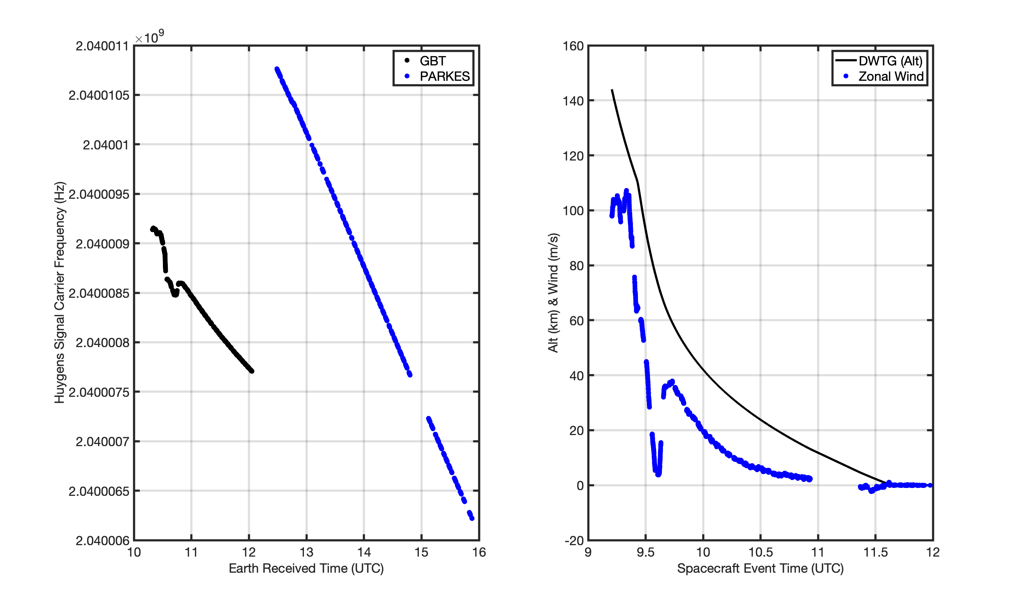
Measured Carrier Frequency
Derived Wind Profile
Landing
On Titan
Parachute
Exchange
GBT Tracking
Parkes Tracking
https://archives.esac.esa.int/psa/ftp/CASSINI-HUYGENS/DWE/HP-SSA-DWE-2-3-DESCENT-V1.0/DATA/

Slide 12
JUICE Payload
10 instruments + PRIDE
Launch in 2023, Arrival 2030

Slide 13
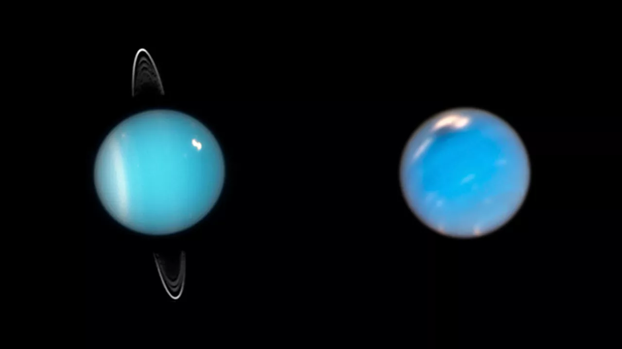
Next atmospheric probe under parachute: Uranus ? Tracking of Uranus Probe (Joint NASA/ESA Uranus Orbiter Probe mission to be launched in the 2030’s) ? Possible concept for radio tracking of a Uranus glider (Master Study by Emilie Bessette, Univ. of Delft, now YGT, ESTEC) ? (Will be proposed as subject of a Design Synthesis Exercise at Univ. Delft, in Spring 2023)
A composite image of Uranus (left) and Neptune based on Hubble Space Telescope observations. (Image credit: NASA, ESA, Mark Showalter (SETI Institute), Amy Simon (NASA-GSFC), Michael H. Wong (UC Berkeley), Andrew I. Hsu (UC Berkeley))

Slide 14
Enjoy your retirement Leonid

