Slide 1
Transients and the SKA Regional Centres
Antonia Rowlinson

Slide 2
Searching for transients
Simple in concept, challenge is in data volume and processing speed

Slide 3
Data products
Inputs:
Outputs
Deep image
Calibrated visibilities
Snapshot images
(sometimes sky model subtracted)
Database of sources and light curves
Snapshot images
Database of light curves
Transient alerts
Visibilities for reprocessing

Slide 4
Calibration and Imaging
We need bulk processing using standard tools and strategies – option to use own parsets
We need this to be conducted in near real-time
We want to process as much data as feasible – e.g. full LoTSS survey, AARTFAAC
Deep images for comparison and epoch-to-epoch transient hunts
Snapshot images to search for short duration transient searches
Option to download visibilities or interactive reprocessing (in LOFAR software image or equivalent) for quality control etc…

Slide 5
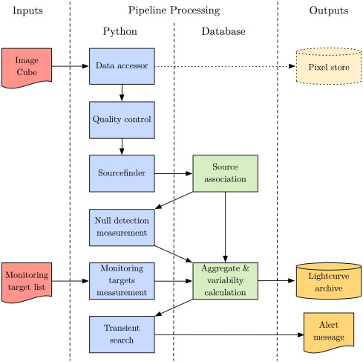
Transient search and triggers
We need to use our own software and database – TraP (Swinbank et al. 2015)
Transient searches and alerts conducted via own scripts
Shell prompt useful for automated scripts
Need access to database via Jupyter Notebooks
Need own python environments
Some streamlining and automating needed – ongoing collaboration to do this through FuSE

