Slide 1
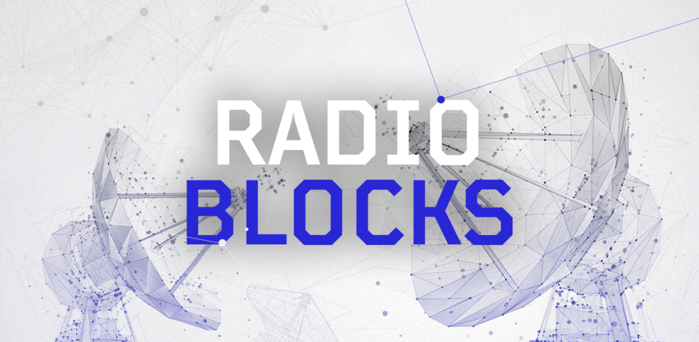

RADIO
New science in Radio Astronomy: applying cutting-edge technology to enhance the entire data chain, from receiver to final output
BLOCKS
Grant number: 101093934

Slide 2

RADIOBLOCKS All-Hands meeting
4 June 2024
Agnieszka Słowikowska
JIVE director and RADIOBLOCKS Coordinator

Slide 3
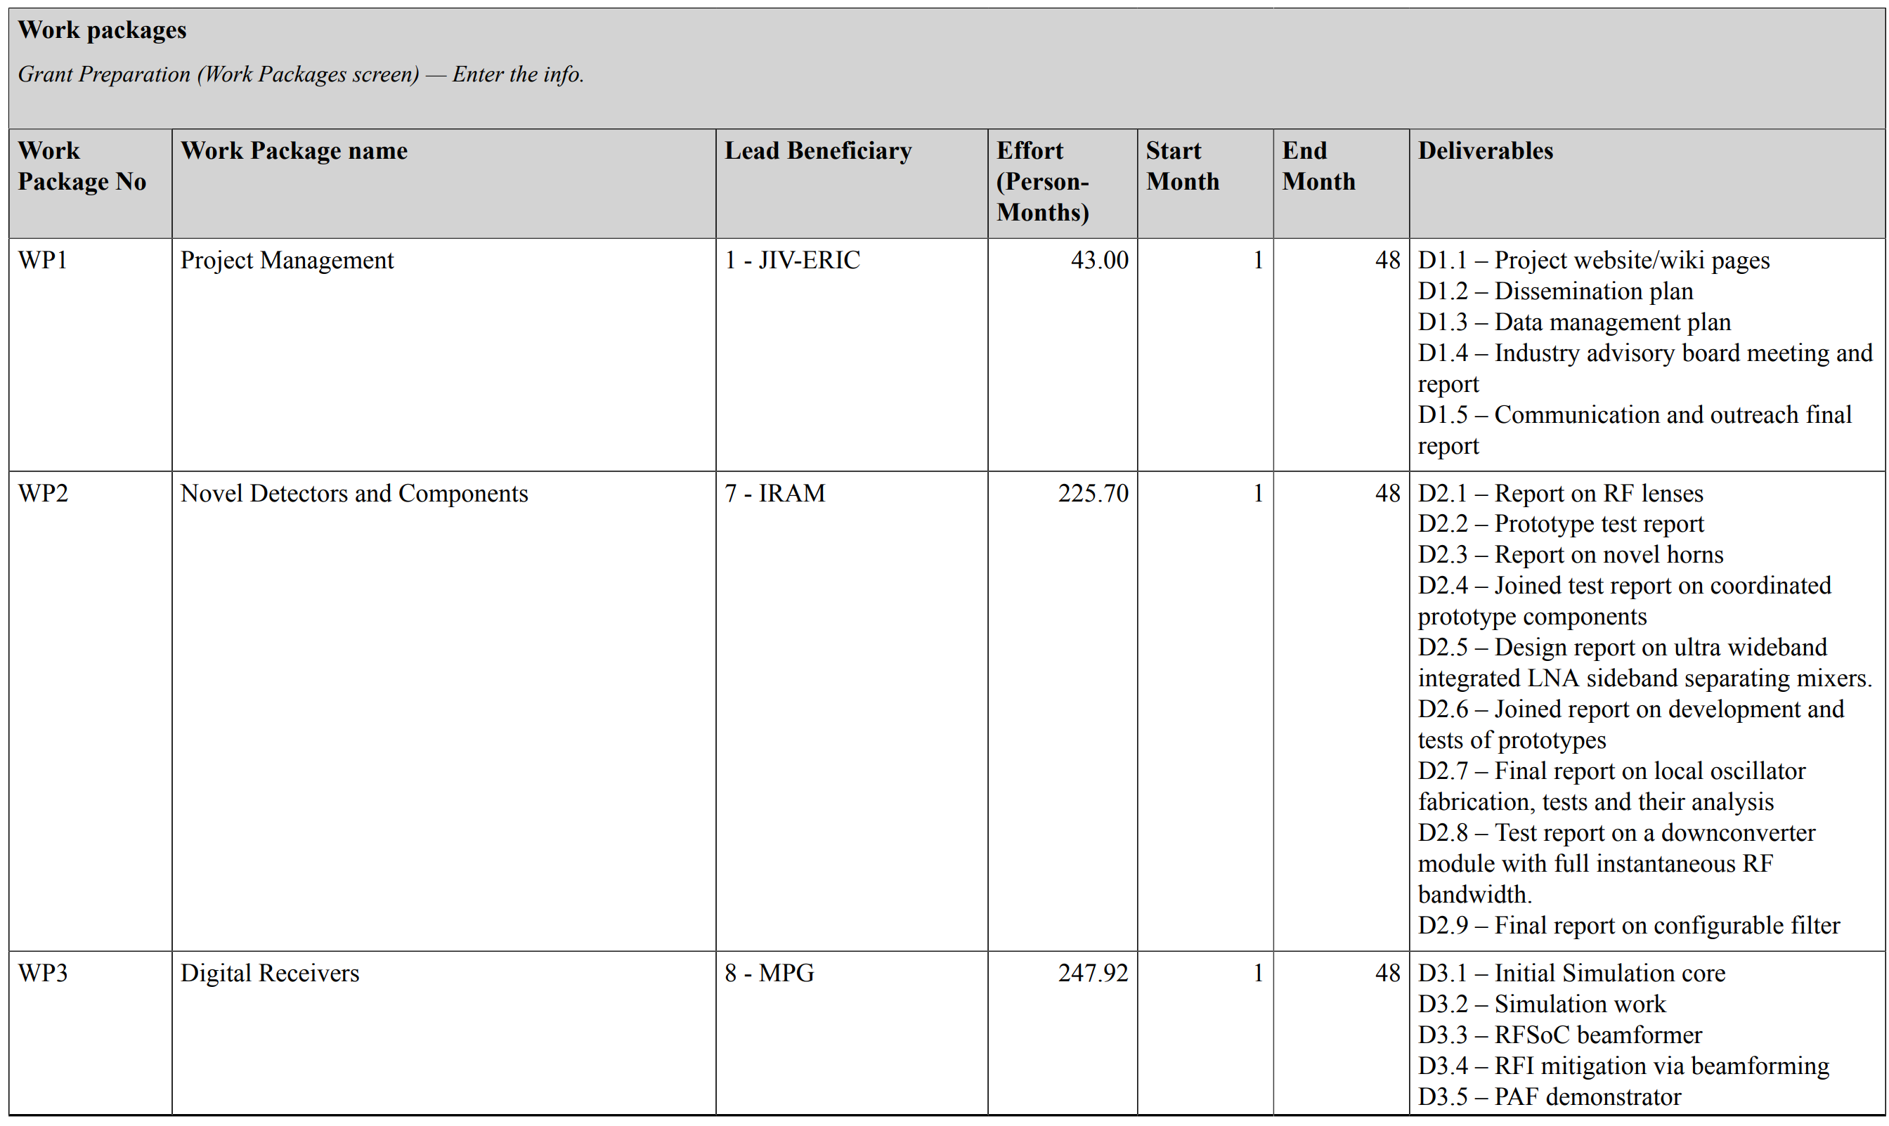
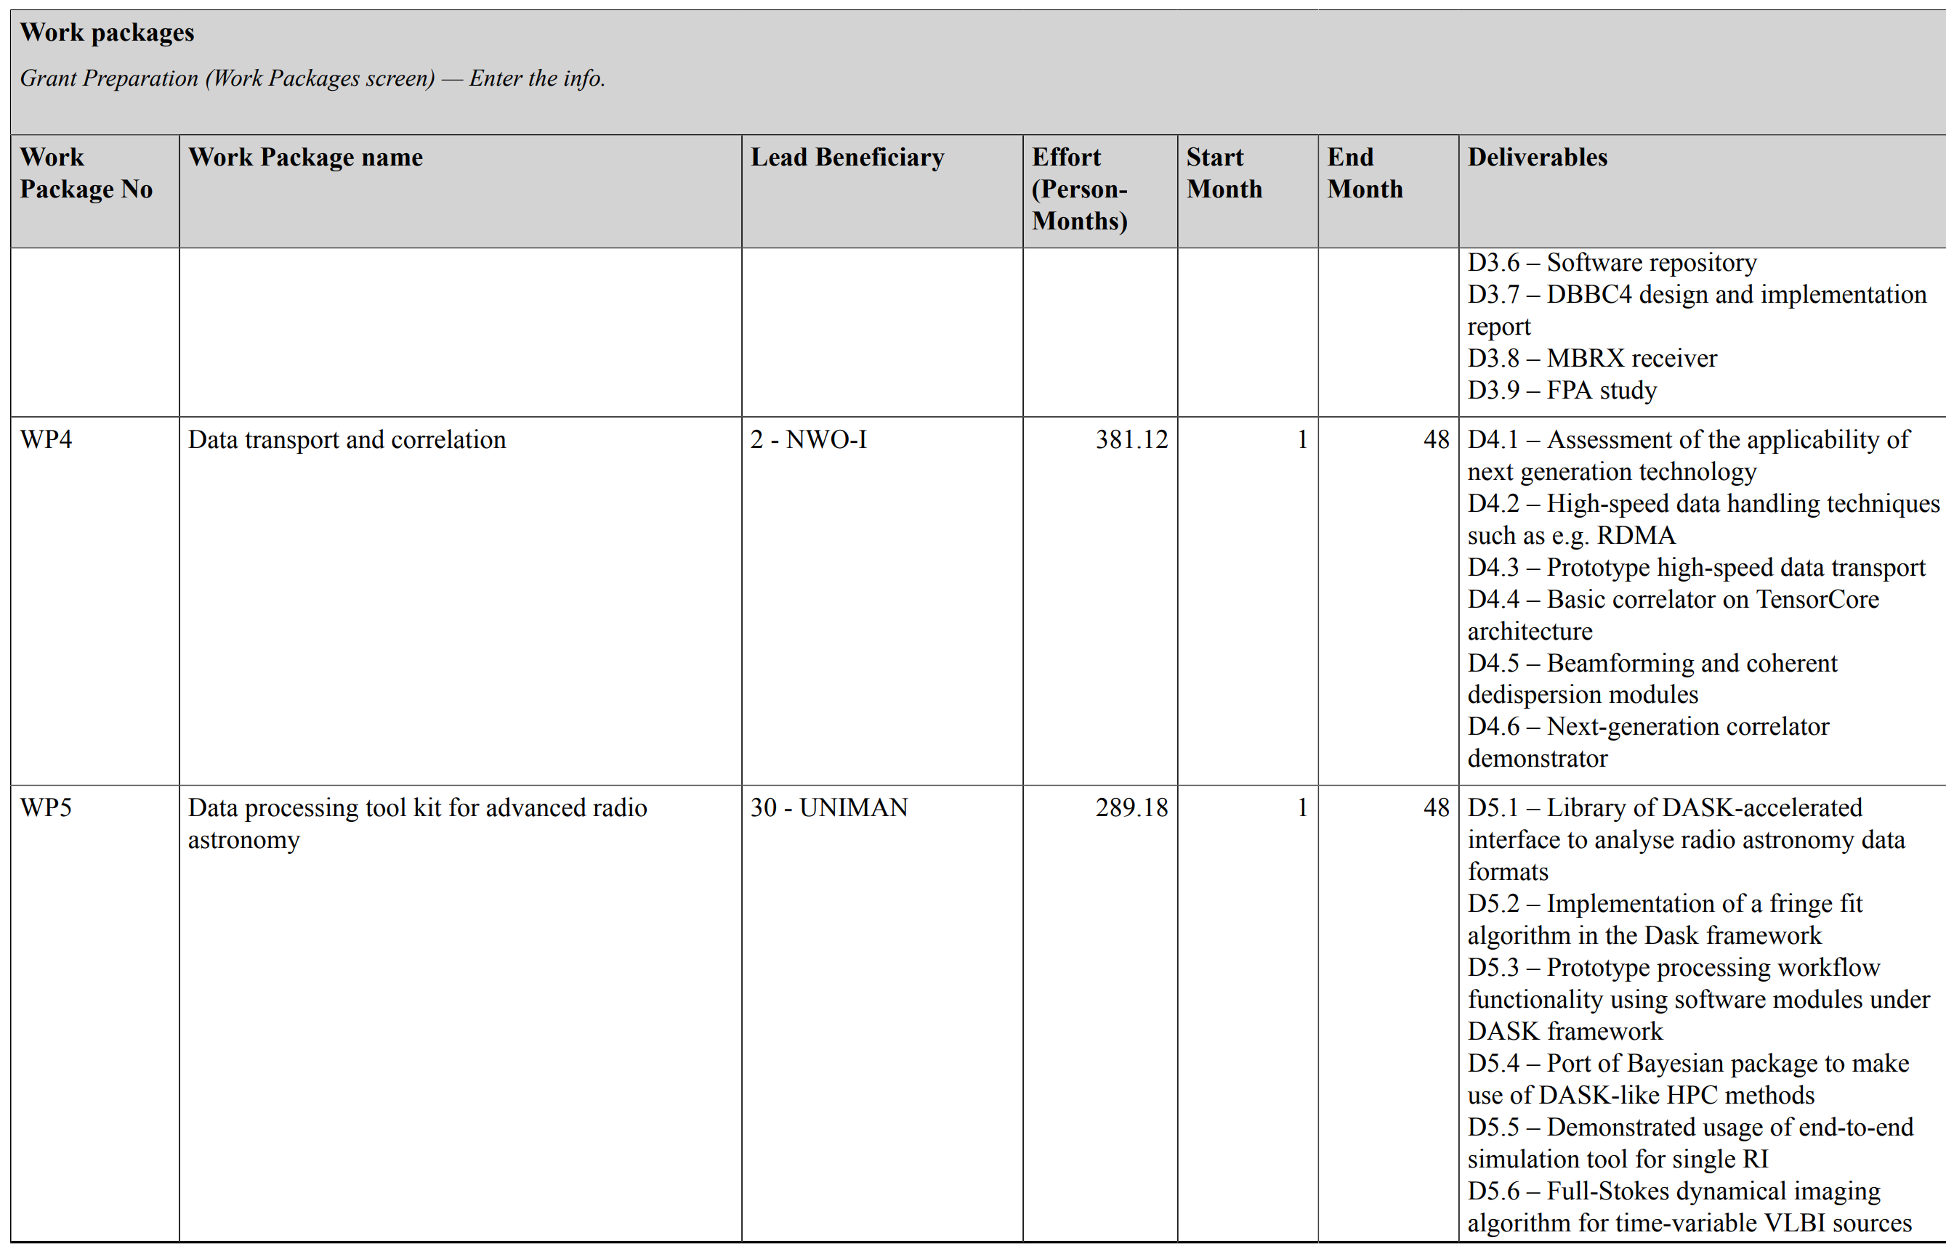
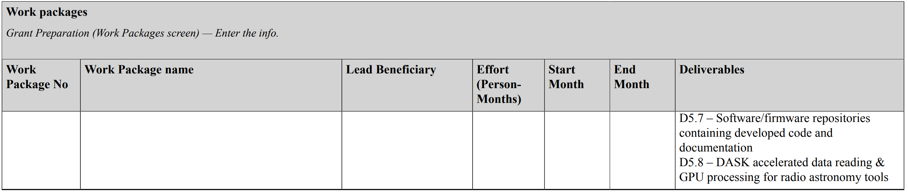
RADIOBLOCKS
4 years: from 1st March 2023 to 28 Feb 2027
Budget from EC: 9M Euros
Additional contribution from Associate Partners (3M Euros)
24 Beneficiaries of the EC grant
8 Associate Partners
32 partners from 12 countries
including 2 IGOs (ESO and SKAO)
Total effort: 1187 PM
WP1 Project Management
WP2 Novel Detectors and Components
WP3 Digital Receivers
WP4 Data transport and correlation
WP5 Data processing tool kit for advanced radio astronomy

Slide 4
Governance
RADIOBLOCKS General Assembly
Radio astronomical facilities
Coordinator
EC
Industry
Executive Team
WP1:
Management Team
WP2
Novel Detectors and Components
WP3
Digital Receivers
WP4
Data transport and correlation
WP5
Data processing tool kit for advanced radio astronomy

Slide 5
RADIOBLOCKS structure
The ‘building block’ approach structures RADIOBLOCKS into four stages of the signal/data flow common to almost all radio telescopes/arrays and maximises the applicability of the developments to a wide range of world leading facilities.
The project fits very well in the context of the local, regional and global scenarios for radio astronomy.

Slide 6
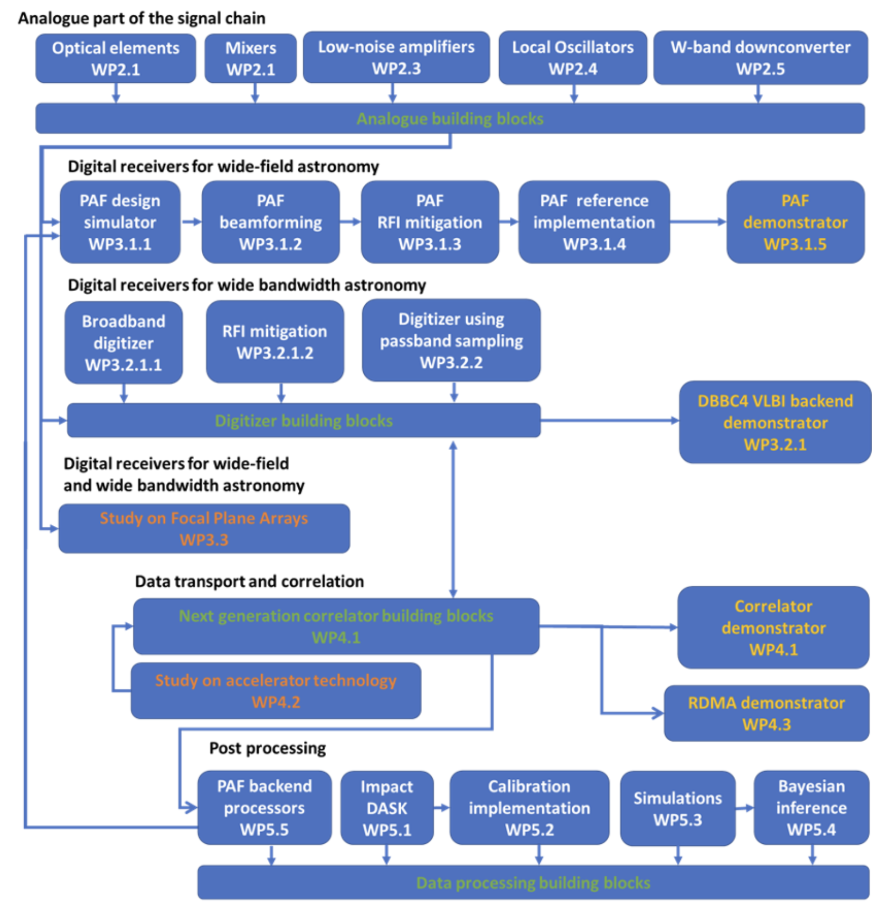
The signal chain
Novel detectors and key components for future sensitive, wideband cm/mm-band receivers are developed in WP2.
Integrating WP2 components into demonstrators of digital systems is the aim of WP3.
The digital receivers to be developed and demonstrated in WP3 have all in common that they produce large volumes of data at high data rates, ready for further processing in WP4 and WP5.
The data produced by new receiving systems (WP2 and WP3) are processed in WP4, which will define interface standards for the newly developed hardware.
Transforming the raw correlator (WP4) output into science-ready images and spectral data cubes is a substantial and complex task, and is the domain of WP5.

Slide 7
Expected results
Digital Receivers
RADIOBLOCKS’ goal is to develop “common building blocks” for technological solution
  beyond state-of-the-art
  across the whole data chain
  enabling a broad range of new science
  enhancing European scientific competitiveness.
The project’s results will be new “blocks” of technology that can be implemented in multiple facilities to answer common challenges.
(See WP presentations for the current results)
Data transport
Correlations
Novel Detectors
Data processing
New Components
RADIOBLOCKS aims to build the necessary enhancements in the sensitivity, bandwidth and field-of-view in world-class radio astronomical facilities.
RADIOBLOCKS facilitates addressing the common technological challenges of the radio facilities to reach their mid- and long-term scientific visions

Slide 8
RADIOBLOCKS targets and key results
The scientific capabilities and competitiveness of radio astronomy in Europe and beyond is the primary and overarching aim of this project.
RADIOBLOCKS has multiple targets:
  Users of the infrastructures
    by developing tools for their needs
  The radio facilities
    by reinforcing their capabilities
  The scientists and engineers
    by improving their know-how
  The industry
    by co-developing advanced technologies
    by increasing the partners’ technological levels
    by strengthening their market positions
  The policymakers
    by facilitating a true innovation system in the scientific field of radio astronomy in Europe and beyond
ARGOS MoU and synergies
New interested parties:
    Rhodes University (ZA)
    ICRAR (Australia)
RADIOBLOCKS selected as an OECD* Global Science Forum project by the German ministry as an example of the Ecosystem of Research Infrastructures
*Organisation for Economic Co-operation and Development

Slide 9





RADIO
building blocks to increase the science delivery potential of radio astronomical observatories
BLOCKS
32 partners – 4 years
started on 1 March 2023
9M Euros from EC HE programme
3M Euros from non-EC partners
https://www.radioblocks.eu/
Maximizing boost for the European major world-leading research infrastructures in radio astronomy
Building blocks as new instruments to increase the science delivery potential of Europe’s major radio astronomical observatories.
Enhancing competitiveness and technological excellence by developing instruments and tools for radio astronomy research infrastructures.
Co-development with industrial partners
  Knowledge exchange between research infrastructures and industry.

