Slide 1


RADIO
New science in Radio Astronomy: applying cutting-edge technology to enhance the entire data chain, from receiver to final output
BLOCKS
Grant number: 101093934

Slide 2
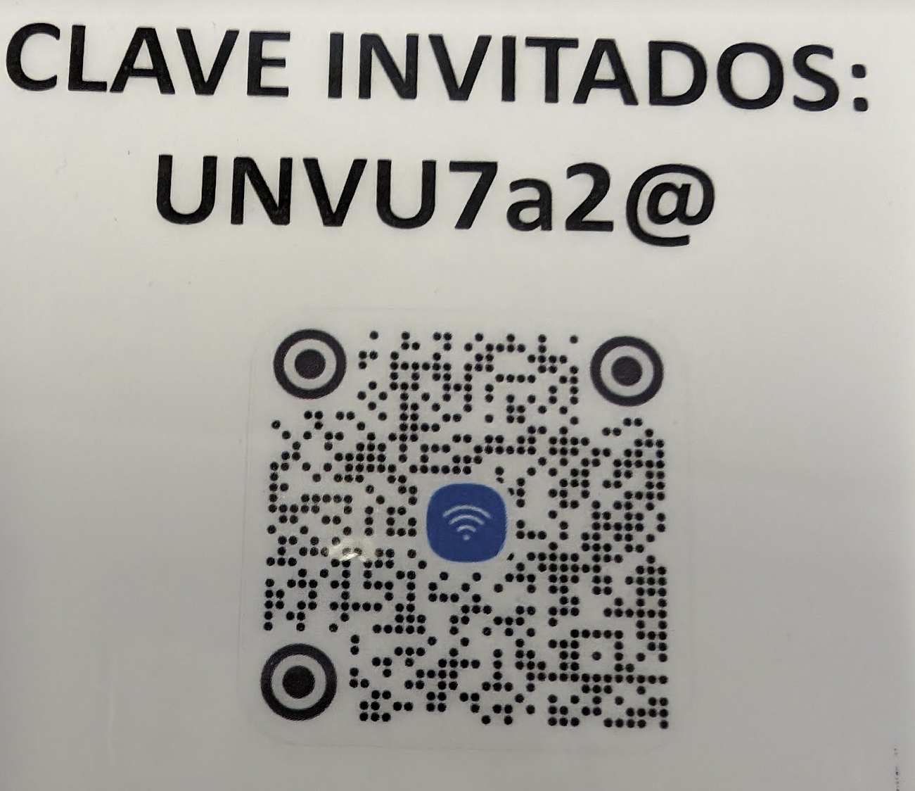
Announcements
WiFi
  Network: INVITADOS
  Password: UNVU7a2@
Snacks and drinks
  At the Observatories
  Follow the RB posters
Visits
  guided tours
Storage room close to reception

Slide 3
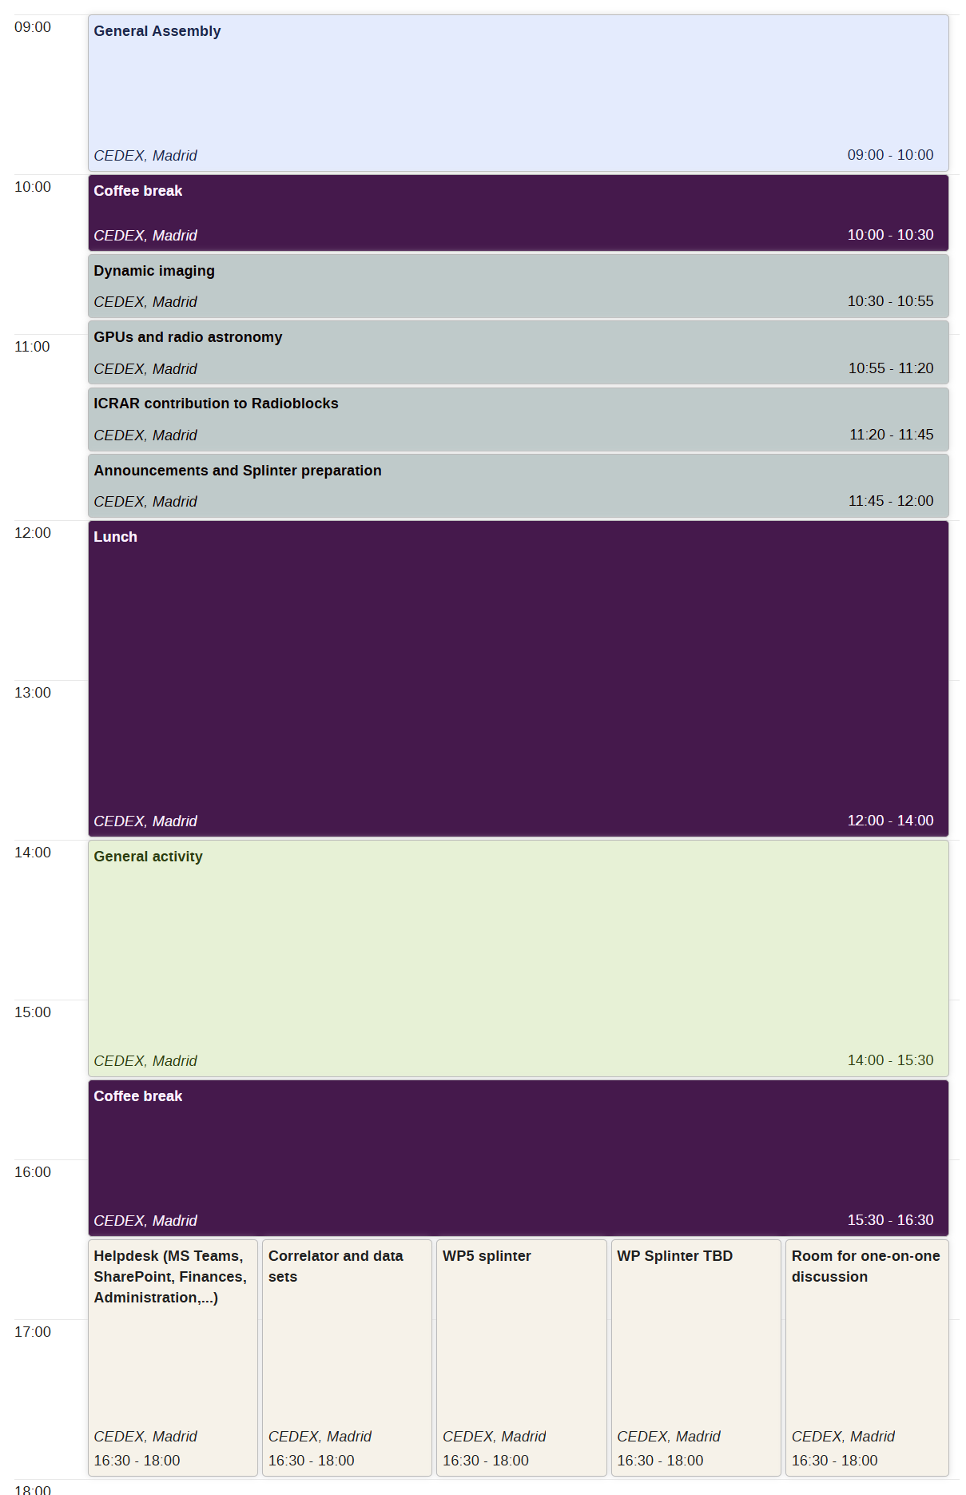
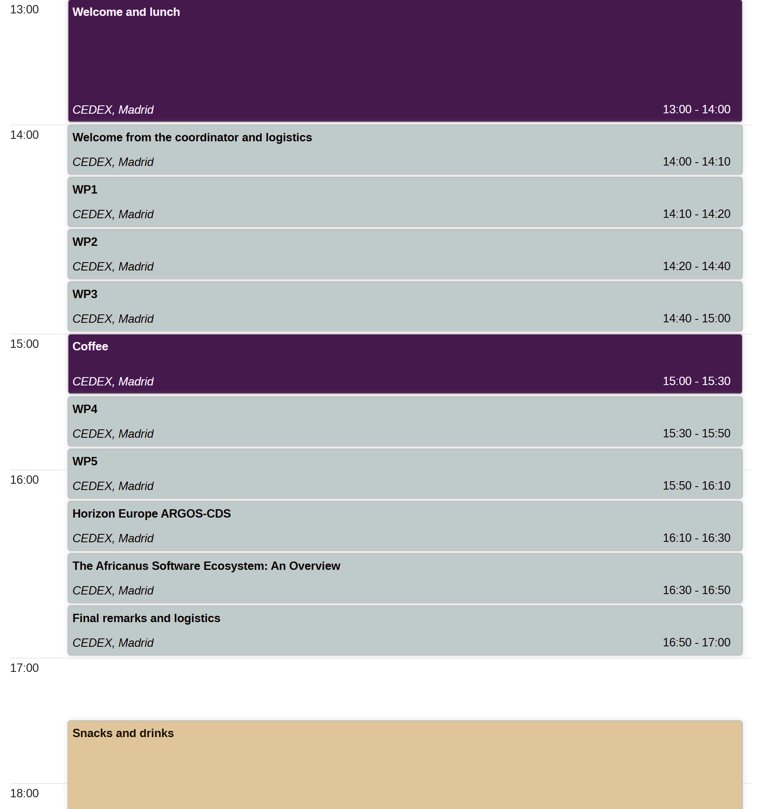
Day 1:
Project progress
Day 2:
All-Hands
Topics of general interest
Long breaks
General communication activity
Splinters
  WP/Tasks splinters
  Helpdesk
  One-on-one discussions
Day3:
WP day`

Slide 4
General Assembly
Wednesday 5 June 2024
by invitation only: for directors or their representatives
Ultimate decision-making body of the project
One representative per partner
Please provide contact or proxy for tomorrow’s meeting
It meets once per year. WP leaders and Project Management are invited to attend the General Assembly meetings.

