Slide 1
RADIOBLOCKS All-Hands meeting 4 June 2024 WP1
Giuseppe Cimò (JIVE)
RADIOBLOCKS Project Manager

Slide 2
WP1:
Management
The first year of the project saw several activities for the RADIOBLOCKS Management Team:
Website (radioblocks.eu)
Kick-off meeting
Communication tools (Teams, SharePoint, mailing lists)
Promotional material (pens, notepads, banners)
Templates (presentations and deliverables)
Repositories (GitHub, GitLab, Overleaf, Zenodo)
Executive Team meeting every two or three month
General Assembly meetings once per year
Responsible for supporting the project activities and the curation, preservation and accessibility of the data collected or produced by RADIOBLOCKS.
Work Package 1 deals with the managerial duties of the project. It is composed of JIVE personnel and includes the coordinator, the project manager, the financial officer, the communication officer and a project officer. WP1 assists other WPs with their activities and collects the project deliverables for the EC portal.
Deliverables or milestones
D1.1 Website( M3)
D1.2 Dissemination Plan (M6)
D1.3 Data management plan (M6)
D1.6 Policy Brief feedback (M12) – requested by the EC
No milestones.
Notes:
Superconductor-Insulator-Superconductor
quasi-optical structures at mm and submillimeter thanks to SIS
New technique to build horns
LNA mostly for high freq. but can be applied to cm telescopes
local oscillators at an astronomically interesting frequency (e.g. 346 GHz for the CO 3-2 line) will be developed, capable of pumping large heterodyne arrays that will constitute the future generation of receivers. UKRI, OBSPARIS and LYTID (an industriel partner) will join forces to develop a multiplier amplifier local oscillator chain. UKRI will develop a doubler around 173 GHz with over 100mW output, OBSPARIS will develop the following doubler to 346 GHz with more than 20mW output. Possible commercial applications

Slide 3
Project management
Key results – project as a whole
Providing intra-project communication channels
Assisting the Exec team
Assisting the General Assembly
Preparing and submitting amendments
Submitting deliverables and dealing with EC portal
Exploring cooperation with relevant stakeholders
Developing and executing the dissemination plans
Financial statements collected from partners
Expenses on track (though too early in the project to make projections)
Periodic report submitted at the end of April
Review (next week!)
This meeting → RADIOBLOCKS as a whole
Promote RADIOBLOCKS everywhere
Deliverables and milestones
submitted on time
Amendment
submitted and approved by EC
CNRS added as affiliated entity
NAOJ and Beyond Gravity left the project
Added deliverables on policy brief (requested by the EC)
Interactions and advocacy with other communities
HE ARGOS-CDS (MoU)
ICRAR (collaborating in several WPs)
RATT – Rhodes University
working in WP5 and willing to join the project
All-Hands (THIS MEETING!)
4-6 June 2024, Madrid

Slide 4
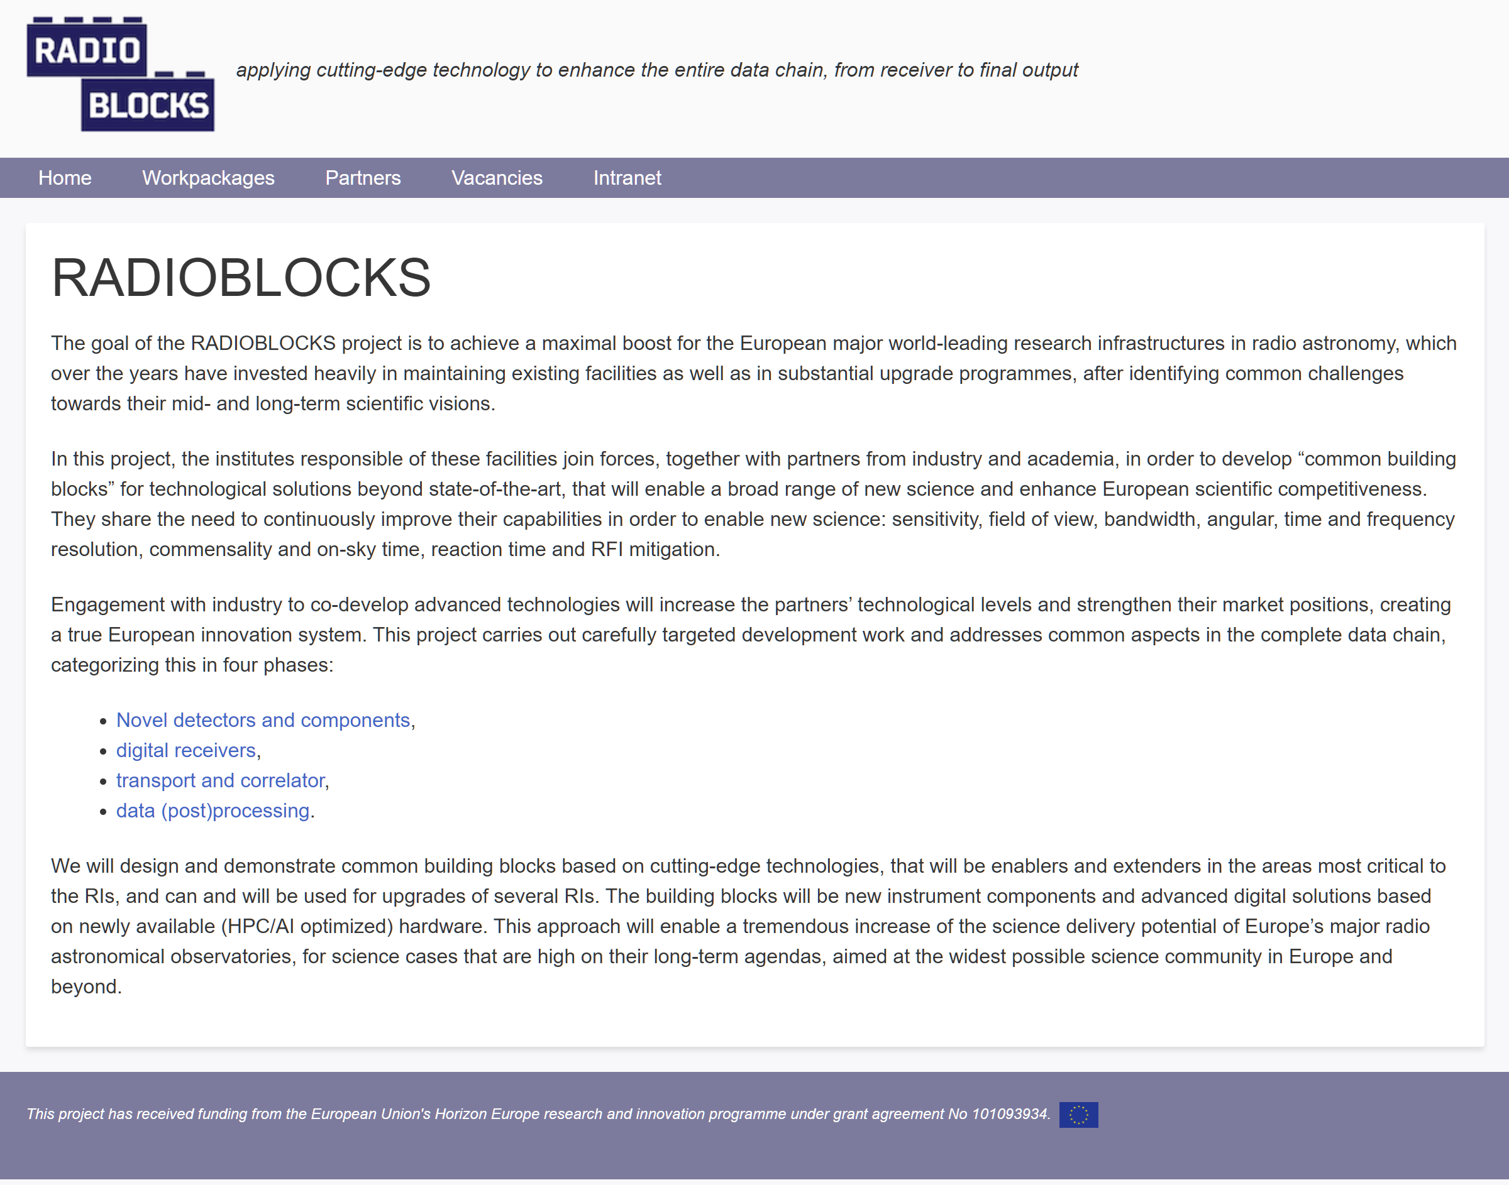
Website and communication activities
Website
always in progress
Communication tools
Teams, SharePoint, mailing lists
Promotional material
Pens, notepads, banners
Templates
presentations and deliverables
Repositories
GitHub, GitLab, Overleaf, Zenodo
Dissemination
LinkedIn, Newsletters
https://www.radioblocks.eu/

Slide 5
Dissemination Plan
Goal
Raise Awareness | Increase awareness among the identified target audiences about the project's objectives, activities, and achievements.
Share Knowledge and Findings | Disseminate project findings, research outcomes, and insights to the scientific community, practitioners, policymakers, and the public.
Facilitate Knowledge Transfer | Enable the transfer of practical knowledge and actionable insights to relevant stakeholders, encouraging the application of the project's outcomes in real-world scenarios.
Engage Stakeholders | Foster engagement and dialogue among stakeholders, including project partners, collaborators, experts, prospect industrial partners, and other identified audiences.
Empower End-Users | Empower radio astronomers with the knowledge and tools necessary to benefit from the project's outcomes, such as improved practices, products, and services.
Build Collaborative Networks | Strengthen partnerships and collaborations with other researchers, organizations, and industries by sharing valuable insights and contributing to knowledge exchange.
Measure Impact | Evaluate the effectiveness of dissemination efforts in terms of audience engagement, understanding, and utilization of project outcomes.
Promote Sustainable Knowledge Sharing | Establish a foundation for continued knowledge sharing beyond the project's duration, ensuring the longevity of the project's impact.
Enhance Public Understanding | Enhance public understanding of the project's significance, contributing to a broader appreciation of scientific research and innovation.
Steps:
Defining target audiences
Brainstorming
Interviews and questionnaires
Defining channels
Specific tool per each channel (scientists, industry, public,...)
Creation of content and material for each channel

Slide 6
Data management Plan
Survey on Data Output of the project
Steps:
Defining Data products
Reports, plans, hardware designs, hardware prototypes, software, publications
Defining ownership and access (see CA)
Mostly for hardware and software
Data organization and storage
GitHub and GitLab
Zenodo community
Work Package | Results | Open (source, access) | Partners in WP
1: Management | Reports, plans, dissemination materials | y | 1
2: Novel Detectors and Components | Reports, hardware prototypes, hardware designs, publications | y | 16
3: Digital Receivers | Reports, hardware designs, software, publications | y | 5
4: Data Transport and Correlation | Reports, software, firmware, publications | y | 9
5: Data Processing Toolkit for Advanced Radio Astronomy | Reports, software, firmware, publications | y | 13
ZENODO is a general-purpose open repository developed under the European OpenAIRE program and operated by CERN.
Integration with GitHub/Lab.
It assign a DOI to all data products: from deliverables to documentations to papers

Slide 7
Interactions and advocacy
Horizon Europe ARGOS-CDS (see talk later today)
Prospective new partners
Rhodes University (see talk later today)
ICRAR (see talk tomorrow morning)
Contact with a high-energy astrophysics consortium
Other communities seek synergies and overlaps with RADIOBLOCKS
OECD Global Science Forum project
Example of the Ecosystem of Research Infrastructures​ (selected by the German ministry)
More advocacy by you! (conferences, workshops, collaborations,...)
Please keep us informed
Notes:
Organisation for Economic Co-operation and Development

Slide 8
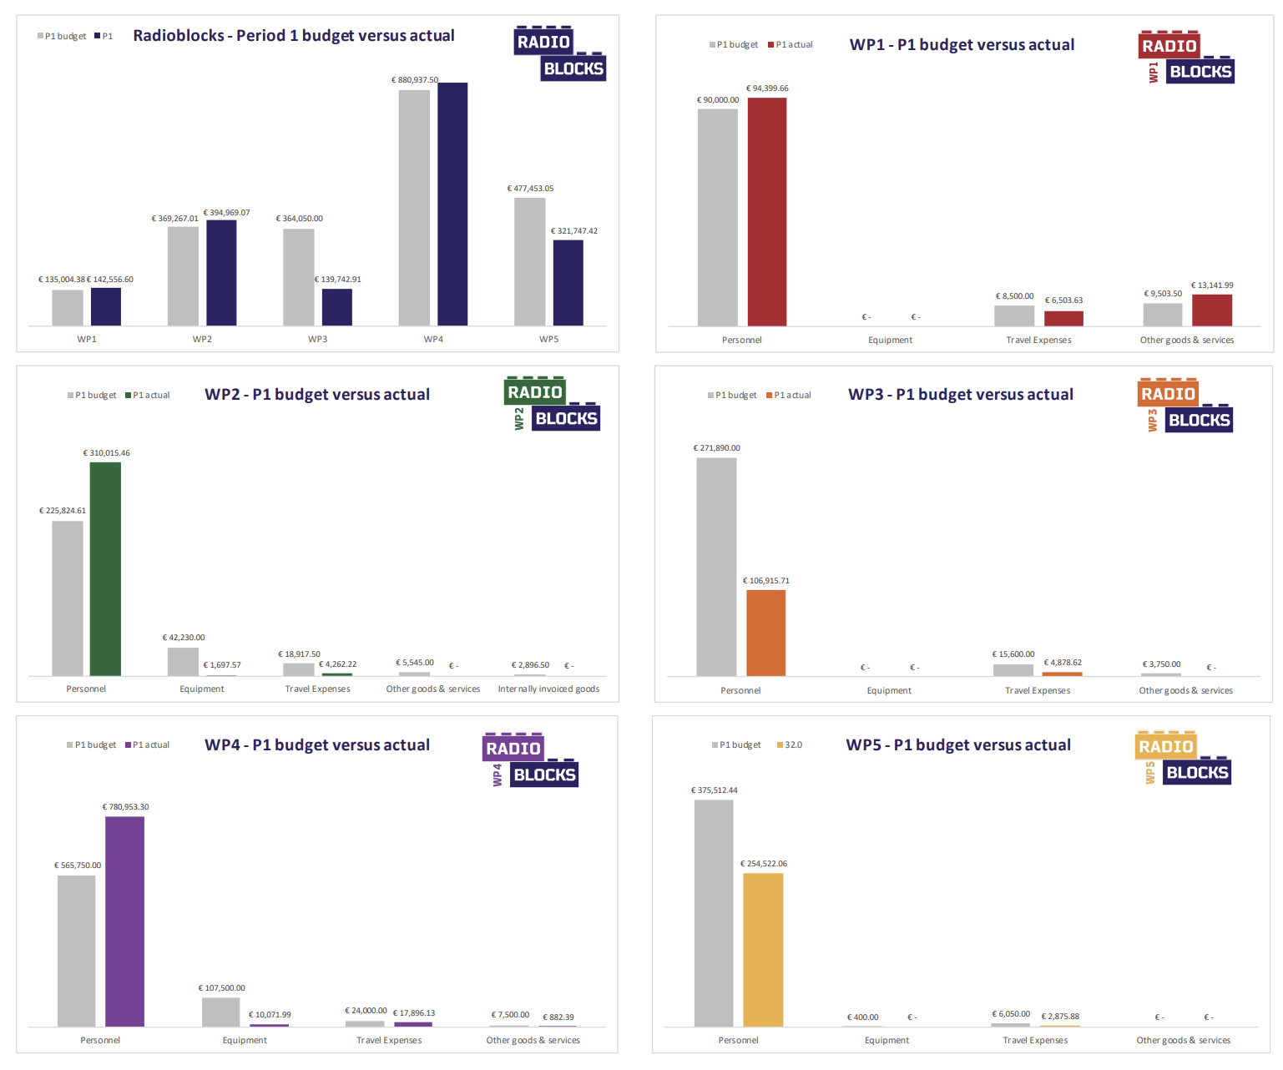
Finances:
WP statements after 1 year
Grey bar – budget (linear!)
Colours – declared expenses

Slide 9
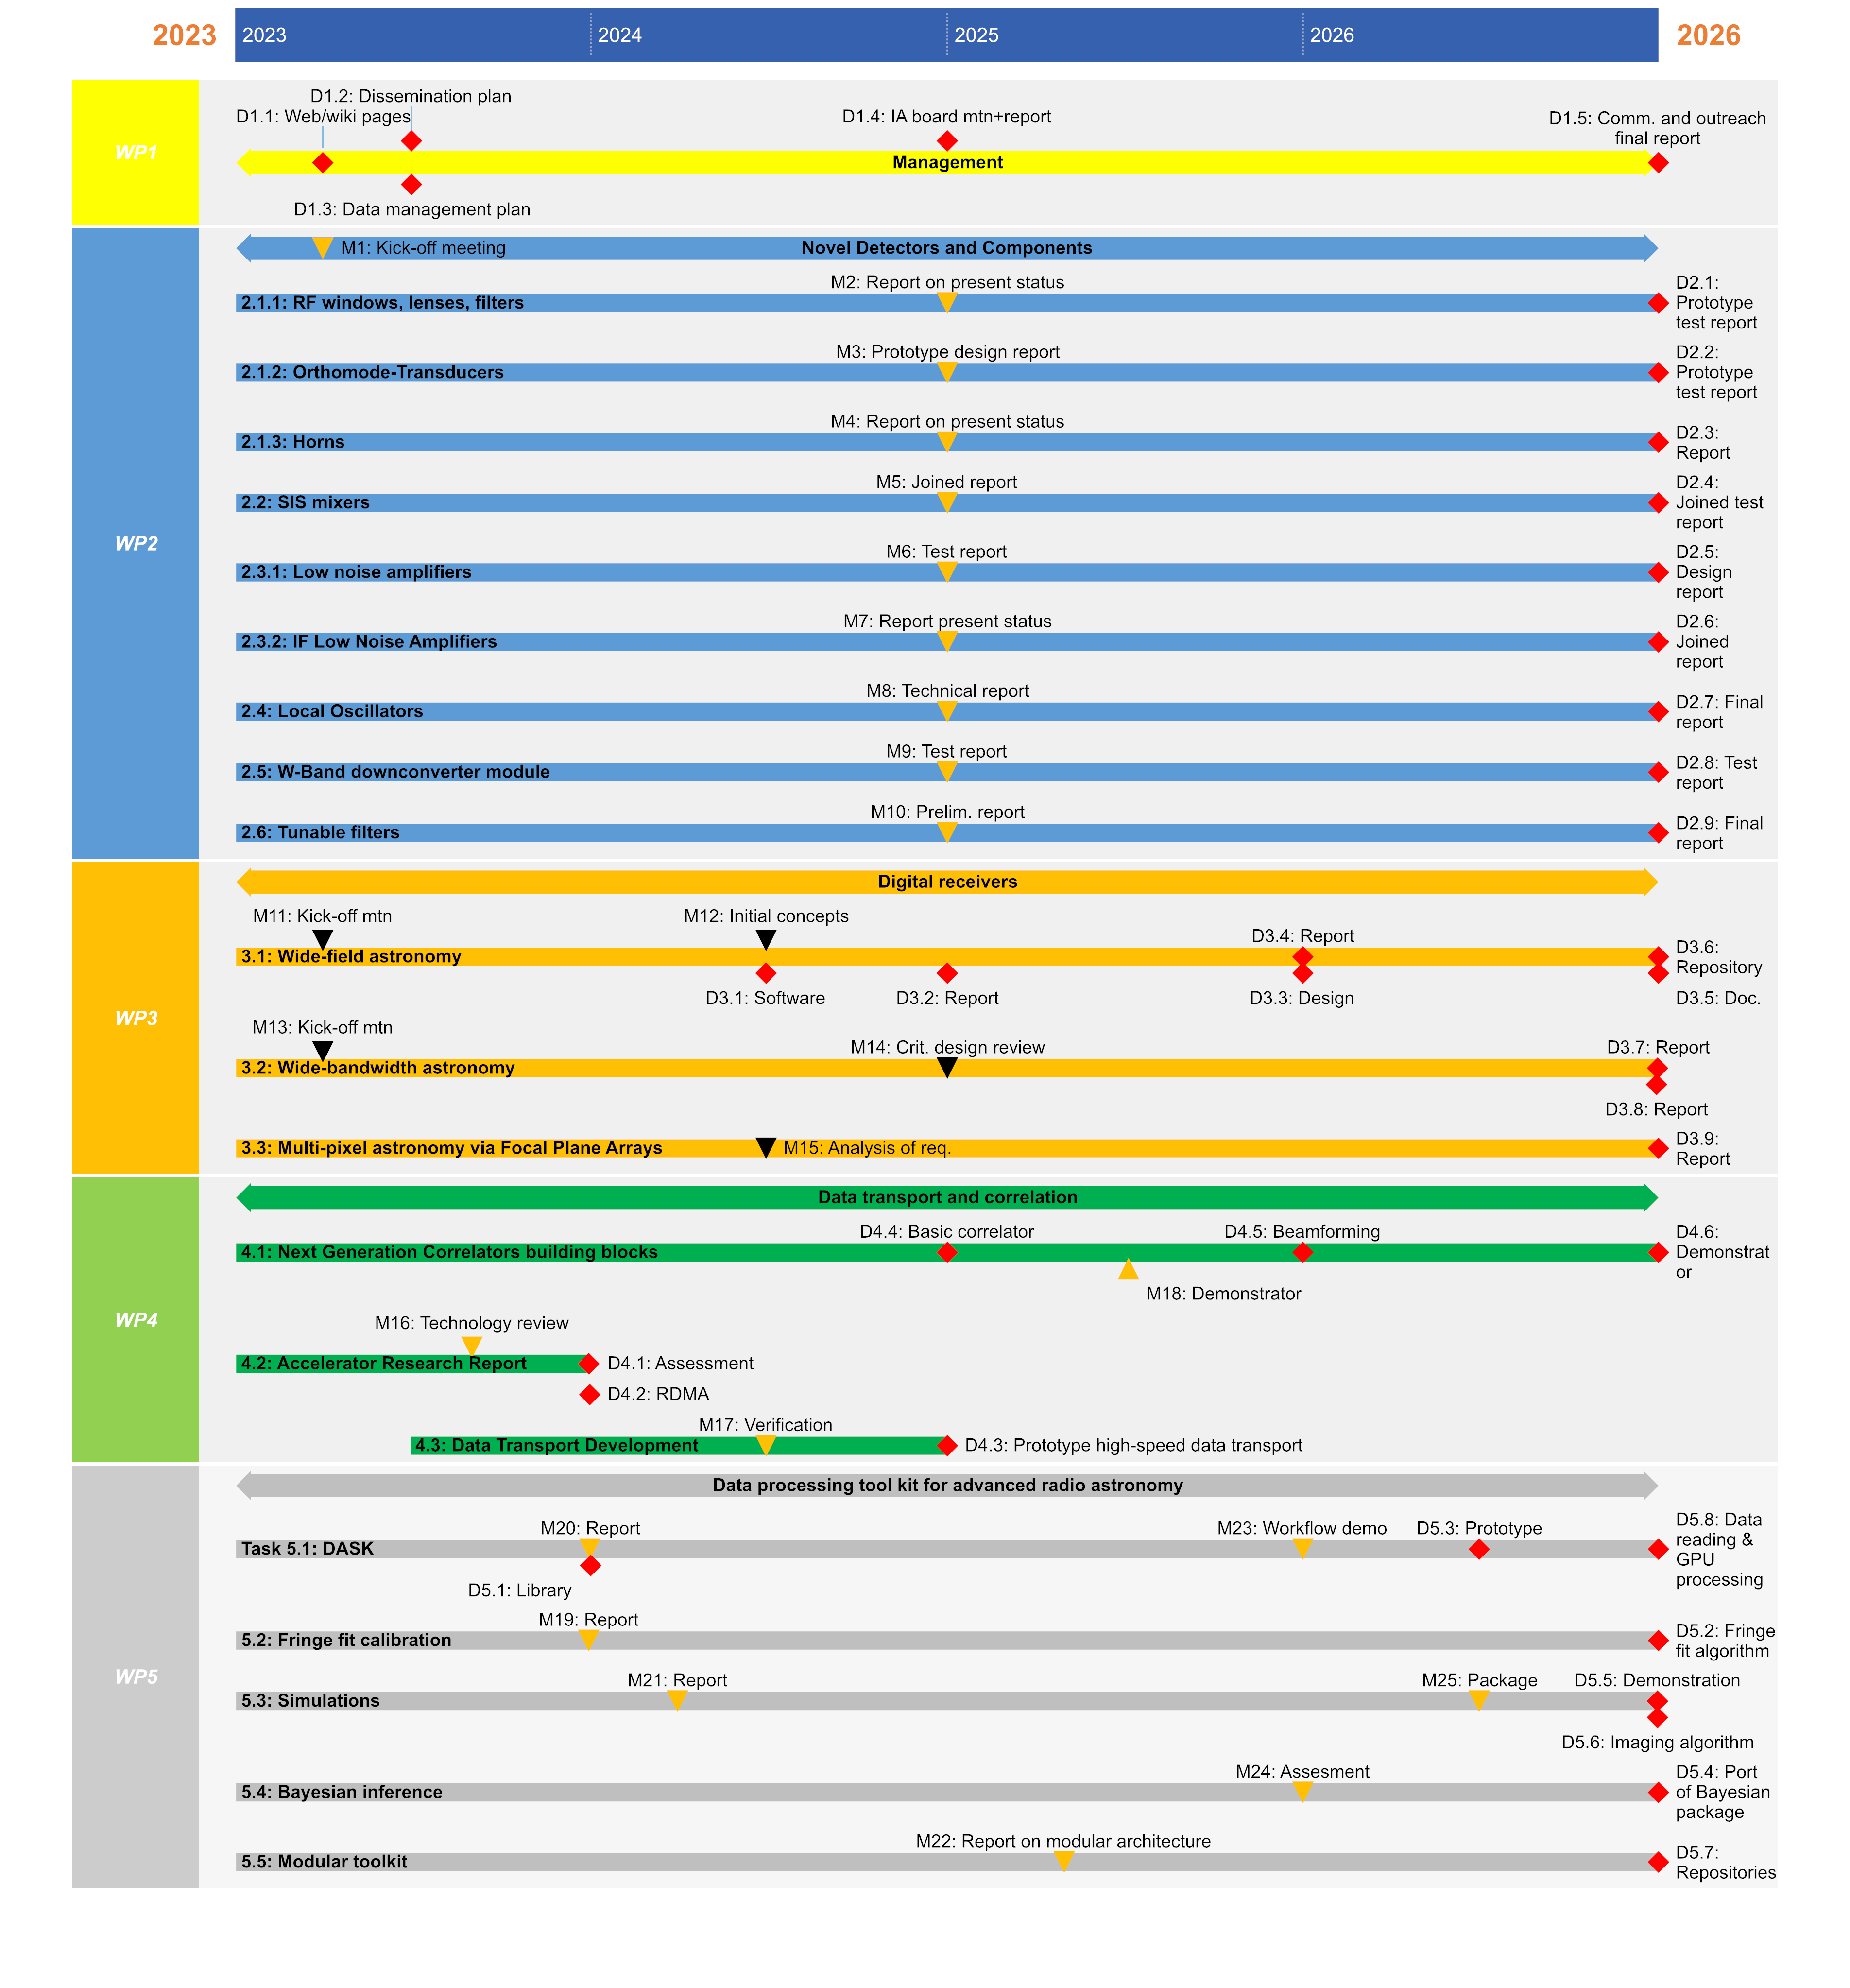
Timeline
You are here!
Deadlines in the first year:
D1.1 Project website (M3)
D1.2 Dissemination plan (M6)
D1.3 Data Management plan (M6)
D4.1 Assessment of the applicability of next
generation technology (M12)
D4.2 High-speed data handling techniques such as
e.g. RDMA (M12)
D5.1 Library of DASK-accelerated interface to
analyse radio astronomy data formats (M12)
The success of a project is not the mere sum of its deliverables.
RADIOBLOCKS is an ambitious project that develops common tools and creates a vibrant community that brings together research infrastructures, academia and industry.

