Slide 1
ICRAR Contribution to RADIOBLOCKS
Maria J. Rioja ICRAR-UWA (Australia), OAN-IGN (Spain)
In collaboration with
Richard Dodson ICRAR-UWA

Slide 2
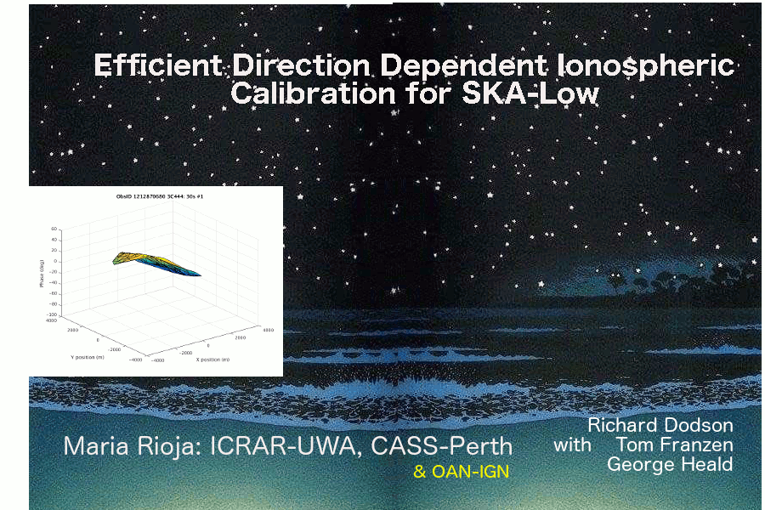
LEAP: Low Frequency Excision of Atmosphere in Parallel

Slide 3
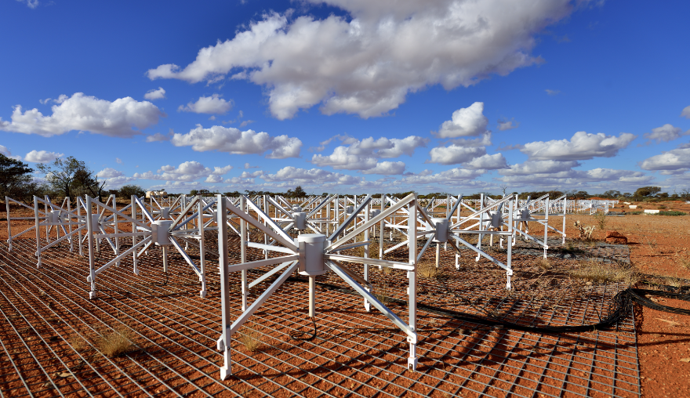
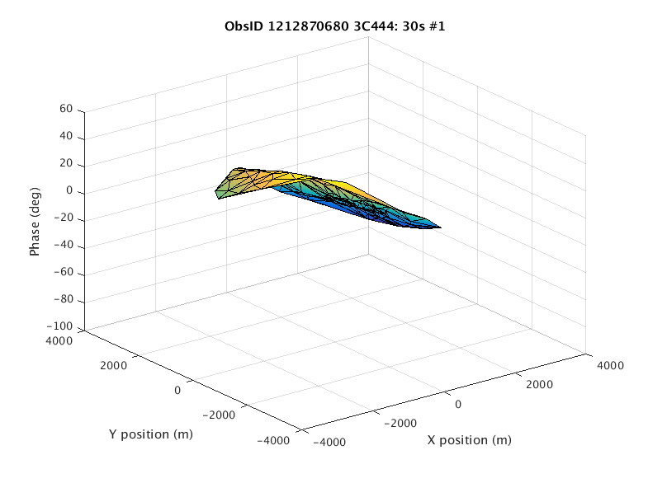
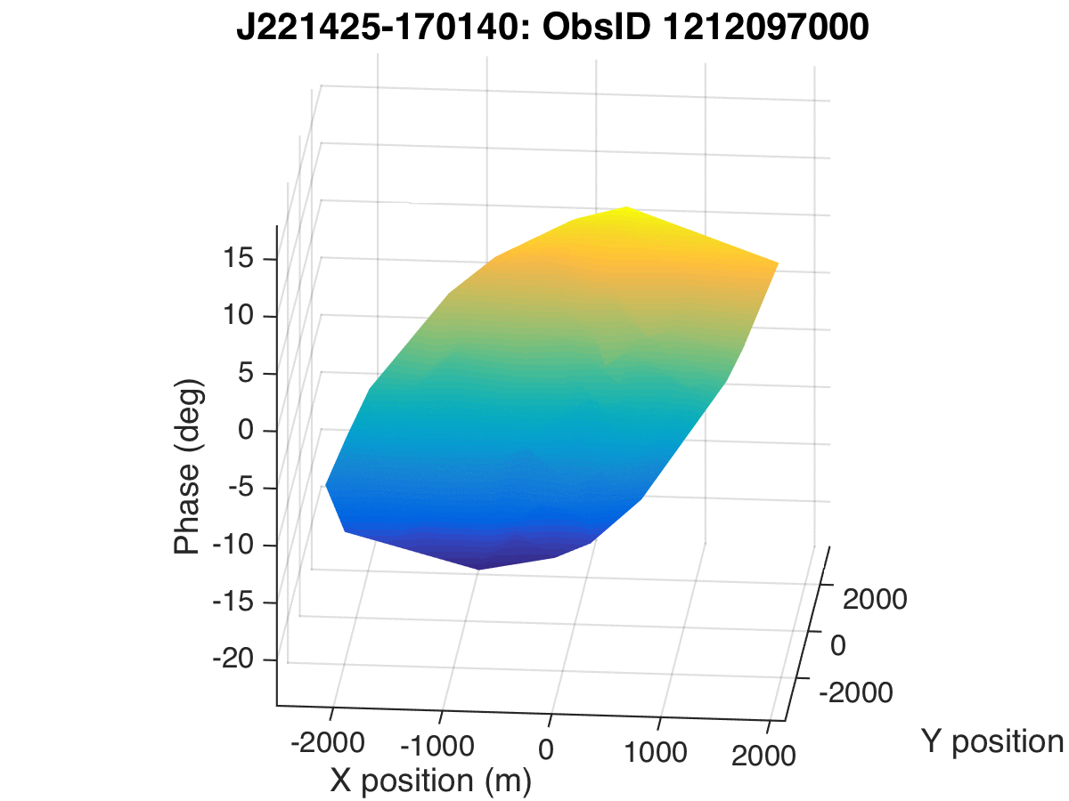
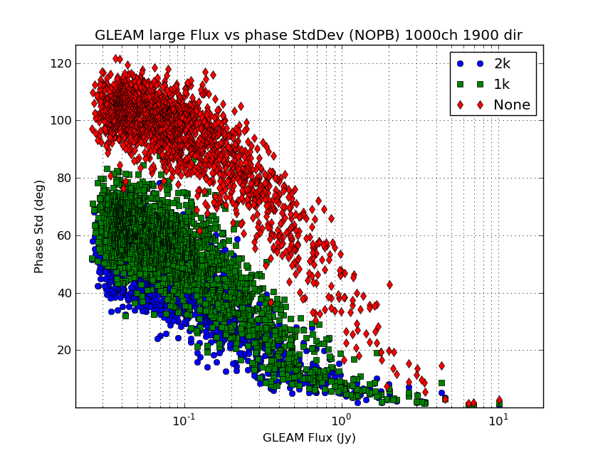
OUTLINE
Motivation for Direction Dependent (DD) calibration
LEAP “in action” using MWA
Comparative performance of LEAP
vs. Standard GLEAM ionospheric calibration
Ionospheric findings
Relevance for SKA-VLBI & Simulation Studies
(RADIOBLOCKS WP 5.3)
MWA: Murchison Widefield Array (70-300MHz, size~5km, dense, very wide FoV, precursor of SKA-Low)
LEAP: Low Frequency Excision of Atmosphere in Parallel (Rioja, Dodson & Franzen, 2018, MNRAS)
GLEAM: The GaLactic and Extragalactic All-Sky MWA Survey
Notes:
\

Slide 4
Motivation
Benefit from increased sensitivity… requires mitigation of systematics down to same level
Systematic Direction Dependent (DD) errors (@SKA frequencies):
The unpredictability of the spatial distribution of the TEC in the ionosphere is the
dominant source of DD errors at low frequencies; also temporal changes.
Image artifacts:
For MWA 1 (3 km) the ionospheric distortions can be approximated as a
“wedge” over the array (for a given direction), resulting in DD position shifts.
For MWA 2 (5 km) this is no longer the case, leading to defocusing
(smeared and reduced peak flux, source distortions, error patterns over large area).
DD calibration:
All existing DD calibration strategies for MWA are linear and can not “refocus”.
The goal of LEAP was to provide this capability. (Rioja,Dodson,Franzen 2018)
LEAP is:
A visibility based DD calibration scheme
Developed for MWA
DD Station-based gains, with some smoothness constraints
Simple and embarrassingly parallel
LEAP: Low Frequency Excision of Atmosphere in Parallel

Slide 5
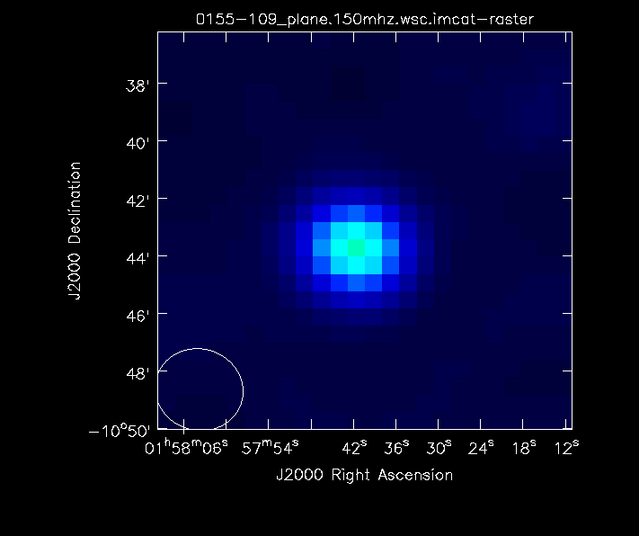
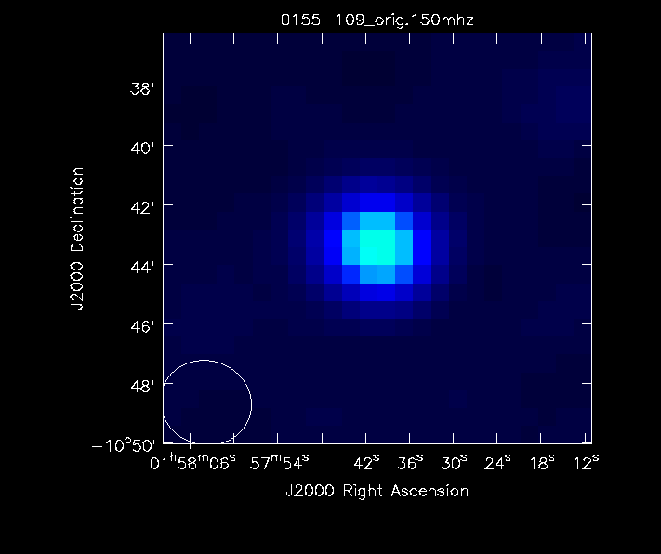
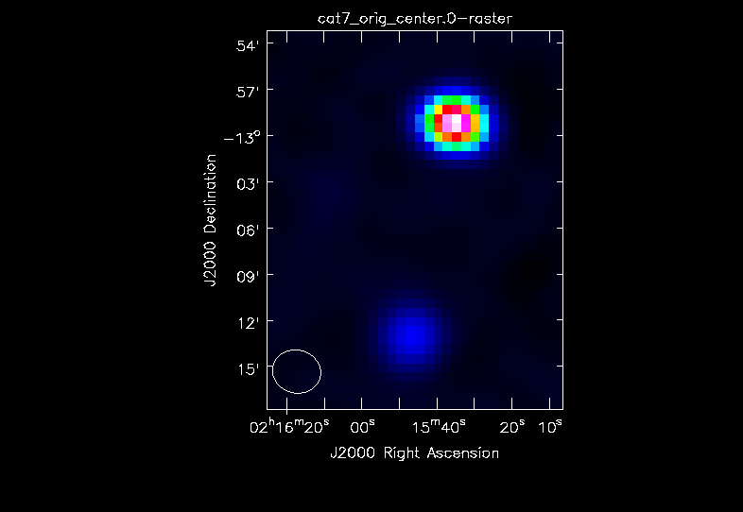
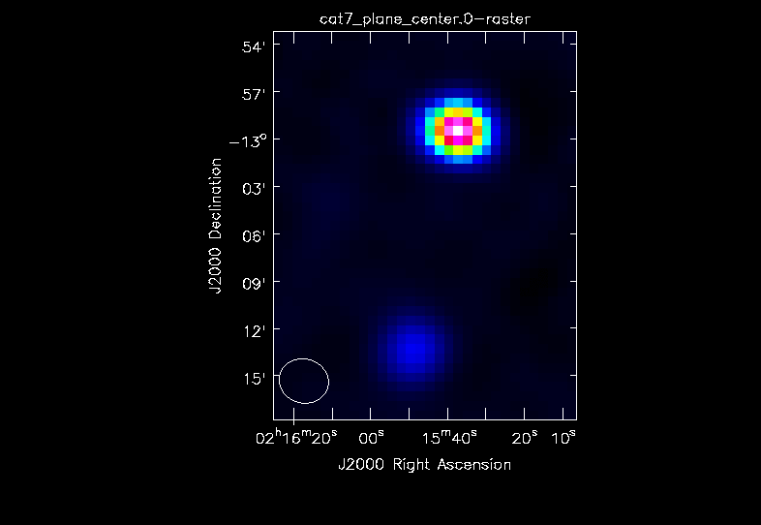
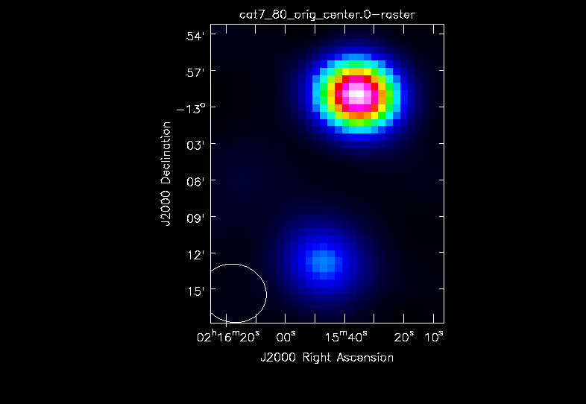
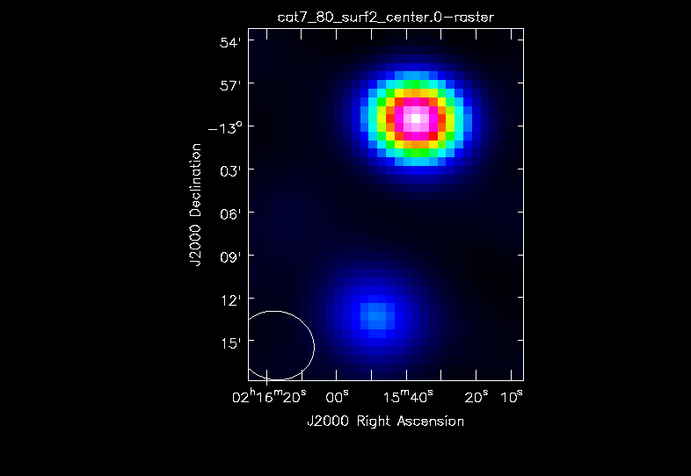
Traditional calibration (DI)…
LEAP calibration
Sequence of 7 2-min long snapshot images of sources
spanning 1 hour, at 150 MHz (MWA-1).
Dir 1
Std.GLEAM calibration
(i.e. ion. linear approx.)
Hurley-Walker+ 2018
150 MHz
Multi Frames
Dir 2
Image Artifacts: SHIFTS & Defocusing
Image Artifacts: Shift & Defocusing
(
80 MHz
Dir 2
Snapshot (2-min)
“building blocks”
(for longer integration images)

Slide 6
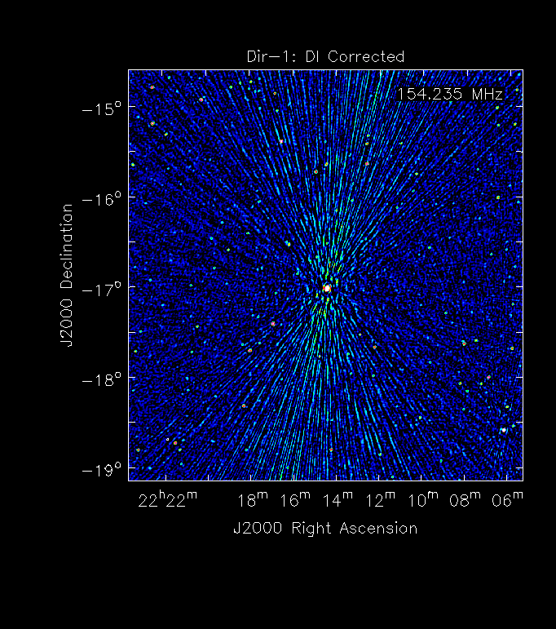
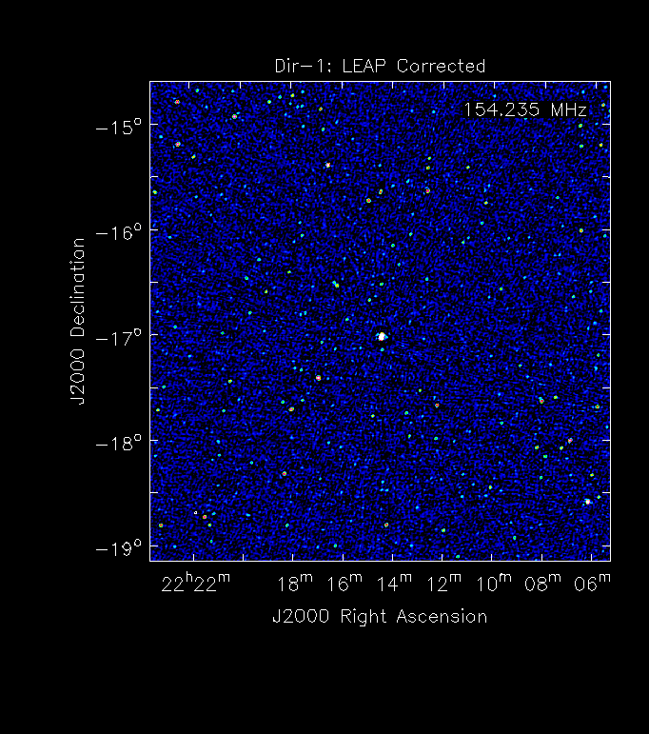
Traditional calibration (DI)…
Std. GLEAM calibration
LEAP calibration
Sequence of 7 2-min long snapshot images of sources
spanning 1 hour, at 150 MHz (MWA-1).
Dir 1
150 MHz
Multi Frames
Dir 2
Image Artifacts: SHIFTS & Defocusing
Image Artifacts: Shift & Defocusing
Image Artifacts: SHIFTS & Defocusing
80 MHz
Dir 2
Snapshot (2-min)
“building blocks”
(for longer integration images)

Slide 7
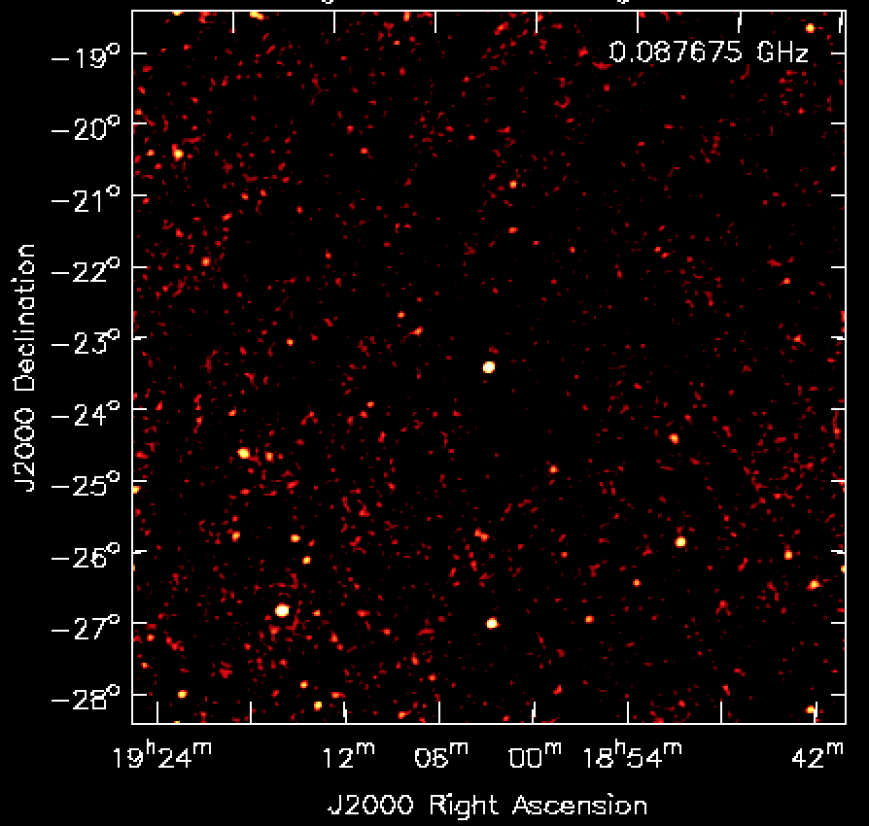
Basics of LEAP
DI image
Freq. Averaged
(Rioja,Dodson,Franzen, 2018, MNRAS)

Slide 8
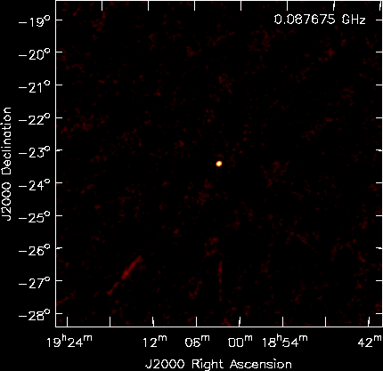
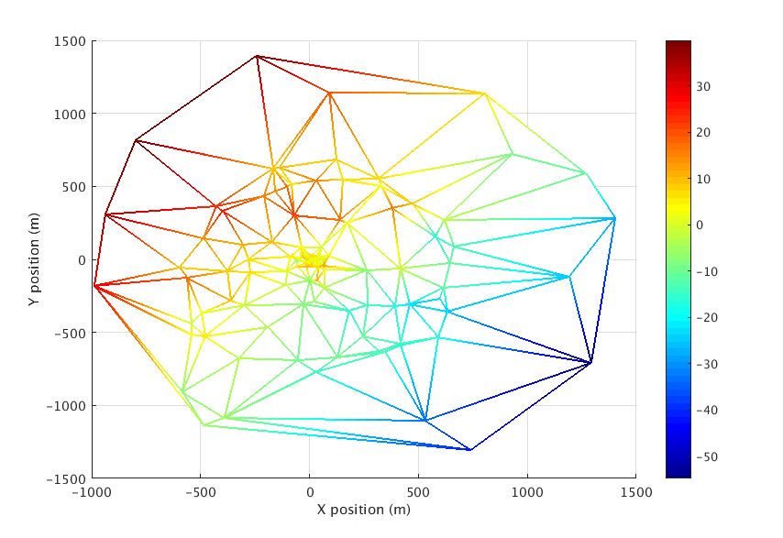
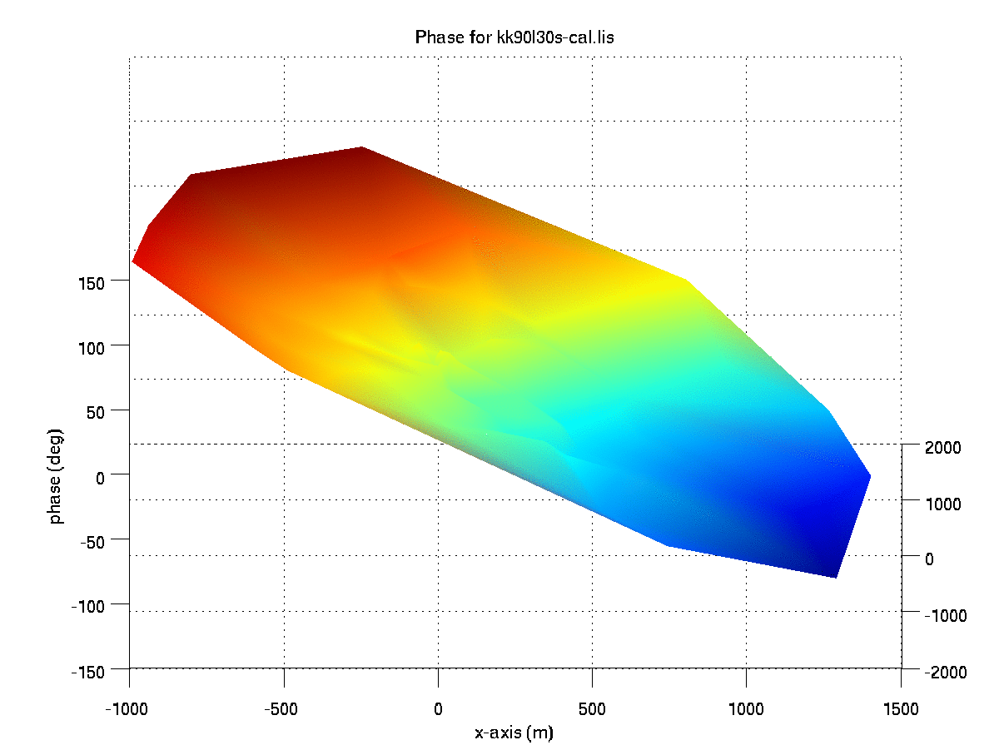

Frequency Smearing acts as an Efficient Filter…
LONGER BASELINES in extended array RESULT IN:
Increased efficency of directional filter
Better DD calibration
What takes to be a good
LEAP calibrator?
6 km
Y(Km)
LEAP Calibrator
for this Direction
6 km
X (Km)
DI image
Freq. Averaged
…. to separate directions within a large FoV
“Sky model” free, therefore,
(Embarrasingly) Parallel – Parallel N-directional solving problem
(Rioja,Dodson,Franzen, 2018, MNRAS)

Slide 9
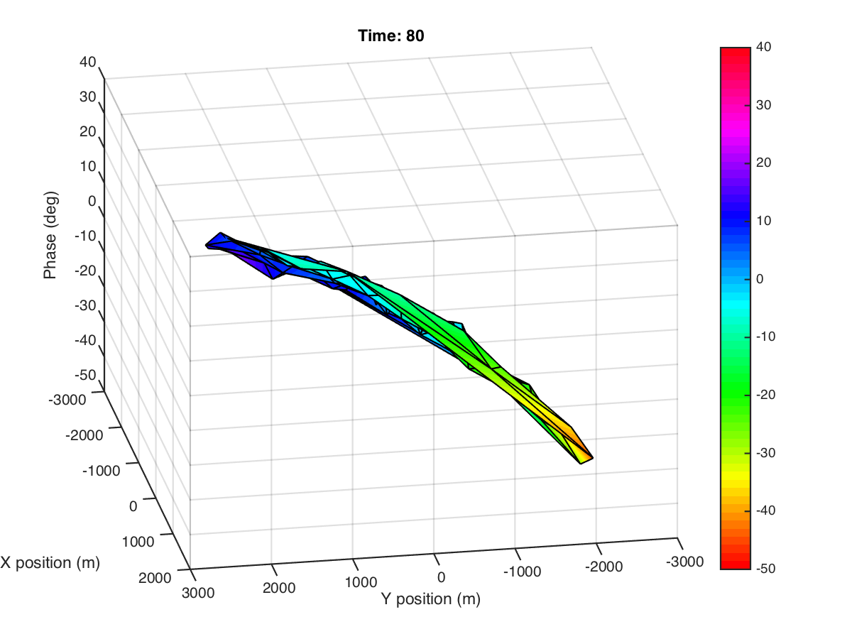
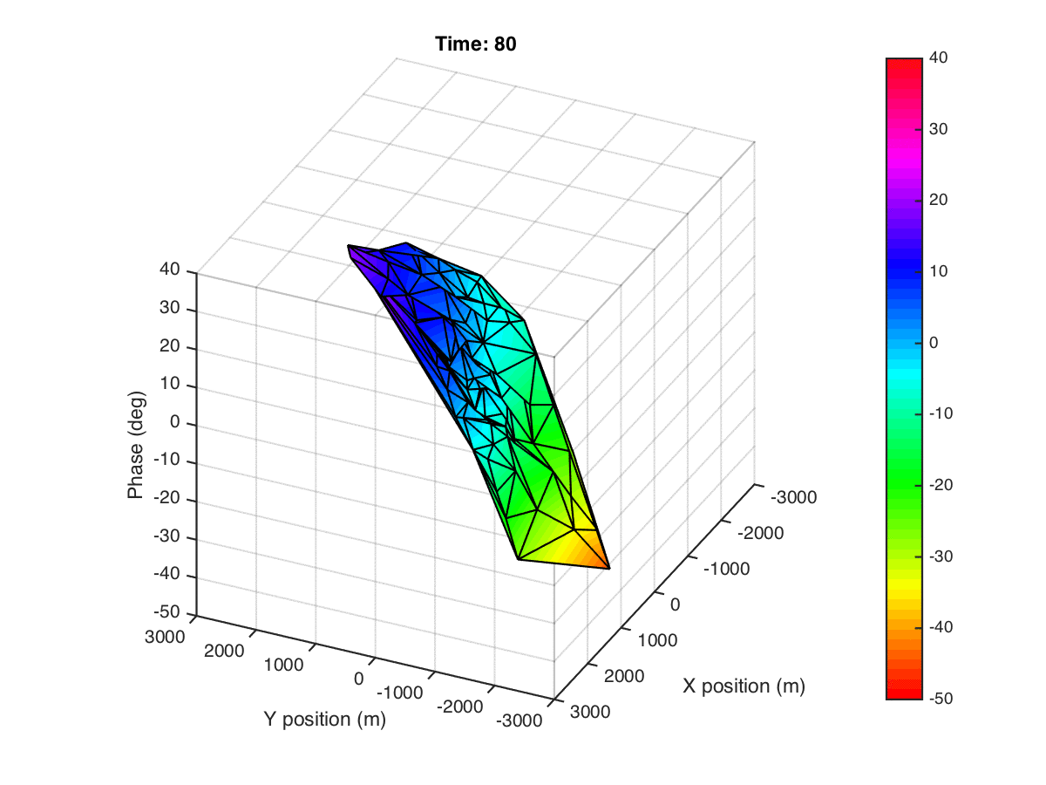
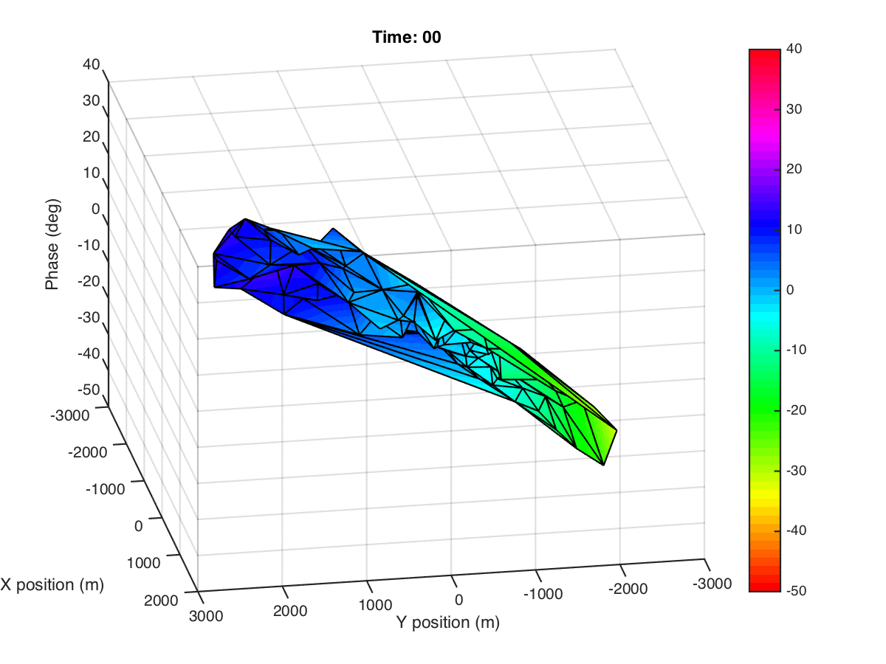
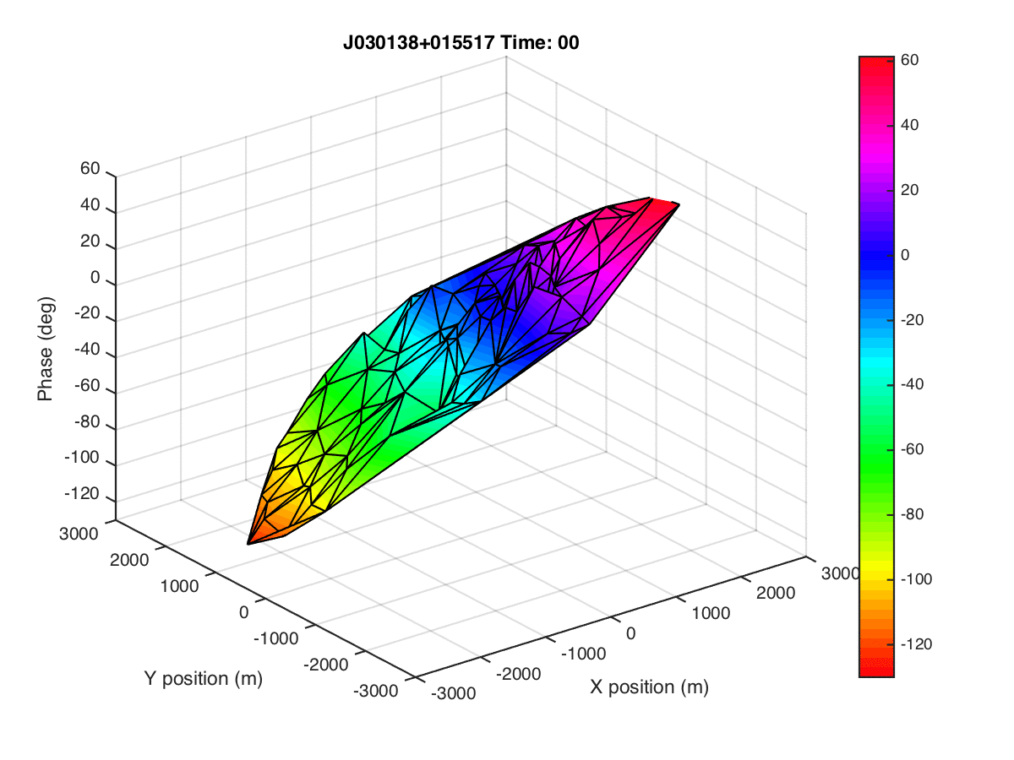
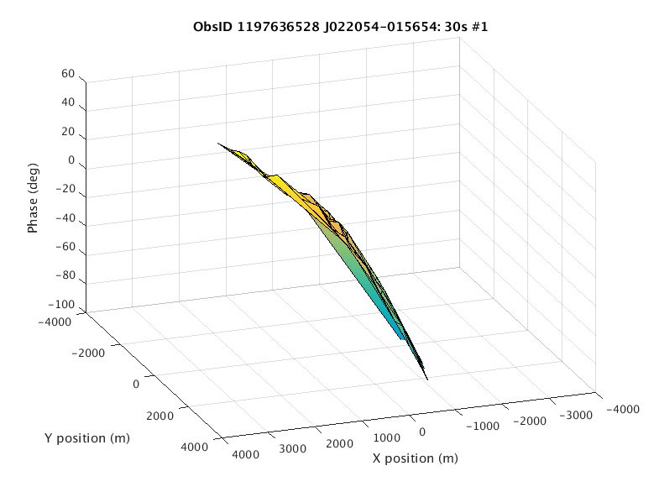
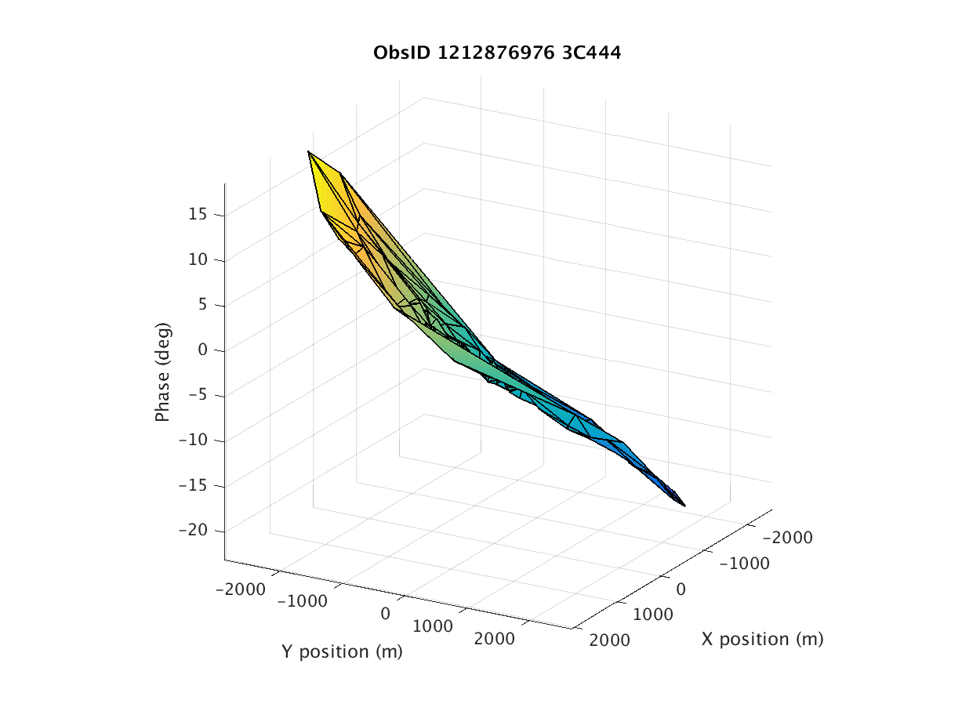



Ionospheric Findings: High Resolution (Small scale) Spatial&Temporal Structure

Slide 10
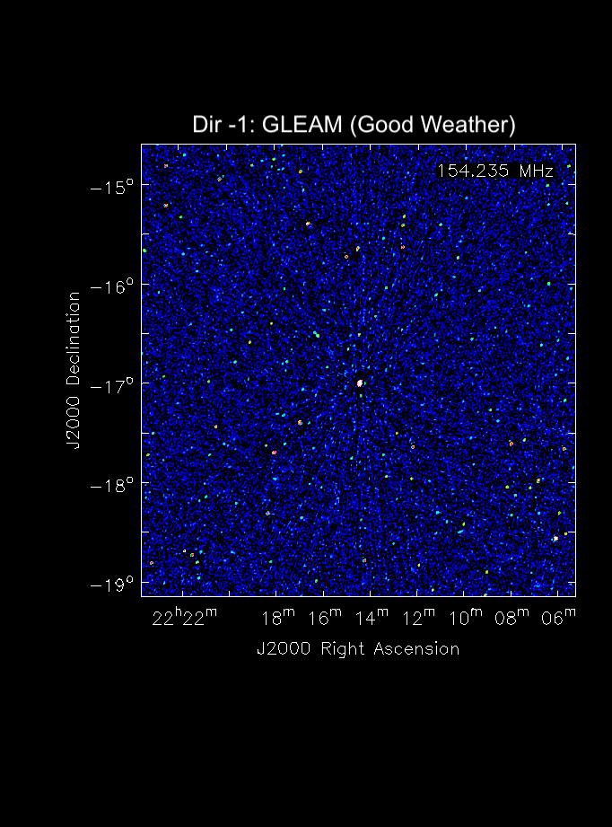
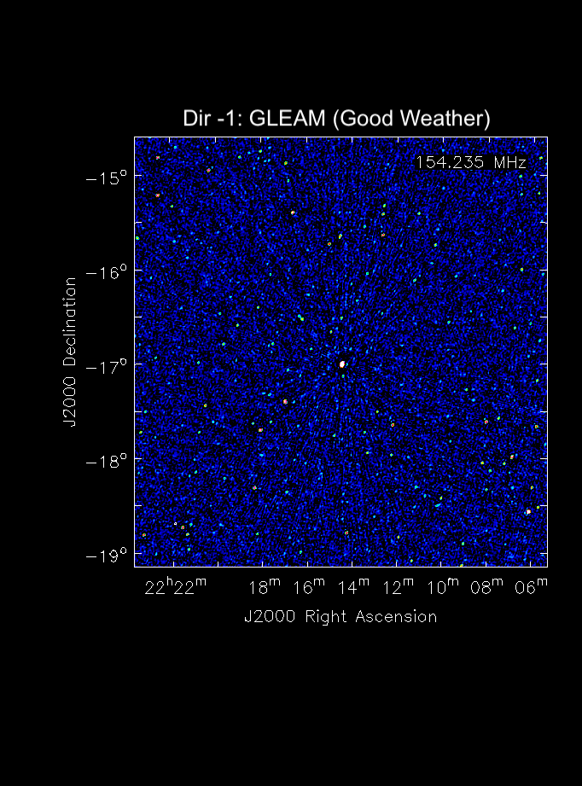
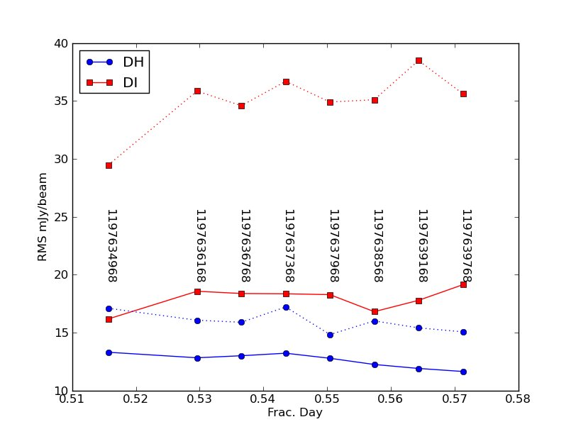
2min MWA@~150 MHz DD images
Dir-1
“Good Weather”
Standard GLEAM Calibration
“Severe weather”
LEAP calibration
“Severe Weather”

Slide 11
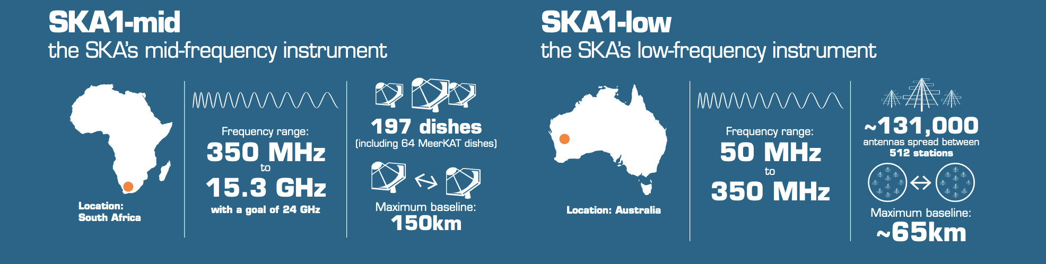

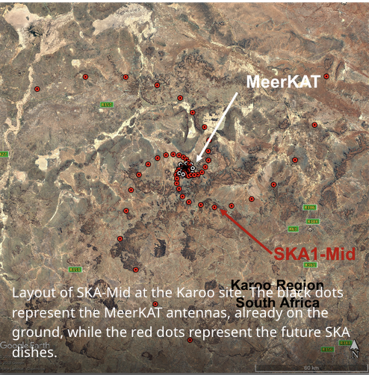
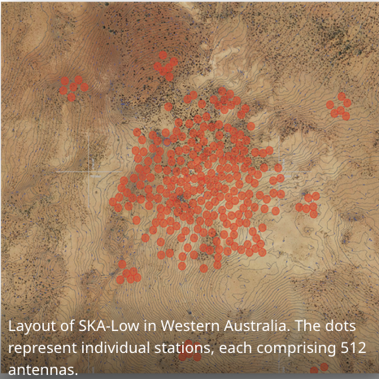
HOW IS THIS RELEVANT TO SKA-VLBI?
SKA: Mid-freq runs from 0.3 to 15GHz. ~200 13m dishes in Phase 1.
SKA: Low-freq runs from 0.05 to 0.3GHz. ~500 35m stations in Phase 1
SKA-MID
SKA-LOW
Moving forwards towards SKA, highlight the relevance of LEAP
Notes:
========
The so called SKA – Low, from 50 to 350 MHz, which will be located in western Australia, consists of more than 100.000 yagi-like antennas arranged in 512 stations spread across a diameter of 65 kilometers. The SKA-Mid, will be located in South Africa, consisting of nearly 200 ~15-m parabolic dishes arranged in a 3-arm spiral configuration within 150 km, for observations from 350 MHz to 15 GHz (and possibly higher).
The SKA telescope improves considerably the angular resolution coverage compared with current radio interferometer arrays and provide between 10-100 times image fidelity of current instruments.
===========
Built in relatively quiet zones
The SKA telescope on its own improves considerably
the angular resolution coverage compared with
current radio interferometer arrays and provide between 10-100 times image fidelity of current instruments.
The SKA will
simultaneously provide multiple VLBI beams on the
sky and interferometric imaging allowing different
angular resolution views of the same field. When
SKA VLBI beams are added to the Global VLBI
network (SKA-VLBI) the resulting instrument achieves
at least milli-arcsecond resolutions. The SKA will also
provide an ultra-sensitive element (micro-Jy noise
level) to the VLBI networks, allowing access to the
Galactic Centre and the Southern Sky. SKA-VLBI will
greatly broaden the science of SKA and many of its
High Priority Science Objectives will benef

Slide 12
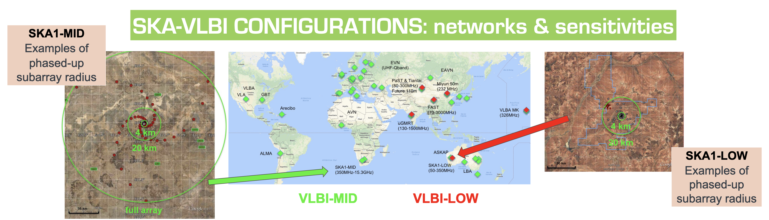
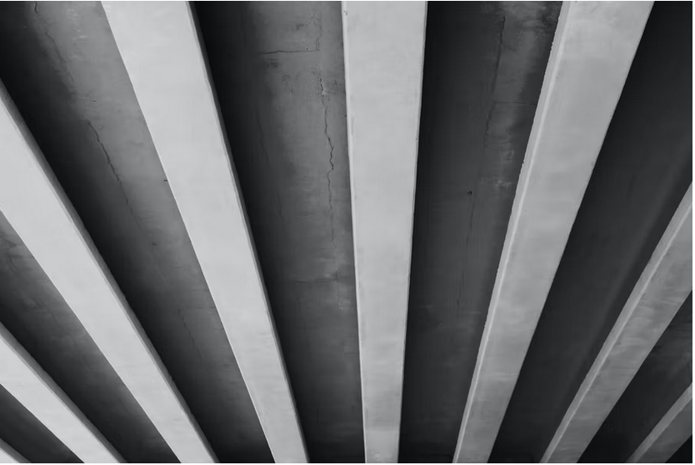
HOW IS THIS RELEVANT TO SKA-VLBI?
Both telescopes are equipped with VLBI capabilities. SKA acts as a single tied-array element.
VLBI with SKA requires a network of partner telescopes.
TECHNOLOGY: Multi Pixel Capability (for MultiView )
Multiple Tied Array Beams (TABs)
Subarray
Introduces DD effects
@300 MHz, SKA-Low, 40m stations, Primary beamwidth ~ 1.4 deg
For VLBI, Tied-Array, eg 10km radius, Tied-Array-Beamwidth ~ 10”
Engineering Change Proposal (PI Cristina Garcia-Miro, Zsolt Paragi +):
Multiple Tied-Array-Beams across the primary beam

Slide 13
Towards SKA:
Real Time DD Calibration for tied-array operations
LEAP, as it does not need a sky-model, can provide a Real Time DD
solution directly from the correlator datastream for the tied-array operations.
SKA (particularly SKA-Low) will need such DD solutions to form tied-array beams for VLBI and/or Pulsar projects.
Informal Inclusion along side YANDA team SKA SDP:
Full inclusion is under discussion
ICRAR-Data Intensive Astronomy (DIA, Australia) developed a Stream-input, Parallel, GPU-based, LEAP calibration application ➔(LEAP-ACCelerator)
Work in Progress:
ALSO could provide a real time monitoring of the ionospheric conditions out of the correlator. I.e. A Real-Time Ionospheric Seeing Monitor
YANDA (ICRAR/CSIRO)
LEAP GPU Version (https://github.com/ICRAR/leap-accelerate)
SKA-Low vs MWA:
SKA instantaneous BW 300 MHz (vs. 30 MHz for MWA); can have longer baselines;
SKA Field-of-view smaller; much higher sensitivity

Slide 14
Current status of LEAP-ACC for SKA project
Requirement:
The SKA correlator outputs must include the sum of the voltages for a pointing direction (tied-array-beam, TAB).
This is for the pulsar and VLBI projects.
It requires the DD atmospheric effects over the array to be removed,
in real time, for any arbitrary line of sight
LONG TERM PROJECT AIMs:
DEMONSTRATE FEASIBILITY OF LEAP FOR SKA Tied Array Beams (TABs) performance i.e. Real Time Direction Dependent CALibration (RCAL-DD)
CHARACTERIZE LEAP-ACC (accelerator) FOR THE ABOVE
PREPARE INTEGRATION INTO SKA PIPELINES (i.e. DALiuGE, & RCAL-DI)

Slide 15
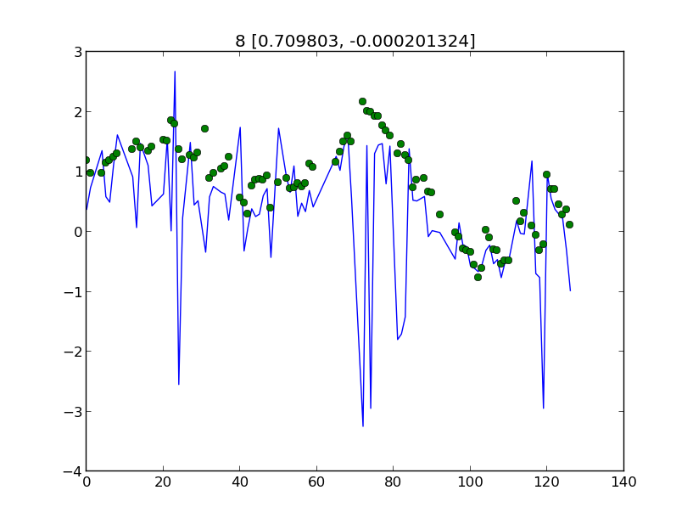
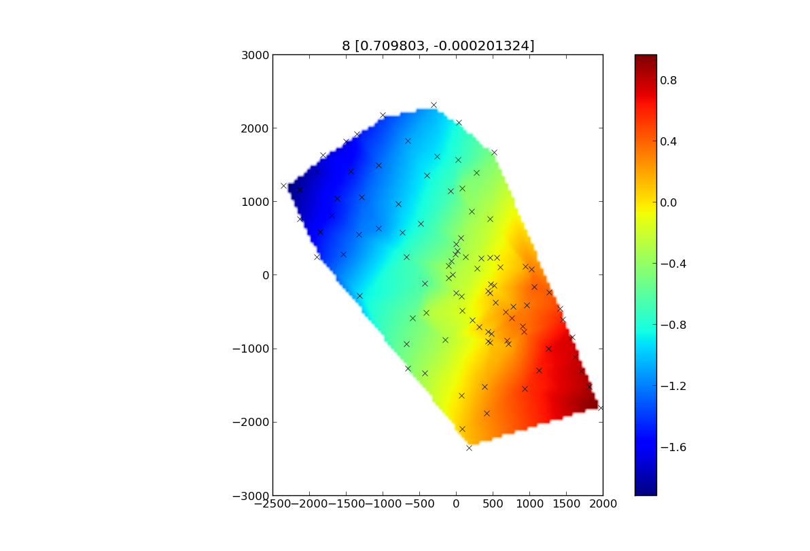
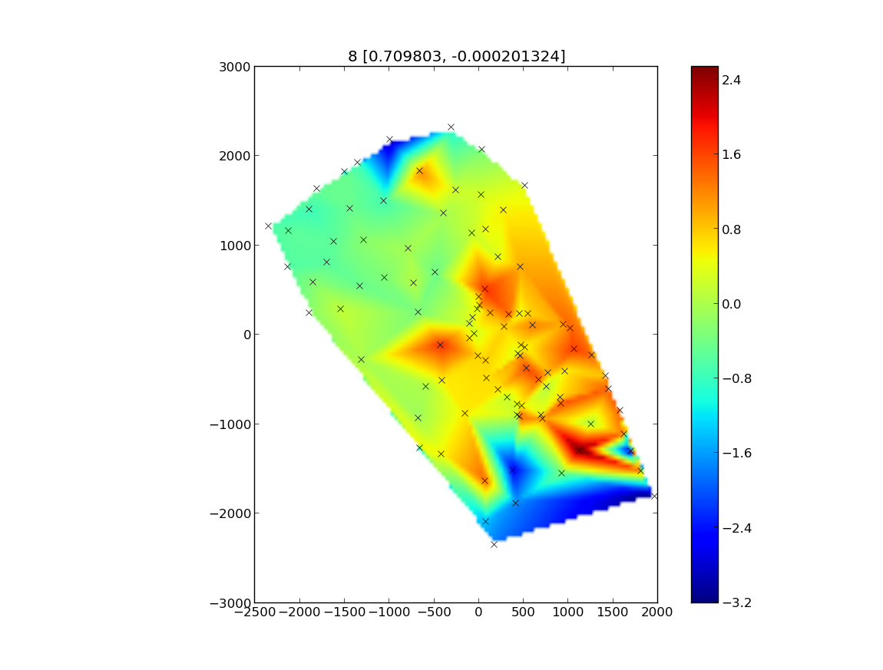
Overview/Timeline/Conclusions
DESIGN PROJECT & COMPARE LEAP-ACC with previous LEAP-CASA using MWA DATA (Sept-Dec 2023)
Conclusions: leap-acc reproduces leap-casa, with a phase slope across the array.
Believe that rotation deficient for MWA data due to reference point. It works for synthetic datasets. Made some changes:
Baseline filtering needs revising. Equipped with many new features as required.
SKA requirements for Tied Array Beam (TAB) are for 95% coherence (2762 says 98%)
Thus, real-time operation is required
Can be steered to anywhere in the HPBW (2939)
My take on SKA requirements adapted to this project:
0) PERFORMANCE OF LEAP-ACC vs. LEAP-CASA
MUST DELIVER THE COHERENCE LOSS REQUIREMENTS FOR SKA-TABS. (ie ACCURATE)
MUST DELIVER THE SPEED PROCESSING REQUIRED FOR SKA-TABs (ie FAST)
MUST PROVIDE PHASE SCREEN SOLUTIONS ACROSS THE WHOLE FoV (ie CALIBRATOR AVAILABILITY)
PHASE CORRECTIONS FOR A SPECIFIC LoS OF TARGET (ie ACCURATE INTERPOLATION)
a plot of the phases (y-axis)
versus antenna number id. (x-axis)

Slide 16

Overview/Timeline/Conclusions
DESIGN PROJECT & COMPARE LEAP-ACC with previous LEAP-CASA using MWA DATA (Sept-Dec 2023)
Conclusions: leap-acc reproduces leap-casa, with a phase slope across the array.
Believe this is due to MWA reference point, as it works with OSKAR datasets. Baseline filtering needs revising.
ACCURATE: 5% LOSS FROM SKY NOISE (OSKAR) (Start Nov 2023; production phase Jan-mid Feb2024)
Conclusions: 20deg phase noise gives 95% flux recovery i.e. follows
Simple Sky works with 100 channels – more complex sky requires 1000 channels and filtering short baselines.
ACCURATE: 5% LOSS FROM IONOSPHERIC SHIFTS (ARatmospy) (Start end Jan 2024; Prod phase mid Feb-April 2024)
With Callan Gray, added 3-D visualisation, screen fitting and statistics reporting to leap-acc
Conclusion: 20km ion. screen working well. Image shifts (and gradients) compatible with typical results
FAST: MUST DELIVER THE SPEED PROCESSING REQUIRED FOR SKA-TABs (Feb 2024)
Conclusions: leap-acc can, on a A100, deliver real time solutions for 1k ch & 200directions.
CALIBRATOR AVAILABILITY: MUST PROVIDE PHASE SCREEN SOLUTIONS ACROSS THE WHOLE FoV (April 2024)
Conclusion: Number of sources in FoV better than 20deg is sufficient for ~1 per sq. Deg.
ACCURATE INTERPOLATION: PHASE CORRECTIONS FOR A SPECIFIC TARGET LoS. (April2024)
Conclusions: Interpolation errors for 1 deg separation is about 2deg/km (for 20km screen)

Slide 17
Simulations Parameter Space – OSKAR
ARRAY:
AA2 Low (#stations 64 ; diam 40m; max baseline ca 7km; very sparse; challenge planar fitting (no fft); Core4 (a filled core. Only limited sims; next phase of project). Primary Beam: with, w/out (without for the toy models)
FREQUENCY:
Bandwidth span: Full 50-350MHz; 3/4th full bw; ½ full bw
# channels/increment/width: 100/3MHz/0.1MHz;
1000/0.3MHz/0.1MHz
That is: effectively full bw coverage & Decimated bw coverage (picket fence)
SKY MODEL (sky noise only)
Customized: Single/multiple source sky model (select RA, DEC);
Real: Complete sky model (i.e. GLEAM sky model or similar)
Toy 1 (offset); gleam fields (gf0,gf1,gf2;gf3,gf4,gf5); pairs; vary source density Toy 40; Toy 25; Toy 81 each 4deg diameter
+ ATMOSPHERE. (Ionosphere only)
ON/OFF; when ON, several weather conditions (r_{o} = 20/10/5km)
(OSKAR BUG: changed station file (new cordinates) to make ion screens usable)
NO THERMAL NOISE
-AA2 can have longer baselines than MWA,
but sparse coverage.
-SKA primary beamwidth smaller than for MWA.
SKA inst. BW 300 MHz
Vs. 30 MHz for MWA
OSKAR: Oxford SKA Radio Telescope Simulator

Slide 18
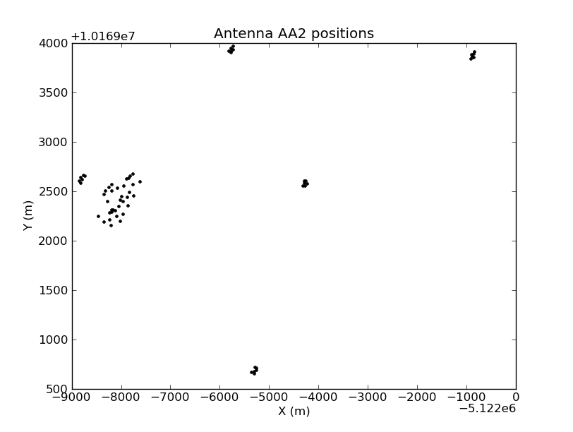
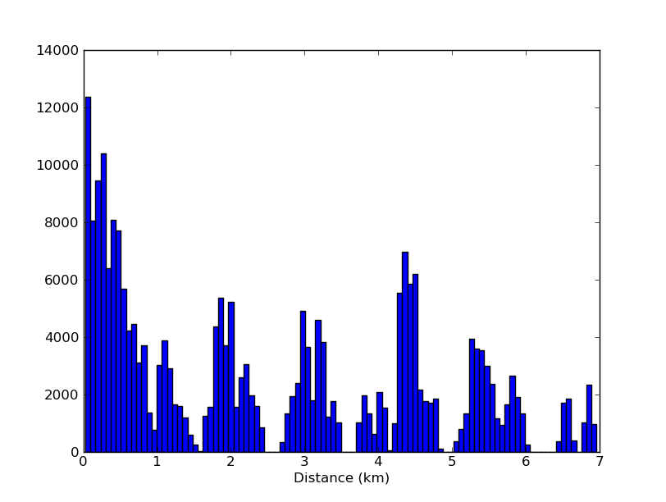
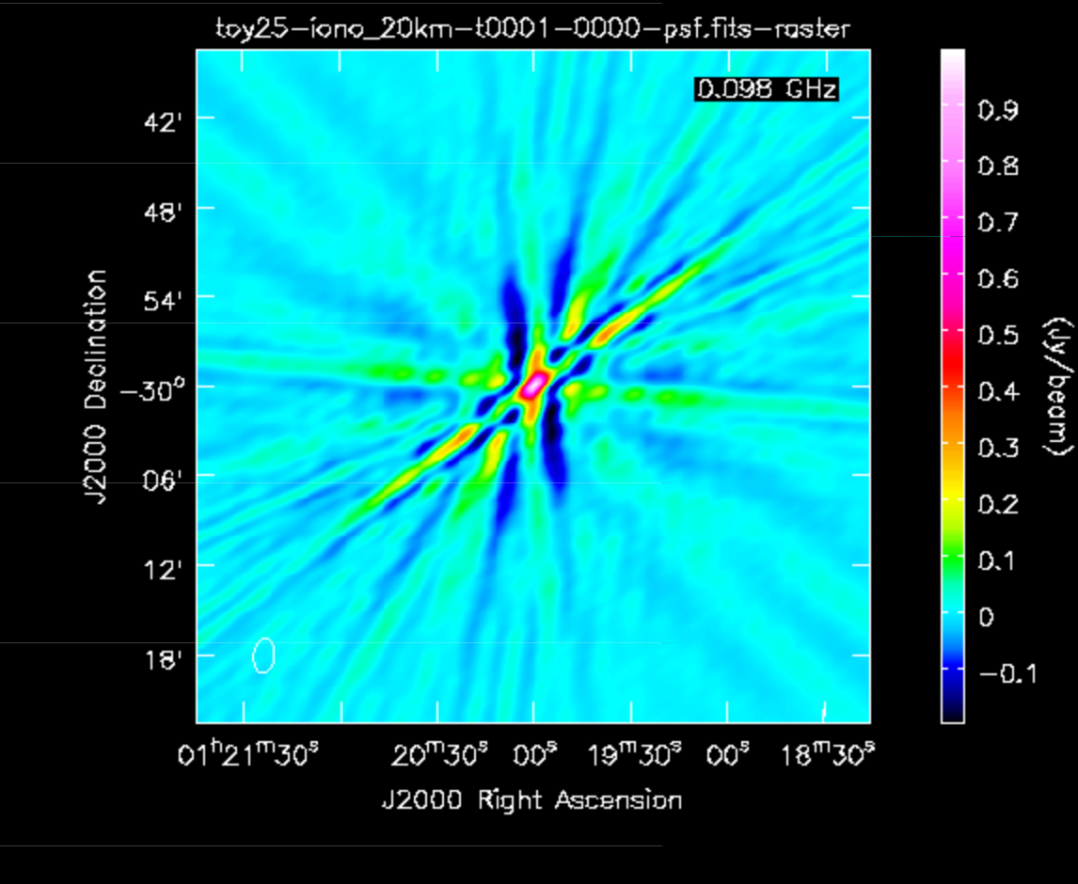
Simulations Parameter Space – OSKAR
ARRAY:
AA2 Low (#stations 64 ; diam 40m; max baseline ca 7km; very sparse; challenge planar fitting (no fft); Core4 (a filled core. Only limited sims; next phase of project). Primary Beam: with, w/out (without for the toy models)
FREQUENCY:
Bandwidth span: Full 50-350MHz; 3/4th full bw; ½ full bw
# channels/increment/width: 100/3MHz/0.1MHz;
1000/0.3MHz/0.1MHz
That is: Full bw coverage & Decimated bw coverage (picket fence)??????
ATMOSPHERE. (Ionosphere only)
ON/OFF; when ON, several weather conditions (r_{o} = 20/10/5km)
(OSKAR BUG: changed station file (new cordinates) to make ion screens usable)
SKY MODEL
Customized: Single/multiple source sky model (select RA, DEC);
Real: Complete sky model (i.e. GLEAM sky model or similar)
Toy 1 (offset); gleam fields (gf0,gf1,gf2;gf3,gf4,gf5); pairs; vary source density Toy 40; Toy 25; Toy 81 each 4deg diameter
NO THERMAL NOISE
UV distribution/Baseline length
Snapshot PSF
XY distribution
Conclusions: Very hard to ensure no wrapping with AA2 – Need filled core

Slide 19
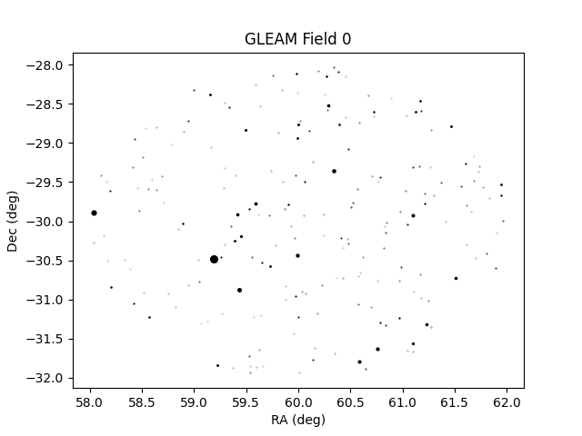
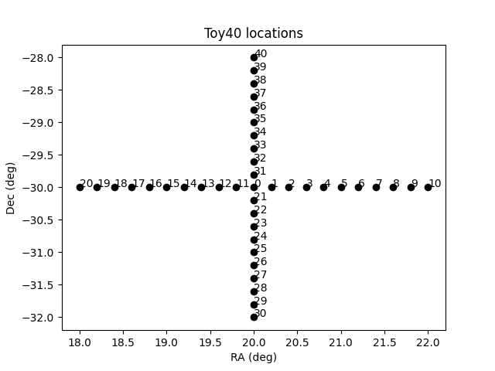
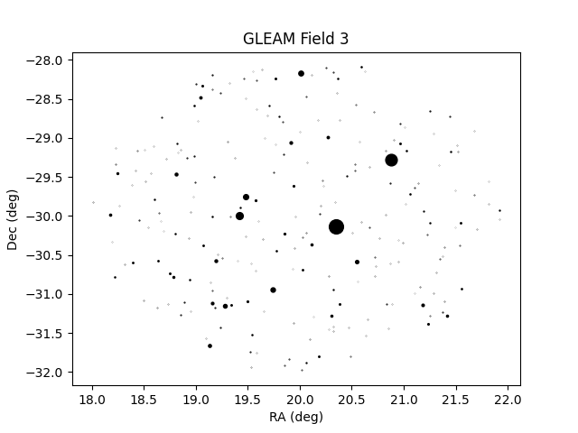
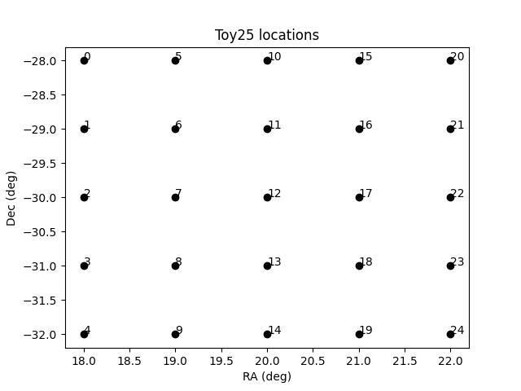
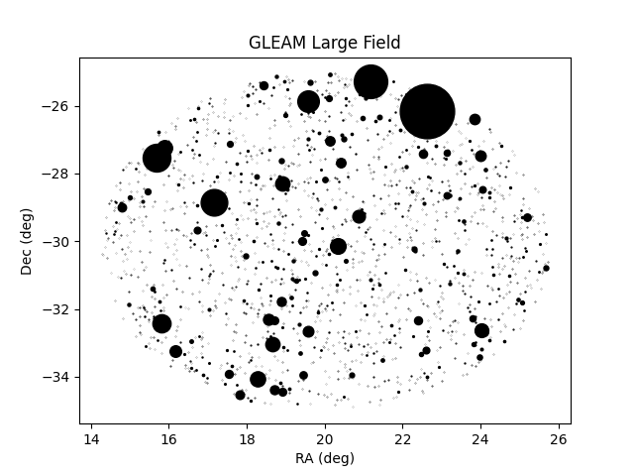
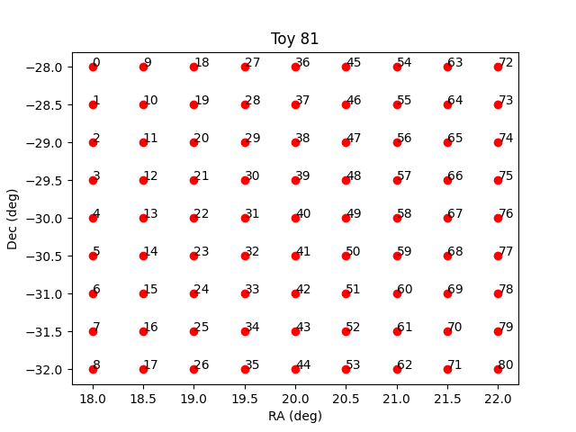
. . . . .
Various sky models used in tests:
Very Simple Models
Toy Models
GLEAM Catalogue
208 sources
0
228 sources
0 0
0 0
0 0 0 0 0
0 0 0 0 0
0 0 0 0 0
0 0 0 0 0
0 0 0 0 0
1600 sources
0 0

Slide 20
Simulations Parameter Space – leap acc
Equipped with new tools:
tools in place to provide values for the complete characterization as we are currently envisaging the scope of the simulation studies.
- CG updated the CLI tool scripts with the easier to implement requests (mid Jan - …)
dumping json calibrations with stats (relevant to sky noise) to csv – (2nd half Jan 2024)
Add Screen fitting and related stats (rms/std) after fitting a plane to the json phase solutions will be important (relevant when we started ionos studies) (mid Feb).
AA2 has poor ground coverage – screen fitting difficult (on-going)
These relevant after leap:
Convert LEAP “*.json” solutions to CASA “cal” files. Conversion to wsclean/IDG calibration pending
Handling data, plotting pipelines, interpolation pipelines
Integrate DI calibration in CASA
Pending Items:
- Rotation for MWA; works fine with synthetic datasets
- Profile values written in csv files
- baseline filtering (still not completely resolved) - external, with CASA
- (resolving) Phase ambiguities
- WSClean calibration files (copy previous code)
Notes:
INCLUDE ORIGINAL TIMELINE as sent to Andreas????? But then the project leads the path…
Timeline, when did this start? June 2023? Until when? Give estimate periods for the different sections.
Sept to Dec 23:
-Design project (Sept)
-Testing of leap acc (Oct-Dec)
-OSKAR (Nov)
%End Jan/ Beg. feb how to characterize FoM (StDev thresholds… for requirements)
Sky noise stats (mid Jan)
Beg February: Playing with Incorporating ionospheric contaminated datasets:
Dealing with ionos screens , rms/std stats after fitting a plane to the json phase solutions will be important.
Ionos start 21 Feb 2024; many challenges (turn ON, alter magnitude (weak,;30;weak,:3; low), reduce bw, try core of AA4…), end of March explore DI with CASA, and start basic again, Toy 1, seems promising, user errors(since March26)… beginning April 11 start again, toy1 (20/10/5km), toy1 offset, 2 source sky model, toy40-NOPB, Toy25 (new), Toy81 (newest), ion “wide” 20km , (april16) studies of ion 10km with toy25 ➔ ion 10km requires DI to bring down residuals (are these due to phase jumps?)/gradients

Slide 21
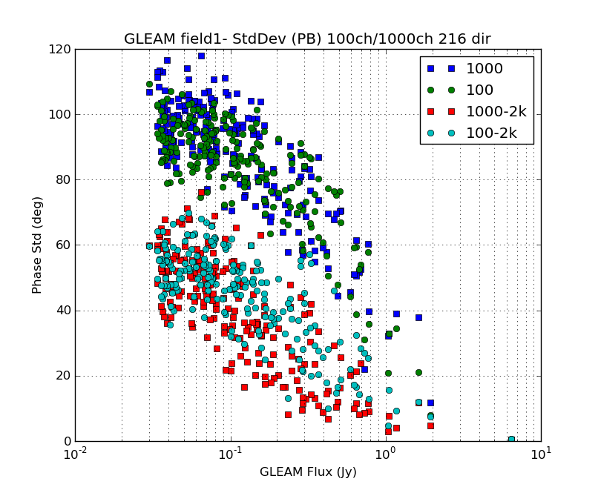
ACCURACY – SKY NOISE
In presence of complex sky
requires 1000 channels
&
Baseline filtering l> 2km
OUR FoM (suitable LEAP calibrators)
StDev w/out ion < 20 deg (to fulfill SKA coherence requirements)
Threshold
Threshold
Conclusions: Simple Sky works with 100 channels – more complex sky requires 1000 channels
and filtering short baselines. Many good LEAP calibrators available.

Slide 22
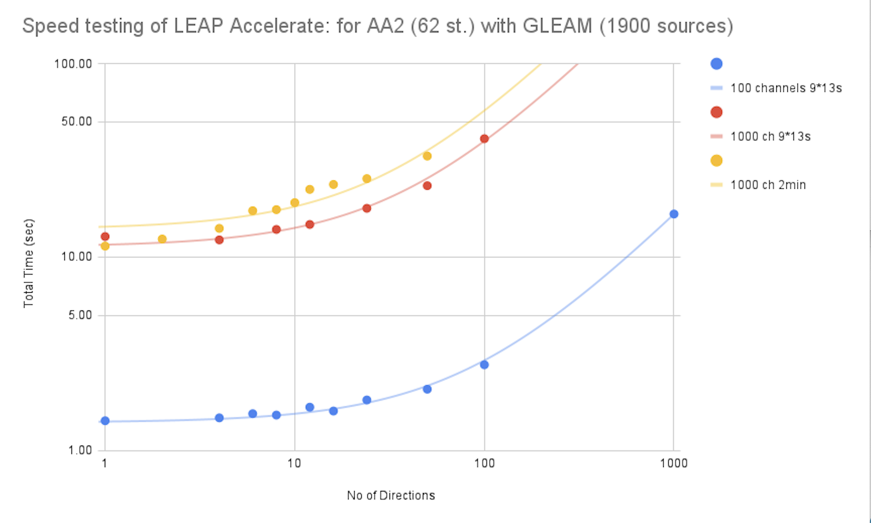
PROCESSING SPEED
Many parallel processes
(i.e. multiple directions)
could be sustained without
loss of performance.
Solving for solution every 13s, 9 times, for 100 and 1000 channels, or solve for 120 sec, once with 1000ch
Conclusion: LEAP-Acc Performance acceptable (very good in fact!)

Slide 23
Analysis Methods in presence of Ionosphere (ION ON):
Range of weather conditions, ionospheric spatial scale: 20km, 10km, 5km
“Leap-only”:
OSKAR *ms => filtered 1k,2k => leap acc => stats*csv plots in CASA (only using python tools)
Preconditioning with DI: (“Iono DI”)
OSKAR *ms => CASA (FFdispersive+GC) ➔ filtered 1k,2k => leap acc => stats*csv plots/interpolation in CASA (python tools)
Add IMAGE domain analysis (very recent)
Developments/pipelines:
- Change station coordinates
-DI dispersive calibration with CASA (trigger CASA updates in comm with developers; tested in extreme regime; on going)
-plotting pipelines
-short baseline editing

Slide 24
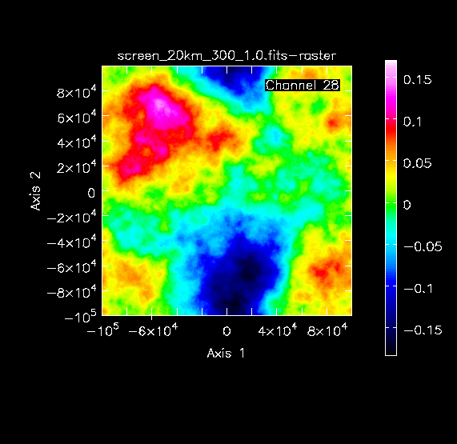
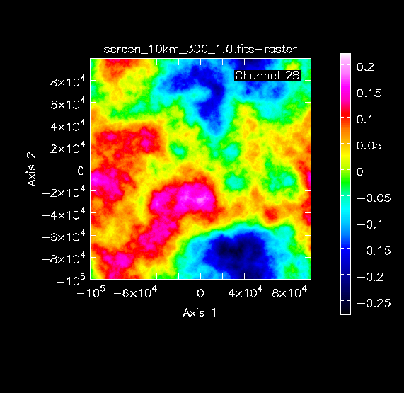
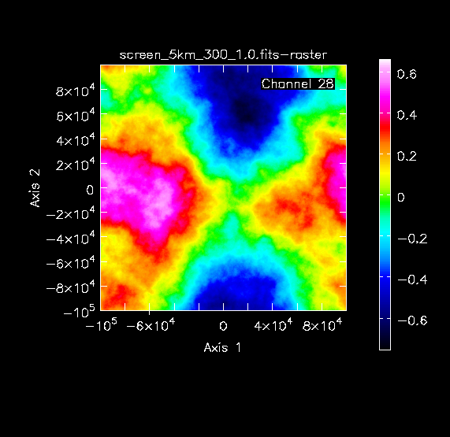
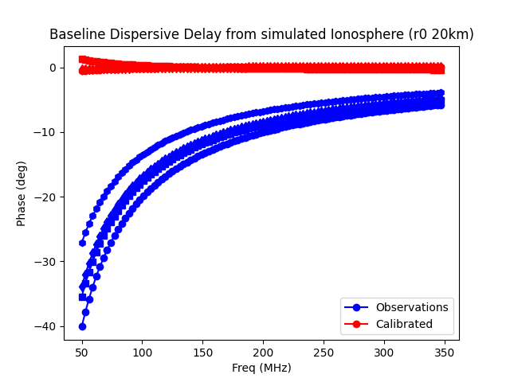
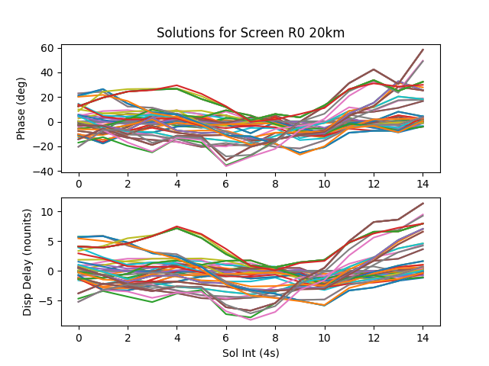


Simulations Parameter Space – ArAtmos.py
Worsening ionospheric weather conditions
R0=20km
R0=10km
R0=5km
1 baseline phase over frequency,
before and after DI calibration
Solutions for 64 stations over 1 minute

Slide 25





Ionospheric Results
SOURCE POSITION SHIFTS (screen gradients)
Toy 25
R₀=20 Km
Toy 25
R₀=5 Km
DEC (deg)
IMPACT OF DD EFFECTS IN TAB FORMATION
Findings: ca pointing errors; correspondence between position shifts/gradients and thresholds for DeltaS/S<5%
OUR FoM (accurate interpolation towards target LoS)
RMSe residual gradient < 2 deg/km (10km tied-array)
RA (deg)
ACCURATE INTERPOLATION: RESIDUALS
5 km ion scale
Toy 25
R₀=10 Km
10 km ion scale
Threshold
20km ion scale
1 cal/deg
16 cal/beam
9 cal/beam
Conclusion: 20km ion. scale working well. Image shifts (and gradients) compatible with typical results

Slide 26

ACCURACY & CALIBRATOR AVAILABILITY – IONOSPHERIC+SKY NOISE
OUR FoM (suitable/number LEAP calibrators)
RMSe with ion+sky noise < 20 deg (to fullfill SKA coherence requirements)
Plenty LEAP calibrators at 20km ion scale
Marginal at 10km
Threshold for SKA requirements
Conclusion: 20km ion. scale working well, compatible with typical weather and many LEAP calibrators

Slide 27

more on “RCAL-DD LEAP” and “RADIOBLOCKS”
Pictorical BUILDING BLOCK Approach
Keywords that resonate with RADIOBLOCKS:
Scalable to SKA, Efficient, Modular,
Can be reused by other facilities etc.

Slide 28
CONCLUSIONS
Work-in-Progress, so far so good!
Matches SKA requirements
NEXT explorations of extended parameter space
Pictorical BUILDING BLOCK approach
PILLARS = BUILDING BLOCKS
Expectations of VLBI/micro-as astrometry
for Next Gen Instruments/era
==.1 microas

Slide 29






CONCLUSIONS
Work-in-Progress, so far so good!
Matches SKA requirements
NEXT explorations of extended parameter space
Pictorical BUILDING BLOCK approach
Calibration & Imaging
METHODS
Engineering
TECHNOLOGY
SENSITIVITY: BW &
COLLECTIVE AREA
PILLARS = BUILDING BLOCKS in
RADIOBLOCKS
Expectations of VLBI/micro-as astrometry
for Next Gen Instruments/era
==.1 microas
Notes:
This is our view on progress, It takes parallel advances in all of the 3 pillars to improve the scientific outcome of next gen instruments.
Now I think of the pillars a building blocks in Radioblocks.

Slide 30
END

Slide 31



LONGER BASELINES IMPROVE EFFECTIVENESS OF DIRECTIONAL FILTER
(due to increased attenuation of smeared background sources)
MWA Phase I vs. Phase II
MWA Phase 1
Strong Source
MWA Phase 2
Phase (deg)
RMS α S_{b} / S_{cal}
3 km
LONGER BASELINES RESULT IN:
Increased efficency of directional filter
Better DD calibration and for more directions (weaker cal. ok)
Precise reconstruction of fine scale ionospheric structure
3 km
X (Km)
Y (Km)
Source Flux Density (Jy)
> 2 Jy
10
10
RMS error of planar fit (deg)
RMS error of planar fit (deg)
Gain solutions get noisier very fast with decreasing flux
Notes:
Longer baselines, both enable and require “full calibration”
This is related to the improved effectiveness of the directional filter resulting from the longer baselines, which results in a better calibration (more precise ionospheric screens) and more calibrators.
For MWA Phase 1, for strong sources, the ionospheric screen is precisely defined, with a small RMS error of planar fit,
But the gain solutions get noisier very fast with decreasing flux, because the relative effect of the background sources is
Increasingly significant as the calibrator flux decreases.
A 2 Jy calibrator has a 1 radian rms error.
Instead, for MWA 2 for the same range of fluxes the RMS error is only 10 deg.
=======================================
The effect of longER baselines in the effectiveness of directional filter.
%A good directional filter is fundamental for the performance of LEAP.
A perfect filter (only the calibrator remains in the freq averaged image) would result in a perfect plane; remaining smeared structure manifest as noise added to the plane.
We can measure that noise as the rms error of a planar fit.
Gain solutions get noisier very fast with decreasing flux... Because the relative effect of the background sources is increasingly significant as the calibrator flux decreases.
A 2 Jy calibrator has a 1 radian rms error and invalidated for “full calibration”. (weak source issue with full calibration)
This is the equivalent for MWA Phase 2 observations.
The longer baselines result in stronger smearing, remaining structures lower level and the directional filter works much better, for many more weaker calibrators.
THE LONGER BASELINES ENABLE/IMPROVE THE EFFECTIVENESS OF THE DIRECTIONAL FILTER
Longer baselines Improve directional filter efficiency, by suppressing background of smeared sources! Which results in:
better calibration
b) more precise reconstruction of fine scale ionospheric distortions above the array
MWA 1… small array, planar distortions above array dominant
2 SNR requirements for LEAP calibrators:
Assess the performance and SNR threshold.
Display plotcal/surface plots? (Association)
Compare mwa 1 and 2 plotcal plots
Longer baselines
Improve directional filter efficiency! Which results in:
better calibration
b) more precise reconstruction of fine scale ionospheric distortions

