Slide 1
OBELICS Task 3.4.2
14-16 Sep 2016
OBELICS meeting / Madrid
1

Slide 2
T3.4.2 tasks
Authorisation, Authentication and Accounting:
analyse existing requirements and protocols
propose and integrate, as required, a global infrastructure using agreed-upon standards
Analyse and integrate Workflow architectures for the orchestration of compute-intensive data analysis on distributed computing infrastructures
Liaison and coordination with ASTERICS WP4 (DADI)
14-16 Sep 2016
OBELICS meeting / Madrid
2

Slide 3
T3.4.2 status at M12
A&A and Workflow tools included within deliverable D3.4 (initial Software Libraries) https://www.asterics2020.eu/dokuwiki/doku.php?id=open:wp3:d-ana_software_repository
Freely available from ASTERICS Wiki
Set of pointers to distributions
Could be of use within ASTERICS (in OBELICS, but also across WPs: of interest for DADI and probably CLEOPATRA)
14-16 Sep 2016
OBELICS meeting / Madrid
3

Slide 7
INAF participation in
OBELICS T3.4.2
26-27 Jan 2016
INAF Team - OBELICS meeting / Rome
7

Slide 8
INAF tasks in T3.4.2
Authorisation, Authentication and Accounting:
analyse existing requirements and protocols
propose and integrate, as required, a global infrastructure using agreed-upon standards
Analyse and integrate Workflow architectures for the orchestration of compute-intensive data analysis on distributed computing infrastructures
Liaison and coordination with ASTERICS WP4 (DADI)
26-27 Jan 2016
INAF Team - OBELICS meeting / Rome
8

Slide 9
INAF T3.4.2 team
Contributed INAF staff (40 person-months):
F. Pasian (OATs/IVOA/Euclid): coordination
A. Costa (OACt/CTA): A&A
M. Frailis (OATs/Euclid): workflows
C. Knapic (OATs/SKA): A&A
G. Taffoni (OATs/IVOA/EGI): A&A, workflows
Hired (28 person-months):
July 2016: M. Molinaro (OATs/IVOA): coordination with DADI
Oct 2016: A. Bignamini (OATs/Indigo-DataCloud): A&A/workflows
1 additional person to be hired:
18 person-months on A&A-workflows integration (from summer 2017)
26-27 Jan 2016
INAF Team - OBELICS meeting / Rome
9

Slide 10
Background/Collaborations
IVOA 2002 F.Pasian, G.Taffoni, M.Molinaro
CTA 2012 A.Costa
SKA 2013 C.Knapic
Euclid 2007 F.Pasian, M.Frailis
IA2 2008 C.Knapic, M.Molinaro, A.Bignamini
EGI A&A 2003 G.Taffoni
SciBus 2011 A.Costa
Erflow 2013 A.Costa, G.Taffoni
StarNET 2013 A.Costa, G.Taffoni, C.Knapic
Indigo-DataCloud 2015 C.Knapic, A.Bignamini
AARC2 2016 A.Costa, (C.Knapic)
INAF Team - OBELICS meeting / Rome
10

Slide 11
CTA A&A Use Case Collection
Guest Observer
ACTOR Definition
Human
NAME, ROLE, DESCRIPTION
System
NAME, DESCRIPTION, Sub-System
Principal Investigator
Observer
Archive User
etc…...
PHS
DDS
DPS
RTA
AS
Notes:
Observer, Guest Observer, CTA Consortium Observer, Archive User, Principal Investigator, Virtual Observatory User…..
Proposal Handling System (PHS), Data Processing System (DPS), Data Dissemination System (DDS), Archiving System (AS), Real time analysis (RTA) software…..

Slide 12
CTA A&A Use Case Collection
Use Case Collection identified as:
Constraints on a system solution
Representative set of activity sequences corresponding to constraints and Scenarios
use cases are are used to analyse the operation of the system in its intended environment in order to identify requirements that may not have been yet formally specified.

Slide 13
CTA A&A Use Case Collection
Some of the defined Use Cases
Authenticate an already registered CTA Consortium user
Authenticate a user based on his institute/laboratory account
Lost password management
User with a local A&A login/password must be able to ask for a new password in case of lost password
Group creation
A&A Administrator or DATA Applications must be able to create a group, associate roles and define group owner(s) (ex : ProposalId group -> data access right)
Group management
A group owner is able to manage his group from a central A&A management system or from specific DATA applications integrated or not in the Gateway: invite users, remove users, account expiration dates,...

Slide 14
CTA A&A User Requirement Specification
User Requirement are grouped in the following Classes:
Authentication Capabilities
Authorization Capabilities
Management Capabilities
Availability
Performance
Security
Portability

Slide 15
SKA A&A Use Cases + Requirements
Use Case: Enterprise solution for user access to resources and zones (buildings, restricted areas etc..) ;
High level requirement: under re-definition for including also new specific use cases;
Prototype status: SAML based user authentication plus use of MySQL for group management;
Integrated with federations (EduGain);
No precursors. INAF/IA2 + IRA experience.

Slide 16
Investigated Technologies
Authentication (external)
Shibboleth
OpGoogle
X509 certificates
enID Connect
Integration with VO directives
A&A
VOSpace
Obs Core
Deliverable D3.2 released
Investigation of existing A&A systems.
Specifically evaluated technologies (not tools!)
Authorization (internal)
Grouper
GMS
Custom DB (MySQL)

Slide 17
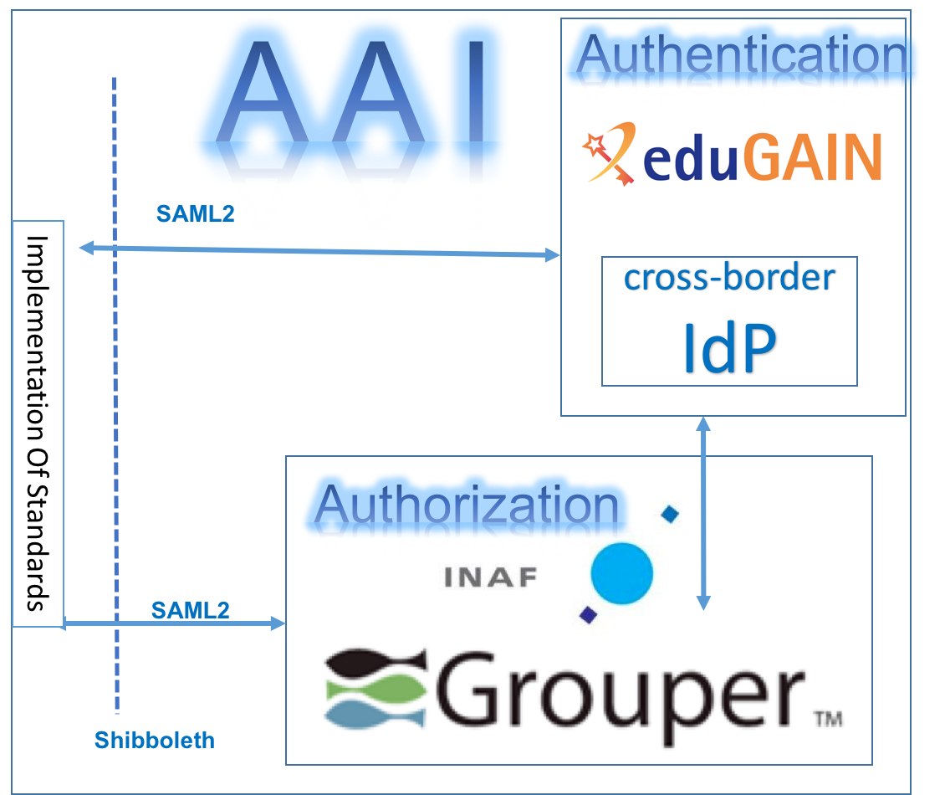
CTA AAI Prototype

Slide 18
CTA Workflow Management System Prototype

Slide 19
AARC2
Duration: 24 MM starting in 2017
Project coordinator – GÉANT
Partners – 26 which cover e-Infrastructures, research infrastructures, libraries, NRENs and SMEs.
RI: ELIXIR, BBMRI-ERIC, DARIAH….
e-infra: GEANT, EGI, PRACE and EUDAT
User Driven approach

Slide 20
AARC2: The CTA Pilot
AARC2 will move towards the implementation of its vision by working with different research communities.
supporting them to deploy federated access
map their requirements to existing (AAI)services and policy frameworks
CTA A&A is a funded pilot
AARC2 Community Engagement forum
Results Validation by getting feedback from the research communities

Slide 21
Future roadmap
WORKING!!
Exploitation in the European and international big infrastructures and projects (EGI ←→ CANFAR/CADC, CTA & SKA prototypes)
Fluency of the integration in existing technologies and standards;
Suitable maintainance plans availability for existing tools and solutions;
Long term support;
Retrocompatibility.
Deliverables from other H2020 projects (INDIGO-Data Cloud, AARC, EGI-Engage)
Studies of proposed technologes and tools;
Availability and resilience;
Long term support for integration tools;
Integrability with existing solution proposed by projects.
Will they properly and easily work??

Slide 22
Involvement
Evaluation of integrability:
Basic technologies:
OAuth 2.0
OpenIDConnect
SAML
Techonology integration tests
Integration between A&A and :
Workflows;
Computing;
Storage systems;
Archives (long term preservation).
Do we have resources (i.e. personnel) for that?
Is it important for the project goals?
Current integration tools:
Unity ; INDIGO IAM; EGI AAI
Already started in some specific cases
(e.g. CTA, EGI-CANFAR, …)

Slide 23
Workflows: work already done
Teach-watching of existing A&A systems.
Specifically evaluated Workflows Management Systems and “languages”
Provided a repository with the WMS commonly used by scientific communities
TAVERNA
KEPLER
PEGASUS
More on the repository….

Slide 24
Future work
Exploitation in the European and international big infrastructures and projects (EGI, ErFlow, Workflow4ever, IVOA, CTA & SKA prototypes)
Suitable maintenance plans availability for existing tools and solutions;
Long term support;
Retro-compatibility.
Integration testing with A&A
Part of a wider
integration work ?

