Slide 1
INFN for OBELICS
INFN in OBELICS
KM3NeT INFN groups
Interested in tasks related to neutrino astronomy/astrophysics
Interested in multimessenger analysis
Mission of the KM3NeT Collaboration: reveal neutrinos through the Cherenkov light of neutrino interaction products in (Mediterranean) sea water
Low-energy research programme (ORCA) focusing on neutrino mass hierarchy
High-energy research programme (ARCA) focusing on IceCube diffuse neutrino flux and observation of astrophysical neutrino sources
KM3NeT is already taking data with 2 Detection Units, more will follow soon
CNAF group
Data management at PB-scale
Benchmark of low-consumption computing technology

Slide 2
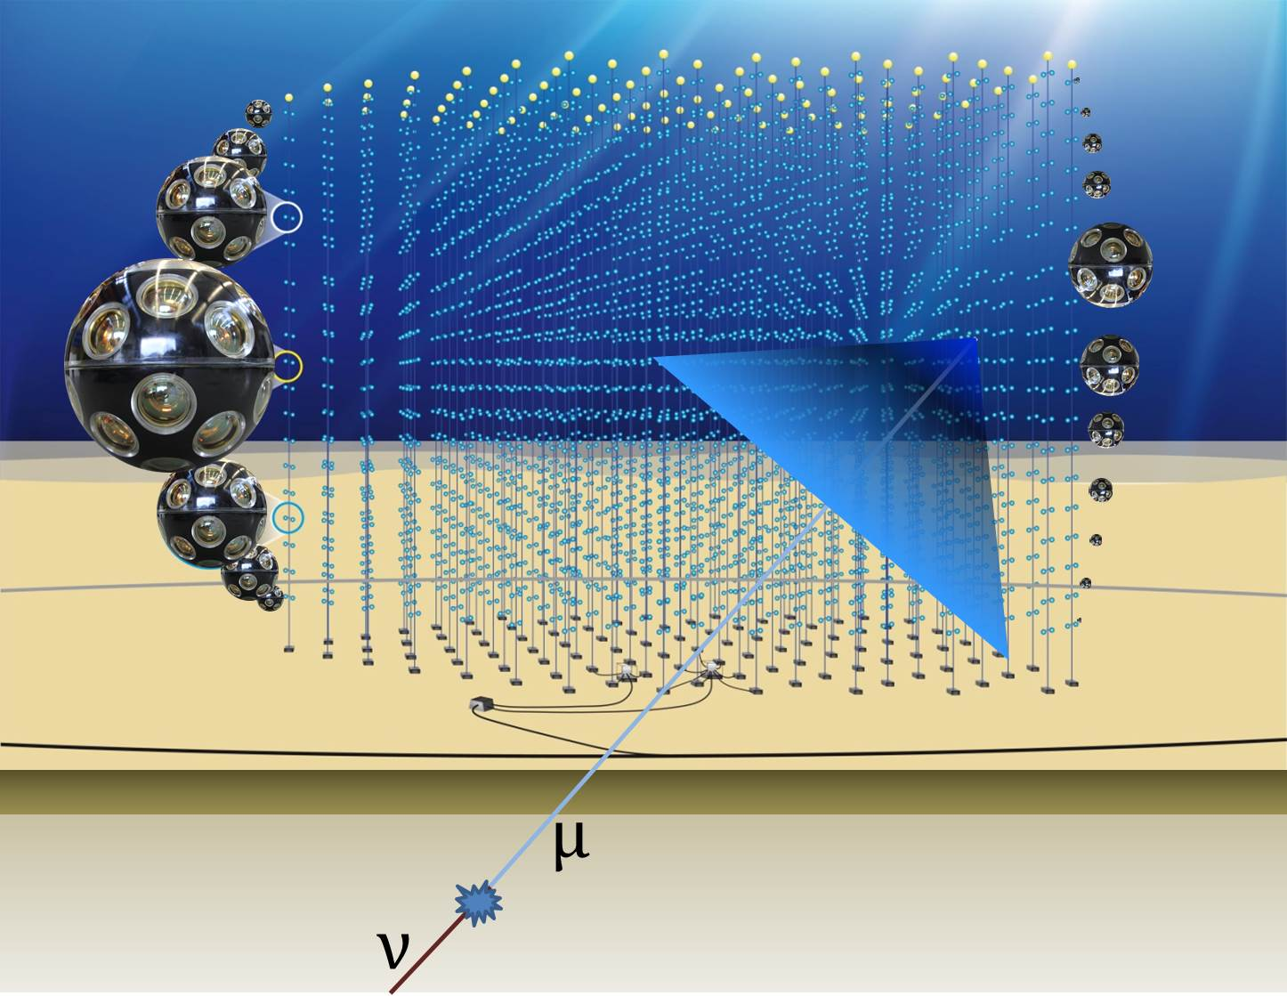
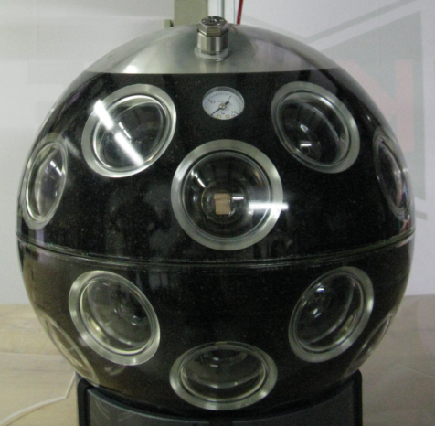
INFN for OBELICS
INFN in OBELICS
KM3NeT

Slide 3
INFN for OBELICS
Persons and activities
FTE’s: involved (EU-funded)
 | Years | Task 3.2 | Task 3.3 | CORELib (3.4) | ROAst (3.4) | pLISA (3.4)
Cristiano Bozza | 4 |  |  |  | 0.1 (0) | 0.1 (0)
Agnese Martini | 3 |  |  | 0.2 (0.2)
Rosa Coniglione | 3 |  |  | 0.2 (0.2)
Tommaso Chiarusi | 1 |  |  | 0.2 (0.2)
Bernardino Spisso | 2 |  |  | 0.5 (0) | 0.5 (0)
Carmelo Pellegrino | 1 |  |  | 1 (0)
Giulia De Bonis | 1 |  |  |  |  | 1 (0)
X1 Y1 (CNAF) | 1 | 0.4 (0.4) | 0.4 (0.4)
X2 Y2 (CNAF) | 1 | 0.1 (0.1) | 0.1 (0.1)

Slide 4
INFN for OBELICS 3.4
Activities in WP 3.4 (1/3)
CORELib: COsmic Ray Event Library
Background to many experiments
Also a tuning benchmark
Potentially useful to other communities
Currently using CORSIKA as generator
Producing and bookkeeping simulated data
- system built on top of GRID-CORSIKA
C++ library for read-out almost completed:
- the API is deﬁned (on the paper sheet/white board)
- on-the-ﬂy conversion to ANTARES evt format (ASCII)
- allows direct reading of compressed ﬁles; supported formats: bzip2 & gzip

Slide 5
INFN for OBELICS 3.4
Activities in WP 3.4 (1/3)
CORELib: COsmic Ray Event Library
Status of production
Proton-induced showers:
- HEMODELS: QGSJET01 with CHARM, QGSJET01 with TAULEP, QGSJET-II with TAULEP, EPOSLHC with TAULEP
- LEMODEL: GHEISHA
- about 21M Evts per HEMODEL
- 7 energy bins (2×10²GeV-10³GeV+equally logarithmically spaced from 1TeV to 10⁹GeV)
- power-law spectrum with -2 spectral index
- zenith angle from 0 to 89 degrees
Production available on many «private» institutional servers:
Pandora @ INFN IRODS @ CCIN2P3 Wiki @ KM3NeT
+ https://www.asterics2020.eu/dokuwiki/doku.php?id=open:wp3:d-ana_software_repository&s[]=corelib
Problem: how to make many TB available for Open Access? EUDAT B2xxx services seem viable, discussion needed

Slide 6
INFN for OBELICS 3.4
Activities in WP 3.4 (1/3)
CORELib: COsmic Ray Event Library
Status of production
Nuclei-induced showers:
- HEMODELS: QGSJET01 with CHARM, QGSJET01 with TAULEP, QGSJET-II with TAULEP, EPOS-LHC with TAULEP
- LEMODEL: GHEISHA
- about 21M Evts per HEMODEL
- 7 energy bins (A×2×10²GeV-A×10³GeV+equally logarithmically spaced from A×1TeV to A×10⁹GeV)
- power-law spectrum with -2 spectral index
- zenith angle from 0 to 89 degrees
Completed jobs:
- Iron 56: 141 jobs for a total 61.543.462 events
- Helium 4: 196 jobs for a total 82.916.671 events

Slide 7
INFN for OBELICS 3.4
Activities in WP 3.4 (1/3)
CORELib: COsmic Ray Event Library
Next future
Complete the CORELib C++ library
Complete the production of Helium, Carbon, Oxygen & Iron primaries.
New production adding Cherenkov radiation (estimated: 400% CPU time increase!)
Make data «more easily» available on the Web

Slide 8
INFN for OBELICS 3.4
Activities in WP 3.4 (2/3)
ROAst: ROot extension for Astronomy
Classes to access astronomical catalogues
Generators of primary particles (neutrinos will be implemented, others will be supported only as placeholders)
Status
Survey of ROOT completed
First activity: GENHEN (GENerator for HE Neutrinos)
Next (in parallel): Survey of catalogues and access techniques
Next (in parallel): Survey of FITS
Next (in parallel): decide between C++11 and C++14
Tentative time schedule: 3 months for first GENHEN implementation

Slide 9
INFN for OBELICS 3.4
Activities in WP 3.4 (3/3)
pLISA: parallel Library for Identification and Study of Astroparticles
Generic interface for machine learning and MVA-based study/id of events
Optimized GPU code to run “under-the-hood” to implement algorithms
Goal: allow generic detectors and easy user extension to library
Status
-Survey of CUDA C for the implementation of GPU code
-First activity: "backbone" of the header file
-Next (in parallel): Survey of existing MVA software tools (TMVA/ROOT)
-Next (in parallel): Survey of existing codes exploiting MVA/neural networks/machine learning algorithms in ANTARES/KM3NeT
-Next (in parallel): focus on the energy estimator (regression problem) → produce a first list of input parameters
pLISA presented at RICAP16 (Frascati, 21-24 June 2016). Poster contribution, to be included in the Conference Proceedings.

Slide 10
ECAP for OBELICS
ECAP in OBELICS – on behalf of Kay Graf (ECAP)
FAU/ECAP is highly involved in Computing and Software in KM3NeT, e.g.
simulations coordinator
computing and software coordinator
physics and software coordinator are at the institution
Therefore the interest of the group is on:
Common data formats → multi-messenger approach
data challenges (peta-scale databases, data distribution and management)
Common computing challenges of the ESFRI projects → e-Infrastructure commons

