Slide 1
KM3NeT e-Needs
Kay Graf – ECAP
OBELIX F2F Meeting – Madrid – Sept. 2016
Presented by C. Bozza (INFN)

Slide 2
What is KM3NeT?
deep-sea research infrastructure in the Mediterranean Sea
includes
ARCA: large telescope for neutrino astronomy/astrophysics ⇒ exceeds existing telescopes by substantial factor in sensitivity
ORCA: dense detector for neutrino physics ⇒ first measurement of neutrino mass hierarchy
provides node for earth and marine sciences

Slide 3
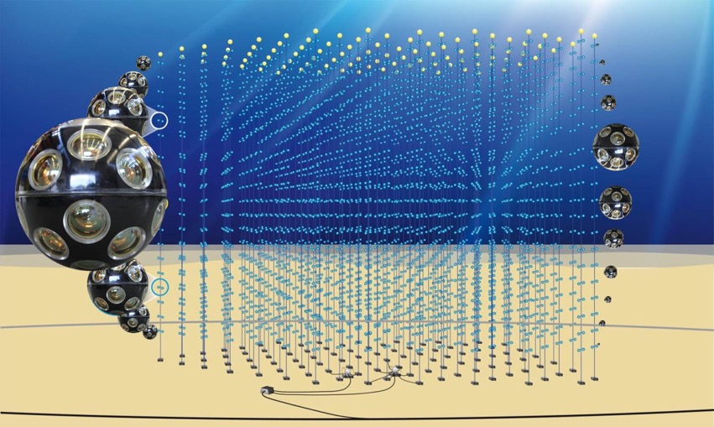
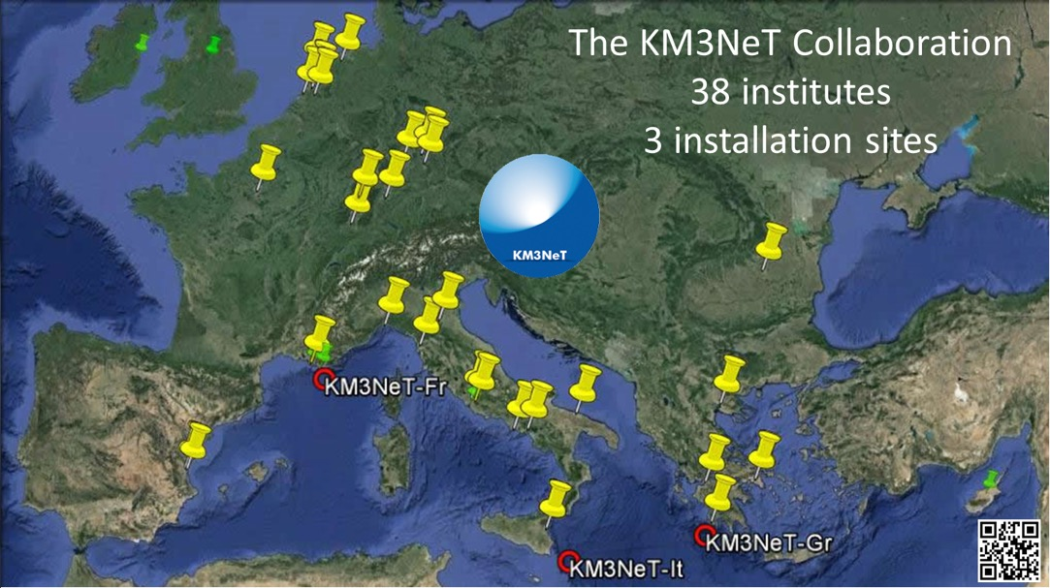
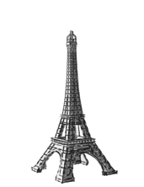
Detector and Collaboration
European collaboration
3 installation sites
starting installation of first phase
artist’s view
ANTARES

Slide 4
Status and Stages of the Project
Phase-1 now
transition from consortium to collaboration
acquired funds for 0.2 building blocks
started construction
start science (size = 3 x precursor experiment ANTARES)
2.0 next
science capitalisation
funding requests on-going for 3 building blocks
3 future
possible expansion

Slide 5
Computing Model and Data Management: General Scheme
Tier-like structure, mixed access: GRID + direct (batch)
Data transfer between the computing centers based on GRID access tools (where applicable)
Central services funded through CNRS and INFN, additional services by the collaboration institutes
Tier | Computing Facility | Processing steps | Access
Tier-0 | at detector site | triggering, online-calibration, quasi-online reconstruction | direct access, direct processing
Tier-1 | computing centres | calibration and reconstruction, simulation | direct access, batch processing and/or grid access
Tier-2 | local computing clusters | simulation and analysis | varying

Slide 6
KM3NeT Preliminary

Slide 7
Data Management Plan
Data formats and meta-data following common practise (root, xml, ascii) → allow for integration in eCommons
use of existing eCommons (e.g. from ANTARES) and specific development via ASTERICS
contacts with e.g. EGI, GÉANT, GARR, RENATER, surfNET
Data storage:
essential: reproducibility and usability of all scientific results over full time of experiment (+ 10 years after shut-down)
parallel storage of low- and high-level data at CC-Lyon and CNAF (long-term commitments, pledged resources)
central services like software repository, central software builds
additional resources available (e.g. 500TB HDD disk space at ReCaS via INFN)
Data processing by specialized service group
Data access: via WAN/GRID access tools (iRODS and gridFTP)

Slide 8
Open Data Policy
central goal: prompt dissemination of scientific results, new methods and implementations
public access
summary data (event information plus quality information) after fixed latency (typically 2 years)
defined in MoU
web based downloads of data and software
on request
more (detailed) data, earlier releases, etc.
observer in KM3NeT collaboration (free of charge)
access to all data, meetings, etc. (but no voting rights)
co-author if he/she contributed to publication

Slide 9
eCommons in Neutrino Astronomy
Integration of IceCube data?
Yes, under umbrella of
joint publications
1st ANTARES/IceCube paper to be published
book on neutrino astronomy in preparation (World Scientific)
exchange of sky maps
exchange of detector performance data
discussions on costs
collaboration between working groups from both experiments (including yearly workshop – MANTS)
Integration of data from other neutrino experiments?
published data
neutrino oscillation data (values + uncertainties) used in combined fits
example Memoranda of Understandings of ANTARES
real-time alerts (e.g. TaToo)
pipe-lined data streams (e.g. Virgo)

Slide 10
Summary
KM3NeT currently in Phase-1
Data management plan and computing model established ⇒ sustainable also for the next project phases
KM3NeT collaboration
actively uses eCommons (taken over from ANTARES and other experiments)
contributes to their further development
Discussion, feedback and advice is always welcome!

Slide 11
Backup Slides

Slide 12
Computing Needs for Phase 1 (per year)
processing stage | size per proc. (TB) | time per proc. (HS06.h) | size per year (TB) | time per year (HS06.h) | periodicity (per year)
Raw Data
Raw Filtered Data | 85 | - | 85 | - | 1
Monitoring and Minimum Bias Data | 43 | - | 43 | - | 1
Experimental Data Processing
Calibration (incl. Raw Data) | 213 | 3 M | 425 | 6 M | 2
Reconstructed Data | 43 | 15 M | 85 | 31 M | 2
DST | 21 | 4 M | 43 | 8 M | 2
Simulation Data Processing
Air showers | 10 | 14 M | 10 | 14 M | 1
atm. Muons | 5 | 1 M | 5 | 1 M | 1
neutrinos | 2 | 22 k | 20 | 220 k | 10
total: | 208 | 37 M | 290 | 60 M
KM3NeT Preliminary

Slide 13
Computing Needs for 1 Building Block (per year)
processing stage | size per proc. (TB) | time per proc. (HS06.h) | size per year (TB) | time per year (HS06.h) | periodicity (per year)
Raw Data
Raw Filtered Data | 300 | - | 300 | - | 1
Monitoring and Minimum Bias Data | 150 | - | 150 | - | 1
Experimental Data Processing
Calibration (incl. Raw Data) | 750 | 24 M | 1500 | 48 M | 2
Reconstructed Data | 150 | 119 M | 300 | 238 M | 2
DST | 75 | 30 M | 150 | 60 M | 2
Simulation Data Processing
Air showers | 100 | 14 M | 50 | 7 M | 0.5
atm. Muons | 50 | 1 M | 25 | 638 k | 0.5
neutrinos | 2 | 22 k | 20 | 220 k | 10
total: | 827 | 188 M | 995 | 353 M
KM3NeT Preliminary

