Slide 1



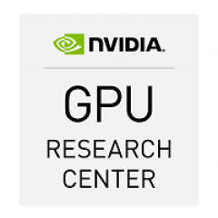
CTA@INAF for
ASTERICS
L. A. Antonelli
INAF-OAR & ASDC

Slide 2
Outline
Description of activities: WP participation, task/sub-task.
Coherence with CTA projects goals.
Funding received.
People formally involved (staff and EU funded).
EU funded hiring.
Achievements, deliverables.
Next steps and perspectives
Contribution to CTA (self –evaluation).

Slide 3
Activities and status description:
WP 3.2
3.2.1.: CTA is an ESFRI project and ASTRI is one of the CTA pathfinder facilities. In such a contest the INAF group is developing data reduction and analysis algorithms to be run on a stream of data also adopting innovative hardware like GPUs.
3.2.2.: FITS has been mainly adopted for the data format and algorithms are optimized on such a format but also the exploration of other data format suitable for CTA are considered.
3.3.3.: We have reached now a good level of integration of the CTA data flow within the ASTRI CTA-precursor, including also the handling secondary data streams and meta-data (environmental and engineering data, temporary local archive, device control software and observation scheduling). We have also integrated some solutions largely adopted by the astronomical community like caldb (by NASA).
3.3.4.: We are testing and benchmarking low-power computer platforms (ARM+GPUs architectures e.g. Jetson TK-1 and the new Jetson TX-1) on the ASTRI data reduction and analysis software. We are going to organize a meeting on computing and information technologies by the ESFRI facilities in order to share experiences on these platforms.

Slide 4
Activities and status description:
WP 3.2
3.2.1.: We are going to explore new reconstruction methods suitable for IACTs instrumentation. In particular Deep Neural Network may provide well suited algorithms to quantify image parameters that can be adapted to CTA but also to other astrophysical experiments. Further implementation of DNN in GPUs will speed up the reduction and data analysis process.
This activity is not already started, a preliminary plan has been prepared and a software engineer is going to be hired for this activity.

Slide 5
Coherence with CTA project goals
Activities carried on in the framework of OBELICS WP 3.2 and WP 3.4.1 well embedded in the CTA project. The OBELICS activities are dedicated to ESFRI projects like CTA and both algorithms and software developed for CTA or its precursors like ASTRI are following the requirement of the CTA Project. The full data reduction chain running on different hardware architectures as well as the software solutions adopted to integrate the CTA archive are compliant with CTA TDR.

Slide 6
Involved staff and recruitment status:
STAFF:
Angelo Antonelli (INAF-OAR) – coordination
Matteo Perri (INAF-OAR)
Stefano Gallozzi (INAF-OAR)
Vincenzo Testa (INAF-OAR)
Denis Bastieri (Univ. Padova)
EU funded:
Francesco Visconti T.D. Engineer (from Sept. 1st) (for 2,5 years) 1FTE
Ciro Bigongiari T.D. Researcher (from Oct. 1st) (for 2,5 years) 1FTE
Fillide Calderini T.D. Administrative Support from Oct. 1st
0,1 FTE/year for 2 years

Slide 7
Achievements & Deliverables
Full data reduction chain for CTA pre-production ASTRI telescopes on different HW platforms.
Libraries and software.
Reports on benchmarking results
Participation and presentation of the work to specific conferences (e.g. GTC, SPIE, …)

Slide 8
Next steps.
Portability of algorithms, libraries and software to other instruments.
A natural application to:
  MAGIC telescopes and cameras
  LST prototype telescope and camera
  MST prototypes and cameras
  ….
  other astronomical or astro-particle ground- and space- based observatories.

Slide 9
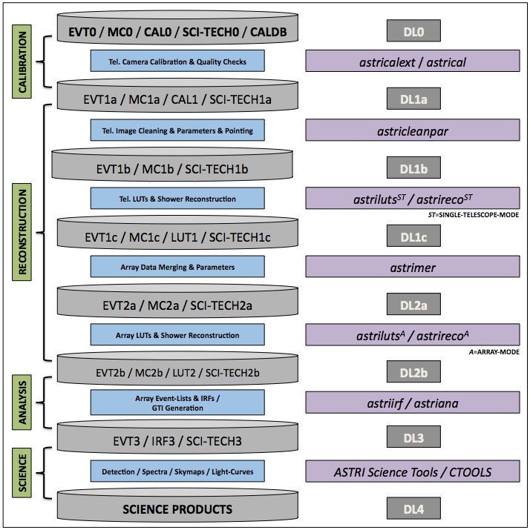
Contribution to CTA: The ASTRI Data Analysis Software
ASTRI-MA scientific data analysis
Full Data Reduction and Analysis Chain.
ASTRI-camera-like calibration
Image-Momentum reconstruction
RF for g/h separation, Energy reconstruction and Direction estimation
Make use of CALDB
DL1(c) ➔ DL2(b): data merging and stereo reconstruction under testing
DL2(b)➔DL3 under testing
DL3➔DL4 with ctools (under testing)

Slide 10
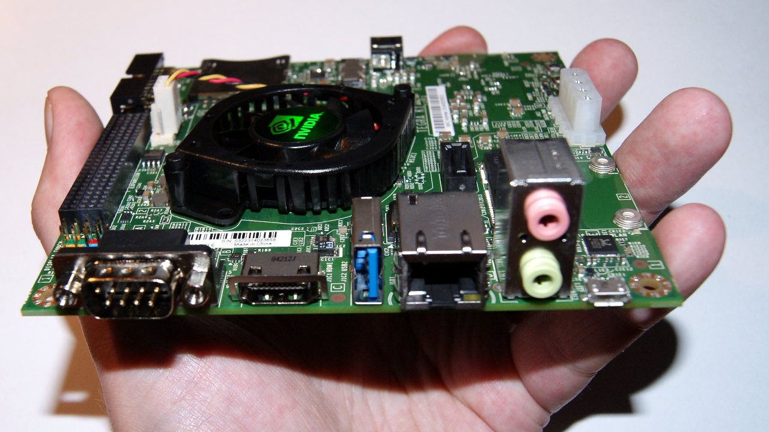
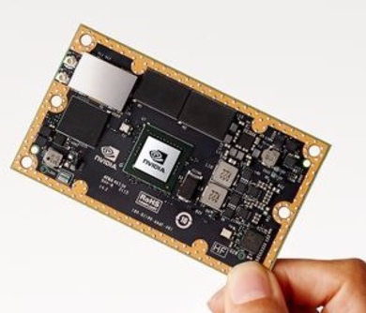
Contribution to CTA: Benchmarking New HW
ASTRI-MA scientific data analysis
Parallelization of the algorithms.
Build phase does not depend on CUDA toolkit (only CPU targets built)
Software modules detect GPUs in the system and act accordingly (thanks C++ polymorphism!)
CPU/GPU execution switchable on user request
Results match within the limits of numerical precision
Processing from DL0 to DL1b (fully-reduced data)
All done in 12.5s: 4400 evt/s (i.e. > 4x peak acquisition rate)
  2.5x slower than on server UM
  1.4x slower than separate modules
  30x less power

