Slide 1
TASK 3.1 : MAUD
MAnagement, User engagement & Data dissemination (MAUD)
Jayesh Wagh, WP3-Programme Coordinator
OBELICS F2F Meeting
16 September 2016

Slide 2
MAUD TO DO LIST
Organizing regular meetings & compiling progress reports.
3 annual general workshops + 3 main thematic events.
Industrial engagement for product co-development (WP1 collaboration & exploitation plan).
Overall data dissemination & communication in cooperation with WP1 & WP2.

Slide 3
1st ASTERICS-OBELICS Workshop Rome, 12-14 December 2016
OBELICS Workshop
ESFRI projects
Industry (HP, NVIDIA)
Partner Consortia (EU-T0)
Partner H2020) project (AARC2
Address Science Data Cloud & Computing models in Astronomy and Astroparticle physics through users and e-infrastructures engagement.
To establish collaborative links between ESFRI Projects, other H2020 projects (ex IndigoDataCloud & AARC2), partnering consortia members (ex. EU-T0 & APPEC) and Industrial partners.

Slide 4
Things done: Venue, dates
Venue: Frentani Conference Center, Rome, Italy.
Dates: 12-14 December 2016
Expected number of participants = 100 max
Scientific committee members identified & informed.
D3.2
Training
M12
D3.6
Workshop
M18
OBELICS workshop talks + tutorials

Slide 5
Things done : Scientific Committee Members + Invitees
No. | Category | Participants | Organization | Scientific Committee
1 | Partner projects | Bob Jones | H2020-HNSciCloud | Yes
2 | Partner projects | Davide Salomoni | H2020-Indigo Data Cloud | Yes
3 | Partner projects | Fabio Pasian | Euclid & OBELICS | Yes
4 | OBELICS | Angelo Antonelli | INAF-OBELICS | Yes
5 | OBELICS | Paul Alexander | Cambridge | Yes
6 | Partner projects | Michele Punturo + Eric CM | LVC-GW network | Yes
7 | Partner projects | Frederic Hemmer | CERN | Yes
8 | Partner projects | Licia Florio- Alessandro Costa | H2020- AARC2 | Yes
9 | ESFRI Project | Dominique Boutigny | LSST | Yes

Slide 6
Things to do
Organizing Committee:
Angelo Antonelli, INAF
Jayesh Wagh, LAPP
Thomas Vuillaume, LAPP
Comments/Suggestions are most welcome…
Identify topics for invited talks.
Identify topics for tutorials.
(a) software parallelisation and big-data frameworks; (b)
new computing technology; (c) archive and metadata-data-base systems.
Suggestions and inputs on overall format of the workshop and organization
- Invited talks, tutorials, poster session, panel discussion etc.
Send out formal invitations.
Communication & dissemination to suitable audience.
Internal meetings every week to review the status of organization.

Slide 7
Call for expressions of interest : Industrial Participation
To encourage the partnering process with the industries for one of the following innovation-related objectives of OBELICS workpackage.
Professional software co-developments.
Co-development of database software frameworks.
Consulting contracts to support technological survey
Co-funded PhD scholarships with major private companies (e.g. CUDA for GPU programming) around astronomical data analysis use cases.
Sub-contracting to SMEs some computing benchmark prototypes.
Comments/Suggestions are most welcome…

Slide 8
Provisional Timescale
Call for expressions opens | 1st December 2016
Closing date for expressions of interest | 31st January 2017
Notification of decision for expressions of interest | 28th February 2017
Full proposal submission deadline | 30th April 2017
Notification of decision on full proposal | 1st June 2017
Funding Allocations = €300000
Number of projects = 1 or 2 with consolidated budget within the funding limit
Notes:
Only fund 1 in this order or two within this scale, text should be more specific

Slide 9
18 months technical report
Input for Midterm review presentation to EC on 14th March 2017. <= 18 months report =Technical Part A (Overall ASTERICS project Summary) + Technical Part B (18 months overview of each WP)
31st October 2016 = 18 months of Project
31 Dec 2016 = 60 days to submit report
11 Nov 2016 = Inputs deadline to WP1-AMST
25 Nov 2016 = First Draft to AGA
29 Nov 2016 = AGA Meeting
5 December 2016 = AGA to provide comments
21 December = Submission to EC
Notes:
31st oct – end of 18 months
60 days to submit report
Inputs deadline to amst- 11 nov
25th nov- first draft to aga
29th nov aga meeting
5th dec- aga comments
21st dec – submission

Slide 10
Technical Part B
Narrative report, explanations of work carried out by beneficiaries during the reporting period (18 months).
Input for the Project review on 14th March 2017.
(“A well justified and compelling explanation for the EC reviewer & project office.”)

Slide 11
Technical Part B
1-2 pages (1 page/subtask) summary from each task leader including following points
Challenges at the beginning of the project
Innovative solutions produced over last 18 months
Efforts required & impact of these solutions
Future activities
Anything else you would like to convey to the EC project office & reviewer
Notes:
Efforts = quality work = writing codes, testing codes, bench marking, real stuff no meetings
Future activities = quality plans with real added value,

Slide 12
Financial Report
Explanation of use of the resources
Travel expenditures and details
Due date :9 December 2016
Notes:
Cnrs Elisabeth = amst

Slide 13
Deliverables
EC-Portal
Task Leaders
Task Participants
MAUD
WP1-AMST
Deliverable table shall be uploaded on wiki pages and will be shared with task leaders through google docs.
Questions regarding content of deliverable = Contact MAUD and WP1-AMST
Final grant agreement shall be shared.
Plan of action for 24 months deliverable : with risk involved and assumptions
MAUD & AMST will only fine tune your inputs for deliverables
Notes:
Ask tl when they can report = trust you+fine tune me

Slide 14
Communication
Intra-WP communication: New recruitments
Content for social media + OBELICS webpage.
Newsletter- inputs every month that can be publishable and mentionable,
Tweet every day to make asterics visible
Short film: ASTERICS-OBELICS to disseminate research activities and achievements .
Notes:
Deliverable table
Newsletter
Update the recruitment table
Content of the deliverable= d
Please keep me informed
Next week plan of action from task leaders
Check plan of action with giovanni= risks, assumptions

Slide 15
D 3.7: Second Training Thematic Event, M24 (May 2017) 1st ASTERICS-OBELICS International School
Venue: LAPP-Annecy in June 2017
Subtitle of the school
Advanced Software Programming for Astronomy & Astroparticle Physics
Potential topics
Parallel programming
Machine learning
Python for astronomy and astroparticle physics
Good code practice
Big data: extraction, visualisation of astronomical database, storage
…
Duration: 5 days
Dates : 06-09 June or 19-23 June 2017
Target audience: PhD students, postdocs, senior researchers
Estimated number of participants: ~90

Slide 16
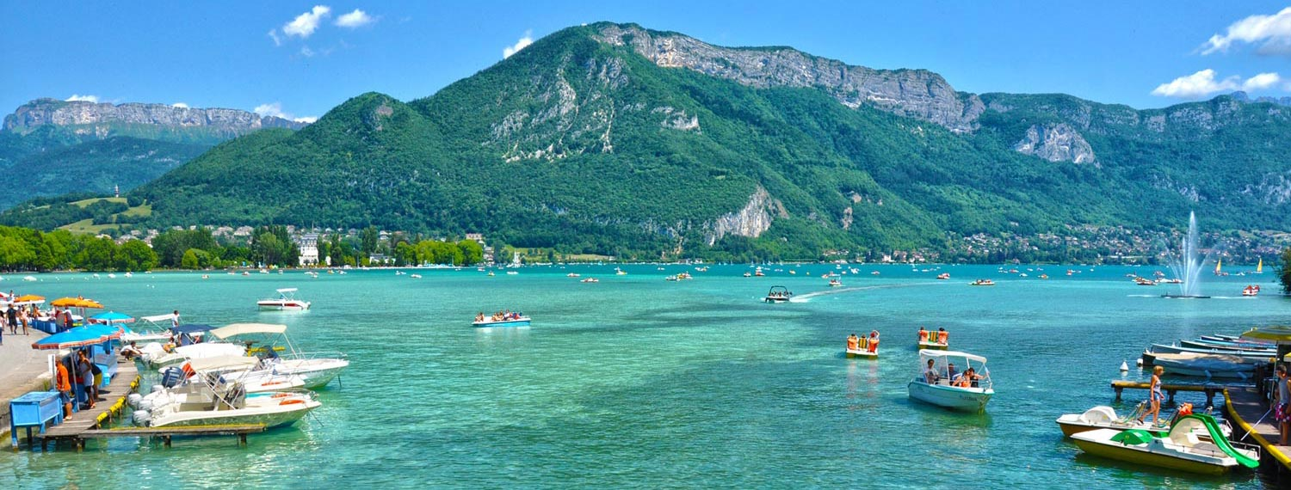
Annecy in June

Slide 17
Scientific committee for the school
Giovanni Lamanna, LAPP
Dominique Boutigny, LAPP
Angelo Antonelli, (T3.2,INAF)
Denis Bastieri, INAF
Marco de Vos, Astron
Vincent Poireau, LAPP
OBELICS Task leaders = Tammo Jan Dijkema (D3.3, Astron), Bojan Nikolic (D3.4, Cambridge)
Comments/suggestions are most welcome…
Organizing committee for the school
Jayesh Wagh
Vincent Poireau
Gilles Maurin
Thomas Vuillaume
Nicolas Chotard
2-3 OBELICS participants from other institutes
Comments/suggestions are most welcome…

Slide 18
Organisation
Lecturers to be invited from CERN, Idex-Université Grenoble Alpes, Versailles, INRIA, industries, LSST people (workshop in June/July 2017), etc. Comments/suggestions are most welcome…
Format of the school
Morning: lectures
Afternoon: hands-on session
Hack day?
Idea following the LSST format
Student groups to work on OBELICS software repositories / competition for best hack project
Keynote lecture?
Xavier Niel (“free” founder)?
UBISOFT representative (video game programming)?

Slide 19
Organisation
Facilities for hands-on session
Option 1
Participants bring their own laptops
Install virtual machines (Docker, Virtual box, …) with everything preinstalled (executables, tutorials, etc.)
Option 2
Participants bring their own laptops
SSH client
Connect to CCIN2P3 or MUST (LAPP farm)
Difficulty: necessity of creation of ~90 temporary accounts
Option 3
Annecy Polytech can provide us with some classrooms with computer facilities

Slide 20
Topics | Lectures | Hands-on sessions
Parallel programming | 4 hrs | • Event based (CTA, Neutrino), • Image Based (EUCLID), • Signal Based (SKA, LIGO, Virgo) Yes
Machine Learning | 4 hrs | Yes
Python for astronomy and astroparticle physics | 4 hrs | Yes
Good code practice | 2 hrs
Big data: database extraction, visualisation of astronomical database, storage | 2 hrs
…
Very preliminary and open to suggestions!
Notes:
Google doc

Slide 21
Things to do
Finalize list of topics for theory & practical
sessions along with potential tutors
Suggestions & inputs on overall format and organization of school
Inputs required: scientific committee members, tutors, speakers, etc.
Scientific committee to meet once or twice a month to get to full speed (starting in September)
Let’s meet this afternoon for those who want to discuss this school?

