Slide 1
INFN-CNAF in T3.2
Daniele Cesini (INFN-CNAF)
OBELICS f2f 14 Sept. 2016 - Madrid

Slide 2
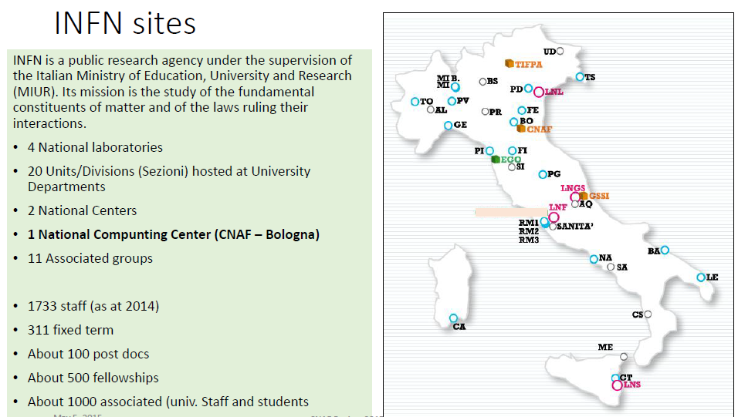
INFN sites

Slide 3
CNAF: a bit of history…

Slide 4
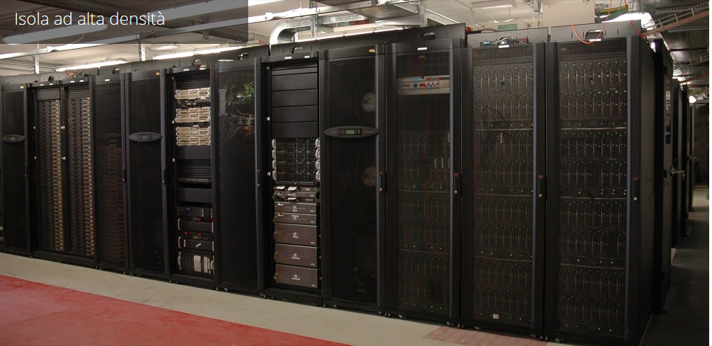
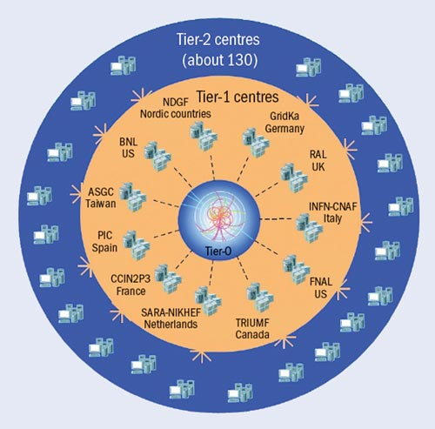
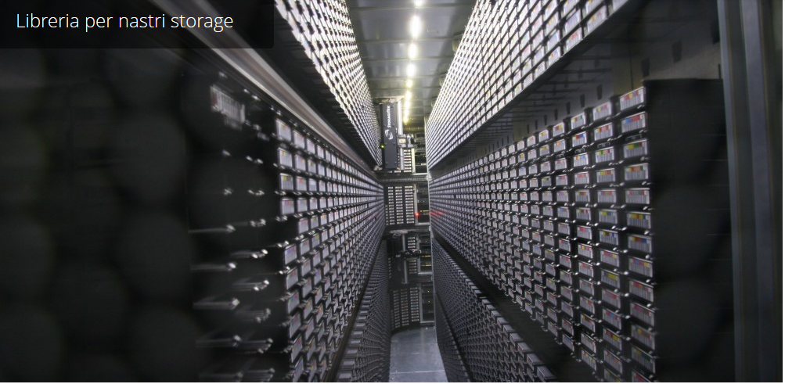
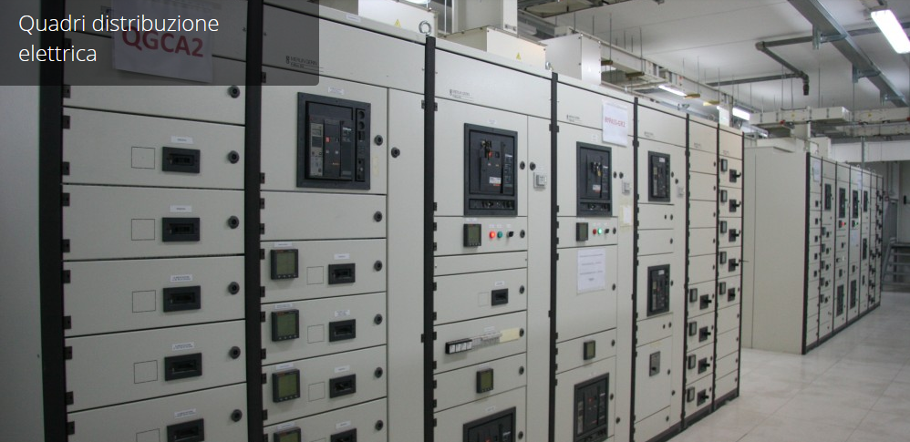
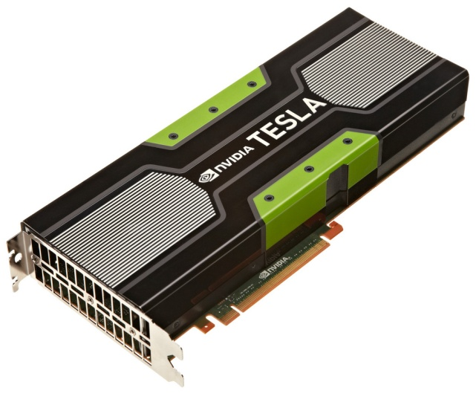
CNAF datacenter
21000 CPU cores
Worldwide LHC computing Grid
25PB disk storage
35PB tape storage
1.2MW Electrical Power
Plus a small HPC farm infiniband interconnected with accelerators (GPUs and PHIs) ➔ 30TFlops dp

Slide 5
CNAF Today
Scientific computing supporting experimental and theoretical INFN groups and related international collaborations
Innovation and development activities mainly focused on:
distributed systems (Grid and Cloud)
new hardware technologies (such as processors, storage systems, system architecture)
software development, according to the needs of the experiments (e.g. off-line components and on-line data acquisition systems)
Attraction of external funds to support innovation and development
Transfer of scientific and technological knowledge towards industry, public administration and society at large.

Slide 6
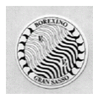
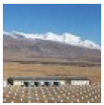
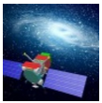
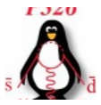
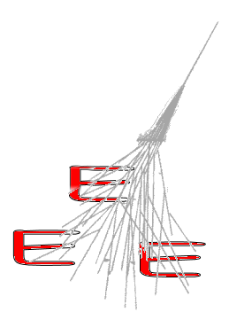
Experiments @CNAF
CNAF is officially supporting 34 experiments
4 LHC
30 non-LHC
Ten Virtual Organizations in opportunistic usage via Grid services

Slide 7
CNAF and ASTERICS
We are hiring 1 person (finally!):
Unix sysadmin with experience on:
Configuration and management of high performance big storage systems
Development of procedures to manage and monitor storage systems
Computing models development in distributed environments
Application porting to low power and hybrid hw architectures
By the end of November 2016
Use myself as a contact until then

Slide 8
T3.2
From the project proposal…
…but open to work on any other topics that can be useful to the project

Slide 9
INFN COSA project on low power architectures
COSA: Computing On SOC Architecture
Duration: 3 years from January 2015
Departments: 7 INFN
CNAF, PI, PD, ROMA1, FE, PR, LNL
Acquire know-how
Porting applications to and benchmarking of low power/low cost System on Chip
Operations of Linux system on SoCs
Benchmarking hybrid architectures
Low latency connections between the SoCs
www.cosa-project.it
Computing
Storage
Experiment DAQ

Slide 10
