Slide 1
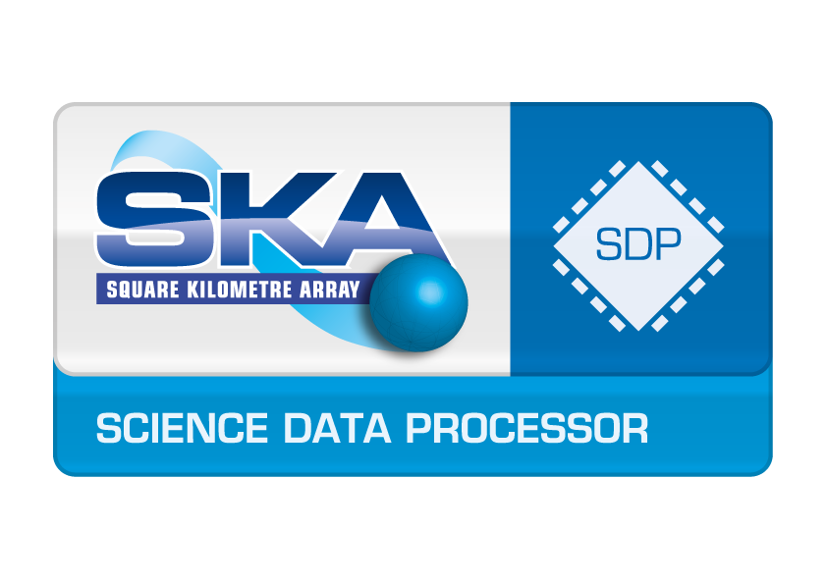
Obelics D-GEX UCAM Summary
Obelics F2F, Madrid 14—16 September 2016
Bojan Nikolic
Astrophysics Group, Cavendish Lab
University of Cambridge
Email: b.nikolic@mrao.cam.ac.uk
Project Engineer
SKA Science Data Processor Consortium

Slide 2
ALMA Data Streaming (partial -- from my own experience)
Data transport from antennas to central building – hard real-time unstamped digital stream
Data transport in/out correlator: DDS (http://portals.omg.org/dds)
Processing (pure streaming):
Optional applying on-line phase and digitisation corrections
Signal averaging
Processing (micro batched):
Calibration calculations. 50 MB/s maximum input rate, only a small fraction of observed data need to be processed

Slide 3
SDP Top-level Components & Key Performance Requirements -- SKA Phase 1
Telescope Manager
Science Data Processor
SDP Local Monitor & Control
Regional Centres & Astronomers
CSP
Data Processor
Data Preservation
Delivery System
High Performance
~100 PetaFLOPS
Data Intensive
~100 PetaBytes/observation (job)
Partially real-time
~10s response time
Partially iterative
~10 iterations/job (~3 hour)
Data Distribution
~100 PetaByte/year from Cape Town & Perth to rest of World
Data Discovery
Visualisation of 100k by 100k by 100k voxel cubes
High Volume & High Growth Rate
~100 PetaByte/year
Infrequent Access
~few times/year max
1 Tera Byte/s

Slide 4
SDP Top-level Components & Key Performance Requirements -- SKA Phase 1
Telescope Manager
Science Data Processor
SDP Local Monitor & Control
Regional Centres & Astronomers
CSP
Data Processor
Data Preservation
Delivery System
High Performance
~100 PetaFLOPS
Data Intensive
~100 PetaBytes/observation (job)
Partially real-time
~10s response time
Partially iterative
~10 iterations/job (~3 hour)
Data Distribution
~100 PetaByte/year from Cape Town & Perth to rest of World
Data Discovery
Visualisation of 100k by 100k by 100k voxel cubes
High Volume & High Growth Rate
~100 PetaByte/year
Infrequent Access
~few times/year max
Goal is to extract information from data and then discard the data
1 Tera Byte/s

Slide 5
Relevance of Streaming 2015 technologies
Multiple Loosely Coupled Task – Yes
Within each iteration & between observation
BSP – Yes: a few (~10) iterations
Synchronisation at end of each iteration
Relatively small synchronised state (sky model + calibration)
Workflow – yes
Streaming – yes (but not interactive)
Steering – yes (feed back of calibration solutions to the receptors)
Data Driven – yes & yes
In the dataflow execution model sense (i.e., not demand-driven)
In the programming model sense (i.e., a declarative description of how to reduce the data are attached to the data themselves)
Slide prepared for a Streaming Conference

Slide 6
SKA Requirements
Batched (3-6 hour) slightly iterative very highly parallel processing (~10 000nodes) on lots of data (~50 PetaByte)
Real-time (~10s latency) calibration and transient detection on high volume data streams (~500 GB/s)
Real-time Quality Assessment: lower volume data (~5 GB/s) but more complex data flow
Distributed database of calibration and sky solutions
Logging, failure resilience, run-time estimation

Slide 7
One possibility being investigated now
Single technology solution based on commercially used `big-data’ frameworks, e.g., Apache Spark
High stability
Support and maintenance available
Can handle in one framework iterative, streaming, quality assessment & databases
Initial evaluation in progress now
In D-GEX this will fit under sub-tasks 3 & 4

