Slide 1
The SKA Data Challenge
Paul Alexander
University of Cambridge Leader the Science Data Processor Consortium
H2020-Astronomy ESFRI and Research Infrastructure Cluster (Grant Agreement number: 653477).

Slide 2
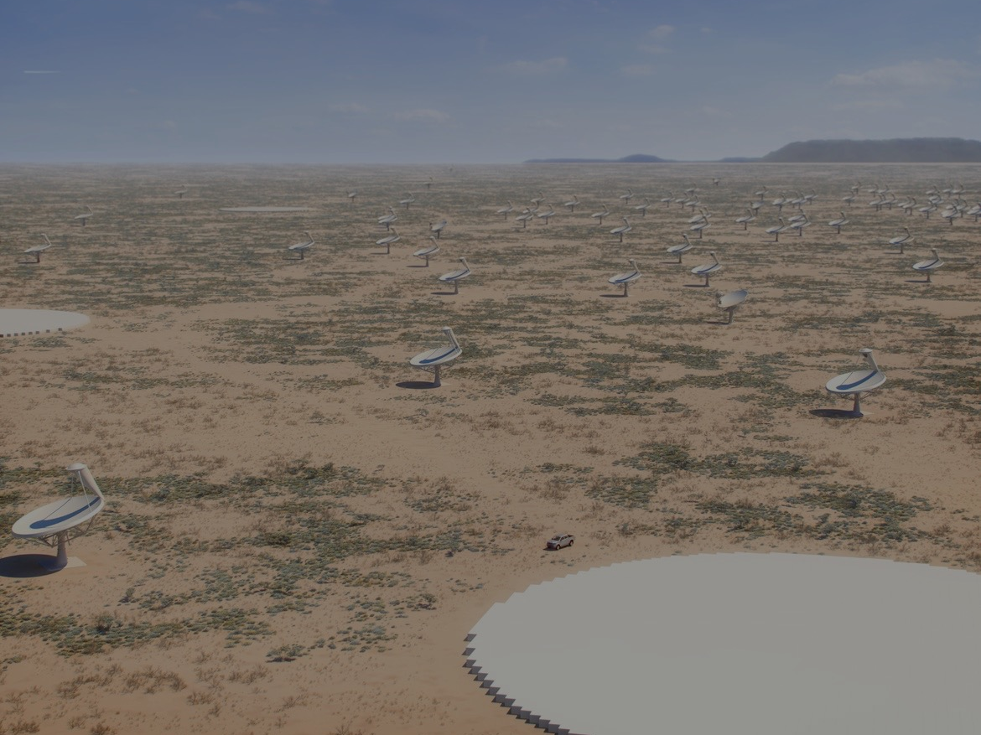
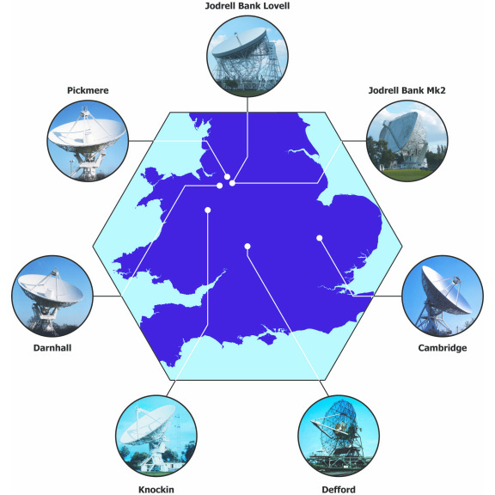
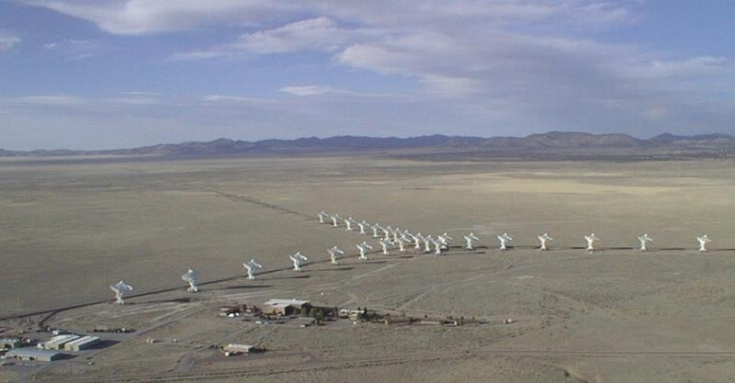
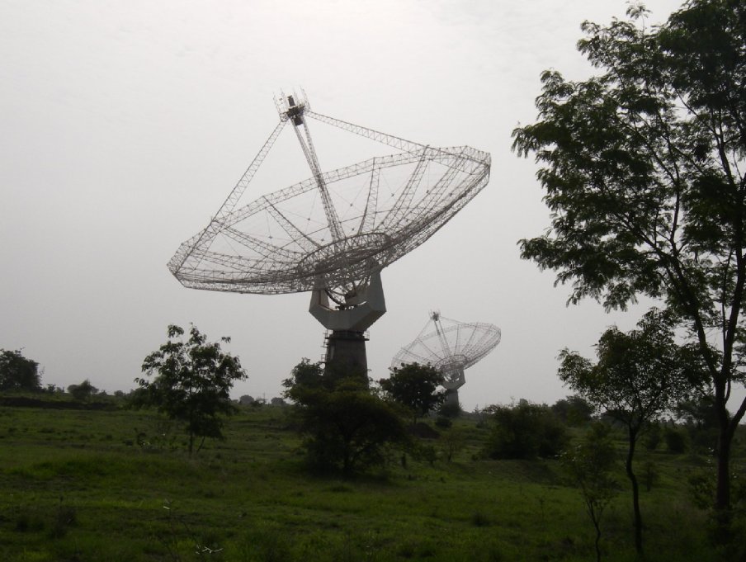
What is the Square Kilometre Array (SKA)
Next Generation radio telescope – compared to best current instruments it is ...
~100 times sensitivity
~ 10⁶ times faster imaging the sky
More than 5 square km of collecting area on sizes 3000km
E-MERLIN
JVLA 27 27m dishes
Longest baseline 30km
GMRT 30 45m dishes
Longest baseline 35 km

Slide 3
What is the Square Kilometre Array (SKA)
Next Generation radio telescope – compared to best current instruments it is ...
~100 times sensitivity
~ 10⁶ times faster imaging the sky
More than 5 square km of collecting area on sizes 3000km
Will address some of the key problems of astrophysics and cosmology (and physics)
Builds on techniques developed in Europe
It is an interferometer
Uses innovative technologies...
Major ICT project
Need performance at low unit cost

Slide 4
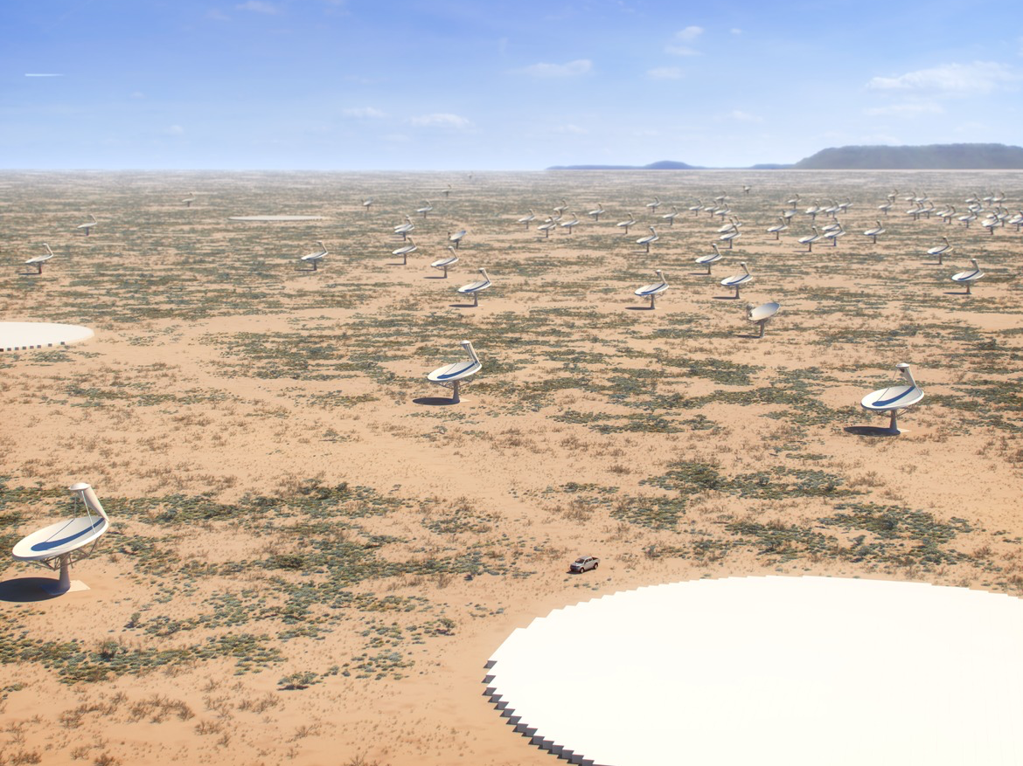
Mid frequency array and mid-frequency aperture array

Slide 5
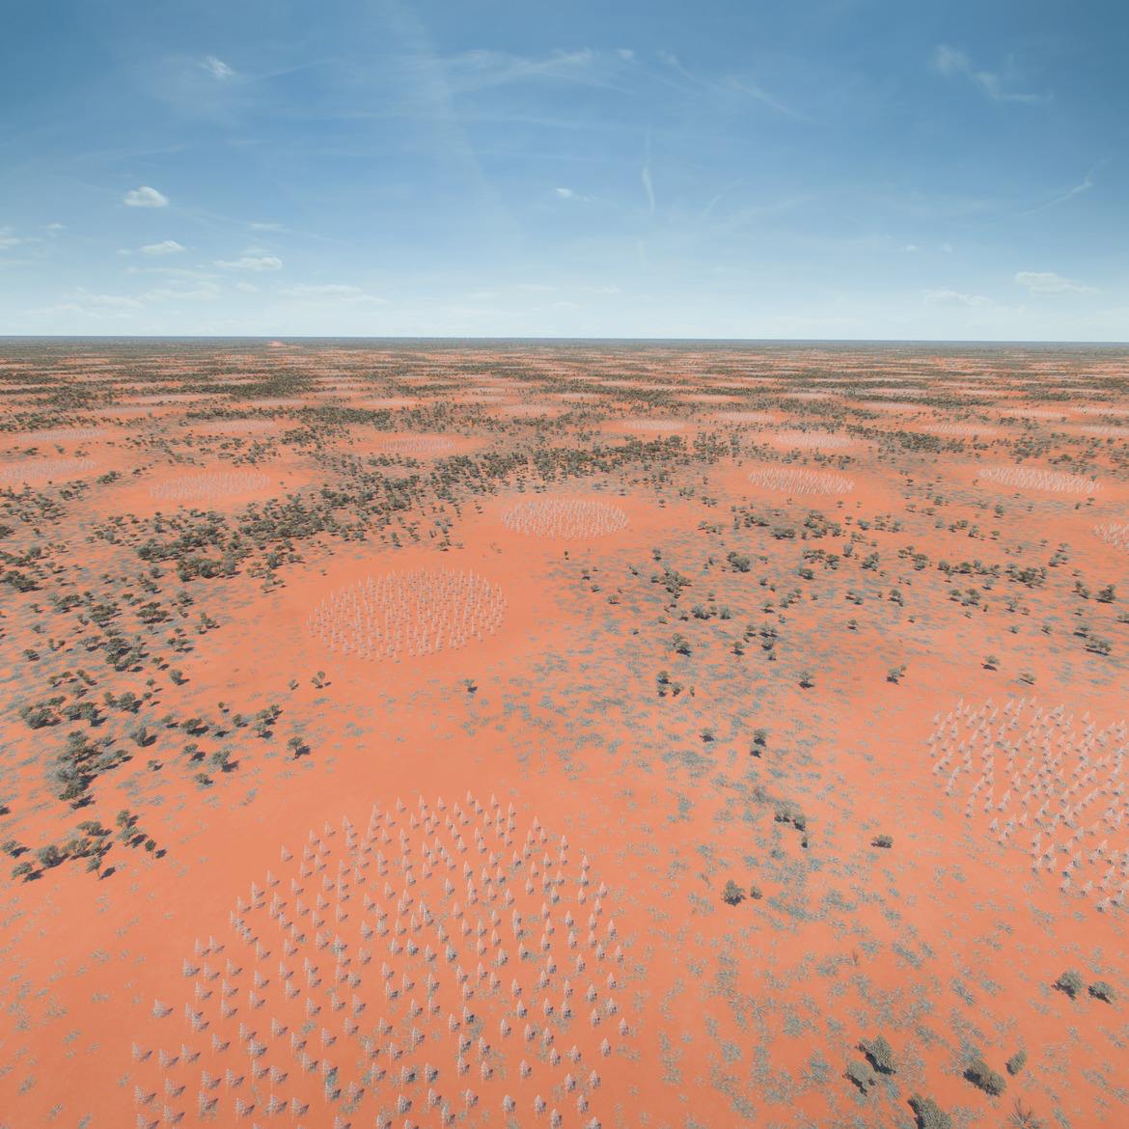
Low-frequency aperture array

Slide 6
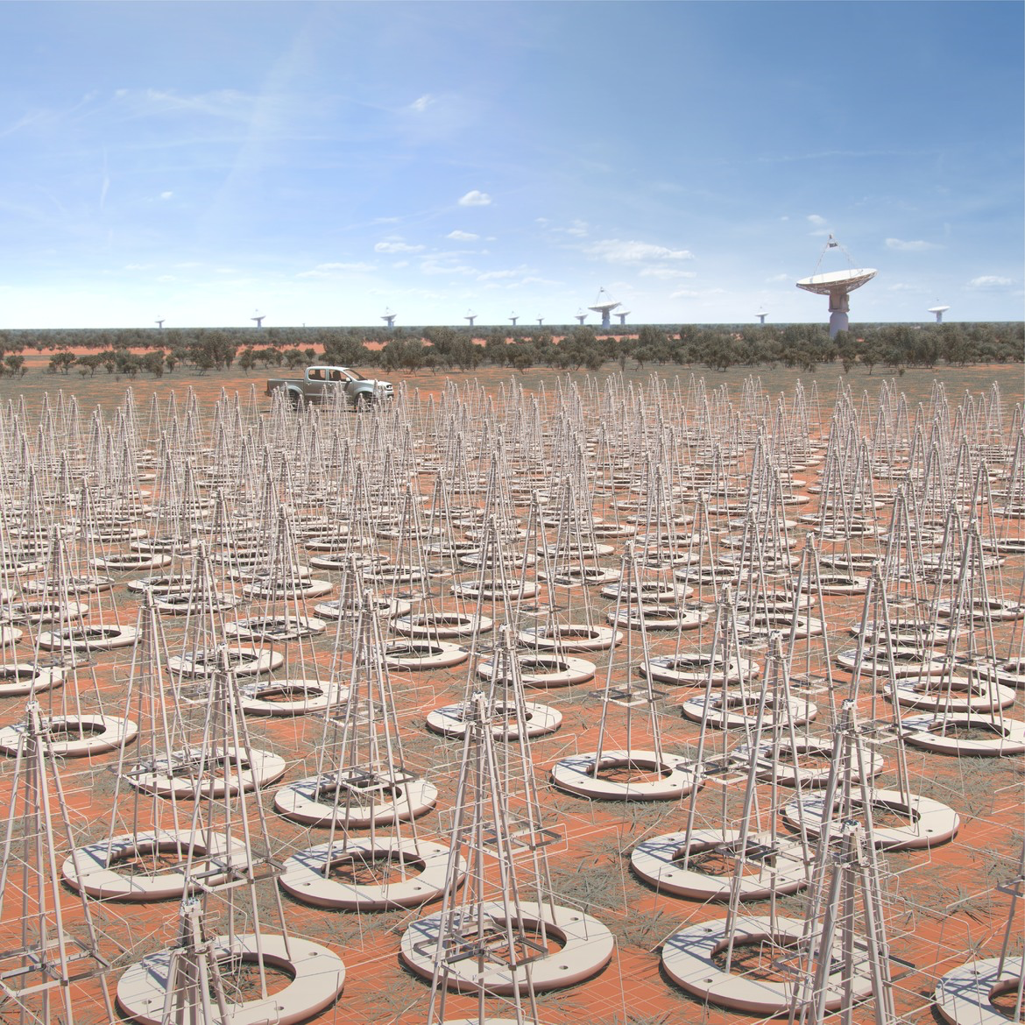
Phased Aperture array for 50 – 350 MHz

Slide 7
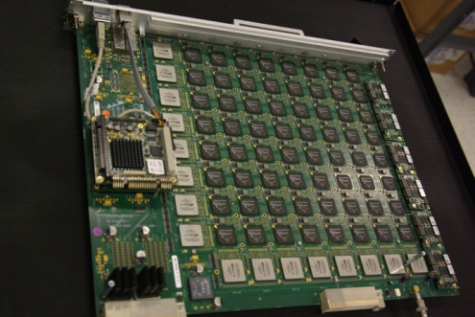
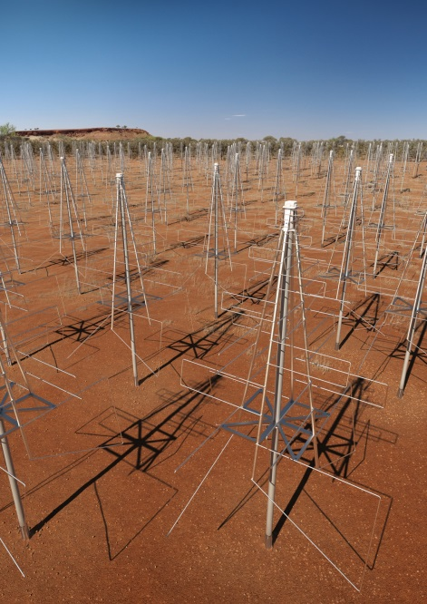
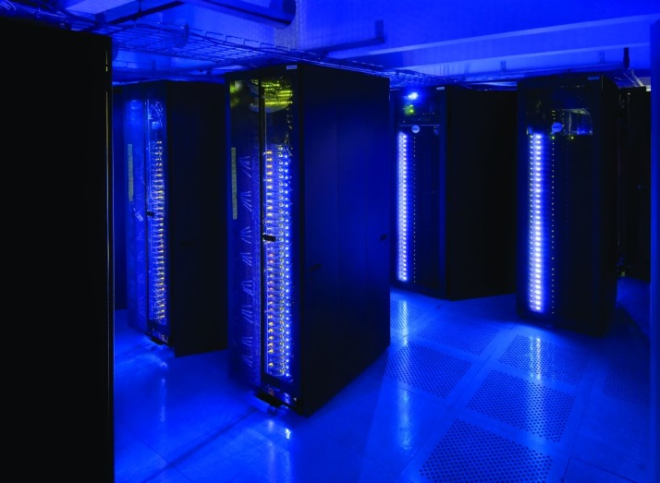
SKA: A Leading Big Data Challenge for 2020 decade
Digital Signal Processing (DSP)
To Process in HPC
2020: 50 PBytes/day
2030: 10,000 PBytes/day
Over 10’s to 1000’s kms
Antennas
Transfer antennas to DSP
2020: 5,000 PBytes/day
2030: 100,000 PBytes/day
Over 10’s to 1000’s kms
HPC Processing
2020: 300 PFlop
2028: 30 EFlop
High Performance Computing Facility (HPC)

Slide 8
Science Case

Slide 9
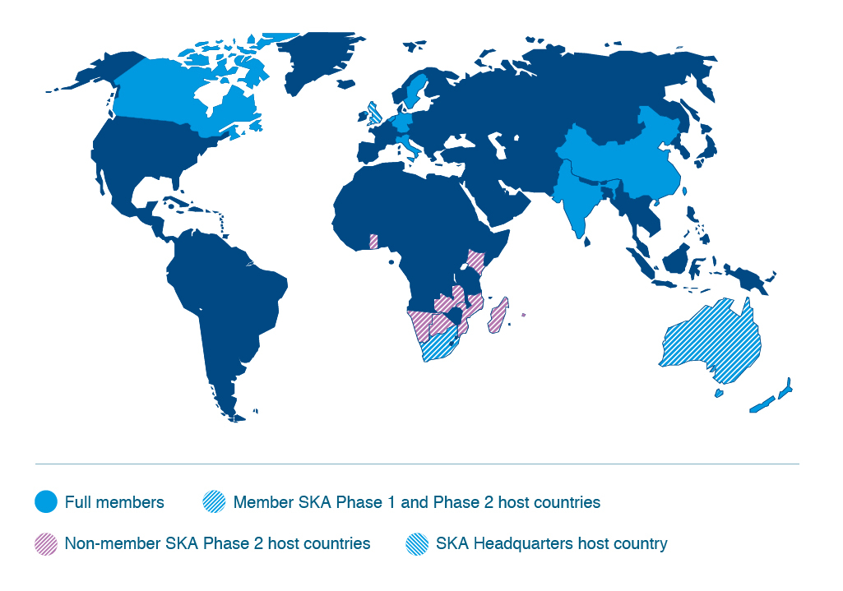
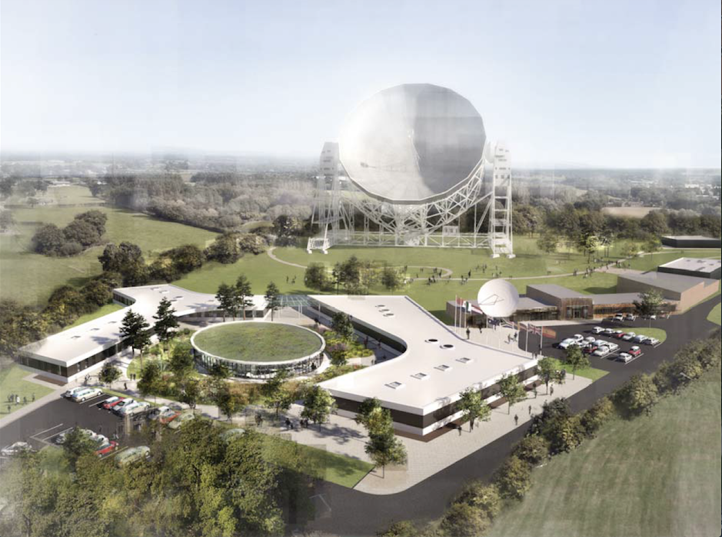
Major Global Partnership
10 Countries:
UK, RSA, AUS, NZ, Canada, China, NL, Italy, India, Sweden
Stage 1 Completion 2023
€ 650m
Stage 2 Completion 2030
€ ?b
Currently detailed design phase

Slide 10
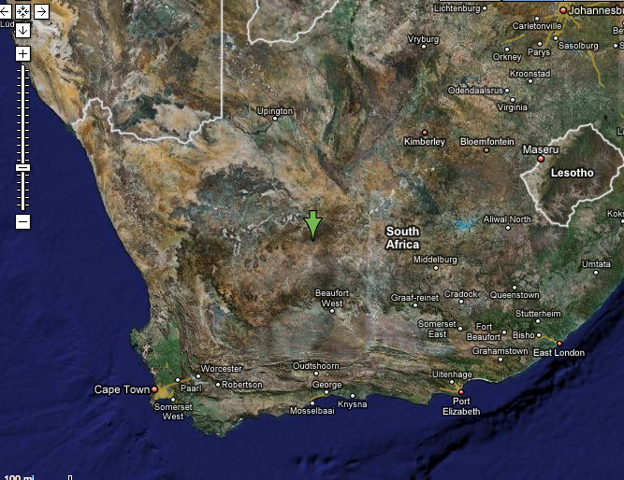
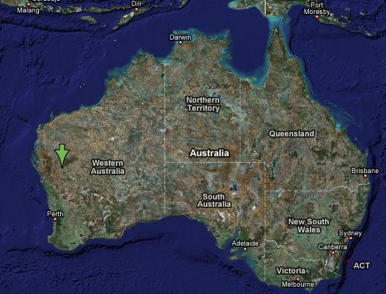
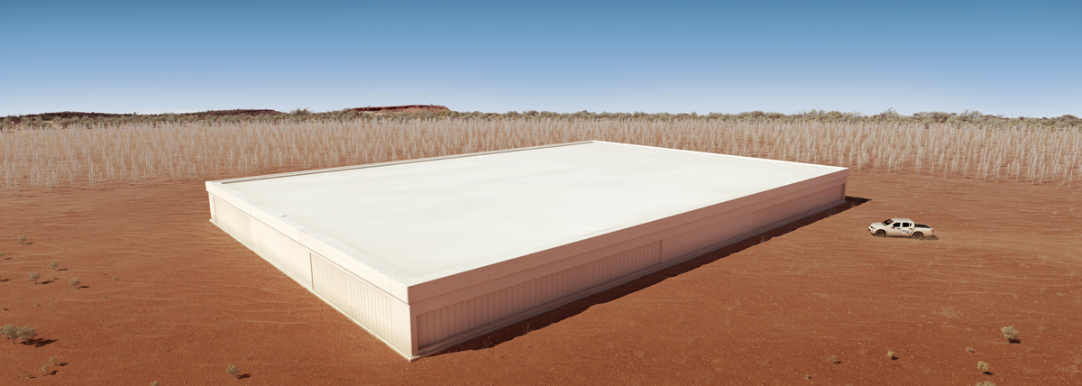
SKA Implementation
SKA1_Mid_Dish
SKA1_Low

Slide 11
The Processing Challenge

Slide 12
Standard interferometer
s
Astronomical signal (EM wave)
B . s
Visibility:
V(B) = E₁ E₂*
= I(s) exp( i ω B.s/c )
Resolution determined by maximum baseline
θ_{max} ~ λ / B_{max}
Field of View (FoV) determined by the size of each dish
θ_{dish} ~ λ / D
Detect & amplify
1
B
2
Digitise & delay
Correlate
X
X
X
X
X
X
Integrate
Process
Calibrate, grid, FFT
SKY Image

Slide 13
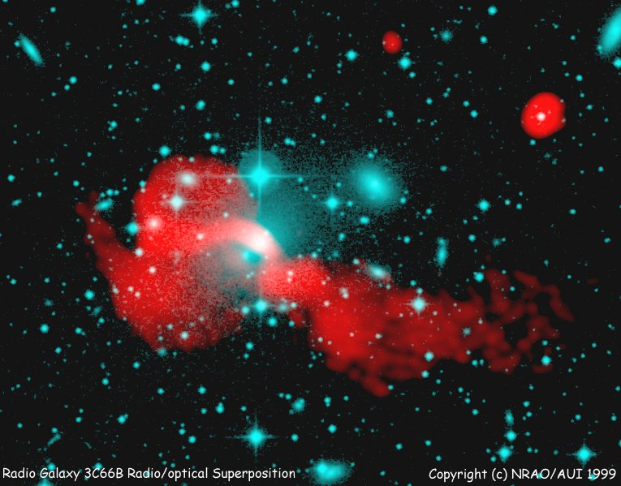
Image formation computationally intensive
Images formed by an inverse algorithm similar to that used in MRI
Typical image sizes up to:
30k x 30k x 64k voxels
Notes:
Obvious tie up with ALMA, NGST, next generation of ground based optical telescopes, SKA has resolution advantage to look in more detail at objects detected in other wavebands.
Will see things that are not visible in the optical – see next slide – this is the story about distant dust-enshrouded galaxies as seen in the sub-mm regime.

Slide 14
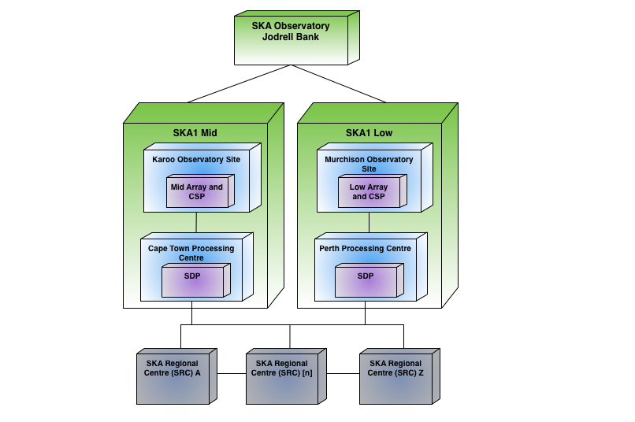
One SDP Two Telescopes
 | Ingest (GB/s)
SKA1_Low | 500
SKA1_Mid | 1000
In total need to deploy eventually a system which is close to 0.5 EFlop of processing

Slide 15
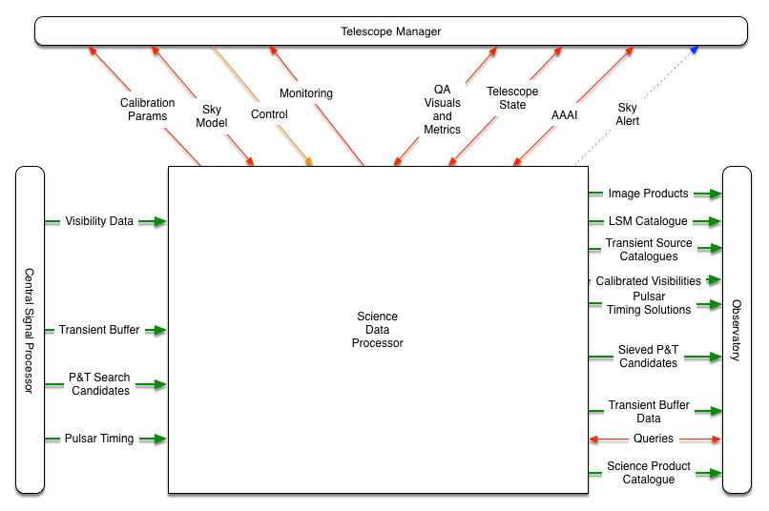
Scope of the SDP

Slide 16
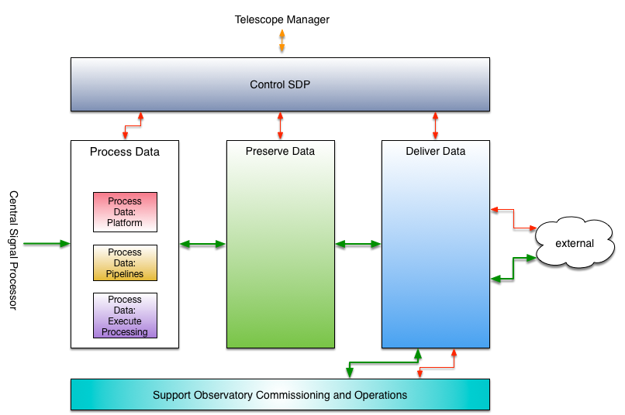
The SDP System

Slide 17
Basic data flow
HSM
Process Data
Real time
Batch
1.5 TByte/s
>1 PByte/day
Preservation
1 PByte/day
1.5 TByte/s
~10 TByte/s
Aggregate read
Regional Centres
High performance buffer
85 PBytes

Slide 18
Observation Scheduling
Loose coupling to SDP
Ingest and real-time processing in SDP tightly coupled schedule
SDP guarantees to be able to Ingest Data
Different observations / experiments significantly different computational cost
Buffer data over a period of ~two weeks to effectively load balance

Slide 19
High Priority Science Objectives
SKAO has developed a list of HPSO experiments – programmes targeting specific scientific goals and taking long periods (~5000-16000 hours) of telescope time.
Draft schedule for these taking 5-15 years to complete
Just an example
We can use these to generate example SDP use cases and archive growth rates.
Also could enable load balancing if we relax latency requirement of off-line processing.
100,000 hours = 11 years

Slide 20
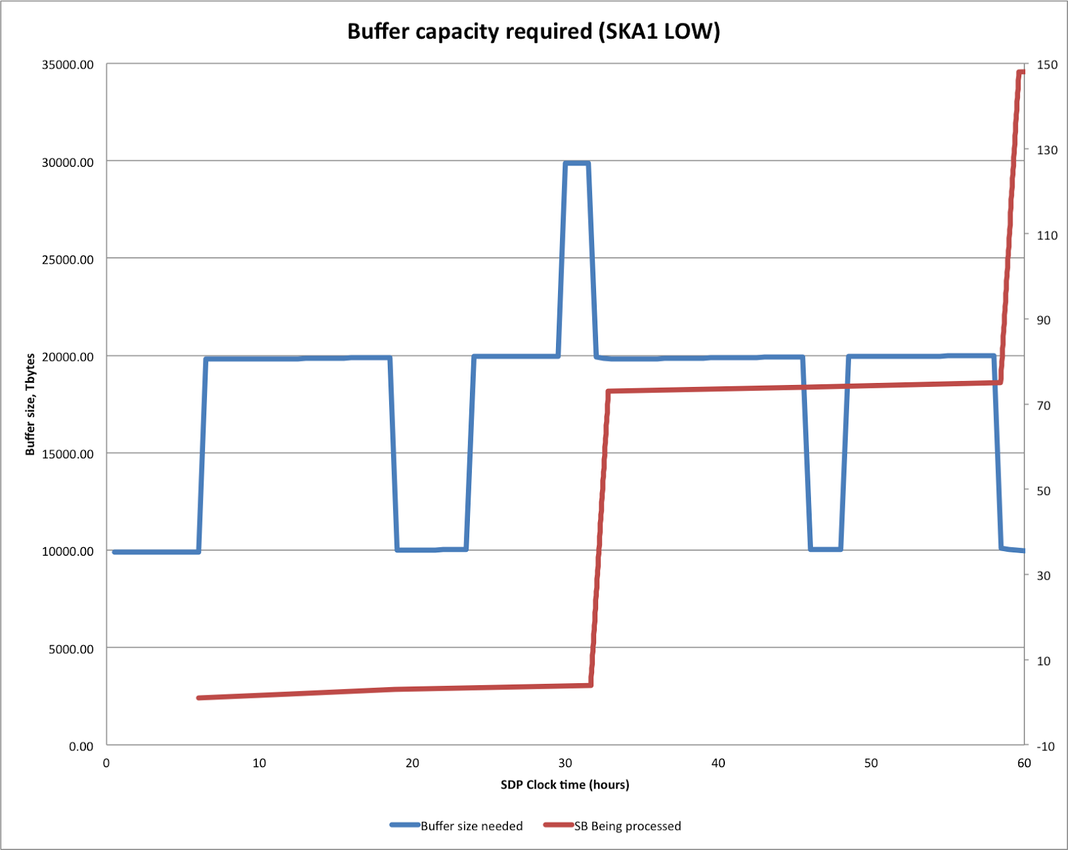
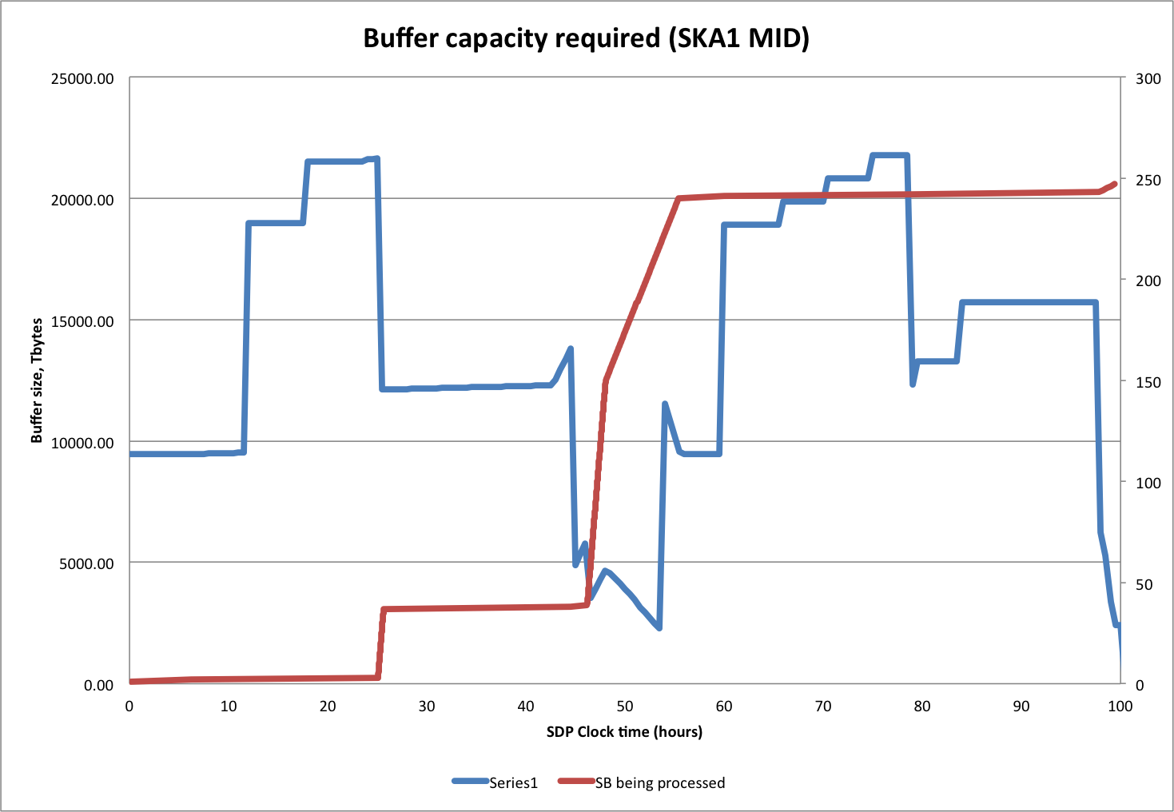
Modeling High Performance Buffer
Mid ~45 PBytes
Low ~45 PBytes
Buffer sized to enable observations to always proceed

Slide 21
The SDP System

Slide 22
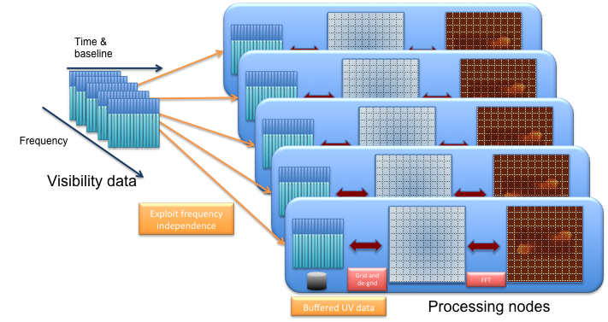
Data Driven Architecture

Slide 23
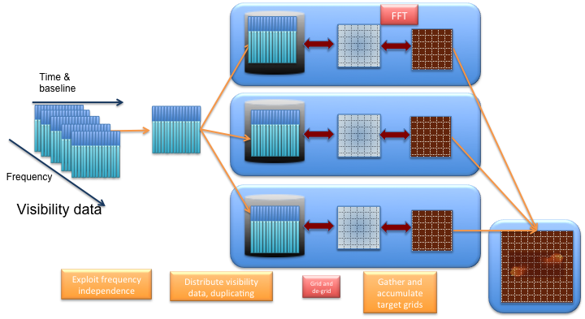
Data Driven Architecture
Smaller FFT size at cost of data duplication

Slide 24
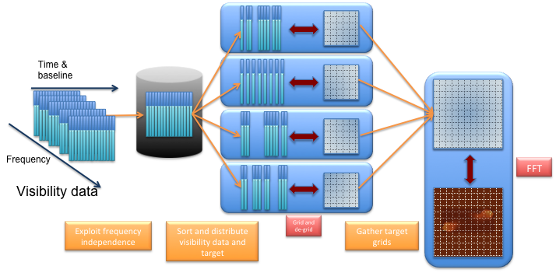
Data Driven Architecture
Further data parallelism in spatial indexing (UVW-space)
Use to balance memory bandwidth per node
Some overlap regions on target grids needed

Slide 25
How do we get performance and manage data volume?
Key concepts:
Exploit intrinsic data without strong coupling to the hardware Achieve suitable efficiency and in particular to load-balance the system;
Separate domain-specific functionality from framework to give performance
Represent pipeline as a graph showing data dependencies between components
Components are the “tasks”, but now explicitly specify all of their required inputs and outputs and their execution is driven by the availability of data
This explicitly limits messages across the whole pipeline
Minimise data movement through the system by analysing the data dependencies and determining where to run processing
Load balancing and scalability by task-based approach
Fault tolerant
restarting processing based on data dependencies and reallocation of work

Slide 26
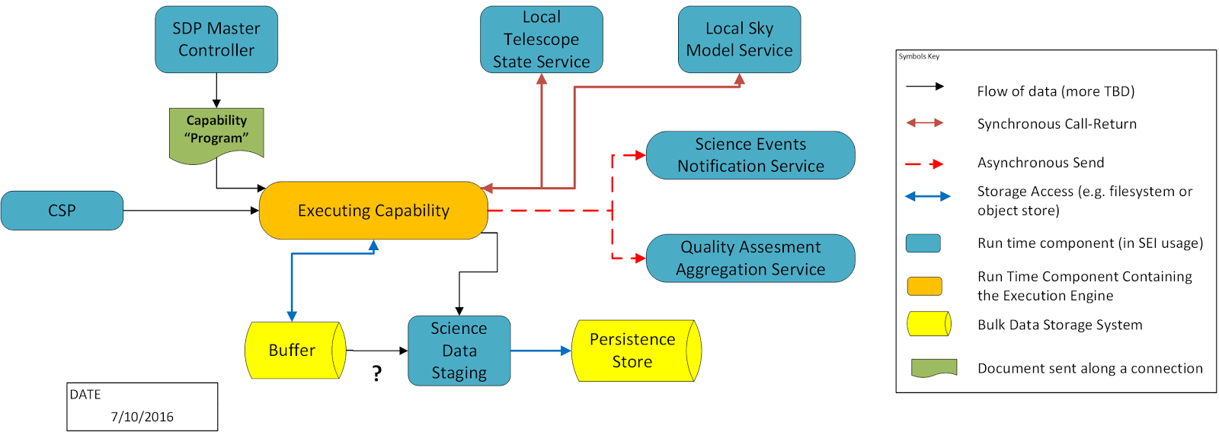
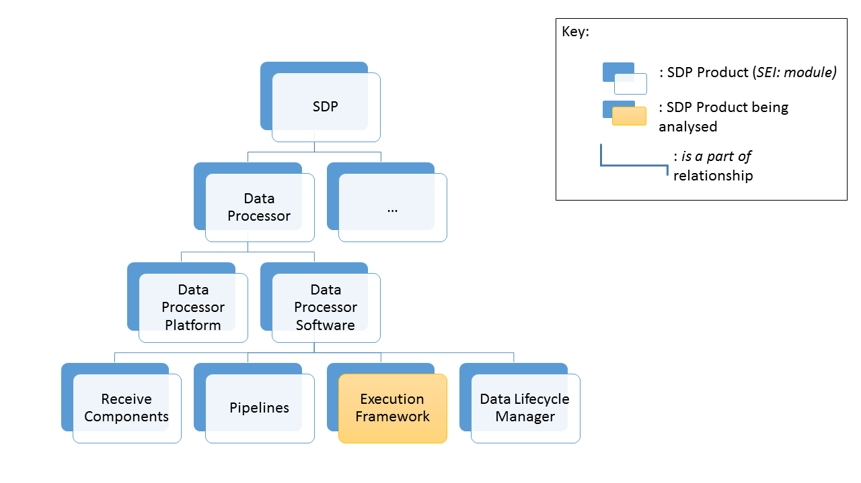
Scalable design

Slide 27
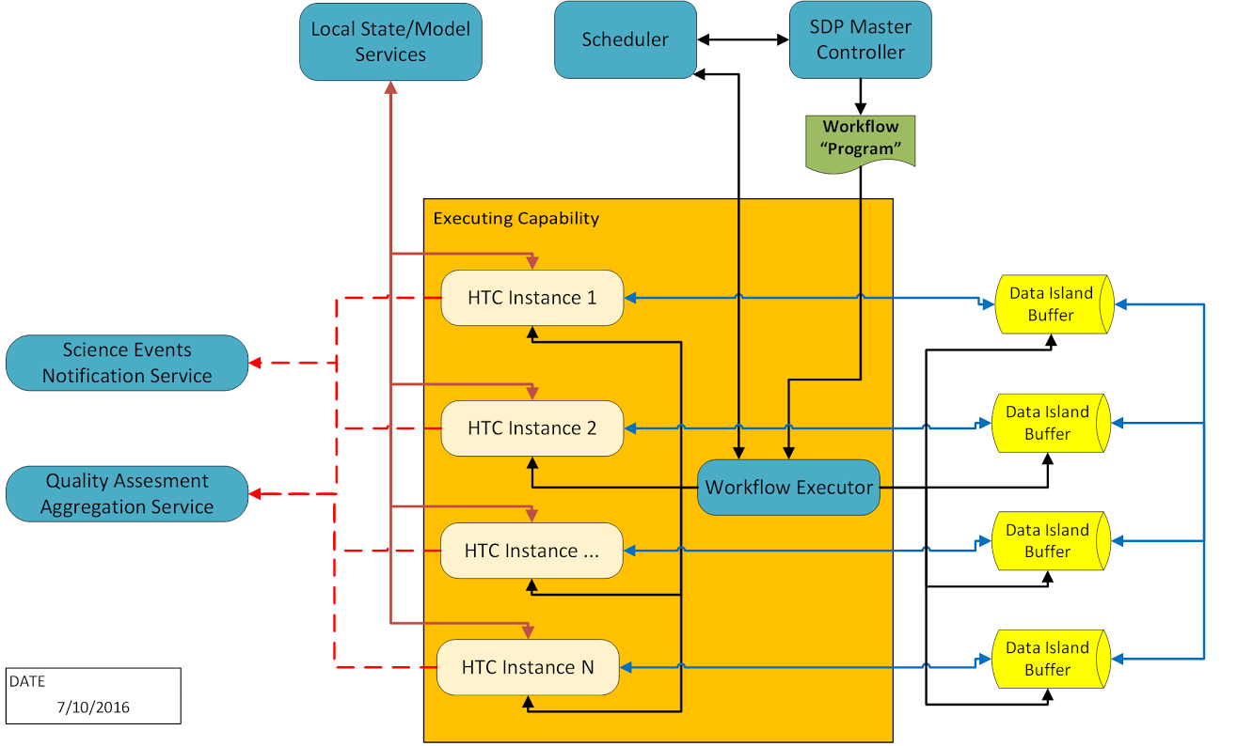
Scalable design

Slide 28
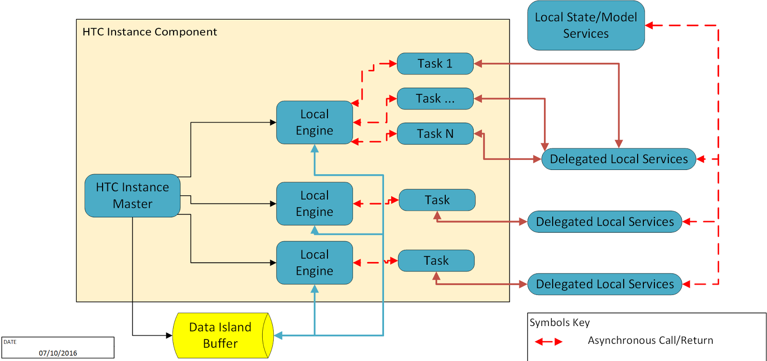
Scalable design

Slide 29
Regional Centres
SKA will have tiered processing organisation
Data products from SKA up to 1PB/day
Still a major Big Data challenge
New tools and ideas needed
Provide access to SKA Data Products and Processing Environment
Typically manage 300 PB data/yr
Provide access to ~ 100 PFlop processing
Provide user support
Other roles
Continued input to SKA Observatory software support and development – Software Engineering Centre of Excellence
Development of framework for supporting Big Data challenge at Regional Centres
Likely to be part of a European Centre using national infrastructures to provide the physical layer

Slide 30
Data rates and processing increase by FACTOR ~100 for SKA2
3-30 EBytes / year of fully processed data for SKA2

Slide 31
Acknowledgements
H2020-Astronomy ESFRI and Research Infrastructure Cluster (Grant Agreement number: 653477)
Science and Technologies Facilities Council

