Slide 1
Community Driven Development in the Identity Space
Licia Florio (GÉANT)
AARC project coordinator
https://aarc-project.eu
ST ASTERICS-OBELICS Workshop,
12-14 December 2016
Rome, Italy

Slide 2
Agenda
Motivation for AARC
What AARC is and what AARC wants to change
Results
How AARC/AARC2 can help
AARC2

Slide 3
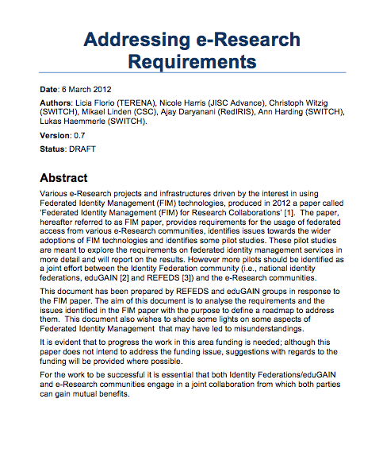

Starting Point: Identified Requirements
Attribute Release
Attribute Aggregation
User
Friendliness
SP
Friendliness
User Managed Information
Persistent Unique Id
Credential translation
Credential Delegation
Levels of Assurance
Guest
users
Step-up AuthN
Non-web-browser
Community based AuthZ
Best
Practices
Social & e-Gov IDs
Incident Response

Slide 4
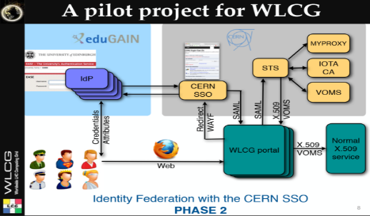















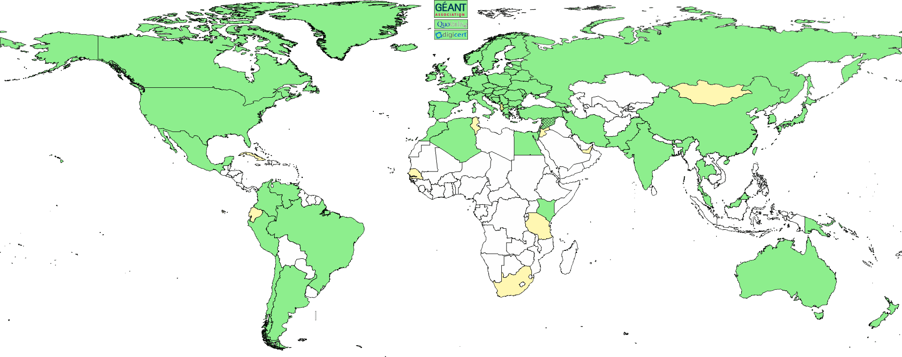





















4

Slide 5

Common Scenario
The scenario:
  There is a technical architect of a research community
  Her community is distributed internationally
  Increasing number of services need authentication and authorization
  She wants to focus on research and not reinvent the wheel
  She starts googling and asking around
So, there are some solutions available, but…

Slide 6
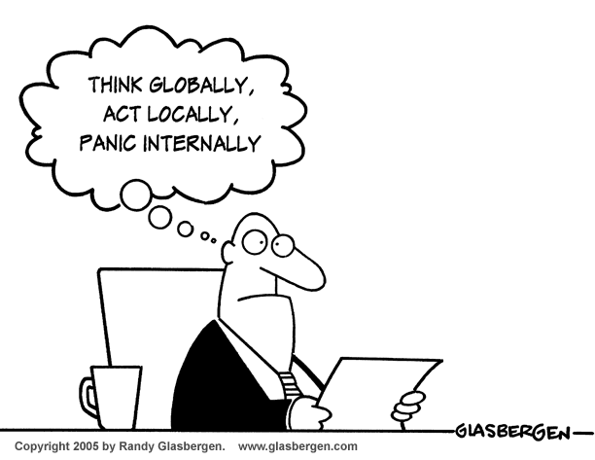
Think Global: the AARC project
  Bring federated access to eScience
  Avoid a future in which new research collaborations develop independent AAIs
  Build on existing tools and framework

Slide 7
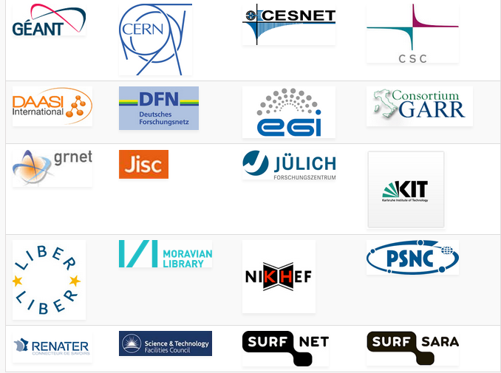
AARC Facts
Authentication and Authorisation
for Research and Collaboration
Two-year EC-funded project
20 partners
  NRENs, e-Infrastructure providers and Libraries as equal partners
About 3M euro budget
Starting date 1st May, 2015
https://aarc-project.eu/

Slide 8

What AARC does want to change and how
Improve usage of FIM – Promote usage of FIM and organise training to leverage identity providers outside the academic boundaries
Address eScience requirements – Design a technical Blueprint Architecture that builds on top of eduGAIN to add components required
Offer support for global policies – Sponsor the development of key policy frameworks that aim to add additional ‘flavours’ to eduGAIN.
Sustainability – Ensure that operations of components of the blueprint architecture and deployment of assurance, security and policy frameworks rest with r/e-infrastructures

Slide 9
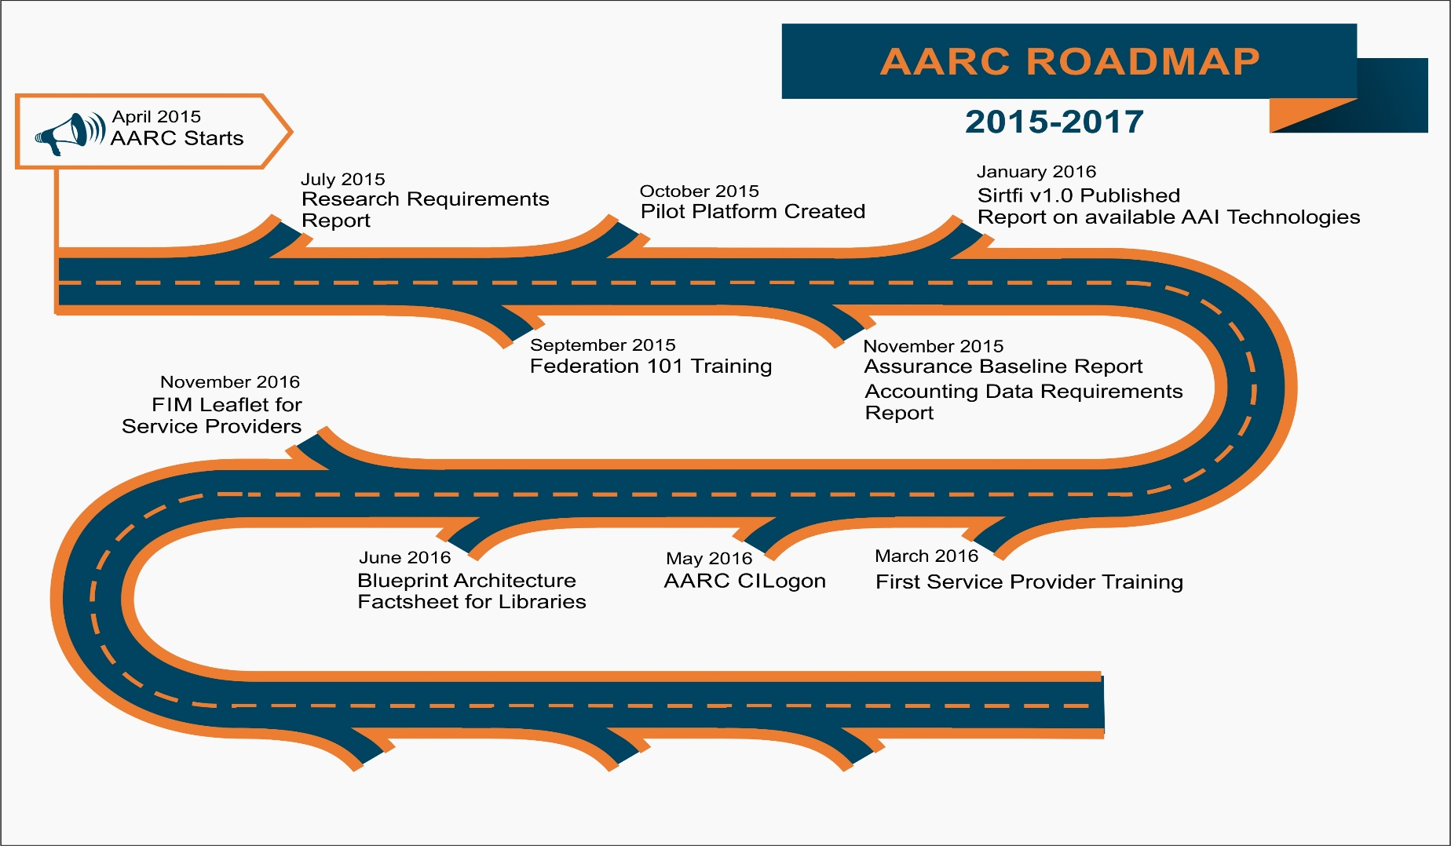
AARC Results
https://aarc-project.eu/achievements/

Slide 10
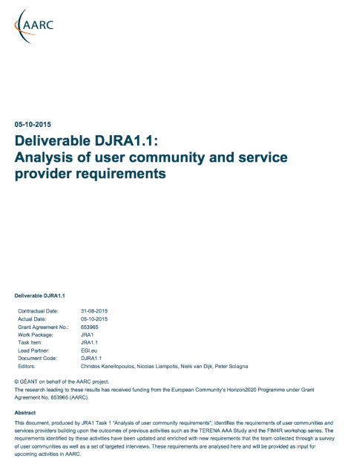
AARC: Analysis of Research Communities and e-Infrastructure
Providers
Attribute Release
Attribute Aggregation
User
Friendliness
SP
Friendliness
Credential translation
Persistent Unique Id
User Managed Information
Credential Delegation
Levels of Assurance
Guest
users
Step-up AuthN
Best
Practices
Community based AuthZ
Non-web-browser
Social & e-Gov IDs
Incident Response
Blue= addressed requirements
Green = requirements for AARC2

Slide 11
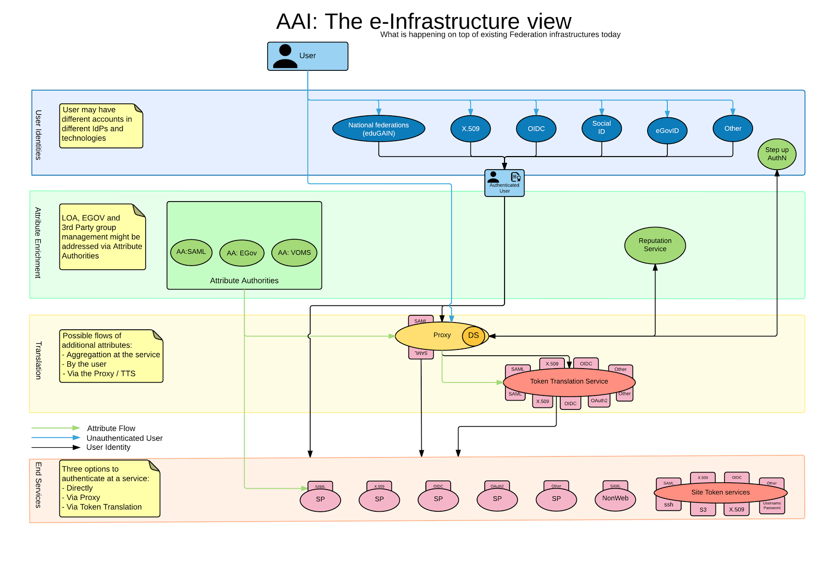

AARC Blueprint Architecture
(1st Draft)
User Community
Requirements
https://goo.gl/kSxENp
https://aarc-project.eu/aarc-draft-blueprint-architecture-available-for-comments/

Slide 12
Why the proxy model?
All internal Services can have one statically configured IdP
No need to run an IdP Discovery Service on each Service
Connected SPs get consistent/harmonised user identifiers and accompanying attribute sets from one or more AAs that can be interpreted in a uniform way for authZ purposes
External IdPs only deal with a single SP proxy
But it comes with each own new challenges

Slide 13
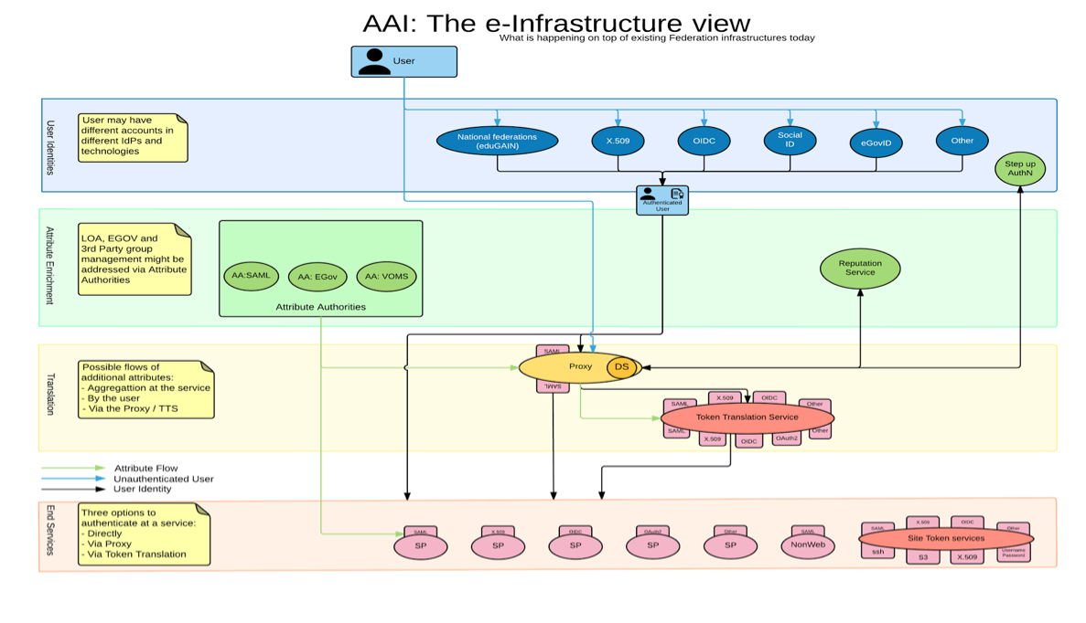

AARC Blueprint Architecture & eduGAIN
r/e-infras
  Implement the AARC blueprint
AARC
  A set of building blocks on top of eduGAIN for International Research Collaboration
eduGAIN and the Identity Federations
  A solid foundation for federated access in R&E

Slide 14
AARC CILogon Pilot: A Token Translations Service for Europe
Use-cases:
Hide PKIX complexity from the users.
Federated Access to web and non-web resources.
Support different type of credentials and delegation.
Enables access to different resource via portal.
Benefits:
Allows for VO services, ie. VOMS
Offered to research communities as service

Slide 15
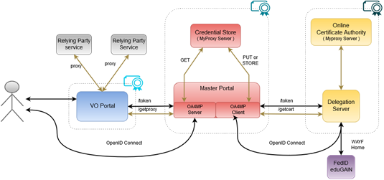
Flow
Sirtfi
REFEDS “R&S”
15
Notes:
VO portal can be anything even a simple shell
Certs stored only for 11 days
Master portal can add attributes via VOMS (or others in the future)

Slide 16
First e-Infrastructure implementations
EGI CheckIn Service
https://wiki.egi.eu/wiki/AAI
ELIXIR AAI
https://www.elixir-europe.org/services/compute/aai
EUDAT B2ACCESS
https://www.eudat.eu/services/b2access
GÉANT eduTEAMS
https://www.eduteams.org

Slide 17
Upcoming AARC work
Policies and best practices for proxy operators
Recommendations for RIs on assurance, data protections and security incidents
Guideline documents on group membership, non-web access, authorisation
Feasibility study for the use eGOV/eIDAS e-IDs
Pilots, pilots, pilots…
Tailored trainings

Slide 18
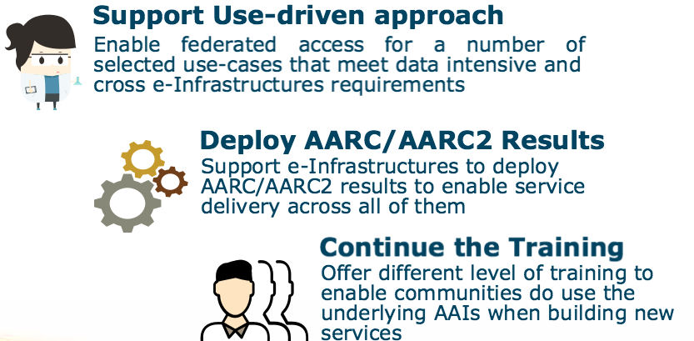
AARC2 In three bullets
Notes:
Starts 1st of May 2017

Slide 19

AARC2 Focus on Pilots and eScience Engagement
8 Pilots with research communities:
  CTA, EPOS, EISCAT_3D, LIGO, LifeWatch, WLCG, Biomedical Science Research, HNSciCloud
Pilots to support interoperability among e-Infrastructures
  In line with the EC vision
AARC/AARC2 to offer support to emerging research collaboration that need AAIs capabilities
Use FIM4R to report on the pilots
Arrange bilateral ad-hoc meetings with communities as needed

Slide 20

What AARC can do for you?
AARC/AARC2 to offer support to emerging research collaborations that need AAIs capabilities
Arrange bilateral ad-hoc meetings with communities as needed
Use FIM4R to promote results on AARC/AARC2 pilots
Check the AARC blog for the latest information
Get in touch: aarc-contacts@lists.geant.org

Slide 21
Licia.Florio@geant.org

Slide 22
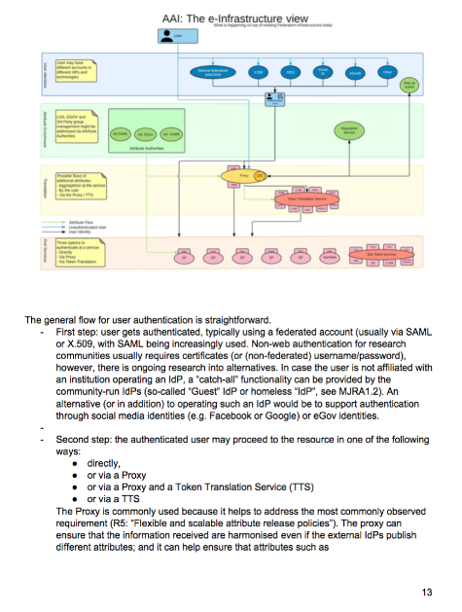
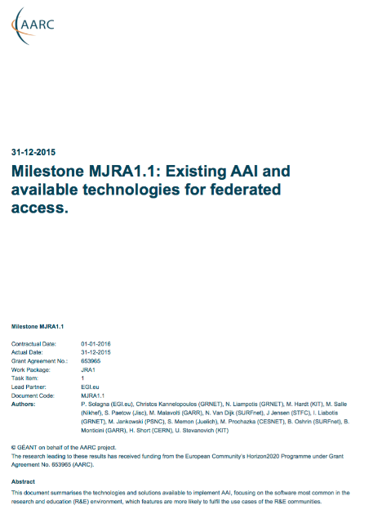
References Pilots
Library, hybrid AuthN
Library, IdP-SP proxy approach
IdPs
Attribute Authorities
Perun and COmanage AAs for BBMRI & EGI
OpenConext attribute aggregation
Proxy
Token Translation
TTS with CI-logon and VO portal for Elixir
ORCID SP, LoA Elevation, Reference implementation of the BPA…
https://goo.gl/kSxENp
Service Provider
https://goo.gl/NzQA2U
https://goo.gl/7dZZF4
https://wiki.geant.org/display/AARC/Pilot+results+and+demos

Slide 23
References
Security Incident Response Trust Framework for Federated Identity
  https://refeds.org/sirtfi
Minimal Assurance Level for low-risk research use cases
  https://wiki.geant.org/display/AARC/LoA+-+Level+of+Assurance
  https://wiki.refeds.org/display/GROUPS/Assurance+Working+Group
Policy and sustainability models for a pan-European Token Translation Service
  https://www.rcauth.eu/
Sustainability models for ”Guest IdPs”
  https://wiki.geant.org/display/AARC/Sustainability+models+for+Guest+IdPs
Requirements for Accounting and Data Protection
  https://wiki.geant.org/display/AARC/DNA3.5%3A+Recommendations+and+template+policies+for+the+processing+of+personal+data

