Slide 1




LIGO & Virgo Analysis and computing: Overview
Michele Punturo – INFN Perugia
1st ASTERICS-OBELICS Workshop
12-14 December 2016, Rome, Italy.
H2020-Astronomy ESFRI and Research Infrastructure Cluster (Grant Agreement number: 653477).

Slide 2
Detection of GW
In February 2016 the LIGO scientific collaboration and the Virgo collaboration announced the first direct detection of the GW in the LIGO detectors
  One century after the prediction of Albert Einstein
  GW150914: The first direct evidence of the existence of Black Holes binaries:
    Ha been detected the “voices” of these BHs during their coalescence
  On the same scientific run another event GW151226 has been detected and a strong candidate LVT151012
  A cornerstone achievement in science, but, even more, the opening of the new era of the GW astronomy and astrophysics

Slide 3
How it has been achieved?

Slide 4
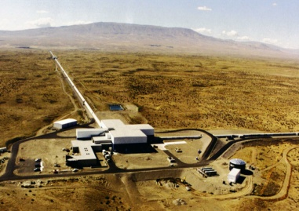

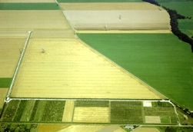
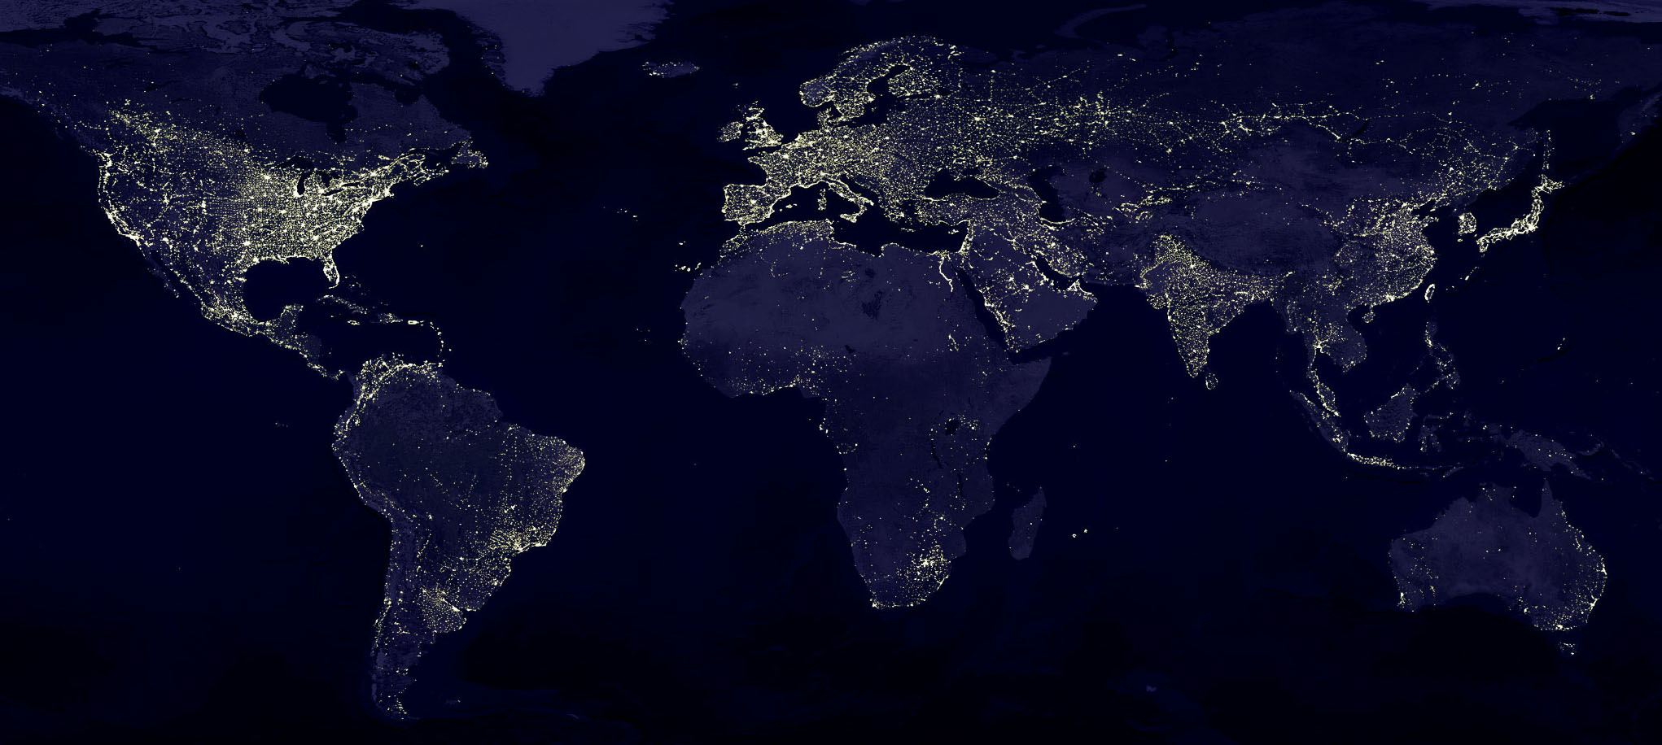
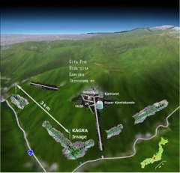
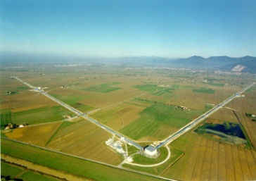




Terrestrial Detectors
Advanced detectors 2015-2025
Standard format (FrVector) for all the GW experiments, driven by the specific format of GW data
GEO600, 0.6 km
~2019
aLIGO Hanford, 4 km
2015
~2024
2017
AdV, Cascina, 3 km
aLIGO Livingston, 4 km

Slide 5
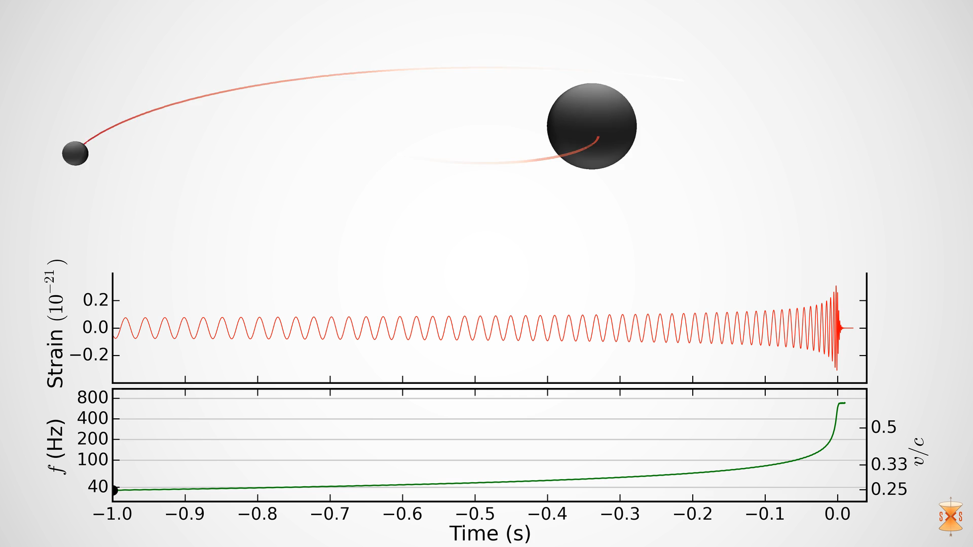
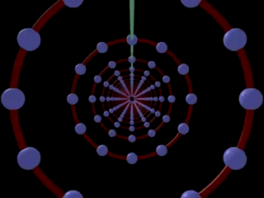
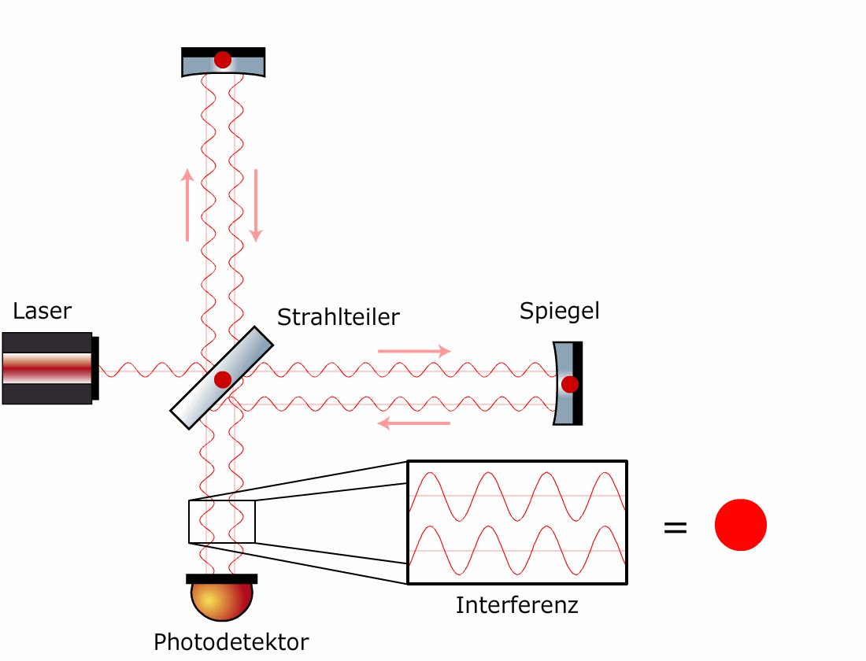
Output of the interferometer
Sampling frequency:
  ~20kHz
DAQ rate:
  25-35MB/s
ADC

Slide 6
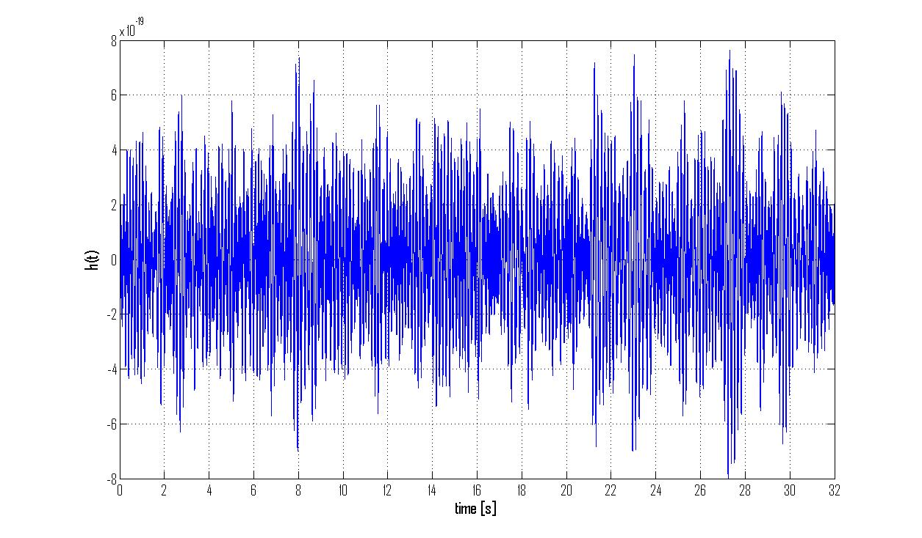
GWD is mainly a noise generator
GW151226 event at 16.6s

Slide 7
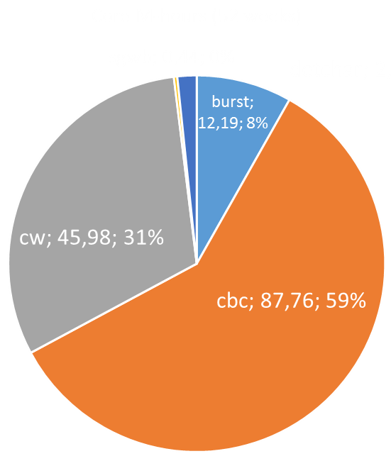
Analysis methods
Several are the methods used to extract the signal from the noise, obviously depending on the GW sources, but we can define 3 major sectors:
  Bursts (unmodeled):
    Fourier transforms, wavelets, energy evaluation, χ² calculation, parameters estimation, online and offline
  CBC (modeled):
    Fourier transforms, matched filtering, χ² calculation, parameters estimationonline and offline
  Continuous waves
    Fourier transform/mathed filtering (known sources), frequencyHough transform (unknown sources), offline

Slide 8
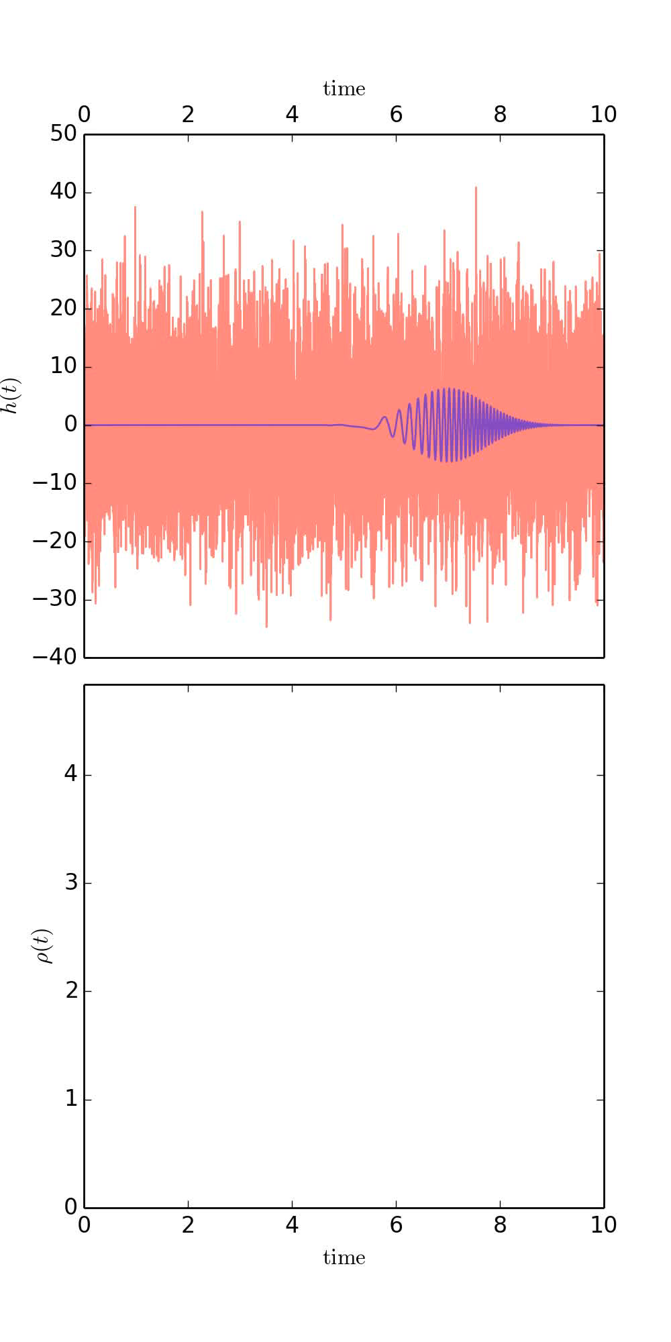
Matched filtering
The matched filter is the detection (and estimation) optimal filter if the template of the signal is known:

Slide 9
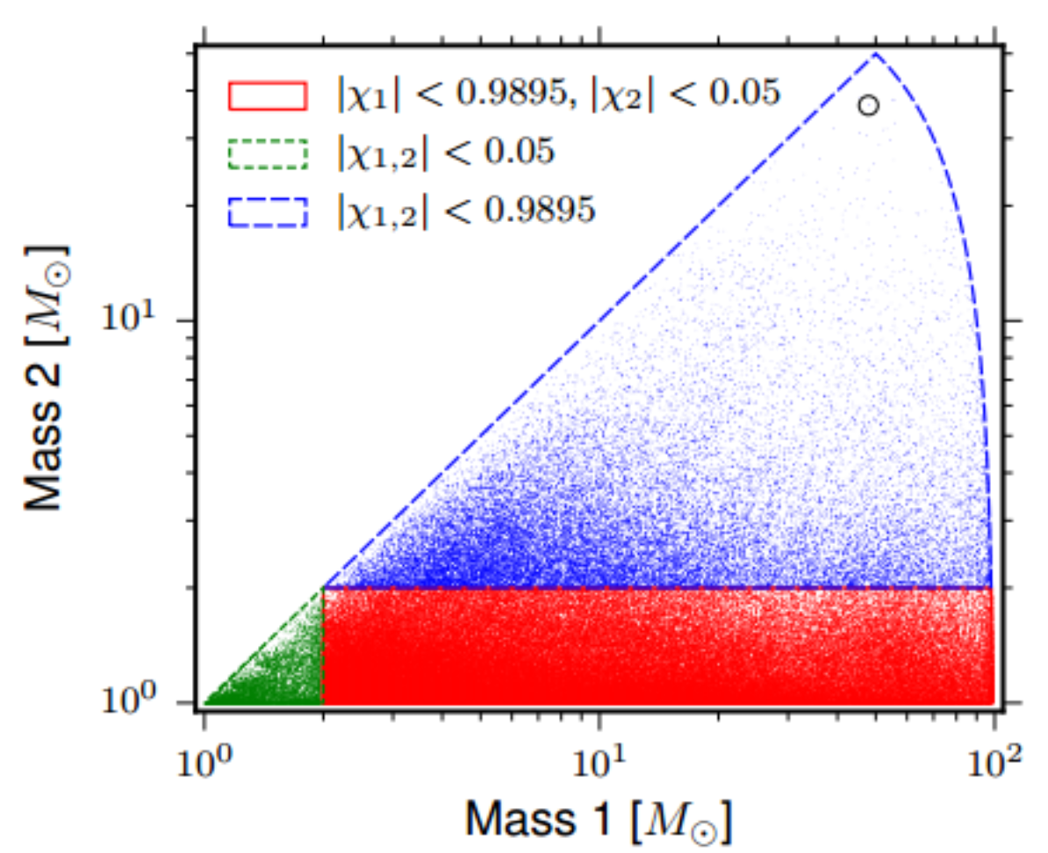
CBC Template bank
But, we don’ know the signal parameters and then we have to create a template grid (masses, orientations, spins, ….)
For GW150914 a bank of ~250.000 templates has been created
To compute the significance of the detection, the outputs of the 2 (or more) detectors are repetitively displaced by an arbitrary time offset and the analysis repeated
More detailed physics (precession)?
Parameter estimation ?
→ More templates (by more than 1 order of magnitude)

Slide 10
Online analysis
The main target of the online analysis is providing triggers to e.m. telescopes (and neutrino detectors)
  82 MOU signed
  60 telescopes are ready for triggers in O2
Requirements: provide detection, significance, (poor) parameters estimation and localization within few minutes
Analysis performed with hierarchical algorithms, with a sub-set of templates, or with burst detection methods
  Analysis both at the Tier0 (Virgo) and Tier1 (ATLAS, Caltech, UWM) sites.

Slide 11
CW analysis for unknown sources
Computing power bounded problem
Requirements mitigated by a hierarchical approach

Slide 12
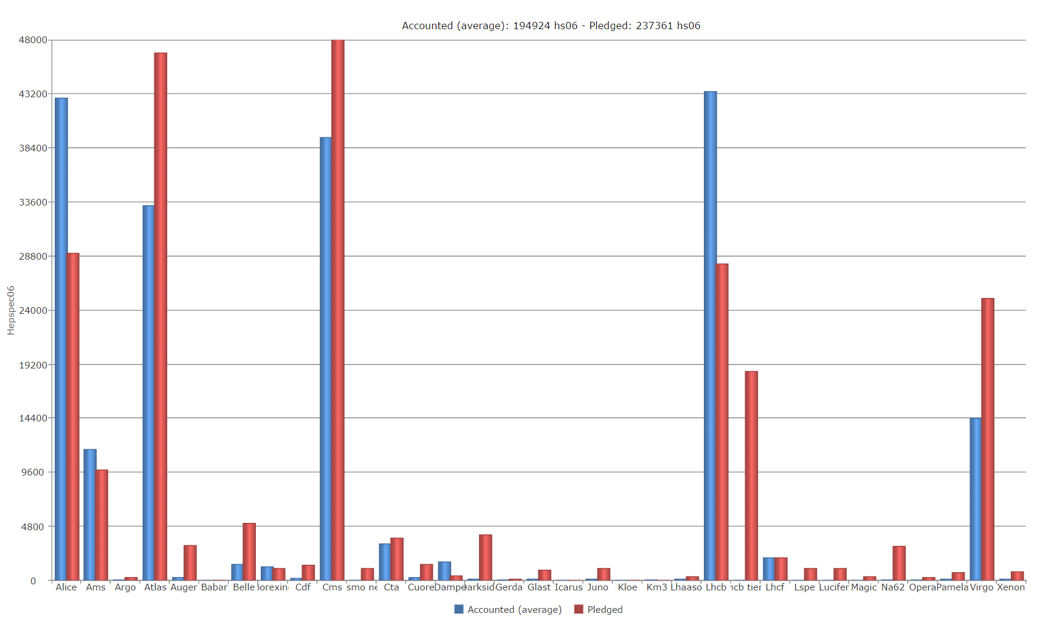
Key elements of the computing model
Relatively small amount of data
High computing requirements
  FFT
  “embarrassingly parallel” problem, we can parallelise
    Over time
    Over templates
    Over background estimation

Slide 13
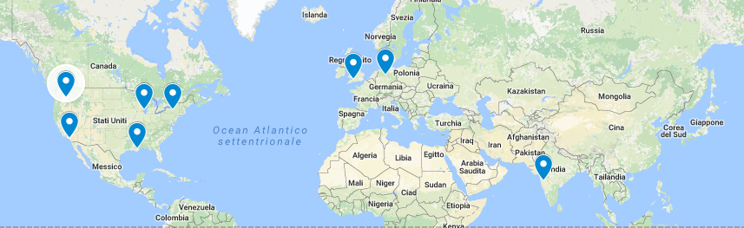
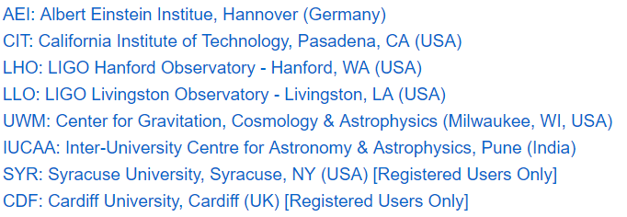
Current LSC computing
Organised in 8 main clusters
  “big farms” with shared filesystem
  Job submission and workflow through Condor
    pyCBC uses Pegasus WMS on top of Condor
  Ligo Analysis Libraries accessible by all the nodes
  Authentication via proxy/ssh

Slide 14
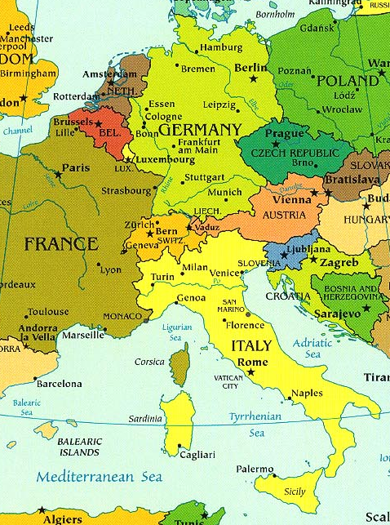


Current Virgo computing
Data Storage:
  CNAF and CCIN2P3
Jobs executed through EGI (or locally):
  CCIN2P3
  CNAF
  Nikhef
  Polish grid infrastructure
Recently, Virgo CC accessible via OSG for some LSC pipelines:
  pyCBC
  BayesWave
  cWB

Slide 15
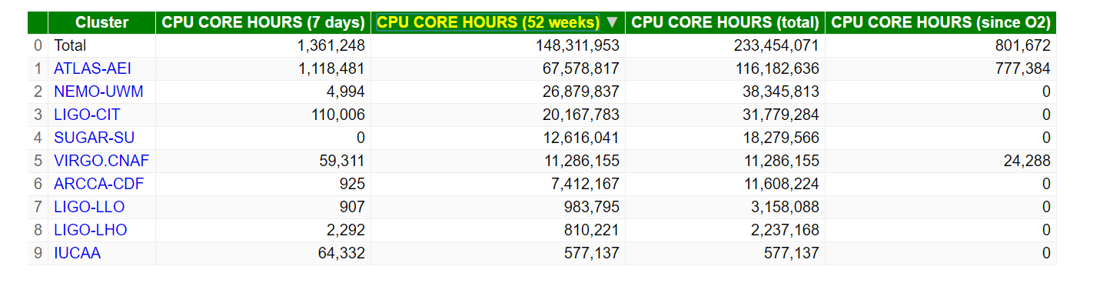
Sizing the problem
One year of Data Analysis

Slide 16
Challenges
Integrates new physics in the template based analysis
  Grown of the computing requests by one or two orders of magnitude if we don’t find “clever” solutions
    Hierarchical approach
    GPUs (see P. Couvares talk)
Include new detectors in the network (Advanced Virgo, KAGRA, LIGO-India)
Online analysis
  Provide triggers within seconds of delay, but having well estimated sources
Better sensitivity in low frequency:
  longer templates, of the order of minutes wrt the current duration (seconds)
    1 order of magnitude more CPU in O3 and later absent optimisation
    3G evolution

Slide 17
GPUs
CBC analysis is made mainly of thousands of FFT and χ² computation in parallel
GPUs appeared since the beginning a promising instrument to parallelize and optimize the code
First attempts in Virgo 2005-2010
  Merlino data analysis environment, based on MPI and built in a many-cores environment
  MACGO project (Manycore computing for future Gravitational Observatories)
  First tests on GPUs shown a speed-up of about 50.
Currently a pyCBC GPU version is under development in LIGO (see P. Couvares talk).

Slide 18
Acknowledgement
H2020-Astronomy ESFRI and Research Infrastructure Cluster (Grant Agreement number: 653477).

