Slide 1

1st ASTERICS-OBELICS WORKSHOP
E4 Experience and Expertise
In HPC
Rome
12-14 Dec. 2016
Daniele Gregori

Slide 2

TABLE OF
CONTENTS
The Company
E4 Production and R&D Labs
Some E4 Solutions, and some case studies
CPU Architecture for HPC and Comparison
D.A.V.I.D.E petaflops class cluster
Other European Projects involved

Slide 3

THE COMPANY
Since 2002, E4 Computer Engineering has been innovating and actively encouraging the adoption of new computing and storage technologies. Because new ideas are so important, we invest heavily in research and hence in our future. Thanks to our comprehensive range of hardware, software and services, we are able to offer our customers complete solutions for their most demanding workloads on: HPC, Big-Data, AI, Deep Learning, Data Analytics, Cognitive Computing and for any challenging Storage and Computing requirements.
E4. When Performance Matters.

Slide 4
COMPANY MILESTONES
2016
First OpenPOWER server
2012
First ARM+GPU server
2005
First Infiniband Cluster
Company growth
2017
First OpenPOWER Petaflop Cluster
2013
First ARM Cluster deployment
2009
First GPU Cluster
2002
2020

Slide 5

WHAT WE DO
E4 COMPANY PILLARS

Slide 6
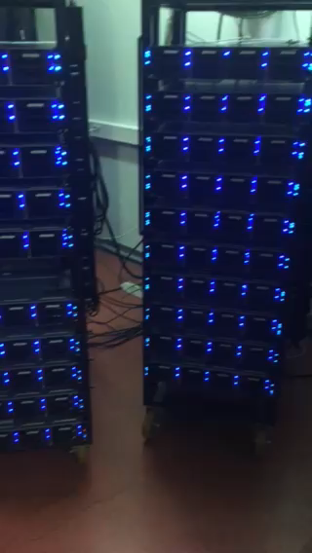
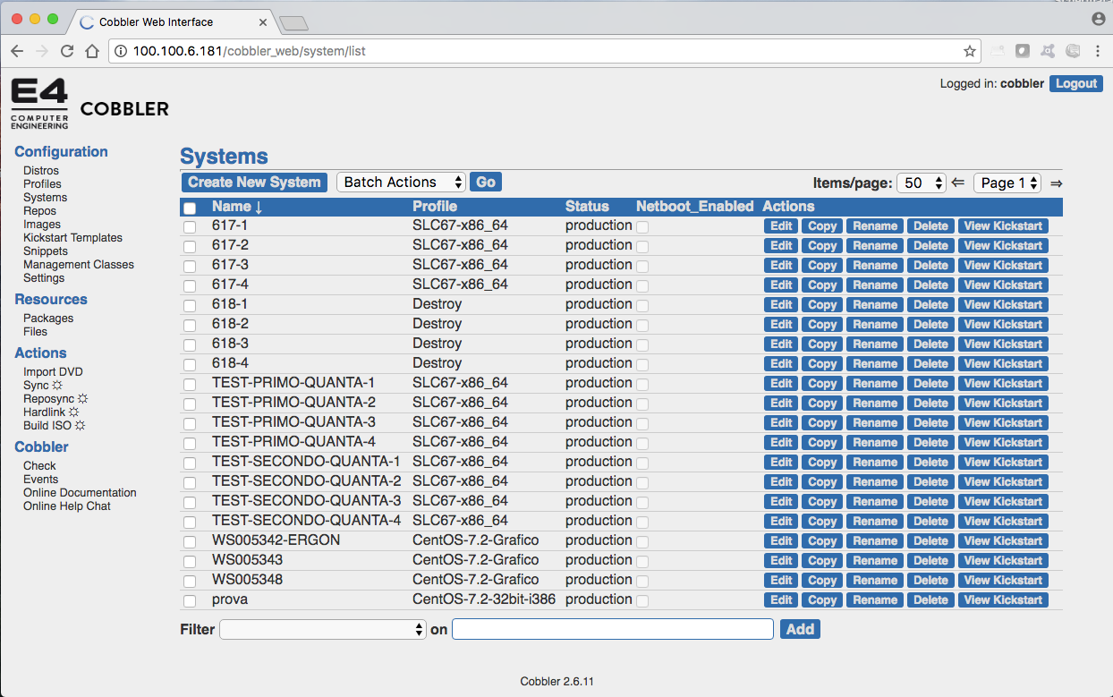
HIGH AUTOMATION
FOR PRODUCTION
Our production takes place through high automation tools for installation, configuration and quality control.
I.E. over 2016 there have been two major CERN productions where we have manufactured ~ 2300 servers and 200 JBOD, in total 30PB and 46756 cores.
We adopt Open Source Software: Cobbler – Puppet – Nagios – Graphite.
We internally support the “E4tools” application development for quality control.
High quality systems: failure rate < 1%

Slide 7
Server Quality
E4 TOOLS
A PROPRIETARY SOFTWARE FOR SYSTEMS’ SET-UP AUTOMATION AND HOMOGENEITY CHECKS
FIRMWARES’ CHECKS,
UPGRADE,
CONFIGURATION
SETUP CHECKS
HOMOGENEITY CHECKS
SANITY CHECKS
PERFORMANCE CHECKS
DETAILED REPORTS
HARDWARE CATALOG, PERFORMANCE REPORT, ERROR REPORT
SUMMARY REPORT FOR EACH MACHINE PRODUCED

Slide 8
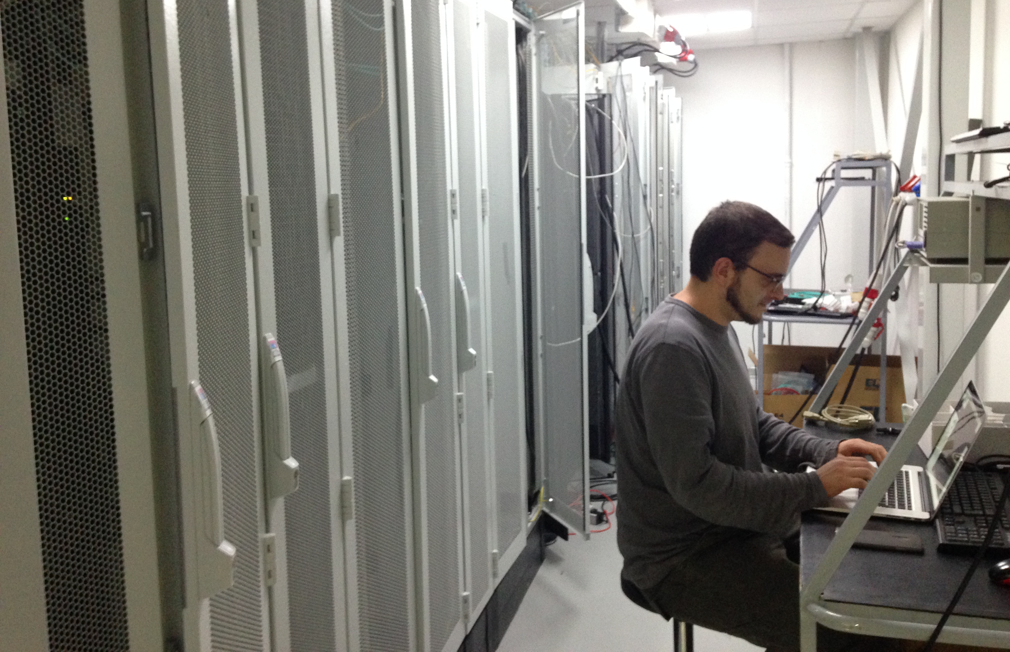
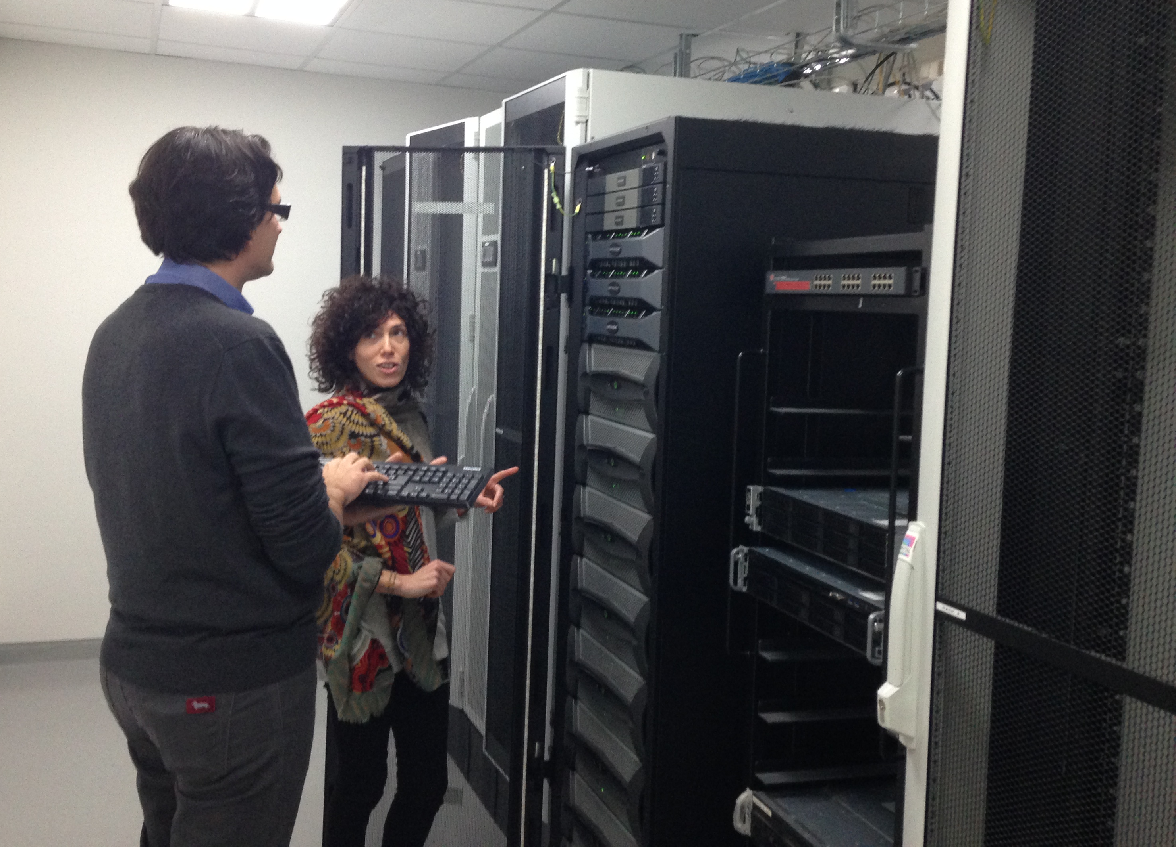
New R&D LAB
30 m²
temperature 27/30°c
6 x Rack 19’
4 x Chiller 22 kw
Active Power available ~100 kw
Hardware Management via OpenDCIM open source Remote access available on demand

Slide 9

R&D CURRENT ACTIVITIES
OpenPower
HPC cluster
Long Term Data Preservation

Slide 10

SCALE-OUT NAS
OUR SOLUTIONS
SOLUTIONS

Slide 11

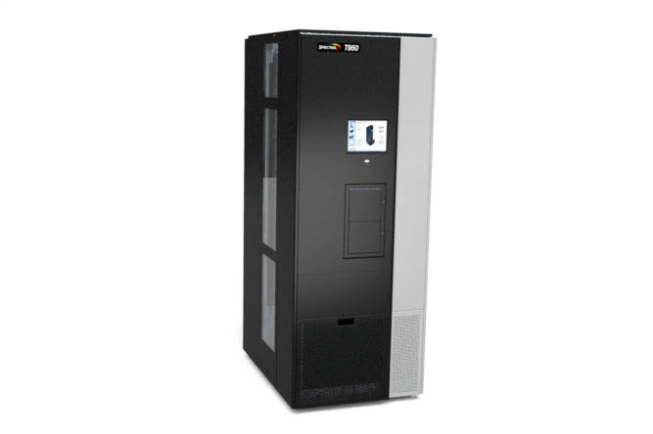
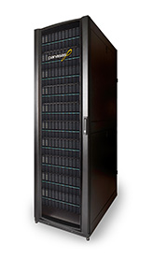

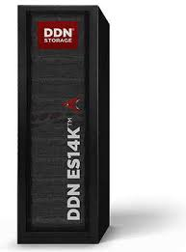
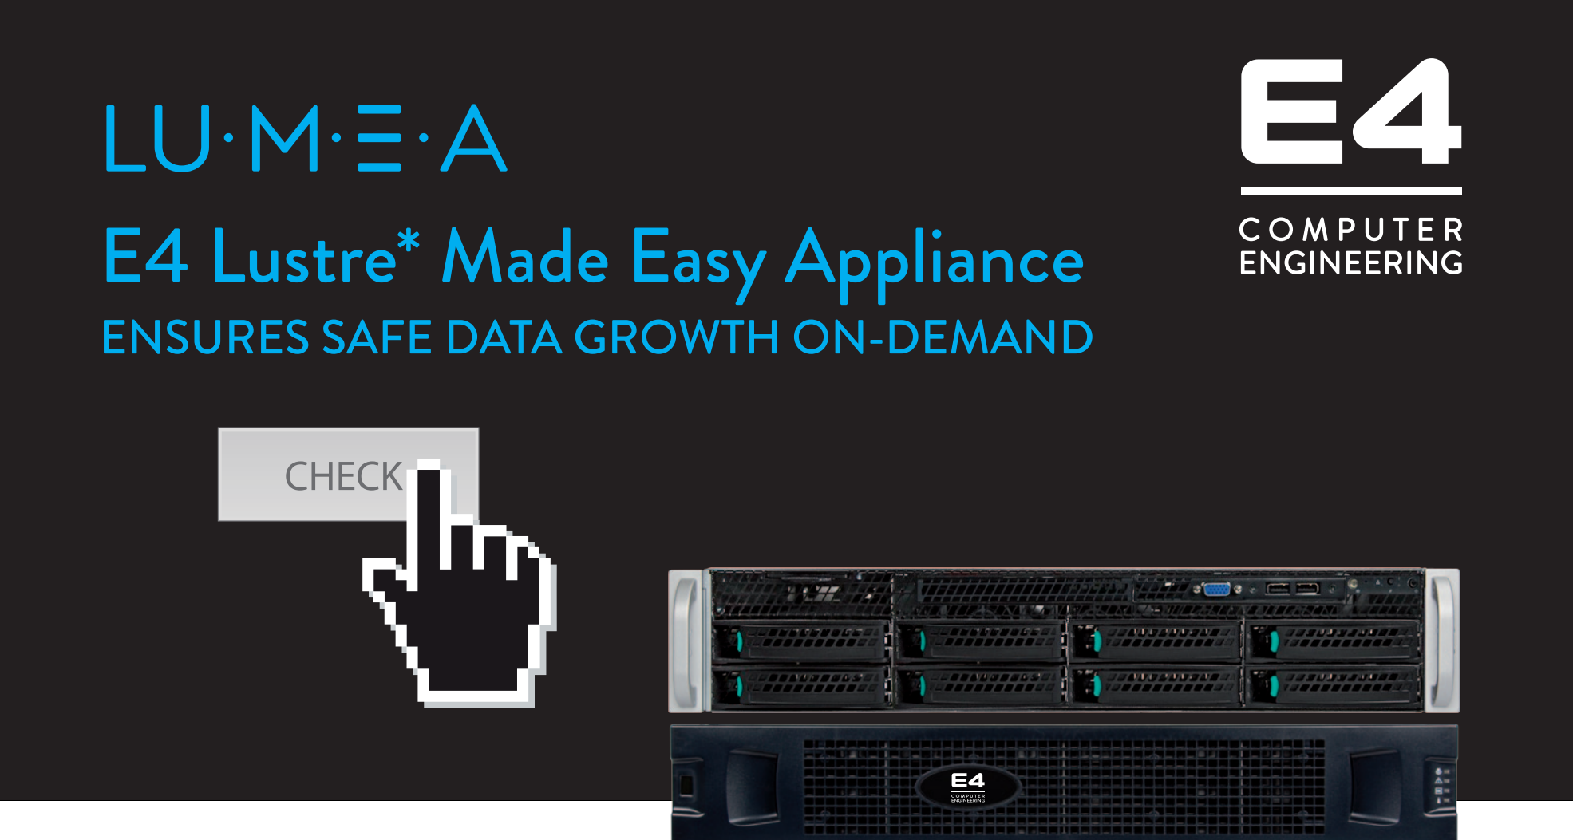




STORAGE & SOFTWARE DEFINED STORAGE
We are able to provide solutions with Parallel Filesystem and hierarchical storage on tape library

Slide 12
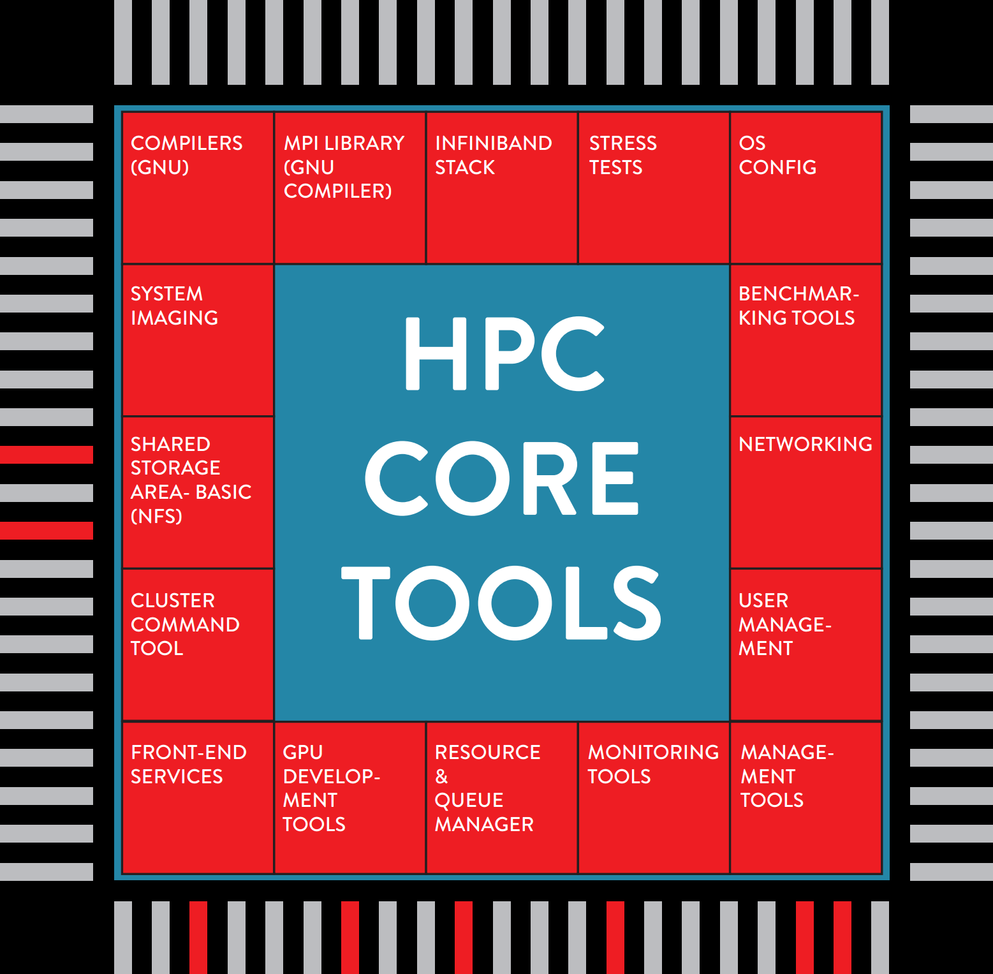
HPC Open Suite
E4 HPC Open Suite - THE PERFECT CLUSTER RECIPE
HPC clusters coupled with different management suites, starting from a collection of open source tools
up to enterprise management solutions. E4 HPC clusters are supplied by default with E4’s HPC OPEN SUITE
NODE PROVISIONING
INSTALLATION CONFIGURATIONBARE METAL REINSTALL
NETWORK SETUP
NETWORK SERVICES
STORAGE
USER MANAGEMENT
RESOURCE/ QUEUE MANAGER
IN-BAND AND
OUT-OF-BAND
MANAGEMENT
CLUSTER COMMAND TOOLS
MONITORING AND ALERTING
POWER MANAGEMENT
DEVELOPMENT TOOLS
DEBUGGING /
PROFILING TOOLS
BENCHMARKING TOOLS
CERTIFICATIONS

Slide 13
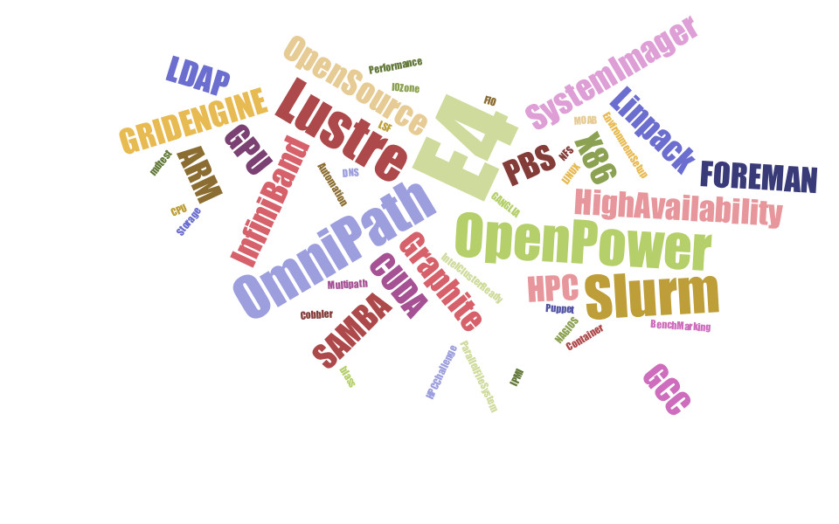
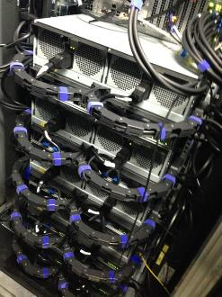
Our Idea of HPC through E4 HPC Open Suite
Best Hardware:
Low Failuere Rate
Performed Benchmark in our lab
Designe solution based on Custormer requirement
+
Best Skills: We are able to configure each Software Components, define the Modules Environment and customize the Cluster for a Ready to Use Solution

Slide 14
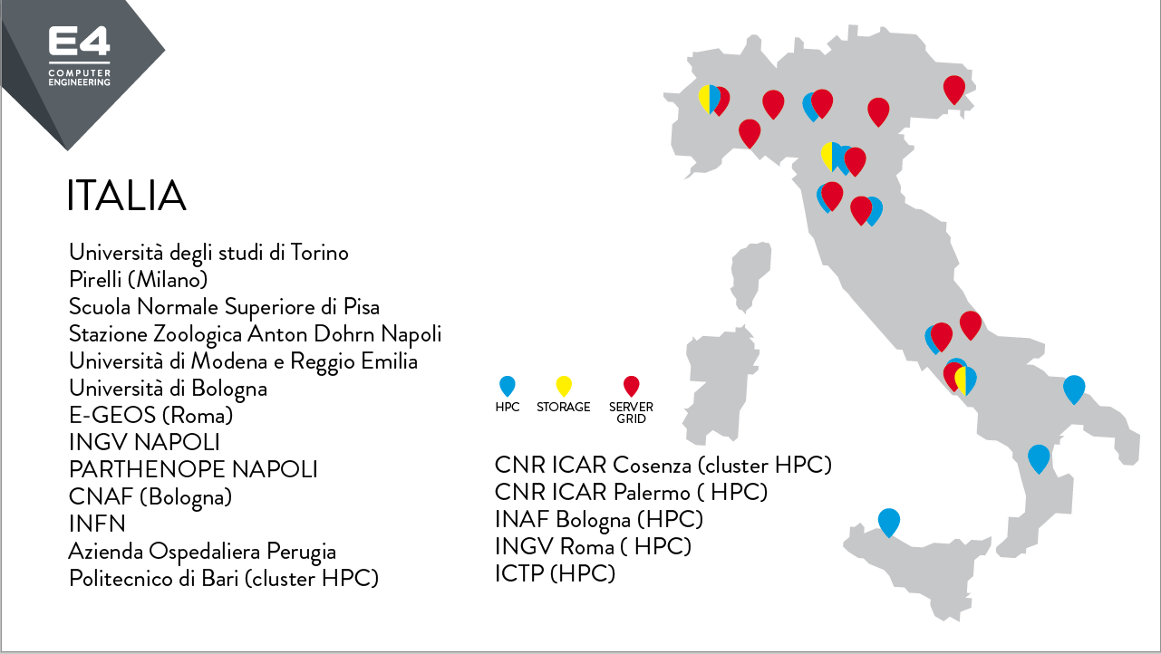
Case Studies Map

Slide 15
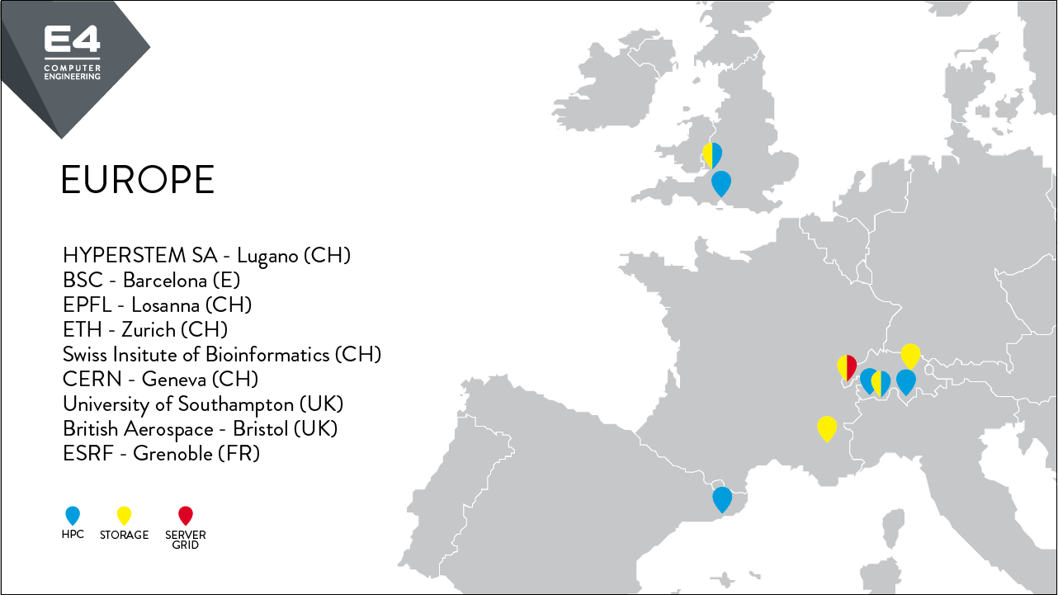

Slide 16

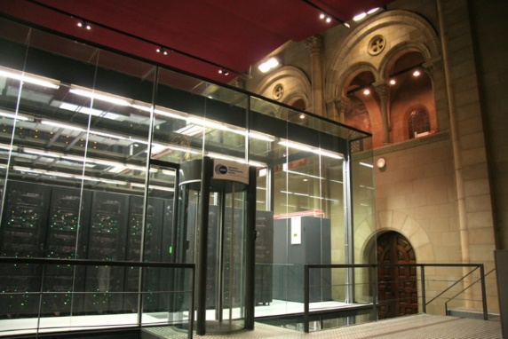

HPC ARM Success Story
REQUIREMENTS | Custom solution based on low power CPU and GPU accelerators
CHALLENGES | Creating an unique prototype with mobile SoC connected to high-end computing GPUs
SOLUTION | 78 compute nodes equipped with Tegra 3 SoC, Nvidia K20, Mellanox Infiniband QDR
APPLICATION | GPU boosting
KEY FACTORS | Low power SoC Prototyping ability
BENEFITS | Accelerated computing at minimum power footprint First worldwide ARM+GPU prototype Disruptive innovation
Customer | BSC PEDRAFORCA CLUSTER
Industry | Supercomputing National Centre

Slide 17

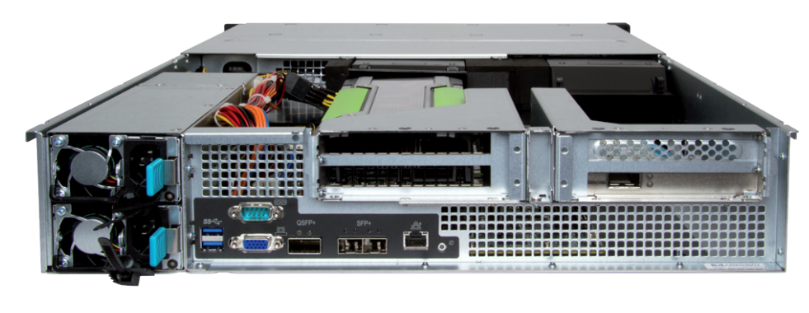


HPC With ARM
HIGHLIGHTS
OS Ubuntu or Fedora Linux Distro
DEVELOPMENT TOOLS NVIDIA CUDA 6.5 (compilers, libraries, SDK)
MPI libraries GNU compilers
CLUSTER, MONITORING
MANAGEMENT TOOLS Resource/Queue manager Monitoring tools for cluster Parallel shell for cluster-wide commands
ARKA RK004
ARM®64 BIT ARCHITECTURE + GPU + IB
Low-power, low-energy platforms designed for HPC environment
Heterogeneous ARM® Architecture + GPU + IB.
New generation ARM® v8 cores 64-bit
Production environment with a full support of the software ecosystem: Linux OS, libraries, compilers and applications
May be used for seismic processing, signal/image processing, video analytics, track analysis and web applications, map-reduce like frameworks (Hadoop)
We provided the ARM clusters at Barcelona Super Computer and Massachusetts Institute of Technology teams for the Student Cluster Competition @ ISC 2016

Slide 18

HPC with Open POWER8
OpenPOWER SERVER OP205
FIRST OpenPOWER8 PROCESSOR-BASED SYSTEM IN EUROPE
BENEFITS
Full stack of tools for cluster management
Cluster available for remote access
Performance tuning services
HIGHLIGHTS
High performance Linux server
Dual IBM POWER8 processor modules
Dual NVIDIA GPU accelerators
Incorporates Mellanox Scalable HPC
Solutions with NVIDIA technology
CAPI technology
Supports up to 1 TB of 1333/1066 MHz DDR3L memory
Flexible and modular I/O
Up to 8 threads
Max 230GBps per socket
During 2016 In our Lab we Realized the first HPC Cluster based on Open POWER 8 in Europe

Slide 19
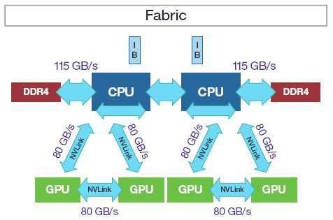
Forthcoming Open POWER 8+
OpenPOWER SERVER OP206
GPGPU-CPU NVLINK
Available only for Power Architecture

Slide 20
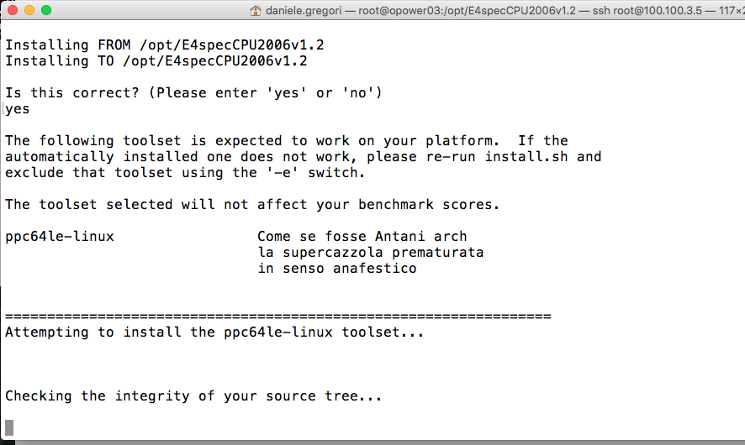
HEPSPEC TEST
On Open Power and X86
OpenPower8 2CPU 8core per CPU @ 3.8GHz, 512 GB RAM
OS: CentOS 7.2.15.11 ppc64le Compiler: gcc 4.8.5
Intel(R) Xeon(R) 2CPU E5-2697A v4 @ 2.60GHz, 128 GB RAM
OS: CentOS 6.6 Compiler: gcc 4.4.7
Test HEPSPEC @ 64 bit
Needs to recompile hepspec and toolset
HEPSPEC is the test adopted in HEP community to addresses the common workload
https://w3.hepix.org/benchmarks/doku.php
https://www.spec.org/
HEP SPEC
444.namd
447.dealII
450.soplex
453.povray
471.omnetpp
473.astar
483.xalancbmk

Slide 21
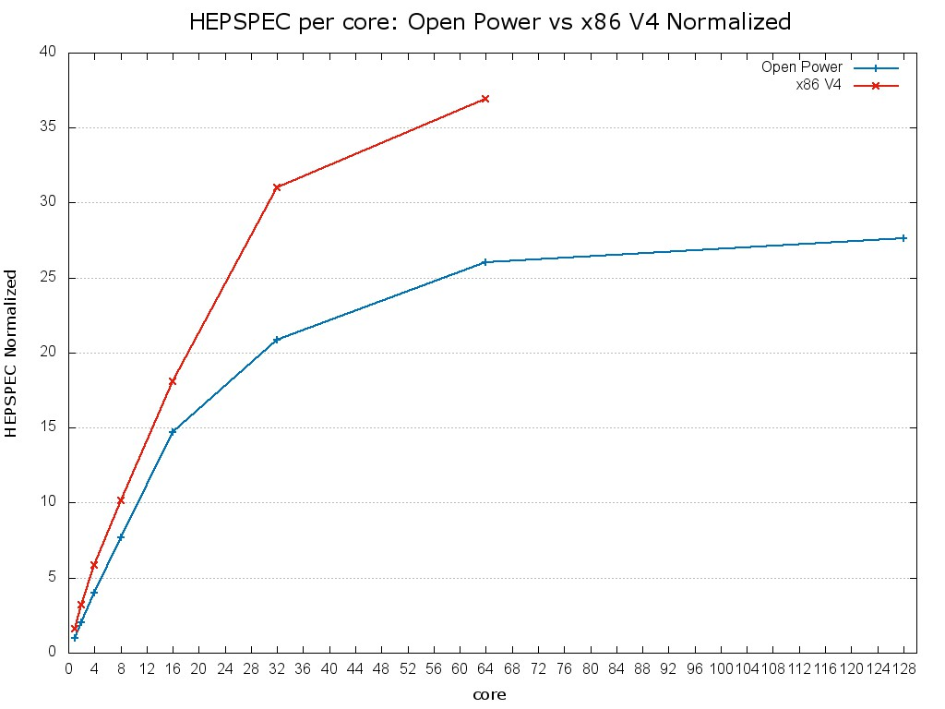
HEPSPEC RESULTS
OpenPower8 2CPU 8core per CPU @ 3.8GHz, 512 GB RAM
OS: CentOS 7.2.15.11 ppc64le Compiler: gcc 4.8.5
Intel(R) Xeon(R) 2CPU E5-2697A v4 @ 2.60GHz, 128 GB RAM
OS: CentOS 6.6 Compiler: gcc 4.4.7
32 physical core
HT on
8 Threads per core
2 Threads per core
16 physical core

Slide 22
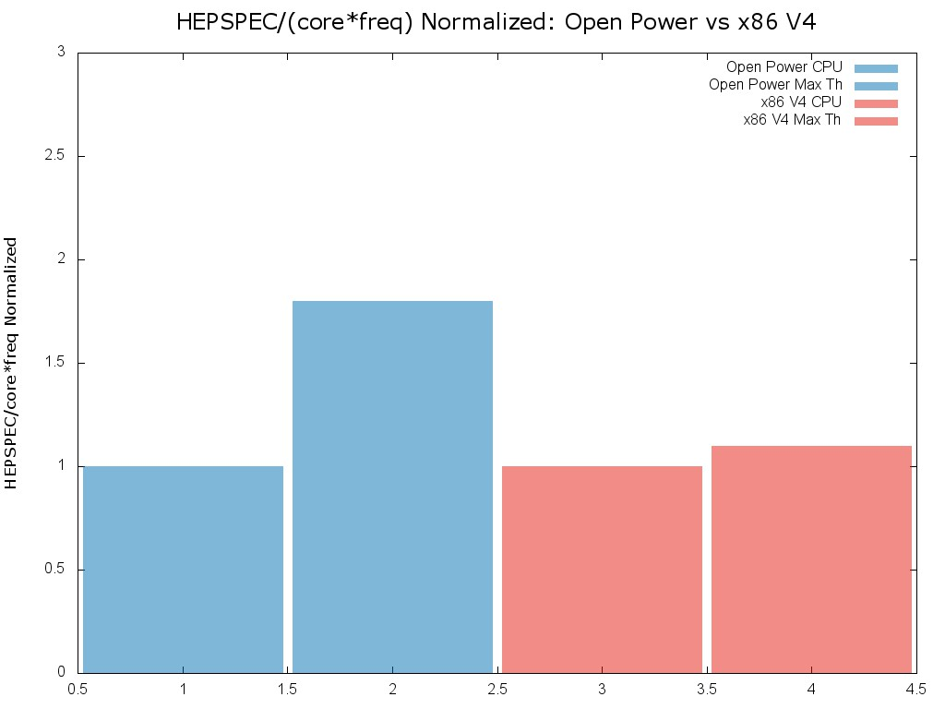
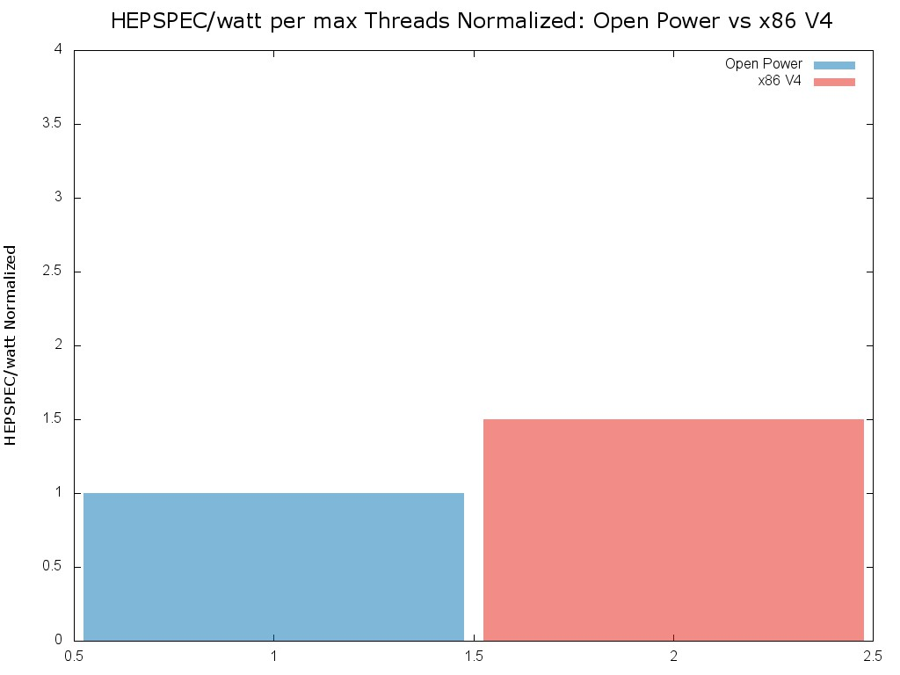
HEPSPEC RESULTS
OpenPower8 2CPU 8core per CPU @ 3.8GHz, 512 GB RAM
OS: CentOS 7.2.15.11 ppc64le Compiler: gcc 4.8.5
Intel(R) Xeon(R) 2CPU E5-2697A v4 @ 2.60GHz, 128 GB RAM
OS: CentOS 6.6 Compiler: gcc 4.4.7

Slide 23
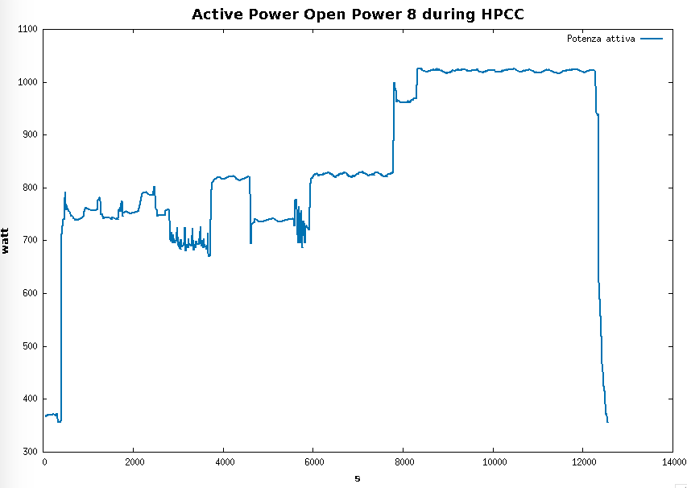
HPC Challenge TEST with Open Power 8:
Active Power in watt
FFT
Latency test
HPL
DGEMM
STREAM
PTRANS
Random Access
test
http://icl.cs.utk.edu/hpcc/

Slide 24
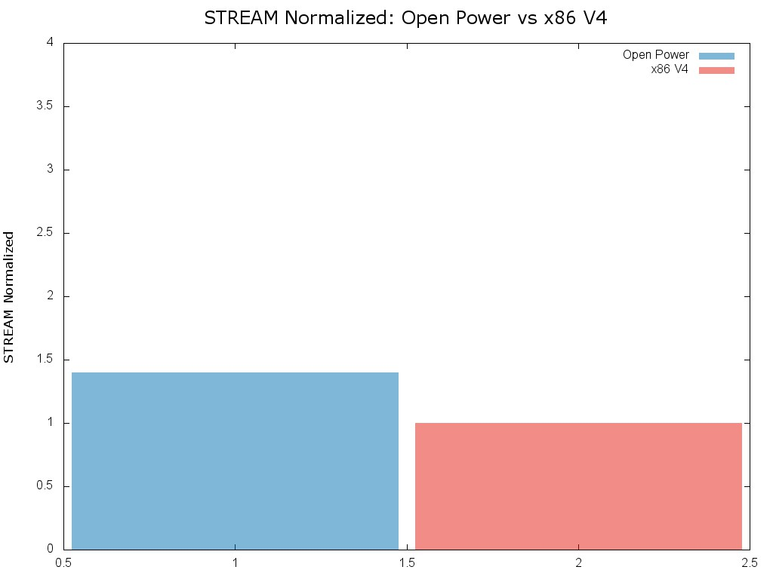
STREAM TEST
Memory performance Benchmark: STREAM http://www.cs.virginia.edu/stream/ + allocazione dinamica della memoria
COPY: a(i) = b(i)
SCALE: a(i) = q*b(i)
SUM: a(i) = b(i) + c(i)
TRIAD: a(i) = b(i) + q*c(i)
OpenPower8 2CPU 8core per CPU @ 3.8GHz, 512 GB RAM
OS: CentOS 7.2.15.11 ppc64le Compiler: gcc 4.8.5
Intel(R) Xeon(R) CPU E5-2697A v4 @ 2.60GHz, 128 GB RAM
OS: CentOS 6.6 Compiler: gcc 4.4.7

Slide 25
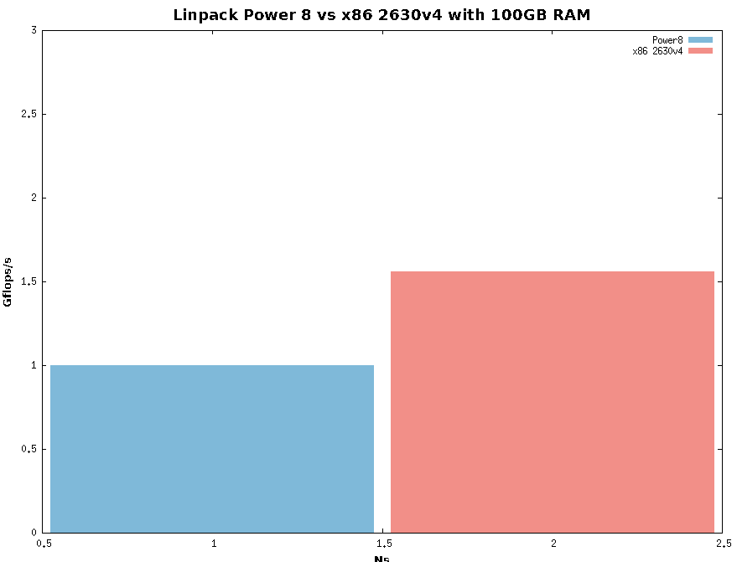
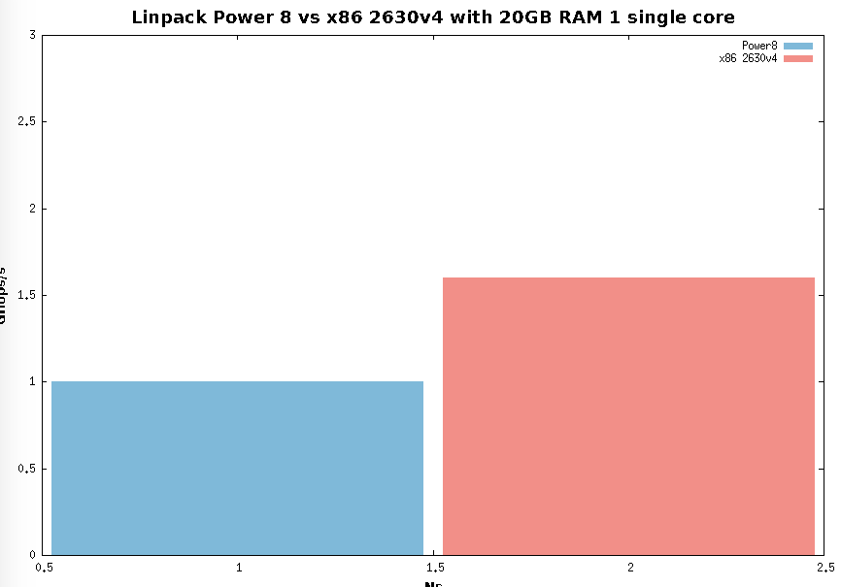
Linpack TEST
http://www.netlib.org/benchmark/hpl/
OpenPower8 2CPU 8core per CPU @ 3.8GHz, 512 GB RAM
OS: CentOS 7.2.1511 ppc64le Compiler: gcc 4.8.5
Intel(R) Xeon(R) 2CPU 10core per CPU E5-2630v4 @ 2.2GHz, 256 GB RAM
OS: CentOS 7.2.1511 Compiler: Intel Parallel Studio 2017

Slide 26
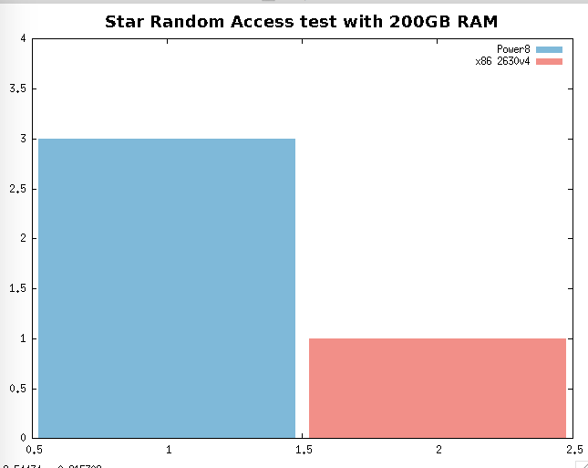
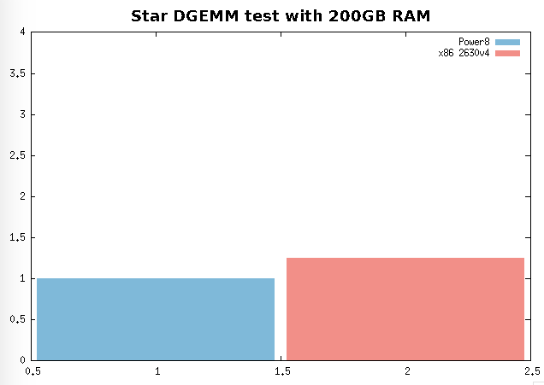
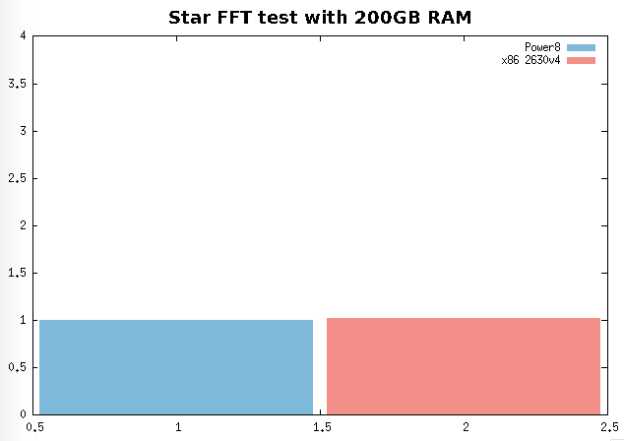
More HPCC TEST Results
http://www.netlib.org/benchmark/hpl/
OpenPower8 2CPU 8core per CPU @ 3.8GHz, 512 GB RAM
OS: CentOS 7.2.1511 ppc64le Compiler: gcc 4.8.5
Intel(R) Xeon(R) 2CPU 10core per CPU E5-2630v4 @ 2.2GHz, 256 GB RAM
OS: CentOS 7.2.1511 Compiler: Intel Parallel Studio 2017

Slide 27

D.A.V.I.D.E. SUPERCOMPUTER
(Development of an Added Value Infrastructure Designed in Europe)
PRACE Awards Third and Final Phase of Pre-Commercial Procurement (PCP)
After successfully completing phase II, during phase III, E4 proposed an innovative design that makes avail of the most advanced technologies, to produce a leading edge HPC cluster showing higher performance, reduced power consumption and ease of use.
https://www.hpcwire.com/off-the-wire/e4-computer-engineering-wins-third-final-phase-praces-pcp/
RESEARCH and PRODUCTION PROJECT
CUSTOMIZED COMPUTE NODES by WISTRON
IBM POWER8+ with NVIDIA NVLink
NVIDIA® TESLA® P100 SXM2
LIQUID COOLING
POWER MONITORING & PROFILING, POWER MANAGEMENT, POWER CAPPING & PREDICTION
CODE PORTING & OPTIMIZATION
OPEN RACK FORM FACTOR with INTEGRATED PIPING &POWER DISTRIBUTION
SYSTEM DESIGN, INTEGRATION, TESTING and DELIVERY
PETAFLOP-CLASS COMPUTING CLUSTER

Slide 28

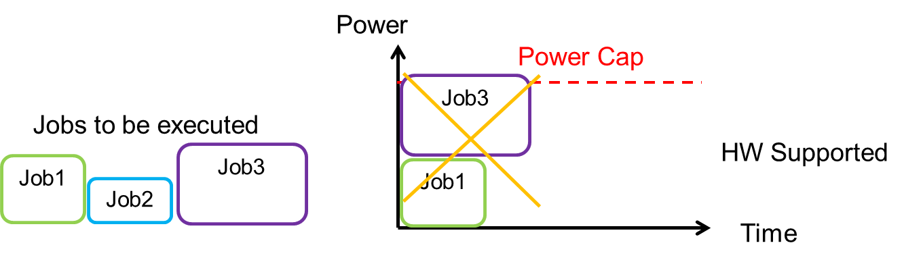
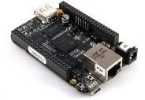
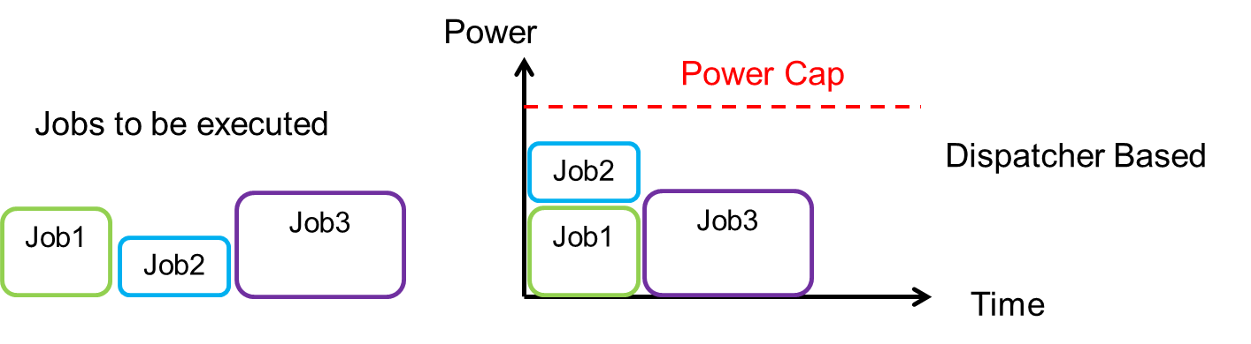
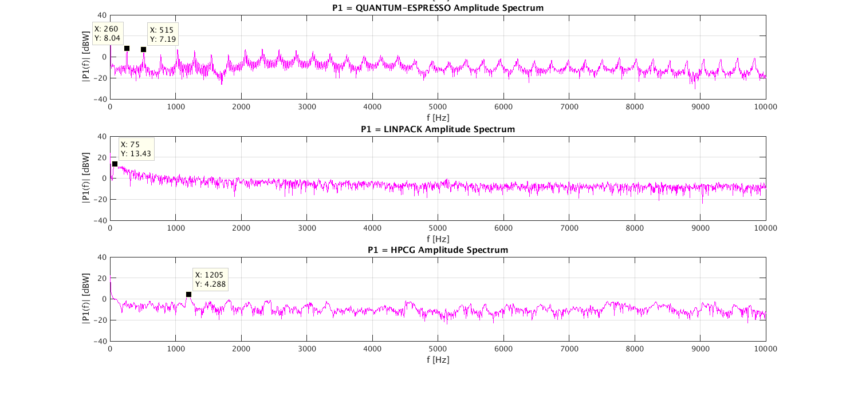
Scalable and fine-grain power monitoring engine and Job Scheduler Power-Capping for D.A.V.I.D.E.
Without Power Capping
Our Solution:
Beaglebone
Black Board
Exceed in power capping
- 1GHz ARM Cortex-A8
- 12bit 8-ch SAR ADC
- PTP HW enabled
No Job Slowdown
No changes in the accounting
BBB sensors detect thepower consumption and an IA system learns the job power consumption, then the scheduler could submit next jobs in base of Power cap limit.
FFT– power spectral analysis

Slide 29
COOPERATION = INNOVATION
MEMBERSHIPS
OpenPOWER Foundation
OpenPOWER WG for Physical Science
ETP4HPC - HPC European Consortium
SPEC
HPC Advisory Council
Open Compute Project
ENERGY AWARENESS COMPUTING
E4 is designing hardware components for high frequency energy sampling
Co-organizer of initiatives, such as COLA workshop, aimed at increasing the knowledge of energy awareness for scientific computing
DESIGN EXASCALE APPLICATIONS
Member of the MAX Center of Excellence of material science (H2020) http://www.max-centre.eu/
We are technology provider.
Direct financial contribution to port scientific applications on ARM and ARM+GPU architectures
INVOLVED IN APEX-D EU PROJECT
(waiting for acceptance)
The goal is to reduce data transport requirements by processing messages as they come. The project will leverage emerging solutions for network interfaces or switches with integrated processing capabilities. Examples are Infiniband or Ethernet network cards with integrated FPGAs or low-power CPU cores.

Slide 30
We are ready for Innovation, and you?
We are looking for…
Cooperation to write new EU Projects to develop new Technologies
Cooperation to develop new Solutions ready for Businnes
Cooperation to benchmark SW and Cluster and write Technological Paper

Slide 31
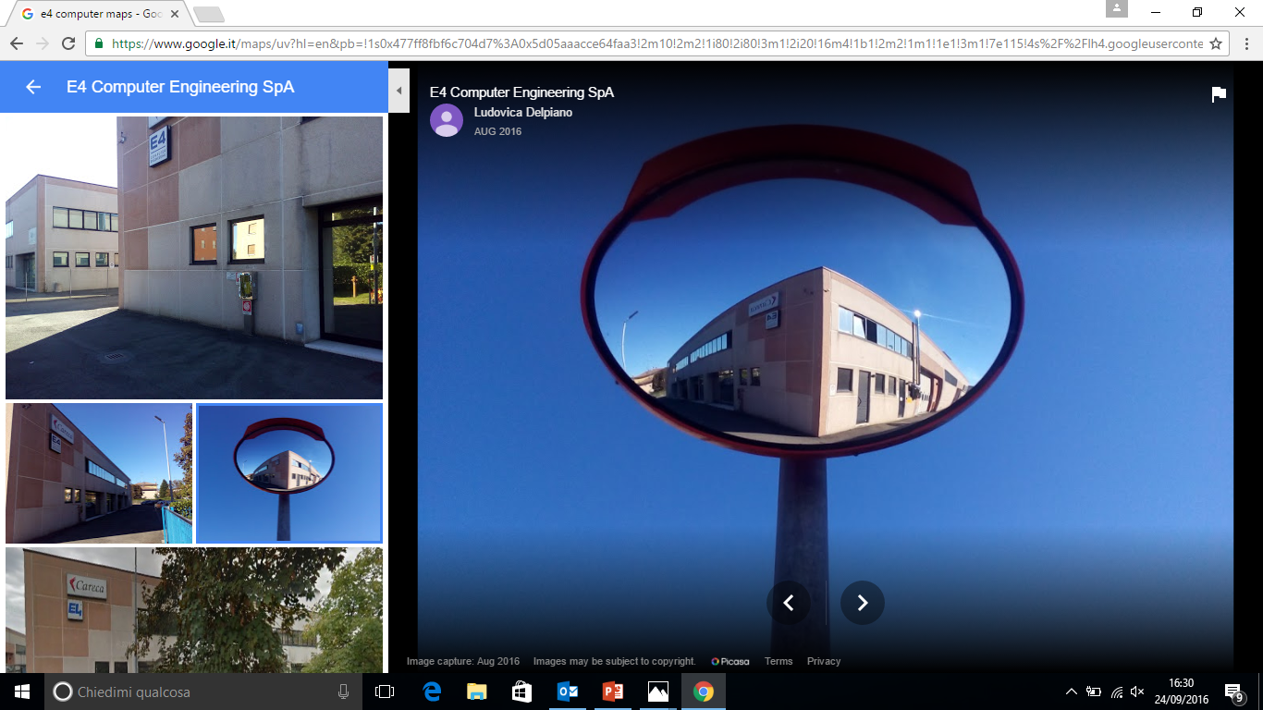
CONTACTS
Email contacts
info@e4company.com
sales@e4company.com
E4 Computer
Engineering SpA
Via Martiri della Libertà, 66,
42019 Scandiano (RE) - Italy
Tel. 0039 0522 991811
Notes:
serve foto bella della sede

Slide 32
THANK YOU

Slide 33
BACKUP

Slide 34


REQUIREMENTS | High Availability HPC Cluster
CHALLENGES | Ensuring faster transfer rate and network interconnection Reducing computing times and obtaining an easy-to-use storage system
SOLUTION | 96 dual socket server (1.152 computing cores) Infiniband Switch QDR 40Gbps ports HPC Storage Panasas > 400TB Networking E4 HPC Suite
APPLICATION | HPC Sequencing
KEY FACTORS | Technical skills Post sale support POC Reliability
BENEFITS | Faster processing times More Secure data back-up thanks to HA
Client | NOVARTIS
Industry | Healthcare
Ref. | Riccardo Beltrami – Head of Computational Biology Unit

Slide 35

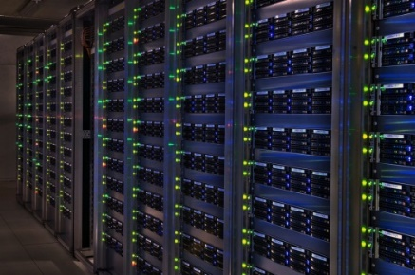


REQUIREMENTS | High density computational nodes Big data storage
CHALLENGES | Delivering standard commodity hardware Providing high performances combined with energy efficiency Ensuring very low failure rate
SOLUTION | 5.600+ dual socket mainboards (61.000+ cores) 35.000+ enterprise class hard disks (100PB Storage)
APPLICATION | Grid Computing
CHALLENGES | Delivering standard commodity hardware Providing combo of high performances & energy efficiency Ensuring very low failure rate
SOLUTION | 12PB high performance storage (CNAF) 5PB direct attached storage (Alice – CMS) 4.500 server dual socket (~ 40k computing cores) Several GPU systems 4h intervention times
APPLICATION | Grid Computing

