Slide 1
RDA on Practical Policies Raphael Ritz MPCDF & RDA Europe
1st ASTERICS – OBELICS Workshop
12.-14. December 2016, Rome, Italy
CC BY-SA 4.0

Slide 2
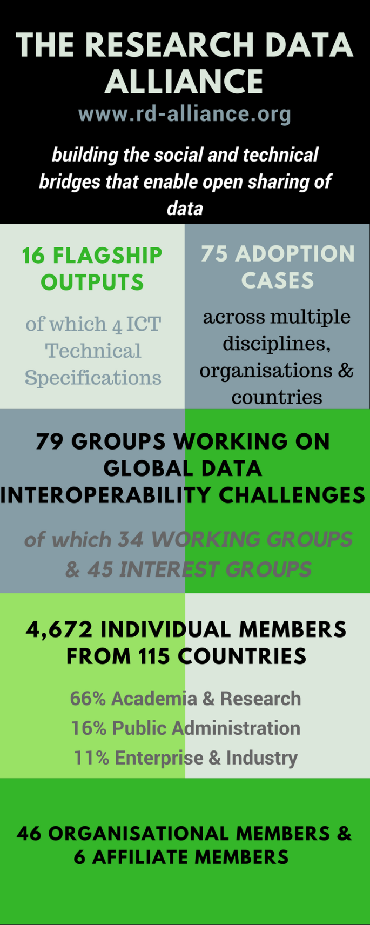
Vision
Researchers and innovators openly share data across technologies, disciplines, and countries to address the grand challenges of society.
Mission
RDA builds the social and technical bridges that enable open sharing of data.
CC BY-SA 4.0

Slide 3
What is RDA?
RDA is an international member based organization focused on the development of infrastructure and community activities that reduce barriers to data sharing and exchange, and the acceleration of data driven innovation worldwide. With more than 4,670 members globally representing 115 countries, RDA includes data science professionals from multiple disciplines, including but not limited to academia, library sciences, earth science, astronomy and meteorology.
RDA is building the social and technical bridges that enable open sharing of data to achieve its vision of researchers and innovators openly sharing data across technologies, disciplines, and countries to address the grand challenges of society.
rd-alliance.org/about-rda
CC BY-SA 4.0

Slide 4
What does RDA do?
Members come together through self-formed, volunteer, focussed Working Groups, exploratory Interest Groups to exchange knowledge, share discoveries, discuss barriers and potential solutions, explore and define policies and test as well as harmonise standards to enhance and facilitate global data sharing.
RDA members collaborate together across the globe to tackle numerous infrastructure & data sharing challenges related to:
Reproducibility
Data preservation
Best practices for domain repositories
Legal interoperability
Data citation
Data type registries
Metadata
and so many more!
rd-alliance.org/about-rda
CC BY-SA 4.0

Slide 5
Who Can Join RDA?
Any individual or organization, regardless of profession or discipline, with an interest in reducing the barriers to data sharing and re-use and who agrees to RDA’s guiding principles of:
Openness
Consensus
Balance
Harmonization
Community-driven
Non-profit and technology-neutral
Individual Membership is free @ https://www.rd-alliance.org/user/register
rd-alliance.org/get-involved.html
CC BY-SA 4.0

Slide 6
Why Join RDA as an Individual Member?
Individual Member Benefits
Contribute to acceleration of data infrastructure development
Work and share experiences with collaborators throughout the world
Access to extraordinary network of colleagues with various levels of experience, perspectives and practices
Gain greater expertise in data science regardless of whether one is a student, early or seasoned career professional
Enhance the quality and effectiveness of personal work and activities
Improve one’s competitive advantage professionally and positioning oneself for leadership within the broader research community
Individual RDA Members 4672
rd-alliance.org/get-involved/individual-membership.html
CC BY-SA 4.0

Slide 7
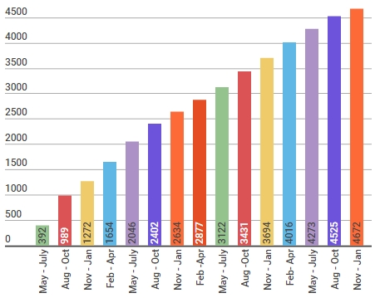
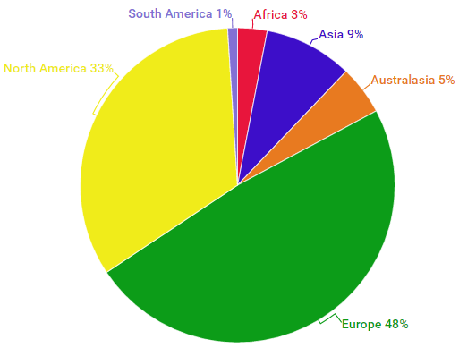
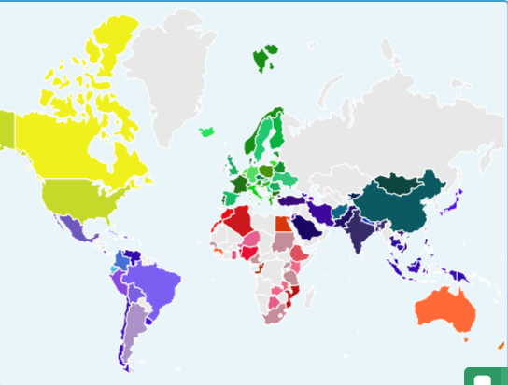
RDA worldwide growth
Total RDA community members 4672
115 Countries
rd-alliance.org/about-rda
CC BY-SA 4.0
Notes:
Guiding Principles:
Openness
Consensus
Balance
Harmonization
Community-driven
Non-profit and technology-neutral

Slide 8
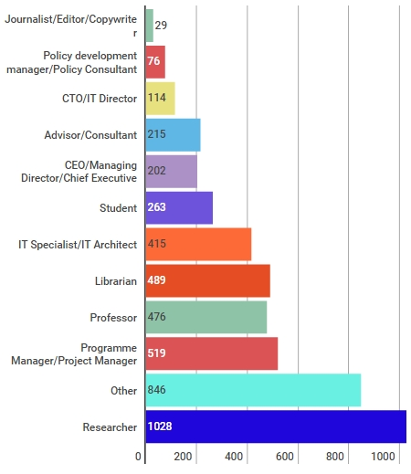
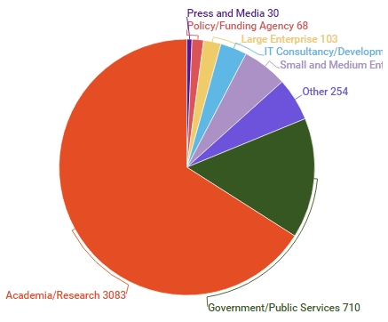
Who is RDA?
rd-alliance.org/about-rda
CC BY-SA 4.0
Notes:
Guiding Principles:
Openness
Consensus
Balance
Harmonization
Community-driven
Non-profit and technology-neutral

Slide 9
Why Join RDA as an Organisational Member?
Organisational Member Benefits
Provide an organizational perspective on the work of RDA and ability to influence RDA’s direction
Assist in implementation & adoption of RDA Recommendations & Outputs
Participate in all RDA Organizational Forums
Receive regular updates on the work of the RDA
Attend Organizational Assembly meetings and vote on proposed policies for consideration by the RDA Council and for members of the Organizational Advisory Board
Provide advice to RDA Council through the Organizational Advisory Board
Be recognized on the RDA Website and at RDA Meetings as a supporter of data interoperability
46 Organisational & 6 Affiliate Members
rd-alliance.org/get-involved/organisational-membership
CC BY-SA 4.0

Slide 10
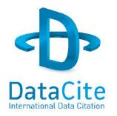
Organisational & Affiliate Members
46 RDA Organisational Members
6 RDA Affiliate Members
rd-alliance.org/get-involved/organisational-membership
CC BY-SA 4.0
Notes:
Guiding Principles:
Openness
Consensus
Balance
Harmonization
Community-driven
Non-profit and technology-neutral

Slide 11
RDA Interest (IG) & Working Groups (WG) by Focus (1)
Total 79 groups:
34 Working Groups & 45 Interest Groups
Domain Science - focused
Agrisemantics WG
BioSharing Registry WG
Fisheries Data Interoperability WG
On-Farm Data Sharing (OFDS) WG
Rice Data Interoperability WG
Wheat Data Interoperability WG
Agriculture Data IG (IGAD)
Biodiversity Data Integration IG
Chemistry Research Data IG
Digital Practices in History and Ethnography IG
Geospatial IG
Global Water Information IG
Health Data IG
Marine Data Harmonization IG
Quality of Urban Life IG
RDA/CODATA Materials Data, Infrastructure & Interoperability IG
Research data needs of the Photon and Neutron Science community IG
Structural Biology IG
Weather, Climate and air quality IG
Community Needs - focused
Data Science and data-related education and training certification and accreditation schemes WG
RDA/CODATA Summer Schools in Data Science and Cloud Computing in the Developing World WG
Teaching TDM on Education and Skill Development WG
Archives & Records Professionals for Research Data IG
Data for Development IG
Development of Cloud Computing Capacity and Education in Developing World Research IG
Education and Training on handling of research data IG
Ethics and Social Aspects of Data IG
rd-alliance.org/groups
CC BY-SA 4.0

Slide 12
RDA Interest (IG) & Working Groups (WG) by Focus (2)
Total 79 groups:
34 Working Groups & 45 Interest Groups
Reference and Sharing - focused
Data Citation WG
Data Description Registry Interoperability WG
Data Security and Trust WG
Empirical Humanities Metadata WG
RDA / WDS Publishing Data Bibliometrics WG
Research Data Collections WG
QoS-DataLC Definitions WG
International Materials Resource Registries WG
National Data Services IG
RDA/CODATA Legal Interoperability IG
Reproducibility IG
Data Discovery Paradigms IG
Repository Core Description WG
Research Data Repository Interoperability WG
Partnership Groups
RDA / TDWG Metadata Standards for attribution of physical and digital collections stewardship WG
RDA/NISO Privacy Implications of Research Data Sets IG
RDA/WDS Scholarly Link Exchange Working Group
Repository Audit and Certification DSA–WDS Partnership WG
RDA/WDS Publishing Data IG
ELIXIR Bridging Force IG
rd-alliance.org/groups
CC BY-SA 4.0

Slide 13
RDA Interest (IG) & Working Groups (WG) by Focus (3)
Total 79 groups:
34 Working Groups & 45 Interest Groups
Data Stewardship and Services – focused
Brokering Framework WG
Brokering Governance WG
WDS/RDA Assessment of Data Fitness for Use WG
RDA / WDS Publishing Data Services WG
RDA / WDS Publishing Data Workflows WG
Active Data Management Plans IG
Data in Context IG
Data Rescue IG
Domain Repositories IG
Libraries for Research Data IG
Long tail of research data IG
Preservation e-Infrastructure IG
RDA/WDS Certification of Digital Repositories IG
RDA/WDS Publishing Data Cost Recovery for Data Centres IG
Repository Platforms for Research Data IG
Research Data Provenance IG
Virtual Research Environments IG
Base Infrastructure – focused
Array Database Assessment WG
Data Foundation and Terminology WG
Data Type Registries WG
Metadata Standards Catalog WG
Metadata Standards Directory WG
PID Information Types WG
Practical Policy WG
Data Fabric IG
Data Foundations and Terminology IG
Big Data IG
Brokering IG
Federated Identity Management IG
Metadata IG
PID IG
Vocabulary Services IG
rd-alliance.org/groups
CC BY-SA 4.0

Slide 14
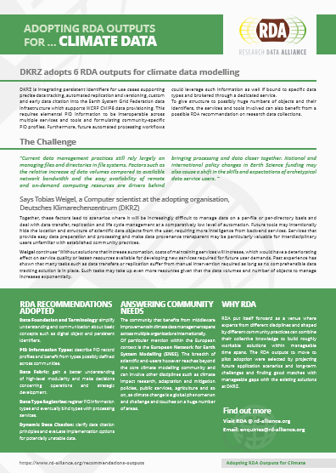
RDA Recommendations that make data work
“Create - Adopt - Use”
Adopted code, policy, specifications, standards, or practices that enable data sharing
“Harvestable” efforts for which 12-18 months of work can eliminate a roadblock
Efforts that have substantive applicability to groups within the data community but may not apply to all
Efforts that can start today
16 flagship recommendations & outputs with over
75 cases of adoption in different domains, organisations and countries
rd-alliance.org/recommendations-outputs
CC BY-SA 4.0

Slide 15
RDA Recommendations & Outputs
THE RDA OUTCOMES LEGEND
Recommendations: are the flagship outputs of RDA. They are RDA’s equivalent of the “specifications” or “standards” that other organisations create and endorse. The process for creating and endorsing these is already defined.
Supporting Outputs: are the outputs of RDA WGs and IGs that are fruit of RDA work, but are not necessarily adoptable bridges. “Upon request”, these sort of outputs go through a community comment period and if no major objections or gaps are identified they get the RDA Brand.
Other Outputs: include workshop reports, published articles, survey results, etc. Anything a WG or IG wants to register and report. Upon request, these are published and discoverable on the RDA website but have no level of endorsement.
rd-alliance.org/recommendations-and-outputs/all-recommendations-and-outputs
CC BY-SA 4.0

Slide 16
RDA Recommendations & Outputs
Data Foundation & Terminology: a model for data in the registered domain.
PID Information Types: a common protocol for providers and users of persistent ID services worldwide.
Data Type Registries: allowing humans and machines to act on unknown, but registered, data types.
Practical Policy: defining best practices of how to deal with data automatically and in a documented way with computer actionable policy.
Metadata standards directory: Community curated standards catalogue for metadata interoperability
rd-alliance.org/recommendations-and-outputs/all-recommendations-and-outputs
CC BY-SA 4.0

Slide 17
RDA Recommendations & Outputs
Data Citation: defining mechanisms to reliably cite dynamic data
Data Description Registry Interoperability solutions enabling cross platform discovery based on existing open protocols and standards
Wheat Data Interoperability impacting the discoverability, reusability and interoperability of wheat data by building a common framework for describing, representing linking and publishing wheat data
Brokering Governance WG: Sustainable Business Models for Brokering Middleware to support Research Interoperability
RDA/CODATA Summer Schools in Data Science and Cloud Computing in the Developing World WG: A framework to run a series of Summer Schools in Data Science and data sharing in low and middle income countries (LMICs)
rd-alliance.org/recommendations-and-outputs/all-recommendations-and-outputs
CC BY-SA 4.0

Slide 18
RDA Recommendations & Outputs
Repository Audit and Certification DSA–WDS: A convergent DSA-WDS certification standard to help eliminate duplication of effort, increase certification procedure coherence and compatibility thus benefitting researchers, data managers, librarians and scientific communities.
RDA/WDS Publishing Data Bibliometrics: improved research data metrics and corresponding services, with the final goal of increasing the overall availability and quality of citations and research data itself.
RDA/WDS Publishing Data Workflows: enhance the possibilities for greater discoverability and a more efficient and reliable reuse of research data benefitting other stakeholders like publishers, libraries and data centres.
RDA/WDS Publishing Data Services: A universal interlinking service between data and the scientific literature. The Scholix initiative a high level interoperability framework for exchanging information about the links between scholarly literature and data. It aims to build an open information ecosystem to understand systematically what data underpins literature and what literature references data.
rd-alliance.org/recommendations-and-outputs/all-recommendations-and-outputs
CC BY-SA 4.0

Slide 19
RDA Recommendations & Outputs
23 Things: Libraries For Research Data An overview of practical, free, online resources and tools that users can immediately take advantage of to incorporate research data management into the practice of librarianship.
Legal Interoperability of Research Data Principles and Implementation Guidelines: a set of principles and practical implementation guidelines offered as high-level guidance to all members of the research community —the funders, managers of data centers, librarians, archivists, publishers, policymakers, university administrators, individual researchers, and their legal counsel.
rd-alliance.org/recommendations-and-outputs/all-recommendations-and-outputs
CC BY-SA 4.0

Slide 20
RDA Practical Policy Working Group Focus
Identify the most important policies
Practical implementations for managing research data collections
Provide recommendations for a “starter kit”
Testbeds:
Evaluate standard policies
Test interoperability across WGs
Policy: Assertion or assurance that is enforced about a collection or a dataset

Slide 21
Concept Graph by Reagan Moore
Purpose
Defines
Collection
Defines
Integrity
Isa
Property
Policy
Procedure
Persistent
State Information
Defines
Controls
Updates
Isa
Workflow
Chains
HasFeature
Function
Isa
Consistency
SysChksumDataObj

Slide 22
Concept Graph by Reagan Moore
Purpose
Defines
Collection
DATA_ID
DATA_REPL_NUM
DATA_CHECKSUM
Replication Policy
Has
Has
Isa
Isa
Isa
Checksum Policy
Isa
Defines
Isa
Digital Object
Has
Attribute
Quota Policy
Has
Integrity
Data Type Policy
Isa
Updates
Isa
Isa
Isa
Authenticity
Persistent
State Information
Isa
Property
Defines
Policy
Controls
Procedure
Updates
Access control
Isa
Has
SubType
Isa
HasFeature
GetUserACL
HasFeature
Periodic Assessment Criteria Policy
Workflow
Policy Enforcement Point
Isa
SetDataType
Completeness
HasFeature
Chains
Isa
Correctness
SetQuota
Function
Isa
HasFeature
Consensus
Invokes
Isa
DataObjRepl
Isa
Isa
Consistency
Operation
SysChksumDataObj
Client Action

Slide 23
Policy Categories
Management
Administrative
Assessment
Integrity
Access Control
Replication
Provenance
Preservation
Collection-based Policies
Regulatory
Description
Data Staging
Data Management Plans
Publication
Data Lifecycle Management
Federation
Compliance

Slide 24
PP: Survey of 30 Institutions for Highest Priority Policies
Policy | Importance
Integrity | 217
Preservation | 150
Access control | 126
Provenance | 108
Data Management plans | 99
Publication | 75
Replication | 66
Data staging | 52
Federation | 37
Metadata sharing | 23
Regulatory | 16
Collection properties | 7
Identifiers | 7
Data sharing | 7
Versioning | 7
Licensing | 6
Format | 6
Data Life Cycle | 6
Arrangement | 5
Processing | 5

Slide 25
Summary of policies in production use
Policy for data retention. How long, how short? Need preservation, or not? (5) Retention and disposition
Notification policies. (Ex. must warn data researcher that their data will be deleted at X time.) (6) notification on event
Transferability policies. The data must be transferable from the repository back to the researcher and the repository of origin. Or, in the event of defunding, the data must be de-accessioned and moved to another repository (or not, depending on relevant SOPs, agreements, etc.).
Policies re: costs and who pays for all of this data storage (8)
Policies around context. Sometimes the original data and additional metadata are needed. Sometimes, the context or derived data is what matters, and not the data itself. (7)

Slide 26
Summary of policies in production use (cont)
Policies re: tagging/annotating data
Search/Information Retrieval policies. What parts of the data will you search on, or not search on? (4) Controlling search
Standard Sys Admin policies: (1) replication, back up, (2) integrity checks, syncing with back ups.
Content policies: do we care what content and file formats users upload? Some do, some don't. (3) Transformative migration
Policy to educate researchers about all of the different policies relevant to the data repository. For example, a user agreement/Terms & conditions statement that researchers must check off.

Slide 27
Best Practices for production policies
Consensus on a policy
Use at multiple institutions
Generality
Best practice policy components
Name of operation that policy controls
Constraints that policy implements
State information that policy uses or modifies
Verification policy
Example of running code
Documentation

Slide 28
Operations managed by policies
Paper posted that lists 70 operations
Policy-verification.docx
Candidate operations
Access control
Backups
Data retention
Descriptive metadata
Format creation
Integrity checks
Notification
Policy constraints
Replication
Restricted search
Storage cost
Tags
Use agreements

Slide 29
Policy Types
Policy type | Operation
Access | Set access control
 | Check access control
 | Audit access control
Backups (time-stamped copies) | Create copy
 | Set timestamp
 | Verify timestamps
Contextual metadata | Extract metadata
 | Register metadata
 | Verify metadata
Data Retention | Set retention period
 | Check retention
 | Verify retention
Disposition | Define migration location
 | Migrate data
 | Verify migration

Slide 30
Policy Types
Policy type | Operation
Format requirements | Specify required format
 | Create format
 | Verify formats
Integrity checks | Set checksum
 | Verify checksum
Notification | Define events
 | Send e-mail on event
 | Log notices
Policy constraints by collection, researcher, funding | Select constraint
 | Apply constraint to policy
 | Verify constraints
Restricted searching | Set search limits
 | Execute restricted search
Signing of use agreements | Generate use form
 | Store agreement
 | Verify agreement
Storage cost tracking | Record usage
 | Audit usage
 | Generate storage cost report

Slide 31
Example: Replication Policy
Operation that is being controlled
Replicate a file
Controls
When is replication done?
When file is ingested
When file is changed
Which files are replicated? Choose based on:
Collection
User
Size
Replication properties
Choice of replication location
Choice of access controls on replica
Requirement for checksum
Verification of checksum on replica creation
Variants:
Versioning of changes vs replication
Backups vs replication (time-stamped copy)
Verification
When should replica existence be verified

Slide 32
Policy : Operation : Constraints : State Information
Policy type | Operation | Constraints | State information
Replication | Set replica properties | When? | Default policy enforcement points
 |  | Number of replicas | Default number
 |  | Where is replicate put? | Default replica location
 |  | Which files (collection/user/size)? | Default policy selection criteria
 |  |  | Default criterium value
 |  | Set replica access controls? | Default access control
 |  | Require checksum? | Replica checksum flag
 |  | When audit? | Default time period
 | Replicate | Delayed or immediate | Replica location
 |  |  | Replica creation time
 |  |  | Replica access control
 |  |  | Replica name
 |  |  | Replica owner
 |  |  | Replica number
 | Verify replica numbers | Periodic rule | Audit time stamp
 |  |  | Log of problems and actions
 | Replace missing replicas |  | Replica location
 |  |  | Replica creation time
 |  |  | Replica access control
 |  |  | Replica name
 |  |  | Replica owner
 |  |  | Replica number

Slide 33
Practical Policy WG Results
Summary of results
Policy templates
Policy verifications
Policy implementations (mostly iRODS, some GPFS)
Available from
https://www.rd-alliance.org/filedepot?cid=104&fid=553
Contacts: Reagan Moore and Rainer Stotzka

Slide 34
Data Fabric IG: Starting Point
Data Foundation&
Terminology
and now?
are there links?
shouldn‘t it all come
together?
Data Fabric IG
bring people together
bring pieces together
look at the whole picture
identify gaps
focus on data creation/consumption
processes
Data Type
Registry
Metadata Standards
Directory
PID Information
Types
Practical Policy

Slide 35
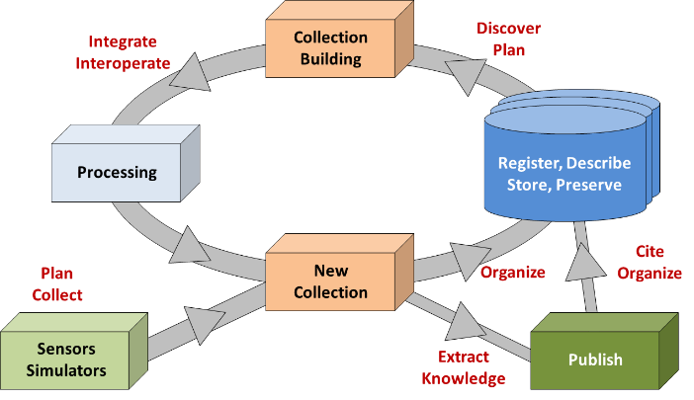
Data Fabric: Scope
Observations
Experiments
Simulations
etc.
https://www.rd-alliance.org/group/data-fabric-ig.html

Slide 36
Call for Supporting and Other RDA Outputs
If your group has produced something that you would like to share with the broader community, please send it to enquiries@rd-alliance.org and indicate whether you would like it to be considered as a ‘Supporting’ or ‘Other’ output.
https://rd-alliance.org/call-supporting-and-other-rda-outputs
rd-alliance.org/call-supporting-and-other-rda-outputs
CC BY-SA 4.0

Slide 37
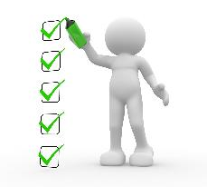
What are Plenary Meetings?
Organised around the world every 6 months
exciting & productive events bringing together a unique community of data science professionals, from multiple disciplines and domains;
help move the community forward in creating tangible deliverables that improve data sharing across disciplines, technologies, and countries;
heart of the plenaries are working meetings of RDA Working & Interest groups and new potential groups through Birds of a Feather meetings
presentation of new Outputs and Adoption cases
rd-alliance.org/plenaries
CC BY-SA 4.0

Slide 38
RDA Plenary Meetings: benefits of attending
Exchange knowledge, share discoveries, discuss barriers and potential solutions
Learn about new trends, strategies, research developments, directions and policies
Expand your network and meet new committed and passionate data science professionals, working in multiple disciplines
Contribute to acceleration of data infrastructure development
rd-alliance.org/plenaries
CC BY-SA 4.0
Notes:
Expand your network and meet new data science professionals, working in multiple disciplines, including but not limited to academia, library sciences, earth science, astronomy and meteorology

Slide 39
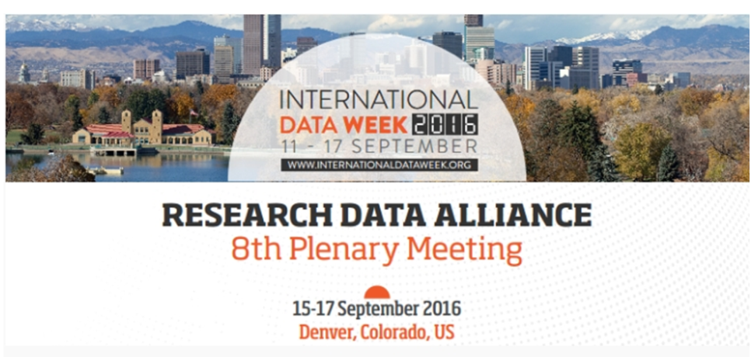
RDA deliverables presented:
RDA/CODATA Summer Schools in Data Science and Cloud Computing in the Developing World WG
Brokering Governance WG
Metadata Standards Catalog WG Recommendations
Biosharing Registry WG Recommendations
Scholix Franmework
+ 6 Adoption cases
69 Breakout session meetings:
12 BoF Meetings
31 Interest group meetings
10 Working group meetings
16 Joint group meetings
69 Breakout sessions
Newcomers Session, 2 RDA organisational members meeting, TAB and Chairs session
RDA/EU sponsored 8 European Early Career Researchers and Scientists & RDA/US sponsored 8 Fellowship
42 posters on display
549 participants from 33 countries
rd-alliance.org/plenaries/rda-eighth-plenary-meeting-denver-co
CC BY-SA 4.0

Slide 40
The 9th RDA Plenary Meeting will take place from 5th to 7th April 2017 at the Barcelo Sants Hotel, Barcelona, Spain. The plenary meeting is organised by the Barcelona Supercomputing Center-Centro Nacional de Supercomputación (BSC-CNS) with the support of RDA Europe.
https://www.rd-alliance.org/plenaries/rda-ninth-plenary-meeting-barcelona
Looking forward to seeing you all in Barcelona!
rd-alliance.org/plenaries/rda-ninth-plenary-meeting-barcelona
CC BY-SA 4.0

Slide 41
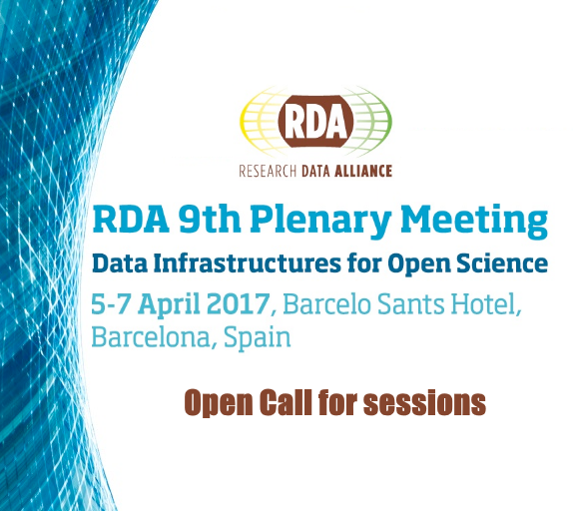
RDA welcomes submissions for session proposals for its 9th Plenary meeting to be held in Barcelona, Spain from 4th to 7th April 2017.
WG and IG sessions
https://www.rd-alliance.org/9th-plenary-meeting-application-form
Joint sessions of existing WGs and IGs
https://www.rd-alliance.org/9th-plenary-joint-meeting-application-form
Is there a topic that you think RDA should address?
Make sure you submit an application for a Birds of a Feather session
https://www.rd-alliance.org/9th-plenary-bof-meeting-application-form
rd-alliance.org/plenaries/rda-ninth-plenary-meeting-barcelona
CC BY-SA 4.0

Slide 42
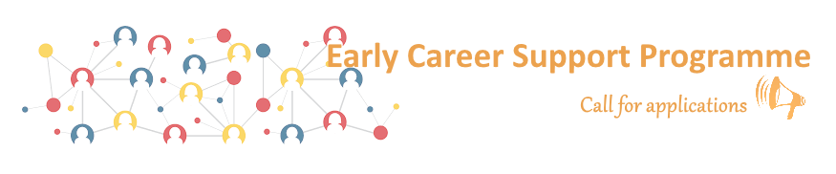
RDA Europe is offering travel support to Early Career European Researchers & Scientists working with Data to attend the 9th RDA Plenary meeting, Barcelona, Spain, 5-7 April 2017.
Find out more about the application & evaluation criteria and submit your application online at https://www.rd-alliance.org/rda-eu-early-career-support-programme-rda-9th-plenary
rd-alliance.org/plenaries/rda-ninth-plenary-meeting-barcelona
CC BY-SA 4.0

Slide 43
The 10th RDA Plenary Meeting will take place from 19 to 21 September 2017 in Montreal, Canada. The meeting is co-organised by RDA, the University of Montreal and Research Data Canada, Canada.
https://www.rd-alliance.org/plenaries/rda-tenth-plenary-meeting-montreal-canada
rd-alliance.org/plenaries/rda-tenth-plenary-meeting-montreal-canada
CC BY-SA 4.0

Slide 44
RDA in a Nutshell www.rd-alliance.org/ @resdatall
RDA Global
Email - enquiries@rd-alliance.org
Web - www.rd-alliance.org
Twitter - @resdatall
LinkedIn - www.linkedin.com/in/ResearchDataAlliance
Slideshare - http://www.slideshare.net/ResearchDataAlliance
RDA Europe
Email - info@europe.rd-alliance.org
Web - europe.rd-alliance.org
Twitter - @RDA_Europe
RDA US
Twitter - @RDA_US

