Slide 1


DIRAC System Tutorials
Luisa Arrabito
LUPM CNRS-IN2P3 France
1st ASTERICS-OBELICS Workshop
12-14 December 2016, Rome, Italy.
H2020-Astronomy ESFRI and Research Infrastructure Cluster (Grant Agreement number: 653477).

Slide 2
Plan
DIRAC introduction
  The project
  The software
  Current DIRAC installations
  Getting started
Workload Management System
Workflow engine (Transformation System)
CTA DIRAC setup
Conclusions

Slide 3
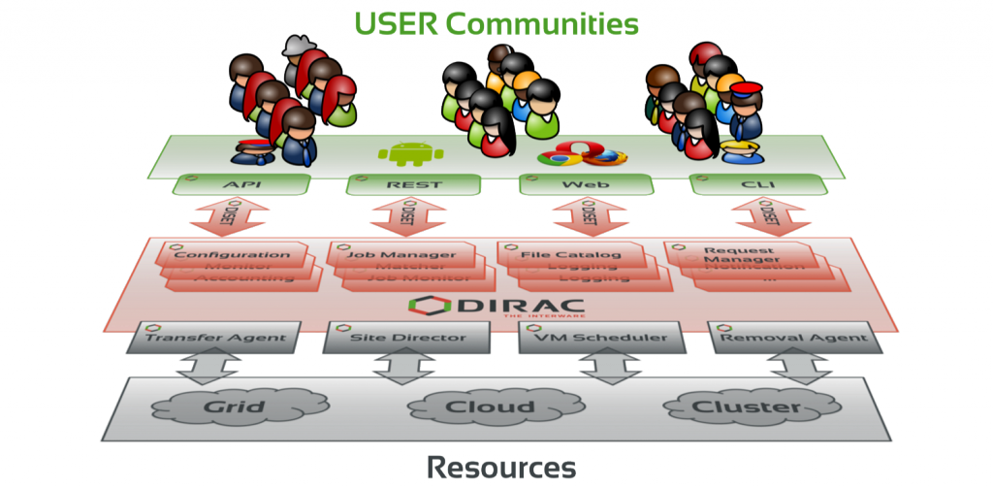
The project
DIRAC (Distributed Infrastructure with Remote Agent Control) interware is an open source software project providing a complete solution to users communities requiring access to distributed resources
  http://diracgrid.org/

Slide 4
The project
Originally developed to support the production activities of the LHCb experiment (~10 years ago)
In 2010 becomes a general purpose software, targeting other communities (CTA, ILC, Belle II, BES III, biomed, ...)
In 2014 CERN, CNRS and UB sign an agreement to create the DIRAC Consortium, later joined by KEK and IHEP
  'Agreement for Development and Maintenance of the DIRAC Software for Distributed Computing'
User driven development cycle: bottom up approach
DIRAC User Workshop once per year

Slide 5









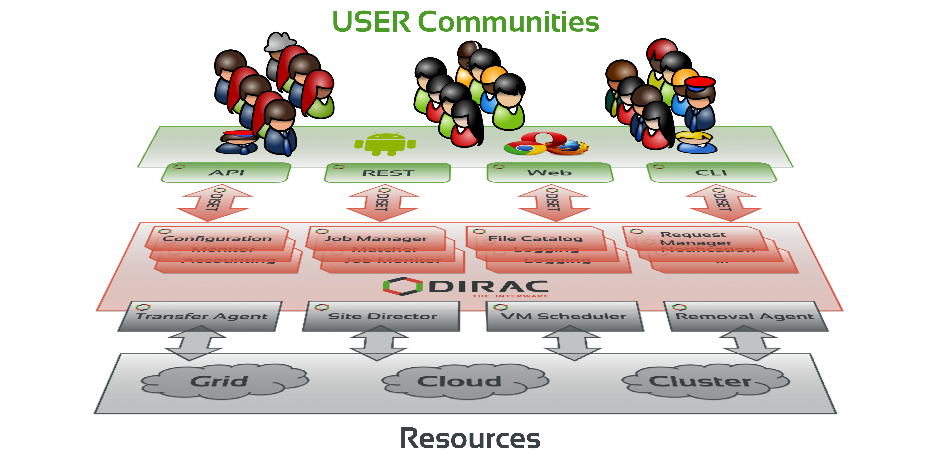
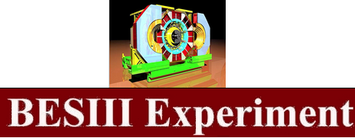










Current actors

Slide 6
The software
Licence GPL V3
Python 2.7
GitHub
  https://github.com/DIRACGrid/DIRAC
  97 Forks
  84 open issues
~200k lines of code
Commits from 15 distinct authors in the last year
2 or 3 minor/major releases per year

Slide 7
Software architecture
Based on a Service Oriented Architecture (SOA)
Focus on modular design
Gradually evolved for supporting more and more use cases
  e.g. more Resources
Support for MySQL and Oracle (LHCb)
Easy to extend for the needs of a given community
  e.g. LHCbDIRAC, CTADIRAC, ILCDIRAC

Slide 8
Software architecture
Composed of several Systems
Each System composed of:
  Services, Agents, DBs
Main Systems
  Workload Management System (WMS)
    Job brokering with Pilot Jobs
    Interoperability with different types of computing resources
  Workflow engine (Transformation System, TS)
    Used by production team to handle large productions
  Data Management System (not covered in this talk)
    All data operations (download, upload, replication, removal, …)
    DIRAC File Catalog as Replica and Metadata Catalog
  Request Management System (not covered in this talk)
    Asynchronous handling of requests, e.g. failed transfers recovery

Slide 9
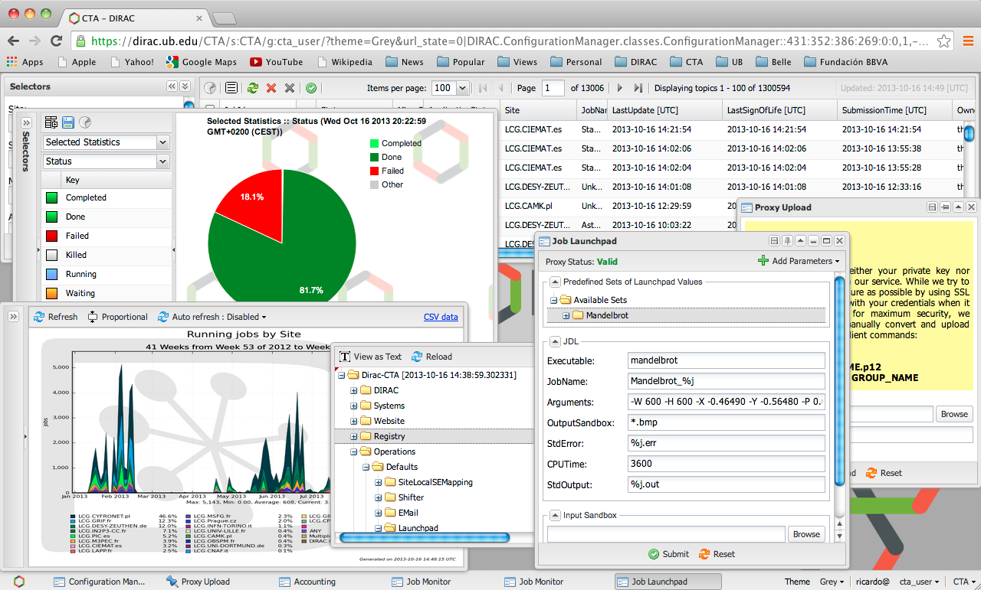
Interfaces
Web portal
Job&Pilot Monitor
Job&Pilot Browsing
Proxy Upload
Launchpad
Accounting
Configuration
Browsing
… or Admin
Certificate
Authentication
Command line tools, Python API, RESTful interface
9

Slide 10
Future development directions
Microservices
Centralized Logging
Python 3
Queuing System
Support for other DBs than MySQL
  ElasticSearch already introduced in the Monitoring Sys.
Block storage support

Slide 11

Current DIRAC installations
Dedicated installations
  LHCb, Belle II, CTA, ILC, BES III
Multi-community installations, i.e. ‘DIRAC as a Service’
  FG-DIRAC
    More than 600 registered users, 20 VOs
    Mostly EGI resources
    France-Cloud resources
  GridPP-DIRAC
    More than 400 registered users, 15 VOs
  DIRAC4EGI
    > 100 users, 10 VOs
    Several active communities: WeNMR, vlemed, EISCAT-3D
    Pushing to use Federated Cloud resources
    Considered to become a Core EGI service

Slide 12
Getting started
The easiest
  Use an existing multi-community DIRAC installation, e.g.
    FG-DIRAC, GridPP-DIRAC, DIRAC4EGI
  Just need to install the DIRAC client on your laptop
For a full evaluation
  Install a server instance dedicated to your community
Doc/Support
  Documentation
    http://diracgrid.org/
  User Forum
    https://groups.google.com/forum/?hl=en#!forum/diracgrid-forum

Slide 13
Client installation
Pre-requisites
  Have a valid grid certificate
  Register to a DIRAC service, e.g. FG-DIRAC
Install the client on your laptop
  User guide
    http://dirac.readthedocs.io/en/rel-v6r15/UserGuide/index.html
  Most Linux distributions and Mac OS supported
  Light installation through a few instructions
  wget –np https://github.com/DIRACGrid/DIRAC/raw/integration/Core/scripts/dirac-install.py --no-check-certificate
  python dirac-install.py –V FranceGrid
  source bashrc
  dirac-proxy-init –x
  dirac-configure defaults-FranceGrid.cfg
  dirac-proxy-init –g frangrilles_user
Point to a given DIRAC instance
Authenticate

Slide 14
Server installation
Minimal requirements
  1 server for core Services/Agents
  1 MySQL server
  1 server for the web portal
Administrator guide
  http://dirac.readthedocs.io/en/rel-v6r15/AdministratorGuide/index.html
Configure your instance
  Resource description
  Users registry
  Policies
  Operational settings

Slide 15
Workload Management System

Slide 16
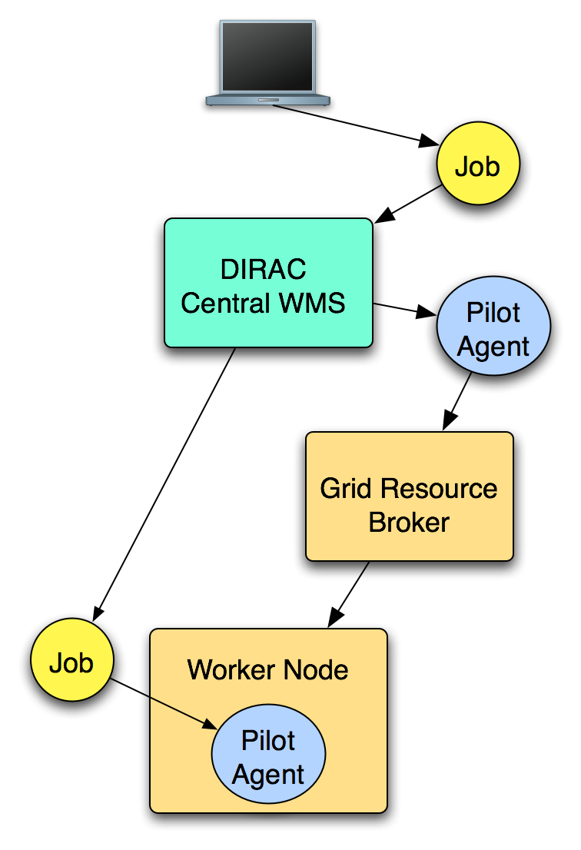
Workload Management System
Implementation of Pilot Jobs
  Introduced by the DIRAC project, now widely used in various WMS
  Efficient usage of resources
  Transparent access to different
  types of resources
  grids, clouds, clusters, etc.
Bulk submission
MPI jobs support

Slide 17


1
1
1
Workload Submission
1
3
1
3
Resource Reservation
1
API/REST/Web/CLI
1
Workload Execution
1
Result Retrieval
2
3
2
Job Manager
Job DB
Job Monitor
Job Sanity Optimizer
4
7
3
Job Path
Optimizer
Optimization Mind
TaskQueue DB
Sandbox
5
4
Input Data Optimizer
6
Scheduling Optimizer
Job State Update
Matcher
1
3
2
1
Pilot Scheduler
VM Scheduler
Grid A
Cloud B
2
2
Pilot
VM
Job Agent
Grid B
Cloud A
Job Agent
1
2
Site A
2
1
Pilot
2
VM
Job Agent
Pilot
Job Agent
1
Job Agent
1
1

Slide 18
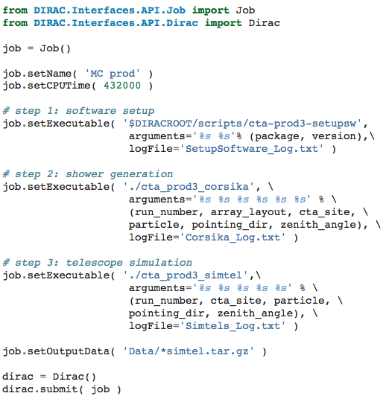
WMS tutorial - 1
Submit your job using the python API
Setup your workflow
Submit your job

Slide 19
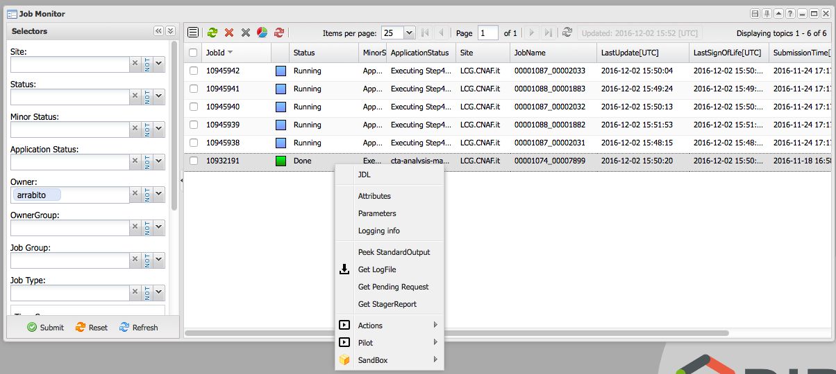
WMS tutorial - 2
Monitor your jobs from the web portal

Slide 20
WMS tutorial - 3
Retrieve your results
  Using command line
      dirac-wms-job-get-output-data 10945942
  Using the python API

Slide 21
Workflow engine (Transformation System)

Slide 22
Transformation System
Workflow engine conceived for ‘large productions’ and ‘repetitive work’
The building block is the ‘transformation’, i.e. a collection of many ‘similar’ tasks
Tasks are automatically created through a data-driven system
Generic system able to handle two types of ‘tasks’
  ‘jobs’ -> submitted to WMS
  ‘data-management operations’ -> submitted to RMS
Used by production managers

Slide 23
Main use cases
MC simulation (no input files)
  Many identical jobs with a varying parameter
Data-processing
  Many identical jobs processing a given input dataset
  Input dataset defined through a meta-data catalog query
  As soon as new files are registered in the catalog (e.g. produced by another transformation), jobs are created to process those files
Data management operations: bulk replication, removal, etc.

Slide 24
How it works?
The production manager defines a transformation
  ‘Body’: the task (job) description, i.e. what is actually executed on the worker node (app1, app2, etc.)
  ‘Type’, e.g. MCSimulation, Data-processing, etc.
  ‘Plugins’, i.e. how input data are grouped and how destination sites are selected (see next slide)
Task_1 → Job_1
Task_2 → Job_2
…
Task_n → Job_n
Job body
Transformation
App Step 1
App Step 2
Finalization Step

Slide 25
Plugins
Transformations plugins
  Used to ‘group’ the task input files according to different criteria
    Standard: by replica location
    BySize: until they reach a certain size
    ByShare: according to a configurable share per SE
TaskManager plugins
  Used to specify the tasks destinations
    BySE (default)
      Set jobs destination depending from the location of its input data
    ByJobType
      By default, all sites are allowed to do every job
      The actual rules are freely specified in the Configuration System

Slide 26
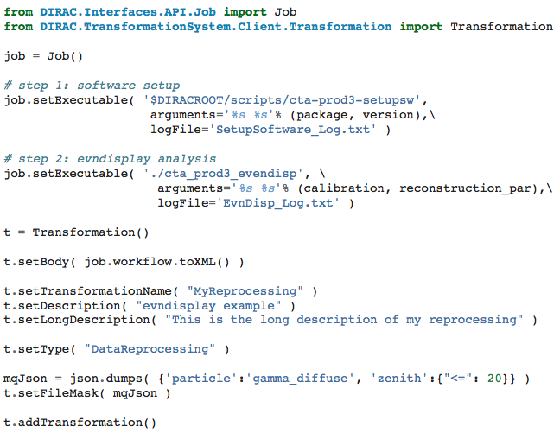
TS tutorial - 1
Create your transformation using the python API
  Example for a data-processing transformation
- define the job Body
- assign it to the trans.
set Type
set catalog query
create the transformation

Slide 27
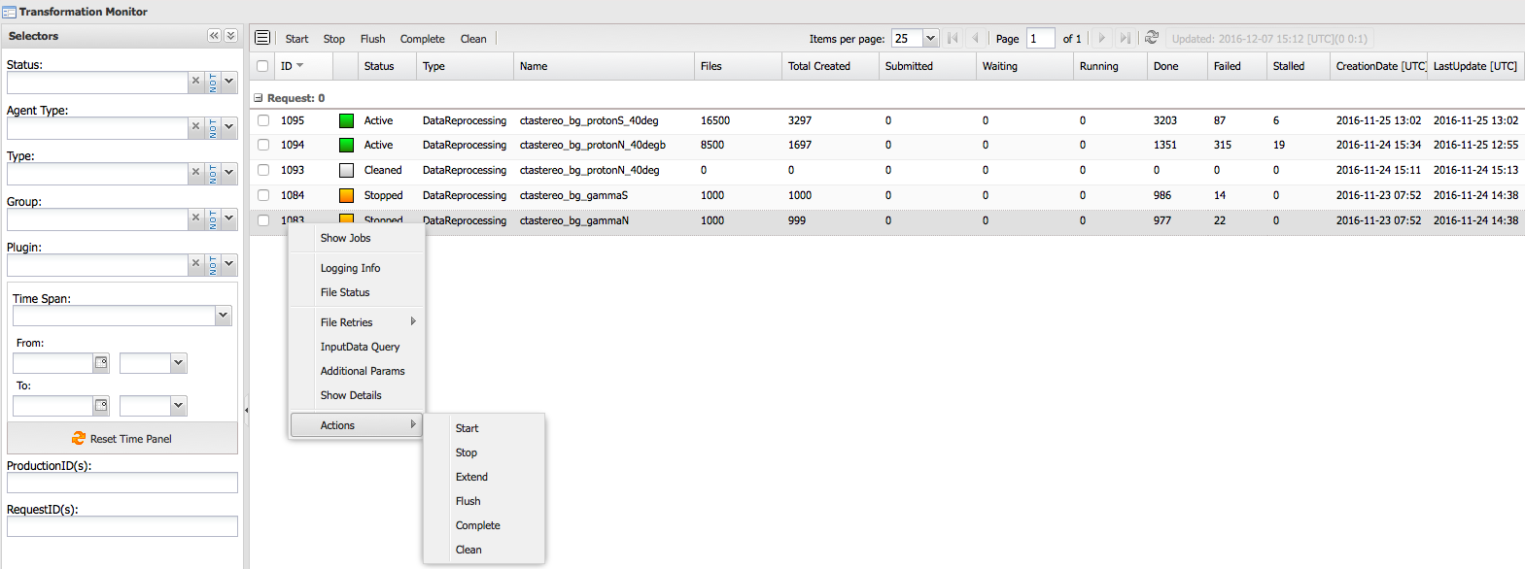
TS tutorial - 2
Monitor your transformation from the web portal
Manage your transformation
  start, extend, stop, clean, archive

Slide 28

Transformation System Architecture
File Catalog
Dedicated Agents create and submit tasks according to given plugins and catalog queries for input files
Agents continuously query a dedicated DB
For data-processing transformations, an agent queries the File Catalog to get the files matching the catalog query of the transformation
Job
Files with
meta-data
Transformation System
InputData
Agent
Database table
Files
Agent
TaskMan. Plugins
Production
Manager
InputDataQuery
Transformation
Agent
Tasks
Request
Task Agent
Workflow
Task Agent
Transformations
Plugins
RMS
WMS

Slide 29
Transformation System evolution:
CTA development contribution
Apply ‘meta-data filters’ when registering files
  Matching files are attached to the transformation
  Avoids ‘large’ File Catalog queries
First implementation successfully applied on recent MC prod./analysis (next slide)
Just merged in latest DIRAC release
File Catalog
Job
Files with
meta-data
Filter by meta-
data
Transformation System
InputData
Agent
Database table
Files
Agent
TaskMan. Plugins
Production
Manager
InputDataQuery
Transformation
Agent
Tasks
Request
Task Agent
Workflow
Task Agent
Transformations
Plugins
RMS
WMS

Slide 30
New TS applied to the MC prod/analysis for layout telescope optimization
Trans. 1
MC production
- Body=‘sim_jobs’
- Param=run_num
Jobs
Job run01
Job run02
…
Files with meta-data
(MD-Query1)
File1
File2
…
particle=gamma;
zenith= 20; prog=simtel_array; ..
Register
in Catalogs
Production
Manager
Production
Workflow
Trans. 2, MD-Query1
MC Analysis
- Body=‘evndisp
analysys’
- Param=‘Files matching
Query1’
‘MD-Filter’
TS Catalog
File
Catalog
Jobs
Job Input File1
Job Input File2
…
Files with meta-data
…
Trans. 3, MD-Query2
…
Register
in Catalogs

Slide 31

CTA DIRAC setup

Slide 32
CTA DIRAC setup
CTA started to evaluate DIRAC 5 years ago with a small server installation and a minimal CTADIRAC software extension
Today we have a more robust production setup
  5 DIRAC servers geographically distributed at CC-IN2P3, PIC and DESY
  Main DIRAC systems in use
    Workload Management System
    Data Management System
      File Catalog (DFC) as replica and metadata catalog
    Transformation System
  CTADIRAC software extension
    Interfaces to easily configure CTA applications
      Especially important for CTA users
    Contributing to the Transformation System

Slide 33

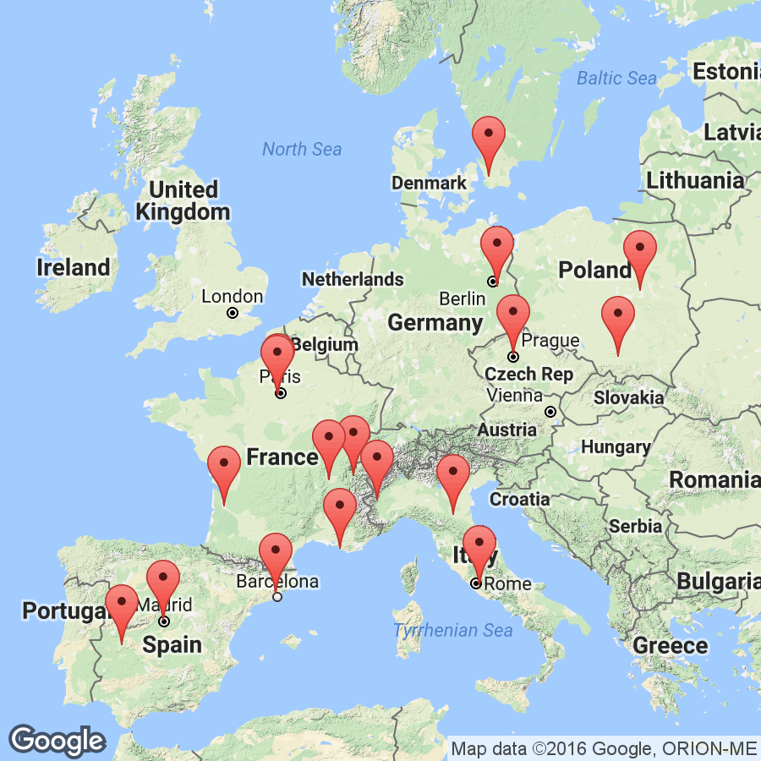
Current computing model for MC simulations and analysis
  Use EGI grid resources (CTA Virtual Organization)
  ~ 20 sites in Europe (CREAM, ARC)
  6 main sites provide in total 2.8 PB
MC production jobs run at all sites
Output data are stored at 6 SEs (1 distributed replica)
MC analysis jobs run at specific sites
Users analysis also running in parallel
Grid sites supporting CTA Virtual Organization

Slide 34
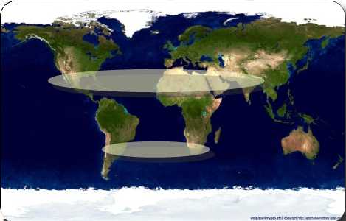
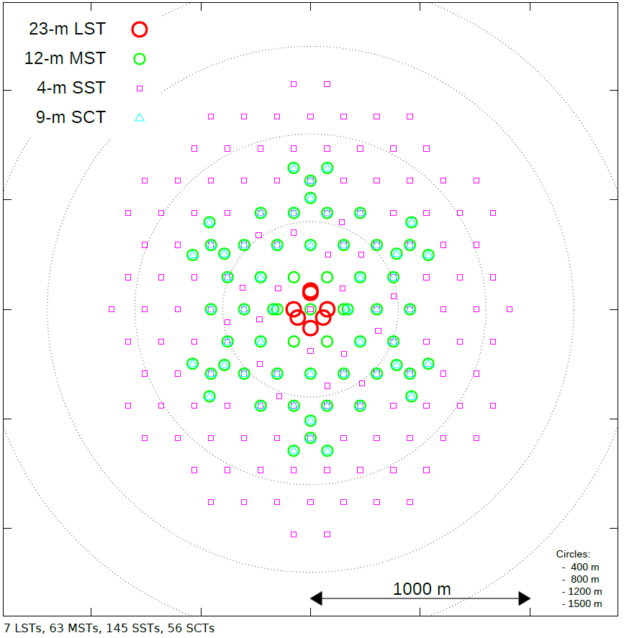
Monte Carlo computing needs for CTA preparation
Two main MC campaigns during past 4 years
Site selection (Prod2)
  Characterize 8 site candidates to host CTA telescopes
    5 B events simulated for each candidate
Site candidates
Final telescope layout for CTA South
Telescope array layout optimization (Prod3)
  Find the optimal layout for a given number of telescopes
  Many telescope positions, with alternative telescope/cameras
  3 different analysis chains run in parallel on the simulated data

Slide 35
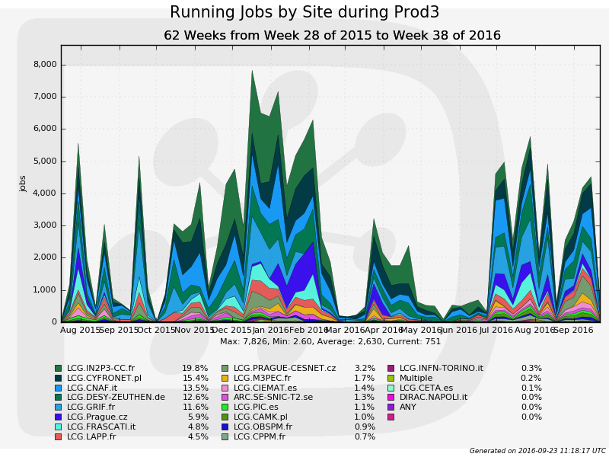
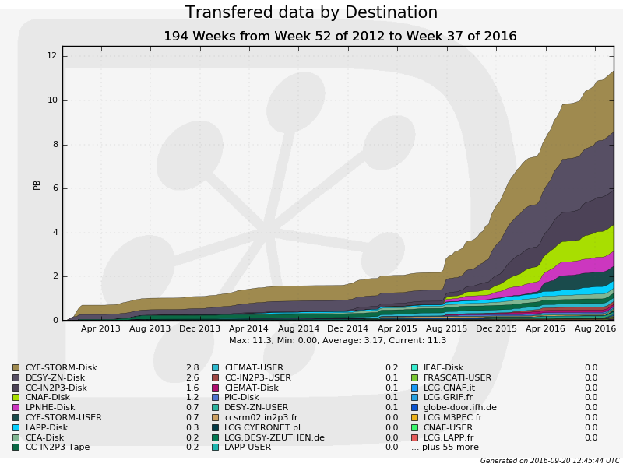
Monte Carlo campaigns during CTA preparation
Resources used for MC Prod2, Prod3 (2013-2016)
  360 M HS06 CPU hours (10% for users analysis)
  11 PB transferred data (2 PB currently on disk/tape)
  25 M files registered in the catalog
Running jobs by site during Prod3
Transferred data by destination
8
8k jobs
12
7
10
6
Start MC Prod3
5
8
4
6
K jobs
PB
3
4
2
1
2
0
0
08/15
10/15
12/15
02/16
04/16
06/16
08/16
04/13
12/13
08/14
04/15
12/15
08/16

Slide 36
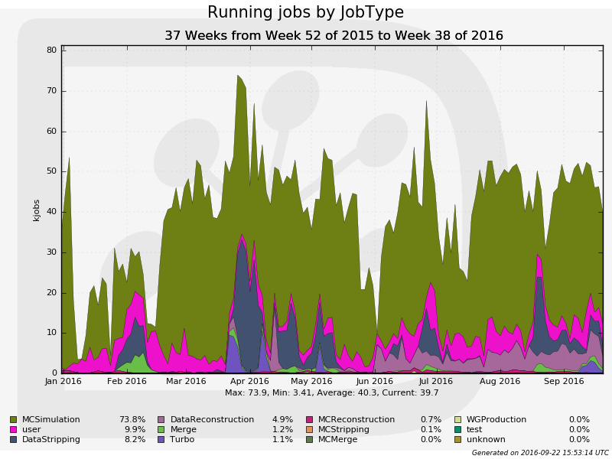
Proven scalability
Running jobs by Job Type in LHCb
K jobs
⬅40.000
Jan 2016
Sep 2016
Computing resources
Grid: CREAM, ARC, HTCondorCE
Private Clusters
Batch: LSF, SGE, Condor, Torque
Clouds: LHCbDIRAC pilots spawned by vcycle
Vac with LHCbDIRAC pilots
BOINC with LHCbDIRAC pilots

Slide 37
Conclusions
DIRAC is an open source project
  User driven development
Well-proven solution for the management of the computing tasks in a distributed environment
Already adopted by many communities, mostly from HEP, Astrophysics and Life Science
  Good experience gained in CTA. Ready to share with others
New interested communities can find support/documentation
  Doc: http://diracgrid.org/
  User Forum
    https://groups.google.com/forum/?hl=en#!forum/diracgrid-forum
  DIRAC User Workshop once per year
    Very fruitful exchange between users and developers
    Including admin/dev tutorials

Slide 38
Acknowledgement
H2020-Astronomy ESFRI and Research Infrastructure Cluster (Grant Agreement number: 653477).

