Slide 1
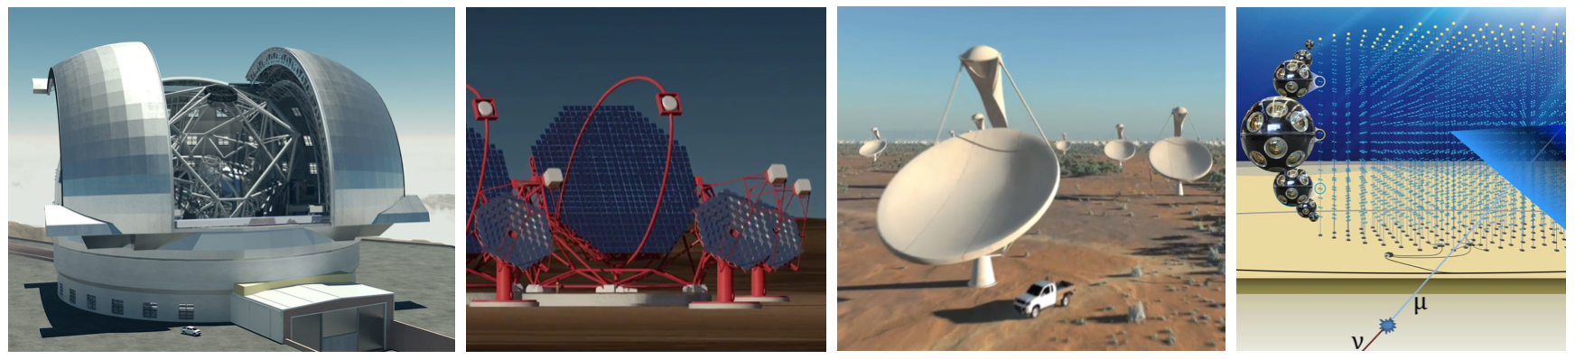
ASTERICS Periodic Review 1
Introduction
Prof. dr. Marco de Vos
devos@astron.nl
ASTERICS Coordinator

Slide 2

The Challenge
To establish a single collaborative cluster of next generation ESFRI telescope facilities and other relevant research infrastructure initiatives in the area of astronomy, astrophysics and astroparticle physics.
“Addressing cross-cutting synergies and common challenges shared by astronomy ESFRI facilities”
Notes:
The added value of an active AGA chair.

Slide 3
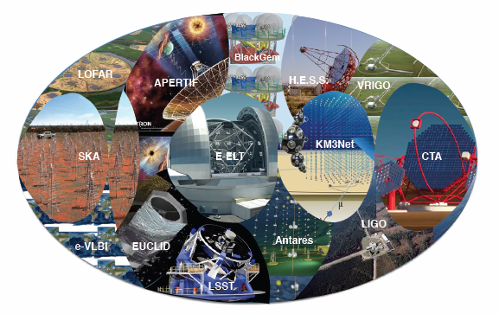
ESFRI telescopes and others
ESFRI projects in proposal:
  CTA, E-ELT, KM3NeT, SKA
Broad range of ESFRI and other facilities:
  E-EVN, ET/EGO, Euclid, LOFAR, …

Slide 4
ASTERICS facts & figures
Astronomy ESFRI & Research Infrastructure Cluster
Horizon 2020 Work Programme INFRADEV-4-2014/2015 Call –
“Implementation and operation of cross-cutting services and solutions for clusters of ESFRI and other relevant research infrastructure initiatives”
Funded at 15 M€ for 4 years
22 partners in 6 countries, representing a major collaboration in Astronomy/Astrophysics/Astroparticle Physics
ASTRON, CNRS, INAF, UCAM, JIVE, INTA, UEDIN, UHEI, OU, FAU, VU, CEA, UVA, UGR, FOM, IEEC, IFAE, UCM, INFN, STFC, DESY, SURFnet

Slide 5
Mission Impossible?
CTA, E-ELT, KM3NeT and SKA all established projects
Have their own aims, planning and issues
Have to solve their own problems within their scope
Are not always in a position to invest in collaboration
ASTERICS approach: add value on critical areas
Stimulate and facilitate community science initiatives
R&D in tools and methods for handling the data deluge
Training developers and users in data science
R&D in commensal observing, time synchronizing, …
Notes:
How did we organise the management of the proejct and was that (good) enough?

Slide 6
Our strengths
Focus on Open Innovation
Essential for getting results in the other projects
Focus on Open Science & Training
Essential for preparing the future user-base of the various facilities
Continued improvement of Open Science methods and understanding
Focus on Open Collaboration
Scientists and engineers from different projects collaborate and engage in ASTERICS
Open to receive from other European projects
Notes:
How did we monitor the finances?

Slide 7
Our weaknesses (so far…)
Limited formal top-level interaction with ESFRI projects
Needed to secure sustained incorporation of ASTERICS achievements
Non-trivial industry engagement model
Contacts are there, but efficiency can be improved
Non-trivial alignment with other (EC funded) projects
Interactions with most of these are now well-established (e.g. RadioNet, RDA, EOSC), but need to continued attention
Notes:
How did we monitor the finances?

Slide 8
Where are we now?
Activities in all WPs well on track
After the usual slow ramp-up because of hiring
See further presentations in this review
Visibility and relevance of ASTERICS established
ASTERICS has linking-pins to AstroNet, APPEC, RadioNet, AENEAS, RISCAPE, EOSC, …
Publications and outreach well established
See further presentations in this review
Some selected highlights – more to come!
Notes:
How did we organise the quality assurance?

Slide 9
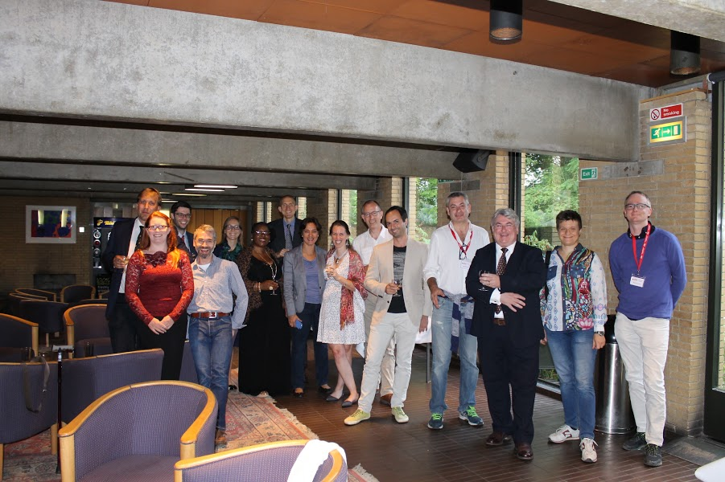
WP2 - DECS
Citizen Science Workshop 1
St Catherine’s College Oxford, July 2016
Representation from
CTA, SKA, E-ELT, and
other astronomy
facilities

Slide 10
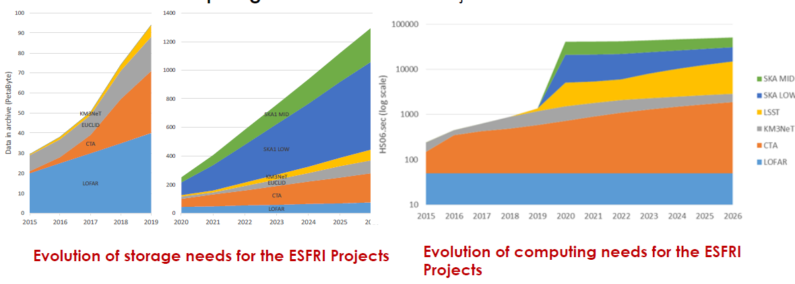
WP3 - OBELICS
(Independent!) Analysis of resource requirements
And means to mitigate the data deluge, e.g. loss-less compression algorithms

Slide 11
WP4 - DADI
Active engagement with ESFRI projects
E.g. collaboration between CDS and EGO on Aladin: customization for the GWSky gravitational wave follow‐up tool
Notes:
The external world and the ASTERIS influence.

Slide 12
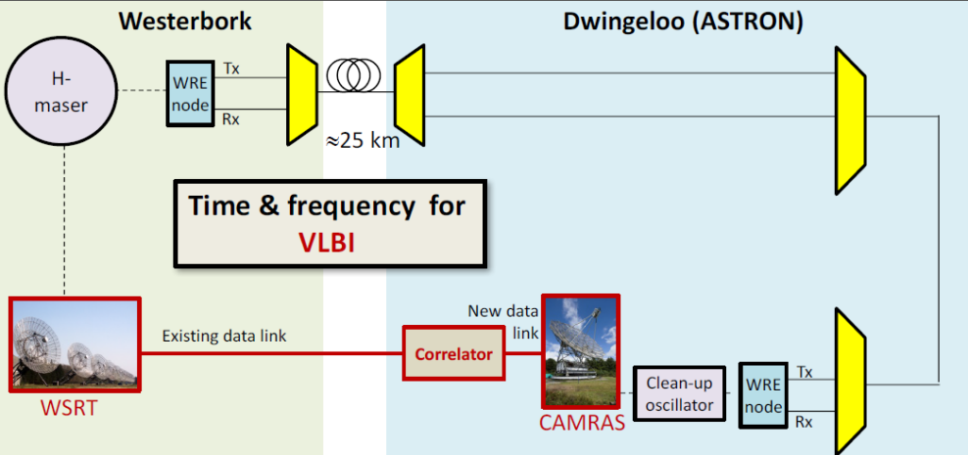
WP5 - Cleopatra
Real-world demonstrations on existing facilities
WR timing in design of SKA-Mid

Slide 13
Future steps
Activities in WPs continue according to plan
Exploitation plan
  Sustain: Tour of ESFRI project directors
  Extend: Make active use of policy forum
Collaboration plan
  Sustain: ASTERICS in EAB of RadioNet etc
  Extend: targeted new strategic collaborations

Slide 14
