Slide 1
WP2 DECS: Dissemination, Engagement and Citizen Science
Stephen Serjeant
ASTERICS Mid-Term Review
March 2017

Slide 2
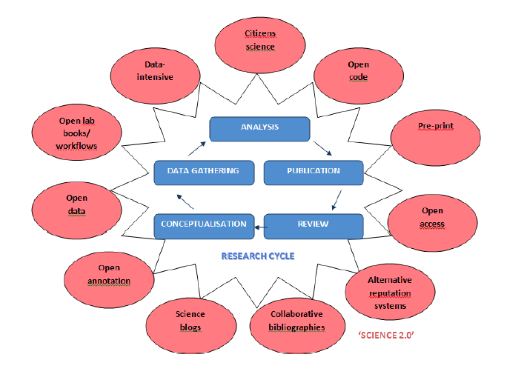
Open Science
Citizen Science is not outreach!
http://ec.europa.eu/research/consultations/science-2.0/background.pdf
Notes:
The usual role of the outreach work package is just dissemination of information, but we want to do something far better. ASTERICS aims to use the best open science practice – not just in open access scientific publications and open access to data through the virtual observatory, but by direct engagement of the public in the process of what computer science people call ‘knowledge discovery’. We’re using citizen science, mass participation experiments. The important thing to remember is that citizen science is NOT outreach. It’s a tool for doing an experiment, like a spectrometer. You’re applying thousands or tens of thousands human brains on an algorithmically-complex classification problem.

Slide 3
DECS
Dissemination, Engagement and Citizen Science Lead: S. Serjeant
Dissemination & public engagement
Open ESFRI facilities to wider stakeholders through citizen science (Open Science, or ‘Science 2.0’)
Audiences: scientific & technical communities, academia, private industry, other public research centres, SMEs, policy makers, general public
Coordinated citizen science experiments to open ESFRIs & pathfinders/precursors to public
Educational resources & efficacy metrics

Slide 4
Tasks
Task | Description
2.1 | DECS production (audio, video, text)
2.2 | Adapt mass participation infrastructure
2.3 | Mass participation experiment operation
2.4 | Translation and testing
2.5 | Internal dissemination and project outreach

Slide 5
Deliverables
Deliverable | Description | Month
2.1, 2.2 | Website live, brochure publication | 3, 12
2.3, 2.7 | Educational resources for mass participation experiments | 23, 35
2.4, 2.8 | Online mass participation experiments | 23, 35
2.5 | Video resources | 29
2.6, 2.9 | Open-access publications from mass participation experiments | 32, 46
✓✓
✓
✓

Slide 6
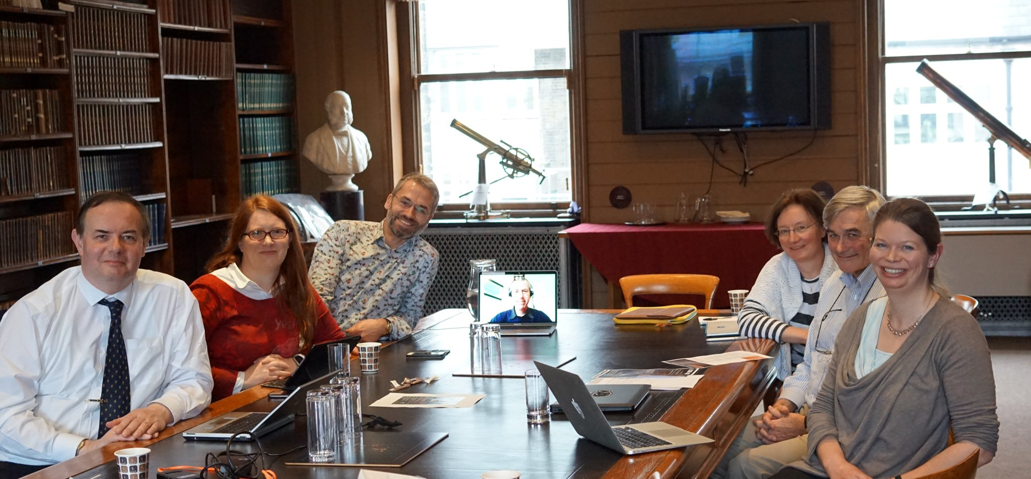
DECS so far, in a nutshell
Press release contacts and machinery in place (2.1)
Website designed and live (2.1)
Banners and brochure printed (2.5)
Newsletters (2.5)
Liaising with policy makers (2.5):
  input to EU Competitiveness Council, Nov 2015
  Written evidence to UK House of Lords Select Committee enquiry
  Joint ASTERICS / OPTICON / EUROPLANET briefing notes on impact of space to be drafted
First ASTERICS Citizen Science workshop, Oxford July 2016 (2.2)
First citizen science experiment launched ahead of schedule (2.2, 2.3)

Slide 7
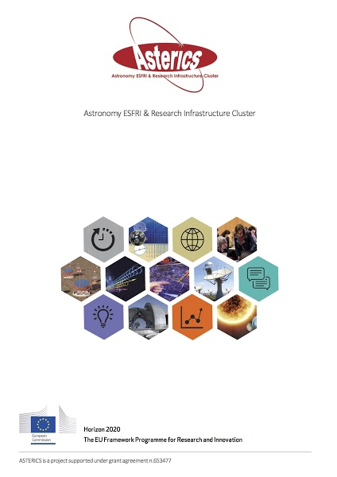
DECS production

Slide 8
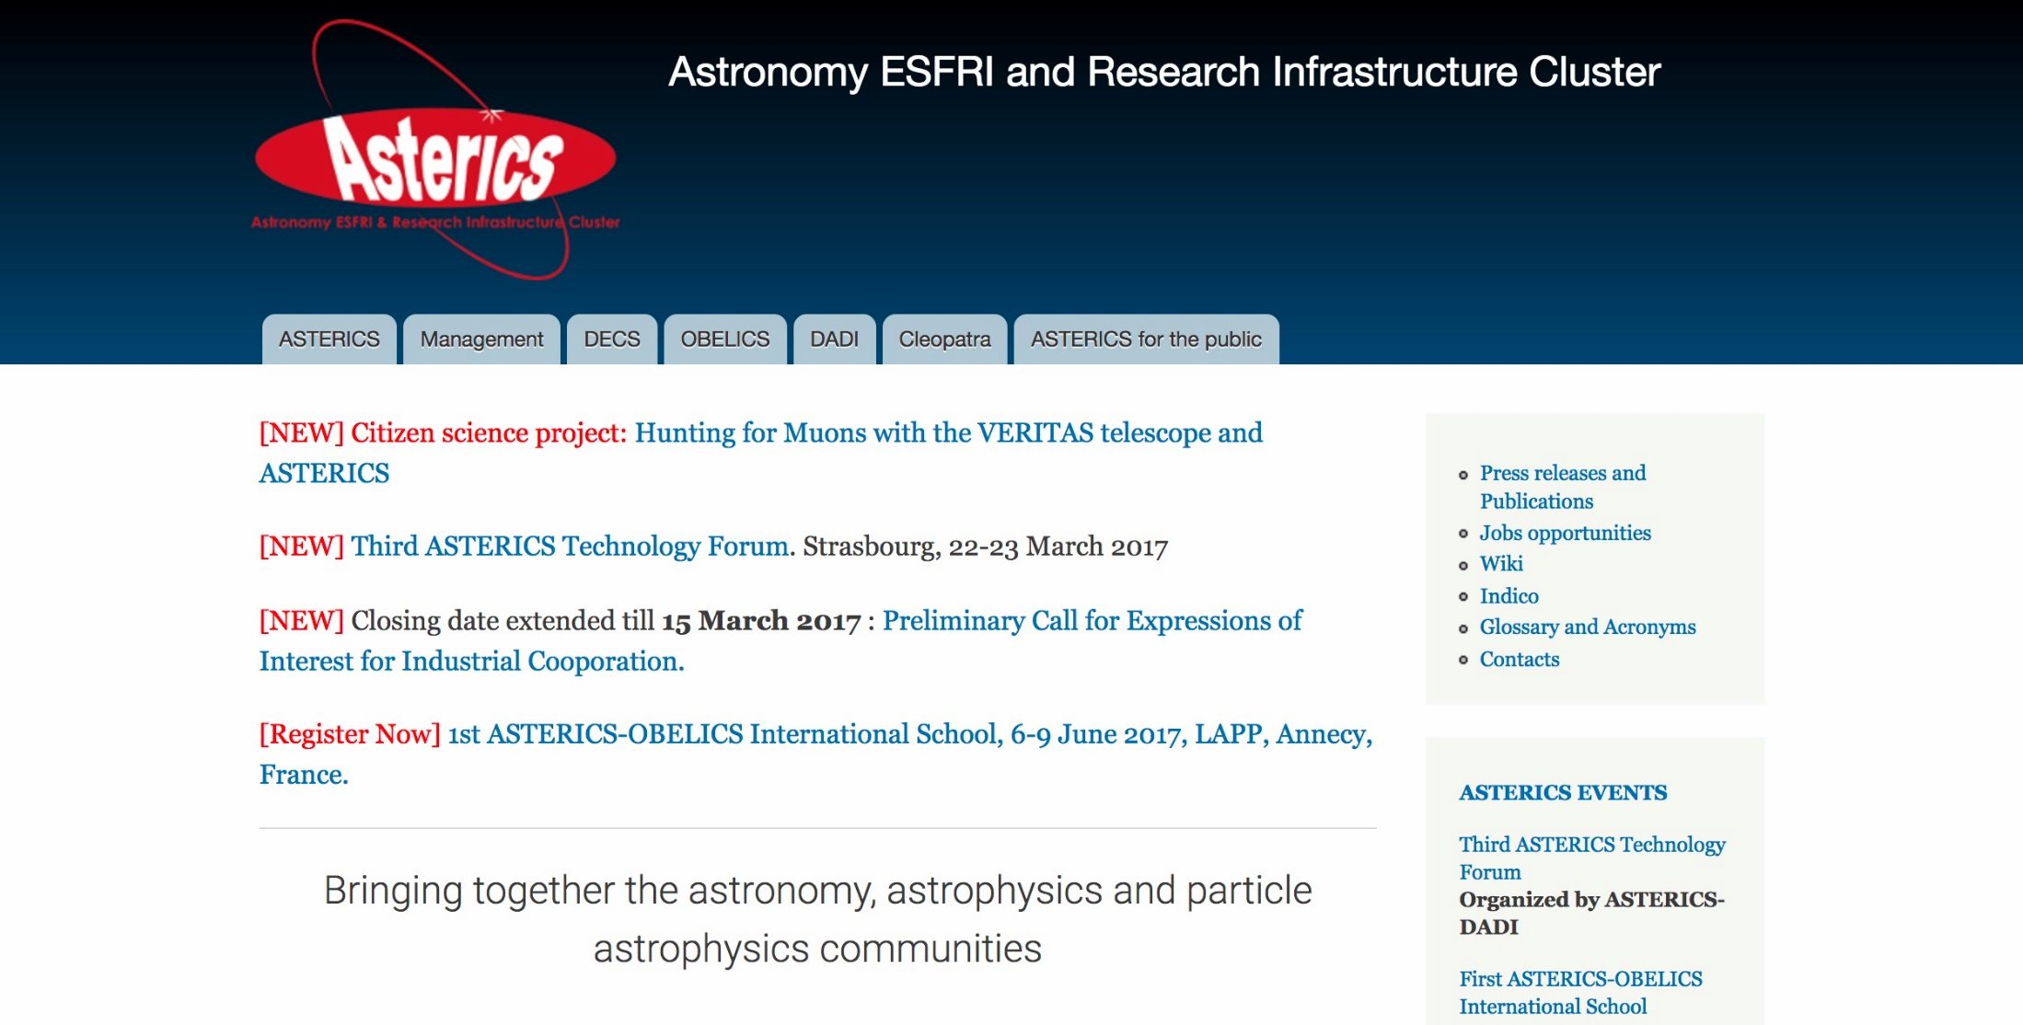
www.asterics2020.eu

Slide 9
Press contacts
The Netherlands: Giuseppe Cimò, ASTRON
France: Strasbourg, Francoise Genova; IAPP, Giovanni Lamanna, with a request to include Denis Mourand and Elizabeth Kohler in CNRS.
Italy: INAF, Fabio Pasian and Massimo Ramella
Spain: INTA, Enrique Solano
UK: Open University, Stephen Serjeant

Slide 10

Policy engagement

Slide 11
Policy engagement

Slide 12
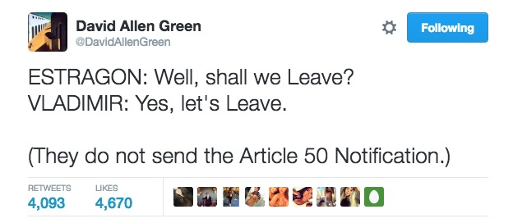
Policy engagement
Written submission to UK House of Lords select committee enquiry into EU science publications
“Brexit means Brexit”
Legal advice is that grant agreements are legally binding between EC and universities, so continue beyond Brexit
Regardless, UK government have guaranteed funding of existing EU H2020 grants
ASTERICS operations unaffected

Slide 13
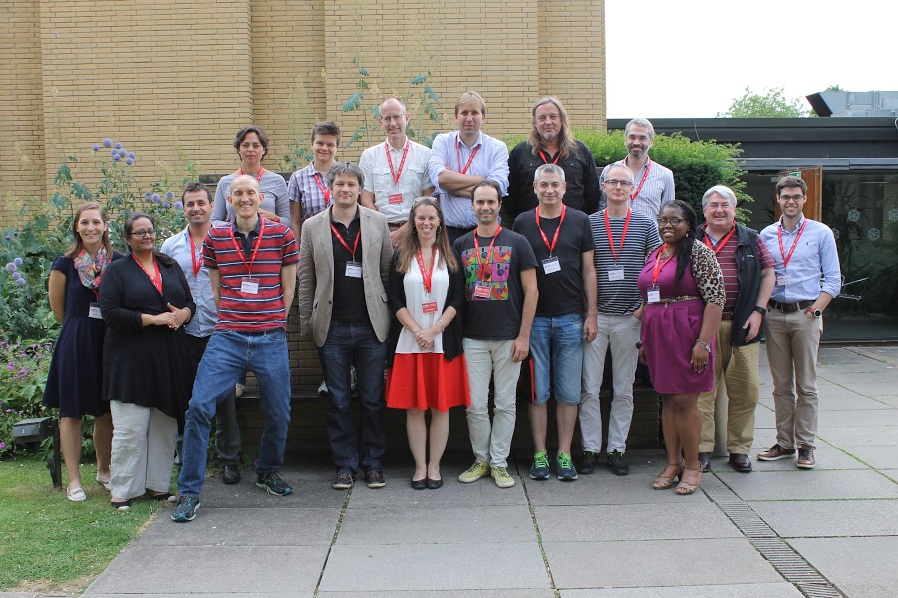
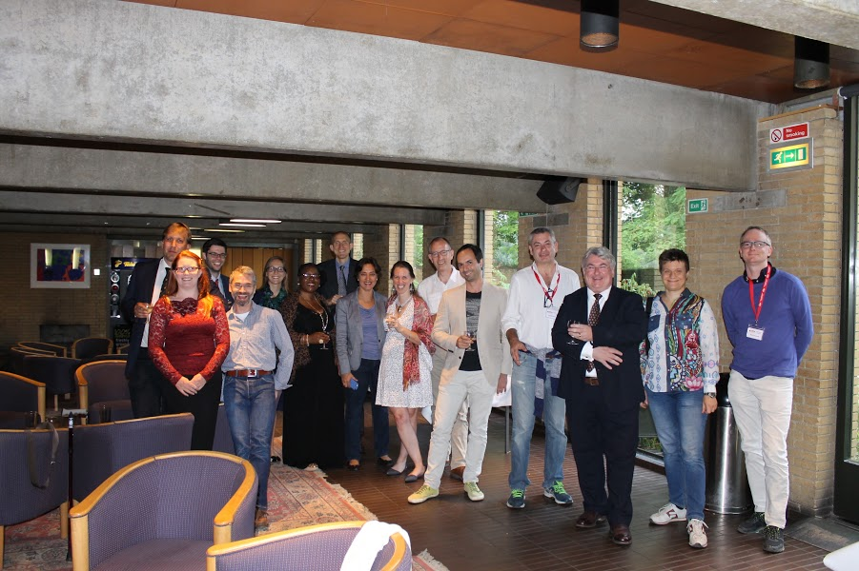
Citizen Science Workshop 1
St Catherine’s College Oxford, July 2016
Representation from CTA, SKA, E-ELT, and other astronomy facilities
E-ELT not well suited to surveys that can be mined through crowdsourcing, but crowdsourcing can identify rare populations in survey data sets to supply E-ELT targets

Slide 14
Pulsar Hunters ++
Lead: Rene Breton
Science goal: Extend the successful Pulsar Hunters Zooniverse project (featured on BBC Stargazing Live) to harder-to-find pulsars
Activity: interactive data visualization of pulsar time and frequency domain data; future application to SKA

Slide 15
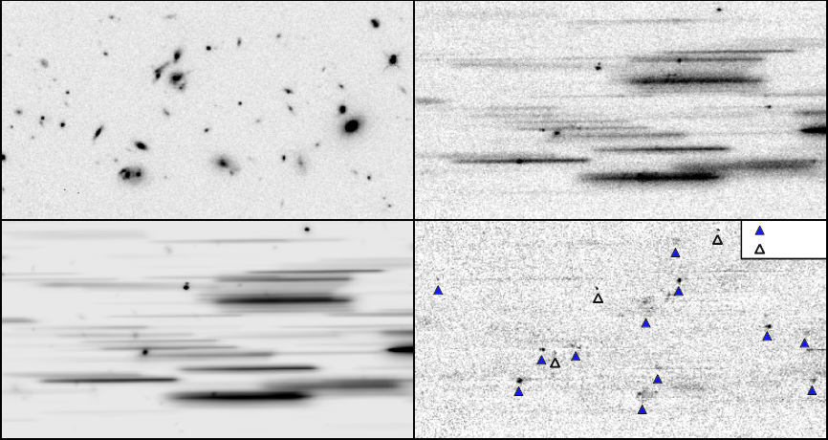
Deblending slitless spectra
Lead: Claudia Scarlatta
Science objective: a spectroscopic survey of star-forming galaxies and AGN, quantifying star formation rates and black hole accretion diagnostics
Activity: interactively deblend objects in confused slitless spectroscopy, for application on HST data (WISH) and future use in Euclid
3D-HST ApJS 2012
Notes:
CLAUDIA SCARLATTA NOT IN EU BUT WE ARE ‘OPEN’ IN GEOGRAPHICAL TERMS AND SHE DONATED HER TIME FOR THE POTENTIAL FUTURE BENEFIT OF THE ESA EUCLID MISSION

Slide 16
CREDO: Cosmic Ray Extremely Distributed Observatory
Lead: Piotr Homola https://credo.ifj.edu.pl/
Science objective: detect ultra-high-energy charged particles with a whole-Earth Cherenkov detector
Activity: use mobile phones as charged particle detectors, either while charging (so horizontal) or while playing Pokemon Go (so orientation known)
First CREDO meeting in August 2016: (47 registrants, 9 countries, 13 nationalities), quite good media coverage (TV, radio, daily press)
“Please feel free to convey my view of the importance of ASTERICS action in the case of CREDO: inspiration, practical know-how, valuable interpersonal exchange.”

Slide 17
Slide from Piotr Homola, CREDO inaugural workshop, August 2016

Slide 18
Slide from Piotr Homola, CREDO inaugural workshop, August 2016

Slide 19
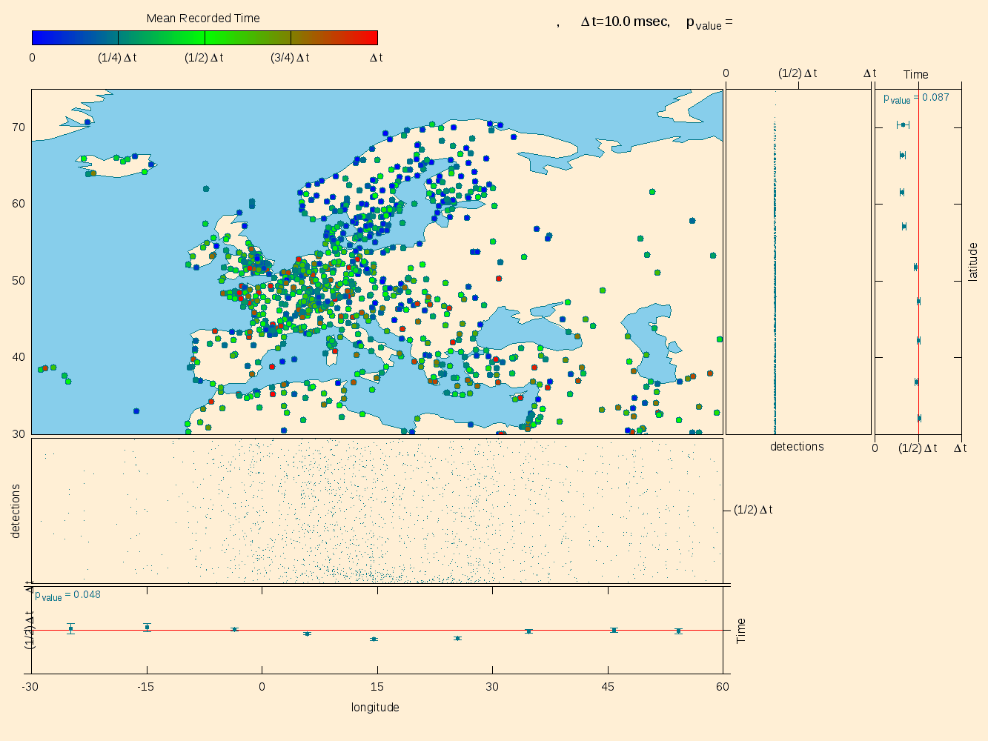
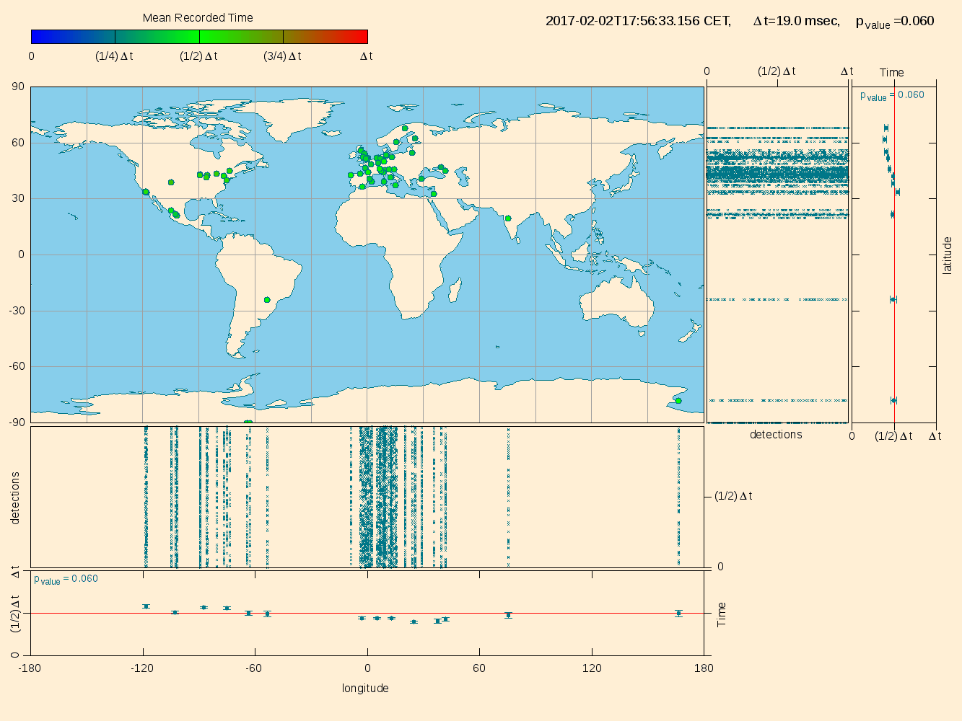
CREDO: Dark Universe Welcome

Slide 20
Muon Hunters
Lead: Lucy Forston, CTA
Science goal: detect fainter Cherenkov events by visual classification
Activity: classify hadron vs. photon events in the CTA telescopes, morphologically and in the time domain; apply first to simulations and to e.g. HESS
Notes:
STRESS THAT LUCY INVITED AS CTA REPRESENTATIVE AND THAT EXPLICIT INTENTION IS TO BUILD EXPERIMENT THAT WORKS ON PATHFINDER DATA AND WILL BE APPLIED LATER ON FULL ESFRI DATA

Slide 21
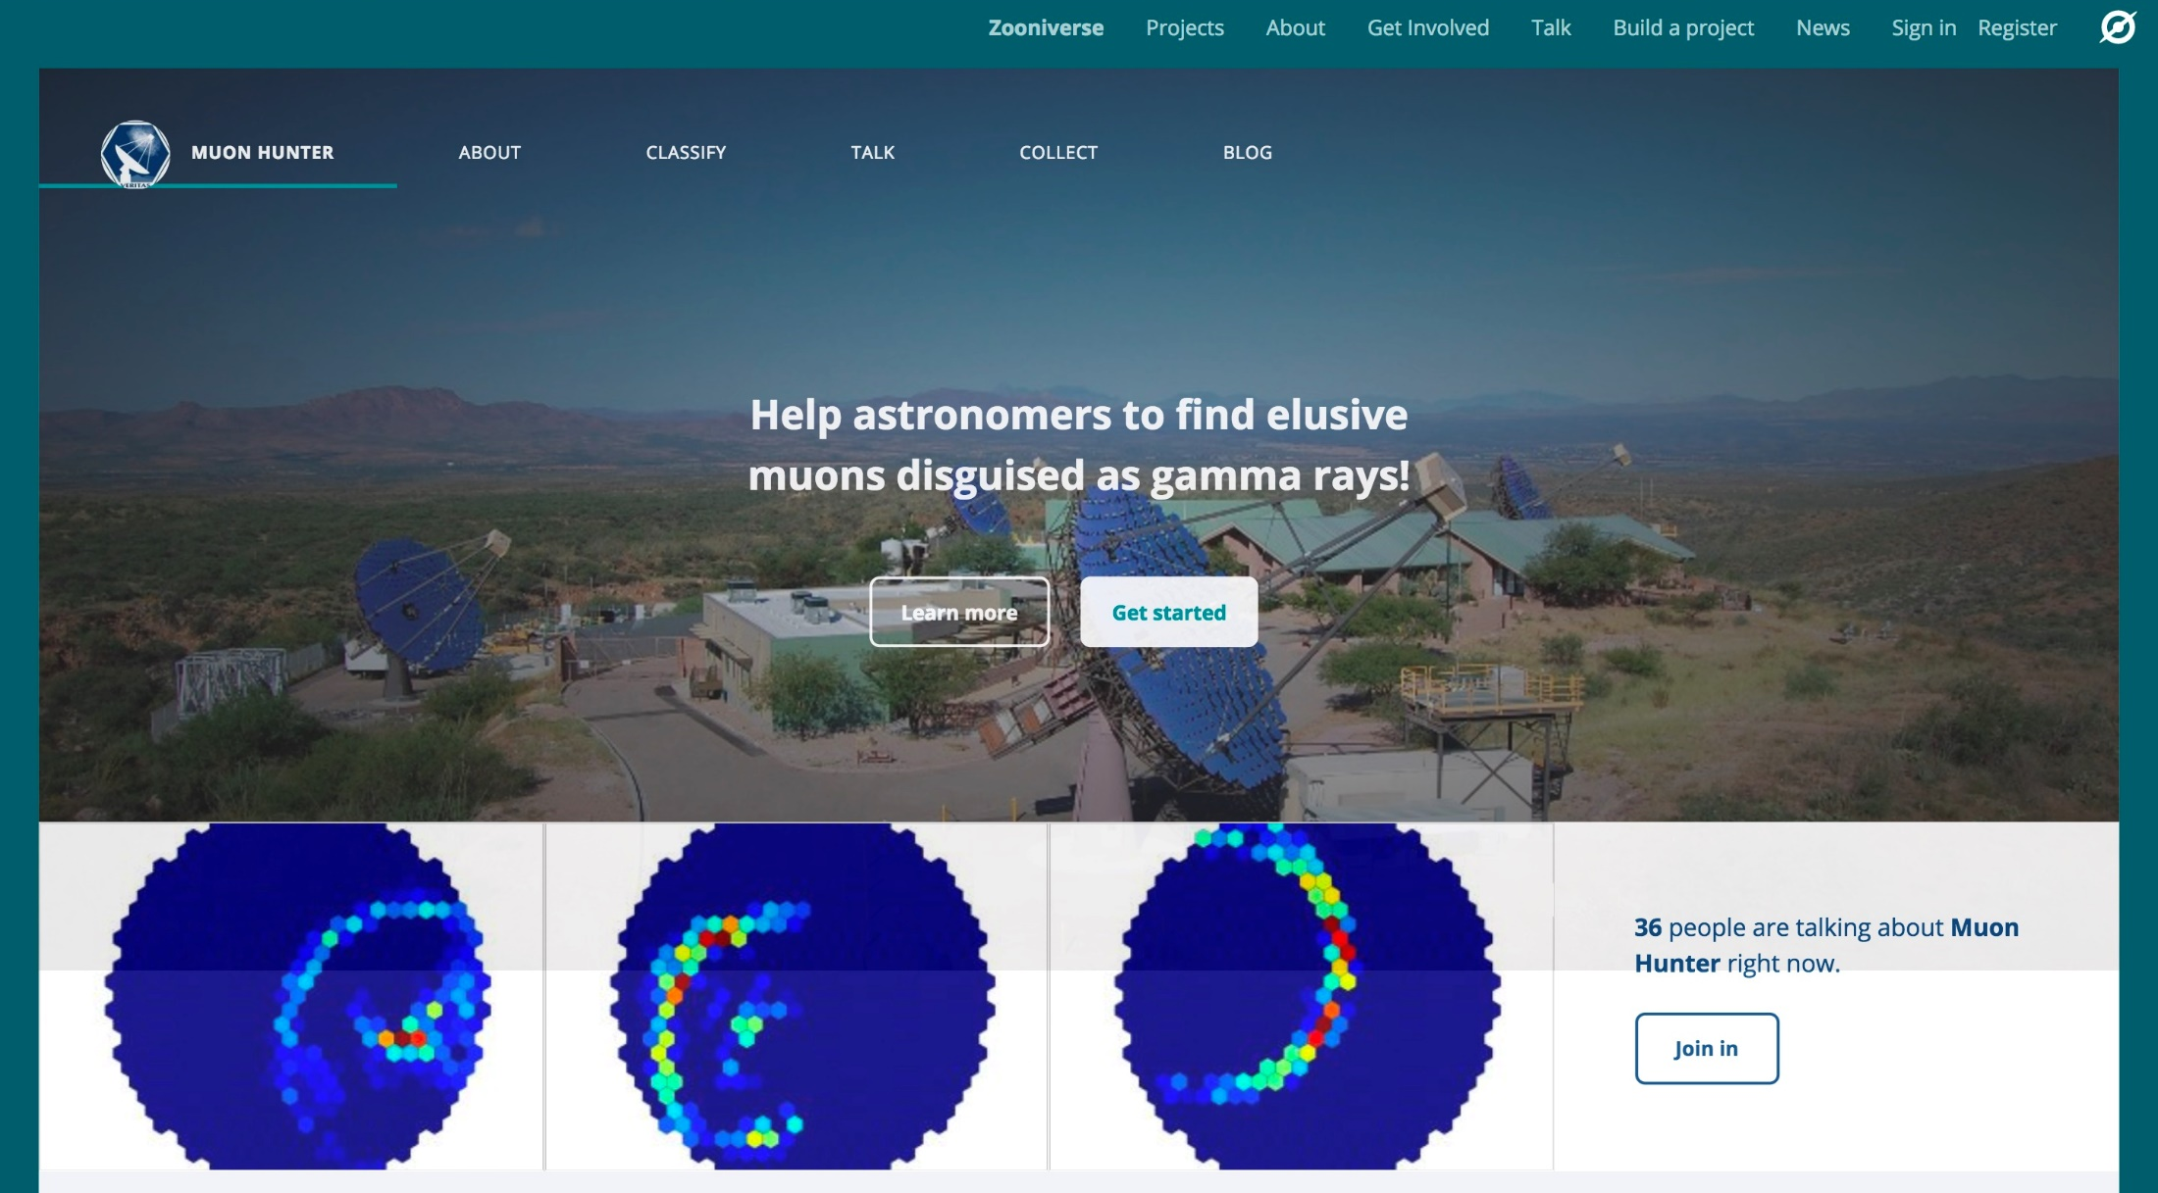
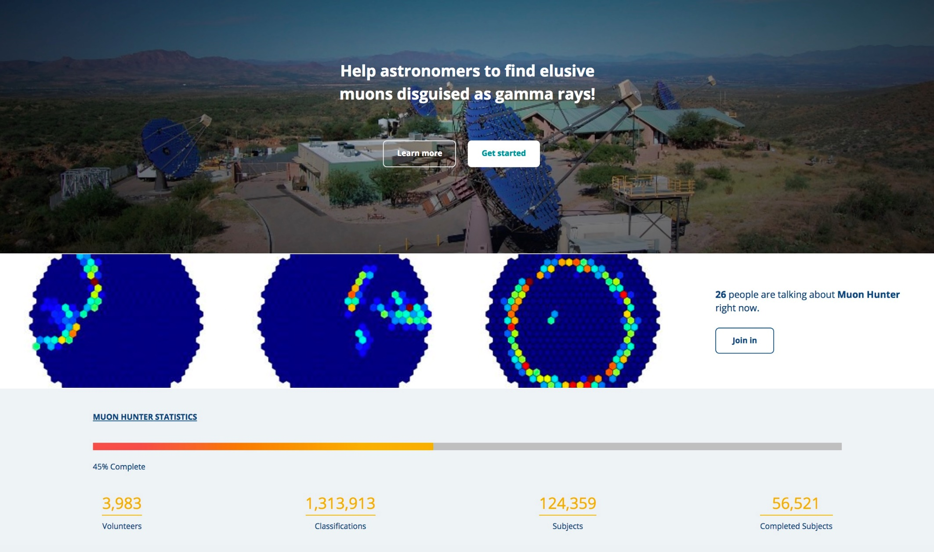
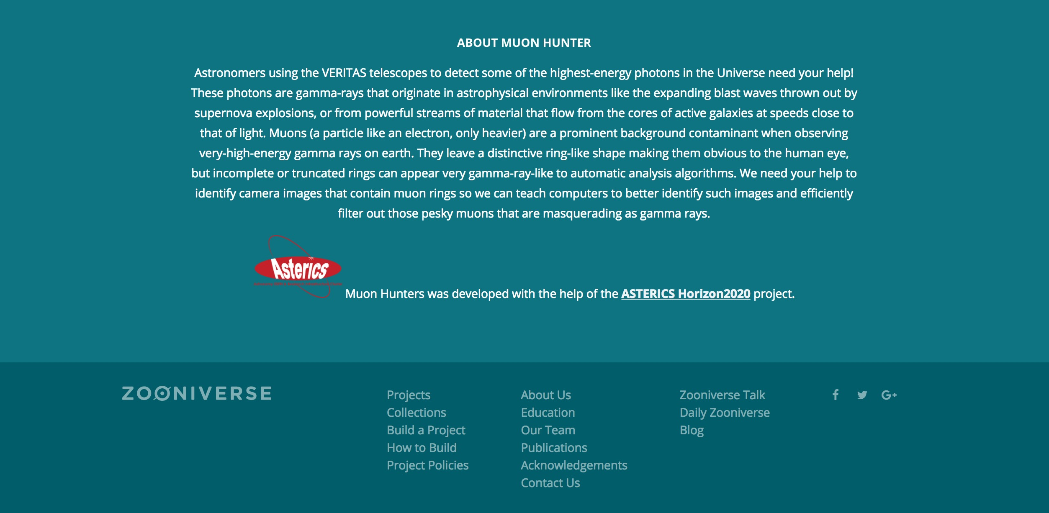
1.3 million classifications in the first five days!

Slide 22
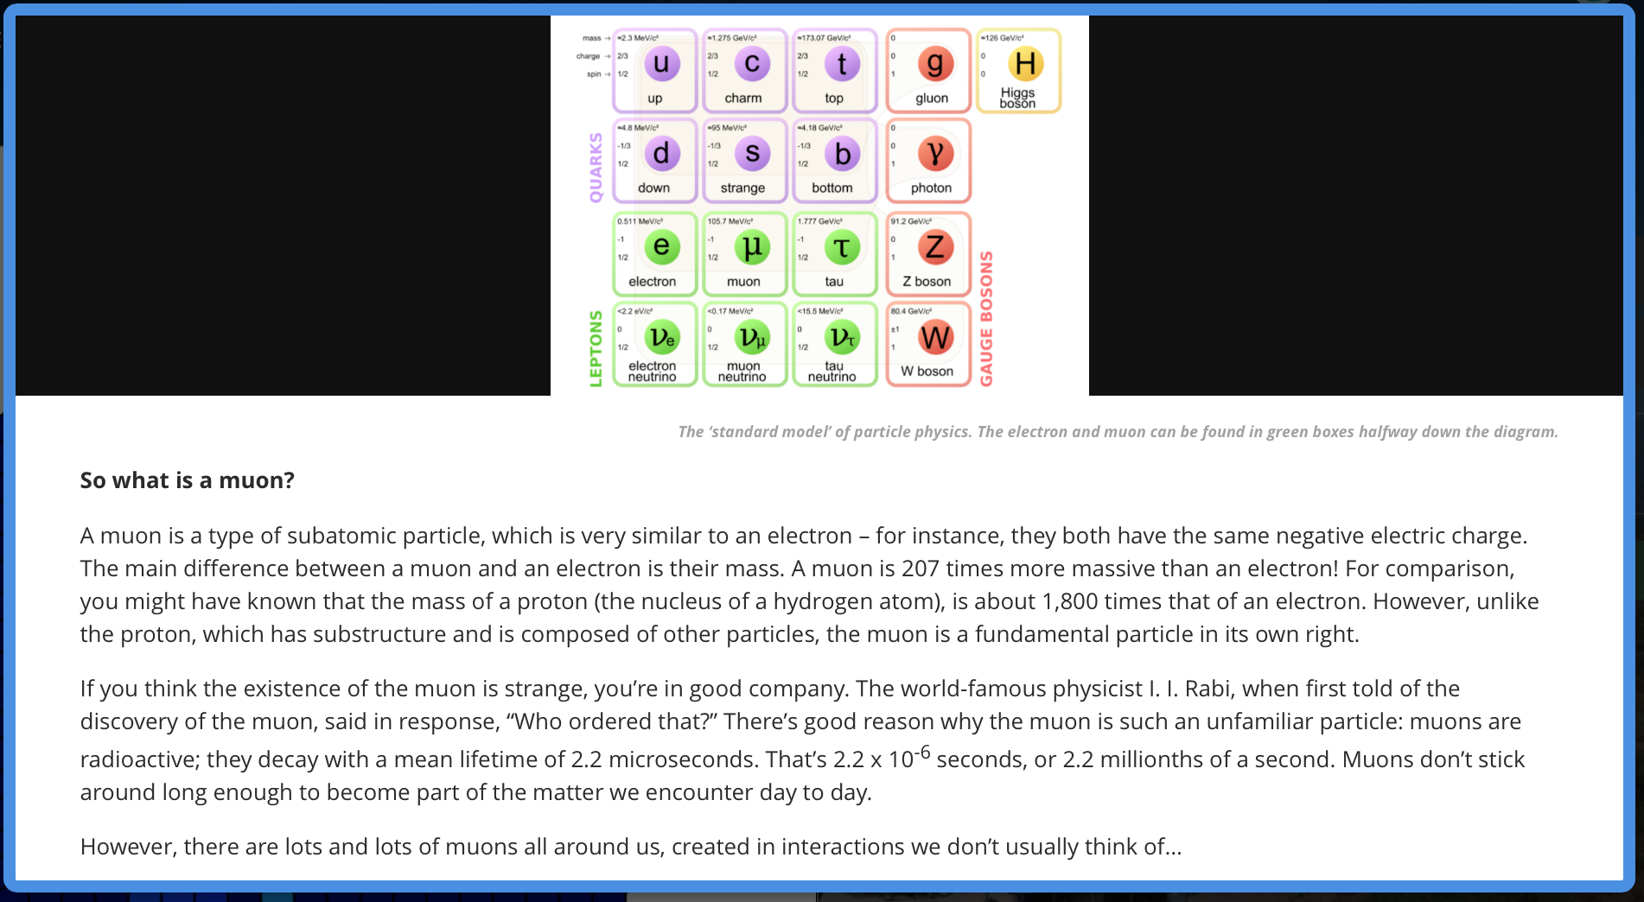
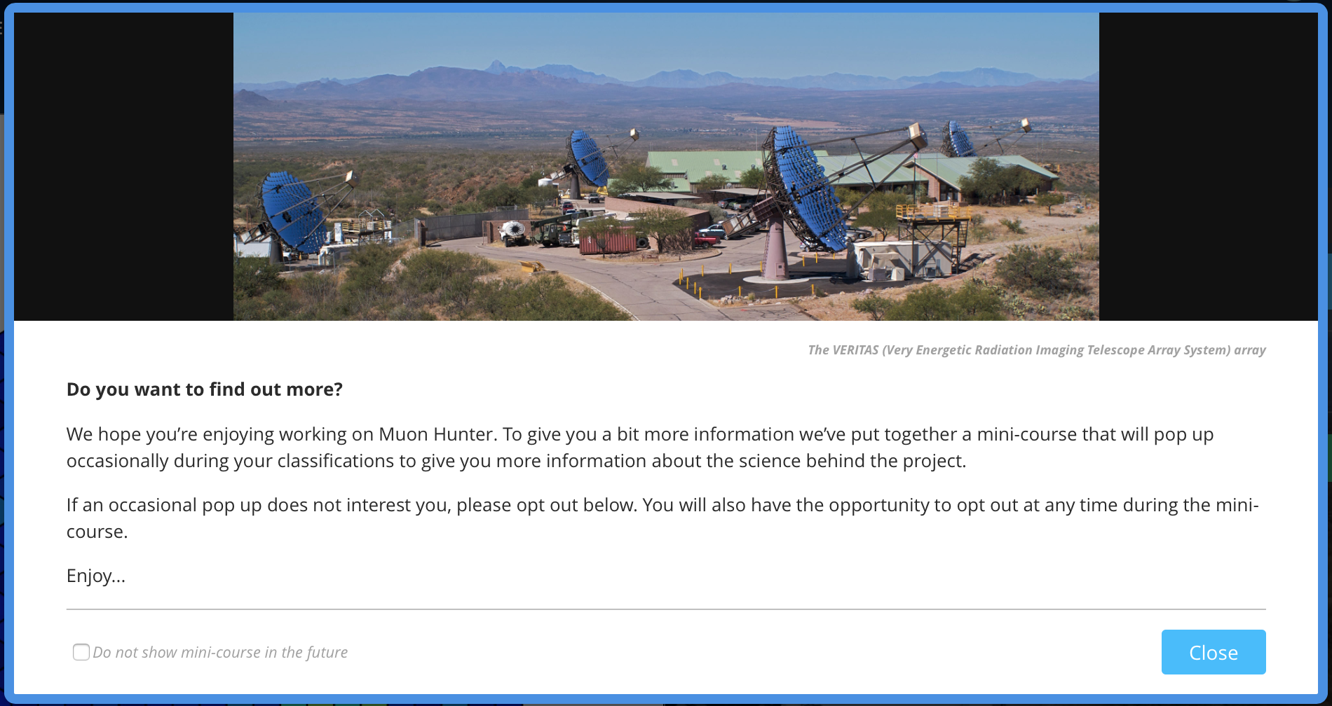
Notes:
EDUCATIONAL RESOURCES DELIBERATELY DESIGNED TO BE EMBEDDED WITHIN CITIZEN SCIENCE EXPERIMENT

Slide 23
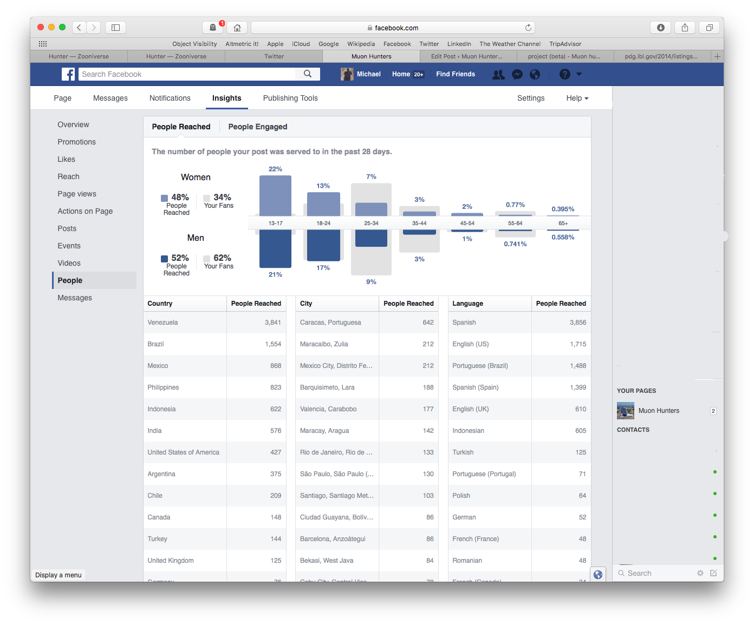

Slide 24
DECS Forward Look
First two mass participation experiments scheduled to go live in March 2017 – one already live
Educational resources ready at the same time; promotional animations under development
Next Citizen Science workshop in 2017 at INAF
Publications of the Astronomical Society of Australia would like to publish the Citizen Science workshop results

