Slide 1
WP4 – DADI Data Access, Discovery and Interoperability
Françoise Genova and the WP4 team

Slide 2
WP4 objectives
Make the ESFRI and pathfinder project data available in the international VO framework
Three complementary and interacting tasks
  Support to ESFRI facilities and gathering their requirements & feedback (INAF/UHEI)
  Support to the European science community and gathering their requirements and feedback (CNRS-CDS/INTA)
  Update of the VO framework from feedback and requirements (incl. liaison with RDA et al.) (CNRS-CDS/UEDIN)
ALL partners involved in ALL activities

Slide 3
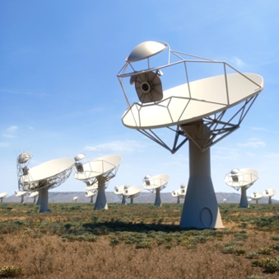
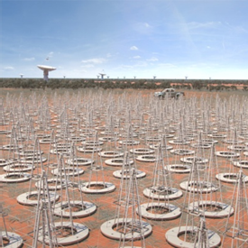
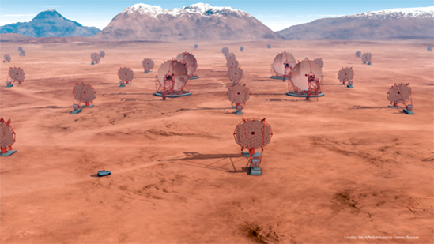
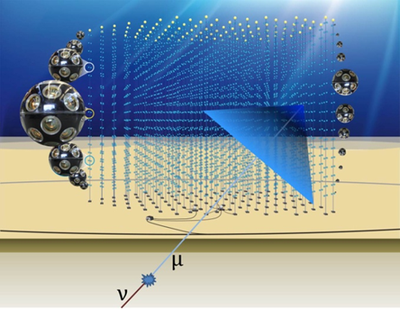
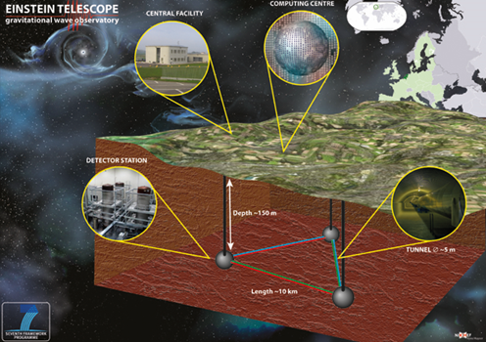
Who is involved
Euro-VO partners, i.e. VO initiatives from France (CNRS/OAS-CDS+UNISTRA), Germany (UHEI), Italy (INAF), Spain (INTA),UK (UEDIN)
Representatives of ESFRI and pathfinders
  CTA (CNRS/LUTH + OBSPAR)
  EGO/VIRGO and ET (CNRS/APC)
  KM3NeT (CNRS/CPPM)
  SKA (ASTRON)
ESO (E-ELT) is an associate of the project
ESA (ESAC) has been working in close collaboration with Euro-VO

Slide 4
Activities during the period
DADI is structured around the organisation of Workshops (Deliverables) and participation in external events (IVOA meetings, which are Milestones, plus ADASS, RDA)
Technological activities on VO standards and VO-enabled tools in the IVOA framework
Intense activity during the first 8 months (2015), with one deliverable for each Task, which created the DADI community, introduced newcomers to the VO, and initiated work in common
Intense activity since then in the three strands of work
  one Workshop for Tasks 4.1 and 4.3
  preparation of the Second School (4.2, D4.5, 15-17 November 2016)
  technological work in the IVOA context and in collaboration between the partners
Specific activities in support of the ESFRIs/pathfinders
Collaborations with an impact!

Slide 5
Deliverables
# | Title | Lead partner | Due date | Actual date and location
D4.1 | First DADI Technology Forum | CNRS/CDS (Task 4.3) | September 2015 | Held 17-18 Sept. 2015 Strasbourg Del. 3 Nov.
D4.2 | First ASTERICS European School | INTA (Task 4.2) | November 2015 | Held 15-17 Dec. 2015 Madrid Del. 17 March 2016
D4.3 | First ESFRI Forum & Training Event | INAF (Task 4.1) | November 2015 | Held 3-4 Dec. 2015 Trieste Del. 17 March 2016
D4.4 | Second DADI Technology Forum | UEDIN (Task 4.3) | March 2016 | Held 7-8 March 2016 Edinburgh Del. 28 June 2016
D4.6 | First European Data Provider Forum & Training Event | UHEI (Task 4.1) | November 2016 | Held 3-4 June 2016 Heidelberg Del. 7 Oct. 2016
NB: Deliverables = Workshops, « text deliverable» (Del.) provided afterwards

Slide 6
Milestones and other relevant meetings
Milestones: IVOA Interoperability meetings
Other relevant meetings
  ADASS Meetings, Sydney (Nov. 2015) & Trieste (Oct. 2016)
  RDA Plenaries, Paris (Sept. 2015), Tokyo (March 2016) & Denver (Sept. 2016)
M2 | IVOA Sesto | Italy | 14-19 June 2015
M5 | IVOA Sydney | Australia | 30 October-1 November 2015
M7 | IVOA Cape Town | South Africa | 8-13 May 2016
M11 | IVOA Trieste | Italy | 21-23 October 2016

Slide 7
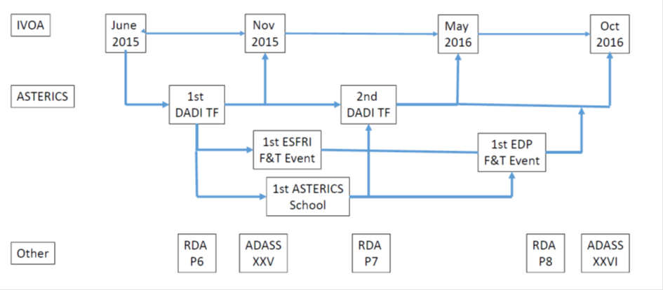
DADI in a nutshell
(first18 months)

Slide 8
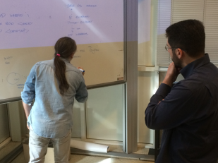
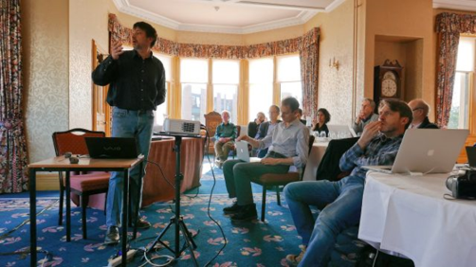
Task 4.3: Technology Forums
34/24 participants
Reports and discussion of technological work and collaborations among partners
Preparation of the IVOA meetings
«Hack-a-thon » = splinter discussions of technical topics
First Tech Forum: DADI kick-off
  Information about ASTERICS, DADI and IVOA
  Presentation of partners’ expertise and on-going work
  Identification of topics of interest for DADI
Second Tech Forum
  Technical discussions on many topics

Slide 9
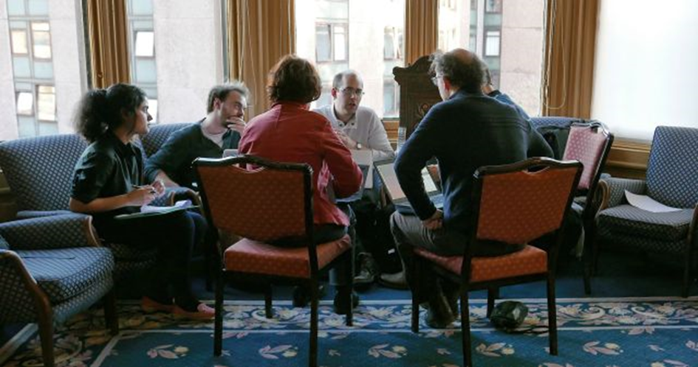
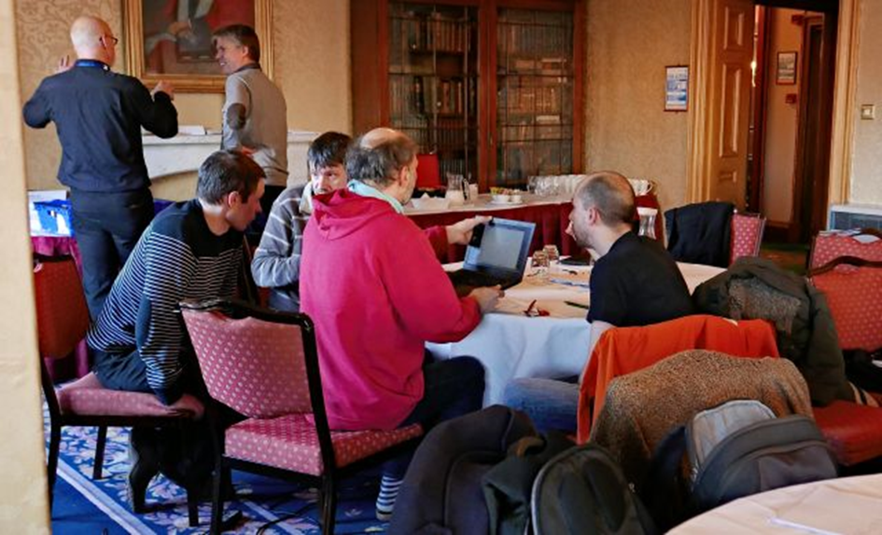
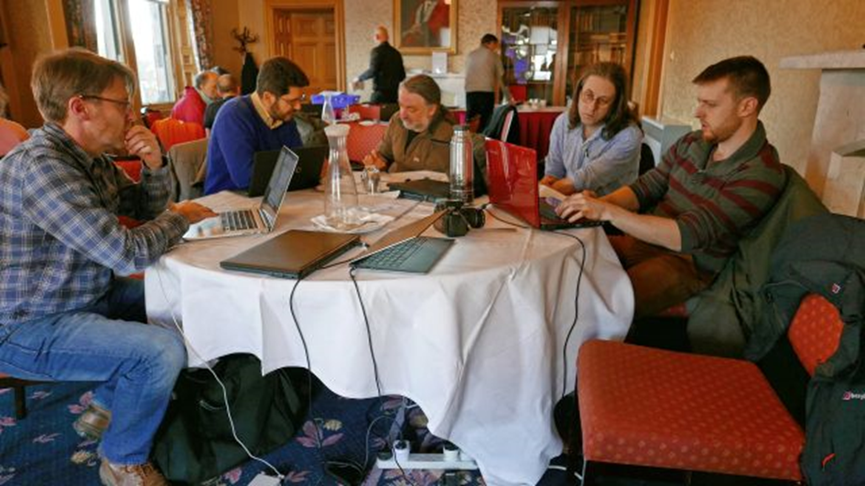
Hack-a-thon discussions in Edinburgh during the Tech Forum

Slide 10
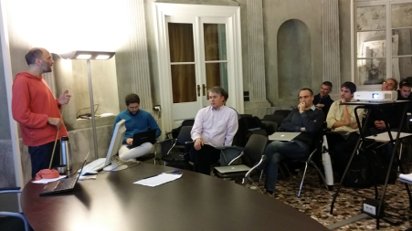
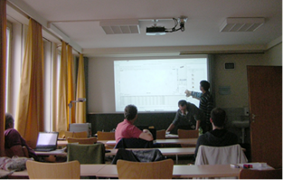
Task 4.1: Forum & Training Events
D4.3: ESFRI Forum - Requirements
  Organised around the topics identified during the First Tech Forum, incl. time domain data access (<> WP5) & Authentication & Autorisation (WP3)
  VO standards and tools already in use
  Initiation of discussion on specific support activities
D4.6: Data Centre Forum & Training
  Wide diversity of sizes and context
  VO part of the landscape
  First Training

Slide 11
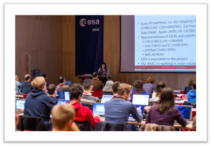
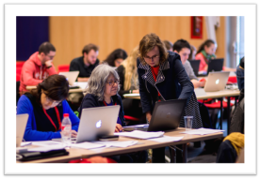
Task 4.2: First DADI School
43 participants from France, Germany, Italy, Spain, UK, and from Belgium, Greece, Lithuania, Poland, Portugal and Slovakia, also CTA, LOFAR, ESO
Learn enough about the VO to be able to use it in one’s own research
  Short presentation of the IVOA and ASTERICS
  “Hands-on” tutorials & “Treasure Hunt”
  Participants’ own projects
  Presentation of some of the projects and feedback session
Significant preparatory work
  Update of the tutorials
  Discussion with the participants about their scientific interests
Follow-up
  Provision of the tutorials
  Feedback to tool providers
  Follow-up activities in Greece, Poland and Italy
  Students from ESFRIs became tutors at the Second School
  Participants polled each year to follow the School impact and monitor their usage of the VO

Slide 12
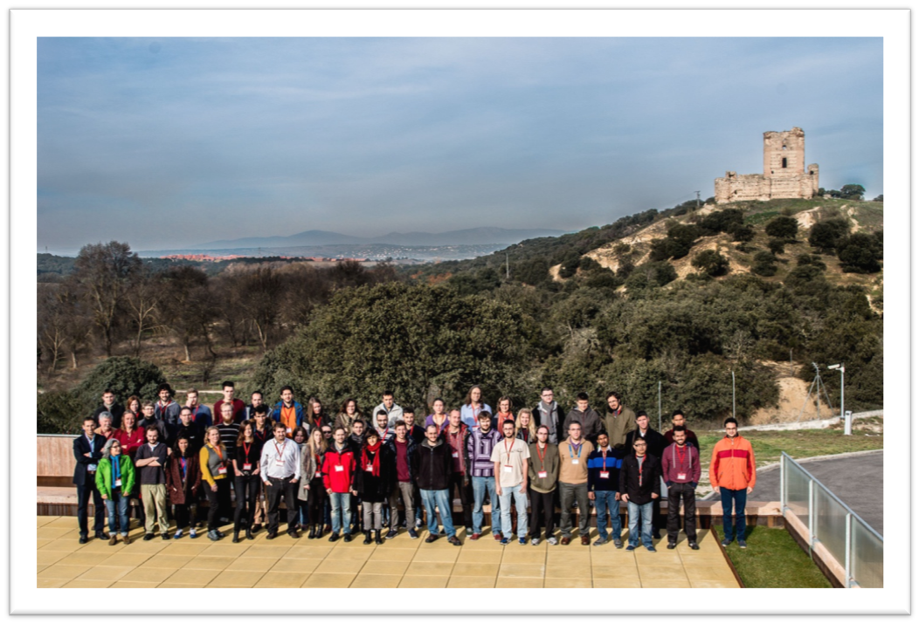

Slide 13
IVOA
DADI technological activities (Task 4.3) are performed in the IVOA context
Significant participation in the meetings and WGs, including leadership of Groups and on standards (editors/authors)
CTA actively participating in the Provenance Data Model definition
Focus session on projects in Cape Town, CTA and Gravitational Wave talks from ASTERICS participants
Survey of project requirements on-going

Slide 14
ADASS XXV & XXVI
The place to be to discuss with large projects about their data
Excellent visibility of ASTERICS, with in 2016
  ASTERICS booth
  Gravitational Wave, Data Models and HPC keynotes
  Several talks on DADI topics
  CLEOPATRA presentation by A. Szomoru
  Posters

Slide 15
Specific meetings & activities
DADI-Gravitational Wave community meeting, Strasbourg, 31 May-1 June 2016
4 «Provenance Days», which are leading the preparation of the IVOA Provenance Data Model
DADI-LOFAR meeting, Strasbourg, 18 Nov. 2016 – publication of visibility data in the VO
Cross-WP discussion of A&A (WP3) and time domain (WP5 – meeting on 21 March 2017)

Slide 16
Summary of Results
Creation of the WP4 team
Training and support of the ESFRI staff, and gathering of their feedback and requirements
Updated and new tutorials including from the ESFRIs
Technological results
  Adaptation of the VO Framework and tools to the ESFRI project needs
  Impact on the IVOA (science requirements, multi-D and time domain standards, Provenance, tools)
Reaching beyond the project partners
  European data providers
  Training and support of the wider European astronomical community, and gathering their feedback and requirements
  Liaison with RDA and other initiatives (EUDAT)
  Cross-WP activities with WP2, WP3 and WP5

Slide 17
Examples of impact
The IVOA « caravan » of standards for multi-D data is nearly completed
Collaboration between CDS and EGO on Aladin customization for the GWSky gravitational wave follow-up tool
Publication of ANTARES data in the VO by GAVO
CTA will use the IVOA Provenance Data Model in its pipeline
Follow-up activities after the First School

Slide 18
Slides presented in Heidelberg
June 2016

Slide 19
Impacts
ESFRI pathfinder data publication in the VO
Usage of VO-enabled tools by the ESFRIs for their own needs
VO building blocks in the ESFRI systems (economy of scale!)
Progress of the IVOA standards and tools (e.g. HiPS sky tessellation, multi-D standards, Provenance, A&A)
The ESFRIs become actors of the VO so that it takes their requirements fully into account
Dissemination of VO knowledge in the community
Excellent science: the integration of astrophysics and astroparticle data is at the forefront

Slide 20
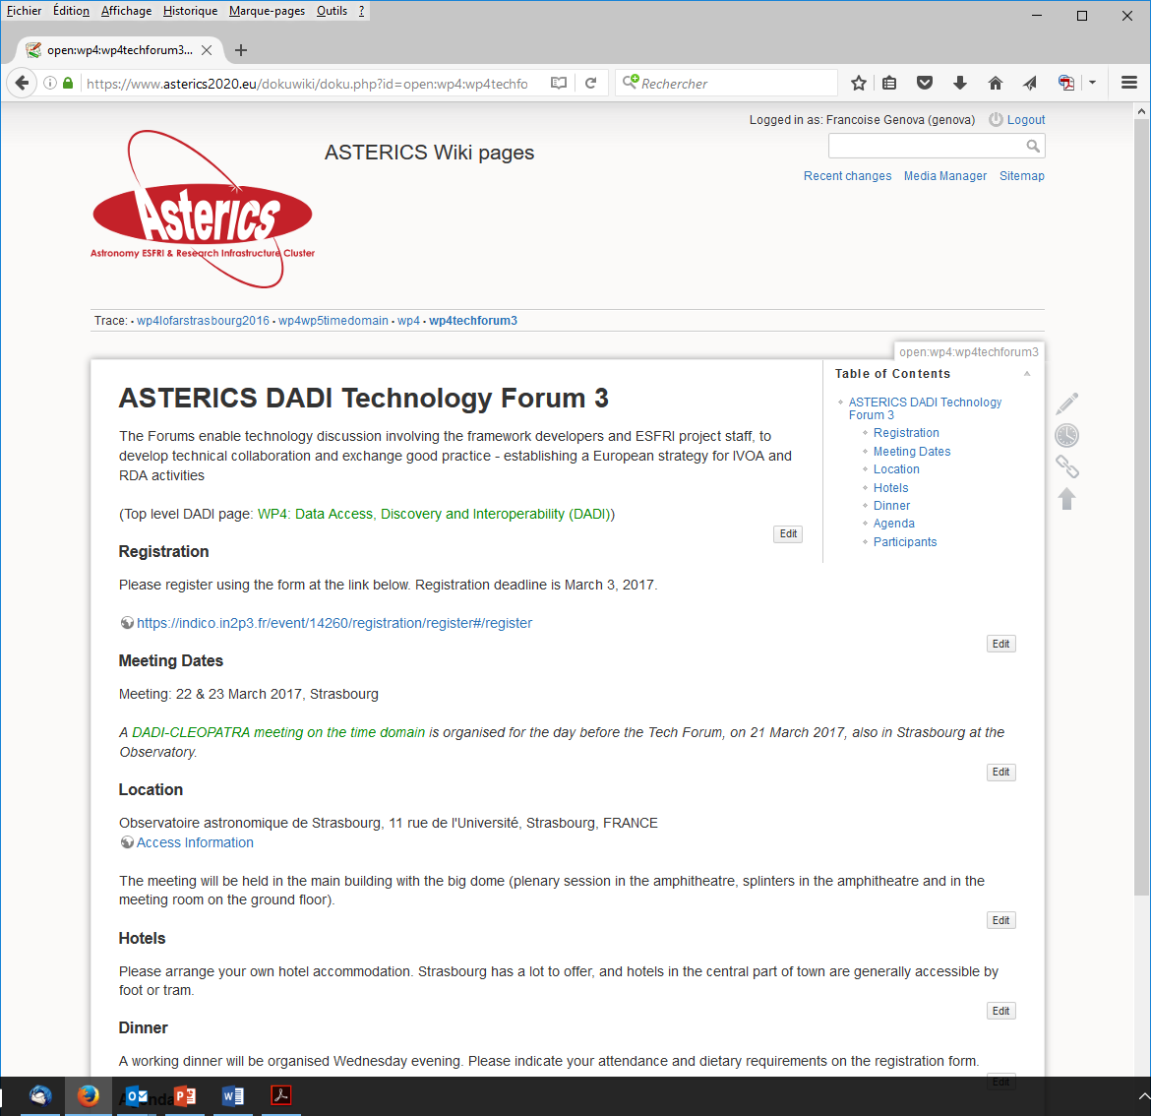
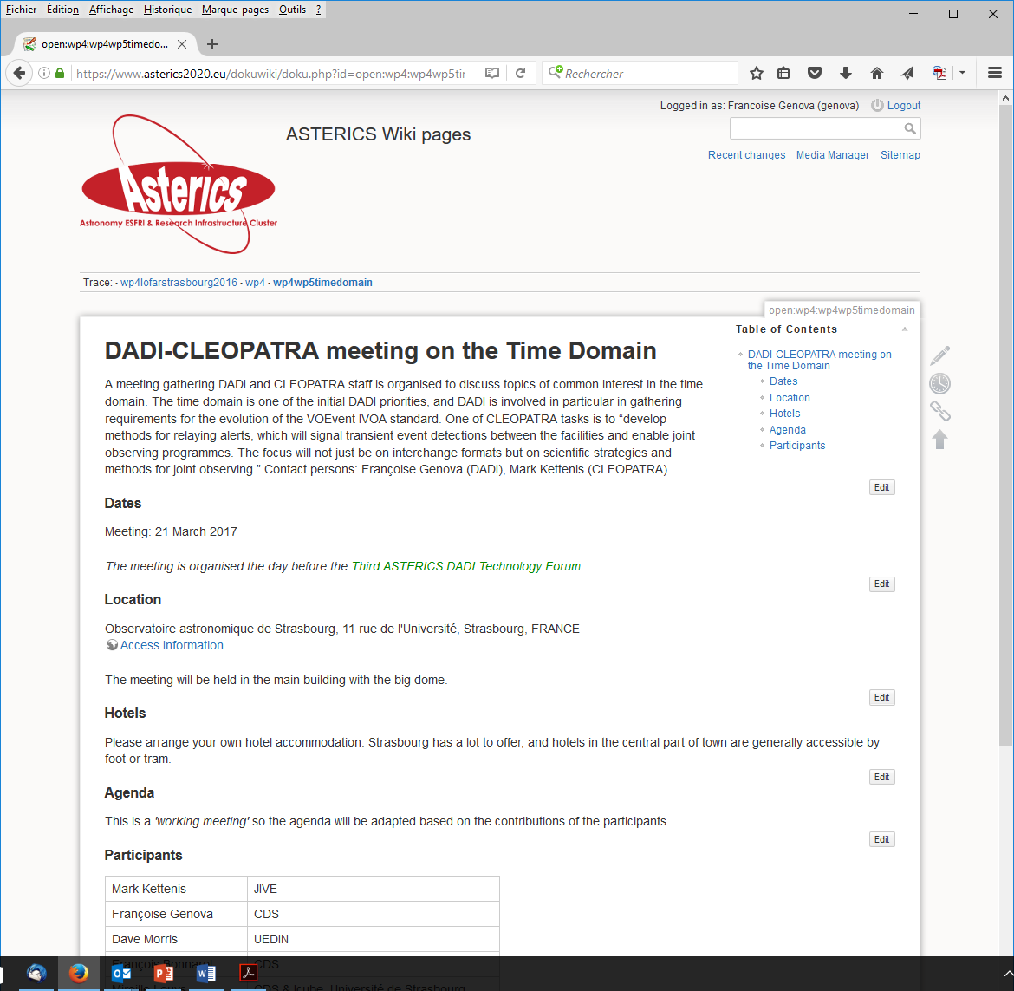
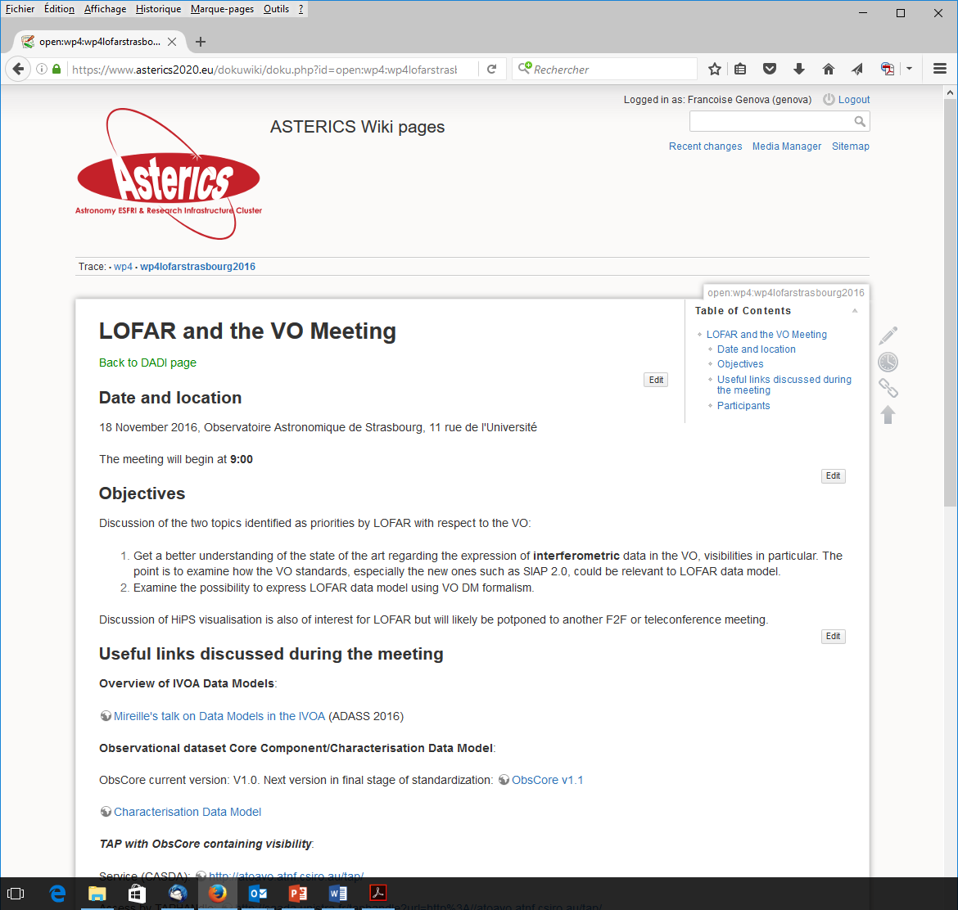
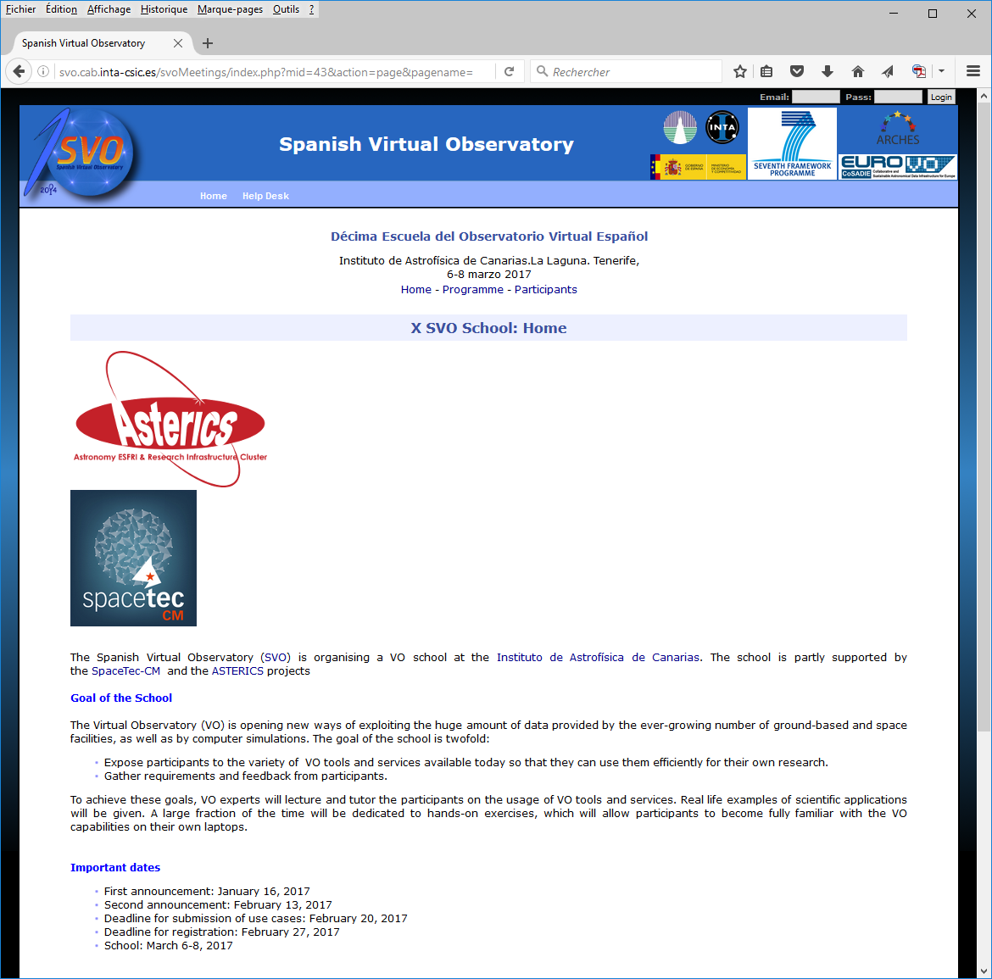
We go on!
Following the initial plans and more
Third Tech Forum
(D4.7)
22-23 March 2017,
Strasbourg
Second School (D4.5),
15-17 November 2016,
Strasbourg
DADI/CLEOPATRA
Time Domain,
21 March 2017
Spanish VO School,
6-8 March 2017
Tenerife
LOFAR and the VO,
18 November 2016,
Strasbourg

Slide 21
Expectations
The initial expectations will be fulfilled
DADI will have a legacy
ESFRI and pathfinders fully involved in the VO
Astronomy/astroparticle projects working hands in hands with common goals
Wrt. Science community: the VO is and will be here and used but invisible because seamless access is the aim

