Slide 1
WP5: Cleopatra
Connecting Locations of ESFRI Observatories and Partners in Astronomy for Timing and Real-time Alerts
Arpad Szomoru
Joint Institute for VLBI ERIC (JIVE)
On behalf of the Cleopatra collaboration

Slide 2
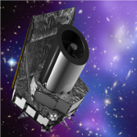
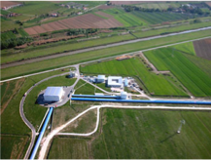
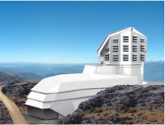

WP5: Cleopatra
~2.5 M€, 4 tasks
12 partners: JIVE, VU, UGR, NIKHEF, SURFnet, ASTRON, UVA, DESY, CNRS-APC, IEEC, GTD, STFC
Euclid
EGO/Virgo
Connecting real facilities now as path to connected future facilities

Slide 3
Objectives
It’s all about connectivity:
Timing: enable and improve long-haul many-element time and frequency transfer over optical fiber networks
Develop methods for rapidly relaying alerts between facilities, formulate scientific strategies, enabling joint observations of transient events
Handling of large data streams: leverage the e-VLBI experience to develop user-friendly, transparent and robust data streaming software
Scheduling of complex multi-element instruments, joint scheduling of multiple facilities around the globe, using advanced scheduling algorithms

Slide 4
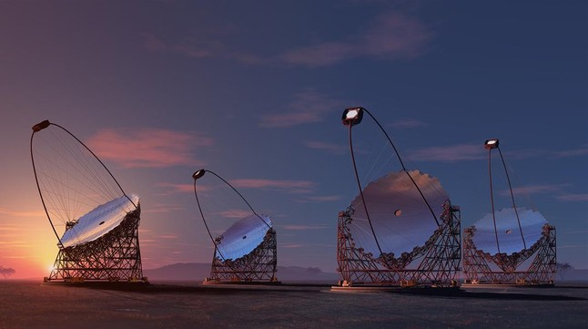
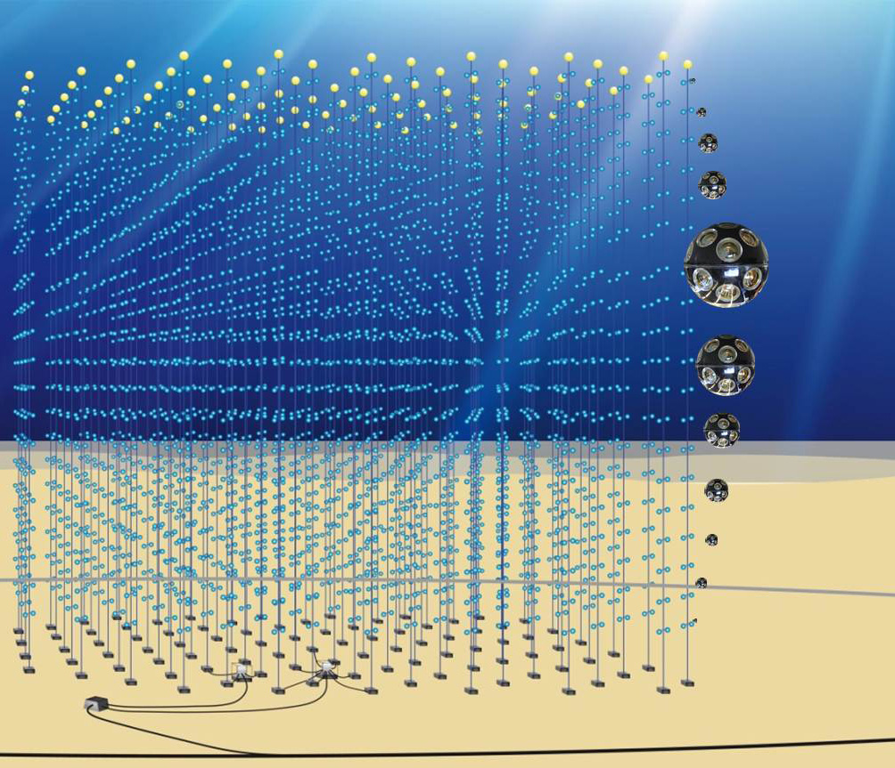
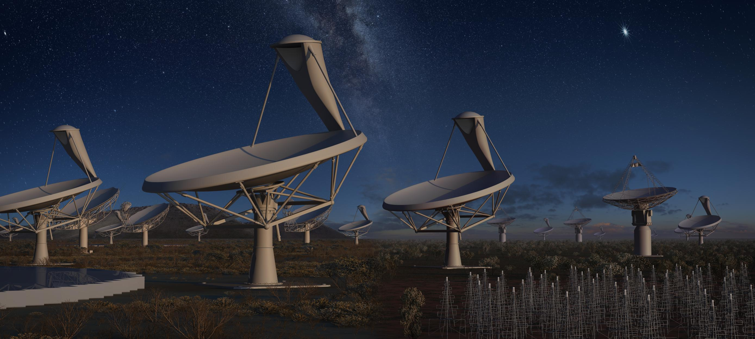
Task 1: Synchronization
VU, ASTRON, JIVE, UGR, FOM, DESY, SURFnet (Koelemeij, Berge)
Time and frequency transfer on optical fiber networks through White Rabbit Ethernet (WRE)

Slide 5
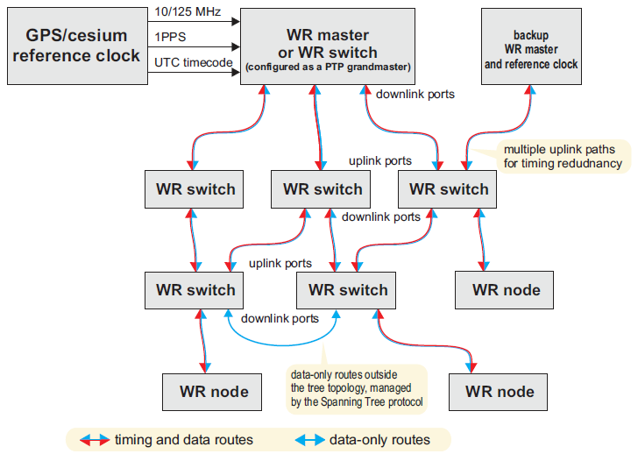
What is White Rabbit?
White Rabbit Ethernet (CERN, based on IEEE Precision Time Protocol)
Atomic clock
Time, frequency, and 1 Gb/s data in one
1 PPS, 10 – 125 MHz
Designed for 1 ns timing over distances <10 km (LHC, CERN)
Commercially available

Slide 6
Task 1: Synchronization
(continued)
Alternative to the intricate and custom-built timing solutions used in previous neutrino telescopes and many radio telescope arrays
Enable highly synchronized real-time observations by widely separated instruments, providing a unique "multi-messenger” view of astrophysical phenomena
Commercial applications: back-up or augment timing and navigation through the Global Navigation Satellite Systems
  Centimeter-level positioning for indoor navigation
  Autonomous vehicles using hybrid optical/wireless networks

Slide 7
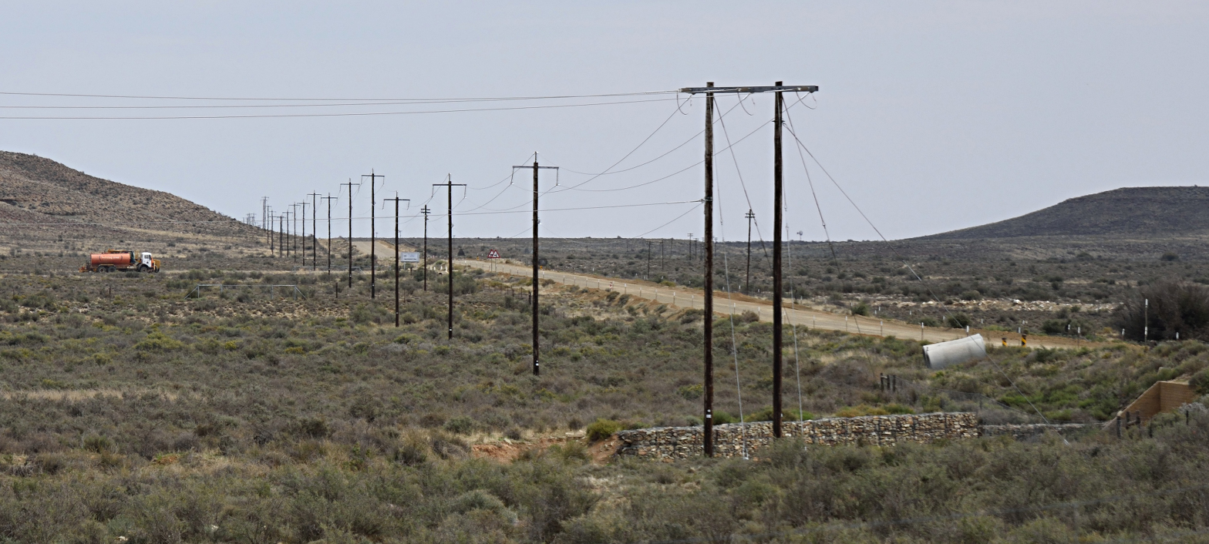
WRE and VLBI: a demo
Need three orders of magnitude improvement in frequency stability
Bi-directional light paths on operational fiber-optic telecommunication networks
New calibration and characterization tools
  Under harsh conditions

Slide 8
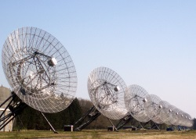
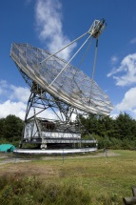
Westerbork
Dwingeloo (ASTRON)
H-maser
Tx
WRE
node
Rx
≈25 km
Time & frequency for
VLBI
New data
link
Existing data link
Correlator
Clean-up
oscillator
WRE
node
Tx
WSRT
CAMRAS
Rx

Slide 9

Westerbork
Dwingeloo (ASTRON)
H-maser
Tx
WRE
node
Rx
OSC
band
2×45 km
≈25 km
OSC Tx
OEO
Time & frequency for
VLBI
DWDM
node Tx
C-band
New data
link
Existing data link
Correlator
OSC
band
Clean-up
oscillator
WRE
node
Tx
WSRT
OSC Rx
CAMRAS
DWDM
node Rx
Rx
C-band
Groningen
Assen
OSC Tx
OEO
OEO
OSC Tx
OSC Rx
DWDM
node Tx
C-band
C-band
2×55 km
DWDM
node Rx
C-band
C-band
OSC Rx
OEO
OSC Tx
OSC Rx

Slide 10
Westerbork
Dwingeloo (ASTRON)
H-maser
Tx
WRE
node
Rx
OSC
band
2×45 km
≈25 km
OSC Tx
OEO
Time & frequency for
VLBI and LOFAR
DWDM
node Tx
C-band
New data
link
Existing data link
Correlator
OSC
band
Clean-up
oscillator
WRE
node
Tx
WSRT
OSC Rx
CAMRAS
DWDM
node Rx
Rx
C-band
Groningen
Assen
WRE
switch
Tx0
Rx0
Rx2
Tx2
Rx1
Tx1
OSC Tx
OEO
OEO
OSC Tx
OSC Rx
DWDM
node Tx
C-band
C-band
2×55 km
65 km
DWDM
node Rx
C-band
C-band
OSC Rx
Rx
Tx
OEO
OSC Tx
OSC Rx
WRE
node
LOFAR CN
Buinen
Clean-up
oscillator
DF

Slide 11
Task 2: Multi-messenger methods
JIVE, ASTRON, CNRS-APC, UVA (Kettenis)
Develop standards for generation, dissemination, distribution and response to transient events (based on VOEvents)
Demonstration during which e.g. radio facilities like LOFAR, EVN, follow up a GW event
Investigate scientific synergies for automated follow-up observations

Slide 12
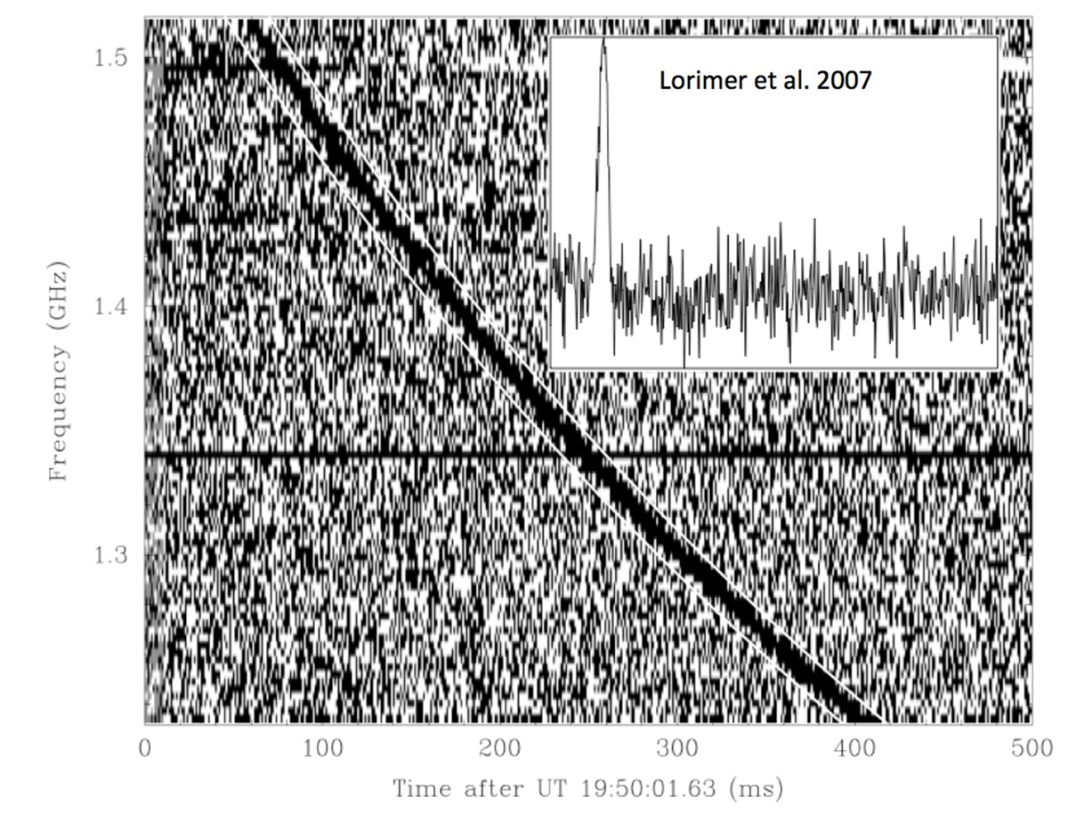
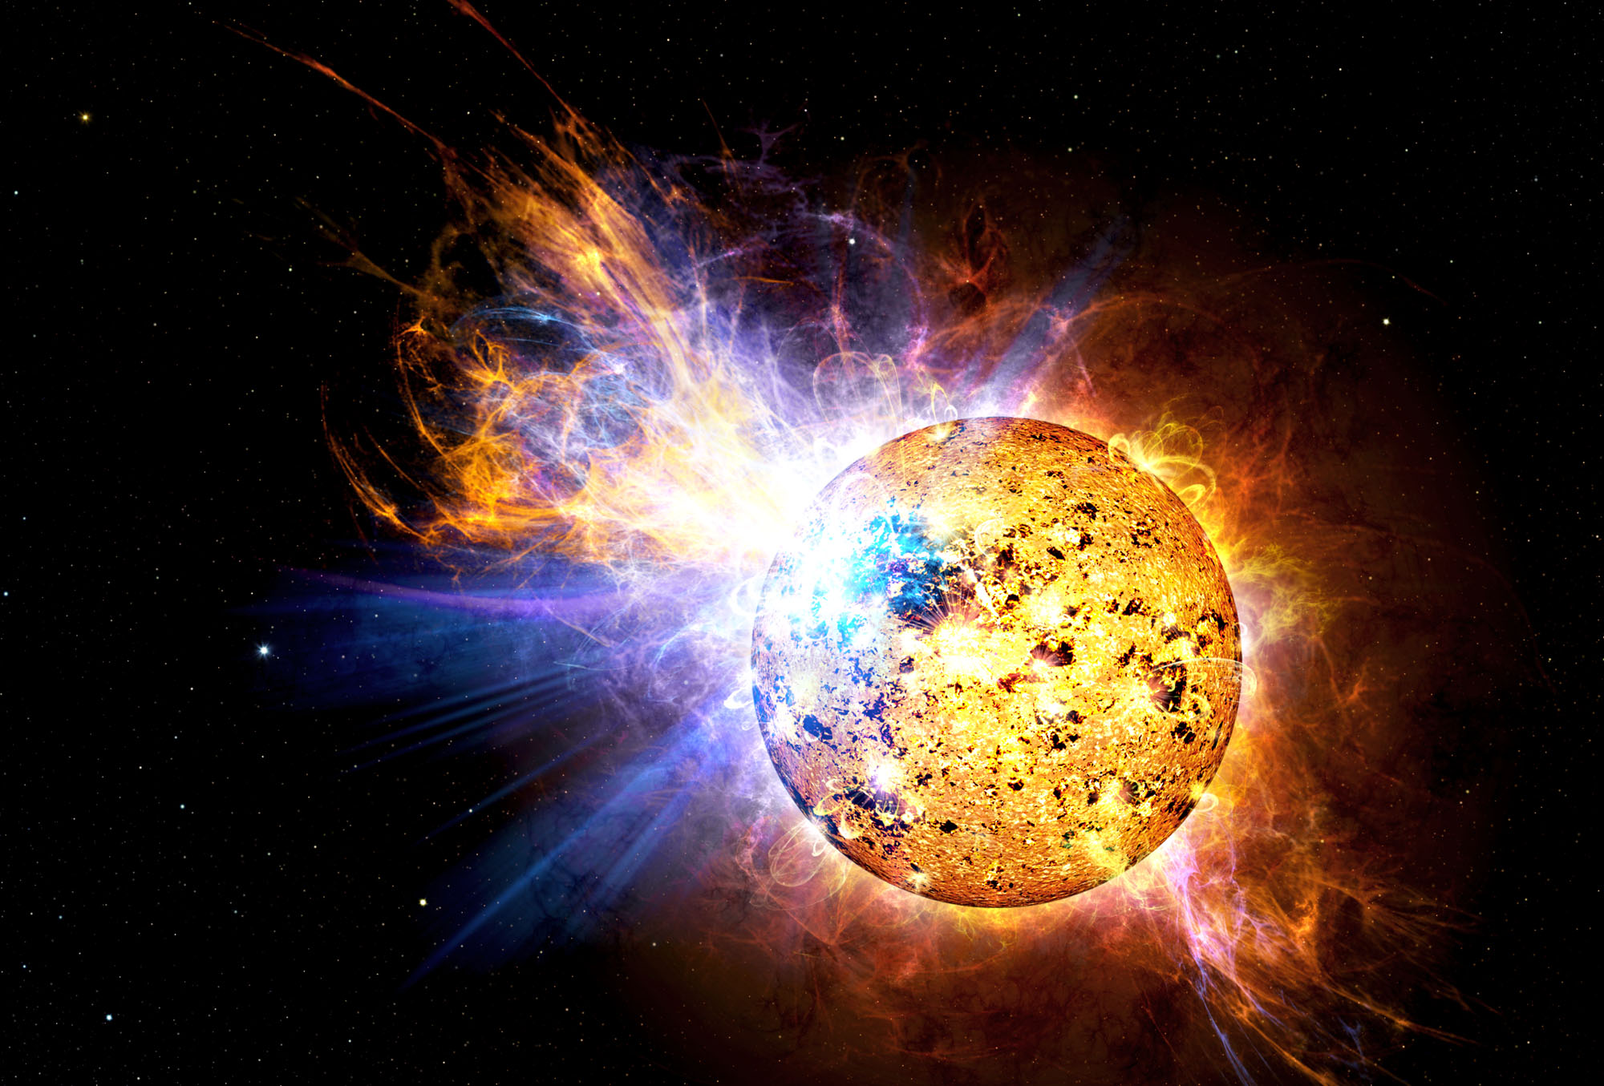
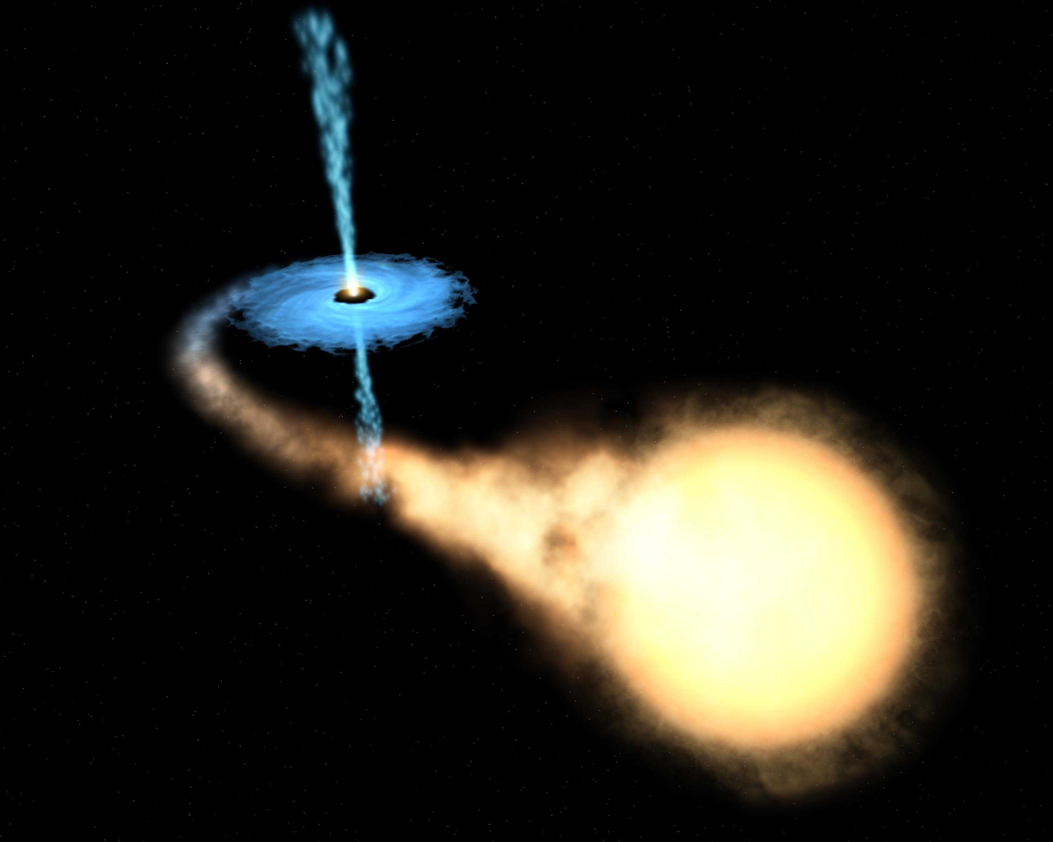
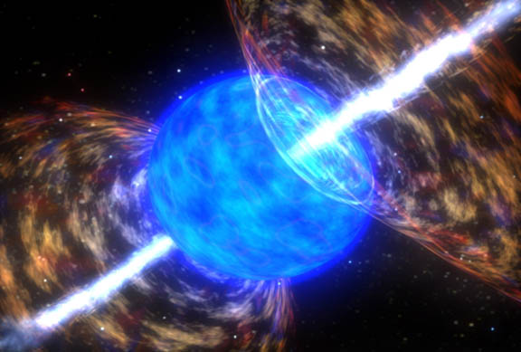
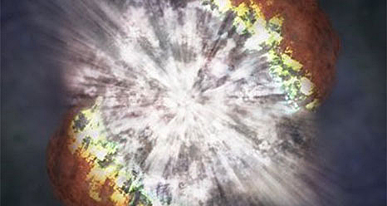
Possible targets
Fast Radio Bursts
Flare stars
X-Ray Binary outbursts
Gamma-ray bursts
Supernovae
Neutrino triggers
Unknown
…
?
Notes:
FRBs important.

Slide 13
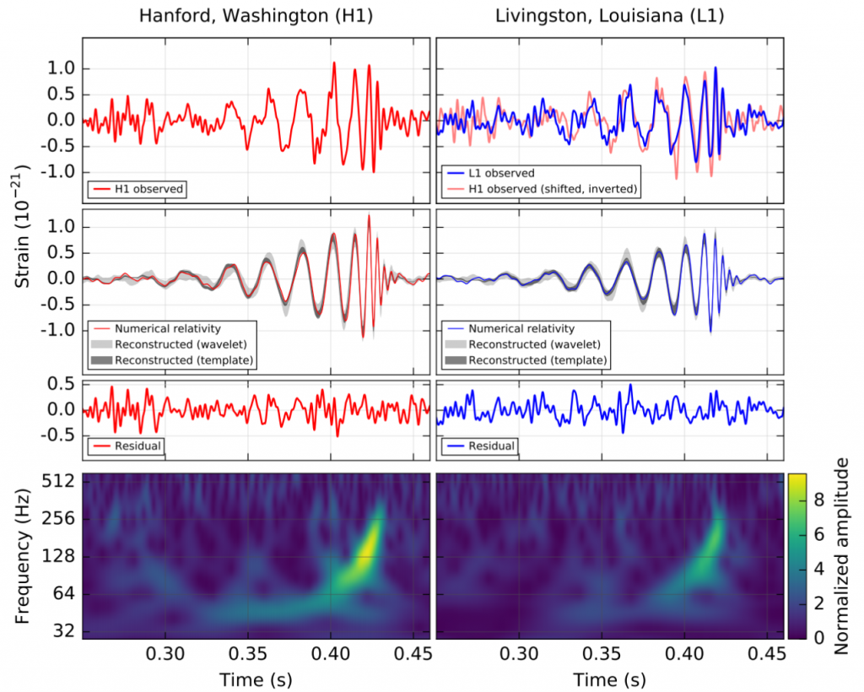
Gravitational waves: GW 150914
Two black holes
Distance of ~400 Mpc
Masses of 36 and 29 M
3 M of energy released
Abbott et al. (2016a)

Slide 14
Multi-wavelength follow-up
Majority of localisation region covered at each wavelength
Follow-up teams used a range of strategies
Abbott et al. (2016b)

Slide 15
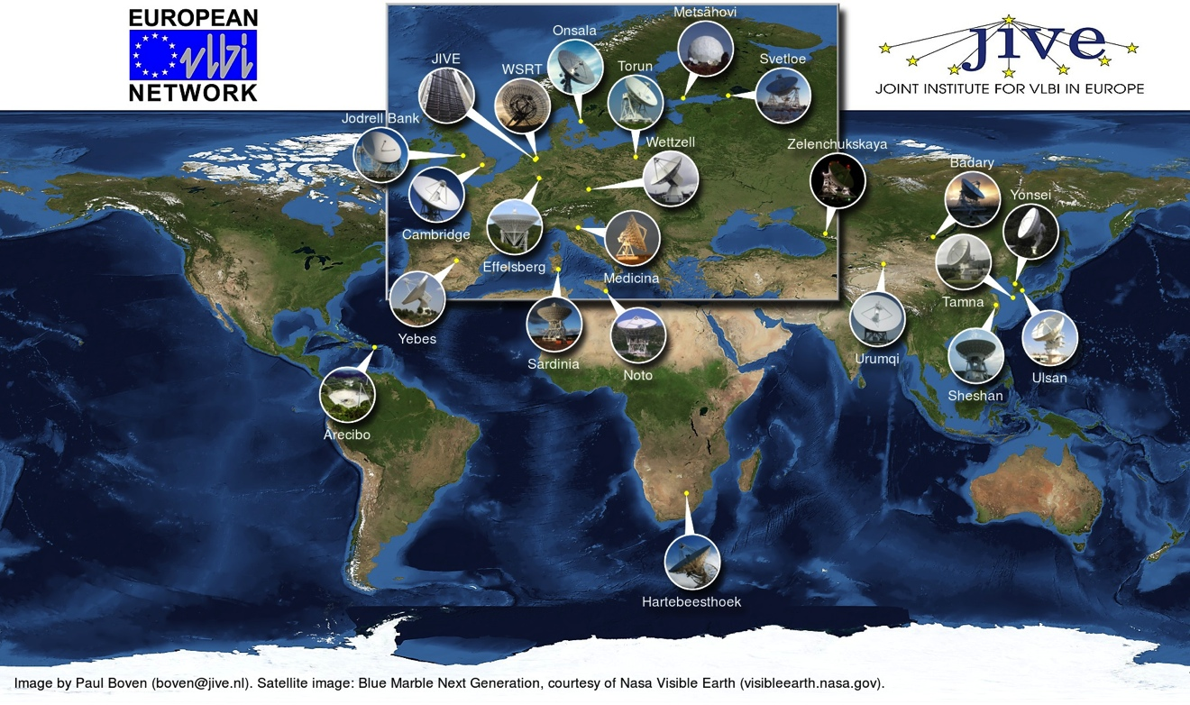
Task 3: User-domain data streaming
JIVE (Verkouter)
High-throughput data transfer utilities mostly use TCP:
  Abysmal performance on long-haul links
  some commercial tools use UDP but these are very expensive
Local experience both with lossy real-time and reliable near-real-time data
But, (e-)VLBI software is way too specialized and non-standard for simple file-to-file transfers
Developing open-source file transfer utility using the UDT protocol
  Reliable, robust, user-friendly

Slide 16
Task 4: Scheduling of large astronomical infrastructures
IEEC, STFC, GTD (Colome)
Complex, many-element detector arrays
  SKA, CTA

Slide 17
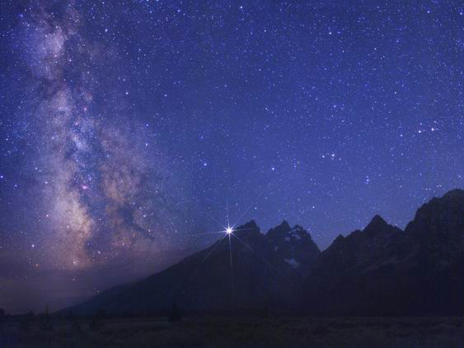

CTA observation modes
Monitoring
4 telescopes
Monitoring
4 Telescopes
Monitoring
4 telescope
Deep field
~1/2 of telescopes
Deep field
~1/3 of telescopes
Monitoring
1 telescope
Divergent & convergent mode in
SUB-ARRAY configuration

Slide 18
Task 4: Scheduling of large astronomical infrastructures
(continued)
Artificial Intelligence (AI) techniques to optimize procedures
  Metaheuristic Optimization: Genetic Algorithms, Multi-objective Evolutionary Algorithms
  Constraint-Based Reasoning: constraint propagation
Maximize science return of SKA and CTA
  But ensure solutions are applicable for other instruments
Incorporate multi-frequency, multi-messenger astrophysics
Provide a framework to coordinate and schedule multiple facilities.

Slide 19
Results: task 1
  Moving ahead at full speed, right from the start
    Has made real impact in WR community
      Improvements are fed back: open source
    Generated serious outside interest: JVLA
    Some delay with one partner, but no risk to project
      Has ramped up effort
    Fed into tender for new photonic equipment for SURFnet(8)
    WR timing in design of SKA-low
      Frequency stability now good enough for frequency transfer
    Commercial applications under development

Slide 20
Results: task 2
  Task 2: slow uptake
    Speed-up since last change of task lead
    Draft of first deliverable document
    Some delay, but no risk to project timeline
      Will fit comfortably within the 4 years
    Active involvement of several astronomers interested in triggered observations
    Interactions with Work Package 4 and Cleopatra task 4
    MoU JIVE-EVN and LIGO regarding follow-up observations

Slide 21
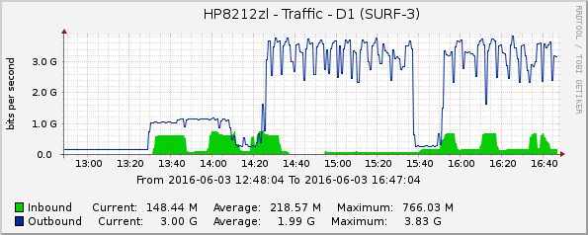
Results: task 3
  Fairly small task, one developer
    Prototype milestone reached well on time
    First tests very promising
      4Gbps file transfers from New Zealand to the Netherlands
    Now re-writing Python into C++11

Slide 22
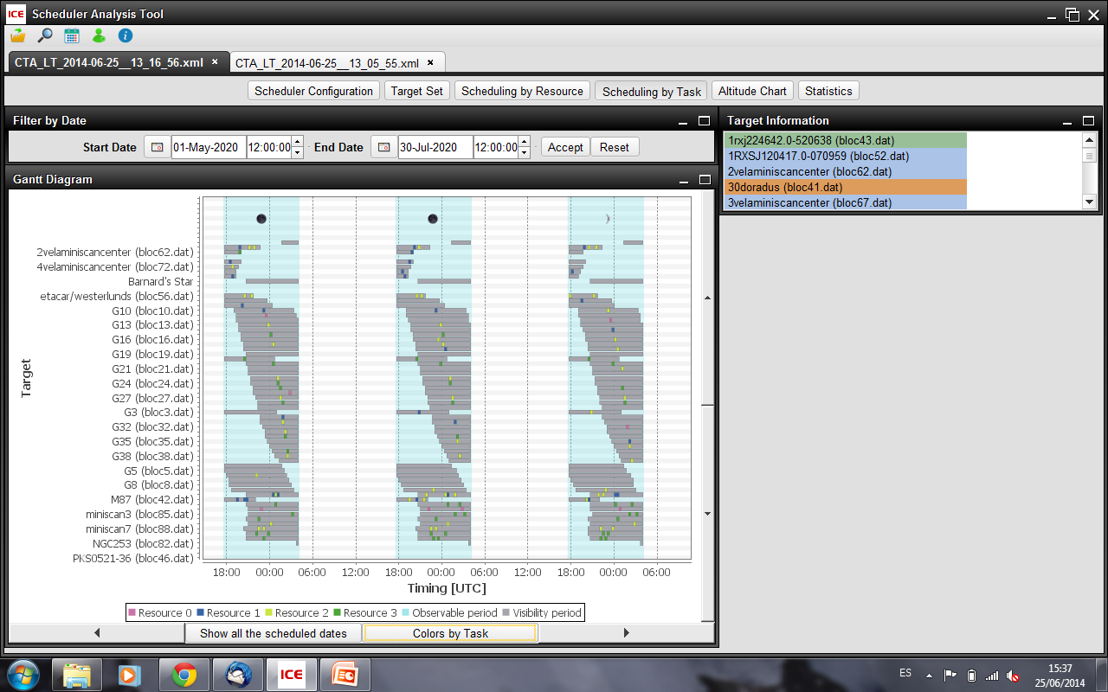
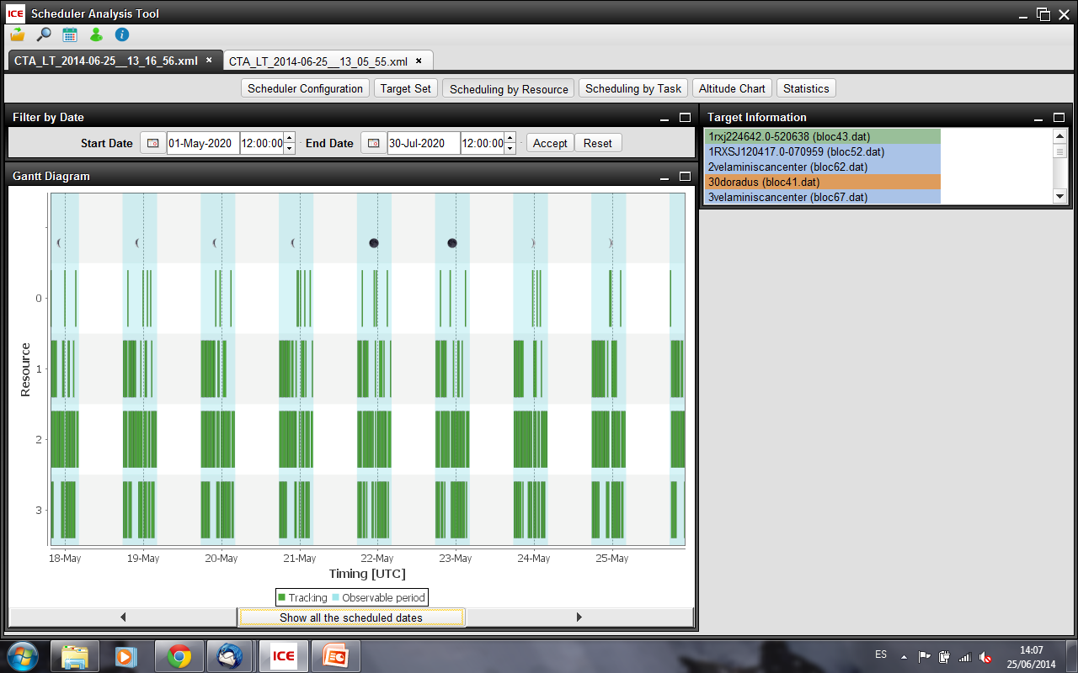
Results: task 4
  Excellent progress, from the start
    Several face to face meetings
    GTD had to change status from third party to full member
    Deliverables late in project:
      Intermediate milestones defined

Slide 23
Outlook
  No major obstacles or deviations: on track
  Task 2: most delayed, but high potential
    Transient astronomy becoming more important (GW!)
    Real need in community for standards, implementation of filters, protocols
  Task 3: small, but could deliver something very useful
  Tasks 1 and 4: clear use cases, big impact
  Several demos coming up, good PR
  Results feed back into commercial applications

Slide 24
`

