Slide 1
ASTERICS Periodic Review 1
Overview and Forward Look
Prof. dr. Marco de Vos
devos@astron.nl
ASTERICS Coordinator

Slide 2
The Challenge
To establish a single collaborative cluster of next generation ESFRI telescope facilities and other relevant research infrastructure initiatives in the area of astronomy, astrophysics and astroparticle physics.
“Addressing cross-cutting synergies and common challenges shared by astronomy ESFRI facilities”
Notes:
The added value of an active AGA chair.

Slide 3
Mission Quite Possible!
CTA, E-ELT, KM3NeT and SKA all involved in WPs
Active collaborations on tools and methods in Obelics & Cleopatra
Active participation in DECS Open Science events
Active participation in DADI Forums and Schools
Added value of commensal observing and complex scheduling
Notes:
How did we organise the management of the proejct and was that (good) enough?

Slide 4
DECS Forward Look
First two mass participation experiments scheduled to go live in March 2017 – one already live
Educational resources ready at the same time; promotional animations under development
Next Citizen Science workshop in 2017 at INAF
Publications of the Astronomical Society of Australia would like to publish the Citizen Science workshop results

Slide 5
Obelics Forward Look
1st ASTERICS-OBELICS International School
large audience, multi-level, multi-discipline
Benchmarking and tool-development LPC
Exploit the different database solutions (Qserv, Spark)
Define a data model based on HDF5 for CTA
Complete libraries and tools for analysis

Slide 6
DADI Forward Look
Ensure DADI legacy in VO, ESFRI and PathFinders
Have astronomy/astroparticle projects working hands in hands with common goals
Ensure to science community that the VO is and will be there to use, but invisible because seamless access is the aim

Slide 7
Cleopatra Forward Look
Complete planned demonstrations
Including the delayed Task 2
Fulfil the real need in community for standards, implementation of filters, protocols
Commercial applications benefit from results

Slide 8
And we will work on…
Formal top-level interaction with ESFRI projects
Tour of ESFRI Project Directors, …
Increased industry engagement
As planned in Obelics and Cleopatra
Increase engagement with (EC funded) projects
Through more active use of Policy Forum
Targeted new strategic collaborations
Notes:
How did we monitor the finances?

Slide 9
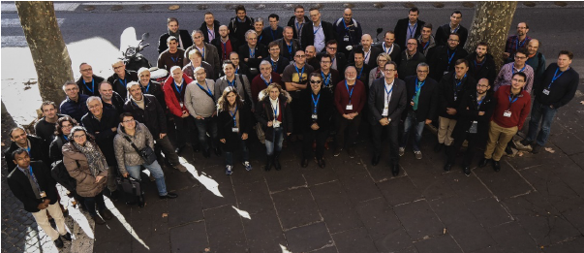
Continued Focus on…
Open Innovation
Open Science
Open Training
Open Collaboration
Notes:
How did we monitor the finances?

Slide 10
