Slide 1
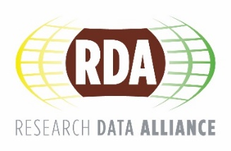
RDA in a nutshell AENEAS Kick-off meeting 28 Feb 2017, Den Haag Tobias Weigel, DKRZ, RDA TAB member
CC BY-SA 4.0

Slide 2
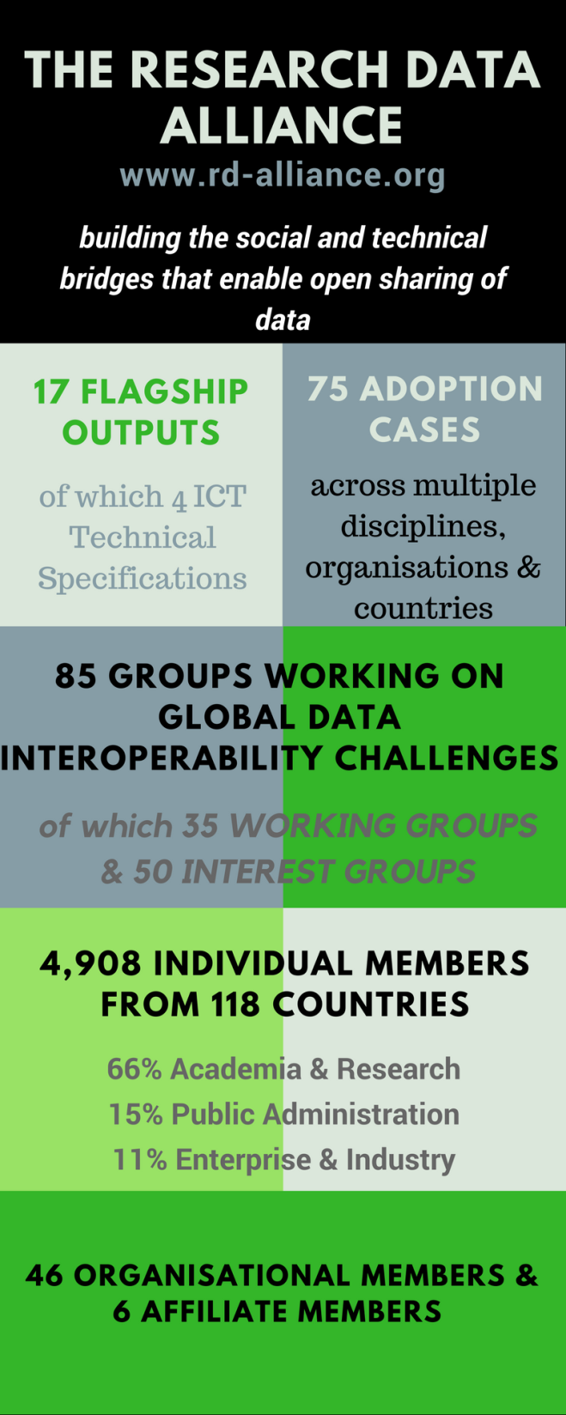
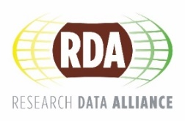
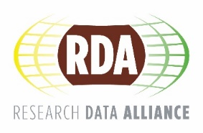
Vision
Researchers and innovators openly share data across technologies, disciplines, and countries to address the grand challenges of society.
Mission
RDA builds the social and technical bridges that enable open sharing of data.
CC BY-SA 4.0

Slide 3
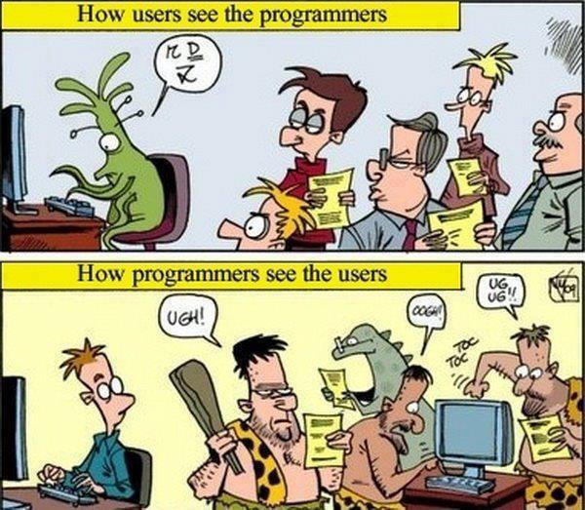
https://goo.gl/wT8XEq

Slide 4
What is RDA?
RDA is an international member based organization focused on the development of infrastructure and community activities that reduce barriers to data sharing and exchange, and the acceleration of data driven innovation worldwide. With more than 4,900 members globally representing 118 countries, RDA includes researchers, scientists and data science professionals working in multiple disciplines, domains and thematic fields and from different types of organisations across the globe.
RDA is building the social and technical bridges that enable open sharing of data to achieve its vision of researchers and innovators openly sharing data across technologies, disciplines, and countries to address the grand challenges of society.
rd-alliance.org/about-rda
CC BY-SA 4.0

Slide 5
What does RDA do?
Members come together through self-formed, volunteer, focussed Working Groups, exploratory Interest Groups to exchange knowledge, share discoveries, discuss barriers and potential solutions, explore and define policies and test as well as harmonise standards to enhance and facilitate global data sharing & re-use.
RDA members collaborate together across the globe to tackle numerous infrastructure & data sharing challenges related to:
Reproducibility
Data preservation
Best practices for domain repositories
Legal interoperability
Data citation
Data type registries
Metadata
and so many more!
rd-alliance.org/about-rda
CC BY-SA 4.0

Slide 6
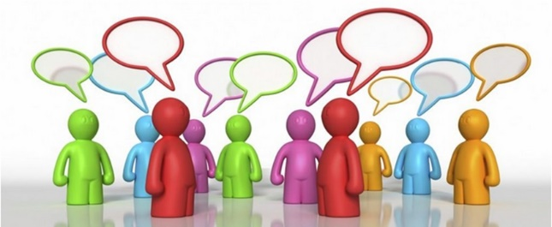
Who Can Join RDA?
Any individual or organization, regardless of profession or discipline, with an interest in reducing the barriers to data sharing and re-use and who agrees to RDA’s guiding principles of:
Openness
Consensus
Balance
Harmonization
Community-driven
Non-profit and technology-neutral
Individual Membership is free @ https://www.rd-alliance.org/user/register
rd-alliance.org/get-involved.html
CC BY-SA 4.0

Slide 7
Why Join RDA as an Individual Member?
Individual Member Benefits
Contribute to acceleration of data infrastructure development
Work and share experiences with collaborators throughout the world
Access to extraordinary network of colleagues with various levels of experience, perspectives and practices
Gain greater expertise in data science regardless of whether one is a student, early or seasoned career professional
Enhance the quality and effectiveness of personal work and activities
Improve one’s competitive advantage professionally and positioning oneself for leadership within the broader research community
Individual RDA Members 4908
rd-alliance.org/get-involved/individual-membership.html
CC BY-SA 4.0

Slide 8
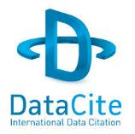
Organisational & Affiliate Members
43 Organisational Members
8 Affiliate Members
rd-alliance.org/get-involved/organisational-membership
CC BY-SA 4.0
Notes:
Guiding Principles:
Openness
Consensus
Balance
Harmonization
Community-driven
Non-profit and technology-neutral

Slide 9
RDA Interest (IG) & Working Groups (WG) by Focus (1)
Total 85 groups:
35 Working Groups & 50 Interest Groups
Domain Science - focused
Agrisemantics WG
BioSharing Registry WG
Fisheries Data Interoperability WG
On-Farm Data Sharing (OFDS) WG
Rice Data Interoperability WG
Wheat Data Interoperability WG
Agriculture Data IG (IGAD)
Biodiversity Data Integration IG
Chemistry Research Data IG
Digital Practices in History and Ethnography IG
Geospatial IG
Global Water Information IG
Linguistics Data Interest Group
Health Data IG
Mapping the Landscape IG
Marine Data Harmonization IG
Quality of Urban Life IG
RDA/CODATA Materials Data, Infrastructure & Interoperability IG
Research data needs of the Photon and Neutron Science community IG
Small Unmanned Aircraft Systems’ Data IG
Structural Biology IG
Weather, Climate and air quality IG
Community Needs - focused
Data Science and data-related education and training certification and accreditation schemes WG
RDA/CODATA Summer Schools in Data Science and Cloud Computing in the Developing World WG
Teaching TDM on Education and Skill Development WG
Archives & Records Professionals for Research Data IG
Data for Development IG
Development of Cloud Computing Capacity and Education in Developing World Research IG
Education and Training on handling of research data IG
Ethics and Social Aspects of Data IG
rd-alliance.org/groups
CC BY-SA 4.0

Slide 10
RDA Interest (IG) & Working Groups (WG) by Focus (2)
Total 85 groups:
35 Working Groups & 50 Interest Groups
Reference and Sharing - focused
Data Citation WG
Data Description Registry Interoperability WG
Data Security and Trust WG
Empirical Humanities Metadata WG
RDA / WDS Publishing Data Bibliometrics WG
Research Data Collections WG
QoS-DataLC Definitions WG
International Materials Resource Registries WG
National Data Services IG
RDA/CODATA Legal Interoperability IG
Reproducibility IG
Data Discovery Paradigms IG
Repository Core Description WG
Research Data Repository Interoperability WG
Partnership Groups
RDA / TDWG Metadata Standards for attribution of physical and digital collections stewardship WG
RDA/NISO Privacy Implications of Research Data Sets IG
RDA/WDS Scholarly Link Exchange Working Group
Repository Audit and Certification DSA–WDS Partnership WG
RDA/WDS Publishing Data IG
ELIXIR Bridging Force IG
rd-alliance.org/groups
CC BY-SA 4.0

Slide 11
RDA Interest (IG) & Working Groups (WG) by Focus (3)
Total 85 groups:
35 Working Groups & 50 Interest Groups
Data Stewardship and Services – focused
Brokering Framework WG
Brokering Governance WG
WDS/RDA Assessment of Data Fitness for Use WG
RDA / WDS Publishing Data Services WG
RDA / WDS Publishing Data Workflows WG
Active Data Management Plans IG
Data in Context IG
Data Rescue IG
Data Versioning IG
Domain Repositories IG
Libraries for Research Data IG
Long tail of research data IG
Preservation e-Infrastructure IG
Preservation Tools, Techniques, and Policies IG
RDA/WDS Certification of Digital Repositories IG
RDA/WDS Publishing Data Cost Recovery for Data Centres IG
Repository Platforms for Research Data IG
Research Data Provenance IG
Virtual Research Environments IG
Base Infrastructure – focused
Array Database Assessment WG
Data Foundation and Terminology WG
Data Type Registries WG
Metadata Standards Catalog WG
Metadata Standards Directory WG
PID Information Types WG
PID Kernel Information WG
Practical Policy WG
Data Fabric IG
Data Foundations and Terminology IG
Big Data IG
Brokering IG
Federated Identity Management IG
Metadata IG
PID IG
Vocabulary Services IG
rd-alliance.org/groups
CC BY-SA 4.0

Slide 12
RDA Recommendations that make data work
“Create - Adopt - Use”
Adopted code, policy, specifications, standards, or practices that enable data sharing
“Harvestable” efforts for which 12-18 months of work can eliminate a roadblock
Efforts that have substantive applicability to groups within the data community but may not apply to all
Efforts that can start today
17 flagship recommendations & outputs with over
75 cases of adoption in different domains, organisations and countries
rd-alliance.org/recommendations-outputs
CC BY-SA 4.0

Slide 13
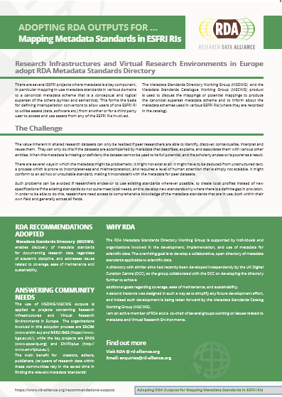
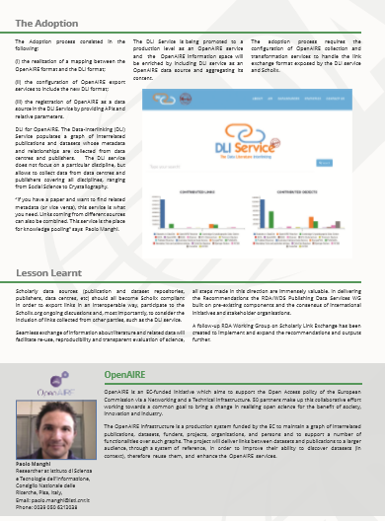
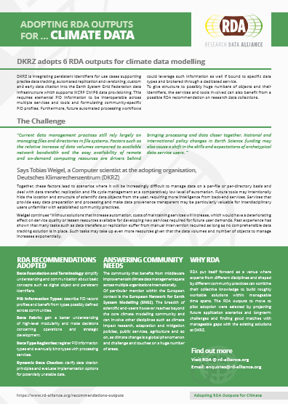
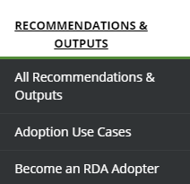
Adoption & Implementation “Solving the problem must include adopters in the process, to ensure that real problems are addressed. Open problem solving is the key.”
RDA Recommendations and Outputs take the form of technical specifications, code, policies or practices, harmonized standards or reference models. In the widest sense these aim for:
Greater data sharing, exchange, interoperability, usability and re-usability;
Greater discoverability of research data sets;
Better management, stewardship, and preservation of research data;
New data standards or harmonization of existing standards.
RDA Adoption Stories - Tell us yours!
Addressing data challenges
https://www.rd-alliance.org/recommendations-and-outputs/all-recommendations-and-outputs
75 Adoption Cases
https://www.rd-alliance.org/recommendations-outputs/adoption-recommendations
Find out how you can become an Adopter
https://www.rd-alliance.org/recommendations-and-outcomes/become-rda-adopter
rd-alliance.org/recommendations-and-outputs/all-recommendations-and-outputs
CC BY-SA 4.0

Slide 14
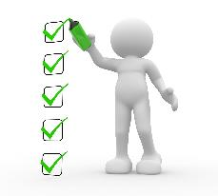
What are Plenary Meetings?
Organised around the world every 6 months
exciting & productive events bringing together a unique community of data science professionals, from multiple disciplines and domains;
help move the community forward in creating tangible deliverables that improve data sharing across disciplines, technologies, and countries;
heart of the plenaries are working meetings of RDA Working & Interest groups and new potential groups through Birds of a Feather meetings
presentation of new Outputs and Adoption cases
rd-alliance.org/plenaries
CC BY-SA 4.0

Slide 15
RDA Plenary Meetings: benefits of attending
Exchange knowledge, share discoveries, discuss barriers and potential solutions
Learn about new trends, strategies, research developments, directions and policies
Expand your network and meet new committed and passionate data science professionals, working in multiple disciplines
Contribute to acceleration of data infrastructure development
rd-alliance.org/plenaries
CC BY-SA 4.0
Notes:
Expand your network and meet new data science professionals, working in multiple disciplines, including but not limited to academia, library sciences, earth science, astronomy and meteorology

Slide 16
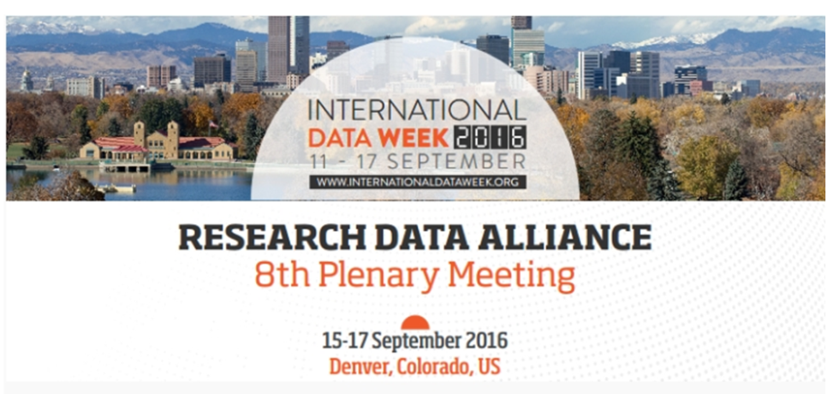
RDA deliverables presented:
RDA/CODATA Summer Schools in Data Science and Cloud Computing in the Developing World WG
Brokering Governance WG
Metadata Standards Catalog WG Recommendations
Biosharing Registry WG Recommendations
Scholix Franmework
+ 6 Adoption cases
69 Breakout session meetings:
12 BoF Meetings
31 Interest group meetings
10 Working group meetings
16 Joint group meetings
69 Breakout sessions
Newcomers Session, 2 RDA organisational members meeting, TAB and Chairs session
RDA/EU sponsored 8 European Early Career Researchers and Scientists & RDA/US sponsored 8 Fellowship
42 posters on display
549 participants from 33 countries
rd-alliance.org/plenaries/rda-eighth-plenary-meeting-denver-co
CC BY-SA 4.0

Slide 17
Register now:
https://www.rd-alliance.org/plenaries/rda-ninth-plenary-meeting-barcelona/rda-9th-plenary-registration
Early Bird Registration until 27th February 2017 midnight CET
https://www.rd-alliance.org/plenaries/rda-ninth-plenary-meeting-barcelona
Looking forward to seeing you all in Barcelona!
rd-alliance.org/plenaries/rda-ninth-plenary-meeting-barcelona
CC BY-SA 4.0

Slide 18
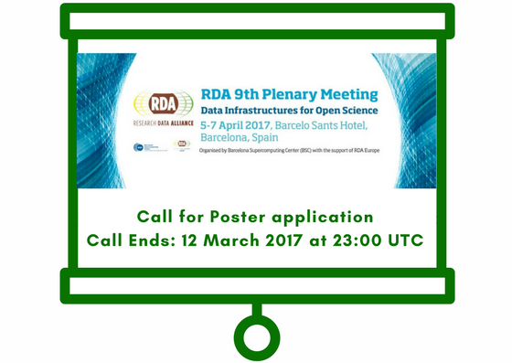
Call for Poster Session
https://www.rd-alliance.org/plenaries/rda-ninth-plenary-meeting-barcelona/rda-9th-plenary-poster-session
APPLICATIONS are due: 12th March 2017 at 23:00 UTC
rd-alliance.org/plenaries/rda-ninth-plenary-meeting-barcelona
CC BY-SA 4.0

Slide 19
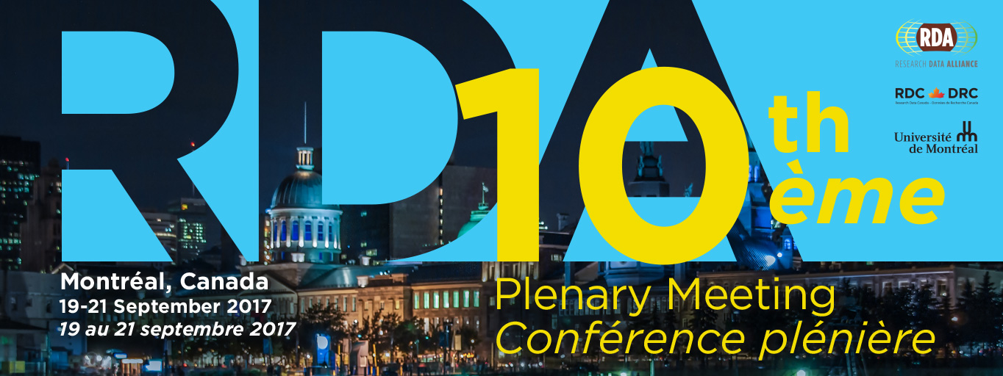
The 10th RDA Plenary Meeting will take place from 19 to 21 September 2017 in Montreal, Canada. The meeting is co-organised by RDA, the University of Montreal and Research Data Canada, Canada.
https://www.rd-alliance.org/plenaries/rda-tenth-plenary-meeting-montreal-canada
rd-alliance.org/plenaries/rda-tenth-plenary-meeting-montreal-canada
CC BY-SA 4.0

Slide 20
RDA in a Nutshell www.rd-alliance.org/ @resdatall
RDA Global
Email - enquiries@rd-alliance.org
Web - www.rd-alliance.org
Twitter - @resdatall
LinkedIn - www.linkedin.com/in/ResearchDataAlliance
Slideshare - http://www.slideshare.net/ResearchDataAlliance
RDA Europe
Email - info@europe.rd-alliance.org
Twitter - @RDA_Europe
RDA US
Twitter - @RDA_US

