Slide 1
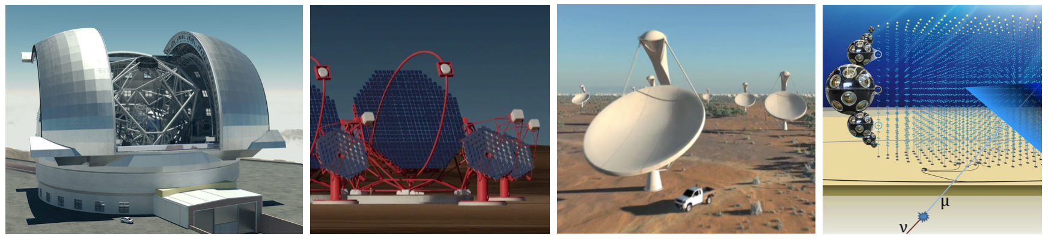
Astronomy ESFRI & Research Infrastructures Cluster
Update for AENEAS Kickoff
Marco de Vos – ASTRON, NL ASTERICS Coordinator

Slide 2

Asterics versus AENEAS
AENEAS brings together SKA partners and eInfra providers on a specific topic (SRCs)
Asterics brings together ESFRI projects on a broad range of topic
  But most of them
  related to data!

Slide 3
Why Cluster Projects?
Implementation of cross-­cutting solutions for clusters of ESFRI research infrastructures
  Stimulate cohesion, increase efficiency
  Platform to discuss policy topics like interoperability and commensal observations
  Platform to study generic aspects where a joint approach can transcend individual efforts

Slide 4
Why ASTERICS?
Many challenging astronomical ESFRI and other research facilities being developed and built currently!
We believe there’s much to gain in working together on a wide range of aspects:
  Reaching out: collaborations, open science
  Handling data: massive data flows, virtual observatory
  Connecting: policy issues, timing and networks

Slide 5
ASTERICS facts & figures
Astronomy ESFRI & Research Infrastructure Cluster
Horizon 2020 Work Programme INFRADEV-4-2014/2015 Call –
“Implementation and operation of cross-cutting services and solutions for clusters of ESFRI and other relevant research infrastructure initiatives”
Focus of ASTERICS: SKA, CTA, KM3NeT, close links to E-ELT and EGO
Funded at 15 M€ for 4 years
22 partners in 6 countries, representing a major collaboration in Astronomy/Astrophysics/Astroparticle Physics
ASTRON, CNRS, INAF, UCAM, JIVE, INTA, UEDIN, UHEI, OU, FAU, VU, CEA, UVA, UGR, FOM, IEEC, IFAE, UCM, INFN, STFC, DESY, SURFnet

Slide 6
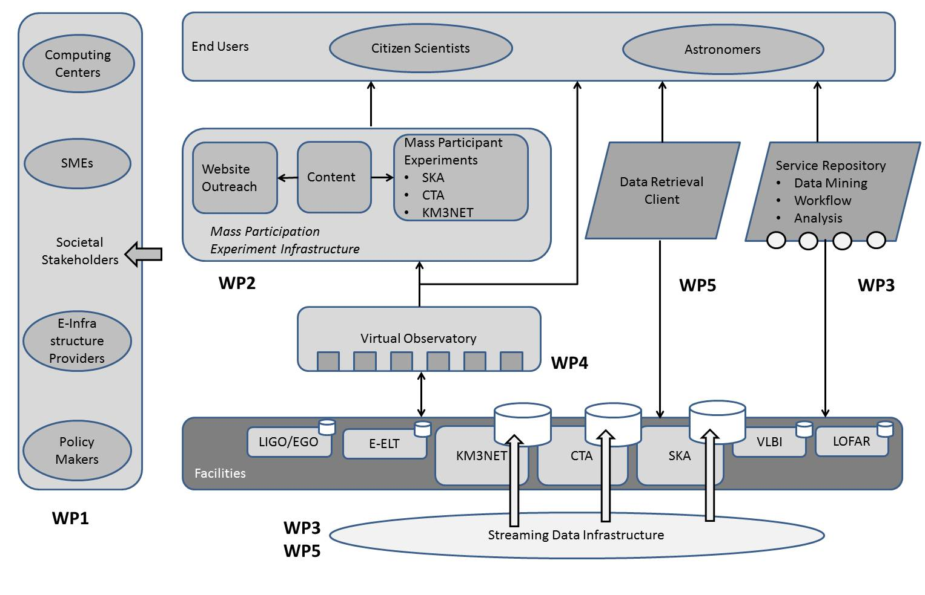
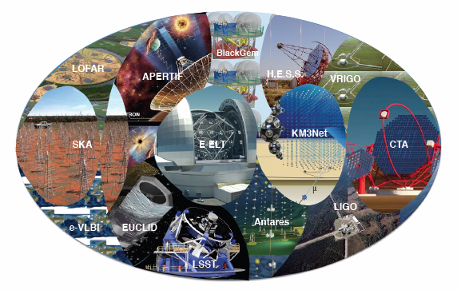
ASTERICS overview
DECS - Dissemination, Engagement and Citizen Science
OBELICS - Observatory E-environments Linked by common ChallengeS
DADI - Data Access, Discovery and Interoperability
CLEOPATRA - Connecting Locations of ESFRI Observatories and Partners in Astronomy for Timing and Real-time Alerts

Slide 7
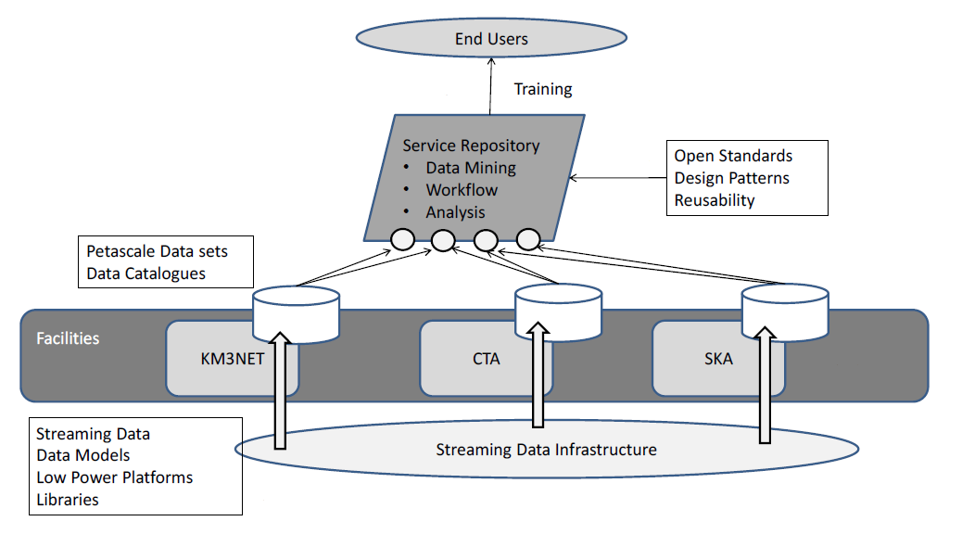
WP3 – OBELICS
Co-development for the robust, scalable, flexible handling and exploitation of then huge data streams and distributed petascale database systems
Data Generation: open formats, streaming processing, low power computing
Data Systems Integration: hybrid architectures, open databases, …
Data Analysis: selected topics (statistical analysis, imaging, workflow)

Slide 8
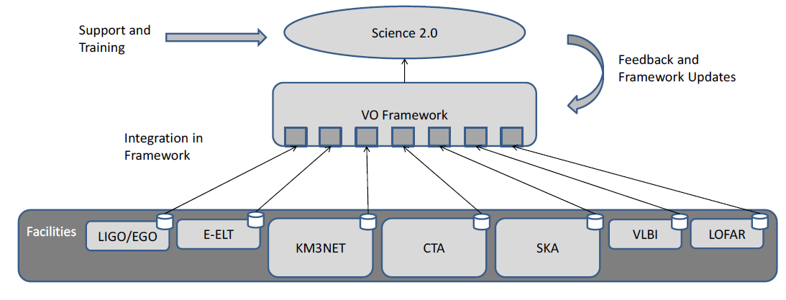
WP4 – DADI
Virtual Observatory Evolution:
Train & support
  ESFRI staff
  pathfinders
Develop
  Requirements
  Feedback
  Adapt

Slide 9
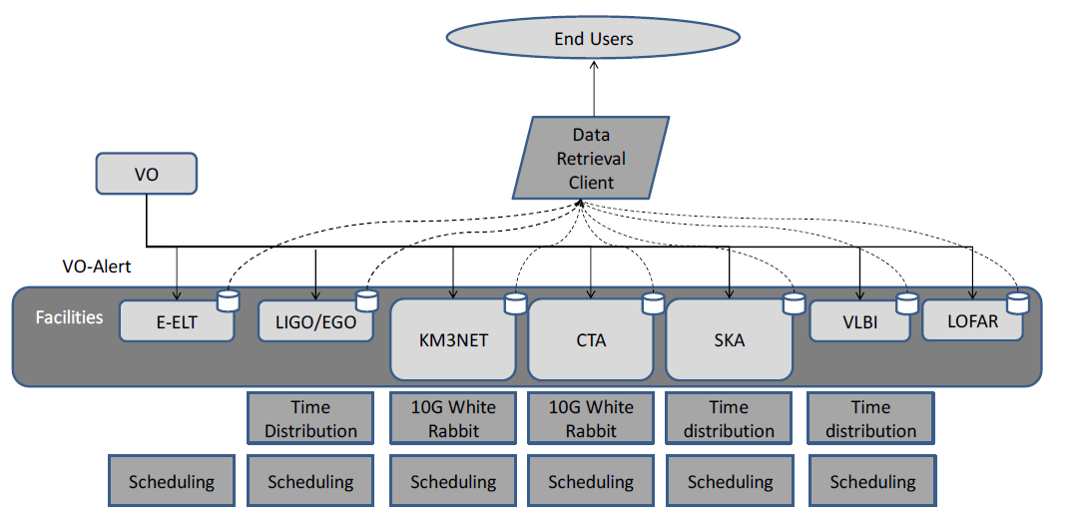
WP5 – CLEOPATRA
Technology development for fibre connectors; relaying alerts; data streaming software; data dissemination; advanced scheduling algorithms
Builds on WRE (White Rabbit Ethernet) and the EC EXPReS/NEXPRES projects

Slide 10
Synergies with AENEAS
AENEAS can rely on the broad network of ASTERICS
  No need to make separate multi-disciplinary links
  Natural entrance in initiatives like European Science Cloud
AENEAS can be efficient interface into SKA community
  Avoids confusion e.g. in EC lobby
  Allows especially WP3, WP5 to concentrate on generic research
Strategic development e.g. towards SKA:
  AENEAS community driven: (European) science interests, specific SKA oriented development
  ASTERICS cluster driven: cohesion, overarching policy, generic topics, libraries and concepts

