Slide 1
AENEAS WP4
Analysis of Global SKA Data Transport and Optimal European Storage Topologies

Slide 2
WP4 Objectives
Investigate and demonstrate the data transfer and storage techniques required to confirm the viability of a distributed computing and network architecture for a European Science Data Centre.
Collaborate with South Africa and Australia to address the challenges of moving large data volumes.
PoC trials and support the work of WP3
Moving up the stack, Study of: data access protocols, data transfer protocols, replica and transfer management, data moving applications
Output: design and best practice recommendations for the construction of the network infrastructure, data transfer and storage required for an ESDC together with
cost models for European and Global connectivity.

Slide 3
WP4 Partners & Stakeholders
Work package number | 4 |  | Lead beneficiary |  |  |  | GEANT LTD
Participant number | 2 | 4 |  | 5 | 6 |  |  | 8
Short name of participant | UMAN | INAF |  | Chalmers | GEANT Ltd |  |  | Jülich
Person/months per participant: | 6 | 1 |  | 20 | 22 |  |  | 9
Start month | 1 |  |  | End month |  | 36
Stakeholders: AARNet, ASTRON, CSIRO, IT,
JIV-ERIC, MPI Bonn, SANReN, STFC

Slide 4
WP4 Tasks
Task 4.1: Evaluation of existing data transfer protocols,
storage sub-systems and applications
Start →T0 month
Task 4.2: Inventory of the storage and network capabilities of existing and planned European Facilities for SKA Start → T0+6 months
Task 4.3: Optimized design and cost model for a distributed ESDC data topology with world connectivity Start → T0 & T0+8 months
Task 4.4: Proof of Concept Activities supporting the design of data access and transport within Europe and from the Host countries to Europe
Start → T0+6 & T0+19 months

Slide 5
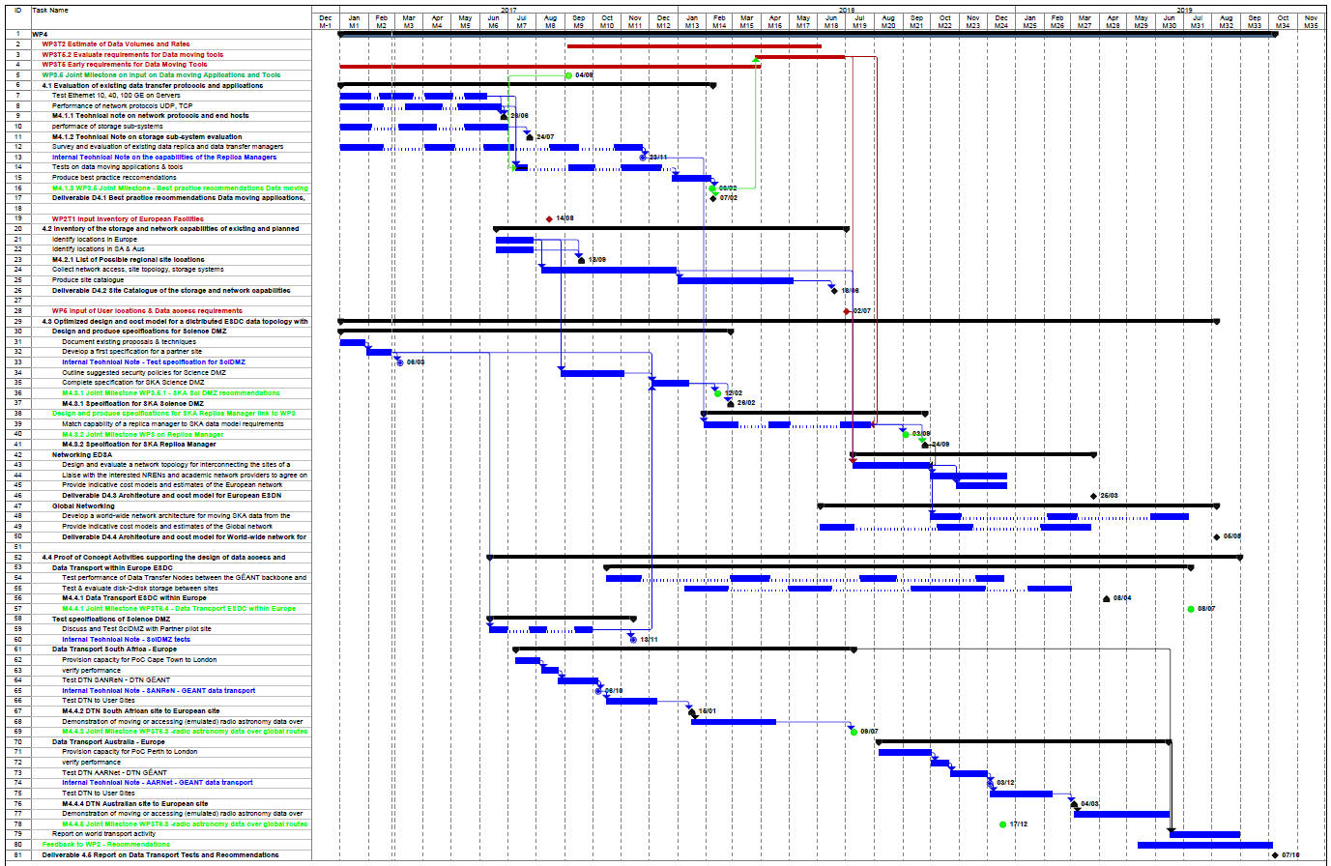
WP4: Task Gantt Chart

Slide 6
Task 4.1: Evaluation of existing data transfer protocols, storage sub-systems and applications
Partners: Chalmers (lead), GÉANT Ltd, Jülich, INAF, UMAN Stakeholders: CSIRO, SANReN, IT
Test network protocols and end-host performance
  10 40 100 GE, UDP, TCP & variants, RDMA
  The effect of CPU socket, core and app locations
Test & evaluate storage sub-systems and file systems
  i/o performance & scaling
  Data curation and safety of the data – modern RAIDx !
Evaluate & test data transfer protocols & applications
  High performance, long distance environment
  Gridftp, aspera, http, …
Survey and evaluate data replica and data transfer managers
  dCache, Hadoop, Ceph, xroot, …

Slide 7
Delivering the Data – Requirements Input
SDP HPC processing places SKA data in telescope archives.
Tiered Model to provide access to the astronomy community:
  Having a replica is a basic requirement.
  Only move the data once.
  Protocols must be suitable
  for high bandwidth and
  real-time transfers.
WP3 & WP5

Slide 8
Task 4.2: Inventory of the storage and network capabilities of existing and planned European Facilities for SKA
Partners: INAF (lead), GÉANT Ltd Stakeholders: ASTRON, IT
Online catalogue of technical capabilities
  Connectivity of the site
  Network topology to compute and storage elements
  Details of the storage technology
WP 2.1 provides an initial list of possible ESDC sites including
  Existing & proposed radio astronomy locations
  National Tier 1 centres

Slide 9
Task 4.3: Optimized design and cost model for a distributed ESDC data topology with world connectivity
Partners: GÉANT Ltd (lead), INAF, Chalmers, Jülich, UMAN Stakeholders: AARNet, CSIRO, SANReN, IT
Close links with WP3 & WP5 establish network requirements
  General user access
  High bandwidth data moving
Design & spec. network infrastructure for a distributed ESDC
  Support internal ESDC, remote access & data transfers with DTNs
  What form of connectivity?
  Formation of De-Militarised Zones at the sites
Assess capability & use of Software Defined Networking
Design & specify a SKA replica manager for ESDC
Develop a global network architecture for moving SKA data
Provide indicative cost models for European and global links.

Slide 10
Possible Global Network Paths
10 year IRU per 100Gbit circuit 2020-2030
Guesstimate of Regional Centres – based on SKA member locations
Some funding model will be needed for SKA.

Slide 11
Task 4.4: Proof of Concept Activities:
Data access and transport within Europe and from the Host countries to Europe
Partners: GÉANT Ltd (lead), Chalmers, UCAM, UMAN Stakeholders: AARNet, CSIRO, JIV-ERIC, SANReN, IT
Work with End Sites & GEANT/NRENs to set up European paths
Work with AARNet & SANReN to set up inter-continental paths
Test DMZ specs as a pilot at an AENEAS partner site
  Facilitate discussions of (existing) security policies
  Testing performance
Measure performance between GEANT DTN & likely ESDC sites
  Network tests
  Storage – storage transfer tests
With AARNet & SANReN test inter-continental performance
  Network tests – protocols & long haul effects – multiple 10 Gigabit
  Storage – storage transfer tests (NREN-NREN & EndSite-EndSite)
  Move Radio Astronomy data with WP3 (EndSite-EndSite)

Slide 12

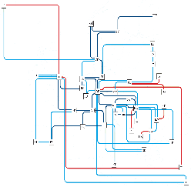
AENEAS Proof of Concepts
With AARNet & SANReN test inter-continental performance
  Network tests – protocols & long haul effects – multiple 10 Gigabit
  Sustained data transfers
  Storage – storage transfer tests (NREN-NREN & EndSite-EndSite)
  Move Radio Astronomy data with WP3 (EndSite-EndSite)
Karoo
SANReN
MRO
AARnet
Notes:
Intercontinental rates: 10 Gbps and multiple 10 Gbps of data.

Slide 13
WP4 Deliverables
D4.1 Best practice recommendations Data moving applications, protocols and storage
→ T0+14 months
D4.2 Site Catalogue of the storage and network capabilities → T0+18 months
D4.3 Architecture and cost model for European ESDN network → T0+27 months
D4.4 Architecture and cost model for World-wide network for SKA → T0+32 months
D4.5 Report on Data Transport Tests and Recommendations → T0+34 months

Slide 14
Interactions and Dependencies with other WP
Milestone number | Milestone name | Related work package(s) | Due date (in month) | Means of verification
6 | Protocols and end hosts evaluation | WP4 | 7 | Technical note written
7 | Storage sub-systems evaluation | WP4 | 8 | Technical note written
10 | Joint Milestone (WP4) on data moving applications & tools | WP3 WP4 | 9 | Internal memo
11 | List of possible regional site locations | WP2 WP4 | 9 | List of possible sites established
19 | Data transfer test South African site to European site | WP4 | 13 | Technical note written
20 | Joint Milestone (WP4) on SKA Sci DMZ recommendations | WP3 WP4 | 14 | Internal memo
21 | Best practice recommendations Data moving applications, protocols and storage | WP3 WP4 | 14 | D 4.1 written
22 | Specification for SKA Science DMZ | WP3 WP4 | 14 | Specification document written
25 | radio astronomy data over global routes from South Africa to Europe | WP3 WP4 | 18 | WP3 Technical note written
27 | Joint Milestone (WP4) on demonstration of moving data from observatory sites (SA) to ESDC | WP3 WP4 | 19 | Demonstration completed
30 | Joint Milestone (WP4) on data replica manager | WP3 WP4 | 21 | Internal memo
31 | Specifications for SKA Replica Manager | WP3 WP4 | 21 | Specification document written
33 | Joint Milestone (WP4) on demonstration of moving data from observatory sites (AUS) to ESDC | WP3 WP4 | 24 | Demonstration completed
35 | Data transfer test Australian site to European site | WP4 | 27 | Technical note written
36 | Report on Data Transport ESDC within Europe | WP3 WP4 | 28 | Technical note written
37 | radio astronomy data over global routes from Australia to Europe | WP3 WP4 | 30 | WP3 Technical note written
40 | Joint Milestone (WP4) on demonstration of moving data within ESDC | WP3 WP4 | 31 | Demonstration completed
Strong supporting links between
WP3 and WP4
T4.1 & T3.2 Data volumes & rates
T4.1 & T3.5.2 requirements for
data moving tools
T4.4 & WP3 PoC tests of science data
Many joint Mile Stones
Input
From WP2: T1 to form list of possible
sites for ESDC. T4.2 (M9 Jul17)
From WP5: User locations &
Data access requirements T4.3
~M20 Jul18
Joint Milestone
Related WP
WP4 Lead

Slide 15
WP4 Moving Forward
T4.1:
Locate test systems and login access. Started investigations of protocols and end systems.
Survey and evaluate data replica and data transfer managers, file systems and storage sub-systems.
T4.2 :
Consideration of technology required for the online catalogue.
Location of the server – www.aeneas2020.eu
T4.3 :
Initial spec for a DMZ on a SKA site
T4.4 :
PoC tests with Australia and South Africa
Establish locations and suitable servers in the NRENs
Formed contacts with other projects: eg Enlighten my Research (NZ, Aus, NL); Asterics

Slide 16

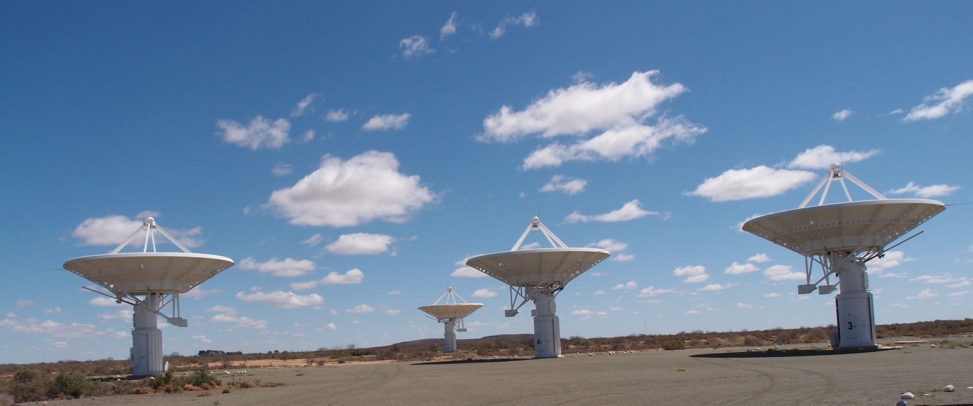
Questions ?
Thanks to Richard Hughes-Jones

