Slide 1
Transients and Science Operations with the SKA

Slide 2
Outline
Introduction to the SKA
Transient science with the SKA
SKA Operations for Transient Science

Slide 3
One Observatory
The Square Kilometre Array
Two Telescopes
SKA-LOW
SKA-MID
Three Sites
Australia (LOW)
South Africa (MID)
UK (GHQ)

Slide 4
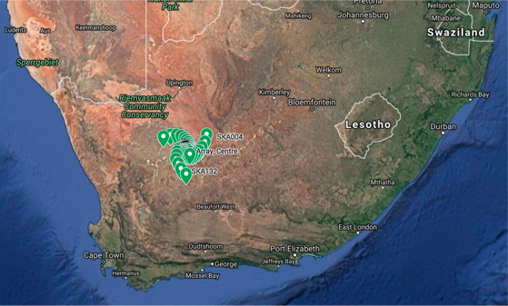
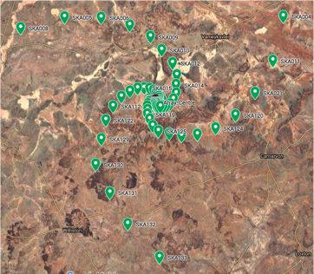
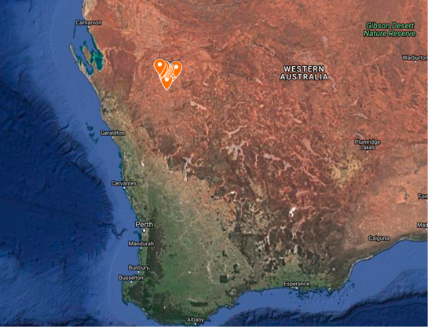
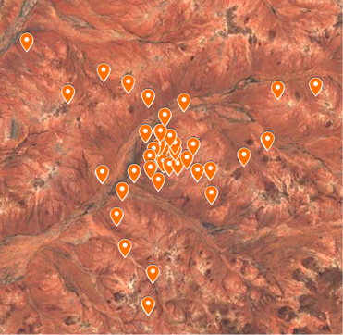
SKA-1 MID – South Africa
SKA-1 LOW– Western Australia

Slide 5

SKA1 MID - Karoo, South Africa
133 SKA1 dishes (15m), 64 MeerKAT (13.5m), core + 3 spiral arms,
150km baseline, 0.35 → 15-GHz covered in 5 bands

Slide 6

SKA1 LOW - Western Australia
131,072 antennas : 512 stations of 256 antennas, core + 3 spiral arms,
65km baselines, 50 → 350-MHz full instantaneous bandwidth

Slide 7
Image fidelity – simulated snapshot images
LOW
MID
SKA1
SKA1
LOFAR
JVLA
(A+B+C+D)

Slide 8
Data flow

Slide 9
Data flow
Ordinarily, the science data processor is not considered a part of the telescope
  data reduction should never hamper or obstruct data acquisition
  data rates and volumes emerging from central signal processor are so high that we will not be in a position to store the raw data from the CSP
  it will be cheaper to re-observe than store the raw data indefinitely
The science data processor becomes a schedulable resource of the telescope for observation planning

Slide 10
Project Status
(to receive from Simon B)

Slide 11
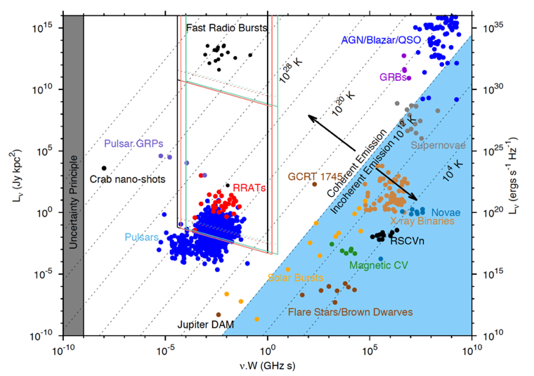
Transients and the SKA
Pietka et al., 2015, MNRAS, 446, 3687 (updated with more FRBs)

Slide 12
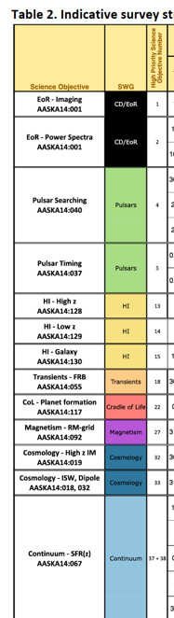

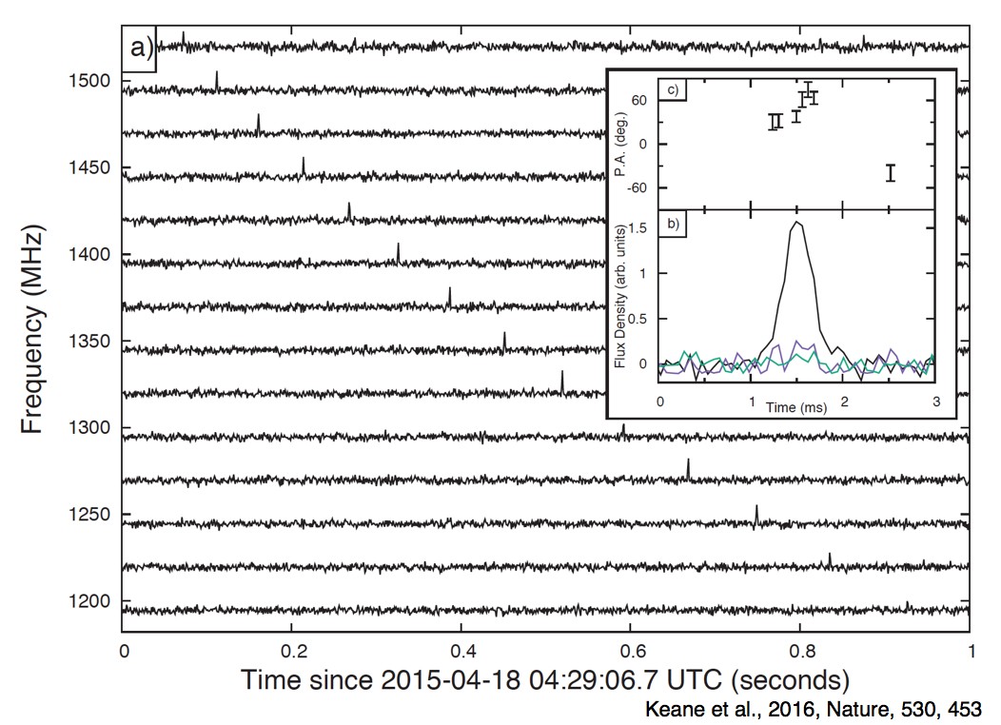
Transients and the SKA
There is a big emphasis on Pulsars and Transients in the SKA science case
  High Priority Science Objectives (HPSOs)
  Pulsar Searches
  Pulsar Timing
  Transients – FRBs

Slide 13
Transients and the SKA
There is a big emphasis on Pulsars and Transients in the SKA science case
  High Priority Science Objectives (HPSOs)
  Pulsar Searches
  Pulsar Timing
  Transients – FRBs
  Precision
  Astrophysics
PSR J0437-4715 has a period of:
P = 0.005757451924362137 seconds
± 0.0000000000000000002 seconds

Slide 14
Transients and the SKA
There is a big emphasis on Pulsars and Transients in the SKA science case
  High Priority Science Objectives (HPSOs)
  Pulsar Searches
  Pulsar Timing
  Transients – FRBs
  Precision
  Astrophysics
  Gravitational Waves

Slide 15
Transients and the SKA
There is a big emphasis on Pulsars and Transients in the SKA science case
  High Priority Science Objectives (HPSOs)
  Pulsar Searches
  Pulsar Timing
  Transients – FRBs
  Precision
  Astrophysics
  Gravitational Waves
  Pulsar Timing Array

Slide 16
SKA Operations & Transients
Search capabilities for Transients
  real-time search capability on both MID and LOW
  1500 tied array search beams on MID
  500 tied array search beams on LOW
  can place beams within subarrays
  different subarrays/beams searching different frequency space
  can trade number of beams for bandwidth
  typical observing of 10-mins per pointing
  transient buffers
    20-30 sec for MID
    ~7 mins for LOW
FRB detection rates
Parkes finds ~ 20 FRBs/300 days
Scaling sensitivity & beam
⇒ FRB_{SKA} ~ 1000s FRBs/sky/day

Slide 17
SKA Operations & Transients
Independence of operation of the correlator, beamformer, pulsar search and timing, allows flexibility of operation and commensal operations
  advantage is to have imaging and non-imaging happening concurrently in the same subarray

Slide 18
SKA Operations & Transients
Frequency Slice Processors on the MID telescope
  allows for flexibility and commensality amongst observing modes

Slide 19
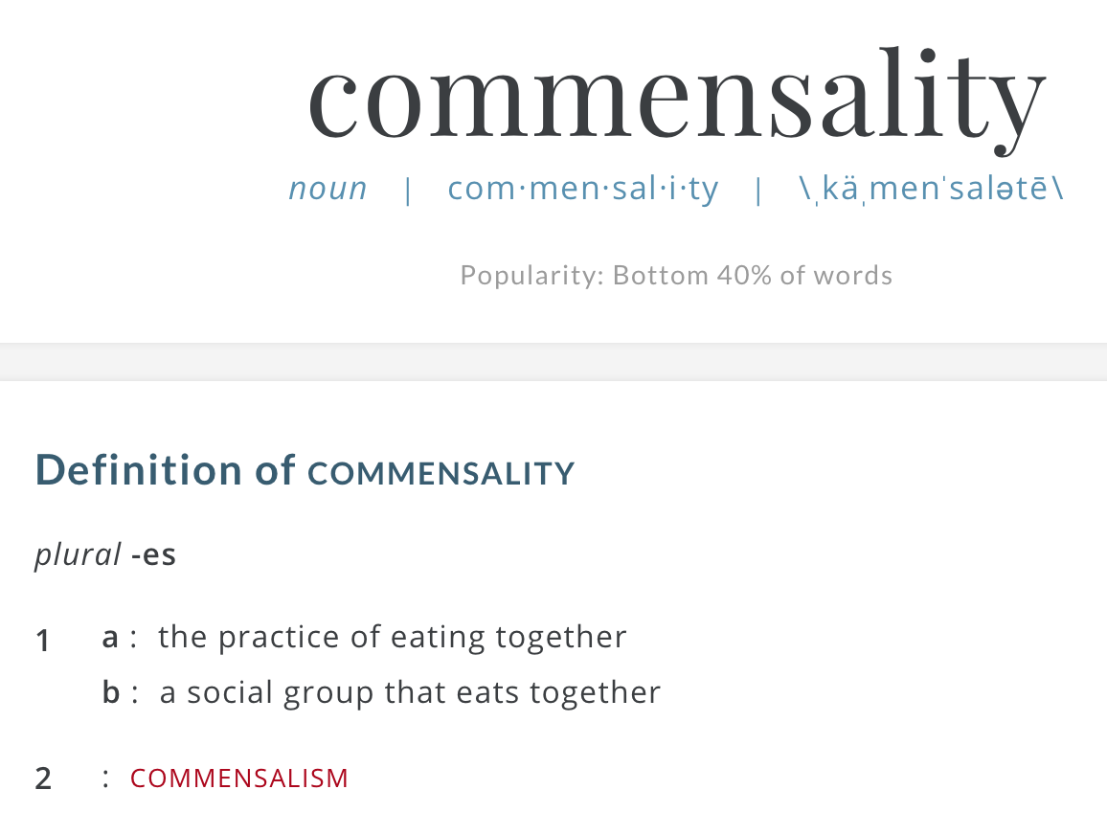
SKA Operations & Transients
Our aim is to perform Pulsar/Transient search and timing observations in a commensal fashion
  Merriam-Webster definition:
Potentially can perform Pulsar
and Transient Search/Timing
for 100% of the available time!
  searching with the telescope core
  while whole telescope is undertaking
  imaging observations
  then localise positions with arms and core
  follow-up with VLBI (available on MID & LOW)
Publish the most interesting candidates, using VO standards, for follow-up

Slide 20
SKA Operations & Transients
Digitized signal comes into the CSP
  processed by the PSS engine with single-pulse events sent to SDP
SDP makes determination on which events need to be analysed and instructs the Telescope Manager to dump the signal buffer from those events
  buffered data is delivered and processed
“Interesting” candidates are published for follow-up via VO events
  internal and external

Slide 21
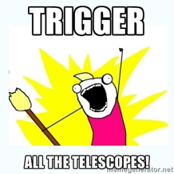
How to optimise searches
Spend as much time observing as possible!
  detections are linear with T_{obs}, unsurprisingly!
Maximise the observed sky
  detections are linear with increasing fov
  put lots of beams on the sky
Get the best sensitivity possible (A_{eff}, Δν,...)
  detections increase with log N – log S
Continuous operations
  24/7/365
  commensality helps → buy a big computer
  get your own telescope
And when you find something interesting....

Slide 22
Conclusions
SKA will generate many 1000s of alert candidates that will be published via VO clients and will be followed up both internally as well as by other facilities
We will also be able to follow up externally generated alerts
  commensality will allow us to respond to alerts more efficiently and (perhaps) to minimise the impact on the active science programme
We are still in the design phase and our consortia will be going through their CDRs in the next year or so
This is a good time for us to learn from the experiences of our multi-messenger colleagues to get our systems, procedures and policies in place and fit-for-purpose
  find me, talk to me!

