Slide 1
About the Svom mission
September2017

Slide 2
SVOM : a French-Chinese space mission
A scientific collaboration between China and France
A difficult and complex history
The center of mass moved eastward in 2015
Launch foreseen by end of 2021 by a Long March rocket
Altitude of the orbit : 630 km, inclination of 30°
Duration of the mission 3 (+3) years
In France Cnes – the space agency – manages the project
In China Academy of Sciences is in charge
Dr Bertrand Cordier from Irfu is the French PI
Equipments are developed by different laboratories in France, UK and Germany

Slide 3
SVOM Scientific Requirements
Permit the detection of all know types of GRBs, with a special care on high-z GRBs and low-z sub-luminous GRBs
Provide fast, reliable and accurate GRB positions
Measure the broadband spectral shape of the prompt emission (from visible to MeV)
Measure the temporal properties of the prompt emission
Quickly identify the afterglows of detected GRBs, including those which are highly redshifted (z>6)
Quickly provide (sub-) arcsec positions of detected afterglows
Quickly provide redshift indicators of detected GRBs

Slide 4
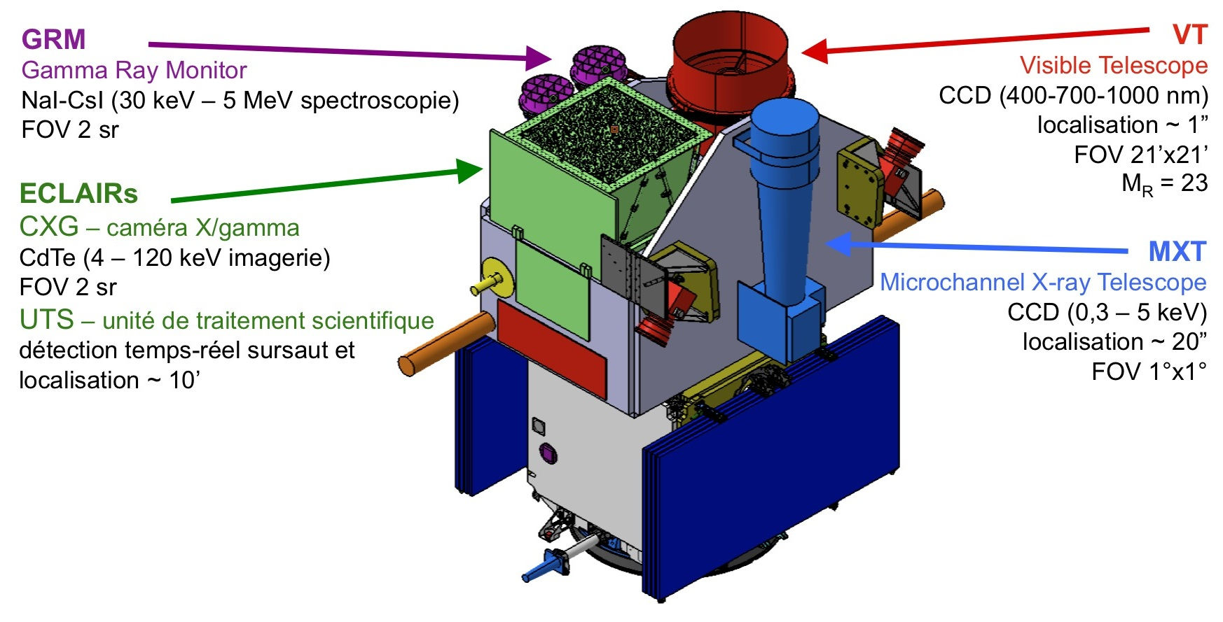

The spacecraft instruments
2 Chinese instruments and 2 European ones

Slide 5
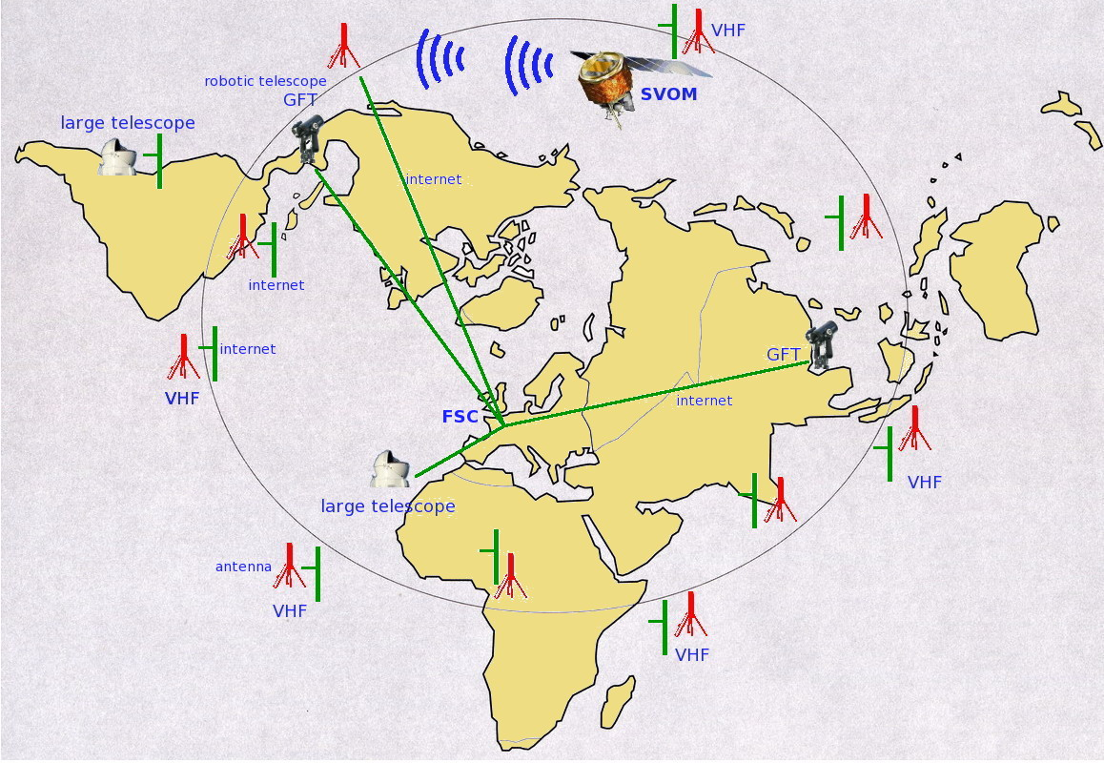
Space ground links
The French Science Center listens to the spacecraft

Slide 6
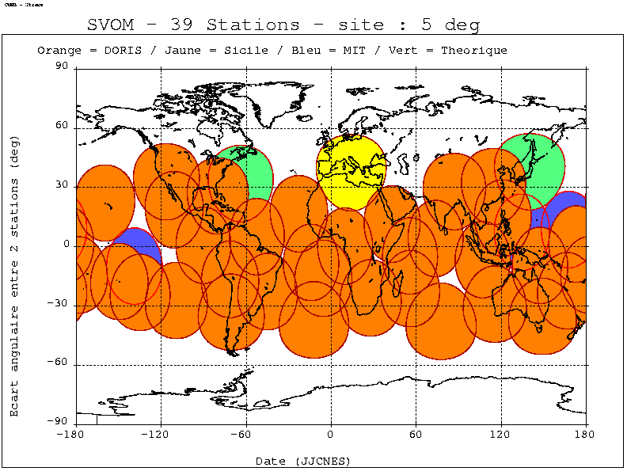
The vhf stations network
Svom is based on the same principle as Hete2
The spacecraft stays permanently in contact with the ground thanks to a VHF radio link

Slide 7
Svom programs
The core program,
  Devoted to the GRB detection and the follow-up
The general program
  Svom does not stay idle
  Observations are programmed
The ToO program
  Different kinds of ToO are identified

Slide 8
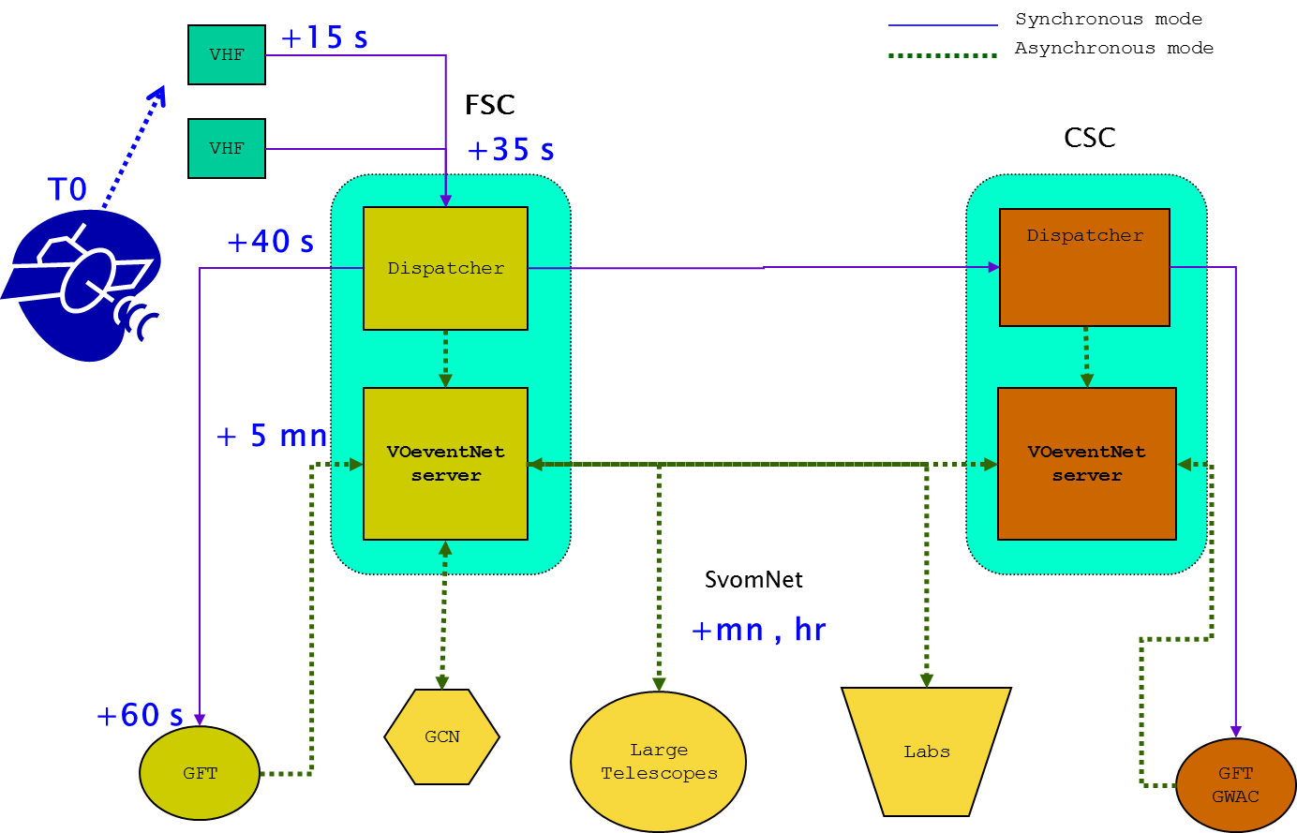
Timing requirements for the CP

Slide 9
French Science Center architecture
Telescopes
Community
VHF
Messaging
Science, system
Publication
BA support
VHF
VHF
Users management
Documentation
VHF listener
Read
Log
Filter
Dispatch
Process
Format
Broadcast
Persist
Networking
Communications
Services
Control
Scheduling
Management
VHF net monitoring
System monitoring
Data processing
System management
GFT
Data processing
System backup
Data storage
Logfiles, science data, ext data, system, etc.
Databases
Data, metadata
Data ingestion
Data ingestion
Data ingestion
Data ingestion
ECLAIRs
Instrument Center
MXT
Instrument Center
French
POC
Chinese
Science Center

Slide 10
Inside our toolbox
RESTful interfaces based on https
Java with Jersey, Python with Flask, Go
Spring framework
API generated with Swagger
Gitlab, Gradle, Sonarqube, Jenkins
Docker
Postgresql
Nats
Cloud (OpenStack) @ In2p3 Computing Center
OpenVPN

Slide 12
VTP vs XMPP
A comparison of VTP & XMPP
VTP | XMPP
Simple | Complex
Simplistic | Powerful
Developed from scratch | Mature technology born in 1998
Tiny community | Large community
No consensus | IETF standard
Used and working for VOEvent | No longer used for VOEvent
Specific clients needed | Bunch of standard clients available

Slide 13
Tests previously implemented
Openfire server installed, configured and tested
http://www.igniterealtime.org/
Manage the XMPP protocol
It supports the pubsub messaging system
Test programs have been implemented.
It has been successfully Dockerized recently at Saclay

Slide 14
Tests previously implemented
VTP : VOEvent Transport Protocol
Comet: a python implementation of VTP
http://comet.transientskp.org/
LOFAR transient key project
A java version has been implemented (code available in git)
fr.svom.xmpp.clients.VtpClient
The comet broker has also been Dockerized at Saclay.

Slide 15
Heard : I’m an open-minded person but …
I don’t want to change the tools I’m used to working with !
Everybody has been using GCN for decades, it is the de facto standard !
Actually, the current VoEvent streams are just GCN messages which have been xmlified !
I’ve heard that there is a IVOA recommendation about VoEvent, but I don’t know where to find it !
I’ve no time to waste trying to figure out how to deal with XML schema !
I’m a high level scientist, XML is boring, it is only for my programmers !
A row in a table looks like : <TR><TD>34.01</TD><TD>0.80</TD><TD>63.3</TD><TD>1997ApJS..109..333W</TD></TR>, are you kidding ?
Json format is much better than XML !
I could not find any user-friendly tool to process my VoEvents !
I doubt that VoEvent format will be able to handle streams of thousands of events by hours !

Slide 16
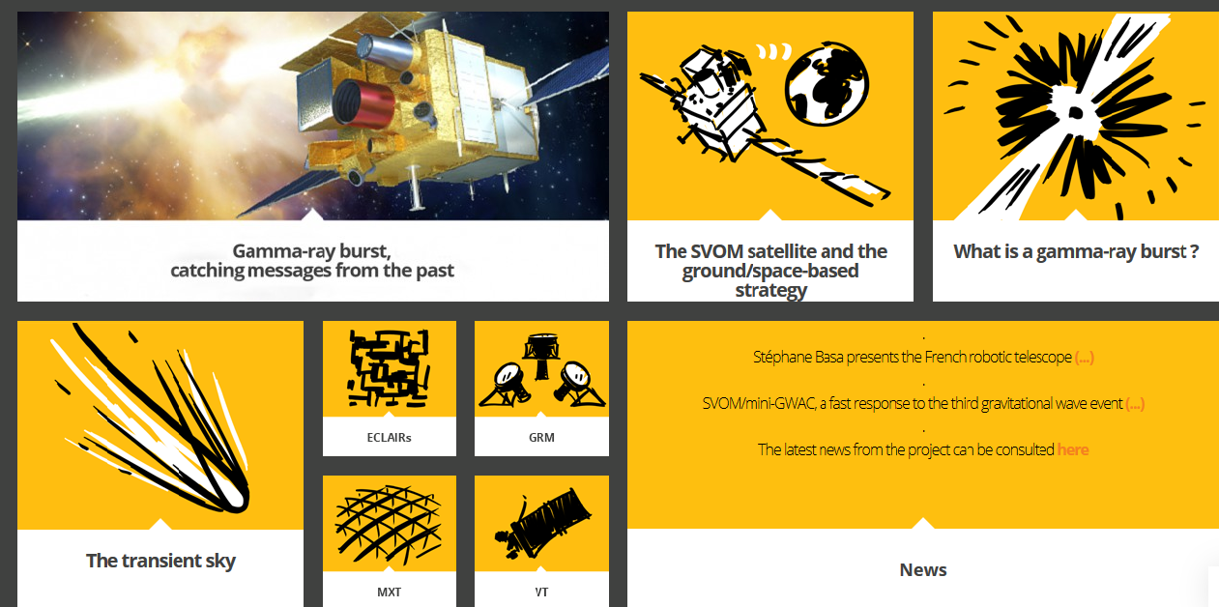
The French web site
http://www.svom.fr

Slide 17


