Slide 1
AENEAS WP4 Workshop

Slide 2
Agenda WP4 Workshop Session A
Welcome & Agenda bashing 5'
Round Table Introductions 15' All
Who I am, My institute & Group, My work interests & expertise
Plans and Discussion of the WP4 Tasks 20' All
Outline of how the Tasks support the Statement of Work
Discussion of the Timelines
Technical Notes, Milestones & Deliverables
Interactions and inter-dependencies with other WP
Some Current Work
Work at Onsala on protocols & data transfers 5‘ Simon Casey
Work at Juelich on dCache for LOFAR 5‘ Oleg Tsigenov
Work at Trieste on Data Transfer Nodes and Physics Transfers 5‘ Riccardo Smareglia
Tests of 100Gigabit Ethernet on PCs & long haul to AARNet 5‘ Richard Hughes-Jones
Coffee 15'

Slide 3
Agenda WP4 Workshop Session B
The work within each Task 20' All
Task Leaders Simon Casey, Mauro Nanni, Richard Hughes-Jones
Agreement Linking People to Tasks 20' All
Timescales & Interaction with WP3 5' All
Functioning of WP4
Initial Work Steps 5' All
Identify Sites and Work in Progress 5' All
Collaboration Tools 5' Richard Hughes-Jones
Lunch Break 60'

Slide 4
Agenda WP3-WP4 Joint Session
Sketch of WP3 Plans 15'
Sketch of WP4 Plans 15'
Discussions Covering: 30'
Time Scales
Joint Milestones and Deliverables
Data Locality
A Data Replica Manager for SKA

Slide 5
Agenda WP4 Workshop Session A
Welcome & Agenda bashing 5'
Round Table Introductions 15' All
Who I am, My institute & Group, My work interests & expertise
Plans and Discussion of the WP4 Tasks 20' All
Outline of how the Tasks support the Statement of Work
Discussion of the Timelines
Technical Notes, Milestones & Deliverables
Interactions and inter-dependencies with other WP
Some Current Work
Work at Onsala on protocols & data transfers 5‘ Simon Casey
Work at Juelich on dCache for LOFAR 5‘ Oleg Tsigenov
Work at Trieste on Data Transfer Nodes and Physics Transfers 5‘ Riccardo Smareglia
Tests of 100Gigabit Ethernet on PCs & long haul to AARNet 5‘ Richard Hughes-Jones
Coffee 15'

Slide 6
Plans and Discussion of the WP4 Tasks

Slide 7
Task 4.1 (1) : Evaluation of existing data transfer protocols, storage sub-systems and applications
Partners: Chalmers (lead), GÉANT Ltd, Jülich, INAF, UMAN Stakeholders: CSIRO, SANReN, IT
Test network protocols and end-host performance
10 40 100 GE, UDP, TCP & variants, RDA, RDMA
The effect of CPU socket, core and app locations
Evaluate & test data transfer protocols & applications
High performance, long distance environment
Gridftp, aspera, mk5B, http, …
Test locations for networking – GEANT DTN, Onsala, JBO, ??
Who has aspera?
RDMA experience?

Slide 8
Task 4.1 (2) : Evaluation of existing data transfer protocols, storage sub-systems and applications
Partners: Chalmers (lead), GÉANT Ltd, Jülich, INAF, UMAN Stakeholders: CSIRO, SANReN, IT
Test & evaluate storage sub-systems and file systems
i/o performance & scaling
Data curation and safety of the data – modern RAIDx !
Survey and evaluate data replica and data transfer managers
dCache, Hadoop, ceph, xroot, …
What file systems?
What data replica and data transfer managers
Test locations for storage

Slide 9
Task 4.2: Inventory of the storage and network capabilities of existing and planned European Facilities for SKA
Partners: INAF (lead), GÉANT Ltd Stakeholders: ASTRON, IT
Online catalogue of technical capabilities
Connectivity of the site
Network topology to compute and storage elements
Details of the storage technology
WP 2.1 provides an initial list of possible ESDC sites including
Existing & proposed radio astronomy locations
National Tier 1 centres
Clouds
Liaison with WP2 on questions & how to approach sites
avoid duplication and
aware of political aspects
Interaction with NRENs via GÉANT for connectivity & costings

Slide 10
Delivering the Data – Requirements Input
SDP HPC processing places SKA data in telescope archives.
Tiered Model to provide access to the astronomy community:
Having a replica is a basic requirement.
Only move the data once.
Protocols must be suitable for high bandwidth and real-time transfers.
Input from WP3 & WP5
How do we get the inputs?

Slide 11
Task 4.3: Optimized design and cost model for a distributed ESDC data topology with world connectivity
Partners: GÉANT Ltd (lead), INAF, Chalmers, Jülich, UMAN Stakeholders: AARNet, CSIRO, SANReN, IT
Close links with WP3 & WP5 establish network requirements
General user access
High bandwidth data moving
Design & spec. network infrastructure for a distributed ESDC
Support internal ESDC, remote access & data transfers with DTNs
What form of connectivity?
Formation of De-Militarised Zones at the sites
Assess capability & use of Software Defined Networking
Design & specify a SKA replica manager for ESDC
Develop a global network architecture for moving SKA data
Provide indicative cost models for European and global links.

Slide 12
Task 4.4: Proof of Concept Activities: Data access and transport within Europe and from the Host countries to Europe
Partners: GÉANT Ltd (lead), Chalmers, UCAM, UMAN Stakeholders: AARNet, CSIRO, JIV-ERIC, SANReN, IT
Work with End Sites & GEANT/NRENs to set up European paths
Work with AARNet & SANReN to set up inter-continental paths
Test DMZ specs as a pilot at an AENEAS partner site JBO
Facilitate discussions of (existing) security policies
Testing performance
Measure performance between GEANT DTN & likely ESDC sites
Network tests
Storage – storage transfer tests
With AARNet & SANReN inter-continental performance check timescales
Network tests – protocols & long haul effects – multiple 10 Gigabit
Storage – storage transfer tests (NREN-NREN & EndSite-EndSite)
Move Radio Astronomy data with WP3 (EndSite-EndSite)

Slide 13
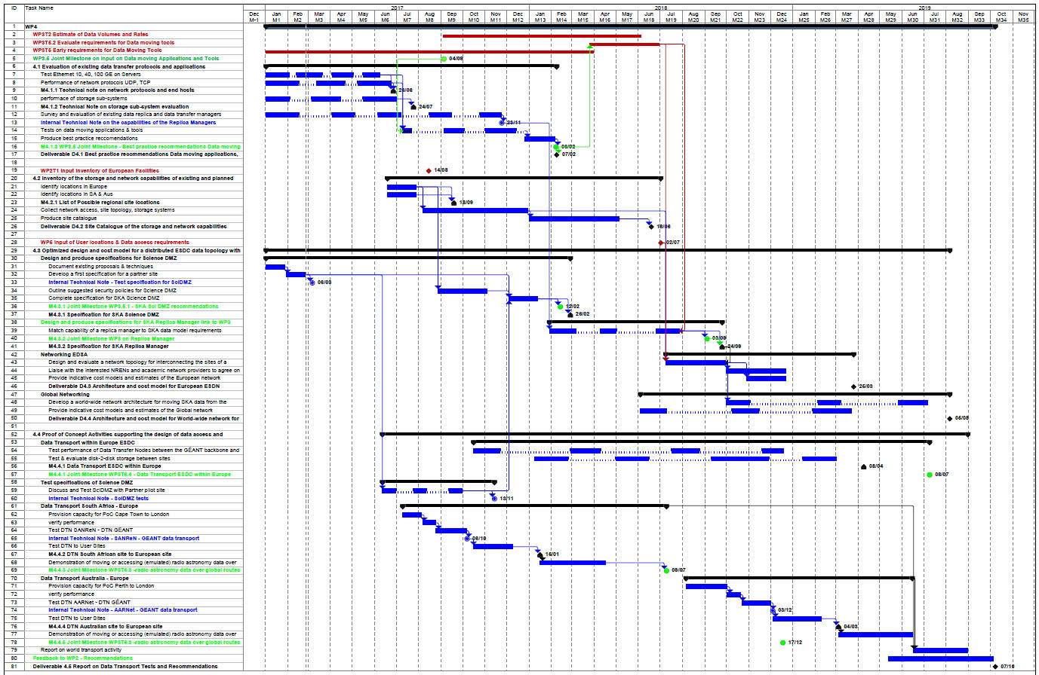
Timelines: Joint & WP4 Mile Stones
M9
M14
M19
M21
M24
M31

Slide 14
WP4 Deliverables
D4.1 Best practice recommendations Data moving applications, protocols and storage → T0+14 months
D4.2 Site Catalogue of the storage and network capabilities → T0+18 months
D4.3 Architecture and cost model for European ESDN network → T0+27 months
D4.4 Architecture and cost model for World-wide network for SKA → T0+32 months
D4.5 Report on Data Transport Tests and Recommendations → T0+34 months

Slide 15
Interactions and Dependencies with other WP
Milestone number | Milestone name | Related work package(s) | Due date (in month) | Means of verification
6 | Protocols and end hosts evaluation | WP4 | 7 | Technical note written
7 | Storage sub-systems evaluation | WP4 | 8 | Technical note written
10 | Joint Milestone (WP4) on data moving applications & tools | WP3 WP4 | 9 | Internal memo
11 | List of possible regional site locations | WP2 WP4 | 9 | List of possible sites established
19 | Data transfer test South African site to European site | WP4 | 13 | Technical note written
20 | Joint Milestone (WP4) on SKA Sci DMZ recommendations | WP3 WP4 | 14 | Internal memo
21 | Best practice recommendations Data moving applications, protocols and storage | WP3 WP4 | 14 | D 4.1 written
22 | Specification for SKA Science DMZ | WP3 WP4 | 14 | Specification document written
25 | radio astronomy data over global routes from South Africa to Europe | WP3 WP4 | 18 | WP3 Technical note written
27 | Joint Milestone (WP4) on demonstration of moving data from observatory sites (SA) to ESDC | WP3 WP4 | 19 | Demonstration completed
30 | Joint Milestone (WP4) on data replica manager | WP3 WP4 | 21 | Internal memo
31 | Specifications for SKA Replica Manager | WP3 WP4 | 21 | Specification document written
33 | Joint Milestone (WP4) on demonstration of moving data from observatory sites (AUS) to ESDC | WP3 WP4 | 24 | Demonstration completed
35 | Data transfer test Australian site to European site | WP4 | 27 | Technical note written
36 | Report on Data Transport ESDC within Europe | WP3 WP4 | 28 | Technical note written
37 | radio astronomy data over global routes from Australia to Europe | WP3 WP4 | 30 | WP3 Technical note written
40 | Joint Milestone (WP4) on demonstration of moving data within ESDC | WP3 WP4 | 31 | Demonstration completed
Strong supporting links between WP3 and WP4 T4.1 & T3.2 Data volumes & rates T4.1 & T3.5.2 requirements for data moving tools T4.4 & WP3 PoC tests of science data
Many joint Mile Stones
Input
From WP2: T1 to form list of possible sites for ESDC. T4.2 (M9 Jul17)
From WP5: User locations & Data access requirements T4.3 ~M20 Jul18
Joint Milestone
Related WP
WP4 Lead

Slide 16
Some Current Work

Slide 17
Agenda WP4 Workshop Session B
The work within each Task 20' All
Task Leaders Simon Casey, Mauro Nanni, Richard Hughes-Jones
Agreement Linking People to Tasks 20' All
Timescales & Interaction with WP3 5' All
Functioning of WP4
Initial Work Steps 5' All
Identify Sites and Work in Progress 5' All
Collaboration Tools 5' Richard Hughes-Jones
Lunch Break 60'

Slide 18
The work within each Task

Slide 19
Linking People to Tasks

Slide 20
Task 4.1: Evaluation of existing data transfer protocols, storage sub-systems and applications
Institute | Person | PM | Role / comments
Chalmers | Simon Casey | 7 | Lead Network protocols
GÉANT | Richard Hughes-Jones | 5 | Network protocols
Jülich | Oleg Tsigenov | 6 | Storage / Replica Manager
INAF | Cristina Knapic (OATS) | 3
 | Mauro Nanni (ORA) | 2
UMAN | Jimmy Cullen | 2 | Network protocols
CSIRO | Shaun Amy | 1
IT | ? | ?
SANReN | Uli Horn | 4 | Storage / Replica Manager
 | SiJu Mammen | 1 | Network protocols

Slide 21
Task 4.2: Inventory of the storage and network capabilities of existing and planned European Facilities for SKA
Institute | Person | PM | Role / comments
INAF | Mauro Nanni (ORA) | 1 | Lead
 | Contractor | 1
GÉANT | Vincenzo Capone | 2.2
ASTRON | Hanno Holties | 1
IT | ? | ?

Slide 22
Task 4.3: Optimized design and cost model for a distributed ESDC data topology with world connectivity
Institute | Person | PM | Role / comments
GÉANT | Richard Hughes-Jones | 5 | Lead
 | Vincenzo Capone | 2
Chalmers | Simon Casey | 6
INAF | Riccardo Smareglia (OATS) | 3
Jülich | Oleg Tsigenov | 2 | Specs. for SKA Replica Manager,
UMAN | Jimmy Cullen | 1
AARNet | Guido Aben | 0.5
 | Peter Elford | 0.7
 | John Nichols | 0.5
CSIRO | Shaun Amy | 1
IT | ? | ?
SANReN | Uli Horn | 2.8
 | SiJu Mammen | 0.8
Institute | Person | PM | Role / comments
Chalmers | Simon Casey | 7 | Lead Network protocols
GÉANT | Richard Hughes-Jones | 5 | Network protocols
Jülich | Oleg Tsigenov | 6 | Storage / Replica Manager
INAF | Cristina Knapic (OATS) | 3
 | Mauro Nanni (ORA) | 2
UMAN | Jimmy Cullen | 2 | Network protocols
CSIRO | Shaun Amy | 1
IT | ? | ?
SANReN | Uli Horn | 4 | Storage / Replica Manager
 | SiJu Mammen | 1 | Network protocols

Slide 23
Task 4.4: Proof of Concept Activities: Data access and transport within Europe and from the Host countries to Europe
Institute | Person | PM | Role / comments
GÉANT | Richard Hughes-Jones | 6 | Lead
 | Vincenzo Capone | 2
Chalmers | Simon Casey | 8 | Network
Jülich | Oleg Tsigenov | 1
UMAN | Jimmy Cullen | 3 | Network
AARNet | Guido Aben | 0.7 | Network
 | Peter Elford | 0.5
 | John Nichols | 0.5
CSIRO | Shaun Amy | 1
IT | ? | ?
JIV-ERIC | Arpad Szomoru | 1
 | Harro Verkouter | 1
Max-Planck | Hans-Rainer Klöckner | 1
SANReN | Uli Horn | 4 | Network & storage
 | SiJu Mammen | 0.4 | Network
UCAM | Anna Scaife | 0.5
UMAN | Rosie Bolton | 0.5

Slide 24
Functioning of WP4

Slide 25
Initial Work Steps, Identify Sites and Work in Progress
T4.1:
Locate test systems and login access. Start investigations of protocols.
Survey and evaluate data replica and data transfer managers, file systems and storage sub-systems.
T4.2 :
Consideration of technology required for the online catalogue.
Location of the server – www.aeneas2020.eu
T4.3 :
Initial spec for a DMZ on a SKA site
T4.4 :
PoC tests with Australia and South Africa
Establish locations and suitable servers in the NRENs
Contact with other projects: eg Enlighten my Research (NZ, Aus, NL); Asterics

Slide 26
WP4 Collaboration Tools
Mailing lists:
aeneas-wp4@astron.nl
WP4 VCs / Telcons
Skype ad hoc
Zoom regular monthly meetings & extended every 3 months
Indico for Meetings:
https://indico.astron.nl/categoryDisplay.py?categId=28
AENEAS Wiki Open and intra pages:
https://www.astron.nl/aeneas2020/doku.php
WP4 Wiki intra pages:
Request a login
https://www.astron.nl/aeneas2020/doku.php?id=intra:wp4:start

Slide 27
Agenda WP3-WP4 Joint Session
Sketch of WP3 Plans 15'
Sketch of WP4 Plans 15'
Discussions Covering: 30'
Time Scales
Joint Milestones and Deliverables
Data Locality
A Data Replica Manager for SKA

