Slide 1
Work at Trieste on Data Transfer Nodes and Physics data transfers
R. Smareglia

Slide 2
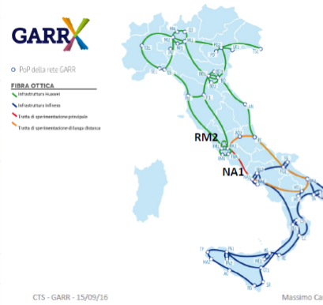
Italy / INAF : Network status
GARR: network Provider
targert: main backbone ➔ 500 Gb
  All service ➔ 100Gb
INAF connctions:
IRA Bologna ➔ 1/10 Gb
OA Trieste ➔ 1 Gb (upgrade to 10 Gb ento 2017)

Slide 3
Data Transfer @ Trieste
Present
  From TNG ( Canary islands)
  From LBT ( Mt. Grham – Arizona)
    Pick transfer rate/day ~ 50 GB
    ➔ single transfer rate ( scp ) ~1-2 Mb/sec
  Data transfer with by simple Multi-Thread (till 10 channel)
  Data Transfer is part of the NADIR data archive system ( developed for spread data archive)

Slide 4
Data Transfer @ Trieste
Under test
  MWA public data mirror ( ~ 150 TB )
  First test on performances in these days ( with Greg Sleap @ Curtin)
  Using
    Iperf – iperf3 to test the network
    Bbcp to test data transfer
    Test Aspera or other system – TBC
  Results
    0.5 Mb/sec without any tunnig (first test last week)
  Target: have MWA public mirror data before summer
  Note test from Trieste and Bologna ➔ 600-900 MB/sec ( with a 1 Gb/sec network)

