Slide 1
Testing 100Gigabit Ethernet on PCs and
10Gig long haul to AARNet

Slide 2
iperf3: TCP Throughput using different CPU cores and Nodes
Firewalls OFF, TCP offload on,
TCP cubic stack
RTT 0.4 ms.
Delay Bandwidth Product 0.5 MB.
Rises smoothly to the plateau
at 0.5 MBytes.
Throughput:
  75 Gbit/s
  Both send & receive on node 1
  60 Gbit/s
  Send on node 0 receive on node 1
  35 Gbit/s
  Both send & receive on node 0
Very few TCP re-transmitted segments observed

Slide 3
iperf: TCP throughput multiple flows
Distribute IRQs over all cores on node 1
Each flow on pair of cores 6-11
for both receive and sending
Firewalls ON, TCP offload on,
TCP cubic
Total throughput:
increase 60 → 86 2 → 3 flows
98 Gbit/s for 4 & 5 flows
then starts to fall
10⁻⁴ - 10⁻⁵ % re-tx 2, 3 flows
10⁻⁴ % re-tx 4, 5 flows
10⁻³ % re-tx 8, 10 flows
Individual flows can vary
by ± 5 Gbit/s

Slide 4
10 Gigabit TCP
GÉANT London to AARNet Canberra
Route using ANA300 & AARNet 100Gig:
London-Washington-LosAngeles-Sydney-Canberra
TCP offload on, TCP cubic stack
RTT 304 ms.
Delay Bandwidth Product 280 MB.
One TCP flow rises smoothly to the
plateau at 350 MBytes.
Throughput:
  Average including slow start 9.09 Gbit/s
  Plateau from 5s onwards 9.73 Gbit/s.
NO TCP re-transmitted segments

Slide 5
Time Series of Achievable TCP Throughput
Route as on the last slide.
Achievable throughput recorded every 10s for 40 hours.
A constant rate of 9.73 Gbit/s was achieved.
Slow start points clearly visible at 6 Gbit/s at the start of every period.
No TCP segment re-transmissions were observed during these tests.

Slide 6
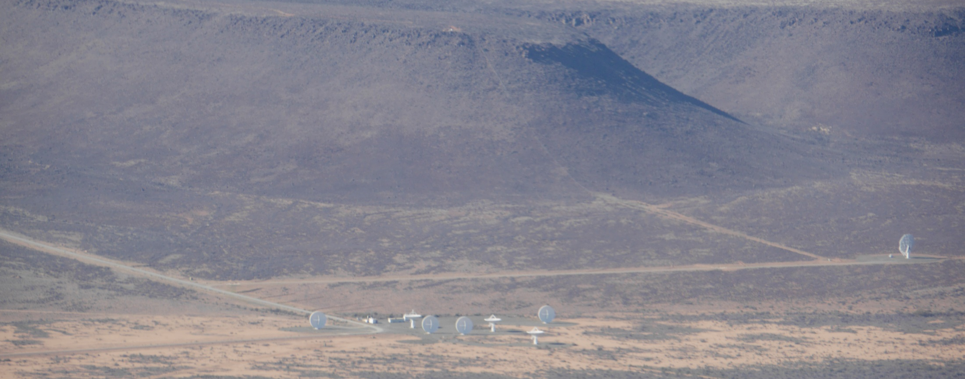
Questions ?
Thanks to Richard Hughes-Jones
Thanks to Shaun Amy

