Slide 1
ASTERICS Kick-Off Meeting: SKA links and interaction
Simon Berry: Director Policy Development
26th May 2015

Slide 2
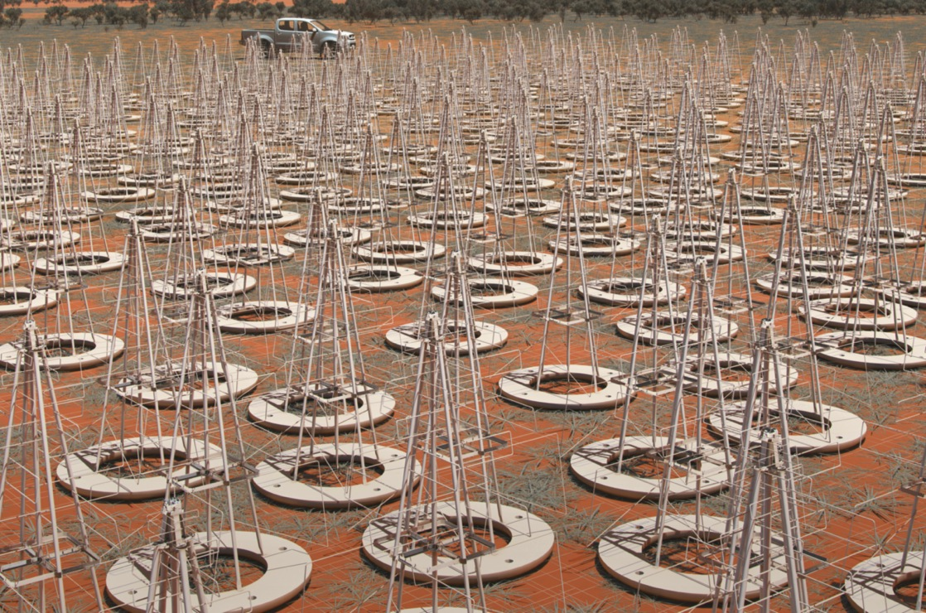

SKA-LOW, Murchison, Australia:
Phase 1: 130,000 dipole antennas over 80km (2018 – 2023)
Phase 2: 500,000 dipoles over 250km (2025 – 2033)

Slide 3

SKA-MID, Karoo, South Africa:
Phase 1: 200 dishes spread over 150km (2018 – 2023)
Phase 2: 2500 dishes spread over 3500km (2025 – 2033)

Slide 4
2015 progress
Significant progress and important decisions:
  Baseline technical and science shape of SKA1 established
  Engineering process – PDR phase completed now moving to CDR activities → highly related to ASTERICS technical developments
  H2020 IN-SKA proposal funded; negotiations underway
  Move to formal negotiations towards SKA IGO
Key Document Set
  Development of base governance/critical planning documents
  Supporting policy developments: procurement, financials, access principles etc
  Development of SKA Observatory functional vision, Operations planning etc

Slide 5
SKA in ASTERICS (1)

Slide 6

SKA in ASTERICS (2)

Slide 7
SKA in ASTERICS (3)
WP1: Management and consortium
  SKAO Interested participant in high-level policy and coordination discussions, AGA, AEAB etc
  Primary direct contact and reporting route through MG: also SKA Board Director
WP2: Dissemination and Citizen Science
  Clear potential with SKA but limited in-house resources; keen to support and work with team to maximise opportunities
WP3: OBELICS
  Data challenge of SKA clear; primary route for linkage through common participants in ASTERICS and SKA Design activities
WP4: DADI
  Currently limited resources towards preparing tools and approaches for user-interface and associated matters: SKA representation through ASTRON and link to design process
WP5: CLEOPATRA
  Links with SKA through SADT design consortium activities: timing and synchronisation studies
  Real-time alerts: will map well into operations planning/scheduling

Slide 8
SKA in ASTERICS (4)
SKA1 Schedule aggressive to construction start (2018)
CDRs end 2016→2017
ASTERICS work, particularly where focused on design choices; timely
‘User’ preparation for early science 2020+; timely
A key issue in SKA will be:
  Complex structure within project, let alone across ESFRI projects (!); need to ensure processes are right to allow outputs to be properly followed up and followed through → need to develop an early plan (ASTERICS-SKA)

