Slide 1
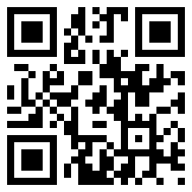
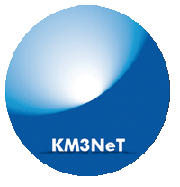
KM3NeT
Astro-particle and Oscillations Research
with Cosmics in the Abyss
(ARCA & ORCA)
ASTERICS kick-off meeting
26−27 May 2015, ASTRON, the Netherlands
Maarten de Jong

Slide 2
Introduction
KM3NeT is a new Research Infrastructure
  network of cabled observatories
  located in deep waters of Mediterranean Sea
  hosting multi-km³ Neutrino Telescope
Discovery and subsequent observation of
high-energy neutrino sources in Universe
Measurement of neutrino mass hierarchy
Synergy with Earth & Sea sciences

Slide 3
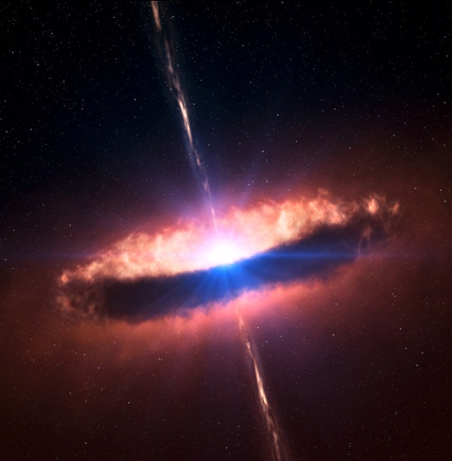

Multi-messenger astronomy
cosmic rays
p, He, ..
ν
γ
neutrinos
Supernova Remnants
Active Galaxies
Gamma-Ray Bursts
...
gamma rays

Slide 4
Detection principle
wave front
neutrino
muon
1
2
3
4
5
~ 100 m
interaction
~ km
time resolution 1 ns
position resolution 10 cm
angular resolution 0.1 deg

Slide 5

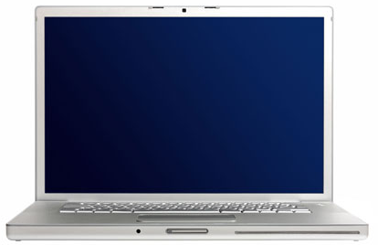
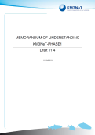
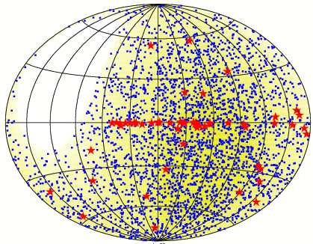
Architecture
10−100 Mb/s
computer
center
0.1−1 Tb/s
shore station
neutrino telescope
KM3NeT
remote
operation
remote access
to data
on
off

Slide 6
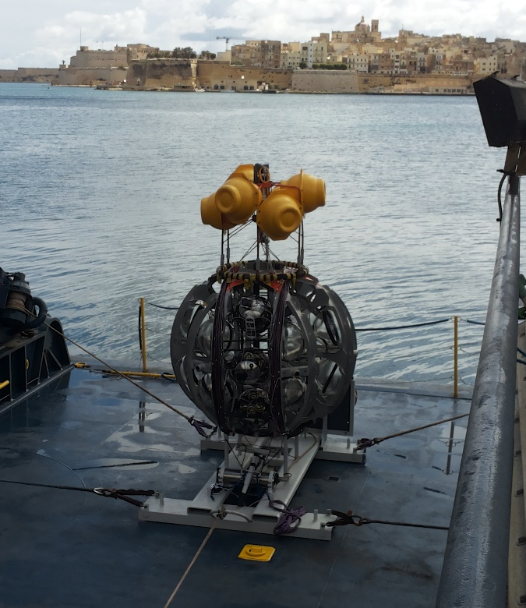
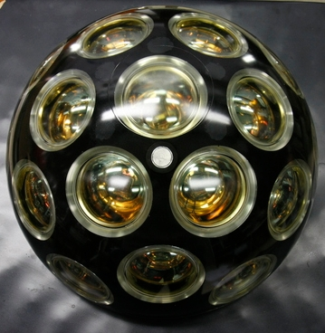

Design
Launcher vehicle
Optical module
~ 600 m
17”
31 x 3” PMTs
low-power HV
LED & piezo inside
FPGA readout
White Rabbit
DWDM
rapid deployment
autonomous unfurling
recoverable

Slide 7
Phased implementation
Phase | Blocks | Primary deliverables
1 | 0.2 | Proof of feasibility and first science results;
2.0 | 2 ARCA | Measurement of neutrino signal reported by IceCube; All flavor neutrino astronomy;
 | 1 ORCA | Neutrino mass hierarchy;
3 | 6 (+1) | Neutrino astronomy including Galactic sources;

Slide 8
KM3NeT status & outlook
R&D
  developed cost-effective technology
  feedback from prototypes confirm key specifications
Phase-1
  going ahead as planned
Phase-2
  ARCA
    measurement of IceCube flux with different methodology,
    complementary field of view and improved resolution
    all flavour neutrino astronomy
  ORCA
    measurement of neutrino mass hierarchy
Future prospects
  exploration of our Galaxy

