Slide 1
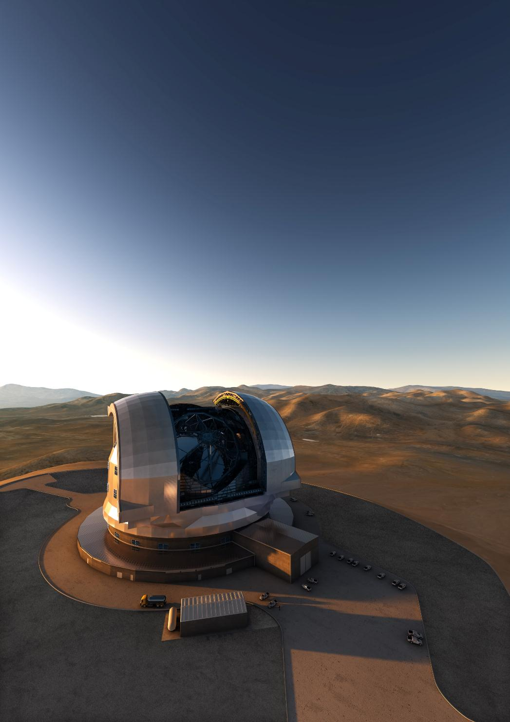
The world’s biggest eye on sky
ELT - Extremely Brief Overview
Roberto Tamai
E-ELT Programme Manager
presented by
Michael Sterzik
Data Management Operations

Slide 2
E-ELT
Council approved E-ELT construction in two Phases
Phase 1 affordable without Brazil
39m E-ELT three instruments and most but not all AO capabilities
First light late 2024 or soon after; cost 1031 MEUR
Phase 2 (~100 MEUR) will complete baseline E-ELT
Council authorized spending on Phase 1
The two-phase approach is a back-up plan
Path to the E-ELT without Brazil, without additional MS contributions and without any new MS other than Poland
By design, Phase 1 starts deviating from baseline in 2017
Provides time for Brazil to join ⇒ return to baseline
This is the preferred way forward, and approval by House and Senate is giant step forward towards this goal
Asterics kick-off meeting, May 26, 2015

Slide 3
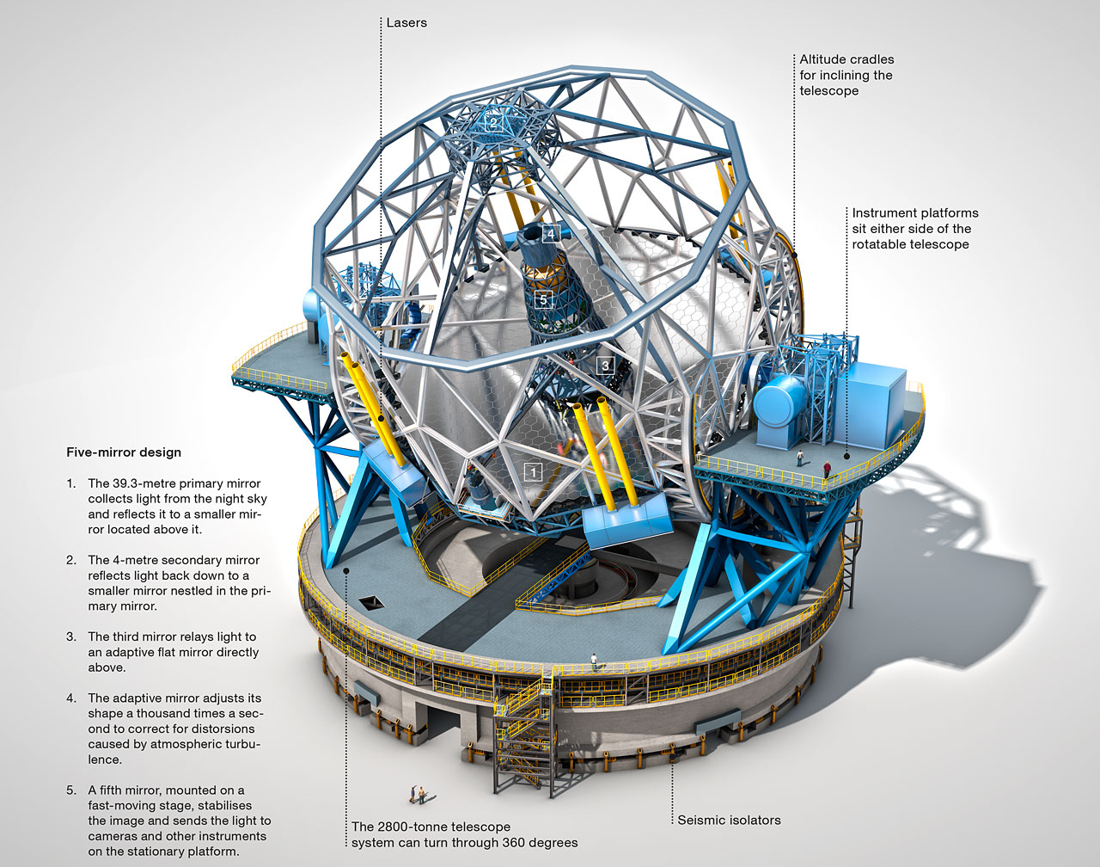
The collecting area will be more than the total collective area of today ground based astronomy!

Slide 4
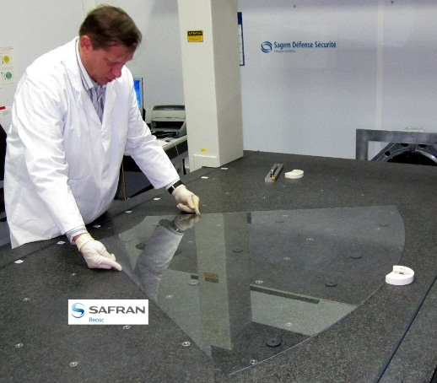
E-ELT Instrumentation
Recent contract awards:
M4 shell and unit
Agreements for 3 Instruments (+AO)
MICADO, HARMONI, METIS (+MAORY)
Instrumentation roadmap
Call for Phase A studies: MOS & HIRES
ELT-6: Specs to be defined later
EPICS: After further technology development
Construction philosophy
‘VLT model’ of consortia working closely with ESO
GTO policy: Cou-1543
Maximum of 15% of E-ELT observing time for GTO to Consortia
65 nights per instrument, spread over 4-8 years
Asterics kick-off meeting, May 26, 2015

Slide 5
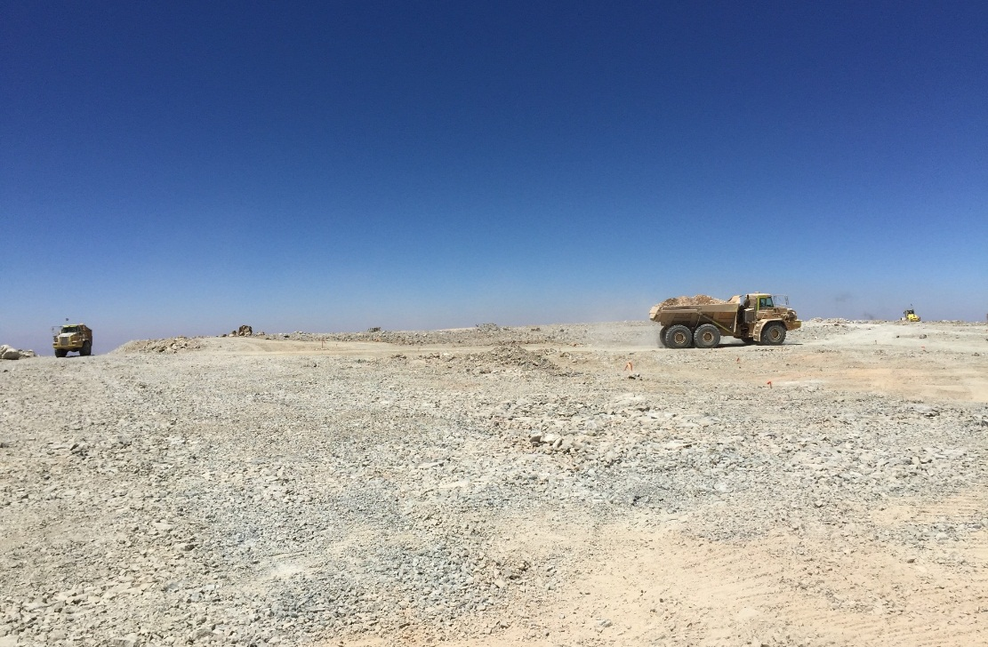
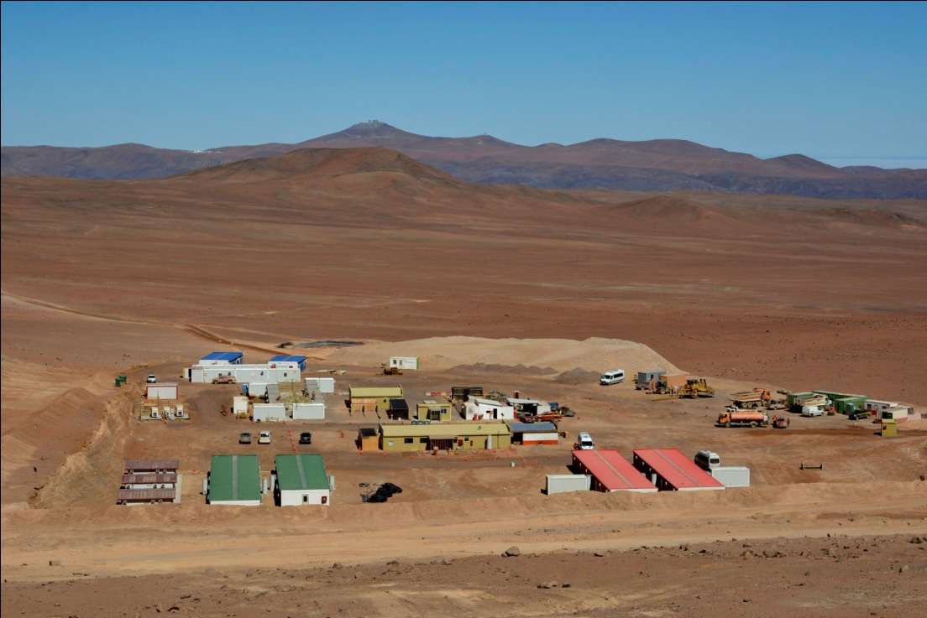
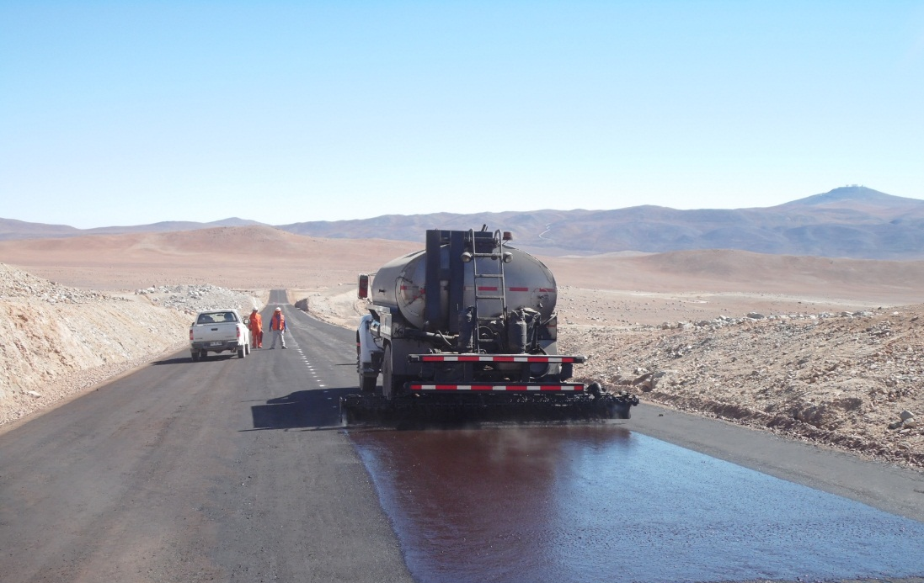
The Road to Armazones
Asterics kick-off meeting, May 26, 2015

Slide 6
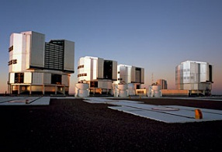
Armazones and Paranal: an Integrated Observatory
Asterics kick-off meeting, May 26, 2015

Slide 7
ELT and VLT: Integrated Operations
Asterics kick-off meeting, May 26, 2015

Slide 8
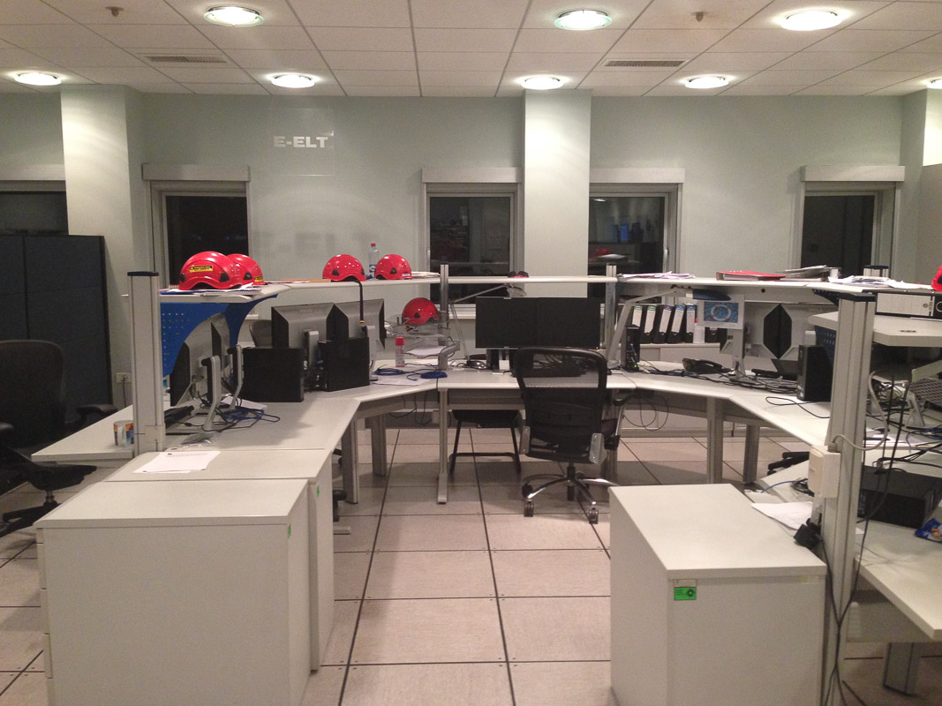
ELT and VLT: Integrated Operations
Asterics kick-off meeting, May 26, 2015

Slide 9
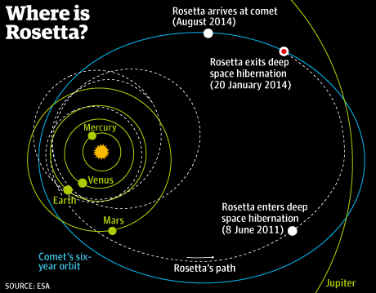
ELT and VLT: Towards Integrated Operations

Slide 10
ELT and VLT: Towards Integrated Operations
2024: ELT+VLT joint operations
the E-ELT?
2020: VLT readiness
for ELT operations
2014: ELT construction
starts
2015: VLT operations evolutionary path

Slide 11
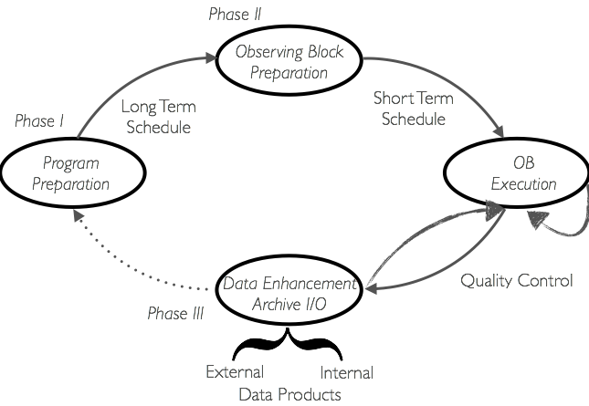
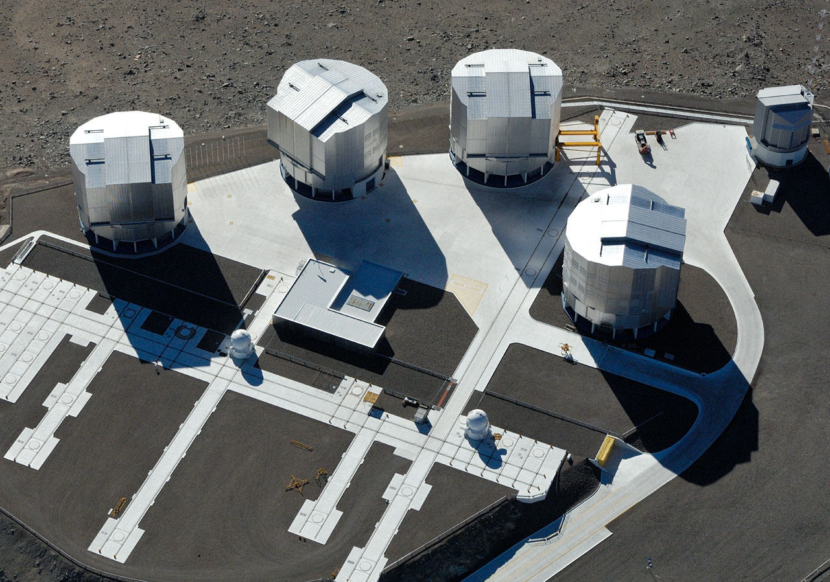
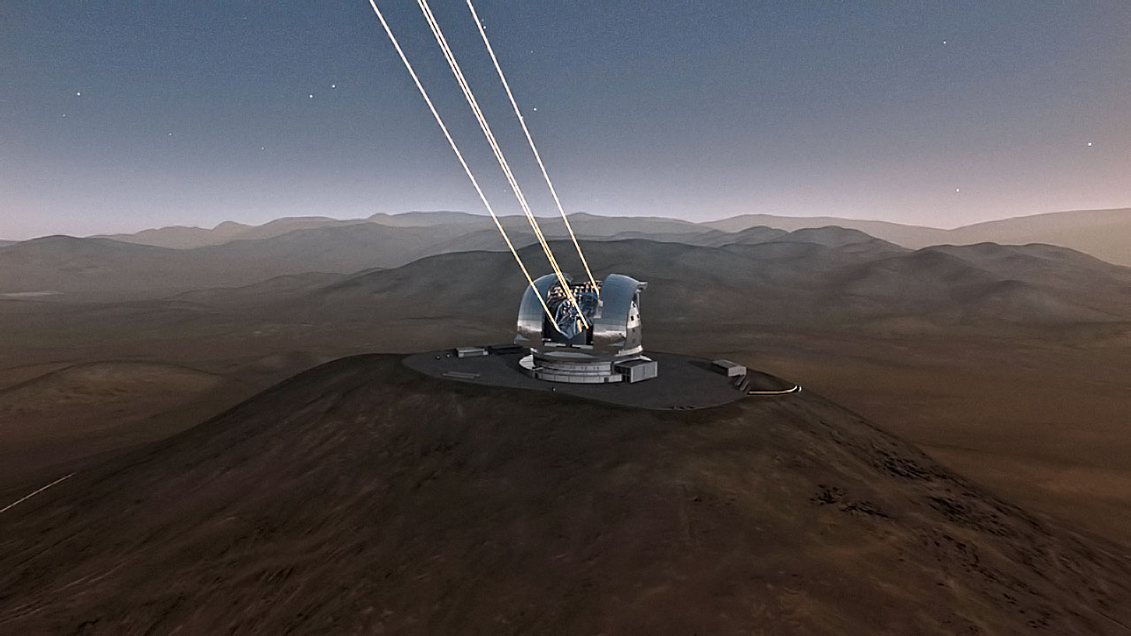
Evolution of VLT Operations
2024: ELT+VLT joint operations
2020: VLT readiness
for ELT operations
2015: VLT operations evolutionary path

Slide 12
2024: ELT+VLT joint operations
2020: VLT readiness
for ELT operations
2015: VLT operations evolutionary path

Slide 13
2024: ELT+VLT joint operations
2020: VLT readiness
for ELT operations
2015: VLT operations evolutionary path

