Slide 1
Astroparticle Physics European Consortium
Job de Kleuver (FOM/APPEC), ASTERICS Kick-off meeting, 26 May 2015

Slide 2
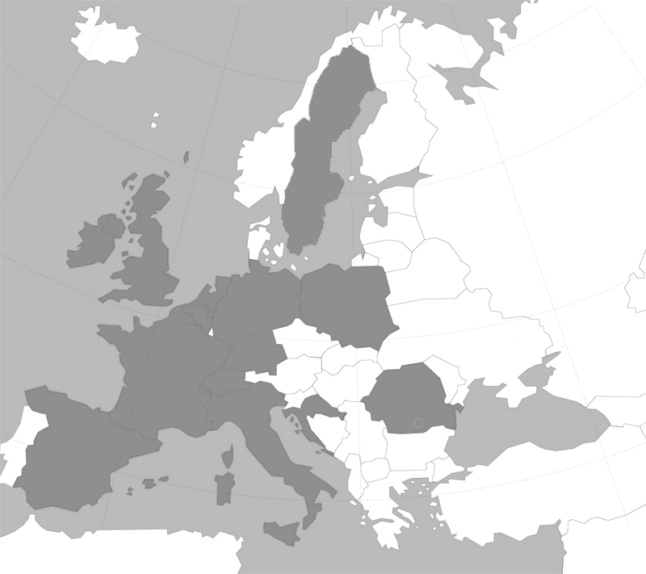
APPEC: Who are we?
AstroParticle Physics European Consortium
CERN – Transnational
ESO – Transnational
JINR – Transnational
ECFA – Transnational
CEA – France
CNRS – France
CSF – Croatia
DESY – Germany
FRS-FNRS – Belgium
FOM – The Netherlands
FWO – Belgium
IFIN-HH – Romania
INFN – Italy
KIT – Germany
LSC – Spain
NCN – Poland
DIAS/RIA – Ireland
SNSF – Switzerland
STFC – United Kingdom
VR – Sweden
Notes:
17 members, 2-3 observers
APPEC was created in 2001, followed by ERANET ASPERA.

Slide 3
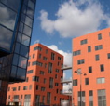
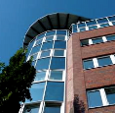
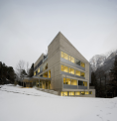
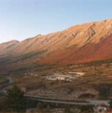
APPEC: How do we Operate?
APPEC
functional centers
STFC - UK
DESY - Hamburg/D
Outreach
Management, Computing & Industry
CNRS - Paris/F
Roadmapping, Common Calls, Interdiscipline
LSC - Canfranc/S
Web server
INFN - L'Aquila/I
Networking, Theory, Graduate Schools

Slide 4
APPEC: Objectives
Strategic objectives
Coordination of European Astroparticle Physics
Develop and update long term strategies (roadmap)
Express collective views on APP in international fora
Implementation objectives
Coordination between existing/developing national activities
Convergence of future large scale projects/facilities
Organisational advice for implementation of large facilities
Launch common calls funded by a (virtual) common pot

Slide 5
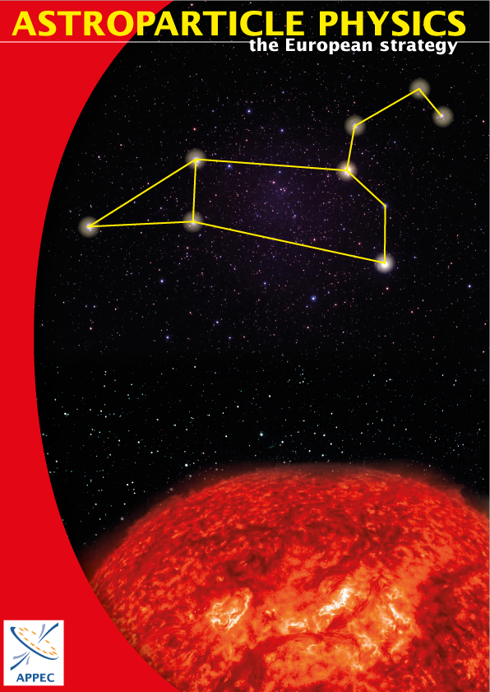
APPEC: Roadmapping
2008
2011
2016?

Slide 6
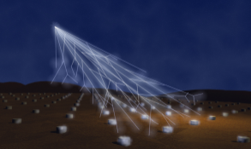
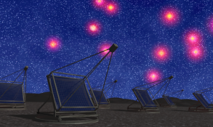
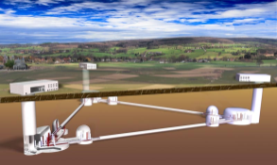
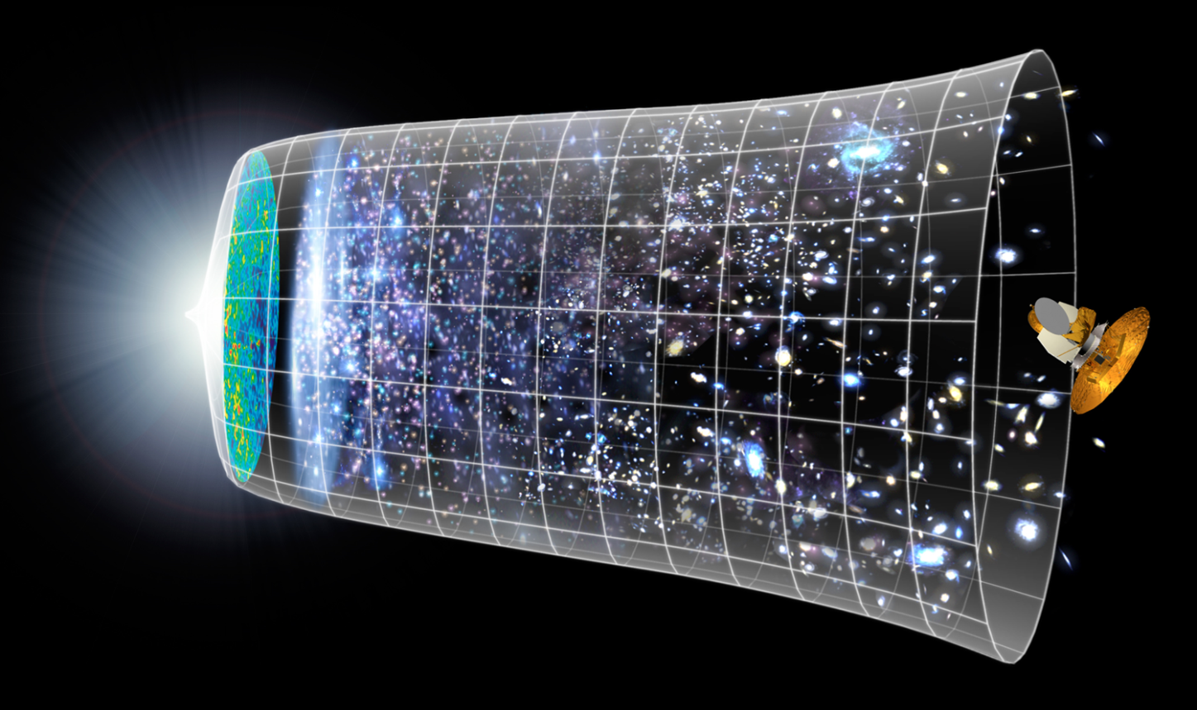
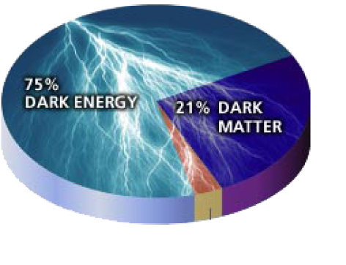
APPEC: Three Main Directions
1. High-energy Universe: multi-messengers
CR
γ
ν
GW
2. Neutrino’s
3. Cosmology

Slide 7
APPEC: Activities
Community meeting in preparation of new Horizon 2020 calls
Lessons learned 2014/2015 calls - 29/30 September 2015, Zagreb
Preparation consortia and applications
New European Astroparticle Physics Roadmap in the works
community event to discuss draft - January 2016, Rome
final document - Spring 2016
Intention to step-up interactions with the experiments groups
How can APPEC help the experiments?
Aim: fact sheet for each major experiment - Fall 2015
Inventory of EU Astroparticle Physics community
Web based ‘census’ - Fall 2015
Notes:
White paper on Computing available soon ( for approval in GA June)

Slide 8
APPEC & ASTERICS
Multi messenger studies
Coordination observations
Computing technologies
Data access issues
Welcome to participate in our events
Interest in developments and results, also for other APP projects!

Slide 9
The End

