Slide 1
Dissemination, engagement and citizen science (DECS)
Stephen Serjeant, ASTERICS meeting, 26-27 May 2015

Slide 2
DECS in a nutshell
(3rd party)
Outward-facing dialogue with
technical communities
decision-makers
the science-inclined public
Inward-facing dialogue within the consortium

Slide 3
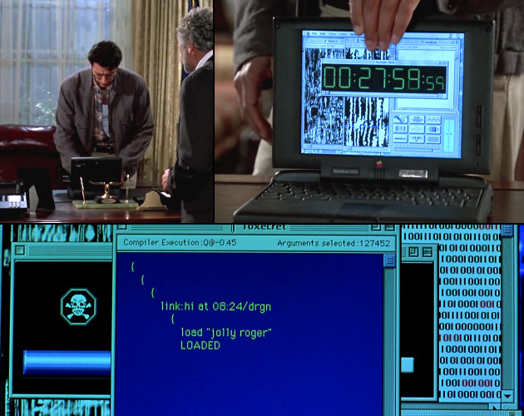
pcmag.com

Slide 4
stackexchange.com
You can connect the bridge computer to the canteen computer, but it will cost 400 million and take five years

Slide 5
DECS audiences
Scientific and technical community
Academia
Private industry
Other public research centres
SMEs
Policy makers
General public: media, schools, students, citizen scientists

Slide 6
DECS objectives
Promotional and outreach material
Coordinated citizen science experiments to open up ESFRI facilities to the general public
Accompanying open educational resources to attract young people to science

Slide 7
Science 2.0
http://ec.europa.eu/research/consultations/science-2.0/background.pdf

Slide 8
Citizen science is not outreach!
How can I use this tool for high priority ESFRI science goals?

Slide 9
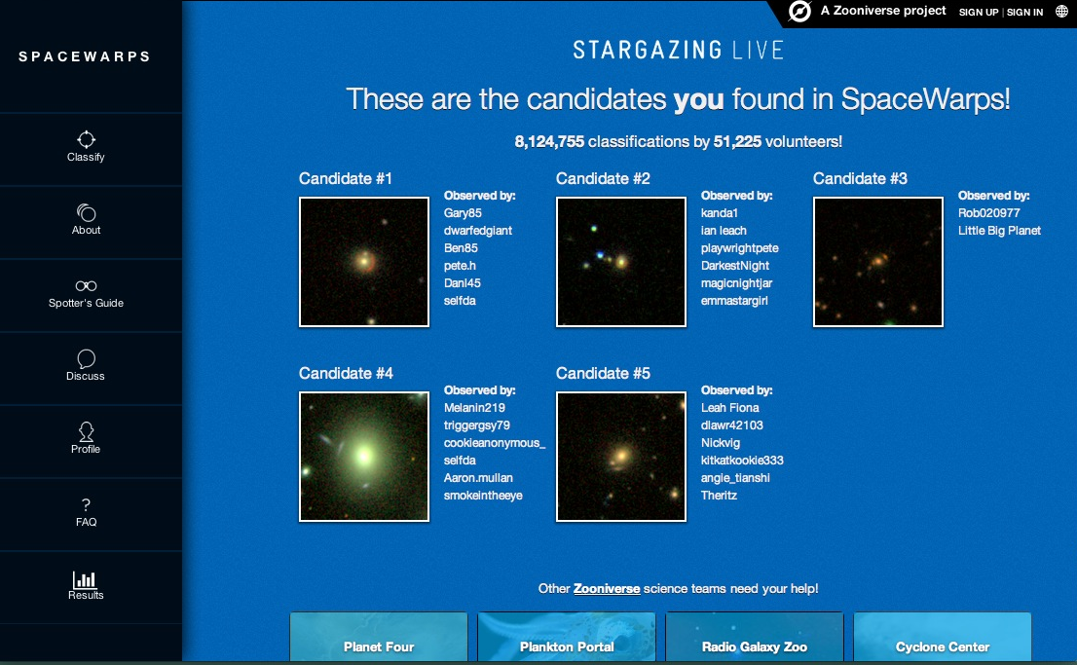
Citizen Science & education platforms

Slide 10
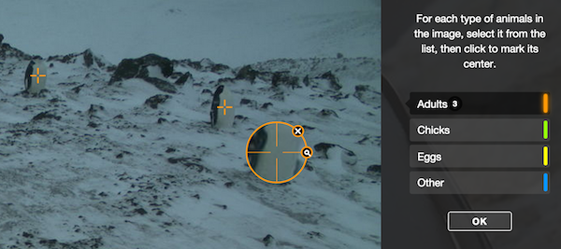
Citizen Science & education platforms
penguinwatch.org

Slide 11
Citizen Science & education platforms

Slide 12
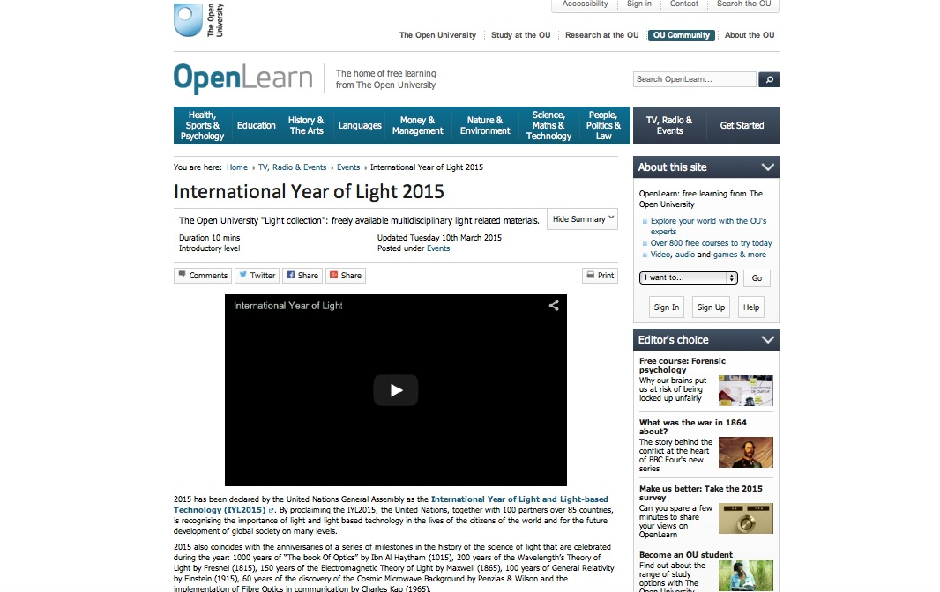
Citizen Science & education platforms

Slide 14
Outlook
We are also crowdsourcing the mass participation experiment ideas!
Host two workshops for ESFRI & pathfinder / precursor mass participation experiment definition
How easy is it?
How beautiful is it?
How important is it?
How famous could I get?
How much am I learning?
Once defined, adapt the Zooniverse Panoptes platform for the ESFRI crowdsourcing experiments
Field-test in schools
Compile and create associated educational resources
Monitor through learning journey analytics
Translate

Slide 15
What would you like a million people to do for you?

