Slide 1
ASTERICS Addressing Cross-Cutting Synergies and Common Challenges for the Next Decade Astronomy Facilities
Fabio Pasian*, Michael A. Garrett, Francoise Genova, Giovanni Lamanna, Stephen Serjeant, Arpad Szomoru,
Rob van der Meer
* Chair of the ASTERICS General Assembly

Slide 2
Background
The European Strategy Forum on Research Infrastructures (ESFRI) is a strategic instrument to develop the scientific integration of Europe
For the Astronomy and Astroparticles communities ESFRI has identified four facilities whose science cases are so out-standing that they can be considered as the main (ground-based) priorities in Europe:
the Square Kilometre Array (SKA)
the Cherenkov Telescope Array (CTA)
the km³ Neutrino Telescope (KM3NeT)
the European Extremely Large Telescope (E-ELT)

Slide 3
What is ASTERICS ?
Astronomy ESFRI Research Infrastructure CluSter (ASTERICS)
Topic: Implementation of cross-­cutting solutions for clusters of ESFRI research infrastructures
Focus of ASTERICS is on projects endorsed by ESFRI: SKA, CTA, KM3NeT, with close links to E­-ELT and EGO, plus path-finders and world-class experiments (e.g. LoFAR, Euclid)
ASTERICS represents the first major European collaboration Astronomy/Astrophysics/Astroparticle Physics
23 partners funded by EC Horizon2020 at 15 M€ for 4 years

Slide 4
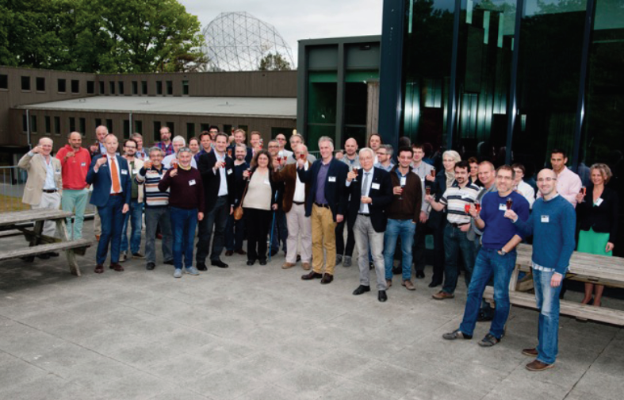
ASTERICS partnership
ASTRON, CNRS, INAF, UCAM, JIVE, INTA, UEDIN, UHEI, OU, FAU, VU, CEA, EVA, UGR, FOR, IEEC, IFAE, UCM, INFN, STFC, DESY, SURFnet, Oxford (with external support of ESO)

Slide 5
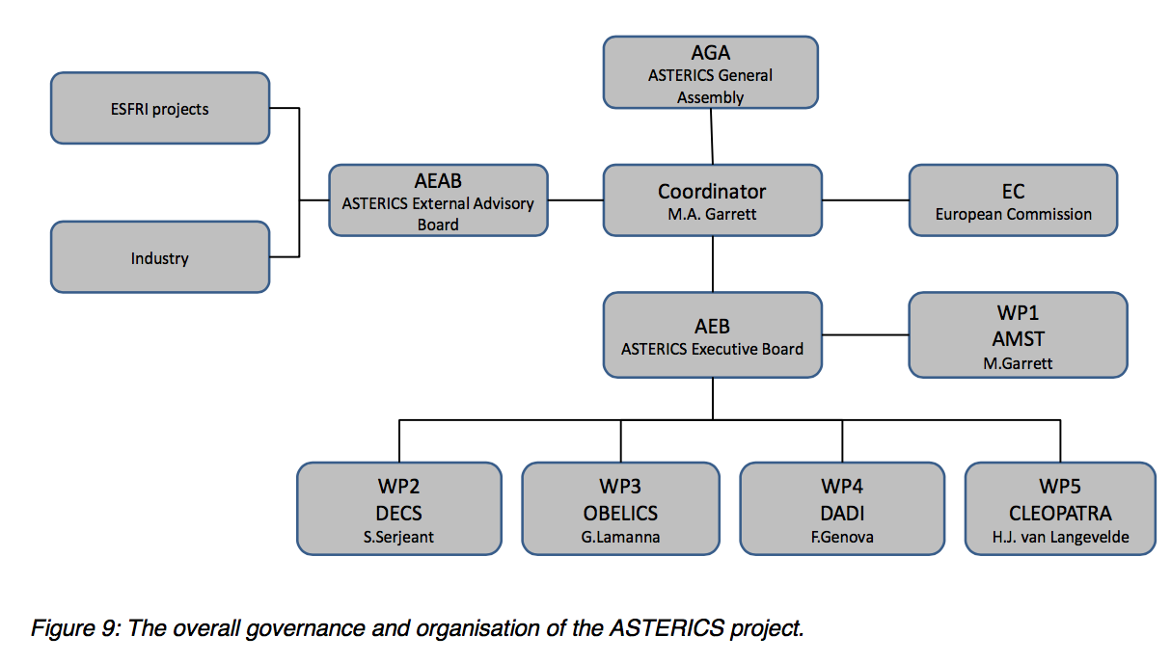
Governance & Management

Slide 6
Governance & Management

Slide 7
ASTERICS Programme
ASTRONET is an initiative created by a group of European funding agencies in order to establish a strategic planning mechanism for all of European astronomy.
ASTRONET has identified some key common challenges for Astronomy:
Public engagement
Big Astronomical Data (BAD?)
extended use of the Virtual Observatory (VO)
ASTERICS has also identified some common R&D h/w (and s/w) technology challenges.
Work programme follows closely

Slide 8
WP2 – DECS
Dissemination, Engagement and Citizen Science - Lead: S. Serjeant
Dissemination and public engagement
Audiences: scientific and technical communities, academia, private industry, other public research centres, SMEs, policy makers, general public
Open ESFRI facilities to wider stakeholders through citizen science (Science 2.0)
Coordinated citizen science experiments to open ESFRIs and pathfinders/precursors to public
Educational resources and efficacy metrics

Slide 9
WP3 – OBELICS
Observatory E-environments Linked by Common challengeS Lead: G. Lamanna
Software interoperability; establishing open standards and software libraries
Training in parallel programming and big data frameworks
Adapt and optimise extremely large database systems for ESFRIs
Demonstrate data integration across ESFRI and pathfinder projects using data mining tools and statistical analysis techniques on petabyte data sets
Coordinate all above with VO (WP4)

Slide 10
WP4 – DADI
Data Access, Discovery and Interoperability - Lead: F. Genova
Train and support wider astronomical community in scientific use of VO framework in particular for pathfinder data, gather their requirements and feedback
Train and support staff of ESFRI projects in Virtual Observatory and gather their requirements
Adapt VO framework and tools to ESFRI projects needs, within the IVOA framework

Slide 11
WP5 – CLEOPATRA
Connecting Locations of ESFRI Observatories and Partners in Astronomy for Timing and Real-time Alerts - Lead: A. Szomoru
Technology development for fibre connectors; relaying alerts; data streaming software; data dissemination (including ALMA and E-ELT); advanced scheduling algorithms
Builds on WRE (White Rabbit Ethernet) and the EC DG-EXPReS/NEXPRES projects

Slide 12
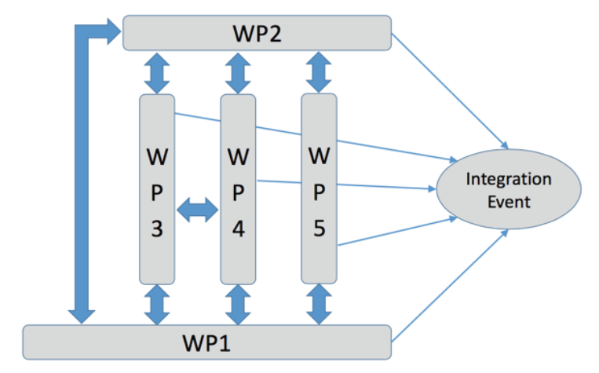
WP integration

Slide 13
Conclusions
Project supported and endorsed by the main players of the multi-disciplinary astronomy and astroparticle physics communities
Programme closely modelled on ASTRONET priorities → aims to tackle common problems, solutions, and cross-facility synergies
Strong focus on “interoperability” - enabling multi-messenger / multi-wavelength astronomy
Best practice platforms, interfaces, education, impact monitoring
Challenging, but feasible - networking needed to avoid duplication
Measure of ASTERICS success is take-up by the ESFRI projects, their precursors and the other projects involved

Slide 14
Thank you for your patience!

