Slide 1
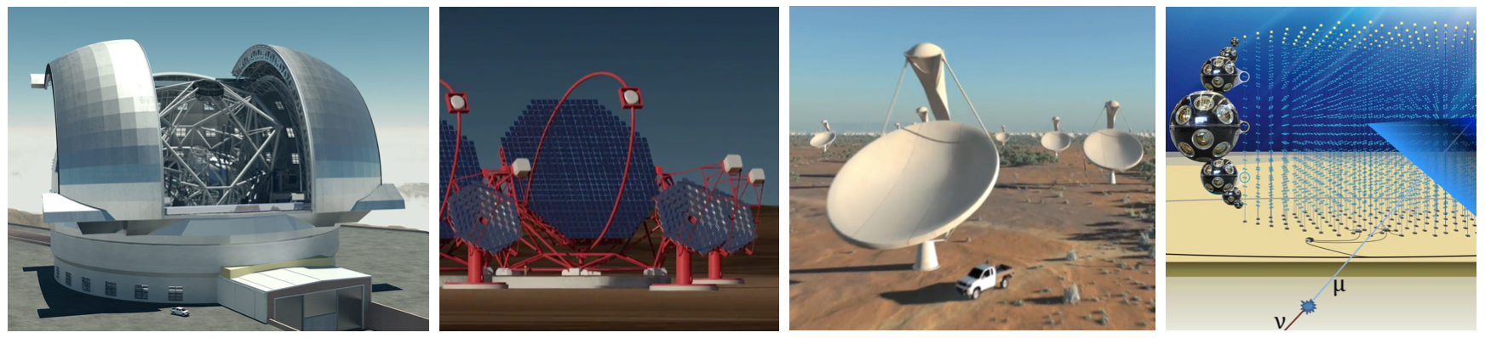
ASTERICS to support enabling the scientific synergies
S15 – Scientific Synergies enabled by the SKA, CTA and Athena
Rob van der Meer – ASTRON, NL ASTERICS PM

Slide 2
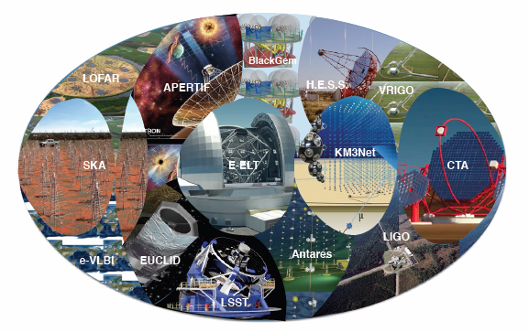
Scientific synergies
Wonderful ideas for science cases on several
combinations of astronomical infrastructures
Static universe
  archive data
Dynamic universe
  Scheduled parallel observations
  Swift follow-up from fast triggers

Slide 3
Obstacles ?
Are there no obstacles for these science cases?
No data (yet) of the new ESFRIs
  Are we prepared for the new data?
New data handling and analysis
  Data does not move
  Program to the data

Slide 4
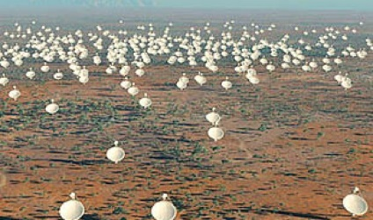
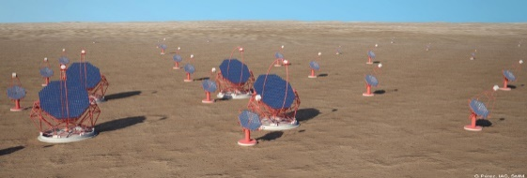
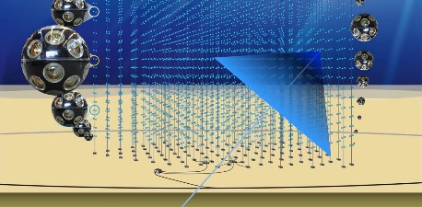
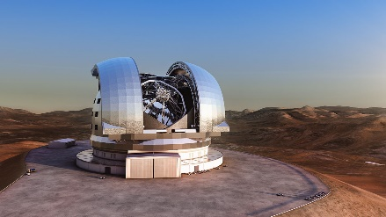
ASTERICS
Astronomy ESFRI and Research Infrastructure Cluster
H2020 project, May 2015 – 2019
Single collaborative cluster
Next generation ESFRI telescope facilities
SKA, CTA, KM3NeT, ELT, (EST)
Astronomy, astro(particle)physics
Facilitate researchers to work together
on a large scale on mutual challenges

Slide 5
Collaboration
Development of multi-messenger tools.
You can:
become a (future) user
determine part of the requirements
Support the development

Slide 6
Bringing together scientists from different messenger groups
DADI work package (WP)
Developing (VO) tools together
Interoperability
Re-use of software
Schools, Trainings
Interaction:
3rd ASTERICS DADI School,
21-23 Nov 2017, Madrid
ESFRI Forum and training,
Dec 2017, Trieste
Technology Forum (VO development), Spring 2018

Slide 7
Bringing together data from different messenger facilities
WPs DADI, OBELICS, DECS
VO standards, IVOA, RDA
Data handling, benchmarking
Citizen Science Experiments, engaging with society at large.
Interaction:
OBELICS Workshop & training,
16-19 Oct 2017, Barcelona
Citizen Science Workshop,
Spring 2018, Trieste (TBC)

Slide 8
Doing the timing right in recording transient events
WP CLEOPATRA
Timing with White Rabbit protocol
Alert protocols and mechanisms
Interaction:
workshop on Radio - γ : Transient Alert Mechanisms,
26-28 Sept 2017, Amsterdam
  www.asterics2020.eu/radio-gamma-workshop

Slide 9
Partners (26)
Project partners
in 6 European countries
NL,UK,FR,DE,IT,ES
Astron Coordinator

Slide 10
Summary
ESFRI facilities fantastic in itself
ASTERICS provides added value
You can help develop the right tools
www.asterics2020.eu

